Slide 1
Campus Fellow Training
A Session

Slide 2
Welcome!
Please sign-in
Follow your trainer’s instructions on how to complete paperwork on your volunteer profile
There are a number of training materials provided for you to use throughout training. Please bring these materials back to the B session.
Notes:
All materials can be downloaded on our website at www.impactamerica.com/taxprep

Slide 3
Training Agenda: A Session
1) Basic Training Refresher
2) Alimony Income
3) State Tax Refund
4) Business Income
5) Retirement Income (with taxable amount)
6) Adjustments to Income
7) Miscellaneous Nonrefundable Credits
8) Volunteer Paperwork

Slide 4
Basic Training Refresher

Slide 5
Basic Training Refresher
Kevin Kent Exercise
  Wages
  Interest
  Unemployment
  Social Security
  Other income
    1099-MISC with Box 3
    Lottery winnings
  Child & Dependent Care Credit
  Earned Income Credit
  Alabama Return (if applicable)
Login to TaxSlayer
  Vita.taxslayerpro.com/IRSTRAINING
  Password:TRAINPROWEB
    Username: Last Name, First initial, “TRAIN” (e.g., SMITHJTRAIN)
    Password: SAVEFIRST

Slide 6
Alimony Income

Slide 7
Alimony
A payment to or for a spouse or former spouse under a separation or divorce instrument
Person RECEIVING the alimony must report it as income
  Note: person PAYING the alimony can take amount as an adjustment – we will cover later on in this training
Notes:
Alimony is a payment to or for a spouse or former spouse under a separation or divorce instrument
The person RECEIVING the alimony must report it as income
Note: The person PAYING the alimony can subtract it as an adjustment. We’ll discuss how to do this later on in this training
Alimony is classified as unearned income

Slide 8
Alimony
May include:
  Medical bills, housing costs and other expenses
Does NOT include:
  Child support or voluntary payments
Notes:
Alimony may include a number of expenses, include medical bills and housing costs
Alimony does NOT, however, include child support or voluntary payments outside of the divorce instrument

Slide 9
Alimony vs. Child Support
Child support payments from a separation or divorce instrument will stop once the child is 18.
Notes:
How do you determine what is considered child support and what is considered alimony?
Child support payments from a separation or divorce instrument will stop once the child is an adult.

Slide 10
Alimony Information
You need the EXACT amount from a divorce or separate instrument executed after 1984
Amount of alimony reported on one tax return as income must match the alimony adjustment amount on the spouse’s tax return
Notes:
You will need the exact amount from a divorce or separate instrument executed after 1984
Amount of alimony reported on one tax return as income must match the alimony adjustment on the spouse’s tax return

Slide 11
Alimony
Open up Kevin Kent in TaxSlayer
  Enter Alimony on line 11
  Federal Section → Adjustments → “Alimony Received”

Slide 12
State Tax Refund

Slide 13
State Tax Refund
Taxpayers who receive a refund of state or local income taxes may receive Form 1099-G listing their refund in box 2.
NOT everyone must include their state tax refund as taxable income.
Notes:
Taxpayers who receive a refund of state or local income taxes MAY receive a Form 1099-G listing their refund in box 2
However, NOT everyone must include their state tax refund as taxable income.

Slide 14
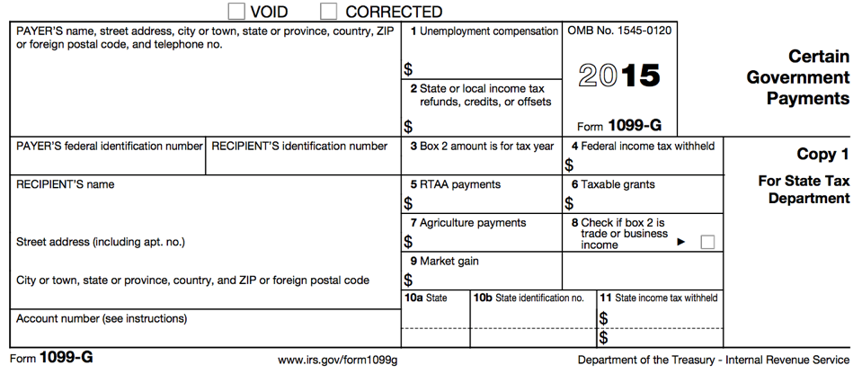

Form 1099-G: Certain Government Payments
Notes:
You’ve seen the Form 1099-G in basic training. Unemployment is reported on line 1 of this form.
If a taxpayer received this form with an amount listed in box 2 (State or local income tax refunds, credits, or offsets), it might need to be reported as taxable income

Slide 15
State Tax Refund
Prior tax year (PTY) state tax refund may be taxable and need to be reported
Conditions in which PTY state tax refund is taxable:
  Received a refund on a state return
  Itemized Deductions in PTY (Federal) AND
  Deducted state income tax instead of state sales tax when itemizing deductions (Federal)
Notes:
A taxpayer with a prior year state tax refund might be taxable and need to be reported—at our tax sites, this refund will usually be an Alabama refund
There are a few conditions in which the prior year state tax refund is taxable:
The taxpayer received a refund on a state return (Alabama)
The taxpayer itemized deductions on their prior year federal return
The taxpayer deducted state income tax instead of state sales tax when itemizing deductions on their federal return

Slide 16
State Tax Refund
What if taxpayer doesn’t know if they itemized deductions last year?
  Ask: “Did you have any mortgage interest, medical expenses, charitable contributions, etc., that you listed on your return last year?”
  A taxpayer may not be sure if they did, but often they are very confident that they did not have any of these deductions listed last year
Notes:
Often, taxpayers don’t remember if they itemized deductions last year. If they came to a SaveFirst site we can look up that information.
If the taxpayer doesn’t didn’t come to one of our sites and doesn’t have a copy of their prior year tax return, you can ask the following question:
“Did you have any mortgage interest, medical expenses, charitable contributions, etc., that you listed on your return last year?
A taxpayer may not be sure if they did, but often they are very confident that they did not have any of these deductions last year.

Slide 17
State Tax Refund
Note: Many taxpayers may have itemized deductions on their state tax returns but NOT their federal tax returns
In this case, the previous tax year state tax refund will NOT be taxable on the federal tax return
Notes:
Note that many taxpayers may have itemized deductions on their state tax returns but NOT their federal tax returns.
In this case, the previous year state tax refund will NOT be taxable on the federal tax return

Slide 18
PTY State Tax Refund
If the taxpayer needs to report the state tax refund, go to:
  Federal Section →Income → State and local refunds
  Enter in the necessary information

Slide 19
Info Needed from PTY Return
To correctly report a state tax refund amount, the following info from the PTY return is needed:
  State tax refund amount
  Sch A, line 5a, state income taxes (TBD)
  Total itemized deductions amount
  Filing status
Notes:
To correctly report a state tax refund amount the following information from the PTY return is needed:
State tax refund amont
Income tax amount from Sch A, line 5a
General sales tax amount from Sch A, line 5b
Total itemized deductions amount, found on Form 1040
Taxable income amount found on Form 104

Slide 20
State Tax Refund
Open up Kevin Kent in TaxSlayer
  Enter State Tax Refund on Line 10
  Federal Section → Income → State and Local Refund

Slide 21
Income: Other Income, Business/Self-Employment

Slide 22
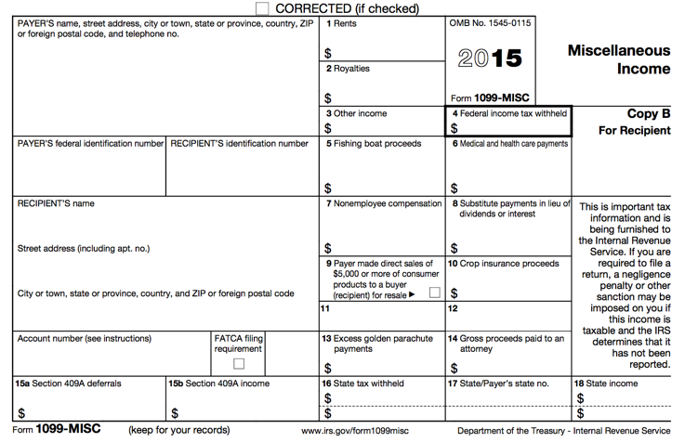

Form 1099-MISC
Notes:
Let’s start by taking a closer look at the Form 1099-MISC
This form has a lot of miscellaneous information that can be reported on it, and is often incorrectly reported on a taxpayer’s income tax return
For our purposes, we will only focus on three boxes:
Box 3: Other income – various types of income can be reported in this box, and often it is unclear how this information should be reported on the tax return
Box 4: Federal income tax withheld – this box will most likely be empty, but it is possible you may see an amount listed here
Box 7: Nonemployee compensation – this is money paid to an nonemployee independent contractor of a company

Slide 23
Form 1099-MISC: Other Income
Reported in box 3
Other income reported in this box is generally:
  Prizes
  Awards
  Taxable damages (from a lawsuit settlement)
  Other taxable income
Other income in box 3 is classified as unearned income
Notes:
The amounts reported in box 3 are called “other income”
These can include……prizes, awards, taxable damages (from a lawsuit settlement), as well as other taxable income
The majority of the time, the income listed in this box is classified as unearned income

Slide 24
Form 1099-MISC: Federal Income Tax Withheld
Reported in box 4
Taxpayers can choose to have federal income tax withheld on other income in box 3
Notes:
The amount reported in box 3 is federal income tax withheld
Taxpayers may choose to have federal income tax withheld on other income in box 3, however, most of the time this box will be blank
However, you should always double-check.

Slide 25
Form 1099-MISC:
Nonemployee Compensation
Reported in box 7
Nonemployee compensation is paid to an independent contractor
Independent contractors work for a company or organization without being considered an “employee”
  Freelancers, part-time workers, contractors, interns
Notes:
Box 7 reports nonemployee compensation
Nonemployee compensation is money paid to an independent contractor of a company
Independent contractors will work for a company or organization without being considered an “employee” – this determination is made by the employer based on guidelines set forth by the IRS, and includes such workers as freelancers, part-time workers, contractors, interns, etc.

Slide 26
Form 1099-MISC:
Nonemployee Compensation
If payment for services from a company or organization is reported in box 7, the taxpayer is being treated as a self-employed worker
Self-employment income, also known as business income, is taxed differently than wages/salary
Notes:
If payment for services from a company or organization is reported in box 7, the taxpayer is being treated as a self-employed worker
Self-employment income, also known as business income, is taxed differently than wages/salary

Slide 27
Business/Self-Employment Income
Income from a personal business (sole proprietor) or independent contractor (nonemployee compensation)
Notes:
Business or self-employment income is defined as income from a personal business (in which the taxpayer owns and is the sole proprietor of) OR income received as an independent contractor (aka Nonemployee compensation reported on a 1099-MISC)

Slide 28
Business/Self-Employment Income
Why is it important to designate between wages and business/self-employment income?
  Federal income taxes are not withheld from business income
  FICA taxes are not withheld from business income
  However, the taxpayer must still pay federal income taxes and FICA taxes on business income!
Notes:
Self-employed workers also work for their income just as employees of company work for their wages, so why is it important to designate between wages and business/self-employment income?
Because federal income taxes are not withheld from business income
FICA taxes are not withheld from business income
HOWEVER, the taxpayer must still pay both federal income taxes AND FICA taxes on this income.
Just because the taxpayer doesn’t have an employer to withhold these taxes for them (because they own the business) or their employer treats them as an independent contractor / nonemployee worker and therefore does not withhold these taxes doesn’t mean they don’t still have to be paid.
Many taxpayers are surprised to find out that they owe quite a bit more in taxes as a result of having business/self-employment income, so it’s important to understand this concept.

Slide 29
Business/Self-Employment Income
Business/self-employment income can be reported to taxpayers in a variety of ways
Notes:
Let’s discuss all the different ways taxpayers can have business/self-employment income reported.

Slide 30
Form 1099-MISC
Notes:
We’ve already discussed the Form 1099-MISC -> business income will be reported in box 7, nonemployee compensation

Slide 31
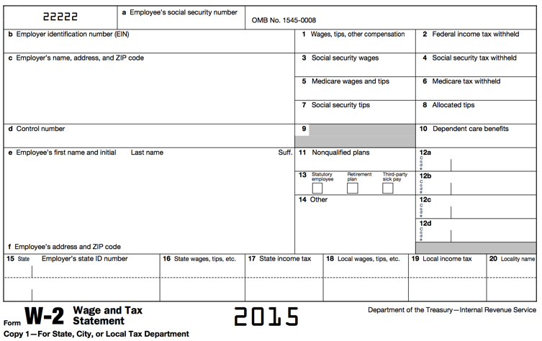
Form W-2: Wage and Tax Statement
See Your Site Coordinator
Notes:
Business income reported on a W-2 will have the Statutory Employee box checked
If you come across a Form W-2 with the Statutory Box checked, see your Site Coordinator

Slide 32
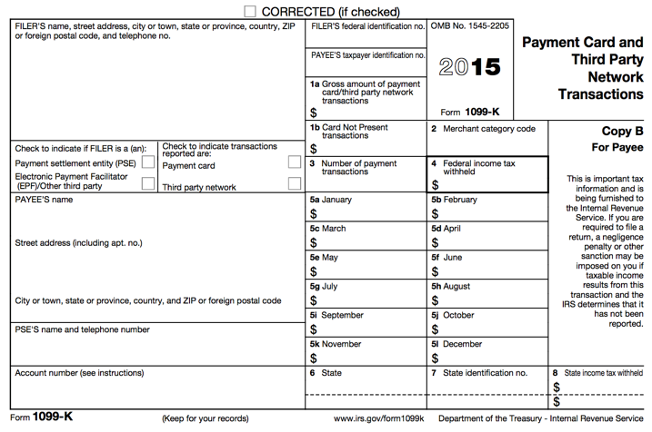
Form 1099-K
See Your Site Coordinator
Notes:
Business Income can also be reported on a Form 1099-K.
If you come across this form, see your Site Coordinator. This form can also report other types of income that are out of scope for VITA.

Slide 33

Cash Payments
Notes:
A taxpayer may also have simply received cash payments for their work, in this case, the taxpayer should have books personal records keeping track of their income

Slide 34
Business/Self-Employment Income
Having a part-time business (even in addition to another job) may still be self-employment income and need to be reported
Remember: Income that was not reported on Form W-2, 1099-MISC or 1099-K still needs to be reported as cash payments.
Notes:
Having a part-time business, even in addition to another job, may still be self-employment income and need to be reported on line 12
Remember, income that was not reported on Form W-2, 1099-MISC, or 1099-K still needs to reported as cash payments

Slide 35
Example
Andy works as an independent contractor for a painting company. He received a 1099-MISC from the company that shows he made $10,000. He also received $2,000 in cash payments from a few different people for the work he completed, but he did not receive a 1099-MISC for the $2,000.
What is Andy’s total business/self-employment income that needs to be reported?
Notes:
Andy works as an independent contractor for a painting company. He received a 1099-MISC from the company that shows he made $10,000. He also received $2,000 in cash payments from a few different people for the work he completed, but he did not receive a 1099-MISC for the $2,000.
What is Andy’s total business income that needs to be reported on Line 12?

Slide 36
Example – Answer
Andy must include the amounts from both the 1099-MISC and cash payments. His total business income that must be reported is $12,000.
Notes:
Andy must include the amounts from both the 1099-MISC and cash payments. His total business income that must be reported is $12,000.

Slide 37
Business/Self-Employment Income vs. Other Income
Business Income
  An activity qualifies as a business if:
    The primary purpose for engaging in the activity is for income or profit
    The taxpayer is involved in the activity with continuity and regularity
Other Income
  A sporadic activity or a hobby does not qualify as a business
  Hobby: undertaken for pleasure during leisure time (not for profit)
Notes:
Business Income
An activity qualifies as a business if the primary purpose for engaging in the activity is for income or profit and the taxpayer is involved in the activity with continuity and regularity
Other Income
A sporadic activity or hobby does not qualify as a business
A hobby would be something undertaken for pleasure during leisure time—not for profit.
This could include getting paid to paint someone’s house one time—not business income because the taxpayer isn’t involved in the activity with regularity or continuity, but the amount would still need to be included as income on the Form 1040, line 21.

Slide 38
Business/Self-Employment Income Terms
Business expenses: amounts that are ordinary and necessary to carry on the business
  Business expenses are subtracted from gross receipts to obtain the net profit/loss
  Net profit/Loss = Gross Receipts – Expenses
Cash method of accounting: Reports all income when received and deducts all expenses when paid
Notes:
Let’s discuss some terms related to business income
Business expenses are amounts that are ordinary and necessary to carry on the business—we'll discuss what qualifies as a business expense in a moment
The cash method of accounting reports all income when received and deducts all expenses when paid

Slide 39
Business/Self-Employment Income Terms
Inventory: the items the taxpayer buys or makes for resale for others
Depreciation: the cost of items that are expected to last more than a year should be spread over a period of years, rather than deducted in the year of purchase
Notes:
Inventory are items the taxpayer buys or makes for resale to others
Depreciation is when the cost of items that are expected to last more than a year should be spread over a period of years, rather than deducted in the year of purchase (for example, the purchase of a car)

Slide 40
Business/Self-Employment Income
VITA Filing Conditions
Less than $25,000 of business expenses
Cash method of accounting
No inventory
Does not want to depreciate assets
Must report a profit— no net loss!
No employees
Notes:
There are a number of conditions that must be met for us to file a tax return with business income:
The taxpayer must have less than $25,000 of business expenses
The taxpayer must use the cash method of accounting
The taxpayer cannot have inventory for sale
The taxpayer must not want to depreciate any assets
The taxpayer must report a profit—NO NET LOSS!
Cannot have any employees

Slide 41
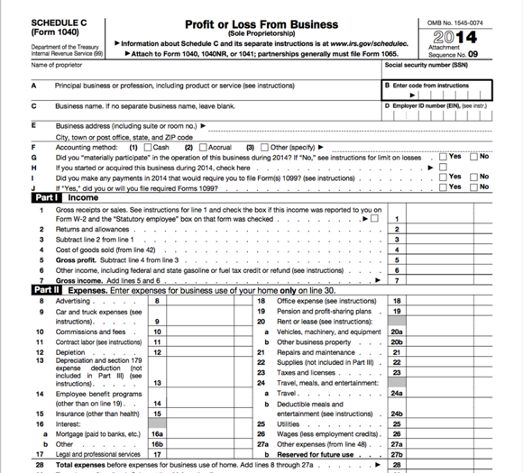
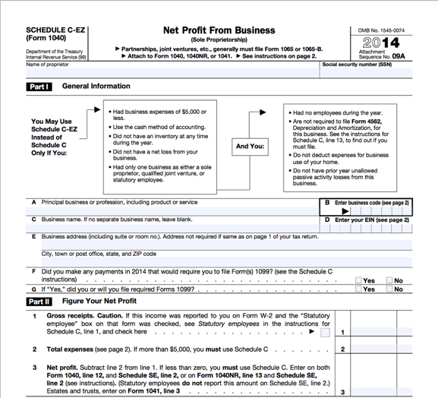
Business/Self-Employment Income
Schedule C & C-EZ
Notes:
Taxpayers will report their business/self-employment income on a Schedule C or Schedule C-EZ when filing their income tax return.
Instead of simply adding the contents of a income document to the Form 1040, like we did for wages, or unemployment, or Social Security Benefits, this form allows us to account not only for the various sources of business income a taxpayer may have had for a single business, but also allows us to account for any business expenses related to operating the business or working a nonemployee for an business.
A taxpayer will only pay federal income taxes and FICA taxes on their Net profit, and these forma allow us to determine what that net profit actually is after subtracting business expenses

Slide 42
Business/Self-Employment Income:
Schedule C or C-EZ
Schedule C-EZ is just the simplified version of the Schedule C
  Use the Schedule C-EZ if there are few business expenses and only one business
    Less than $5,000
  Use the Schedule C if there are a lot of business expenses and/or more than one business
    $5,000 to $25,000
Notes:
When do you report business income on a Sch C or a Sch C-EZ?
The Sch C-EZ is just the simplified version of the Sch C
Use the Sch C-EZ if there are less than $5,000 of business expenses and only one business
Use the Sch C if there are between $5,000 and $10,000 of business expenses and if the taxpayer has more than one business
A sidenote here – these amounts – less than $5,000 or between $5,000 and $10,000 – refer ONLY to the amount of business expenses reported. A taxpayer can have $30,000 worth of business income and only have $4,000 worth of business expenses, which allows them to file the Schedule C-EZ.

Slide 43
Deductible Business Expenses:
Advertising
Costs associated with promoting the business through various means:
  Yellow pages
  Newspapers
  Magazines
  Billboards
  Racing sponsors
  Television spots
Notes:
Now we are going to go over different types of deductible expenses.
Advertising expenses include costs associated with promoting the business through various means, such as the yellow pages, newspapers, magazines, billboards, racing sponsors, television spots, etc.

Slide 44
Deductible Business Expenses:
Car & Truck Expenses
A taxpayer who uses a car/truck in a business may be able to deduct the costs of operating and maintaining the vehicle
Vehicle expenses are calculated using the standard mileage rate
Actual expenses include depreciation, which is out of our scope
Notes:
A taxpayer who uses a car/truck in a business may be able to deduct he costs of operating and maintaining the vehicle
Vehicle expenses are calculated using the federal standard mileage rate of 54 cents per mile in 2016
Actual expenses also include depreciation, however, that is outside the scope of VITA

Slide 45
Deductible Business Expenses:
Commissions and Fees
Commissions paid to both individuals and businesses
Any kind of fee necessary to operate the business
Notes:
Any type of commission or fee that is paid to both individuals and businesses are deductible business expenses

Slide 46
Deductible Business Expenses:
Insurance
Insurance policies and coverage are deductible for the business operation
  Property
  Automobile (business vehicles only)
  Malpractice
If the standard mileage rate is used, no deduction is allowed for automobile insurance premiums
Health insurance is NOT deductible
Notes:
Insurance policies and coverages are deductible for the business operation, including property automobile, and malpractice insurance
However, if the standard mileage rate is used, there is no deduction allowed for automobile insurance premiums (because the standard mileage rates accounts for that)
Note: Health insurance is NOT a deductible business expense.

Slide 47
Deductible Business Expenses:
Interest
Interest paid on operating loans
NOT mortgage interest
Notes:
Interest paid on operating loans is considered a deductible business expense, however, mortgage interest is NOT.

Slide 48
Deductible Business Expenses:
Legal and Professional Services
Fees paid to professionals:
  Attorneys
  Accountants
  Appraisers
  Engineers
Notes:
Fees paid to professionals such as attorneys, accountants, appraisers and engineers are also considered deductible business expenses

Slide 49
Deductible Business Expenses:
Office Expense
Supplies:
  Pens
  Paper
  Postage
  Other necessarily office supplies
Notes:
Office expenses include supplies such as pens, paper, postage, staplers, etc.

Slide 50
Deductible Business Expenses:
Rent or Lease
Rental fees for:
  Cars
  Trucks
  Vans
  Machinery, equipment and other personal property
Leases of more than 30 days are out of scope
Notes:
Rental fees for cars, trucks, vans, machinery, equipment and other personal property are also deductible business expenses, however, leases of more than 30 days are out of scope.

Slide 51
Deductible Business Expenses:
Repairs and Maintenance
Repairs on:
  Equipment
  Automobiles
  Office space
  Buildings
  Etc.
Notes:
Repairs on equipment, automobiles, office space, and buildings are some possible expenditures that are deductible business expenses

Slide 52
Deductible Business Expenses:
Supplies
Costs for general operating supplies not associated with the cost of goods sold
Remember: business/self-employment income involving inventory is out of scope
Notes:
Any costs for general operating supplies NOT associated with the cost of goods sold (remember, inventory is out of scope for VITA) are deductible business expenses.

Slide 53
Deductible Business Expenses:
Taxes and Licenses
Taxes and license fees paid in the operation of the business:
  State and local sales taxes imposed on the taxpayer as the seller of services
  Real estate and personal property taxes
  Certain licenses and regulatory fees
Notes:
Taxes and license fees paid in the operation of the business, including state and local sales taxes imposed on the taxpayer as the seller of goods or services, real estate and personal property taxes, and certain licenses and regulatory fees are all deductible business expenses.

Slide 54
Deductible Business Expenses: Travel/Meals and Entertainment
Ordinary and necessary expenses of traveling away from home for business
Notes:
Ordinary and necessary expenses of traveling away from home for business, including meals and entertainment can be deductible business expenses

Slide 55
Deductible Business Expenses:
Utilities
Normal electric, gas, water and telephone
No deduction for personal expenses
Notes:
Normal, electric, gas, water and telephone utility expenses are deductible, however, you cannot deduct any personal expenses, even if they are used for work (so a taxpayer can not deduct these expenses if they work out of their home)

Slide 56
Deductible Business Expenses:
Business Mileage Rates
  If used for business purposes, taxpayer can receive a mileage deduction at the federal rate
    Cannot deduct commuting miles
Cannot calculate depreciation (out of scope)
Notes:
If used for business purposes, taxpayers can receive a mileage deduction at the federal rate—however, only business miles can be deducted—not commuting miles
Commuting miles are two and from work, business miles are from work to a job—for example, a painter can deduct the miles traveled between jobs.
Remember, you cannot calculate depreciation, it is out of scope for VITA

Slide 57
Business/Self-Employment Income
Open up Kevin Kent in TaxSlayer
  Enter Business/Self-Employment on Line 12
  Federal Section→Income→1099-MISC→ADD TO SCH C

Slide 58
Retirement Income

Slide 59
Employer Controlled
Employer Sponsored
Defined Contribution Retirement Plans
Defined Benefit Retirement Plans
Pensions
Civil Service
Annuities
401(k)
Retirement Income
403(b)
Annuities
Taxpayer Funded
IRA
Individual Retirement Plans
Roth IRA
Notes:
Retirement can be very tricky when it comes to filing federal income taxes. There are multiple forms income can be reported on, there are many different types of retirement plans available, and unfortunately, most taxpayers don’t have a firm grasp on exactly what type of plan they have
We will begin this section by talking about the different categories of retirement that we may see at our sites.
Then, we will look a little more closely at some of the categories in particular, followed by how retirement income is actually taxed.
Next, we will spend some time looking at the actual forms retirement income can be reported on, and talk about why determining what type of retirement plan a taxpayer has is important.
We will end this section by looking at two special cases of retirement income and how to handle each on the tax return.

Slide 60


Defined Benefit Plans
An older, traditional type of pension plan
Workers’ retirement benefits are calculated (and thus “defined”) by a formula that takes into account
  YEARS OF SERVICE
  SALARY HISTORY
Notes:
Defined benefit plans are an older, traditional type of pension plan
Worker’s retirement benefits are calculated (and thus “defined” by a formula that takes into account:
Years of service
Salary history

Slide 61
Defined Benefit Plans
Employer controls the plan and guarantees that the employee will receive a certain amount of retirement compensation
Most employees under a DB plan do not have to contribute any portion of their salary to the plan
Funded mostly by the employer
Can be referred to as a pension plan
Notes:
Employer controls the plan and guarantees that the employee will receive a certain amount of retirement compensation
Most employees under a DB plan do not have to contribute any portion of their salary to the plan
Funded mostly by the employer
Can be referred to as a pension plan

Slide 62
Defined Benefit Plans
Numerous rules governing when retirees can start drawing their pension benefits
DB plans not very “portable”
Who has a Defined Benefit plan?
  Civil Servants (teachers, city employees, federal workers, soldiers, etc.)
  Some older, mature corporations with stable workforces
Notes:
Numerous rules governing when retirees can start drawing their pension benefits
DB plans not very “portable”, meaning it is difficult for an employee to take their retirement plan with them if they change jobs
Who has a Defined Benefit plan?
Civil Servants (teachers, city employees, federal workers, soldiers, etc.)
Some older, mature corporations with stable workforces

Slide 63
Defined Contribution Plans
More modern type of employer plan
Employee controls amount contributed to the plan as well as how the funds are invested
Retirement benefits depend on how the fund assets perform and grow
Funded primarily by the employee, with the employer often matching contributions to a certain amount
Notes:
Defined contribution plans are a more modern type of employer plan
Defined contribution plans do not promise a specific monthly benefit at retirement
Usually, the employee and/or the employer contribute money to your individual account in the plan
Often, the employee is responsible for choosing how these contributions are invested and deciding how much to contribute through pretax contributions
Employer will then often match a certain percentage of the employee’s contributions

Slide 64
Defined Contribution Plans
Most common type of DC plan is a 401(k)
Participants may elect to defer a portion of his/her gross salary via a pretax payroll deduction to the plan
Contributions can be invested, at the employee’s direction, in select mutual funds, money market funds, annuities, or stock offered by the plan
Notes:
401(k) plans are one of the most common types of DC plans.
Participants may elect to defer a portion of his/her gross salary via a pre-tax deduction to the plan (which means they are not subject to income tax until the employee receives it as a distribution from the retirement account)
Contributions can be invested, at the employee’s direction, in select mutual funds, money market plans, or stock offered by the plan

Slide 65
Defined Contribution Plans
The employee must direct contributions and investments to grow the assets adequate for retirement
Examples:
  401(k)
  403(b)
  Some Annuity Contracts
Notes:
The employee must direct contributions and investments to grow the assets adequate for retirement
Some other common examples of a Defined Contribution plan are:
401(k)
403(b)
Some annuity contracts

Slide 66
Individual Retirement Plans
Investing tool used by individual taxpayers to earmark funds for retirement savings
Traditional IRA (in scope) and Roth IRA (out of scope for Campus Fellows)
Established by individual taxpayers, who are allowed to contribute 100% of compensation (or self-employment income) up to a certain dollar amount each year
Notes:
Another type of retirement plan is an Individual Retirement Arrangement, or IRA.
IRAs are investing tools used by individual taxpayers to earmark funds for retirement
There are several types of IRAs
Traditional IRAs are the only one in scope for Campus Fellows
Roth IRAs (out of scope for Campus Fellows)
IRAs are established by individual taxpayers, who are allowed to contribute 100% of their earned compensation (including business/self-employment income) up to a certain dollar amount each year

Slide 67
Individual Retirement Plans
Offers numerous tax benefits
  Contributions to Traditional IRA can be taken as an adjustment to income (dependent on certain conditions)
  In general, eventual withdrawal from an IRA is taxed as income; including capital gains on the investment
  Because income is likely to be lower after retirement, the tax rate may be lower
Notes:
IRAs offers numerous tax benefits
Contributions to Traditional IRA can be taken as an adjustment to income (dependent on certain conditions)
In general, eventual withdrawal from an IRA is taxed as income; including capital gains on the investment
Because income is likely to be lower after retirement, the tax rate may be lower

Slide 68
Individual Retirement Plans
Combined with potential tax savings at the time of contributions, IRAs can be a very valuable tax management tool for individuals
Also, depending on income, an individual may be able to fit into a lower tax bracket during his/her working years because of the adjustment to income from contributions
Notes:
Combined with potential tax savings at the time of contributions, IRAs can be a very valuable tax management tool for individuals
Also, depending on income, an individual may be able to fit into a lower tax bracket during his/her working years because of the adjustment to income from contributions

Slide 69
Defined Benefit Retirement Plans
Funded by the employer
Monthly set amount based on salary history, years of service
Employee pays taxes on payments received
Defined Contribution Retirement Plans
Employer-sponsored, employee contributes portion of gross salary pre-tax
Offers benefits by allowing employee to defer taxes
Individual Retirement Plans
Funded by individual taxpayers
Like DC plans, offers benefits by allowing employee to defer taxes
Notes:
Here is a summary of the three categories
Point out the similarities and differences between the three categories before moving on to the next section

Slide 70
Common Types of Retirement Plans
Pension: series of payments for past work (based on salary history and years of service)
  Defined Benefit Plan
401(k) Plan: part of employee’s gross salary is placed in a retirement plan on a pre-tax basis (not subject to income tax until employee receives it as a distribution from retirement account)
  Defined Contribution Plan
Notes:
Pension: series of payments for past work (based on salary history and years of service)
Defined Benefit Plan
401(k) Plan: part of employee’s gross salary is placed in a retirement plan on a pre-tax basis (not subject to income tax until employee receives it as a distribution from retirement account)
Defined Contribution Plan

Slide 71
Common Types of Retirement Plans
Individual Retirement Arrangements: A personal savings plan that offers tax advantages to set aside money for retirement
  Earnings generally accumulate tax free until withdrawn
  Types:
    Traditional
    Roth: Usually Out of Scope (in scope under certain conditions)
    SIMPLE: Out of Scope!
    SEP: Out of Scope!
Notes:
Individual Retirement Arrangements: A personal savings plan that offers tax advantages to set aside money for retirement
Earnings generally accumulate tax free until withdrawn
Types:
Traditional
Roth: out of scope for Campus Fellows
SIMPLE: Out of Scope!
SEP: Out of Scope!

Slide 72
Retirement Forms
Retirement income can be reported on:
  Form 1099-R → Distributions From Pensions, Annuities, Retirement or Profit-Sharing Plans, IRAs, Insurance Contracts, etc.
  Form CSA 1099-R → Statement of Annuity Paid (civil service retirement payments)
  Form CSF 1099-R → Statement of Survivor Annuity Paid
  Form RRB1099R → Annuities or Pensions by the Retirement Railroad Board (out of scope for Campus Fellows)
Notes:
Retirement income be reported on four different forms:
Form 1099-R → Distributions from pensions, annuities, retirement or profit-sharing plans, IRAs, Insurance Contracts, etc.
Form CSA 1099-R → Statement of Annuity Paid (civil service retirement payments)
Form CSF 1099-R → Statement of Survivor Annuity Paid
Form RRB 1099-R → Annuities or Pensions by the Retirement Railroad Board (out of scope for Campus Fellows)

Slide 73
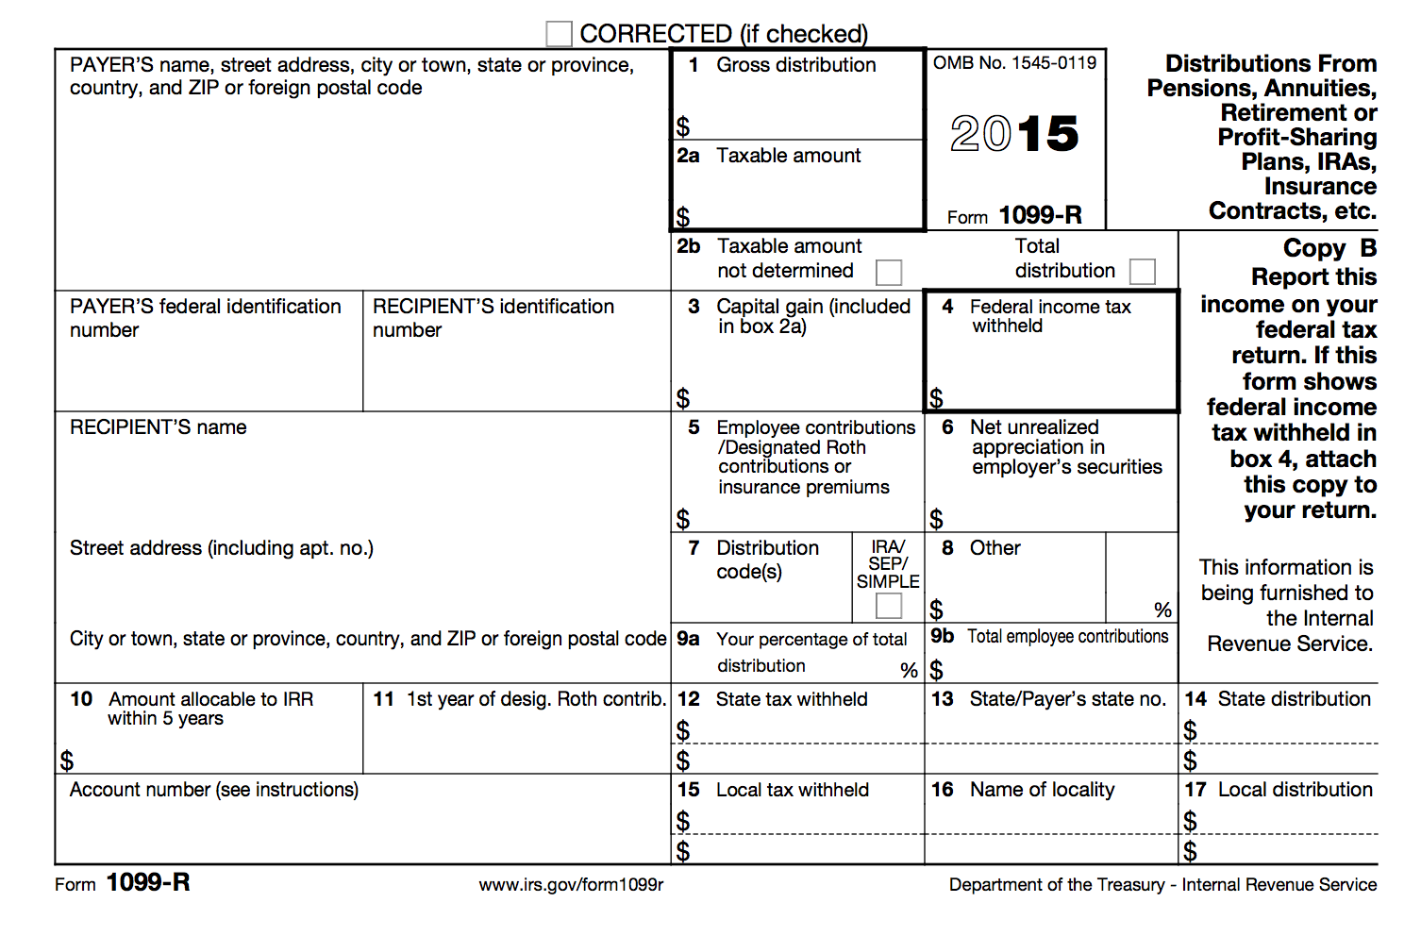
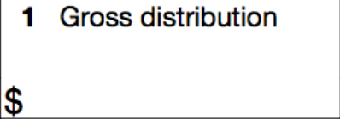
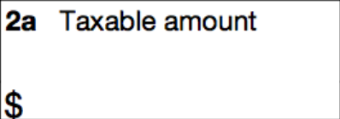

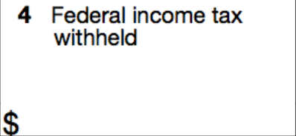
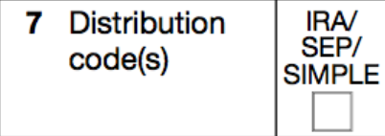

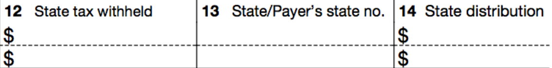
Form 1099-R: Distributions From Pensions, Annuities, Retirement…
Notes:
Box 1: Shows the total amount received during the tax year
Box 2a: This part of the distribution is the taxable portion. Sometimes this amount is blank—we will deal with what to do if the taxable amount is not determined in the next retirement lesson
Box 2b: If the first box is checked, the payer was unable to determine the taxable amount if this box was checked—again, we will deal with what happens when box 2a is blank in the next retirement lesson. If the second box is checked, the distribution was a total distribution that closed out the account
Box 4: Shows the federal income tax withheld on the distribution
Box 7: The distribution code identifies the type of distribution received. If the IRA/SEP/SIMPLE box is checked, the distribution is from a traditional IRA, SEP, or SIMPLE account
Box 9b: Depending on what type of plan the distribution is from, there may be an amount shown for the employee’s total investment in the plan. This will be used in helping us calculate the taxable portion if box 2a is blank
Box 12-14: If state income tax was withheld from the distribution, these boxes may show the amount subject to state tax and how much was withheld

Slide 74
Form 1099-R: Gross Distribution
Reported in box 1
Shows the total amount received during the tax year
Amount could be a rollover, or taxpayer may have received it as periodic payments, as non-periodic payments, or as a total distribution
Notes:
Reported in box 1
Shows the total amount received during the tax year
Amount could be a rollover, or taxpayer may have received it as periodic payments, as non-periodic payments, or as a total distribution

Slide 75
Form 1099-R: Taxable Amount
Reported in box 2a
Shows the total amount that is subject to federal income tax
The box MAY be blank and require additional computation to determine taxable amount
  Out of scope for Campus Fellows if box 2a is blank
Notes:
Reported in box 2a
Shows the total amount that is subject to federal income tax
The box MAY be blank and require additional computation to determine taxable amount
Out of scope for Campus Fellows is box 2a is blank

Slide 76
Form 1099-R: Taxable Amount Not Determined & Total Distribution
Reported in box 2b
❒Taxable Amount Not Determined indicates that the payer was unable to determine the taxable amount—box 2a should also be blank
❒Total Distribution indicates that the distribution was a total distribution that closed out the account
Notes:
Reported in box 2b
❒Taxable Amount Not Determined indicates that the payer was unable to determine the taxable amount—box 2a should also be blank
❒Total Distribution indicates that the distribution was a total distribution that closed out the account

Slide 77
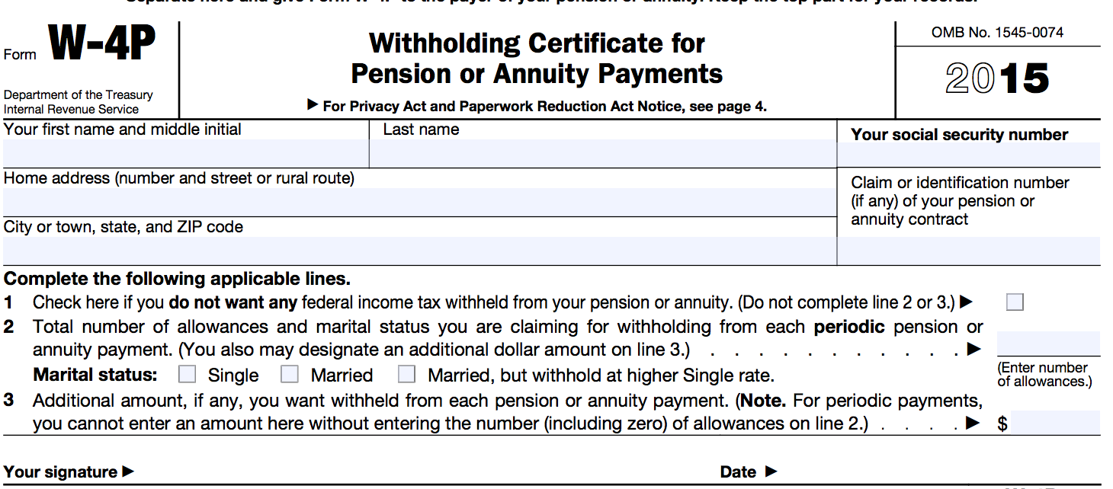
Form 1099-R: Federal Income Tax Withheld
Reported in box 4
Reports the amount of federal income tax withheld on the gross distribution
Similar to the Form W-2, this amount is determined by filling out a Form W-4P

Slide 78
Form 1099-R: Distribution Code(s) & IRA/SEP/SIMPLE
Reported in box 7
Distribution Code(s) identify the type of distribution received
Only certain distribution types are in scope for VITA
Notes:
Reported in box 7
Distribution Code(s) identify the type of distribution received
Only certain distribution types are in scope for VITA

Slide 79
Form 1099-R: Distribution Code(s) & IRA/SEP/SIMPLE
1: Early distribution, no known exception (in most cases, under age 59 ½)
2: Early distribution, exception applies (under age 59 ½)
3: Disability
4: Death
7: Normal distribution
B: Designated Roth account distribution
G: Direct rollover and rollover distribution
See the Publication 4012, Income Tab for a full list of box 7 distribution codes (and which are in scope)
Notes:
The following is a list of codes you will see in Box 7 of the 1099-R. The codes highlighted in yellow are the most common we will see
1: early distribution, no known exception (in most cases, under age 59 ½) → the taxpayer will typically have to pay a penalty if they take an early distribution.
2: early distribution, exception applies (under age 59 ½)
3: Disability → we’ll talk more specifically about disability in a moment
7: Normal distribution → this will be the most common code In box 7
B: Designated Roth account distribution
G: Direct rollover and rollover distribution → we’ll talk more specifically about this in a moment as well
See the Publication 4012, income tab, for a full list of box 7 distribution codes, and which are in scope

Slide 80
Form 1099-R: Distribution Code(s) & IRA/SEP/SIMPLE
❒IRA/SEP/SIMPLE indicates that the distribution was from a traditional IRA, SEP, or SIMPLE retirement account
ONLY traditional IRAs are in scope for Campus Fellows!
Verify with the taxpayer that the amount distributed was from a traditional IRA
Notes:
❒IRA/SEP/SIMPLE indicates that the distribution was from a traditional IRA, SEP, or SIMPLE retirement account
ONLY traditional IRAs are in scope for Campus Fellows!
Verify with the taxpayer that the amount distributed was from a traditional IRA

Slide 81
Form 1099-R: Total Employee Contributions
Reported in box 9b
For certain plans, an amount may be listed here showing the taxpayer’s contributions to the plan
This amount is used to help determine the taxable amount if box 2a is blank (however, this is out of scope for Campus Fellows)
Notes:
Reported in box 9b
For certain plans, an amount may be listed here showing the taxpayer’s contributions to the plan
This amount is used to help determine the taxable amount if box 2a is blank (however, this is out of scope for Campus Fellows)

Slide 82
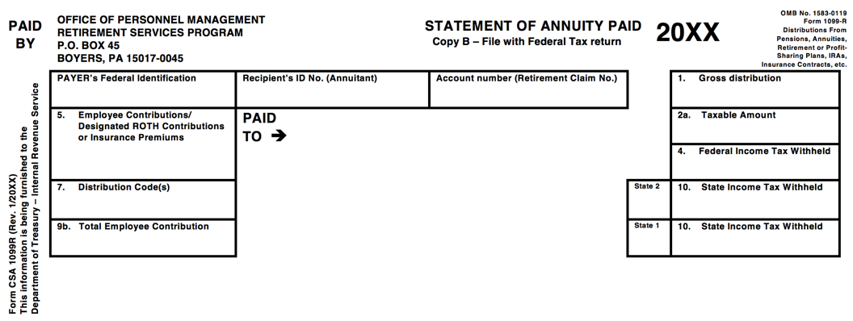
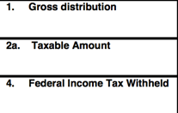
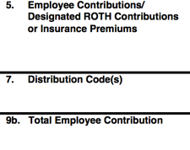
Form CSA 1099-R: Statement of Annuity Paid
Notes:
The form looks different from the Form 1099-R, but it reports the same information in boxes 1, 2a, 4, 5, 7, and 9b

Slide 83
Form CSA 1099-R: Statement of Annuity Paid
Provides the same information as the Form 1099-R
Issued to civil service employees
Remember, civil service employees have Defined Benefit retirement plans
Notes:
Provides the same information as the Form 1099-R
Issued to civil service employees
Remember, civil service employees have Defined Benefit retirement plans

Slide 84
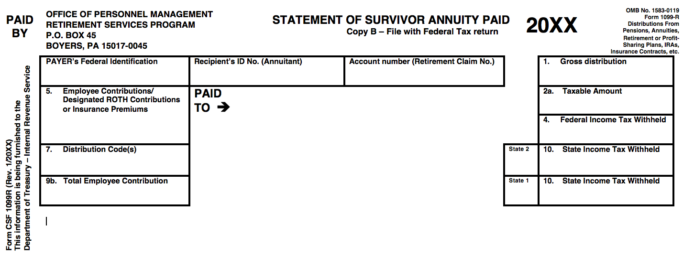
Form CSF 1099-R: Statement of Survivor Annuity Paid
Notes:
The form looks looks very similar to the Form CSA 1099-R and reports the same information.

Slide 85
Form CSF 1099-R: Statement of Survivor Annuity Paid
Provides the same information as the Form 1099-R
Issued to survivors of civil service employees (if the employee elected to have a survivor annuity for spouse and/or children)
Remember, civil service employees have Defined Benefit retirement plans
Notes:
Provides the same information as the Form 1099-R
Issued to survivors of civil service employees (if the employee elected to have a survivor annuity for spouse and/or children)
Remember, civil service employees have Defined Benefit retirement plans

Slide 86
Why is it important to determine what category of retirement plan a taxpayer has?

Slide 87
Why is it Important…?
Some retirement plans are not taxable on the state level
It is extremely important to determine what type of retirement plan a taxpayer has because it will change how the AL return is completed in TaxSlayer
Notes:
It is of vital importance to determine what type of retirement plan a taxpayer has because some plans are not taxable on the state level
If this is the case, you must add the income back to the AL return in TaxSlayer

Slide 88

Why is it Important…?
Defined Benefit Plans
…are NOT taxable in Alabama
TaxSlayer does not know the difference between Defined Benefits and Defined Contributions; it thinks all are Defined Benefits.
Notes:
Specifically, defined benefit plans are NOT taxable in Alabama
TaxSlayer does not know the difference between Defined Benefits and Defined Contributions, it thinks all 1099-R(with no IRA box checked or code 3 or code G) are Defined Benefits plans.
If the 1099-R comes from a defined contributions plan, you need to “add” that income to the AL return.

Slide 89
How to Determine the Plan Type
What if the taxpayer doesn’t know what type of plan they have?
Unfortunately, the Form 1099-R often doesn’t make clear what type of plan the distribution is from

Slide 90
Defined Benefit Retirement Plans
Not clearly evident from the 1099-R
Will require asking taxpayer questions, consulting resources
Defined Contribution Retirement Plans
Not clearly evident from the 1099-R
Will require asking taxpayer questions, consulting resources
Individual Retirement Plans
❒IRA/SEP/SIMPLE box will be checked on the Form 1099-R
Notes:
Both DB and DC plans are not clearly evident from the Form 1099-R, and will require asking the taxpayers questions and consulting various resources
Individual Retirement Plans will have the IRA box checked – remember, you have to check the box in TaxSlayer

Slide 91
Defined Benefits vs. Defined Contributions
To find out if a retirement plan is Defined Benefits or Defined Contributions
  Consult the DB list in the Campus Fellow Manual
  Call the company that administers the plan
  Call the state Department of Revenue
  Call the IRS
  Ask for a Summary Plan Description
Notes:
To find out if a retirement plan is Defined Benefits or Defined Contributions, you can consult an online list at our website, check your campus fellow manuals which you will receive in January, call the company that administers the plan, call the Alabama Department of Revenue, call the IRS, or talk to your site coordinator.

Slide 92
Defined Benefits vs. Defined Contributions
All retired civil servants (teachers, city employees, soldiers, etc.) have Defined Benefits plans
401(k)s are NOT Defined Benefits
Notes:
Note that ALL retired civil servants—teachers, city employees, soldiers, etc.—have DEFINED BENEFIT PLANS.
4019(k)s are NOT defined benefit plans.

Slide 93
Why is it Important…?
Defined Benefit Plans
…are NOT taxable in Alabama
TaxSlayer does not know the difference between Defined Benefits and Defined Contributions; it thinks all are Defined Benefits.
Notes:
Specifically, defined benefit plans are NOT taxable in Alabama
TaxSlayer does not know the difference between Defined Benefits and Defined Contributions, it thinks all 1099-R(with no IRA box checked or code 3 or code G) are Defined Benefits plans.
If the 1099-R comes from a defined contributions plan, you need to “add” that income to the AL return.

Slide 94
Defined Benefits or Defined Contributions?
You can also ask the taxpayer the following questions to help you reach a decision:
  Do you receive the same amount every pay period? (If yes → likely Defined Benefits, but not guaranteed!)
  Did your employer match your retirement contributions? (If yes → likely Defined Contributions)
  Were your contributions placed into an investment account? (If yes → Defined Contributions)
Notes:
To help you determine if a plan is defined benefits or defined contributions, you can ask the taxpayer the following questions:
Do you receive the same amount every pay period? If yes, it is defined benefits
Did your employer match your retirement contributions? If yes, it is defined contributions and you do not need to check any box
Were your contributions placed into an investment account? If yes, is defined contributions and you do not need to check any box
.

Slide 95
Summary Plan Description
A document provided by the plan administrator that includes a plain language description of important features of the plan, e.g., when employees begin to participate in the plan, how service and benefits are calculated, when benefits become vested, when payment is received and in what form, and how to file a claim for benefits
Notes:
A document provided by the plan administrator that includes a plain language description of important features of the plan, e.g., when employees begin to participate in the plan, how service and benefits are calculated, when benefits become vested, when payment is received and in what form, and how to file a claim for benefits
This is something you can ask the taxpayer for, but you may want to have your Site Coordinator talk to the taxpayer if it becomes necessary to ask for this document
Ideally, a taxpayer would have access to a SPD, although the reality is that most will not bring this when they file their return
It still does not hurt to ask if the retirement plan type cannot be easily determined

Slide 96
Example
Joe has been receiving his retirement payments for several years and has received a 1099-R. When you ask him if he knows what kind of plan it is, he says he has no idea but he knows it is from his employment as a teacher. Is this a defined benefits or defined contributions plan?
Notes:
[have a volunteer read the example]
Joe has been receiving his retirement payments for several years and has received a 1099-R. When you ask him if he knows what kind of plan it is, he says he has no idea but he knows it is from his employment as a teacher. Is this a defined benefits or defined contributions plan?

Slide 97
Example – Answer
Defined benefits plan
Remember, all civil servants will have a DB plan
Defined benefits plans are NOT taxable in AL
Notes:
Defined benefits plan – Box 1
All civil servants will have a defined benefits plan

Slide 98
Example
Maria began receiving her retirement payments this year and was issued a 1099-R. She tells you that this is being drawn from an investment account that she would contribute to and her former employer would match that contribution. Is this a defined benefits plan or defined contributions plan?
Notes:
[have a volunteer read the example]
Maria began receiving her retirement payments this year and was issued a1099-R. She tells you that this is being drawn from an investment account that she would contribute to and her former employer would match that contribution. Is this a defined benefits plan or defined contributions plan?

Slide 99
Example – Answer
Defined contributions plan
Defined contributions plans ARE taxable in AL
Notes:
Defined contributions plan—don’t check any of the boxes

Slide 100
Example
Charles has been receiving his retirement for seven years. Every month, he receives $100. Is this a defined benefits plan or defined contributions plan?
Notes:
[Have a volunteer read the example]
Charles has been receiving his retirement for seven years. Every month, he receives $100. Is this a defined benefits plan or defined contributions plan?

Slide 101
Example – Answer
Likely a Defined benefits plan, but ask more questions to confirm!
Defined benefits plans are NOT taxable in AL
Notes:
Defined benefits plan – don’t need to do anything for AL

Slide 102
Everybody Together Now… Why is this important?
Defined Benefit Plans
…are NOT taxable in Alabama
Defined Contributions ARE taxable and must be added to the AL return, because TaxSlayer thinks all 1099-Rs are DB
Notes:
Everybody together now…

Slide 103
Rollover
Refers to transferring the holdings in one retirement account to another
Specifically, the retirement account is emptied and distributed to the owner, who then deposits them into a new account for reinvestment
This is a TAX-FREE DISTRIBUTION
  But still must be reported on the federal tax return
  Code G will be in Box 7 of the 1099-R
Notes:
Refers to transferring the holdings in one retirement account to another
Specifically, the retirement account is emptied and distributed to the owner, who then deposits them into a new account for reinvestment
This is a TAX-FREE DISTRIBUTION
But still must be reported on the federal tax return
Code G will be in Box 7 of the 1099-R

Slide 104
Rollover
Why do taxpayers do this?
  The money is really not going to be used, it is still be saved for retirement—it’s simply being rolled over into a new qualified retirement savings plan or back into the same retirement account
Example:
  Julia left her job at Dog Food Company, but wanted to take her 401(k)—Julie is going to take a full tax-free distribution of her account and roll it over to a new qualified retirement savings plan
Notes:
Rollovers are tax-free distribution.
Why?
The money is really not going to be used—it is still being saved for retirement. It’s simply being rolled over into a new qualified retirement plan or back into the same retirement account.
Example:
Julia left her job at Dog Food Company, but wanted to take her retirement account with her to her new job—Julie is going to take a full tax-free distribution of her account and roll it over to a new qualified retirement savings plan

Slide 105
Disability Pension Income
Why would a taxpayer have disability pension income?
  Perhaps they had an accident that rendered them totally and permanently disabled
Disability payments may be coming from a qualified retirement pension plan

Slide 106
Disability Pension Income
Why is it important to determine if a taxpayer’s 1099-R is for disability pension payments?
…because until a taxpayer reaches the retirement age FOR THAT SPECIFIC PLAN, the income will be treated like wages, which might make the taxpayer eligible for the...
EARNED INCOME TAX CREDIT

Slide 107
Disability Pension Income
Code 3 will be in box 7 on a 1099-R, HOWEVER, you must…
  Check to see if taxpayer has reached retirement age for that specific plan
    If taxpayer isn’t sure, may need to consult retirement paperwork or contact plan manager
    Don’t just rely on a previous year return—previous tax preparer might not have entered in correctly

Slide 108
Disability Pension Income
If taxpayer has not reached retirement age, check the box that says “Check here to report on Form 1040, Line 7 (Distribution code must be a "3")”and verify that amount appears on the Form 1040 as wages
If taxpayer has reached retirement age, do NOT check that box and verify that the amount appears on the Form 1040 as retirement income

Slide 109
Retirement Income
Open up Kevin Kent in TaxSlayer
  Enter Retirement on Line 15/16
  Federal Section → Income→ IRA/Pension Distribution → Add or Edit a 1099-R

Slide 110
Adjustments to Income

Slide 111
Total Income
(Earned + Unearned)
Adjusted Gross Income
Adjustments
Notes:
Just as a reminder, adjustments are subtracted from total income on Page 1 of the Form 1040 to get “Adjusted Gross Income”

Slide 112
Adjustments to Income
Adjustments are basic life expenses that help decrease the amount of taxable income:
  Educator expenses
  Half of self-employment tax
  Early withdrawal penalty
  Alimony paid
  IRA contributions (traditional)
  Student loan interest
  College tuition payments
  Jury duty pay turned over to employer
Notes:
Adjustments to income are basic life expenses that help decrease taxable income.
These adjustments will be found on lines 23-35 of the Form 1040.
There are 8 adjustments that are in scope for VITA.

Slide 113
Educator Expenses
Eligible Educators
  K-12 teachers, instructors, counselors, principals, or aides
  Worked at least 900 hours (part-time)
  Ordinary and necessary amounts of:
    Books
    Supplies
    Equipment
Notes:
To take the educator expenses adjustments, the taxpayer (or spouse) must be a K-12 teacher, instructor, counselor, principal, or aide.
They must have worked at least 900 hours, which is considered part-time.
Qualifying expenses include ordinary and necessary amounts of books, supplies, and equipment (including computers and software.

Slide 114
Educator Expenses
Qualified expenses up to $250 are eligible
If taxpayer and spouse are both eligible educators, up to $500 are eligible
Note: More than $250 (or $500 total for taxpayer/spouse) can be taken as an itemized deduction
Notes:
You can enter qualified expenses up to $250 for the taxpayer and the spouse.
If the taxpayer and spouse are both eligible educators, you can deduct up to $500 total, but NOT more than $250 for each.

Slide 115
Half of Self-Employment Tax
Self-Employment Taxes
  Nonemployees & self-employed must pay an additional tax that covers FICA taxes that weren’t withheld during the year
  Note that nonemployees & self-employed workers don’t have an employer to pay ½ of these FICA taxes, so they end up paying the full share
Notes:
Self-Employment Taxes
Nonemployees & self-employed must pay an additional tax that covers FICA taxes that weren’t withheld during the year
Note that nonemployees & self-employed workers don’t have an employer to pay ½ of these FICA taxes, so they end up paying the full share

Slide 116
Half of Self-Employment Tax
Offsets the tax burden placed on individuals who do not have employers to pay half of their taxes
Available to all self-employed workers who were required to pay the self-employment tax
Notes:
This adjustment offsets the tax burden placed on individuals who do not have employers to pay half of their Social Security and Medicare taxes.
TaxSlayer will automatically calculate this adjustment on Form 1040, line 27 if you have completed the Schedule C or Schedule C-EZ.
Verify that an amount appears on this line if you have completed the Sch C or Sch C-EZ.

Slide 117
Penalty on Early Withdrawal of Savings
When a taxpayer withdraws savings before maturity, a penalty is incurred
  Box 3: Form 1099-INT or Form 1099-OID
Taxpayer can deduct these penalties from income
Notes:
Another adjustment that TaxSlayer will automatically calculate is one for early withdrawal penalties. Just make sure you enter all penalties in the correct line of the interest statemen. TaxSlayer will pull these amounts straight to line 30.

Slide 118
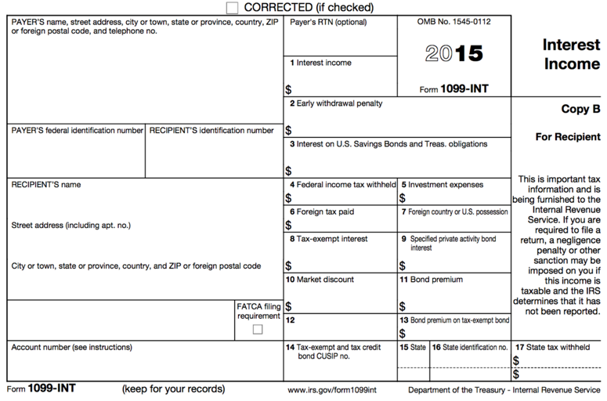

Form 1099-INT: Interest Income

Slide 119
Alimony Paid
A payment to or for a spouse or former spouse under a separation or divorce instrument
  Child support and voluntary payments NOT considered alimony
Deduct total alimony paid for the entire year, not just one month
Notes:
Earlier in this training, we discussed how to report alimony income received. Now we will discuss how to report alimony income paid.
Remember that alimony is payment to a spouse or former spouse under a divorce/separation agreement, and does not include child support and voluntary payments outside the divorce instrument
You must deduct the total alimony paid for the entire year, not just one month

Slide 120
IRA Contributions Deduction
Eligibility Requirements
  Only contributions to a Traditional IRA are deductible
  Must be under the age of 70 ½ at the end of the tax year
  Must have taxable compensation
  Contributions must be made by the filing date of the return
Notes:
To be eligible for this adjustment:
A taxpayer must have contributed to a traditional IRA
Must be under the age of 70 ½ at the end of the tax year
The taxpayer must have taxable compensation
The contributions must have been made by the due date of filing the return.

Slide 121
IRA Contributions Deduction
Contribution limit is the lesser of:
  Total amount of earned income, or
  $5,500 ($6,500 if over the age of 50)
    Note: these amounts are subject to change
Notes:
The contribution for this adjustment is the lesser the total amount of taxable compensation or $5,500 ($6,500 if over the age of 50)

Slide 122
IRA Contributions Deduction: Joint Returns
If the taxpayers file a joint return and one spouse’s compensation is greater than the other’s compensation, then:
  Married taxpayers’combined contributions cannot exceed combined compensation.
  Neither spouse can contribute more than $5,500 ($6,500 if age 50 or older).
Notes:
If the taxpayers file a joint return and one spouse’s compensation is greater than the other’s compensation, then:
Married taxpayers’ combined contributions cannot exceed combined compensation.
Neither spouse can contribute more than $5,500 ($6,500 if over the age of 50)
This means that on a joint return, no more than $11,000 can be entered for taxpayer and spouse under 50, and neither spouse can contribute more than $5,500.

Slide 123
Student Loan Interest
Up to $2,500 of interest paid during the year on a loan for qualified higher education expenses in the name of a:
  Taxpayer
  Spouse
  Dependent (or a dependent at the time the loan was obtained)
Note: Student must have been enrolled at least half-time in a program leading to a degree, certificate, or other credential.
Notes:
If a taxpayer paid student loan interest in the tax year, up to $2,500 paid during the year on a loan for qualified higher education expenses may be taken as an adjustment to income
This adjustment can be taken in the name of a taxpayer, spouse, or a dependent (when the loan was obtained—even if they are no longer currently the taxpayer’s dependent)
Note: The student must have been enrolled at least half-time in a program leading to a degree, certificate, or other credential.

Slide 124
Student Loan Interest
Eligibility Requirements
  Loan was obtained for an eligible student and was paid within a reasonable period of time before/after obtaining the loan
  School is:
    Accredited
    Qualified to participate in a student aid program or conduct internship/residency programs leading to a degree or certificate
Notes:
The loan must be for an eligible student and must be paid within a reasonable period of time before/after obtaining the loan
The school must be accredited and qualified to participate in student aid programs or conduct internship/residency programs leading to a degree or certificate.

Slide 125
Student Loan Interest
Eligibility Requirements
  Taxpayer is NOT:
    Married Filing Separately
    Able to be claimed as a dependent
Note: If the taxpayer cannot be claimed as a dependent but his/her parents paid the student loan interest and the student is legally liable for the loan, the student should claim the deduction.
Notes:
Taxpayer cannot be MFS (another reason why MFS is not an advantageous filing status), nor able to be claimed as a dependent by someone else.
However, if the taxpayer cannot be claimed as a dependent but his/her parents paid the student loan interest, the student can claim the deduction.

Slide 126
Student Loan Interest
Qualified expenses:
  Include tuition and fees required for enrollment, room and board, transportation, books, and supplies
  Usually reported on Form 1098-E or another statement from the lender
  Amount must be reduced by scholarships, employer-provided benefits, or tax-free education expenses
Notes:
Qualified expenses for the student loan interest adjustment include tuition and fees required for enrollment, room and board, transportation, books, and supplies.
Student loan interest will usually be reported on a Form 1098-E or on another statement from the lender.
The amount of student loan interest must be reduced by scholarships, employer-provided benefits, or tax-free education expenses.

Slide 127
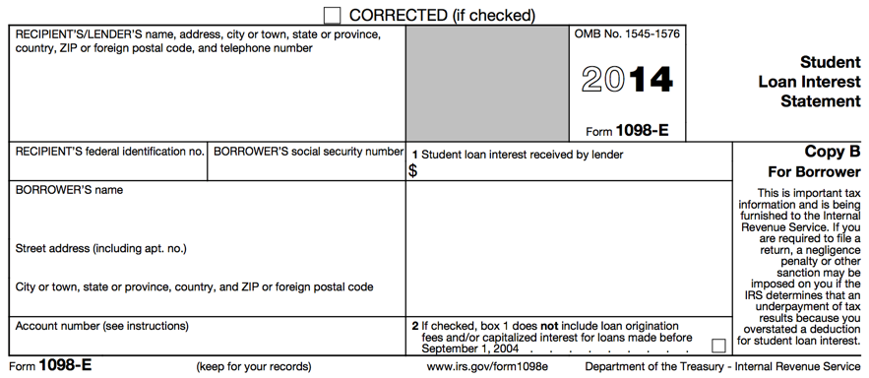

Form 1098-E: Student Loan Interest Statement
Notes:
Here is what the Form 1098-E looks like. Student loan interest received by the lender will appear in Box 1.

Slide 128
Tuition and Fees Deduction
Tuition amounts paid by the taxpayer can be taken as an adjustment to income OR used to claim an education credit (if taxpayer qualifies)
The tuition and fees deduction can be claimed for the taxpayer, spouse, and/or any qualified dependents
Notes:
If a taxpayer paid tuition and fees to an accredited institution in the tax year, they may be eligible to take an adjustment to income or an education credit (if the taxpayer qualifies).
The tuition and fees deduction can be claimed for the taxpayer, spouse, and/or any qualified dependents

Slide 129
Tuition and Fees Deduction
Tuition and fees deduction CANNOT be claimed if the taxpayer is:
  Married Filing Separately
  Able to be claimed as a dependent
Note: Only OUT-OF-POCKET expenses can be claimed; you must subtract amounts paid with scholarships and grants
Notes:
The adjustment cannot be claimed by a taxpayer if married filing separately or if claimed as a dependent by someone else.
Note: only out-of-pocket expenses can be claimed—you must subtract the amounts paid with scholarships and grants.

Slide 130
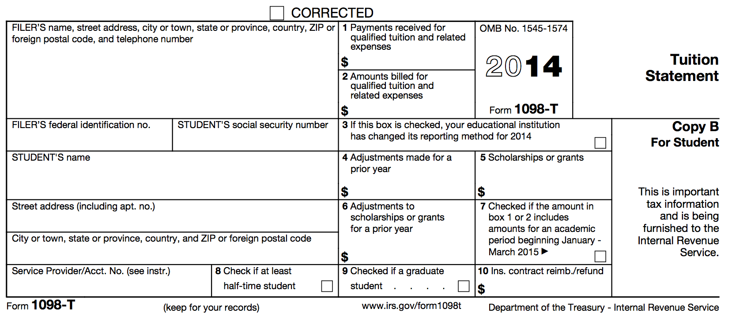


Form 1098-T: Tuition Statement
Notes:
Tuition amounts are reported on a 1098-T.
Box 1 shows the payments received for tuition and related expenses
Box 5 show the amount of scholarships or grants received—you must subtract scholarship amounts tuition before figuring entering the adjustment

Slide 131
Tuition and Fees Deduction
Qualified Expenses:
  Up to $4,000 in qualified tuition and related expenses;
  NOT BOOKS unless a condition of enrollment/attendance
Notes:
Taxpayers can deduct up to $4,000 in qualified tuition and related expenses, but this does NOT include the cost of books.

Slide 132
Jury Duty Pay Given to Employer
Jury duty pay is taxable income
BUT: if that pay is given to the employer, it can be deducted as an adjustment
Notes:
Jury duty pay is taxable income, HOWEVER, if that pay is given to the employer, it can be deducted as an adjustment

Slide 133
Adjustments to Income
TaxSlayer Walkthrough
Open up Kevin Kent in TaxSlayer
  Enter Adjustments to Income

Slide 134
Miscellaneous Nonrefundable Credits

Slide 135
Nonrefundable Credits
Remember: Nonrefundable credits directly reduce the tax liability, but only to zero (no refund of additional credit is available)
Foreign tax credit
Residential energy credit
Notes:
Remember: Nonrefundable credits directly reduce the tax liability, but only to zero (no refund of additional credit is available)
The two credits we will discuss are the Foreign tax credit and Residential energy credi

Slide 136
Foreign Tax Credit
Taken if a taxpayer paid income tax to a foreign country; U.S. possession; or political subdivision, agency, or instrumentality of a foreign country
Foreign tax paid > $300 ($600 if MFJ) is out of our scope!
We may see some foreign tax reported on a 1099-DIV or 1099-INT in Box 6
Notes:
The Foreign tax credit is taken if a taxpayer paid income tax to a foreign country; U.S. possession, or political subdivision, agency, or instrumentality of a foreign country.
If a taxpayer has greater than $300 of foreign tax paid, it is out of our scope.
We may see some foreign tax reported on a 1099-DIV or 1099-INT in Box 6

Slide 137
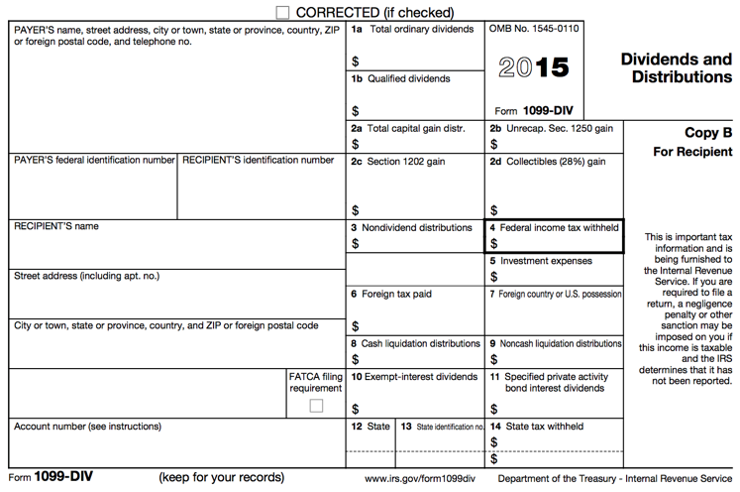

Form 1099-DIV: Dividends and Distributions
Notes:
Foreign tax paid is found in box 6

Slide 138
Residential Energy Credit
Two Types of Residential Energy Credits
  Residential energy-efficient property credit – OUT OF SCOPE!
  Nonbusiness energy property credit
Available to a taxpayer:
  Who made purchases for qualified energy efficient improvements for his/her main home
  Who owns his/her home
Notes:
There are two types of residential credits, but only the Nonbusiness Energy Property Credit is in scope for VITA
This credit is available to a taxpayer who made purchases for qualified energy efficient improvements for his/her main home and who owns his/her home.

Slide 139
Nonbusiness Energy Property Credit
Non-business energy property (for home improvement):
  Heating
  Ventilating
  Air-conditioning
  Insulation
  Roofs
  Water heaters (non-solar)
  Windows
  Doors
Notes:
The non-business energy property credit (for home improvements) including heating, ventilating, air-conditioning, insulation, roofs, non-solar water heaters, and door.

Slide 140
Eligibility Requirements
Improvements must be for taxpayer’s main home
  The home where the taxpayer lives most of the time
  Temporary absences do not change main home
Credit is only available for improvements made to existing homes
  Cannot claim based on expenses paid during the construction of a home
Notes:
Improvements must be for taxpayer’s main home
The home where the taxpayer lives most of the time
Temporary absences do not change main home
Credit is only available for improvements made to existing homes
Cannot claim based on expenses paid during the construction of a home

Slide 141
Eligible Expenses
Any insulation material or system that is specifically and primarily designed to reduce heat loss or gain of a home when installed in or on such a home
Exterior windows and skylights
Exterior doors
Any metal roof with appropriate pigmented coatings or asphalt roof with appropriate cooling granules that are specifically and primarily designed to reduce the heat gain of your home
Notes:
Eligible expenses include any insulation material or system that is specifically and primarily designed to reduce heat loss or gain of a home when installed in or on such a home
Exterior windows and skylights
Exterior doors
Any metal roof with appropriate pigmented coatings or asphalt roof with appropriate cooling granules that are specifically and primarily designed to reduce the heat gain of your home…

Slide 142
Eligible Expenses
Certain electric heat pump water heaters
Electric heat pumps
Central air conditioners
Natural gas, propane, or oil water heaters
Stoves that use biomass fuel
Notes:
…Certain electric heat pump water heaters
Electric heat pumps
Central air conditioners
Natural gas, propane, or oil water heaters
Stoves that use biomass fuel…

Slide 143
Eligible Expenses
Qualified natural gas, propane, or oil furnaces
Qualified natural gas, propane, or oil hot water boilers
Certain advanced main air circulating fans used in natural gas, propane, or oil furnaces
Notes:
…Qualified natural gas, propane, or oil furnaces
Qualified natural gas, propane, or oil hot water boilers
Certain advanced main air circulating fans used in natural gas, propane, or oil furnaces

Slide 144
Credit Dollar Limits
Total combined credit – $500
  For all tax years after 2005
Windows credit limit – $200
  For all tax years after 2005
Air circulating fan – $50
Natural gas, propane, oil furnace or hot water boiler - $150
Energy-efficient building property – $300
Notes:
The total combined credit allowed for all tax years after 2005 is $500.
For windows, the limit for all years after 2005 is $200
For air circulating fans, the limit is $50
For natural gas, propane, oil furnaces, or hot water boilers, the limit is $150.
For energy-efficient building property, the limit is $300.

Slide 145
Miscellaneous Nonrefundable Credits
TaxSlayer Walkthrough
Open up Kevin Kent in TaxSlayer
  Enter Foreign Tax Credit & Residential Energy Credits

Slide 146
End of A Session
Please complete Volunteer Paperwork online
This must be complete before you leave the A session today!

Slide 147
Campus Fellow Training
B Session

Slide 148
Training Agenda: B Session
9) Itemized Deductions
10) Education Credits
11) Affordable Care Act Provisions
12) Out of Scope Topics
13) Quality Review Process

Slide 149
Itemized Deductions

Slide 150
Itemized Deductions
Every taxpayer can take a specific amount for a “standard” deduction
  Reduces taxable income
There are certain designated expenses that a taxpayer can choose to list out separately, and, if they total more than the standard deduction, the taxpayer will “itemize” deductions
  Reduces taxable income by a greater amount
Notes:
As you learned in basic training, every taxpayer can take a specific amount for a “standard” deduction—this amount reduces taxable income.
There are certain designated expenses that a taxpayer can choose to list out separately, and, if they total more than the standard deduction, the taxpayer will “itemize” his deductions—thus reducing taxable income by a great amount.

Slide 151
When to Itemize Deductions
A taxpayer can receive a larger deduction by itemizing if he/she has:
  At the Federal Level (higher standard deduction):
    Home mortgage payment
    Large number of medical bills
  At the State Level (lower standard deduction):
    Expenses that may/may not have been sufficient to justify itemization on the federal level
Note: If a taxpayer is MFS and his/her spouse itemizes, the taxpayer must also itemize, regardless of whether the Standard Deduction would be higher
Notes:
A taxpayer can receive a larger deduction by itemizing on the federal level if he/she has a large number of medical bills/home mortgage payment—the federal return has a higher standard deduction, so it takes a fairly large amount of expenses for itemizing to be beneficial.
A taxpayer can receive a larger deduction by itemizing on the state level if he/she has expenses that may/may not have been sufficient to justify itemization on the federal level—the state return has a lower deduction, so it doesn’t take as many expenses for itemizing to be beneficial.
NOTE: If a taxpayer is MFS and his/her spouse itemizes, the taxpayer must also itemize, regardless of whether the standard deduction would be higher.

Slide 152
Qualifying Expenses
Unreimbursed Medical Expenses
Charitable Contributions
Taxes
Home Mortgage Interest
Miscellaneous Deductions
Notes:
There are several categories of qualifying expenses for itemizing we will discuss. They are: unreimbursed medical expenses, charitable contributions, taxes, home mortgage interest, and miscellaneous deductions.

Slide 153
Unreimbursed Medical Expenses
A taxpayer can claim expenses for
  Him/Herself
  Spouse
  Dependents
Notes:
A taxpayer can claim expenses for him/herself, spouse, and dependents

Slide 154
Unreimbursed Medical Expenses
Covered Medical Expenses
  Unreimbursed medical and dental expenses
  Eligible long-term care premiums
Be sure the expenses were not paid with pretax dollars or reimbursed by an insurance company.
Notes:
Medical & dental expenses and eligible long-term care premiums MUST be unreimbursed to be itemizable.
Verify that the expenses were not paid with pre-tax dollars or reimbursed by an insurance company before itemizing.

Slide 155
Unreimbursed Medical Expenses
Why can a taxpayer not itemize expenses paid with pretax dollars?
  NO DOUBLE BENEFITS!
  Expenses that were deducted pretax from pay have already given the taxpayer the benefit of a lower taxable income
  Cannot use these expenses a second time to lower taxable income again
Notes:
Why can a taxpayer not itemize expenses paid with pretax dollars?
NO DOUBLE BENEFITS!
Expenses that were deducted pretax from pay have already given the taxpayer the benefit of a lower taxable income
Cannot use these expenses a second time to lower taxable income again

Slide 156
Unreimbursed Medical Expenses
Deductible Medical Expenses
  Co-pays to doctor, dentist, eye doctor
  Prescription drugs
  Cost of glasses or hearing aids
  Cost of medical equipment
Notes:
You can refer to Publication 502 on the IRS website for a more complete listing, but here are a few of the most common deductible medical expenses:
Co-pays to doctor, dentist, eye doctor
Prescription drugs
Cost of glasses or hearing aids
Cost of medical equipment

Slide 157
Unreimbursed Medical Expenses
Deductible Medical Expenses
  Health insurance premiums
  Long-term care insurance premiums
  Cost of surgery, operations
  Miles to and from doctor
NOTE: For a complete listing of deductible and nondeductible expenses
see Campus Fellow Handbook and Schedule A instructions
Notes:
You can refer to Publication 502 on the IRS website for a more complete listing, but here are a few of the most common deductible medical expenses:
Health insurance premiums
Long-term care insurance premiums (cap on amount based on age)
Cost of surgery, operations
Miles to and from doctor

Slide 158
Unreimbursed Medical Expenses
Nondeductible Medical Expenses
  Life insurance policy premiums
  Funeral, burial, cremation costs
  Unnecessary cosmetic surgery
  Nonprescription drugs
NOTE: For a complete listing of deductible and nondeductible expenses
see Campus Fellow Handbook and Schedule A instructions
Notes:
There are some nondeductible medical expenses as well. Here are the most common:
Life insurance policy premiums
Funeral, burial, cremation costs
Unnecessary cosmetic surgery
Nonprescription drugs

Slide 159
Charitable Contributions
Qualifying Organizations:
  Religious
  Charitable
  Educational
  Scientific
  Literary
Non-qualifying Organizations:
  Business
  Civic/Political
  Social
  Foreign
  Homeowners’ Associations
Notes:
There are both qualifying and non-qualifying organizations deductible charitable contributions
Some qualifying organizations include religious, charitable, educational, scientific, and literary organizations.
Some non-qualifying organizations include business, civic/political, social, foreign, and homeowners’ associations.

Slide 160
Charitable Contributions
Deductible Expenses:
  Monetary donations
  Dues, fees, and assessments
  Fair market value (FMV) of clothing, furniture
  Uniforms required to be worn during service
  Unreimbursed transportation expenses
    Tolls, bus fare, parking fees, charitable miles
IMPORTANT: The taxpayer must keep receipts!
Notes:
There are certain deductible and nondeductible items that can be itemized.
Some deductible items include monetary donations, dues, fees, and assessments, the fair market value of clothing, furniture, etc., uniforms required to be worn during service, and unreimbursed transportation expenses including tolls, bus fare, parking fees, and the cost of gas at 14 cents per mile
It’s really important to note that the taxpayer MUST keep receipts! We don’t have to see every receipt to itemize, but the taxpayer needs to be advised that they need to have receipts for everything they itemize.

Slide 161
Charitable Contributions
FMV of Donated Goods
  If a taxpayer has made non-cash contributions to charity and does not have receipts, use the following resources to determine the FMV of donated items:
  Salvation Army Valuation Guide
Notes:
If a taxpayer has made any non-cash contributions to charity and does not have receipts, they can a Salvation Army valuation guide (or another guide) to determine the FMV of donated items.

Slide 162
Charitable Contributions
Nondeductible Expenses:
  Raffle, bingo, lottery tickets
  Tuition
  Value of time of service
  Blood
  Contributions to individuals
  The FMV of any good received in exchange for a donation (i.e. t-shirts, cds, tote bags, etc.)
Notes:
Some nondeductible charitable contribution expenses include raffle, bingo, and lottery tickets, tuition, value of time of service, blood, contributions to individuals, and the FMV of any good received in exchange for a donation (e.g., a t-shirt received for signing up for a charity race).

Slide 163
Charitable Contributions
Limits to Charitable Contributions
  Contributions that total more than 20% of their AGI may be able to deduct only a percentage of their contributions, and must carry over the remainder to a later tax year
  If taxpayers have >$500 of noncash contributions, they need to be referred to a professional preparer if they want to deduct the full amount.
  Form 8283 (OUT OF SCOPE)
Notes:
There are some limits to charitable contributions. Contributions that total more than 20% of their AGI may be able to deduct only a percentage of their contributions, and must carry over the remainder to a later tax year.
IMPORTANT: If a taxpayer has greater than $500 of non-cash contributions, they need to be referred to a professional preparer if they want to deduct the full amount—more than that is out of scope for VITA.

Slide 164
Charitable Contributions
Recordkeeping – cash contributions
  Canceled check or bank statement
  Written communication from the charity
    Name of charity, date and amount
Notes:
Taxpayers need to keep good records of charitable donations. For cash contributions, a canceled check, bank statement, or written communication from the charity with the name of the charity, date, and amount contributed is sufficient.

Slide 165
Charitable Contributions
Recordkeeping – noncash contribution
  For each contribution < $250
    Written communication, description, FMV
  For each contribution between $250 and $500
    Written communication, description, FMV and acknowledgement of any goods received in return
  For each contribution > $500
    Refer to professional preparer if taxpayer wants to take full amount
Notes:
For noncash contributions less than $250, written communication, a description, and the fair market value is sufficient. For each contribution between $250 and $500, written communication, a description, the FMV, and an acknowledgement of any goods received in return is needed.
Remember, any contributions above $500 are out of scope for VITA, and if the taxpayer wants to take the full amount, they must be referred to a professional preparer.

Slide 166
Taxes
Deductible
  Taxes imposed on and paid by the taxpayer in the tax year
Nondeductible
  Taxes the taxpayer pays for someone else
  Taxes not paid during the tax year
Notes:
The next category of itemizable deductions is Taxes.
Deductible taxes include taxes imposed on and paid by the taxpayer in the tax year.
Nondeductible taxes include taxes the taxpayer pays for someone else and taxes not paid in the tax year.

Slide 167
Taxes
Deductible
  State and local taxes
  Real estate taxes
  Personal property taxes
  State and local taxes on a new car purchase
  Ad valorem tax on car tags
Nondeductible
  Federal taxes
  Hunting licenses
  Water/sewer
  Taxes on alcohol, tobacco, or gas
  Utilities
Notes:
Deductible taxes include state and local taxes, real estate and property taxes, state and local taxes on a new car purchase, and ad valorem tax on car tags (taxpayer must subtract $24.50 for the physical tag from the total amount—only the actual tax can be included).
Some nondeductible taxes include federal taxes, hunting licenses, water/sewer taxes, taxes on alcohol, tobacco, or gas (sin taxes), and utilities.

Slide 168
State and Local Taxes
Taxpayers can choose one of the following, but not both:
  Income taxes
  Sales taxes
    County sales tax amounts differ
    AL state sales tax is 4%
    TaxSlayer will make an estimate of sales tax paid based on income
Notes:
Taxpayers can choose to itemize either income taxes or sales taxes, but not both.
Note that county sales tax amounts differ, but Alabama state sales tax is always 4% (It’s 5.5% in Birmingham).

Slide 169
Home Mortgage Interest
Any interest paid on a loan secured by the taxpayer’s home, line of credit, or a home equity loan.
Generally reported on Form 1098
Notes:
The next category of itemizable deductions is Home Mortgage Interest. Home mortgage interest is any interest paid on a loan secured by the taxpayer’s home, line of credit, or a home equity loan.
Home mortgage interest is generally reported on Form 1098

Slide 170
Home Mortgage Interest
Only taxpayers who are legally liable for the debt can deduct the interest
Taxpayers may have more than one mortgage or may have refinanced and have multiple statements
Points: only points paid as a form of interest (for the use of money) can be deducted
Notes:
Only taxpayers who are legally liable for the debt can deduct the interest.
Taxpayers may have more than one mortgage or may have refinanced and have multiple statements—they can be added up an entered on the return.
Only points paid as a form of interest (for the use of money) can be deducted.

Slide 171
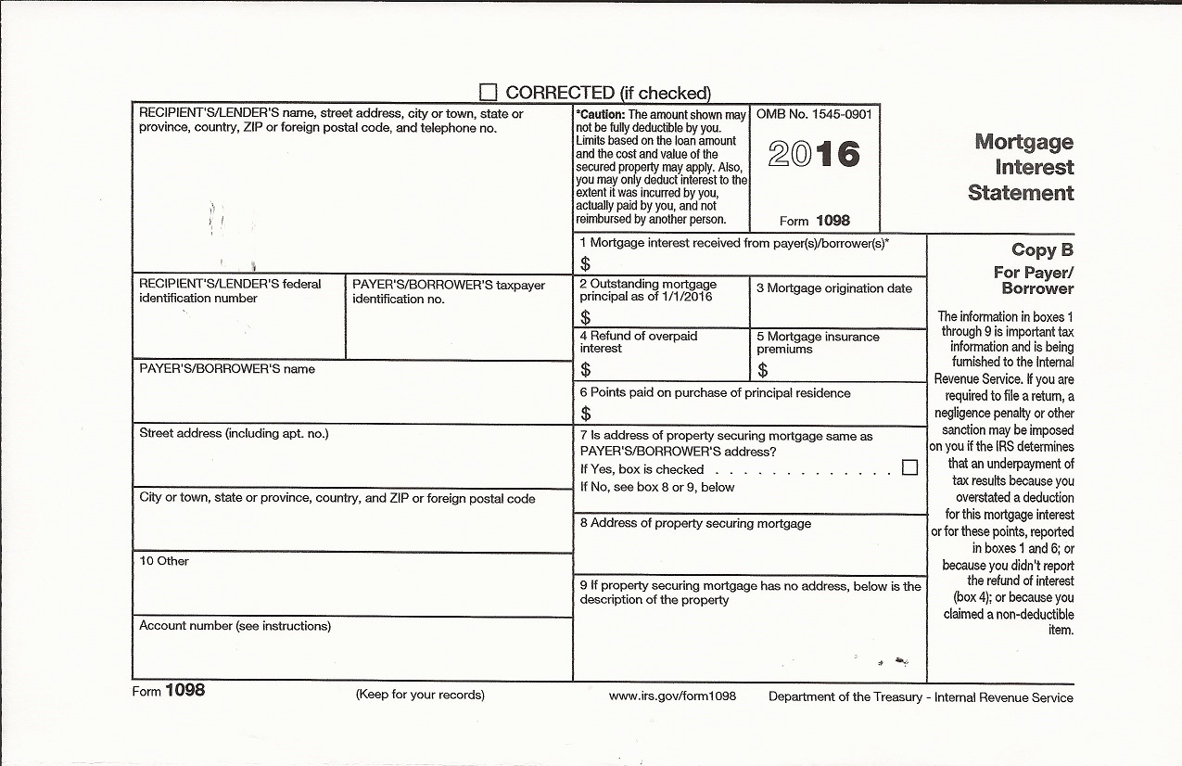
Form 1098: Mortgage Interest Statement
Notes:
Here is the Form 1098, Mortgage Interest Statement.
You may see amounts for Mortgage Interest Received in Box 1, points paid in Box 2, mortgage insurance premiums in box 4, and real estate taxes in box 5 (these should be entered on the Schedule A, line 6 in the Taxes You Paid section)

Slide 172
Form 1098: Mortgage Interest Statement
Boxes 10 or 11 may also report real estate taxes
These amounts can be included as an itemized deduction
Notes:
Boxes 4 or 5 MAY also report real estate taxes, which can be included as an itemized deduction

Slide 173
Nondeductible Interest
Personal interest
  personal loans
  car loans
  credit cards
  etc.
Notes:
Any kind of personal interest is nondeductible. This includes personal loans, car loans, credit cards, etc.

Slide 174
Casualty and Theft Losses
Out of Scope!
Notes:
On the Schedule A, you will see a section for Casualty and Theft Losses. This is out of Scope for VITA.

Slide 175
Miscellaneous Deductions
Union dues
Uniforms (that cannot be worn in any other circumstance)
Professional books, journals
Small tools and supplies, used for business
Notes:
The last category is miscellaneous itemizable deductions. These are entered on the Schedule A, lines 21-28.
Some miscellaneous deductions include union dues, uniforms (that cannot be worn in any other circumstance), professional books and journals, small tools and supplies used for business…

Slide 176
Miscellaneous Deductions
Employment-related educational expenses
  Includes educator expenses > $250 (after the adjustment)
Expenses for looking for a new job
Tax preparation fee from last year
Safe deposit box
Gambling losses up to amount of winnings
Notes:
…employment-related educational expenses (including educator expenses greater that $250 after the adjustment is taken), expenses for looking for a new job, tax prep fees from last year, safe deposit box fees, and gambling losses up to amount of winnings.

Slide 177
Nondeductible Expenses
Burial or funeral expenses
Wedding expenses
Fees and licenses
Fines, penalties, traffic tickets
Home repairs and insurance
Rent
Insurance premiums (except health and mortgage)
Losses from sale of home
Notes:
Here are some common nondeductible expenses that you will be asked by taxpayers about: burial or funeral expenses, wedding expenses, fees and licenses, fines, penalties, or traffic tickets, home repairs and insurance, rent, insurance premiums (except health and mortgage), and losses from sale of home.

Slide 178
Example
Are the following expenses deductible?
Medical insurance premiums
Vitamins
Federal income tax
Interest on car loan
Church contribution
Tax preparation fee from last year

Slide 179
Example – Answer
Are the following expenses deductible?
Medical insurance premiums - YES
Vitamins
Federal income tax
Interest on car loan
Church contribution
Tax preparation fee from last year

Slide 180
Example – Answer
Are the following expenses deductible?
Medical insurance premiums - YES
Vitamins - NO
Federal income tax
Interest on car loan
Church contribution
Tax preparation fee from last year

Slide 181
Example – Answer
Are the following expenses deductible?
Medical insurance premiums - YES
Vitamins - NO
Federal income tax - NO
Interest on car loan
Church contribution
Tax preparation fee from last year

Slide 182
Example – Answer
Are the following expenses deductible?
Medical insurance premiums - YES
Vitamins - NO
Federal income tax - NO
Interest on car loan - NO
Church contribution
Tax preparation fee from last year

Slide 183
Example – Answer
Are the following expenses deductible?
Medical insurance premiums - YES
Vitamins - NO
Federal income tax - NO
Interest on car loan - NO
Church contribution - YES
Tax preparation fee from last year

Slide 184
Example – Answer
Are the following expenses deductible?
Medical insurance premiums - YES
Vitamins - NO
Federal income tax - NO
Interest on car loan - NO
Church contribution - YES
Tax preparation fee from last year - YES

Slide 185
Itemized Deductions (Alabama Return)
If the taxpayer is itemizing deductions on the Federal and State returns or if the taxpayer is just itemizing on the State return, you always enter the itemized deductions on Sch A on the Federal return.
  Never start to itemize on the AL return.
  It is okay to leave the deductions on the Federal return even if the taxpayer does not have enough to itemize, because there is a good chance he/she can itemize on the State return.
All of the information from the Sch A carries over to the AL40

Slide 186
Itemized Deductions
TaxSlayer Walkthrough
Open up Kevin Kent in TaxSlayer
  Enter Itemized Deductions

Slide 187
Education Credits

Slide 188
Education Credits
Education credits help to offset the cost of higher education expenses paid during the year
Two education credits available
  Nonrefundable: Lifetime learning credit
  Partially Refundable: American opportunity credit
Notes:
The purpose of education credits is to offset higher education expenses paid during the year for the taxpayer, the spouse, or a dependent.
There are two types of education credits—the American Opportunity Credit, which is up to 40% refundable, and the Lifetime Learning Credit, which is nonrefundable.

Slide 189
General Eligibility
Filing status cannot be Married Filing Separately
Cannot be claimed as a dependent on someone else’s return
Accredited institution
CAN claim on the basis of expenses paid with student loans
Notes:
There are several eligibility requirements a taxpayer must meet to take an education credit:
A taxpayer’s filing status cannot be MFS
They cannot be claimed as a dependent on someone else’s return
Qualified expenses include tuition and fees required for enrollment
They must have paid tuition to an accredited institution
CAN claim the credit on the basis of expenses paid with student loan

Slide 190
Dependents
When the student can be claimed as a dependent:
  Taxpayer must claim credit if taxpayer claims the exemption
  Student must claim credit if taxpayer does not claim exemption
If the taxpayer claims the dependency exemption, any amount paid by the student is considered to have been paid by the taxpayer
Notes:
When a student can be claimed as a dependent
The taxpayer must claim the credit if the taxpayer claims the exemption for the dependent
The student must claim the credit if the taxpayer does NOT claim the exemption
If the taxpayer claims the dependency exemption, any amount paid by the student is considered to have been paid by the taxpayer.

Slide 191
American Opportunity (Hope) Credit | Lifetime Learning Credit
Up to $2,500 per eligible student ($1,000 is refundable) | Up to $2,000 credit per return
Available for the 1st 4 years of college | Available for all years
Student must be pursuing a degree or recognized education credential | Student does not need to be pursuing a degree or credential
Student must be enrolled at least half time | Available for one or more courses
No felony drug conviction on student’s record | Felony drug conviction does not apply
Expenses include tuition, fees, and course materials | Expenses include only tuition and fees
Cannot claim if MFS
Notes:
This chart shows the differences between the two education credits, the American Opportunity (Hope) Credit and the Lifetime Learning Credit
[read through each line and point out differences between the two]

Slide 192



Form 1098-T: Tuition Statement
Notes:
Often, a taxpayer will have tuition amounts reported on a Form 1098-T.
You may see amounts in box 1, 2, or 5, and box 7 or 8 may be checked

Slide 193
Form 1098-T: Payments Received For Qualified Tuition and Related Expenses
Reported in box 1
Shows the total payments RECEIVED by the institution in the tax year from any source for qualified tuition and related expenses
Notes:
Box 1 shows the total payments RECEIVED by the institution in the tax year from any source for qualified tuition and related expenses

Slide 194
Form 1098-T: Amounts Billed for Qualified Tuition and Related Expenses
Reported in box 2
Shows the total payments BILLED in the tax year for qualified tuition and related expenses
Some institutions will only list an amount in box 2 (and will not list the amount RECEIVED in box 1)
If there is ONLY an amount listed in box 2, you must ask the taxpayer how much they actually paid during the tax year before using the amount for the credit (or adjustment)
Notes:
Box 2 shows the total payments BILLED in the tax year for qualified tuition and related expenses
Some institutions will only list an amount in box 2 (and will not list the amount RECEIVED in box 1)
If there is ONLY an amount listed in box 2, you must ask the taxpayer how much they actually paid during the tax year before using the amount for the credit (or adjustment)

Slide 195
Form 1098-T: Scholarships or Grants
Reported in box 5
Shows the total of all scholarships or grants administered and processed by the institution
The amount of scholarships or grants must be subtracted from the total amount of expenses paid when figuring the credit (or adjustment)
Notes:
Box 5 shows the total of all scholarships or grants administered and processed by the institution
The amount of scholarships or grants must be subtracted from the total amount of expenses paid when figuring the credit (or adjustment)

Slide 196
Form 1098-T: Amounts for an Academic Period Beginning Jan – March 20XX
Reported in box 7
This box will be checked if the amount in box 1 or 2 (amounts RECEIVED and BILLED by the institution) includes amounts paid for an academic period beginning in January AFTER the tax year
Notes:
Box 7 will be checked if the amount in box 1 or 2 (amounts RECEIVED and BILLED by the institution) includes amounts paid for an academic period beginning in January AFTER the tax year

Slide 197
Form 1098-T: Amounts for an Academic Period Beginning Jan – March 20XX
Example:
  A taxpayer is filing a 2016 tax return
  Box 7 is checked
  Box 1 or 2 amounts thus include amounts that were received or billed by the institution for the spring academic period beginning in January – March of 2017
Notes:
Example:
A taxpayer is filing a 2016tax return
Box 7 is checked
Box 1 or 2 amounts thus include amounts that were received or billed by the institution for the spring academic period beginning in January – March of 2017

Slide 198
Form 1098-T: Check if At Least Half-time Student
Reported in box 8
Shows whether the student is considered to be carrying at least one-half the full-time workload for the student’s course of study at the institution
Number of hours considered half-time can vary based on the institution’s policies
Notes:
Box 8 shows whether the student is considered to be carrying at least one-half the full-time workload for the student’s course of study at the institution
Number of hours considered half-time can vary based on the institution’s policies

Slide 199
Qualified Expenses for Credit
American Opportunity (Hope) Credit
  Qualified tuition and related expenses up to $4,000 per eligible student
  Includes expenses for course materials – books, supplies, and equipment needed for a course of study, whether or not they were purchased from institution
Notes:
For the American opportunity credit, qualified tuition and related expenses up to $4,000 per eligible student can be used to calculate the credit.
These qualified expenses include any expenses for course-related materials (books, supplies, and equipment needed for a course of study, whether or not they were purchases from the institution)

Slide 200
Qualified Expenses for Credit
Lifetime Learning Credit
  Expenses include only tuition and fees
  Course-related books, supplies and fees are included ONLY if they must be paid to the institution as a condition of enrollment
Notes:
For the Lifetime learning credit, expenses include ONLY tuition and fees.
Course-related books, supplies, and fees are included ONLY if they must be paid to the institution as a condition of enrollment.

Slide 201
Expenses That Do Not Qualify
Room and board
Insurance
Medical expenses (including student health fees)
Transportation costs
Personal, living or family expenses
Expenses for a course involving sports, games or hobbies, unless it is required for the degree/certificate
Notes:
Room and board
Insurance
Medical expenses (including student health fees)
Transportation costs
Personal, living or family expenses
Expenses for a course involving sports, games or hobbies, unless it is required for the degree/certificate

Slide 202
No Double Benefits
The taxpayer CANNOT claim:
  Both the American opportunity and lifetime learning credits for the same qualified tuition expenses
  Expenses paid with a tax-free scholarship, grant, or other assistance, including Pell grants (in other words, the taxpayer must subtract these scholarships from the total expenses before claiming either credit)
Notes:
The Taxpayer CANNOT claim both the American opportunity credit AND the lifetime learning credit for the same qualified tuition expenses—no double benefits!
The taxpayer CANNOT claim expenses paid with a tax-free scholarship, grant, or other assistance, including Pell grants (in other words, the taxpayer must subtract these scholarship from the total expenses before claiming either credit)

Slide 203
No Double Benefits
The taxpayer CANNOT claim:
  Both an education credit AND the tuition and fees adjustment for the same qualified tuition expenses
  Most taxpayers benefit more from the credit, but you should try the expenses as both an adjustment AND a credit to determine which benefits the taxpayer more
Notes:
The taxpayer CANNOT claim both a credit and the tuition and fees adjustment
Most taxpayers benefit more from the credit, but you should try the expenses as both an adjustment AND a credit to determine which benefits the taxpayer more

Slide 204
Qualified Expenses
IMPORTANT!
Verify with the taxpayer that the amount in Box 1 or 2 of Form 1098-T is actually the amount paid in the current tax year for qualified expenses!
Notes:
It is VERY IMPORTANT to verify with the taxpayer that the amount in Box 1 or 2 of the Form 1098-T is actually the amount paid in the current tax year for qualified expenses.

Slide 205
Payments for the Next Academic Year
Taxpayers can claim payments paid in the tax year for the academic period that begins in January – March of the next tax year
Remember: Box 7 will be checked on the Form 1098-T indicating that the amount in box 1 or 2 includes amounts paid for the next academic year
Notes:
Taxpayer CAN claim payments prepaid for the academic period that begins in the first three months of the next calendar year.
Remember: Box 7 will be checked on the Form 1098-T indicating that the amount in box 1 or 2 includes amounts paid for the next academic year

Slide 206
Payments for the Next Academic Year
Example:
  Michael pays $1,500 in December 2015 for the winter semester that begins in January 2016
  He can use the $1,500 paid in December 2015 to compute his credit for his 2015 tax return
  However, he cannot count the $1,500 again on his 2016 tax return
Notes:
Example:
Michael pays $,1500 in December 2015 for the winter semester that begins in January 2016
He can use the $,1500 paid in December 2015 to compute his credit for 2015.
However, he cannot count the $1,500 again on his 2016 return.

Slide 207
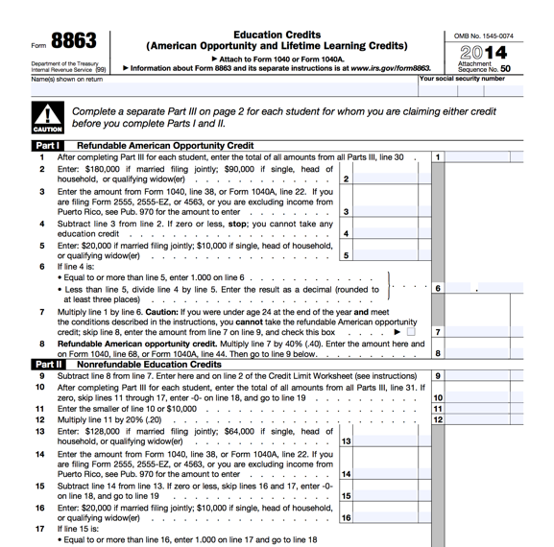
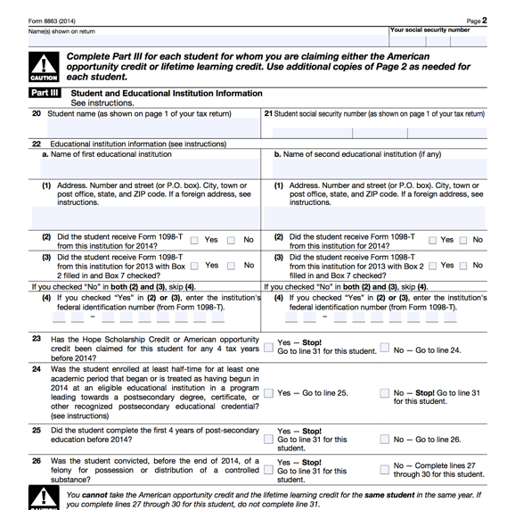
Form 8863: Education Credits
Notes:
Form 8863 is used to determine how much of the lifetime learning or American opportunity credit can be claimed. A separate Form 8863 form must be completed for EACH student on the tax return. The form looks different in TaxSlayer, but this is the actual printout of the form.

Slide 208
Determining the Amount of the Credit
Review the list of qualifying students and expenses and decide which credit is best.
Enter each qualifying student on Form 8863
Enter the students’ qualifying expenses
  Include only qualified expenses
  Are reduced by untaxed benefits (scholarships, grants, etc.)
  Are reduced by amounts paid in previous years
  Do not exceed the limit for the credit
Notes:
To determine the amount of credit, first review the list of qualifying students and expenses and decide which credit is more advantageous.
Next, enter each qualifying student and SSN on a separate 8863
Enter the students’ qualifying expenses, reduced by untaxed benefits (scholarships, grants, etc.), reduced by amounts paid in previous years. Do not exceed the limit for the credit.

Slide 209
Nonrefundable vs. Refundable
Lifetime Learning Credit
  Entirely nonrefundable
  Limit to $2,000 PER RETURN (not per eligible student)
American Opportunity Credit
  Partially refundable – up to $1,000 PER STUDENT
  Limit to $2,500 PER STUDENT (not per return)
Notes:
Lifetime Learning Credit
Entirely nonrefundable
Limit to $2,000 PER RETURN (not per eligible student)
American Opportunity Credit
Partially refundable – up to $1,000 PER STUDENT
Limit to $2,500 PER STUDENT (not per return)

Slide 210
Refundable American Opportunity Credit for Taxpayers under the age of 24
See Your Site Coordinator if you have a taxpayer under the age of 24 claiming an education credit – the taxpayer may or may not be eligible to take the refundable American Opportunity Credit, but the process for determining eligibility is complicated

Slide 211
Example
James takes one course at a local community college. He received a Form 1098-T showing qualified tuition expenses of $1,000. He lives with his parents, who can claim him as a dependent. Who is entitled to claim the credit? Which credit?

Slide 212
Example – Answer
If James’s parents claim him, they must claim the credit
If James’s parents do not claim him, James must claim the credit
Lifetime Learning Credit

Slide 213
Example
LaQuandra is a sophomore enrolled at UAB full-time. She provides all of her own support. She paid $10,000 in the tax year for tuition and fees for enrollment to UAB. She received a tax-free scholarship worth $4,000, and paid the rest from a student loan in her name. Can LaQuandra claim an education credit? Which one? How much of her expenses are qualified expenses?

Slide 214
Example – Answer
Yes
American Opportunity Credit
Qualified expenses = $6,000 ($4,000)

Slide 215
Education Credits
TaxSlayer Walkthrough
Open up Kevin Kent in TaxSlayer
  Enter Education Credits

Slide 216
Affordable Care Act
Notes:
The federal government, state governments, insurers, employers, and individuals share responsibility for improving the quality and availability of health insurance coverage in the United States
The ACA reforms the existing health insurance market by prohibiting insurers from denying coverage or charging higher premiums because of an individuals pre-existing conditions.
The ACA also created the Health Insurance Marketplace (also known as www.healthcare.gov)

Slide 217
What is the Affordable Care Act (ACA)?
The federal government, state governments, insurers, employers, and individuals share responsibility for improving the quality and availability of health insurance coverage in the United States
The ACA reforms the existing health insurance market by prohibiting insurers from denying coverage or charging higher premiums because of an individuals pre-existing conditions.
The ACA also created the Health Insurance Marketplace (also known as www.healthcare.gov)
Notes:
The federal government, state governments, insurers, employers, and individuals share responsibility for improving the quality and availability of health insurance coverage in the United States
The ACA reforms the existing health insurance market by prohibiting insurers from denying coverage or charging higher premiums because of an individuals pre-existing conditions.
The ACA also created the Health Insurance Marketplace (also known as www.healthcare.gov)

Slide 218
Healthcare.gov
Where taxpayers:
  Find information about health insurance options
  Purchase health insurance
  Obtain help paying premiums and out-of-pocket costs (if eligible)
A refundable tax credit, The Premium Tax Credit, is available through the Marketplace and helps eligible taxpayers pay for coverage
Notes:
Healthcare.gov, also known as the Marketplace, where where taxpayers find information about health insurance options, purchase health insurance, obtain help paying for premium and out-of-pocket costs (if eligible)
A refundable tax credit, The Premium Tax Credit, is available through the Marketplace and helps eligible taxpayers pay for coverage

Slide 219
Shared Responsibility Provision
The Affordable Care Act requires individuals to:
  Have qualifying health coverage, called minimum essential coverage, for each month of the year
  Qualify for a coverage exemption, OR
  Make a shared responsibility payment when filing their federal income tax returns
    This is essentially a tax penalty for not having coverage

Slide 220
Use Your Resources!
Use the Publication 4012, ACA Tab
to help you complete the ACA provisions on the tax return!
Notes:
Your Publication 4012, ACA tab and Affordable Care Act Survival Kit Guide will help you to complete any ACA portions of the tax return
If you are ever unsure about a situation involving the ACA, please see your Site Coordinator!

Slide 221
What is Minimum Essential Coverage?
Minimum essential coverage (MEC) is health coverage that satisfies the individual shared responsibility requirement
Most health insurance is MEC
No proof of coverage is needed. Oral statement from the taxpayer is acceptable, unless normal due diligence leads you to believe the taxpayer’s statement is incorrect
Notes:
Minimum essential coverage (MEC) is health coverage that satisfies the individual shared responsibility requirement
Most health insurance is considered MEC – we will discuss specific types in a moment
No proof of coverage is needed. Oral statement from the taxpayer is acceptable, unless normal due diligence leads you to believe the taxpayer’s statement is incorrect

Slide 222
Who Needs MEC?
Everyone on the tax return needs MEC or a coverage exemption
The taxpayer is responsible for the insurance, coverage exemption, or individual shared responsibility payment (penalty) of each person on the return
Notes:
Everyone on the tax return needs MEC or a coverage exemption
The taxpayer is responsible for the insurance, coverage exemption, or individual shared responsibility payment (penalty) of each person on the return

Slide 223
How Many Months Do Taxpayers Need to Have MEC?
Everyone needs MEC for every month
  A person is considered covered for the whole month if they had coverage for at least one day
  A person who was born or died during the year is required to have coverage for every full month alive
Notes:
Everyone needs MEC for every month
A person is considered covered for the whole month if they had coverage for at least one day
A person who was born or died during the year is required to have coverage for every full month alive

Slide 224
Types of Minimum Essential Coverage
Employer-Sponsored Coverage
  Group health insurance coverage for employees under
    A governmental plan (such as the Federal Employees Health Benefit Program)
    A grandfathered health plan
  A self-insured health plan for employees
  COBRA coverage
  Retiree coverage
Notes:
There are several different categories of minimum essential coverage.
First, employer-sponsored coverage includes group health insurance coverage for employees under a governmental plan or grandfathered health plan (**for your reference: this is a plan that is not MEC but was sufficient before the ACA was enacted**)
It also included a self-insured health plan for employees, COBRA coverage (**for your reference: this is coverage that can be purchased by a taxpayer immediately after leaving or getting laid off from a job that continues previous coverage, usually at a higher cost), and Retiree coverage

Slide 225
Types of Minimum Essential Coverage
Individual Health Coverage
  Health insurance purchased directly from an insurance company
  Health insurance purchased through healthcare.gov
  Health insurance through a student health plan
Notes:
Next, individual health coverage includes health insurance purchased directly from an insurance company, health insurance purchased through the Marketplace (healthcare.gov) and health insurance through a student health plan

Slide 226
Types of Minimum Essential Coverage
Government-Sponsored Programs:
  Medicare Part A coverage
  Medicare Advantage plans
  Most Medicaid coverage
  Children’s Health Insurance Program (CHIP)
    ALL Kids (Alabama)
Notes:
Next, government-sponsored programs include coverage from Medicare Part A, Medicare Advantage plans, MOST Medicaid coverage (**for your reference: some Medicaid plans only provide limited coverage that excludes hospital, doctor, or other basic services, which is NOT considered MEC)
It also includes the Children’s Health Insurance Program (CHIP), which is called ALL Kids in Alabama.

Slide 227
Types of Minimum Essential Coverage
Government-Sponsored Programs:
  Most TRICARE coverage
  Veteran Affairs comprehensive health care
  Peace Corps volunteer health coverage
  Department of Defense Nonappropriated Fund Health Benefits Program
  Refugee Medical Assistance
Notes:
It also includes MOST TRICARE coverage (**for your reference: TRICARE is primarily for active duty and retired military personnel and families—like Medicaid, limited coverage from TRICARE does not qualify as MEC)
It also includes coverage from the Department of Veteran Affairs, coverage for Peace Corps volunteers, as well as DoD Nonappropriated Fund Health Benefits Program and Refugee medical assistance

Slide 228
Types of Minimum Essential Coverage
Other Coverage
  Certain foreign coverage
  Certain coverage for business owners
Notes:
Finally, some health care plans don’t fit into the other categories, but do qualify for MEC, such as certain foreign coverage and certain coverage for business owners

Slide 229
Does NOT Qualify as MEC
There are some health plans that may provide limited benefits but do not qualify as MEC
Includes:
  Coverage consisting solely of excepted benefits such as standalone dental/vision insurance, disability income insurance, worker’s comp insurance
  Medicaid providing only specific medical services (such as family planning, pregnancy-related, etc.)
  AmeriCorps and AfterCorps coverage
Notes:
There are some health plans that may provide limited benefits but do not qualify as MEC
Includes:
Coverage consisting solely of excepted benefits such as standalone dental/vision insurance, disability income insurance, worker’s comp insurance
Medicaid/TRICARE providing only specific medical services (such as family planning, pregnancy-related, etc.)
AmeriCorps and AfterCorps coverage

Slide 230
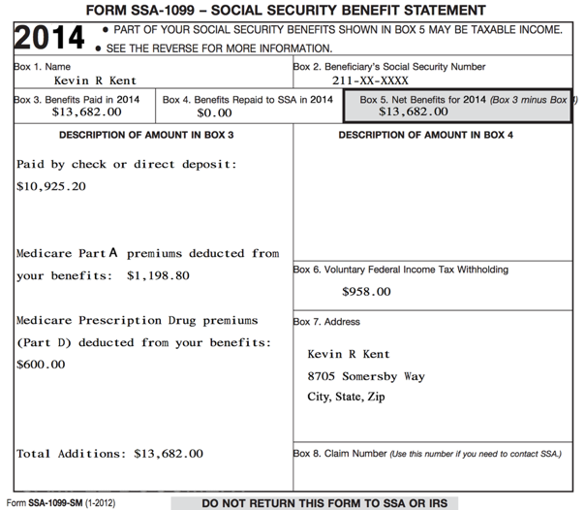
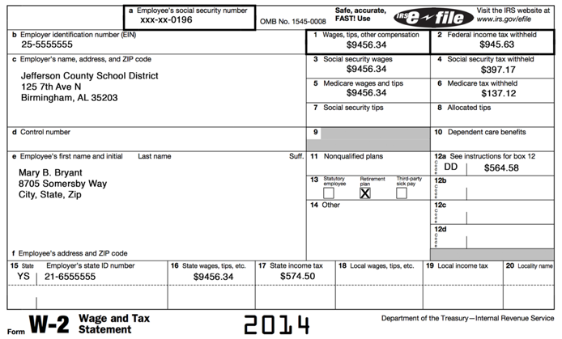

Tax Forms That Show Evidence of Coverage: Form W-2, Form SSA-1099
Notes:
There are a couple of tax forms you are already familiar with that shows evidence of minimum essential coverage.
The Form SSA-1099, which reports social security benefits received, reports Medicare Part A premiums
The Form W-2, which reports wages & salaries from a job, can report employer-sponsored health coverage in box 12, using code DD.

Slide 231
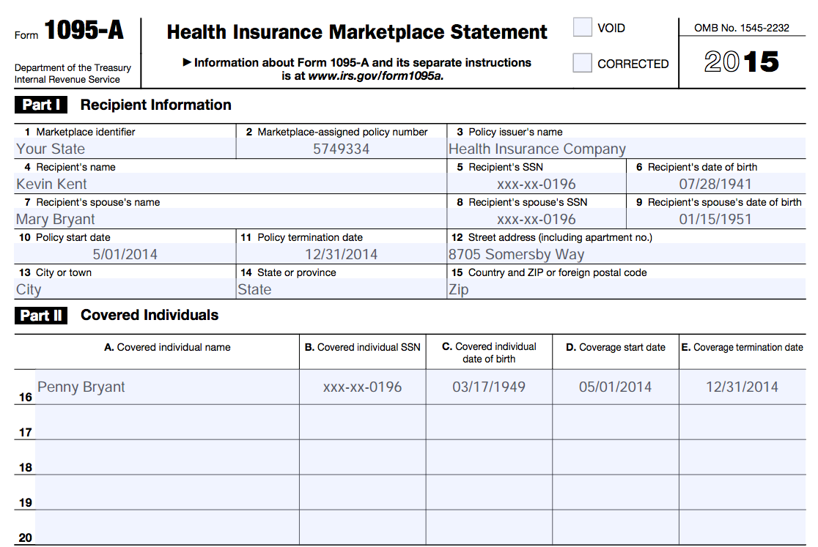
Tax Forms That Show Evidence of Coverage: Form 1095-A
Notes:
We will discuss this form in more detail in a moment, but the Form 1095-A is a Health Insurance Marketplace Statement reporting coverage information for insurance purchased through healthcare.gov

Slide 232
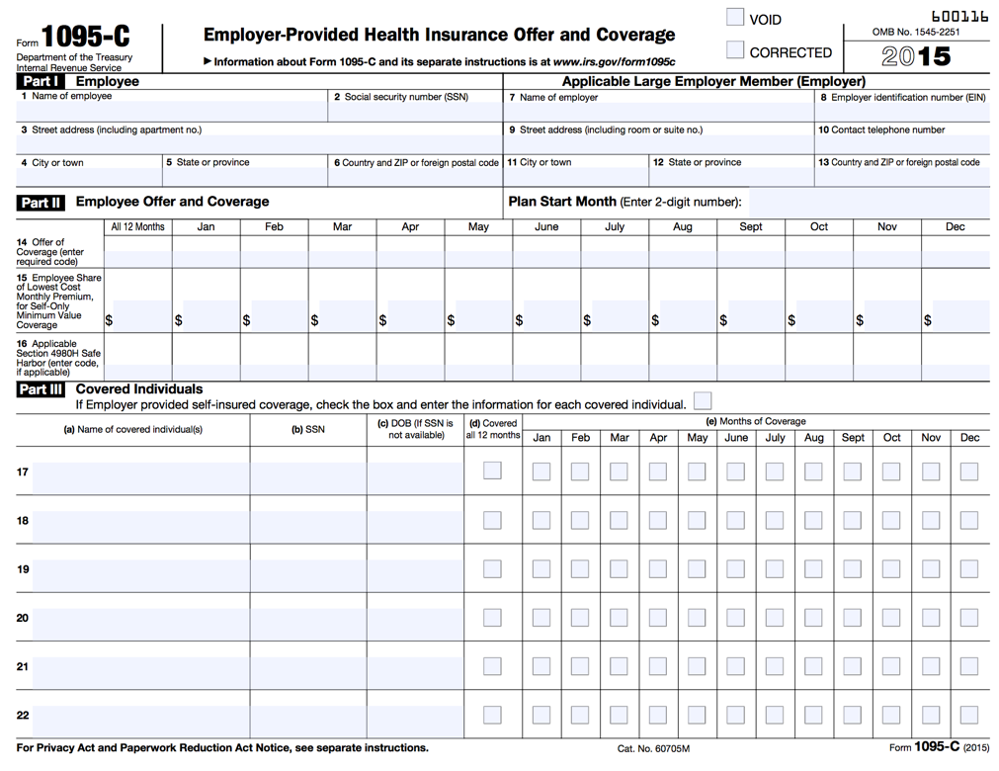
Tax Forms That Show Evidence of Coverage: Form 1095-C
Notes:
Some taxpayers may bring Form 1095-C, Employer-Provided Health Insurance Offer and Coverage
This form will primarily be issues by certain large employers who are subject to a specific provision laid out by the Affordable Care Act. It also shows evidence of health coverage. Not every taxpayer who has employee-sponsored coverage will receive this form

Slide 233
What is a Health Coverage Exemption?
A reason for not having health insurance that avoids payment of the individual shared responsibility payment
Notes:
Let’s talk now about health coverage exemptions
Health coverage exemptions are reasons for not having health insurance that avoids payment of the individual shared responsibility payment

Slide 234
Who Needs a Health Coverage Exemption?
Anyone without insurance coverage for any month should be screened for exemption eligibility
Notes:
Anyone without insurance coverage for any month should be screened for exemption eligibility

Slide 235
Exemptions: Where Do I Start?
Step 1 | Does anyone on the tax return already have an exemption in hand from the Marketplace (healthcare.gov)?
 | Marketplace exemptions require an application. If a person applied for an exemption, they should have received an Exemption Certificate Number (ECN) from healthcare.gov (it is a 6 or 7 alphanumeric code)
Notes:
Determining if a taxpayer qualifies for an exemption can be tricky
You should start by finding out if anyone on the tax return already has an exemption in hand from the Marketplace
These are exemptions the taxpayer had to apply for through healthcare.gov, and if they qualified, they received an Exemption Certificate Number (ECN) from healthcare.gov (a 6 or 7 alphanumeric code)
We will discuss what these exemptions might include in a moment

Slide 236
Exemptions: Where Do I Start?
Step 2 | Is household or gross income under the filing threshold?
 | If YES, everyone on the tax return is exempt from the coverage requirement, and there is no need to consider additional exemptions
Notes:
If the taxpayer doesn’t have an exemption from the Marketplace, next check to see if the taxpayer’s household OR gross income is under the filing threshold
If they are, then everyone on the tax return is exempt from the coverage requirement, and there is no need to consider further exemptions

Slide 237
Exemptions: Where Do I Start?
Step 3 | If the family does not qualify for an exemption under Step 2, does any individual qualify for an exemption that can be claimed directly on the return?
 | If YES, enter the exemption code on the tax return
Notes:
If the family is not under the filing threshold and does not have a Marketplace granted exemption, you should next check to see if any individual qualifies for an exemption that can be claimed directly on the tax return
This is something you will determine by talking to the taxpayer and using your resources (including your Site Coordinator!)

Slide 238
Exemptions: Where Do I Start?
Step 4 | For any uninsured individual that does not qualify under Step 2 or 3, does any individual on the tax return qualify for an exemption from healthcare.gov?
 | If YES, see your Site Coordinator for additional help in applying for the exemption and enter “pending” on the tax return
Notes:
Finally, if any uninsured individual does not qualify for an exemption to be claimed on the tax return, you should talk to the taxpayer and see if they may qualify for an exemption granted by healthcare.gov
Your Site Coordinator will help you and the taxpayer apply for a Marketplace exemption, and you will enter “pending” in the appropriate place on the tax return to indicate the taxpayer has applied for an exemption

Slide 239
Exemptions: Granted By Healthcare.gov
Homelessness
Eviction in the last 6 months or facing eviction or foreclosure
Utility shut-off notice
Domestic violence
Recent death of a close family member
Notes:
Let’s now discuss what hardship exemptions can be granted by healthcare.gov
Many of the following have very specific guidelines before they can be claimed (which is why you should have a Site Coordinator help in applying for these exemptions online)
Read through list of exemptions

Slide 240
Exemptions: Granted By Healthcare.gov
Disaster that resulted in significant property damage
Bankruptcy in the past 6 months
Debt from medical expense in last 24 months
High expense caring for ill, disabled or aging relative
Notes:
Read through list of exemptions

Slide 241
Exemptions: Granted By Healthcare.gov
Determined ineligible for Medicaid because state did not expand coverage**
  Will be common at SaveFirst sites!
Other exemptions
If it seems your taxpayer may qualify for a hardship exemption granted from healthcare.gov, see your Site Coordinator!
Notes:
Many taxpayers will be eligible for an exemption because they were determined ineligible for Medicaid because Alabama did not expand coverage
Last year, we were able to directly claim this exemption for taxpayers who qualified on the return. Unfortunately, this year taxpayers must apply to Medicaid and be denied to receive the exemption this year
If it seems your taxpayer may qualify for a hardship exemption granted from healthcare.gov, see your Site Coordinator for additional help

Slide 242
Exemptions: Household/Gross Income Below Filing Threshold
Household Income
The Modified Adjusted Gross Income (MAGI) of each individual on the tax return with a filing requirement. Include dependent income ONLY IF the dependent has a filing requirement
Gross Income
All the income received in the form of money, goods, property, and services that is not exempt from tax, including taxable portions of Social Security (do not income dependent income)
See Filing Basics tab of Pub 4012 for Filing Thresholds
Notes:
If the modified adjusted gross income (MAGI - **for your reference: MAGI is AGI + tax-exempt interest + excluded foreign income) of the ENTIRE household is below the filing threshold, everyone on the return is eligible for this exemption
Note: You only need to include a dependent’s income when determining household income if the dependent is required to file a tax return.
If the gross income, which is all the income received in the form of money, goods, property and services that is not exempt from tax, including taxable social security is below the filing threshold, everyone on the return is eligible for this exemption
Note: You do not need to include dependent’s income when determining gross income

Slide 243
Exemptions: Claimed on the Tax Return
Certain noncitizens and U.S. citizens living abroad
Federally recognized Indian tribe or eligible for services through the Indian Health Service
Member of a health care sharing ministry
Incarceration
Notes:
There are a number of exemptions that can be claimed directly on the tax return simply by inputting a letter code (A, B, C, etc.)
Read through list of exemptions

Slide 244
Exemptions: Claimed on the Tax Return
Unaffordable Insurance (cost of coverage exceeds 8.13% of household income)
Aggregate cost of employer insurance in unaffordable
Short coverage gap (less than 3 months)
Full list of exemptions for Individuals claimed on the tax return can be found in Pub 4012, ACA Tab
Notes:
Read through list of exemptions
A full list of exemptions can be found in Pub 4012, ACA tab

Slide 245
What is a Premium Tax Credit?
A premium tax credit (PTC) lowers the cost of health insurance coverage purchased from healthcare.gov
PTCs can be either:
Taken in advance (payment forwarded directly to the insurer monthly to reduce premiums), OR
Taken on the tax return (payment is claimed as a lump sum when filing the return)
Notes:
A premium tax credit (PTC) lowers the cost of health insurance coverage purchased from healthcare.gov
PTCs can be either:
Taken in advance (payment forwarded directly to the insurer monthly to reduce premiums), OR
Taken on the tax return (payment is claimed as a lump sum when filing the return)

Slide 246
Premium Tax Credits: Where Do I Start?
Step 1 | Did the taxpayer or dependent purchase coverage from healthcare.gov?
 | If YES, complete Form 8962 and go to Step 2. If NO, do not complete Form 8962 and STOP.
Notes:
How do I determine if a taxpayer qualifies for a premium tax credit?
Only taxpayers who purchase health insurance from healthcare.gov potentially qualify for a PTC
If the taxpayer did purchase coverage from healthcare.gov, you must complete a special form on the tax return

Slide 247
Premium Tax Credits: Where Do I Start?
Step 2 | Did the taxpayer receive Form 1095-A, Health Insurance Marketplace Statement?
 | If YES, use this to complete Form 8962. All members of a household in a single policy will be on one Form 1095-A (if family members enroll in different policies or made mid-year changes, there will be multiple 1095-As) If NO, call the Marketplace call center and/or check taxpayer’s account on healthcare.gov
Notes:
Next, make sure the taxpayer has Form 1095-A, Health Insurance Marketplace Statement. You will use this form to help you complete the tax return
Note that taxpayers may have multiple 1095-As if they purchased multiple policies or made changes mid-year.
If the taxpayer purchased Marketplace insurance but does not have this form, they need to contact the Marketplace call center or check their account on healthcare.gov for the form before we can complete the return

Slide 248
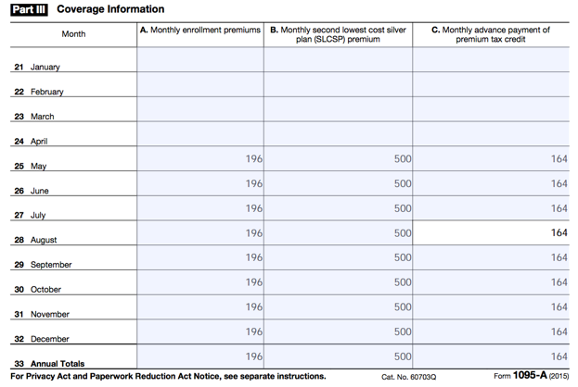
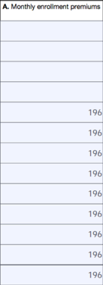
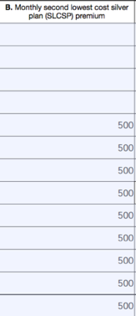
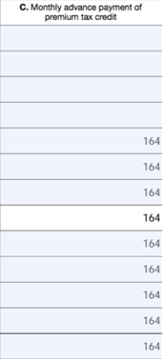
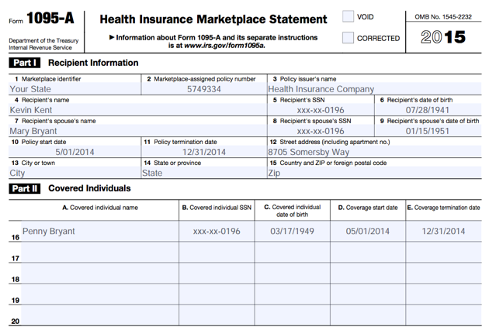
Form 1095-A: Health Insurance Marketplace Statement

Slide 249
Affordable Care Act
TaxSlayer Walkthrough
Open up Kevin Kent in TaxSlayer
  Enter Affordable Care Act related information

Slide 250
Out of Scope Topics

Slide 251
Additional Topics – Out of Scope at Tax Site
IRS changed VITA certification levels
There are more advanced topics on your 2016 IRS Advanced Certification test, but you will not prepare these at the tax sites
We will briefly review now…
Notes:
The IRS has changed the certification levels for the coming tax season and has included new topics on the basic certification exam. We will briefly discuss those topics now. However, these topics will remain out of scope for SaveFirst basic volunteers. Given our time limits with just these two short training sessions, we do not have enough time to thoroughly cover these topics to prepare you to handle them at the tax sites. These topics are not particularly common and will not apply to most taxpayers you serve at the site.
We absolutely welcome you to return as a volunteer next year and certify at a higher level if you are interested in attending additional training to prepare these topics for taxpayers at the sites.

Slide 252
Additional Topics for 2016 VITA Advanced Exam – Out of Scope at Tax Site
1) Sale of Stock
2) Capital Loss Carryover
3) Retirement Income (the Simplified Method)
4) Retirement Income (Additional Tax on IRAs)
5) Cancellation of Debt-Nonbusiness Credit Card
6)Cancellation of Debt-Home Mortgage
  Use Handout: “Helpful Tips for Out of Scope Topics
  on 2016 IRS Advanced Certification Exam”
  *********
Notes:
These out of scope topics include:
IRAs/Pensions
Higher Education Expenses
Itemized Deductions

Slide 253
Additional Topics – Out of Scope at Tax Site
Sale of Stock
Sale of stock is reported as a capital gain (or loss) on a Form 1099-B or a Tax Reporting Statement from the Broker

Slide 254
Additional Topics – Out of Scope at Tax Site
Sale of Stock
In order to properly report the sale of stock on the tax return, the following information from the 1099-B or Tax Reporting Statement is needed:
  Date of Acquisition (1b)
  Date of Sale or Exchange (1a)
  Sales Price of Stocks, Bonds, etc. (2a)
  Cost or Other Basis (3)

Slide 255
Additional Topics – Out of Scope at Tax Site
Sale of Stock
In order to properly report the sale of stock on the tax return, the following information from the 1099-B or Tax Reporting Statement is needed:
  Whether or not the basis was reported to the IRS

Slide 256
Additional Topics – Out of Scope at Tax Site
Sale of Stock
A capital gain occurs when the amount realized (the gross proceeds from the sales) is GREATER than the adjusted basis of the stock (how much the taxpayer paid for the stock)
A capital loss occurs when the amount realized is LOWER than the adjusted basis of the stock

Slide 257
Additional Topics – Out of Scope at Tax Site
Sale of Stock
Holding period starts the day after the property is acquired and continues through the day it is sold
  Short-term: stock is held for one year or less
  Long-term: stock is held for more than one year

Slide 258
Additional Topics for 2016 VITA Advanced Exam – Out of Scope at Tax Site
1) Sale of Stock
2) Capital Loss Carryover
3) Retirement Income (the Simplified Method)
4) Retirement Income (Additional Tax on IRAs)
5) Cancellation of Debt-Nonbusiness Credit Card
6)Cancellation of Debt-Home
  Use Handout: “Helpful Tips for Out of Scope Topics
  on 2016 IRS Advanced Certification Exam”
  *********
Notes:
These out of scope topics include:
IRAs/Pensions
Higher Education Expenses
Itemized Deductions

Slide 259
Additional Topics – Out of Scope at Tax Site
Capital Loss Carryover
If a taxpayer had a capital loss more than the allowable loss for the tax year, they can “carry” that loss over to the next tax year to help reduce taxable income
The limit is generally $3,000—any loss greater than that should be carried over to the next tax year

Slide 260
Additional Topics – Out of Scope at Tax Site
Capital Loss Carryover
Carryover loss from the previous year can be found on the Worksheet for Capital Loss Carryovers of that tax year
Long-term capital loss is found on line 13

Slide 261
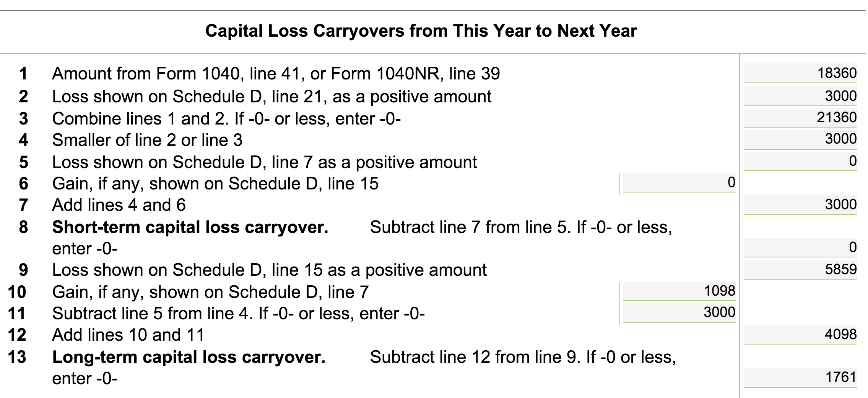
Additional Topics – Out of Scope at Tax Site
Capital Loss Carryover
Enter amounts from line 13 (above) onto Sch D, by going to: Federal Section → Capital Gains and Losses → Other Capital Gains Data

Slide 262
Additional Topics for 2016 VITA Advanced Exam – Out of Scope at Tax Site
1) Sale of Stock
2) Capital Loss Carryover
3) Retirement Income (the Simplified Method)
4) Retirement Income (Additional Tax on IRAs)
5) Cancellation of Debt-Nonbusiness Credit Card
6)Cancellation of Debt-Home Mortgage
  Use Handout: “Helpful Tips for Out of Scope Topics
  on 2016 IRS Advanced Certification Exam”
  *********
Notes:
These out of scope topics include:
IRAs/Pensions
Higher Education Expenses
Itemized Deductions

Slide 263
Additional Topics – Out of Scope at Tax Site
Retirement Income – The Simplified Method
If the taxable amount (box 2a on Form 1099-R) is not determined, you must use the Simplified Method to calculate the taxable portion of the retirement distribution for the tax year
Use the Simplified Method worksheet by clicking the blue “Worksheet” link under the 2a box on the 1099-R in TaxSlayer

Slide 264
Additional Topics – Out of Scope at Tax Site
Retirement Income – The Simplified Method
To complete the Simplified Method, you’ll need to gather some information, some from the taxpayer, some from the Form 1099-R

Slide 265
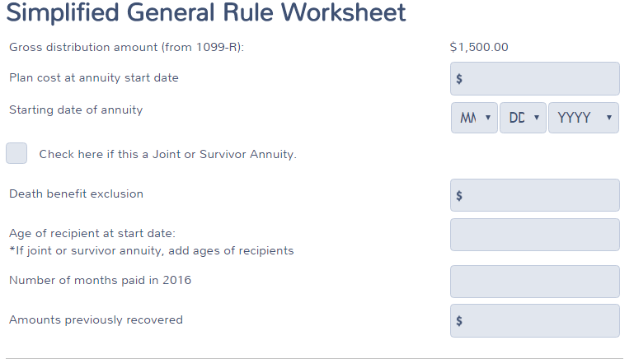
Additional Topics – Out of Scope at Tax Site
Retirement Income – The Simplified Method
Box 9b of 1099-R
Date they started receiving
Age of Recipient at start date
How many months did they receive payment in tax year? (Usually 12)

Slide 266
Additional Topics – Out of Scope at Tax Site
Retirement Income – Code Q on 1099-R
For purposes of the test, a code Q on a 1099-R indicates a Roth IRA distribution(not taxable).
Only under certain conditions is this in scope for VITA.
See your site coordinator if you ever see this!
For the test, just know that Code Q indicates that the distribution will not be taxable.

Slide 267
Additional Topics for 2015 VITA Advanced Exam – Out of Scope at Tax Site
1) Sale of Stock
2) Capital Loss Carryover
3) Retirement Income (the Simplified Method)
4) Retirement Income (Additional Tax on IRAs)
5) Cancellation of Debt-Nonbusiness Credit Card
6)Cancellation of Debt-Home Mortgage
  Use Handout: “Helpful Tips for Out of Scope Topics
  on 2015 IRS Advanced Certification Exam”
  *********
Notes:
These out of scope topics include:
IRAs/Pensions
Higher Education Expenses
Itemized Deductions

Slide 268
Additional Topics – Out of Scope at Tax Site
Retirement Income – Additional Tax on IRAs
If a taxpayer is required to pay an additional tax on their IRA, other qualified retirement plan, etc., it will appear on Form 1040, Pg 2, line 59

Slide 269
Additional Topics – Out of Scope at Tax Site
Retirement Income – Additional Tax on IRAs
Taxpayers who make an early withdrawal from a a retirement account may have an additional tax penalty that will appear on this line
Indicated by Code 1 in box 7 of Form 1099-R

Slide 270
Additional Topics – Out of Scope at Tax Site
Retirement Income – Additional Tax on IRAs
HOWEVER, depending on what the taxpayer used the funds for, they may qualify for an exception to the 10% additional tax on the early distribution
Note: early distributions from a 401(k) to pay for household expenses due to unemployment do NOT qualify

Slide 271
Additional Topics – Out of Scope at Tax Site
Retirement Income – Additional Tax on IRAs
Exceptions to the 10% additional tax
  IRA distributions were made for higher education expenses
  IRA distributions were made for the purchase of a first home, up to $10,000
  Distributions were made due to total and permanent disability

Slide 272
Additional Topics for 2016 VITA Advanced Exam – Out of Scope at Tax Site
1) Sale of Stock
2) Capital Loss Carryover
3) Retirement Income (the Simplified Method)
4) Retirement Income (Additional Tax on IRAs)
5) Cancellation of Debt-Nonbusiness Credit Card
6)Cancellation of Debt-Home Mortgage
  Use Handout: “Helpful Tips for Out of Scope Topics
  on 2016 IRS Advanced Certification Exam”
  *********
Notes:
These out of scope topics include:
IRAs/Pensions
Higher Education Expenses
Itemized Deductions

Slide 273
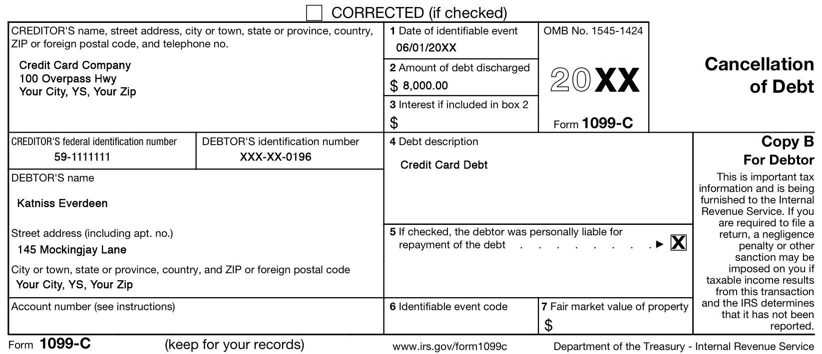
Additional Topics – Out of Scope at Tax Site
Cancellation of Debt
Cancelled debt from a nonbusiness credit card is reported on a Form 1099-C

Slide 274
Additional Topics – Out of Scope at Tax Site
Cancellation of Debt-Nonbusiness Credit Card Debt
Taxpayers who have canceled debt from a Form 1099-C who were solvent (the condition in which assets are greater than liabilities) BEFORE the debt was canceled will report it on Form 1040, line 21, other income

Slide 275
Additional Topics – Out of Scope at Tax Site
Cancellation of Debt-Home Mortgage
Taxpayers who have canceled debt from a Form 1099-C Home Mortgage may be able to exclude that cancelled debt from their income.
If the taxpayer:
  Never used the property to engage in trade or business
  Never used mortgage to pay for other expenses(car, credit card)
  And the debt discharged was <2 million dollars
THEN they can exclude the debt by filling out the form 982

Slide 276
Additional Topics – Out of Scope at Tax Site
Helpful Tips For Out of Scope Topics…
Practice Exercise #1: Frodo Baggins
Review practice exercise #1 in the Helpful Tips… handout and answer the following question
Frodo qualifies for an exception to the 10% additional tax on the early distribution from his IRA.
  True
  False

Slide 277
Additional Topics – Out of Scope at Tax Site
Helpful Tips For Out of Scope Topics…
Practice Exercise #2: Peeta and Katniss Everdeen
Review practice exercise #2 in the Helpful Tips…
On your own, in TaxSlayer:
  Enter the filing status
  Enter personal information
  Enter dependents
Notes:
IRAs/Pensions
Retirement income from an Individual Retirement Account (IRA) or Pension reported on 1099-R
From Form 1040, link from Line 16 Pension to a Form 1099-R
Gross Distribution
Taxable Amount
Boxes in line 2b
Taxable Amount Not Determined
Total Distribution
Federal Income Tax Withheld
Distribution Code(s)
Total Employee Contributions

Slide 278
Additional Topics – Out of Scope at Tax Site
Helpful Tips For Out of Scope Topics…
Practice Exercise #2: Peeta and Katniss Everdeen
Gather necessary information to complete the Simplified Method (for 1099-R from District 12 Corporation)
  You must complete the Simplified Method because the taxable amount (box 2a) is not determined
  First, enter the 1099-R as indicated on the Form in TaxSlayer
Notes:
IRAs/Pensions
Retirement income from an Individual Retirement Account (IRA) or Pension reported on 1099-R
From Form 1040, link from Line 16 Pension to a Form 1099-R
Gross Distribution
Taxable Amount
Boxes in line 2b
Taxable Amount Not Determined
Total Distribution
Federal Income Tax Withheld
Distribution Code(s)
Total Employee Contributions

Slide 279
Additional Topics – Out of Scope at Tax Site
Helpful Tips For Out of Scope Topics…
Practice Exercise #2: Peeta and Katniss Everdeen
Information Needed
  Cost in the plan at the start date:
  Age of recipient at the start date of the retirement plan:
    Peeta was born on February 19, 1946
    He started receiving payments on March 1, 2016
    Therefore, his age at the start date was…
$14,500
70 years
Notes:
IRAs/Pensions
Retirement income from an Individual Retirement Account (IRA) or Pension reported on 1099-R
From Form 1040, link from Line 16 Pension to a Form 1099-R
Gross Distribution
Taxable Amount
Boxes in line 2b
Taxable Amount Not Determined
Total Distribution
Federal Income Tax Withheld
Distribution Code(s)
Total Employee Contributions

Slide 280
Additional Topics – Out of Scope at Tax Site
Helpful Tips For Out of Scope Topics…
Practice Exercise #2: Peeta and Katniss Everdeen
Information Needed
  Number of months payments were received this year:
    Since Peeta started receiving payments on March 1, 2016, he received payments for this year (2016).
10 months
Notes:
IRAs/Pensions
Retirement income from an Individual Retirement Account (IRA) or Pension reported on 1099-R
From Form 1040, link from Line 16 Pension to a Form 1099-R
Gross Distribution
Taxable Amount
Boxes in line 2b
Taxable Amount Not Determined
Total Distribution
Federal Income Tax Withheld
Distribution Code(s)
Total Employee Contributions

Slide 281
Additional Topics – Out of Scope at Tax Site
Helpful Tips For Out of Scope Topics…
Practice Exercise #2: Peeta and Katniss Everdeen
Follow along with your trainer and enter the following into TaxSlayer:
  Finish Form 1099-R with Simplified Method
  Add additional Form 1099-R
  Enter interest, dividends, and sale of stock from Tax Reporting Statement
Notes:
IRAs/Pensions
Retirement income from an Individual Retirement Account (IRA) or Pension reported on 1099-R
From Form 1040, link from Line 16 Pension to a Form 1099-R
Gross Distribution
Taxable Amount
Boxes in line 2b
Taxable Amount Not Determined
Total Distribution
Federal Income Tax Withheld
Distribution Code(s)
Total Employee Contributions

Slide 282
Additional Topics – Out of Scope at Tax Site
Helpful Tips For Out of Scope Topics…
Practice Exercise #2: Peeta and Katniss Everdeen
Follow along with your trainer and enter the following into TaxSlayer:
  Enter capital loss carryover from previous year
  Enter canceled debt from Form 1099-C-Nonbusiness Credit Card Debt
  Enter canceled debt from Form 1099-C Mortgage and form 982 exclusion.
Answer the questions on the following slides once complete
Note: the “Helpful Tips...” packet has step-by-step instructions and TaxSlayer screenshots for your reference
Notes:
IRAs/Pensions
Retirement income from an Individual Retirement Account (IRA) or Pension reported on 1099-R
From Form 1040, link from Line 16 Pension to a Form 1099-R
Gross Distribution
Taxable Amount
Boxes in line 2b
Taxable Amount Not Determined
Total Distribution
Federal Income Tax Withheld
Distribution Code(s)
Total Employee Contributions

Slide 283
Additional Topics – Out of Scope at Tax Site
Helpful Tips For Out of Scope Topics…
Practice Exercise #2: Peeta and Katniss Everdeen
What is the total taxable interest income show on line 8a of Form 1040?
  $15
  $85
  $125
  $210
Notes:
IRAs/Pensions
Retirement income from an Individual Retirement Account (IRA) or Pension reported on 1099-R
From Form 1040, link from Line 16 Pension to a Form 1099-R
Gross Distribution
Taxable Amount
Boxes in line 2b
Taxable Amount Not Determined
Total Distribution
Federal Income Tax Withheld
Distribution Code(s)
Total Employee Contributions

Slide 284
Additional Topics – Out of Scope at Tax Site
Helpful Tips For Out of Scope Topics…
Practice Exercise #2: Peeta and Katniss Everdeen
How does the Code Q on Peeta’s Form 1099-R from Essex Bank affect the return?
  The entire $5,500 distribution is taxable
  Half of the $5,500 distribution is taxable
  There is a 10% additional tax on the distribution
  The entire $5,500 distribution is not taxable
Notes:
IRAs/Pensions
Retirement income from an Individual Retirement Account (IRA) or Pension reported on 1099-R
From Form 1040, link from Line 16 Pension to a Form 1099-R
Gross Distribution
Taxable Amount
Boxes in line 2b
Taxable Amount Not Determined
Total Distribution
Federal Income Tax Withheld
Distribution Code(s)
Total Employee Contributions

Slide 285
Additional Topics – Out of Scope at Tax Site
Helpful Tips For Out of Scope Topics…
Practice Exercise #2: Peeta and Katniss Everdeen
What is the amount shown on Form 1040, Line 13 – Capital Gain or Loss?
  A gain of $957
  A gain of $1,017
  A gain of $1,407
  A gain of $1,467
Notes:
IRAs/Pensions
Retirement income from an Individual Retirement Account (IRA) or Pension reported on 1099-R
From Form 1040, link from Line 16 Pension to a Form 1099-R
Gross Distribution
Taxable Amount
Boxes in line 2b
Taxable Amount Not Determined
Total Distribution
Federal Income Tax Withheld
Distribution Code(s)
Total Employee Contributions

Slide 286
Additional Topics – Out of Scope at Tax Site
Helpful Tips For Out of Scope Topics…
Practice Exercise #2: Peeta and Katniss Everdeen
How much of the $19,500 gross distribution reported on Form 1099-R is taxable this year? _____________
$18,809
Notes:
IRAs/Pensions
Retirement income from an Individual Retirement Account (IRA) or Pension reported on 1099-R
From Form 1040, link from Line 16 Pension to a Form 1099-R
Gross Distribution
Taxable Amount
Boxes in line 2b
Taxable Amount Not Determined
Total Distribution
Federal Income Tax Withheld
Distribution Code(s)
Total Employee Contributions

Slide 287
Additional Topics – Out of Scope at Tax Site
Helpful Tips For Out of Scope Topics…
Practice Exercise #2: Peeta and Katniss Everdeen
Where is the canceled debt from Non-business credit card on Form 1099-C reported on the Everdeen’s tax return?
  On Form 1040, line 7 as wages
  It is not reported on the return
  On Schedule A as a miscellaneous deduction
  On Form 1040, line 21 as other income
Notes:
IRAs/Pensions
Retirement income from an Individual Retirement Account (IRA) or Pension reported on 1099-R
From Form 1040, link from Line 16 Pension to a Form 1099-R
Gross Distribution
Taxable Amount
Boxes in line 2b
Taxable Amount Not Determined
Total Distribution
Federal Income Tax Withheld
Distribution Code(s)
Total Employee Contributions

Slide 288
Additional Topics – Out of Scope at Tax Site
Helpful Tips For Out of Scope Topics…
Practice Exercise #2: Peeta and Katniss Everdeen
The Basis of the Everdeen‘s home is reduced by $30,000.
True or False

Slide 289
Intake/Interview & Quality Review Process

Slide 290
Your Role as a Campus Fellow
In addition to completing intermediate topics on the tax return, one of your primary roles will be assisting your Site Coordinator with the Quality Review Process
We will now review the Intake/Interview Form and discuss the Quality Review Process in detail
Notes:
In addition to completing intermediate topics on the tax return, one of your primary roles will be assisting your Site Coordinator with the Quality Review Process
We will now review the Intake/Interview Form and discuss the Quality Review Process in detail

Slide 291
Intake/Interview & Quality Review Sheet
Form 13614-C (October 2016)
All VITA programs are required to use this sheet for every tax return filed at the tax site.
Notes:
By now you’re familiar with this form from your practice exercise. However, we want to spend some time just going through this form and taking the time to really look more closely at every part of it.

Slide 292
Assuring a Quality Service and Accurate Return
Taxpayers using services offered through the Volunteer Tax Assistance (VITA) and Tax Counseling for the Elderly (TCE) Programs should be confident they receive quality service. This includes having an accurate tax return prepared.
A basic component of preparing an accurate return begins with listening to the taxpayer and asking the right questions.
Form 13614-C, Intake/Interview & Quality Review Sheet, is a tool designed to help the volunteer ask the right questions. When used properly, this form effectively contributes to accurate tax return preparation.
Notes:
Taxpayers using services offered through the Volunteer Tax Assistance (VITA) and Tax Counseling for the Elderly (TCE) Programs should be confident they receive quality service. This includes having an accurate tax return prepared.
A basic component of preparing an accurate return begins with listening to the taxpayer and asking the right questions.
Form 13614-C, Intake/Interview & Quality Review Sheet, is a tool designed to help the volunteer ask the right questions. When used properly, this form effectively contributes to accurate tax return preparation.

Slide 293
Using this Form Completely and Appropriately
The IRS conducts oversight to ensure that EVERY part of the form is being used appropriately and completely during the interview with the taxpayer and while preparing their return.
The IRS requires compliance with use of this form to ensure high quality tax returns for our VITA program.
Notes:
The IRS conducts oversight to ensure that EVERY part of the form is being used appropriately and completely during the interview with the taxpayer and while preparing their return.
The IRS requires compliance with use of this form to ensure high quality tax returns for our VITA program.

Slide 294
Required for Use by IRS VITA Sites
An important tool for accuracy and due diligence!
Must be completed by (or with) the taxpayer.
Will be used to conduct the Quality Review process.
Must be kept at tax site for site records (do not let the taxpayer take the form with them)
No records brought to the site should be kept on file
For privacy and identity protection purposes, SSNs should NOT be printed on the I/I form
Notes:
An important tool for accuracy and due diligence!
The form must be completed by (or with) the taxpayer.
The form will be used by your Site Coordinator or a more advanced trained volunteer to conduct the Quality Review process, which further ensures the accuracy of the returns filed for families at our sites.
Must be kept at tax site for site records. If the taxpayer has finished their return and the return is ready to be filed, do not let the taxpayer take the form with them. You will be instructed by your Site Coordinator where to file this form at the tax site.
Note that NO records that the taxpayer brings in to the site should be kept on file at the tax site.
For privacy and identity protection purposes SSNs should not be printed on the Intake/Interview form.

Slide 295
Intake/Interview Form is a Huge Asset to You
Provides an extra record for you to double-check information on the tax return in TaxSlayer and note things the taxpayer forgets to mention when speaking with you
Notes:
The form provides an extra record for you to double-check information on the tax return in TaxSlayer and note things the taxpayer forgets to mention when speaking with you. Since the taxpayer typically fills this out on their own, it’s like an extra set of ears listening to the taxpayer about information they may need to include on the return.

Slide 296
The Intake Process: Completing Form 13614-C
In most cases, the taxpayer completes pages 1, 2, and 3 of the Intake Interview Form (Form 13614-C) and the Affordable Care Act Supplement Form in the waiting room before sitting down with you, the tax preparer.
Provide assistance as needed (be sensitive and perceptive to the needs of the taxpayers)
Notes:
When the taxpayer arrives at the site, he or she will sign in and pick up a clipboard, pen, and Intake/Interview form to complete while they wait for their name to be called to be waited on.
Some taxpayers may need assistance with completing the form due to disability or blindness. It’s important to be sensitive and perceptive to the needs of the taxpayers at your tax site. It is also important to encourage your volunteers to be sensitive and perceptive to the taxpayers’ needs as well.
Always offer assistance to taxpayers completing their Intake/Interview Forms in the waiting room if you are not busy with another taxpayer.
If a taxpayer has not completed the Intake/Interview form before their name is called, they can go with you to the tax preparation station and finish completing the intake/interview form with you at the station.

Slide 297
Complete an Intake/Interview Form for EVERY Return
We MUST have an intake/interview form and Affordable Care Act Supplement Form on file for EVERY return filed at our tax sites.
Notes:
We MUST have an intake/interview form on file for EVERY return filed at our tax sites.

Slide 298
The Intake Process: Tax Return and Volunteer Certification Levels
It is a violation of our VITA Grant and IRS Compliance and your Volunteer Standards of Conduct Agreement to file a tax return that is out of scope of the VITA tax site.
At SaveFirst sites, to ensure all returns are in-scope for VITA:
  Consult the SaveFirst Scope of Service Chart – at every tax station and in the Site Coordinator Handbook/Campus Fellow Handbook
  If a topic seems complicated or unfamiliar to you, double-check the SaveFirst Scope of Service Chart to be sure it is listed in scope.
  Sometimes this determination may be unclear. If you are unsure, talk to your Site Coordinator.
Notes:
It is a violation of our VITA Grant and IRS Compliance and your Volunteer Standards of Conduct Agreement to file a tax return that is out of scope of the VITA tax site.
At SaveFirst sites, to ensure all returns are in-scope for VITA:
Consult the Scope of Service Chart – at every tax station, in the Pub 4012 Volunteer Resource Guide, and in your Site Coordinator Handbook
If a topic seems complicated or unfamiliar to you, double-check the Scope of Service Chart to be sure it is listed in scope.
Sometimes this determination may be unclear. If you are unsure, talk to your Site Coordinator.

Slide 299
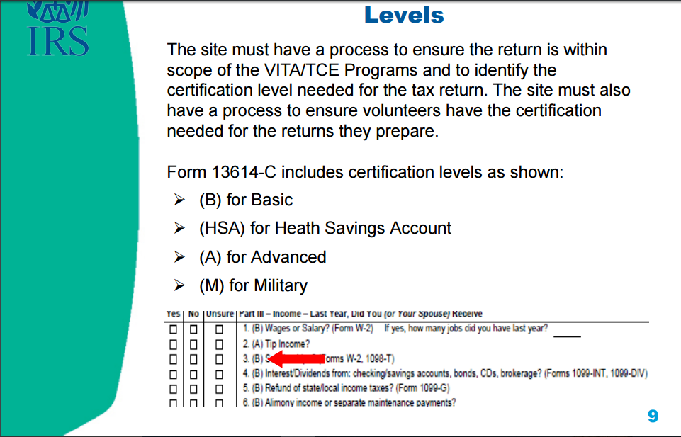

Slide 300
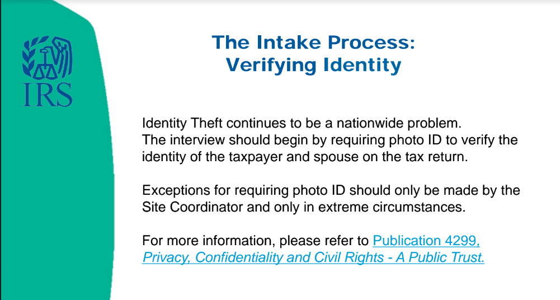

Slide 301
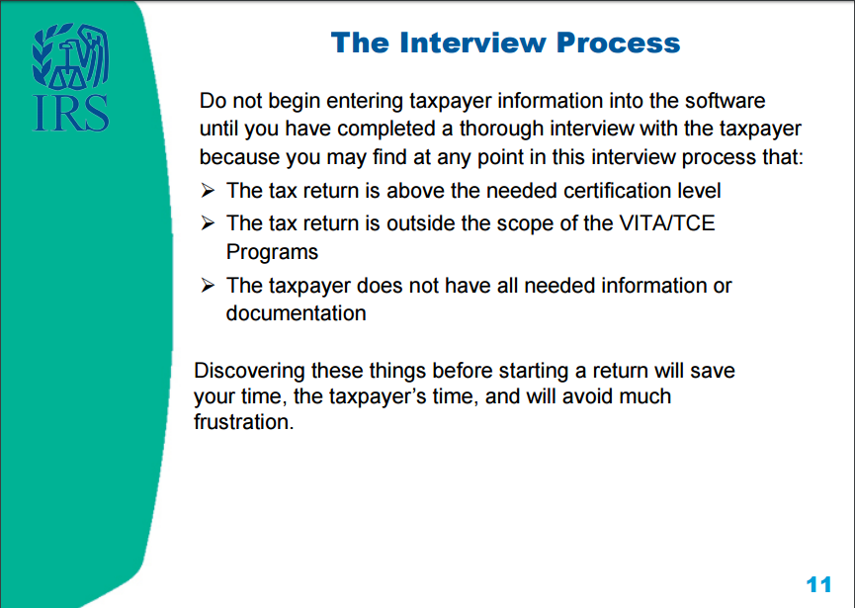

Slide 302
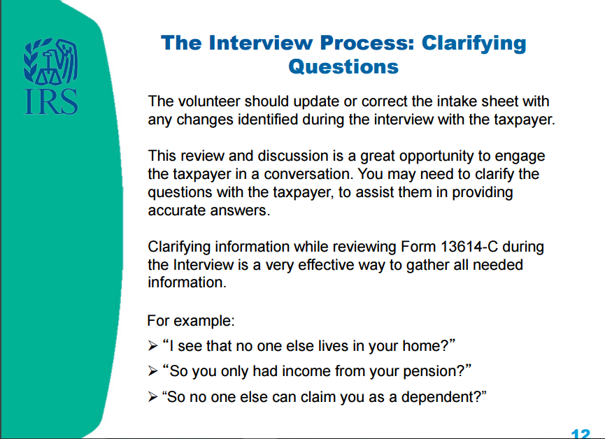

Slide 303
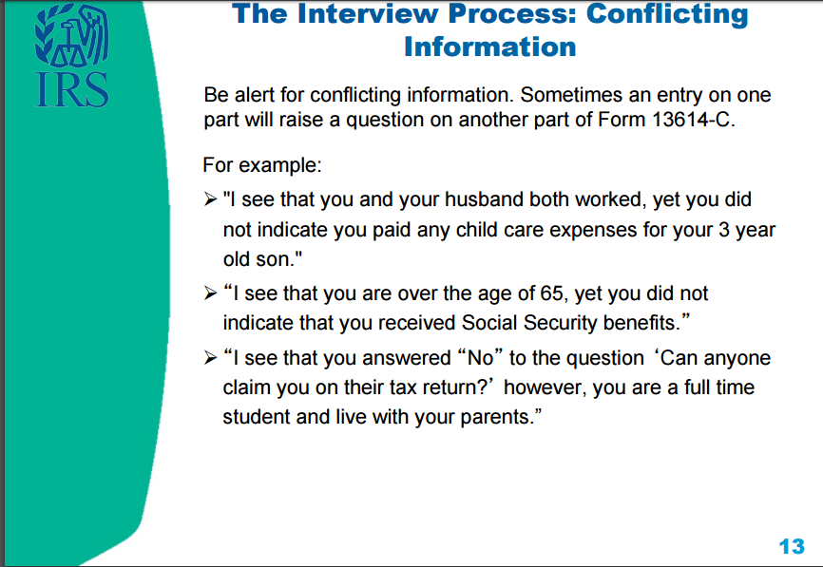

Slide 304
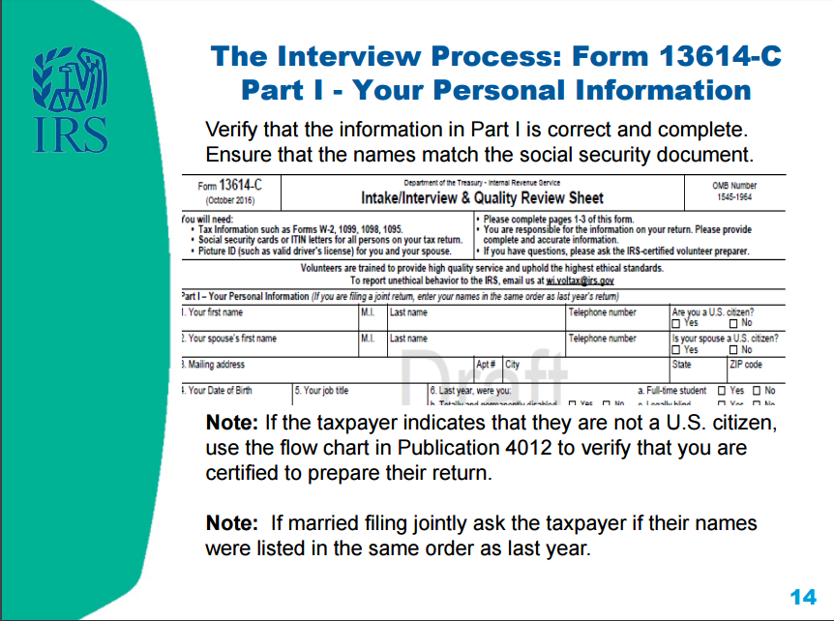

Slide 305
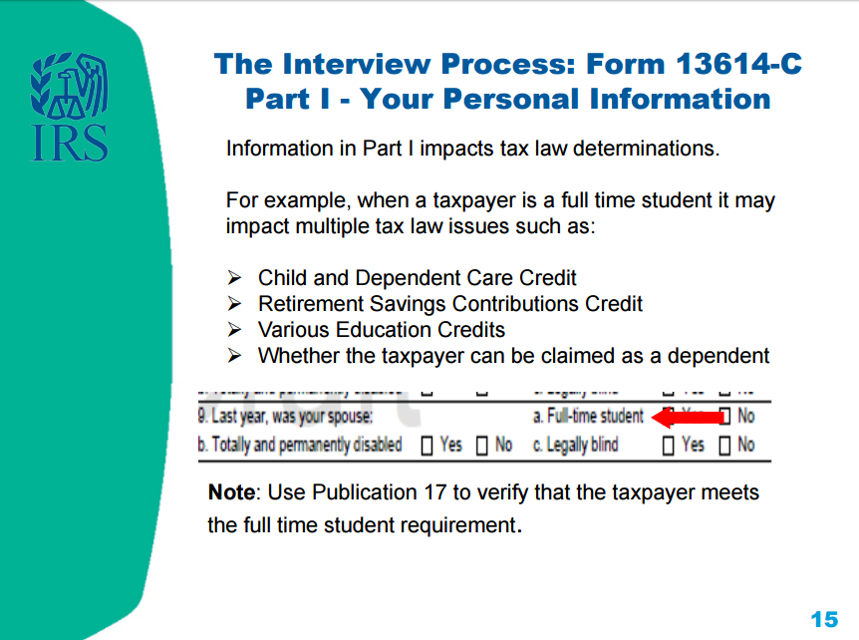

Slide 306
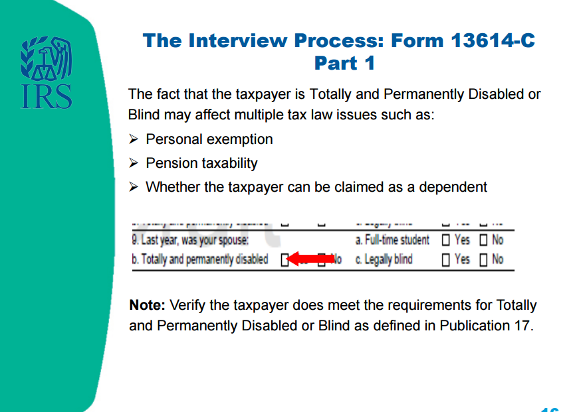

Slide 307
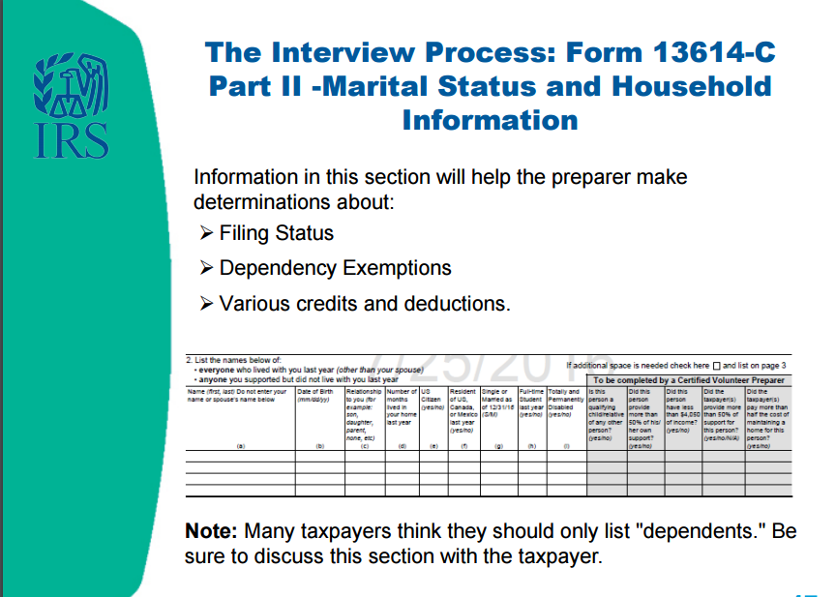

Slide 308
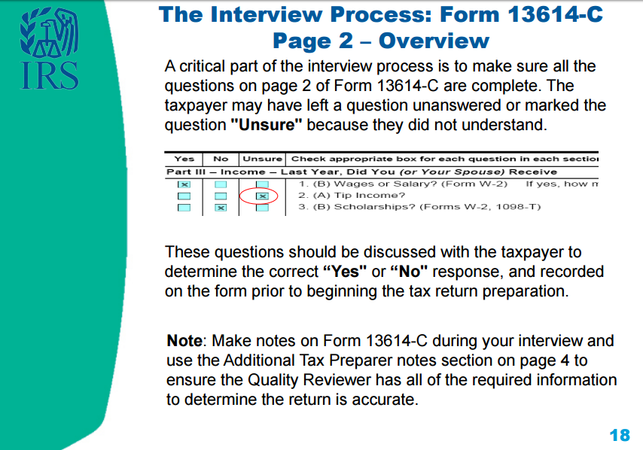

Slide 309
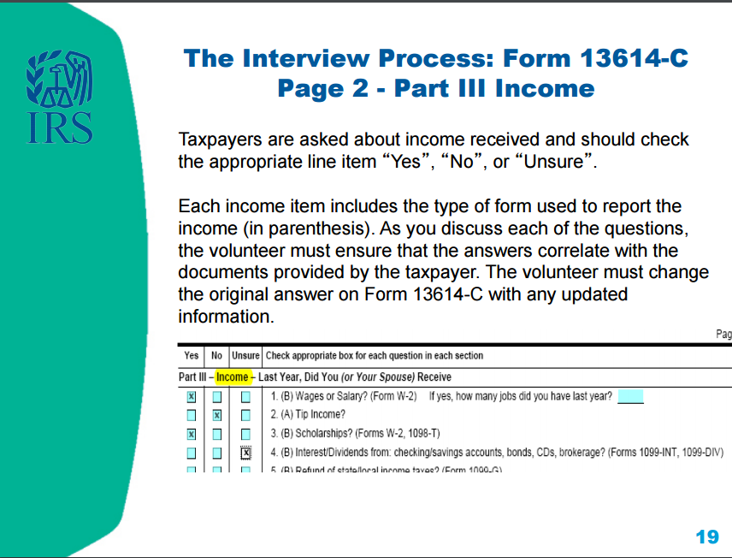

Slide 310
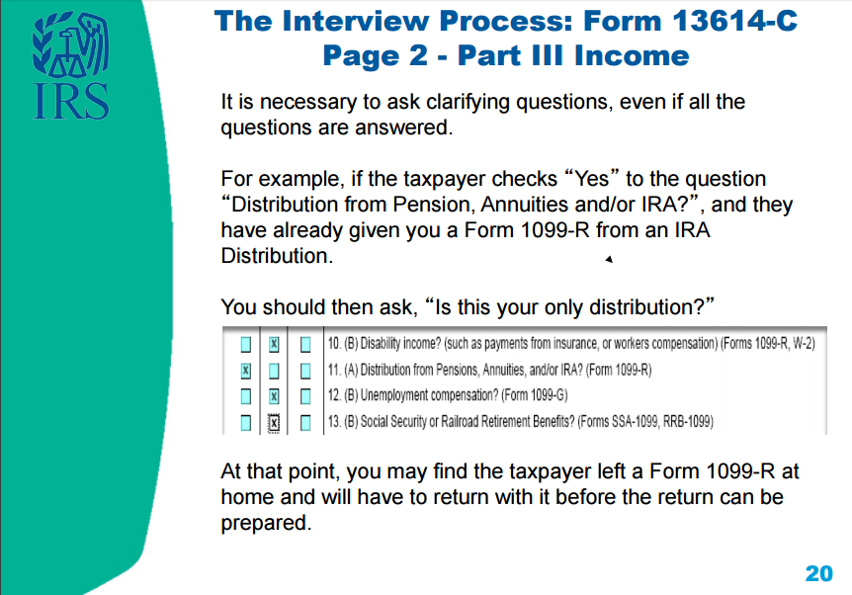

Slide 311
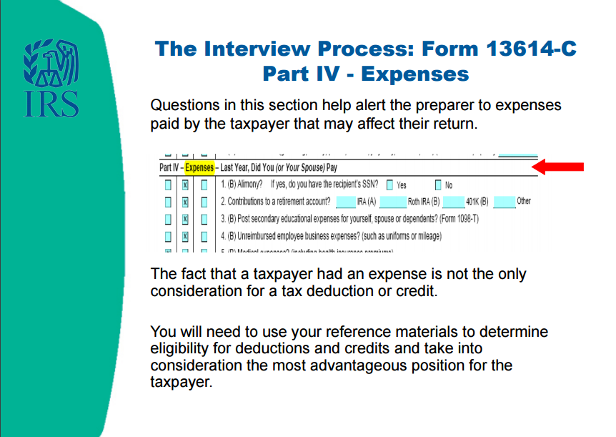

Slide 312
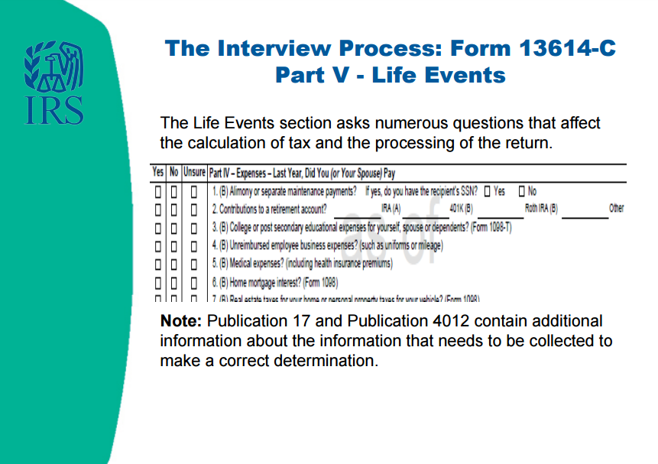

Slide 313


Slide 314


Slide 315


Slide 316


Slide 317

Notes:
The Quality Reviewer will be one of our most experienced SaveFirst volunteers. Most reviews will be conducted by Site Coordinators, and some will also be conducted by Campus Fellows, who are returning SaveFirst volunteers who have attended additional training and acquired a higher level of IRS certification.
Keep in mind that you could apply to be a returning volunteer Campus Fellow next year!

Slide 318


Slide 319


Slide 320


Slide 321


Slide 322


Slide 323


Slide 324


Slide 325
Take the Quizzes!
Log in to your VMS account and complete the two quizzes:
  Intake Interview and Quality Review
  Volunteer Standards of Conduct

Slide 326
Congratulations!
This complete the fall Campus Fellow Training
Please complete the Jack White – Campus Fellow Training Exercise for practice on your own
Continue to check impactamerica.com/taxprep – we will update with additional training videos throughout the fall/winter
  Specifically, we will post a walkthrough video of the Kevin Kent exercise for you to watch

Slide 327
Next Steps
Attend Testing Session
  Pass IRS Advanced Certification with score of 80% or higher!
Feel free to contact your Campus Fellow trainer with questions

Slide 328
Campus Fellow Training

