Slide 1
Volunteer Basic Tax Training
A Session

Slide 2
SaveFirst Basic Volunteer Overview
Basic Tax Training (A & B Sessions)
IRS Basic Certification
  Intake/Interview & Quality Review Exam (B Session)
  Volunteer Standards of Conduct Exam (B Session)
  IRS Basic Certification Exam (attend testing session or on your own)
    Passing Score: 80% or better
    Must pass before serving at a tax site

Slide 3
SaveFirst Basic Volunteer Overview
Please sign-in
Follow your trainer’s instructions on how to complete paperwork on your volunteer profile
There are a number of training materials provided for you to use throughout training. Please bring these materials back to the B session.
Notes:
All materials can be downloaded on our website at www.impactamerica.com/taxprep

Slide 4
The Impact SaveFirst Volunteers will have this Season
Serve a record 11,000 families this year
Save families over $4.2 million in commercial fees
Provide a quality reliable service and an alternative to a costly, predatory industry for hard-working families
SaveFirst: An Initiative of Impact America

Slide 5
Resources
SaveFirst Basic Volunteer Training Agenda
SaveFirst Basic Volunteer Training Notes
SaveFirst Basic Training Summary Chart
SaveFirst Baisc Training TaxSlayer Exercises
Helpful Tips for Out of Scope Topics on the 2016 IRS Basic Certification Exam (use on the test)
Selection from IRS Publication 4012 Volunteer Resource Guide
SaveFirst Volunteer FAQs and Volunteer Etiquette
Impact America Staff

Slide 6

Please “Like” our Facebook Page
Please take some time to “like” our Facebook page: Impact America
We will provide important tax season updates on this page

Slide 7
Training Outline: A Session
1) Tax Terminology & Form 1040 Overview
2) Tax Preparation Process
  Preliminary Interview
3) Exemptions
4) Filing Status
5) Filing Basics

Slide 8
Training Outline: A Session
6) Income
7) Standard Deduction
8) Nonrefundable Credits
  Child & Dependent Care Credit
  Child Tax Credit
  Retirement Savings Contribution Credit

Slide 9
Tax Terminology
Form 1040 Overview
Notes:
Welcome to SaveFirst Unit I Training
What we are going to do in this first training video is take a look at basic tax terminology and introduce you to the Form 1040.

Slide 10
Tax Terminology Objectives
After completing this section, the volunteer will be able to:
  Define important tax terminology
  Describe the relationship between total income, tax credits, and amount owed or refunded

Slide 11
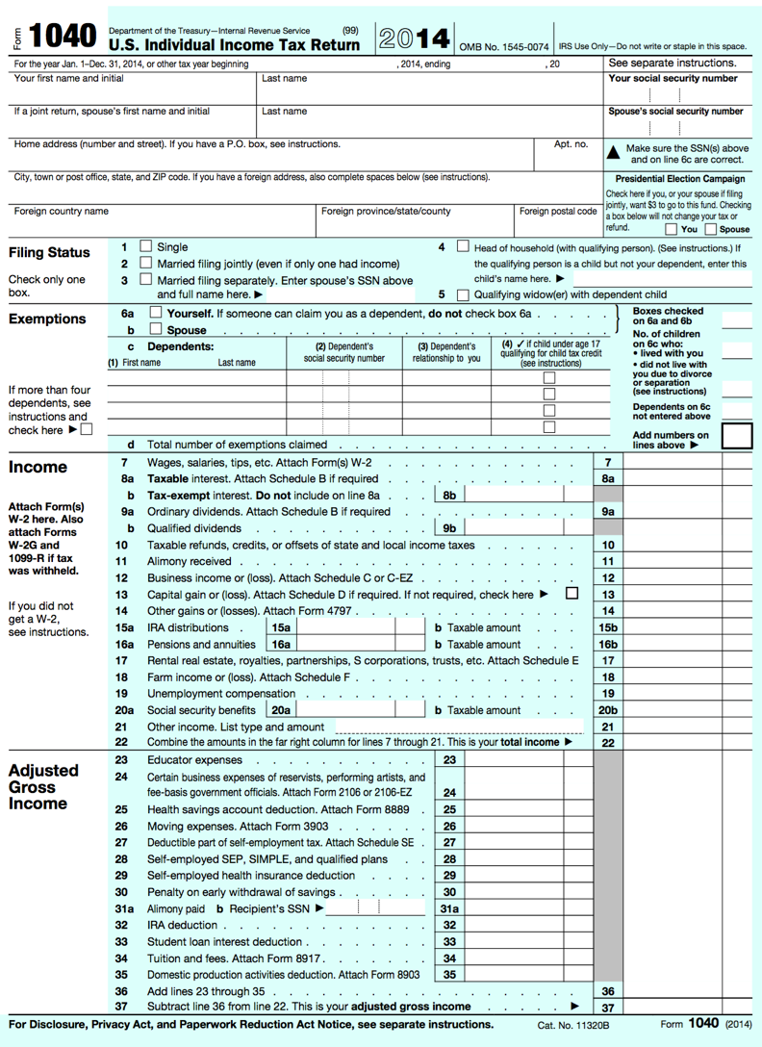
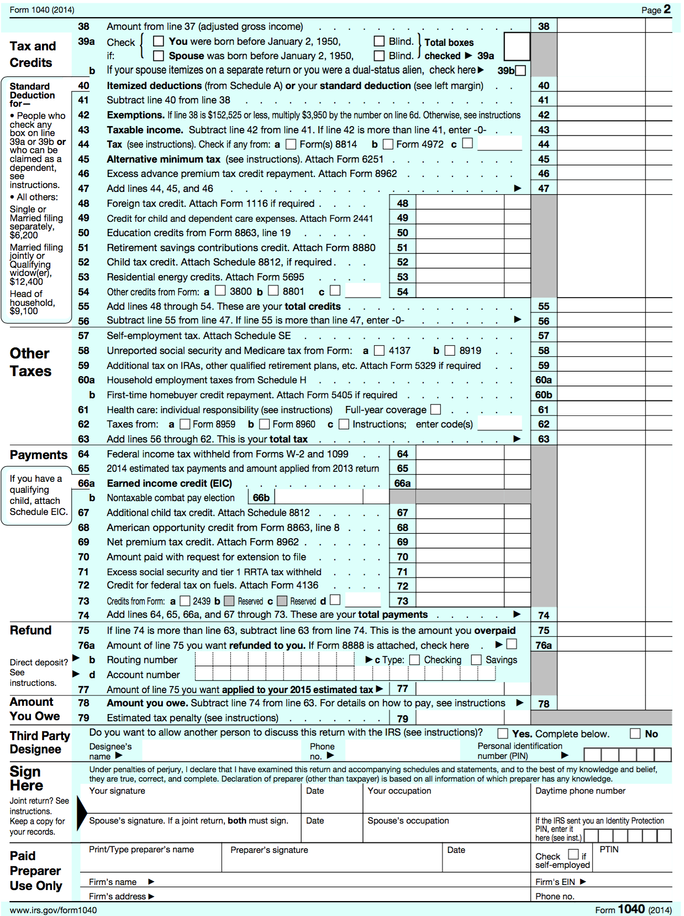
Notes:
This is the form that we will use to file taxes. We will use an electronic version of the Form 1040 in TaxSlayer. You will find a copy of the Form 1040 in your training materials. Since TaxSlayer will calculate many of the blanks for you, you will not have to make the mathematical calculations as you would if completing the return by hand.
After we go through the rest of the tax terminology, we will return to look more closely and see where all of that information appears on this form.

Slide 12
Filing Status
Based on marital status and family situation
  Single
  Married Filing Jointly
  Married Filing Separately
  Head of Household
  Qualifying Widow(er) with Dependent Child
  Choose correct Filing Status on Lines 1-5
Notes:
Impacts the rate at which the taxpayer’s income is taxed and which credits and adjustments the taxpayer may be eligible for
Based on marital status and family situation
There are five options to choose from, and they are found on lines 1-5 on the Form 1040
It’s important to note that the line numbers listed here may change slightly from year to year, but if you follow along with the Form 1040 in your material, you can find the line descriptions to match what we are discussing here.

Slide 13
Exemption
Amount the taxpayer can claim for himself, his spouse, and his dependents that decreases taxable income.
Total # of Exemptions found on line 6d
Notes:
The taxpayer may claim an exemption for himself, his spouse, and his dependents
Each exemption decreases the amount of taxpayer’s income that will be taxed
The total number of exemptions is found on line 6d.

Slide 14
Exemption
A taxpayer may claim 2 types of exemptions:
  Personal exemption (lines 6a/6b)
    Taxpayer can claim herself (and spouse)
  Dependency exemption (line 6c)
    Taxpayer can claim qualifying dependents

Slide 15
Dependent
An individual whom the taxpayer supports or lives with the taxpayer
  Qualifying child
  Qualifying relative

Slide 16
Earned vs. Unearned Income
Earned: income received through work
  Wages, salary, tips, etc.
Unearned: income other than pay from work
  Interest, social security, retirement, etc.
Income is entered on Lines 7-21
Total income is found on Line 22

Slide 17
Adjustment
Decreases the amount of income on which the taxpayer will be taxed
Adjustments are entered on Lines 23-35
Total adjustments are found on Line 36

Slide 18
Adjusted Gross Income (AGI)
Amount of taxable income after adjustments are made
AGI is found on Lines 37/38

Slide 19
Deduction
Amount subtracted from the AGI to further decrease taxable income
  Standard deduction: based on filing status
  Itemized deductions: taxpayer can chose to enter expenses if larger than standard deduction amount
  Standard/Itemized Deduction(s)
  found on Line 40

Slide 20
Taxable Income
Any income that is subject to federal income tax
Can include both earned and unearned income
Taxable Income found on Line 43

Slide 21
Tax Liability
Amount of tax that must be paid based on the taxable income
Tax Liability (before credits
are subtracted) found on Line 47

Slide 22
Tax Credit
Direct reduction of the taxpayer’s liability
Two Types of tax credits:
  Nonrefundable credits
  Refundable credits

Slide 23
Nonrefundable Tax Credit
Reduces the tax liability – only to zero.
  Child and Dependent Care Expenses
  Retirement Savings Contribution Credit
  Child Tax Credit
Nonrefundable Credits entered on Lines 48-54
Total Nonrefundable Credits found on Line 55
Notes:
Nonrefundable tax credit: A nonrefundable tax credit allows the taxpayer to reduce his tax liability to zero, but not to receive any refund if there is any credit left over. So, if you have $1500 of tax liability and $2000 in nonrefundable credits, you can take $1500 of nonrefundable credits. That’s it.

Slide 24
Refundable Tax Credit
Reduces tax liability to zero
Taxpayer will receive the remainder of the credit value as a refund.
  Earned Income Tax Credit
  Additional Child Tax Credit
  American Opportunity Education Credit
Refundable Tax Credits entered on Lines 66-69
Notes:
Refundable tax credit: A refundable tax credit allows the taxpayer to reduce his tax liability to zero and then get a refund for the remainder of the credit value. . So, if you have $1500 of tax liability and $2000 in nonrefundable credits, you can take $1500 of credits to reduce your tax liability to $0 and then take the last $500 as a refund.

Slide 25
Withholding
Amount of money that can be taken from each form of income and received by the government each pay period
Total Withholding found on Line 64

Slide 26
Federal Income Tax Process Overview

Slide 27

TOTAL INCOME
Earned Income
Notes:
Total income is made up of earned income and…

Slide 28

TOTAL INCOME
Unearned Income
Earned Income
Notes:
Total income is made up of earned income and…

Slide 29
TOTAL INCOME
TAXABLE INCOME
after adjustments, deductions, and exemptions
Unearned Income
Earned Income
Notes:
Total income is made up of earned income and…

Slide 30
TOTAL INCOME
TAXABLE INCOME
after adjustments, deductions, and exemptions
TAX LIABILITY
Unearned Income
Earned Income
Notes:
Total income is made up of earned income and…

Slide 31
TOTAL INCOME
TAXABLE INCOME
after adjustments, deductions, and exemptions
TAX LIABILITY
Unearned Income
TAX CREDITS
Earned Income
AMOUNT OWED OR REFUNDED
Notes:
Total income is made up of earned income and…

Slide 32
Tax Preparation Process
Notes:
Welcome back to Unit I Training.
In this lesson, we will discuss Exemptions.

Slide 33
Tax Preparation Process
Part 1: Preliminary Interview
Part 2: Preparing the Return in TaxSlayer
Part 3: Quality Review
Part 4: Finishing the Return
Part 5: Filing the Return

Slide 34
Part 1: Preliminary Interview
Taxpayer completes pages 1, 2, and 3 of Intake/Interview Form & Affordable Care Act Supplement Form
Verify photo ID(s) & Social Security card(s)
Ensure taxpayer cannot be a dependent of anyone else (Pub 4012: C-1, C-5 to C-6)
Determine dependents (Pub 4012: C-3 to C-8)
Notes:
Before sitting down with you at the station, the taxpayer will complete pages 1,2, and 3 of the Intake/Interview form (typically in the waiting room). There is a sample Intake/Interview form in your training materials. Please bring that out and review it with me now.
When the taxpayer sits down with you, you must:
Verify photo ID AND Social Security card(s)
Ensure taxpayer cannot be a dependent of anyone else using Pub 4012 charts
Determine dependencies using Pub 4012 charts
Complete Section II at the bottom of Page 1 marked “To be completed by a Certified Volunteer Preparer”
Determine filing status using Pub 4012 charts
Confirm all information has been completed on the Intake/Interview form (all questions on Pg 2 should have “yes” or “no” marked – if unsure is marked, clarify with the taxpayer and call your supervisor as needed)
Fill in your full name at the bottom of page 4 where asked for the “Certified Volunteer Preparer’s name”

Slide 35
Part 1: Preliminary Interview
Complete part of Section II “To be completed by a Certified Volunteer Preparer”
Determine filing status (Pub 4012: B-1 to B-3)
REVIEW pages 1-3 of I/I Form
  Collect necessary forms
  “Yes” or “No” answer for all questions on page 2
Write your full name at the bottom of page 4
Notes:
Before sitting down with you at the station, the taxpayer will complete pages 1,2, and 3 of the Intake/Interview form (typically in the waiting room). There is a sample Intake/Interview form in your training materials. Please bring that out and review it with me now.
When the taxpayer sits down with you, you must:
Verify photo ID AND Social Security card(s)
Ensure taxpayer cannot be a dependent of anyone else using Pub 4012 charts
Determine dependencies using Pub 4012 charts
Complete Section II at the bottom of Page 1 marked “To be completed by a Certified Volunteer Preparer”
Determine filing status using Pub 4012 charts
Confirm all information has been completed on the Intake/Interview form (all questions on Pg 2 should have “yes” or “no” marked – if unsure is marked, clarify with the taxpayer and call your supervisor as needed)
Fill in your full name at the bottom of page 4 where asked for the “Certified Volunteer Preparer’s name”

Slide 36
Part 1: Preliminary Interview – Identification
Photo IDs
  Verify photo IDs for taxpayer (and spouse)
Social Security cards
  Obtain and verify a SS card (original or copy)
    Verify SS numbers for taxpayer (and spouse)
    Verify SS numbers for dependent(s)
  Enter name EXACTLY as it appears on SS card!

Slide 37
Part 1: Preliminary Interview – Acceptable Documents other than SS Card
Form SSA-1099 statement
Medicare Card (with an “A” after the SSN)
ITIN card
  Issued for nonresidents who need to file tax returns but cannot receive SS cards
  9XX-XX-XXXX (enter just like SS number)
ATIN for dependent
  Issued for child while adoption is pending
  9XX-XX-XXXX (enter just like SS number)

Slide 38
Part 1: Preliminary Interview – Why conduct an interview?
You get to know the taxpayer and build a relationship
You might miss credits and deductions that could increase the taxpayer’s refund
You might miss important income documents that must be recorded
You may find that the return is out of scope
Required by the IRS for due diligence

Slide 39
Tax Preparation Process
Part 1: Preliminary Interview
Part 2: Preparing the Return in TaxSlayer
Part 3: Quality Review
Part 4: Finishing the Return
Part 5: Filing the Return

Slide 40
Exemptions
Notes:
Welcome back to Unit I Training.
In this lesson, we will discuss Exemptions.

Slide 41
Exemptions Objectives
After completing this section, the volunteer will be able to:
  Determine a taxpayer’s eligibility for a personal exemption
  Assess whether a person qualifies as a dependent of a taxpayer
Notes:
This sections contains a lot of information – it’s one of the more difficult concepts to grasp, and also one of the most important.
Make sure you follow along closely, and if there’s something you don’t understand—pause the video, rewind, and watch it again!

Slide 42
Personal Exemptions
Each personal exemption decreases the taxable income by $4,050
Taxpayers can claim exemptions for:
  Taxpayer UNLESS the taxpayer can be claimed as a dependent by someone else.
  Spouse UNLESS the spouse can be claimed as a dependent by someone else.
Notes:
Remember that there are two types of exemptions: personal and dependency.
Each personal exemption decreases the taxable income by _______.
The taxpayer can claim a personal exemption for himself if he cannot be claimed as a dependent by anyone else.
The taxpayer can claim a personal exemption for his spouse, if they are married at the end of the year. The spouse cannot be claimed as a dependent by someone else if they are filing jointly.

Slide 43
Personal Exemptions
Remember:
It’s not whether the taxpayer IS claimed as a dependent, but whether the taxpayer CAN BE claimed as a dependent that determines whether the taxpayer can claim an exemption.
Notes:
Taxpayers may not claim personal exemptions if they can be claimed as a dependent by anyone else. It doesn't matter whether or not they actually are claimed. Even if the taxpayer (or spouse) is not actually claimed, BUT could be claimed, he still cannot claim a personal exemption.
TaxSlayer automatically marks personal exemptions within the software—but only if you mark whether or not the taxpayer and spouse can be claimed as a dependent by someone else. Again, not that they are being claimed, but rather if they could be claimed.

Slide 44
Dependency Exemptions
Each dependency exemption decreases taxable income by $4,050
A taxpayer can claim exemptions for:
  qualifying children
  qualifying relatives
These qualifying individuals usually live in the taxpayer’s home and generally receive significant support from the taxpayer
Notes:
Each dependency exemption also decreases the taxable income by _______.
Dependents can either be qualifying children or qualifying relatives.
Dependents are typically persons living in the household with the taxpayer or whom the taxpayer supports. There are very specific requirements for who can be claimed as a dependent on the tax return.

Slide 45
Determining Dependency Exemptions
Open the Publication 4012 to the Exemptions Tab to Table 1: Dependency Exemption
ALWAYS BEGIN WITH THIS CHART TO DETERMINE IF A PERSON QUALIFIES AS A DEPENDENT
Notes:
It is very important to always use the chart in the Pub 4012 to determine the number of qualifying persons. The IRS requires that we use this chart to determine dependency status for all of the taxpayer’s dependents. These questions will help you accurately determine the taxpayer’s dependents for tax purposes.

Slide 46
Qualifying Child or Qualifying Relative?
If no one else can claim the taxpayer or spouse as a dependent, you need to determine if the other people living in the house can be Qualifying Children, and if not see if they can be Qualifying Relatives
Remember: Each dependent decreases the taxable income by $4,050!
Notes:
If no one else can claim the taxpayer or spouse as a dependent, you need to determine if the taxpayer’s possible dependents can be Qualifying Children and, if not, see if they can be Qualifying Relatives.
Ask the volunteers: Why is it important to know if there are Qualifying Children or Qualifying Relatives?
Answer: Each one decreases the taxable income by _______.

Slide 47
Determining Dependency Exemptions
Always begin with Table 1: Dependency Exemption to determine if a person can be claimed as a dependent:
  If answer is NO in Step 9, then the person is a Qualifying Child
  If answer is YES in Step 9, use Qualifying Child of More Than One Person Table
  If answer is YES in Step 7 AND parents live apart, use Qualifying Child of More Than One Person Table AND Table 3: Children of Divorced or Separated Parents or Parents Who Live Apart
  If answer is NO in Steps 5-7, then use Table 2: Dependency Exemption for Qualifying Relative to see if person is a Qualifying Relative
Notes:
In order to determine the number of exemptions and if a person is a qualifying child or relative, always begin with the chart in the Pub 4012 to see if the person is a qualifying child. You will work through each step of the chart, asking the taxpayer questions and following the directions based on his/her answers.
When determining if a person is a qualifying child or qualifying relative, four different scenarios can result when you begin with the chart : qualifying child, qualifying child of more than one person, qualifying child of divorced/separated parents and qualifying relative.
We are going to start with the first scenario, which occurs when you follow the chart on all the way to Step 9, and the answer is NO in Step 9. In this situation, the person can be claimed as a qualifying child for the dependency exemption.

Slide 48
Qualifying Child:
The Taxpayer Eligibility Test
Step 1 | Can you or your spouse (if filing jointly) be claimed as a dependent on someone else’s tax return this year? | If YES: Stop If NO: Go to Step 2
Notes:
Remember: it is required that you ask the taxpayer these questions.
Step 1 is the Taxpayer Eligibility Test. If the taxpayer can be claimed as a dependent, then he/she will not be able to claim any dependents.
If the answer is NO, then continue on to Step 2.

Slide 49
Qualifying Child:
The Marital Status Test
Step 2 | Was the person married as of December 31st? | If YES: Go to Step 3 If NO: Go to Step 4
Notes:
Step 2 is the marital status test and asks about whether the child is married.
If the answer is YES, then move to Step 3 and if the answer is NO, then move to Step 4. We are going to move to Step 3 now.

Slide 50
Qualifying Child:
The Joint Return Test
Step 3 | Is the person filing a joint return for this tax year? (Answer “NO” if the person is filing a joint return only to claim a refund of income tax withheld or estimated tax paid) | If YES: Stop If NO: Go to Step 4
Notes:
Step 3 is the joint return test and is also asking about whether the child is married.
The child can be married and still be a qualifying child as long as
(a) the child is not filing a joint return; OR
(b) the child is filing a joint return ONLY for the purpose of claiming of refund.

Slide 51
Qualifying Child:
The Citizenship Test
Step 4 | Was the person a U.S. citizen, U.S. resident alien, U.S. national, or a resident of Canada, or Mexico? | If YES: go to Step 5 If NO: Stop
Notes:
Step 4 is the citizenship/residency test. In order to be a qualifying child, the child must be a U.S. citizen, resident alien, U.S. national, or a resident of Canada, or Mexico.
If the answer is YES, continue to Step 5.

Slide 52
Note: Taxpayers with ITIN Cards
Remember: Taxpayers receive ITIN numbers if they are nonresidents but need to file a tax return and cannot obtain a SSN
If a taxpayer lived in the United States all year and has an ITIN card, they will be considered a resident alien for tax purposes
A “child” passes the citizenship test in this situation
Notes:
Every taxpayer will begin their tax preparation process with a preliminary interview

Slide 53
Qualifying Child:
The Relationship Test
Step 5 | Was the person your son, daughter, stepchild, eligible foster child, brother, sister, half brother, half sister, stepbrother, stepsister, or a descendant of any of them (i.e. your grandchild, niece, or nephew)? | If YES: go to Step 6 If No: Go to Table 2
Notes:
Step 5 shows the relationship test. The child must be one of the following relationships to be a qualifying child: son, daughter, stepchild, eligible foster child, brother, sister, half-brother, half-sister, stepbrother, stepsister, or a descendent of any of these.
If the answer is YES, continue to Step 6.

Slide 54
Qualifying Child:
The Age Test
Step 6 | Was the person: under age 19 at the end of the year and younger than you (or spouse if filing jointly)? OR a full-time student, under age 24 at the end of the year and younger than you (or spouse, if filing jointly)? OR permanently and totally disabled* at any time during the year? | If YES: Go to Step 7 If NO: go to Table 2
Notes:
Step 6 asks the age test. Was the child:
Under age 19 at the end of the year and younger than you (or spouse if MFJ)? OR
A full-time student under age 24 at the end of the year and younger than you (or spouse if MFJ)? OR
Permanently and totally disabled* at any time during the year?
*A person is permanently and totally disabled if he or she cannot engage in any substantial gainful activity because of physical or mental condition, AND a doctor determines the condition has lasted or can be expected to last continuously for a least a year or can lead to death.
If the answer is YES, move on to Step 7. Remember, in this first scenario we are learning about what occurs when we work all the way through the chart and answer NO in Step 9. We will deal with the other situations later.

Slide 55
“Permanently and Totally Disabled”
A person is considered permanently and totally disabled if he or she cannot engage in any substantial gainful activity because of a physical or mental condition, AND
A doctor determines the condition has lasted or can be expected to last continuously for at least a year or can lead to death

Slide 56
Qualifying Child:
The Residency Test
Step 7 | Did the person live with you as a member of your household, except for temporary absences,* for more than half the year? (Answer “YES” if the child was born or died during the year.) | If YES: Go to Step 8 (Use Table 3 if parents live apart) If NO: go to Table 2
Notes:
Step 7 is the residency test. In order to be a qualifying child, the child must have lived with the taxpayer for over half the year, except for temporary absences.
Another exception to this rule occurs in the case of divorced parents, separated parents, or parents who did not live with each other during the last six months of the year. Again, we will deal with this scenario later.
So if the answer is YES, move on to Step 8.

Slide 57
“Temporary Absences”
A child is considered to have lived with you during periods of time when one of you, or both are temporarily absent due to illness, education, business, vacation, military service, or detention in a juvenile facility
Notes:
t is important to note that a child is considered to have lived with you during periods of time when one of you or both are temporarily absent due to illness, education, business, vacation, military service, or detention in a juvenile facility.

Slide 58
Qualifying Child:
The Support Test
Step 8 | Did the person provide more than half of his or her own support* for the year? | If YES: Stop If NO: go to Step 9
Notes:
Step 8 is the support test. In order to be a qualifying child, the child cannot have provided over half of his/her support during the year.
That's not asking about how much support the taxpayer is providing for the child. It is just asking whether or not the child provided over half of his own support.
If the answer is NO, then continue to Step 9.

Slide 59
Qualifying Child:
The Other Adults Test
Step 9 | Is the person a qualifying child of any other person? | If YES: Go to the chart: QC of More Than One Person If NO: You can claim this child as a dependent.
Notes:
Step 9 is asking whether the child can be claimed as a qualifying child by anyone else. This can be a difficult thing to determine, and it's not enough to just ask the taxpayer whether someone else can claim the child – the taxpayer may not necessarily know or understand all the specific qualifications for children to be considered dependents (see next slide).

Slide 60
Exercise
TRUE or FALSE:
Every taxpayer can claim a personal exemption for himself.

Slide 61
Exercise – Answer
FALSE
A taxpayer who can be claimed as a dependent by someone else CANNOT claim an exemption for him/herself.

Slide 62
Exercise
Rebecca is unmarried with one child, Colin. Colin is 8 years old and lives full time with his mother, who provides all of his support. He is a U.S. citizen, and no other adults live in their household. Can Rebecca claim Colin as a dependent?
Use the Publication 4012
Notes:
Have a volunteer read the scenario and then walk through the chart together as a group (C-5).

Slide 63
Exercise – Answer
YES
Colin meets all the requirements to be claimed as a qualifying child.

Slide 64
Exercise
Paul is a U.S. citizen who is 26 years old, permanently disabled, unmarried, did not pay for more than half of his support and lived with his parents for the entire year.
Can Paul be claimed as a dependent by his parents?
Notes:
64

Slide 65
Exercise – Answer
YES.
Paul meets all the requirements to be claimed as a qualifying child.

Slide 66
Determining Dependency Exemptions
Always begin with Table 1: Dependency Exemption to determine if a person can be claimed as a dependent:
  If answer is NO in Step 9, then the person is a Qualifying Child
  If answer is YES in Step 9, use Qualifying Child of More Than One Person Table
  If answer is YES in Step 7 AND parents live apart, use Qualifying Child of More Than One Person Table AND Table 3: Children of Divorced or Separated Parents or Parents Who Live Apart
  If answer is NO in Steps 5-7, then use Table 2: Dependency Exemption for Qualifying Relative to see if person is a Qualifying Relative
Notes:
Remember, in order to determine the number of exemptions and if a person is a qualifying child or relative, always begin with the chart to see if the person is a qualifying child.
We are now going to go through the second scenario, which occurs when you follow the chart all the way to Step 9 and the answer is YES in Step 9.
In this situation, the child is a qualifying child of more than one person. You need to determine who can claim the child using the chart

Slide 67
Qualifying Child of More Than One Person
Did any other adult live in your home?
What was that other adult’s relationship to the child?
Could the other adult be
claimed as a dependent
by someone else?
Write these questions under STEP 9 in the Pub 4012!
Notes:
There are several questions you need to be asking in step 9 to determine if the answer is YES or NO (you should write these on the chart under Step 9):
Did any other adult live in the home? (If another adult lived in the home, he or she may be able to claim the child.)
What was that adult's relationship to the child? (If the other adult is related to the child, then he or she may be able to claim the child.)
Could the other adult be claimed as a dependent by someone else? (If the other adult could be claimed as a dependent, he or she will not be able to claim any dependents.)
Every time you reach Step 9, make sure to ask the taxpayer these questions.

Slide 68
Qualifying Child of More Than One Person
Sometimes, a child meets all of the tests to be claimed by more than one taxpayer.
  Example: a mother and a grandmother
Parenthood and AGI are taken into consideration in determining who is eligible to claim the child.
This situation is complicated to determine. SEE YOUR SITE COORDINATOR if you believe a child meets all the tests to be claimed by more than one taxpayer
Notes:
This scenario occurs because sometimes, a child meets all of the tests to be claimed by more than one taxpayer, such as a mother and grandmother.
Both parental status and Adjusted Gross Income (AGI) play an important role in the decision process.
Turn to chart on C-4 so we can review the four rules for determining who can claim the child. These rules may be difficult to remember, so just make sure to turn to this chart to review the rules when you are working with a taxpayer.

Slide 69
Determining Dependency Exemptions
Always begin with Table 1: Dependency Exemption to determine if a person can be claimed as a dependent:
  If answer is NO in Step 9, then the person is a Qualifying Child
  If answer is YES in Step 9, use Qualifying Child of More Than One Person Table
  If answer is YES in Step 7 AND parents live apart, use Qualifying Child of More Than One Person Table AND Table 3: Children of Divorced or Separated Parents or Parents Who Live Apart
  If answer is NO in Steps 5-7, then use Table 2: Dependency Exemption for Qualifying Relative to see if person is a Qualifying Relative
Notes:
Again, in order to determine the number of exemptions and if a person is a qualifying child or relative, always begin with the chart on C-5 to see if the person is a qualifying child.
We are now going to go through the third scenario, which occurs when you follow the chart on C-5 to Step 7, the answer is YES in Step 7 AND the parents are divorced, separated or live apart.
In this situation, the child is a qualifying child of divorced or separated parents. You need to determine who can claim the child using the charts on C-4 or C-8.

Slide 70
What if the parents live apart?
The custodial parent generally claims the dependency exemption for his/her child
The noncustodial parent can claim the exemption if the parents have signed an agreement
  Form 8332 (REQUIRED for post-2008 divorce)
This situation is complicated to determine. SEE YOUR SITE COORDINATOR
Notes:
Because of the residency test, the child of divorced or separated parents will typically be considered the qualifying child of the custodial parent, which is the parent the child lived with for the longest.
The noncustodial parent can claim the dependency exemption ONLY if there is an agreement made by the parents to that effect – generally, this is a signed Form 8332.

Slide 71
Determining Dependency Exemptions
Always begin with Table 1: Dependency Exemption to determine if a person can be claimed as a dependent:
  If answer is NO in Step 9, then the person is a Qualifying Child
  If answer is YES in Step 9, use Qualifying Child of More Than One Person Table
  If answer is YES in Step 7 AND parents live apart, use Qualifying Child of More Than One Person Table AND Table 3: Children of Divorced or Separated Parents or Parents Who Live Apart
  If answer is NO in Steps 5-7, then use Table 2: Dependency Exemption for Qualifying Relative to see if person is a Qualifying Relative
Notes:
Remember, there are two types of dependency exemptions: qualifying children and qualifying relatives.
And, you always begin with the chart on C-5 to determine the dependency exemptions.
We are now going to go through the final scenario, which occurs when you follow the chart on C-5 and the answer is NO in Steps 5-7.
In this situation, the person is a NOT a qualifying child, so you need to determine if he/she can be a qualifying relative by turning to the charts on C-6 and C-7. Turn to C-6 now.

Slide 72
Qualifying Relative:
The Qualifying Child Test
Step 1 | Is the person your qualifying child or the qualifying child of anyone else? | If YES: Not a qualifying relative If NO: Go to Step 2
Notes:
Let’s begin looking at what the Qualifying Relative tests include.
Step 1 asks if the person is a qualifying child of the taxpayer or any other taxpayer. If the person is a qualifying child of someone else, he or she cannot be a qualifying relative (because he or she should be claimed as a qualifying child).
Notice the question asks if the person is a qualifying child of any other taxpayer. If the child lives with some other adult who is not required to file a tax return (e.g., because he or she does not make enough money), then the child will not be a qualifying child of that person. Think about two parents who do not live together. The child lives with the mother, but the father wants to claim the child. If the child meets all of the requirements to be a qualifying relative of the father, then he may claim the child UNLESS the mother must file taxes and therefore is eligible to claim the child as her qualifying child. They cannot decide between themselves who will claim the child if the mother has the right to claim the child as a qualifying child and the father can only claim the child as a qualifying relative.

Slide 73
Qualifying Relative:
The Relationship Test
Step 2 | Was the person your son, daughter, stepchild, foster child, or a descendant of any of them? OR Was the person your brother, sister, or a son or daughter of either of them? OR Was the person your father, mother, or an ancestor or sibling of either of them? OR Was the person your half brother, half sister, stepbrother, stepsister, stepfather, stepmother, son-in-law, daughter-in-law, father-in-law, mother-in-law, brother-in-law, or sister-in-law?* | If NO, go to Step 3. If YES, go to Step 4
Notes:
Step 2 lists all of the relationships that a person can be to be considered a taxpayer's qualifying relative: son, daughter, foster child, brother, sister, niece, nephew, parent, grandparent, in-laws, etc. These individuals do not have to live with the taxpayer to be considered qualifying relatives.
Note that cousin does not pass the relationship test for qualifying relative.

Slide 74
Relationship Test Notes
The relatives in the Step 2 are considered “relatives who do not have to live with you”
Any of the relationships that were established by marriage are not ended by death or divorce
Notes:
These individuals do not have to live with the taxpayer to be considered qualifying relatives.

Slide 75
Qualifying Relative:
The Residency Test
Step 3 | Was the person any other person (other than your spouse) who lived with you ALL YEAR as a member of your household? | If NO: You can’t claim this person. If YES: Go to Step 4
Notes:
Step 3 states that a person can be considered a qualifying relative even if he is not related to the taxpayer if he lived with the taxpayer as a member of the household for the entire year. So, to be a qualifying relative, the person must either be related to the taxpayer OR live with the taxpayer.

Slide 76
Residency Test Notes
Note that any person who is not one of the relationships in Step 2 MUST live with the taxpayer for all 12 months of year, except for the exceptions below
There are exceptions for:
  kidnapped children
  a child who was born or died during the year
  certain temporary absences – school, vacation, medical care, etc.
Notes:
There are exceptions for kidnapped children; a child who was born or died during the year; certain temporary absences – school, vacation, medical care, etc.

Slide 77
Qualifying Relative:
The Gross Income Test
Step 4 | Did the person have a gross taxable income of less than the $4,050? | If NO: You cannot claim this person. If YES: Go to Step 5
Notes:
Step 4 gives us the gross income test. For a person to be claimed as a qualifying relative of a taxpayer, he cannot have made over _______ in taxable income. You'll notice that this is the same amount as the exemption amount that the taxpayer would be able to claim if he is able to claim the dependency. You’ll also notice that qualifying children do not have this same requirement.

Slide 78
Qualifying Relative:
The Support Test
Step 5 | Did YOU provide more than half of the person’s total support for the year? | If YES: You can claim this person as your dependent If NO: Go to Step 6
Notes:
Step 5 gives us the support test. In order to claim a person as a qualifying relative, the taxpayer must have provided over half of the person's total support for the year. This test is different than the support test for qualifying children. The support test for qualifying children stated that the child cannot have provided over half of his own support. The support test for qualifying relatives states that the taxpayer must provide over half of the person's total support. If yes, you are done, and the taxpayer can claim the person as a qualifying relative.
If a child receives Social Security Benefits uses them toward his or her own support, those benefits are considered as provided by the child.

Slide 79
Qualifying Relative:
Multiple Support Tests
Step 6 | Did another person provide more than half of the person’s total support? | If NO: Go to Step 7
Step 7 | Did two or more people together provide more than half the person’s total support? | If YES: Go to Step 8
Step 8 | Did you provide more than 10% of the person’s total support for the year? | If YES: Go to Step 9
Step 9 | Did the other person(s) providing more than 10% of the person’s total support for the year provide you with a signed statement (Form 2120) agreeing not to claim the exemption? | If YES: You can claim an exemption for this person
This situation is complicated to determine. SEE YOUR SITE COORDINATOR
Notes:
There is an exception to the support test, and it involves two or more individuals contributing to the support of some person. This is what is known as the multiple support agreement. Tests 7-10 deal with this situation and are broken down more thoroughly on the next slide.

Slide 80
Exercise
Roderick, age 29, lives with his uncle. Last year, he worked part-time and earned $2,100. His uncle provided for the rest of his support, including rent and household costs.
Can his uncle claim Roderick as a dependent? Can Roderick claim a personal exemption?
Notes:
Have a volunteer read the scenario and then walk through the charts together as a group (C-5 then C-6 and C-7).

Slide 81
Exercise – Answer
YES.
His uncle can claim Roderick as a qualifying relative.
NO.
Roderick cannot claim a personal exemption because he can be claimed as a dependent.

Slide 82
Exercise
Gina Brown provides all support for her uncle. Uncle Jim is unmarried, 72 years old, and lives in another city. He has no gross income for the calendar year. Can Gina claim Uncle Jim as a dependent?
Notes:
Have a volunteer read the scenario and then walk through the charts together as a group (C-5 then C-6 and C-7).

Slide 83
Exercise - Answer
YES.
Jim meets all of the requirements to be
a qualifying relative of Gina.

Slide 84
Filing Status

Slide 85
Filing Status Objectives
After completing this section, the volunteer will be able to:
  Choose the most advantageous (and allowable) filing status for a taxpayer

Slide 86
Five Filing Statuses
Single
Married Filing Jointly
Married Filing Separately
Head of Household
Qualifying Widow(er) with Dependent Child
Notes:
There are five filing statuses:
Single
Married Filing Jointly
Married Filing Separately
Head of Household (meaning that an individual is considered unmarried and provides support for a child/relative and keeps up a home)
Qualifying Widow/er with dependent child

Slide 87
Determining Filing Status
Open the Publication 4012 to the Filing Status Tab to Chart: Determination of Filing Status – Decision Tree, Chart: Filing Status, and Chart: Who is a Qualifying Person Qualifying You To File as Head of Household
ALWAYS USE THESE CHARTS TO DETERMINE A TAXPAYER’S FILING STATUS
Notes:
It is very important to always use the chart in the Pub 4012 to determine the number of qualifying persons. The IRS requires that we use these charts to determine filing. A taxpayer may think they already know what filing status they should use, but these questions will help you accurately determine the most advantageous allowable filing status for the taxpayer.

Slide 88
Single
If on the last day of the tax year (Dec. 31st), the taxpayer was
  Not married OR
  Legally separated/divorced OR
  Widowed
IMPORTANT:
Some taxpayers considered single can also file under a more advantageous status (HoH or QW).
Be sure to check all options!
Notes:
A taxpayer is considered single if, on the last day of the tax year (Dec 31), he or she was
not married;
legally separated/divorced (not simply living apart from spouse);
widowed.
However, it is important to note that some taxpayers who have a marital status as SINGLE may also be eligible to file under a more advantageous status such as HoH or QW. So be sure to check all of the filing status options!

Slide 89
Married Filing Jointly
If on the last day of the tax year,
  They lived together as a married couple OR
  They lived apart but were not legally separated/divorced OR
  One spouse died during the year, and the taxpayer did not remarry.
Notes:
If a taxpayer is married on the last day of the year, then he/she can choose to file jointly with the spouse. Taxpayers can be MFJ if, on the last day of the year, they
(a) live together as a married couple OR
(b) live apart but are not legally separated/divorced OR
(c) the spouse died during the year and the taxpayer has not remarried.

Slide 90
Married Filing Separately
Married taxpayers can also file separately; HOWEVER,
  If one spouse itemizes, the other spouse must itemize.
  Taxpayers filing with this status are not eligible to claim several tax credits.
Be careful!
This status generally results in a HIGHER overall TAX.
Notes:
Married taxpayers can also choose to file separately.
However, if a married couple files separately and one spouse itemizes, then the other spouse must itemize. This could ultimately increase their taxable income, but we will talk more about what itemization means later.
Typically, this will result in a higher tax and loss of some tax credits.
You may encounter a taxpayer who has previously filed as MFS or wants to because his/her spouse has a lot of debt and has not been making the payments (such as student loan debt). Make sure to explain to them the disadvantages of filing as MFS.

Slide 91
Why Do Some Choose MFS?
Sometimes MFS is chosen when one spouse does not want to be responsible for the other spouse’s tax obligations or filing separately may result in a lower total tax (this is rare)
Sometimes to avoid an offset of their refund against their spouse’s outstanding debts (child support, student loans, etc.)
Note: Even in these circumstances, there may be other options that allow them to file jointly and not be responsible for these debts (Injured Spouse Form)
Notes:
Sometimes MFS is chosen when one spouse does not want to be responsible for the other spouse’s tax obligations or filing separately may result in a lower total tax. But this rarely happens!
Sometimes to avoid an offset of their refund against their spouse’s outstanding debts (child support, student loans…)
There may be a more advantageous way for the taxpayer to file (with the Injured Spouse Form), which can be filed with a joint return but relieve the “injured spouse” of the debts from other spouse, allowing them to keep their portion of the refund

Slide 92
Why Do Some Choose MFS?
Note: sometimes taxpayers must file separately because they are separated and not in communication with their spouse and don’t have the option of filing jointly
Notes:
Sometimes MFS is chosen when one spouse does not want to be responsible for the other spouse’s tax obligations or filing separately may result in a lower total tax. But this rarely happens!
Sometimes to avoid an offset of their refund against their spouse’s outstanding debts (child support, student loans…)
There may be a more advantageous way for the taxpayer to file (with the Injured Spouse Form), which can be filed with a joint return but relieve the “injured spouse” of the debts from other spouse, allowing them to keep their portion of the refund

Slide 93
Note
If a spouse died during the tax year, and the taxpayer did not remarry, they are considered married for the entire year.
The surviving spouse is eligible to file as MFJ or MFS.
Surviving spouses that remarry must file with the new spouse, as MFJ or MFS.
  The deceased spouse’s filing status becomes MFS.
Notes:
If a spouse died during the tax year, and the taxpayer did not remarry, they are considered married for the entire year.
The surviving spouse is eligible to file as MFJ or MFS.
Surviving spouses that remarry must file with the new spouse, as MFJ or MFS. The deceased spouse’s filing status becomes MFS.

Slide 94
Head of Household
This is the most complicated filing status to determine, yet it is one of the most common at SaveFirst tax sites
There are two scenarios when a taxpayers can file Head of Household:
Notes:
This is the most complicated filing status to determine, and will require you to use multiple charts in the Publication 4012 to help you determine, yet it is one of the most common at SaveFirst tax sites
There are two scenarios in which a taxpayer can file of Head of Household:

Slide 95
Head of Household
Scenario #1: Married Taxpayers
  Must be “considered unmarried”*
  File a separate return from spouse
  Maintain more than half the costs of keeping up a home
  The home is the main home for a dependent child, stepchild, or foster child for more than ½ the year
    Note: A grandchild does NOT meet this test
  The taxpayer claims an exemption for the child
Notes:
The first scenario concerns a married taxpayer who is separated from his or her spouse
The taxpayer must be “considered unmarried” – we will discuss what this means in a moment
The taxpayer must file a separate return from their spouse
The taxpayer must maintain more than half the costs of keeping up a home
The home must be the main home for a dependent (the key word here is dependent) child, stepchild, or foster child for more than ½ the year
Note that a grandchild does NOT meet this test!
So even though a grandchild can be a qualifying child for the dependency exemption, they are not a qualifying person in this scenario for HoH
Finally, the taxpayer must claim the exemption for the dependent child—no one else can claim the dependent child

Slide 96
“Considered Unmarried”
    A legally married taxpayer can be considered unmarried if s/he has not lived with the spouse at any time during the last six months of the tax year.
Notes:
For a married taxpayer to be “consider unmarried” for the purposes of Head of Household, he or she must not have lived with the spouse AT ANY TIME during the last six months of the tax year
This means that if a taxpayer moved out from their spouse on August 1st of the tax year, they cannot be considered unmarried for the purposes of HoH

Slide 97
Head of Household
Scenario #2: Single Taxpayers
  Maintain more than half the costs of keeping up a home
  A “qualifying person” lived with the taxpayer for more than ½ the year
Notes:
The second scenario concerns a single taxpayer with a qualifying person for Head of Household
In this scenario, the taxpayer must maintain more than half the costs of keep up a home
And a qualifying person must live with the taxpayer for more than ½ the year
There is a unique situation in which the qualifying person does NOT have to live in the home, but we will discuss that in a moment

Slide 98
Head of Household: Qualifying Person
See
Who Is a Qualifying Person Qualifying You To File as Head of Household
in the
Filing Status Tab of the Pub 4012
for a list of qualifying persons
Notes:
Turn in the Filing Status Tab to the Chart: Who is a Qualifying Person Qualifying You To File as Head of Household
You will always need to consult this page when determining if a single taxpayer has a qualifying person for HoH

Slide 99
Head of Household: Qualifying Person
In general, a qualifying child is a qualifying person
  Whether or not the taxpayer claims the exemption
In general, a qualifying relative is a qualifying person if:
  The taxpayer can claim the exemption for the person
  The person meets one of the relationships listed
  The person lives with the taxpayer for more than ½ the year
    Exception: a mother/father who is a qualifying relative does not have to live in the home with the taxpayer
Notes:
Let’s talk about who is a qualifying person. In general, a qualifying child (as determined in the Exemptions chart) is a qualifying person for HoH
Whether or not the taxpayer claims the exemption or not
If you will remember from the Exemptions lesson, sometime parents will sign a Division of Benefits form which allows the custodial parent to file as HoH without claiming the exemption for the child
In general, a qualifying relative (as determined in the Exemptions chart) is a qualifying person if:
The taxpayer can claim the exemption for the person
The person meets one of the relationships listed:
These are the same relationships as defined in the Relationship Test in Qualifying Relatives Exemptions chart
The person lives with the taxpayer for more than ½ the year
There is one exception to this rule—a mother/father who is a qualifying relative does not have to live in the home with the taxpayer to be considered a qualifying person, but the taxpayer does have to pay ½ the cost of keeping up the parent’s home
Determining if a taxpayer can qualifying for HoH can get complicated, which is why it is extremely important to use the charts in the Publication 4012. If you aren’t quite sure that you understand how to determine HoH—rewind the video and watch it again! This will be one of the most important pieces of tax knowledge for you to know this year.

Slide 100
Head of Household: Separated Parents
Even if the custodial parent has given up his/her right to claim the dependency exemption for a child (Form 8332), s/he can file Head of Household using that child as her/his qualifying person
Noncustodial parent can never claim Head of Household
This situation is complicated to determine. SEE YOUR SITE COORDINATOR
Notes:
If the custodial parent has given up her right to claim the dependency exemption for a child (Form 8332), that child is still her qualifying person for HoH.
The noncustodial parent can NEVER claim HoH (unless he has some other qualifying person living in his household).

Slide 101
Qualifying Widow(er) with Dependent Child
A taxpayer files QW if his/her
  Spouse died recently, AND
  The taxpayer did not remarry, AND
  The taxpayer has a dependent child (son, daughter, stepson, stepdaughter), AND
  The taxpayer provides over half the costs to maintain the main home for himself and the child.
Notes:
Qualifying Widow with dependent child is perhaps the most exclusive filing status.
Only taxpayers whose spouses died recently, who remain single, and who are able to claim a dependency exemption for a son, daughter, stepson, or stepdaughter can use this status.

Slide 102
Unmarried, Widowed Taxpayer?
If the spouse died during the current tax year: Married Filing Jointly
If the spouse died during one of the two preceding tax years and taxpayer has a qualifying child: Qualifying Widow(er)
If the spouse died three or more years before the current year: Single or Head of Household
Notes:
If the spouse died in the tax year, the taxpayer will file MFJ.
If the spouse died in one of the two preceding years, the taxpayer can file QW if he/she meets all of the qualifications:
(a) taxpayer has not remarried;
(b) taxpayer has a son, daughter, stepson, stepdaughter for whom he/she can claim an exemption;
(c) taxpayer pays over half the costs of keeping up a main home for him/herself and child(ren).
If the spouse died in three or more years before the current tax year, the taxpayer cam file as single or HoH.

Slide 103
From Lowest to Highest Tax Burden
Notes:
This slide shows the filing statuses from lowest to highest tax burden (i.e., from lowest taxes owed to highest taxes owed).
You’ll want to give the taxpayer the best status that he/she qualifies for.
Remember that we want to strongly discourage taxpayers from filing separately. Discuss the taxpayer’s concerns and present any possible alternatives.

Slide 104
Exercise
Lily left her husband in August of the tax year, but they did not get divorced. She took her children with her, supported them during all of the tax year, and will claim them as dependents. Lily refuses to file a joint return with her husband.
Which filing status should she use?
Notes:
Have a volunteer read the scenario, then walk through the charts together in Tab B.

Slide 105
Exercise – Answer
Married Filing Separately.
Because Lily lived with her husband for some part of the last six months of the year, she cannot file as Head of Household.
Notes:
Answer: MARRIED FILING SEPARATELY

Slide 106
Exercise
Em left her husband in February of the tax year, but they did not get divorced. She took her children with her, supported them all year, and will claim them as dependents. Em refuses to file a joint return with her husband.
Which filing status should she use?
Notes:
Have a volunteer read the scenario, then walk through the charts together in Tab B.

Slide 107
Exercise – Answer
Head of Household.
A legally married taxpayer can be considered unmarried and file as HoH if he/she has not lived with the spouse at any time during the last six months of the tax year.
Notes:
Answer: Head of Household

Slide 108
Exercise
Lane, a single woman, lives alone. She provides full support for her mother, Theresa, who lives in a nearby town. Since Theresa had no income for the year, Lane paid all costs to maintain her home and will claim her as a dependent.
What is Lane’s filing status?
Notes:
Have a volunteer read the scenario, then walk through the charts together in Tab B.

Slide 109
Exercise – Answer
Head of Household.
A taxpayer can file as Head of Household on the basis of a dependent parent who does not live with him/her only if the taxpayer pays ½ of the costs of keeping up the parent’s home.
Notes:
Because Ginger’s mother does not live with her, Ginger must provide over half the costs of keeping up her mother’s home in order to claim HoH. A taxpayer can file HoH for a parent (only a parent, not grandparent or any other relative) who does not live in the taxpayer's home, provided that the taxpayer provides over half the costs of keeping up the parent's home

Slide 110
Exercise
Brian and Ashley were happily married since 1965. They had no children, but Brian’s brother, who they claim an exemption for, lived with them for the last 10 years. Ashley passed away two years ago. Even after her death, Brian continued to maintain the entire cost for the home and his brother still lived there.
What is Brian’s filing status?
Notes:
Have a volunteer read the scenario, then walk through the charts together in Tab B.

Slide 111
Exercise – Answer
Head of Household.
Brian cannot file as Qualifying Widow(er) with dependent child, because his brother is NOT his dependent child. Even though he is his dependent, he is not Brian’s child.
Notes:
HoH: Brian cannot file as QW because his brother is NOT his dependent child.

Slide 112
Filing Basics

Slide 113
Filing Status Objectives
After completing this section, the volunteer will be able to:
  Verify that a taxpayer is required to file a tax return
  Recommend when a taxpayer should file a tax return, even if not required to

Slide 114
Who Must File?
To decide whether someone must file a tax return, you need to know the individual’s:
  Age
  Gross income (approximate)
    All the income received during the year in the form of money, goods, property and services not exempt from tax (earned and unearned)
    Do not include Social Security unless
      MFS and lived with spouse at any time during year OR
      ½ of Social Security + other gross income and any tax-exempt interest is more than $25,000 ($32,000 if MFJ)
  Filing status
Notes:
Not all individuals are required to file a tax return.
To decide whether someone must file a tax return, we need to know the individual’s age, gross income, and filing status

Slide 115
Who is Legally Required to File a Return?
Use Who Must File Tab in the Pub 4012
  Chart A – For Most People Who Must File
  Chart B – For Children and Other Dependents
  Chart C – Other Situations When You Must File
  Chart D – Who Should File
Notes:
Open your Publication 4012 to the Who Must File tab. Most of the time, you will use Chart A – For Most People Who Must File, to determine if a taxpayer needs to file a return
In order to use this chart, you will need to pre-determine what the taxpayer’s filing status will be, as well as an estimate of their gross income.
As you can see in your charts, for most filing statuses, there are two different income thresholds to determine if a taxpayer needs to file a return or not—the first is for taxpayers under 65 and the second for taxpayers over 65. Taxpayers who are over 65 will have a higher threshold.
Notice that the filing threshold amounts vary depending on filing status, and that Married Filing Separately has a threshold equal to the Exemption amount—another reason why it is not beneficial to file as MFS.
Refer to Chart B for reference to when children & other dependents are required to file. Specifically, if a parent can claim a child as a dependent, the dependent may still need to file a return if they have earned income greater than a certain amount—generally in the $6,000 range if they are single (but notice how this amount is much lower than Single threshold amount).

Slide 116
Children & Other Dependents
Refer to Chart B under Who Must File Tab
If a parent can claim a child as a dependent, the dependent may still need to file a return
A dependent needs to file a return if earned income is greater than $6,300

Slide 117
Other Situations When You Must File
Taxpayer owes special taxes
Taxpayer received Health Savings Account distributions
Taxpayer has net self-employment earnings of at least $400
Taxpayer received an advanced premium tax credit to pay for health insurance
Taxpayer owes an individual shared responsibility payment for failing to maintain minimum essential health coverage all year

Slide 118
Who Should File
Had income tax withheld from pay
Made estimated tax payments
Qualify for the Earned Income Credit
Qualify for Additional Child Tax Credit
Qualify for American Opportunity Credit
Notes:
Some taxpayers may not be required to file based on filing status, age, and gross income received during the year, some taxpayers may not be required to file, but should file.
Had income tax withheld from pay – they may have some or all of it refunded if they overpaid.
Made estimated tax payments – again, they may have some or all of it refunded if they overpaid.
Qualify for the Earned Income Credit – remember, this important federal benefit is only available by filing a tax return.
Qualify for Additional Child Tax Credit - a taxpayer may not have to file or owe taxes, but may still qualify for this refundable credit if they have children.
Qualify for American Opportunity Credit – taxpayer may not have to file or owe taxes, but may still qualify for this partially refundable credit.

Slide 119
TaxSlayer – Beth Branch
Review Intake/Interview Form & Notes
Determine personal & dependency exemptions & filing status
Vita.taxslayerpro.com/IRSTRAINING
  Password: TRAINPROWEB
Create TaxSlayer account
  Use most regularly checked email address
  Username: SMITHJTRAIN (last name, first initial, the word “train”)
  Password: SAVEFIRST
Walkthrough Interview, Filing Status, Personal Info, and Dependents Info

Slide 120
Break
We will now take a 10 minute break!

Slide 121
Income

Slide 122
Income Objectives
After completing this section, the volunteer will be able to:
  Recognize various types of income documents
  Summarize the taxability of each type of income to the taxpayer

Slide 123
Taxable Income
Wages
Unemployment Compensation
Some Social Security Benefits
Self-Employment Income
Nonemployee Compensation
Dividends
Interest
Gambling Winnings
Awards
Prizes
Punitive Damages (from a Lawsuit Settlement)
Refund of State Taxes
Jury Duty Fees
Tips
Retirement Annuities
Retirement Pensions
Retirement IRA Distributions
Notes:
As you should remember from the tax terminology section, not all income, is taxable income. Taxable income is any income that is subject to federal income tax and includes wages, tips, interest, alimony, IRA distributions, unemployment compensation, jury duty pay, gambling winnings, a portion of social security benefits. This is not an exhaustive list, but these are the most common sources of income you will see at the site.

Slide 124
Nontaxable Income
Child Support
Gifts
Life Insurance Proceeds
Other Insurance Payments
Sickness/Injury Payments (Third Party Sick Pay)
Public Assistance Payments
Worker’s Compensation
Veterans’ Benefits
Supplemental Security Income (SSI)
Inheritances
Federal Income Tax Refunds
Notes:
These sources of income are exempt from federal income tax: child support, gifts, inheritances, insurance payments, life insurance, public assistance payments, Supplemental Security Income, veterans’ disability benefits.
They are not taxable and therefore you won’t report them on the 1040 because they will not affect tax liability.
If you have a question about whether a type of income is taxable or not, you can turn the chart on D-1 in your spiral notebook for a more complete list of taxable vs. nontaxable income.

Slide 125
Taxable & Nontaxable Income
Open the Publication 4012 to the Income Tab to
Income Quick References Guide
for a more complete listing of
taxable and nontaxable income

Slide 126
Earned vs. Unearned Income
Earned: income received through work
  Wages, salaries, tips, self-employment
  “Income you have to work for”
Unearned: income other than pay for work
  Produced by investments (such as interest on savings, dividends on stocks), social security benefits, retirement savings
  “Income that works for you”
Notes:
As you should remember from the tax terminology lesson, earned income is income received through work
It includes wages, salaries, tips, self-employment income, etc.
Unearned income is income other than pay for work
It is produced by investments (such as interest on savings, dividends on stocks), social security benefits, retirement savings
One of our previous Corps members liked to think of earned income as “income you work for” and unearned income as “income that works for you.” I think that’s a good way to describe the difference between earned and unearned income, and will be especially helpful when you need to discern how much earned income a taxpayer has.
Why is it necessary to know the difference? The main reason is because the amount of earned income received corresponds to the Earned Income Tax Credit and how much it’s worth—so it’s important to know the difference, especially to combat misconceptions among taxpayers about who qualifies for the Earned Income Tax Credit. We will discuss this concept more thoroughly when we talk about the Earned Income Credit.

Slide 127
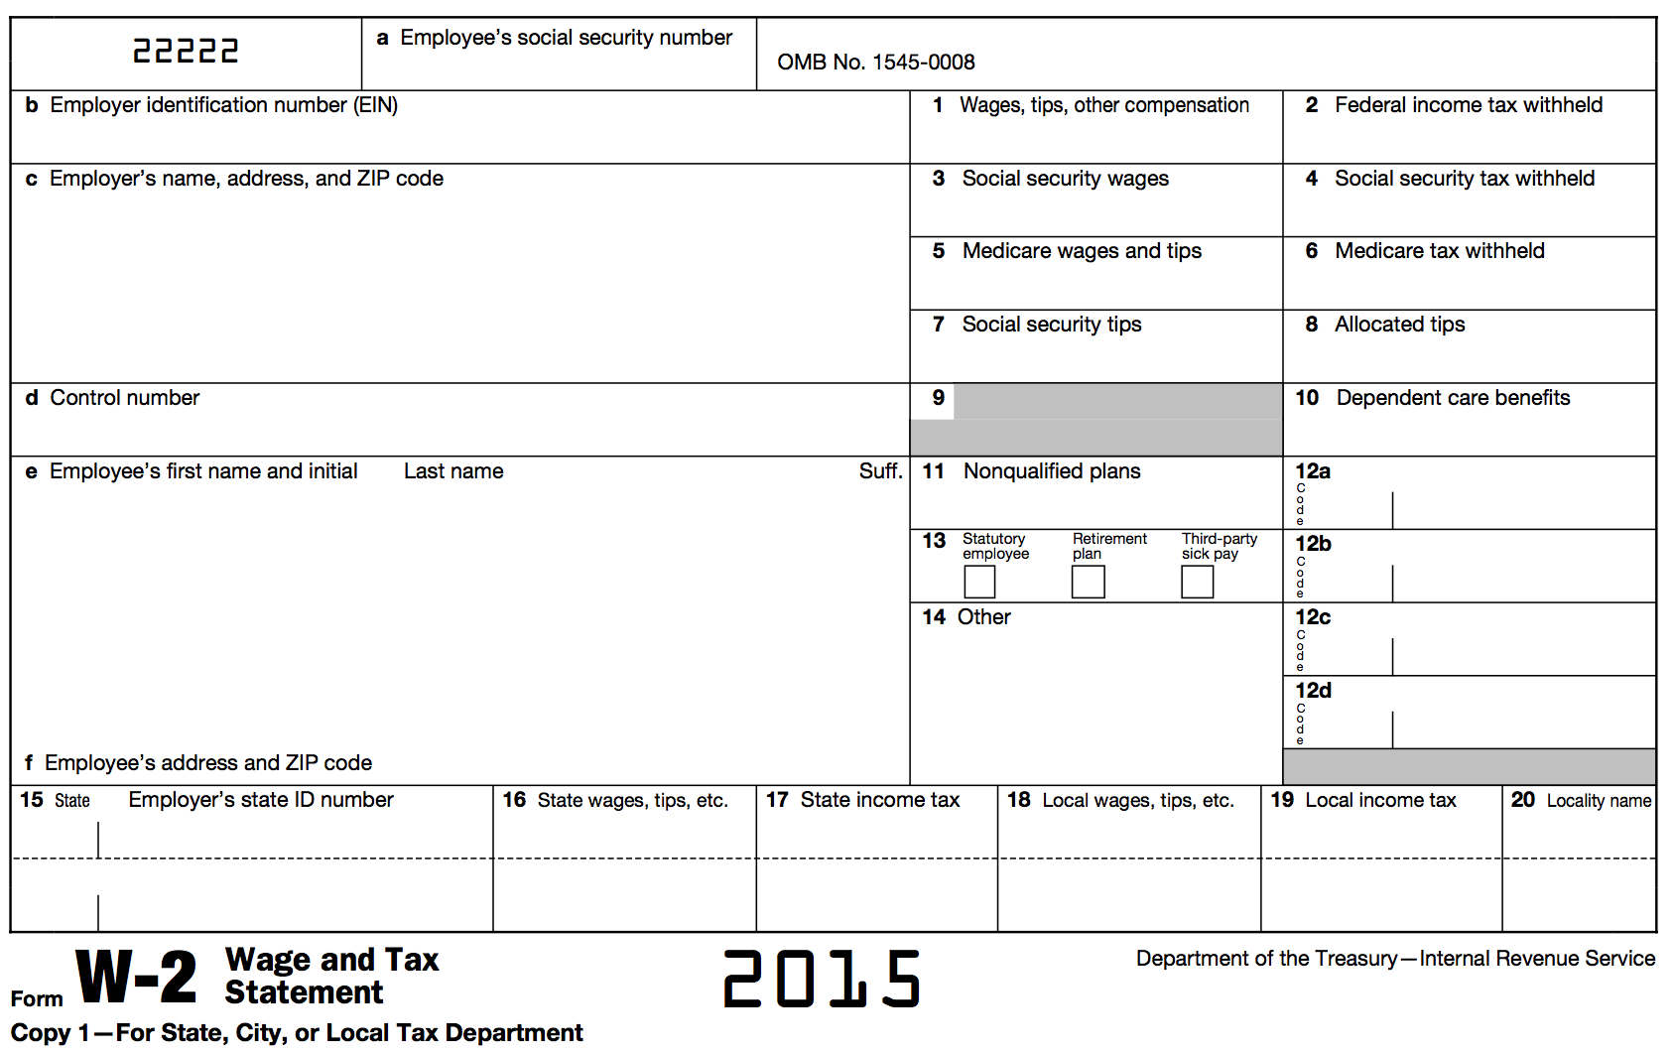


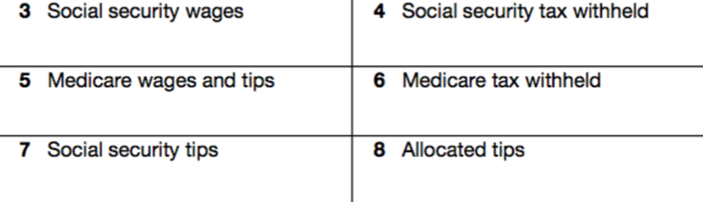






Form W-2: Wage and Tax Statement
Notes:
We will begin with the Form W-2. It’s appropriate that we begin with this form because it is by far the most common tax document you will see at the tax sites.
It has a lot of information reported on it, much that you will need to internalize—but much of the information that can be reported here you just need to know where to find what it means.
Let me briefly call your attention to the parts of the form that we will be taking a closer look at in this lesson:
Box 1: Wages, tips, other compensation – the amount paid to the employee during the tax year
Box 2: Federal income tax withheld – the amount of federal income tax withheld from the taxpayer’s wages for the year
Box 3-7: Related to FICA taxes (or Social Security and Medicare Taxes)
Box 8: Allocated Tips
Box 10: Dependent care benefits (provided by the employer to the taxpayer)
Box 12: Shows a variety of standard codes, some of which you will learn to immediately recognize and will require you to take further action, some of which you will need to look up using your resources
Box 13: Various boxes checked that may change how this income is reported (or whether or not it needs to be reported)
Box 14: Much like box 12, shows a variety of codes, however these are not always clear and may require additional investigation to determine if anything listed is necessary to complete the return
Box 16-17: Shows the amount of wages attributable to a particular state (if they have an income tax) and amount of state income tax withheld
Box 18-20: Shows the amount of local wages and income tax withheld, if applicable

Slide 128
Form W-2: Wages, Tips, Other Compensation
Reported in box 1
The total amount of wages, tips, salaries, bonuses, commissions, etc. paid to the employee for the entire tax year
Classified as earned income

Slide 129
Form W-2: Federal Income Tax Withheld
Reported in box 2
The federal tax system is a “pay as you go” system, meaning that tax is paid as income is earned during the year
The tax paid is referred to as withholding
The amount reported in box 2 is the total amount of tax withheld for the entire year

Slide 130
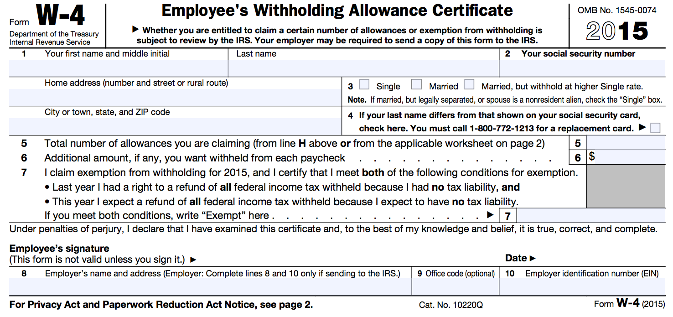
Form W-2: Federal Income Tax Withheld
This amount is determined prior to starting a job by filling out a Form W-4
Personal Allowances
  Single/Married
  Dependents
  Spouse information
  Childcare Expenses
The number of personal allowances listed determines how much federal income tax is withheld from pay
Notes:
Ideally, the amount of federal income tax withheld on wages (an each subsequent type of income) should be enough to cover any potential tax liability the taxpayer may have at the end of the tax year – which is why filing a federal tax is akin to “settling up” with the federal government.
The taxpayer has already been paying tax to the federal government each year, we are just trying to determine now if the taxpayer paid too much or too little.
Of course, many taxpayers that we serve end up getting a full refund of their federal income tax withheld because they receive enough in tax credits to wipe out their tax liability.

Slide 131
Form W-2: FICA Taxes
Reported in boxes 3, 4, 5, 6, and 7
Federal Insurance Contributions Act
  Employment tax imposed on employees AND employers specifically to fund Social Security and Medicare programs
  FICA is the part of the Internal Revenue Code that gives the federal government the authority to collect these taxes
Notes:
The next section of boxes on the Form W-2 are related to FICA taxes
First of all, what is FICA?
Employment taxes that are imposed on both the employee and the employer specifically to fund two federal programs: Social Security and Medicare
Federal Insurance Contributions Act – the part of the Internal Revenue Code that gives the federal government the authority to collect these taxes
You may also occasionally here these taxes referred to as “payroll taxes”

Slide 132
Form W-2: FICA Taxes
Reported in boxes 3, 4, 5, 6, and 7
Federal Insurance Contributions Act
  Employee pays ½ and employer pays ½
  Boxes 3, 5, and 7 show how much of the employee’s wages are subject to FICA taxes
  Boxes 4 and 6 are the actual FICA taxes withheld from pay and are separate from federal income tax withheld in Box 2
Notes:
The taxes imposed on wages varies from year to year, but it typically centers somewhere around 12% for Social Security and 3% for Medicare. The employee pays ½ of this cost and the employer pays the other ½ .
For 2014, the employee would have paid 6.2% in Social Security tax and 1.45% in Medicare tax. These collectively are referred to as payroll taxes, and unfortunately, unlike federal income tax, do not factor in to the total tax liability that is calculated when filing a federal tax return—meaning that a taxpayer cannot be refunded the tax that was withheld, even though they might receive a full refund of their federal income tax withheld.
Just a sidenote: taxpayers who are self-employed workers or nonemployee contractors are also required to pay FICA taxes on their income, HOWEVER, they do not have an employer to pay ½ so they are on the hook for 100% of these taxes. We will discuss this further in the next training!

Slide 133
Form W-2: Allocated Tips
Reported in box 8
The difference between the tips the employee reports to the employer and what the employer designated the employee’s tips should be
These amounts not included in box 1
FICA taxes not withheld from allocated tips
  Paid by using Form 4137 when filing tax return
Notes:
Allocated tips in box 8 apply to taxpayers working in a job that receives tips—so waiters, waitresses, bellhops, etc.
Most tips are totaled up in box 1 with wages, however, allocated tips are listed separately.
Allocated tips are the difference between the tips the employee reported to employer and what the employer designated the employee’s tips should have been
The reason the are separated out from box 1 wages is because FICA taxes have not been withheld from allocated tips. FICA taxes must be paid on this additional amount when filing a federal income tax return.

Slide 134
Form W-2: Dependent Care Benefits
Reported in box 10
These are dependent care benefits the employer paid either directly to the employee or on the employee’s behalf for dependent care expenses (i.e., to daycare)
Notes:
Sometimes, and employer provides dependent care benefits paid directly to the employee or on the employee’s behalf for dependent care expenses—usually to a daycare.
If there is ever an amount listed in box, an additional form must be completed—Form 2441. This form is for the Child and Dependent Care Expenses Tax Credit—we will discuss this form in more detail in a later training!
Jus know that an amount in this box will require additional action outside of the W-2.

Slide 135
Form W-2: Box 12 Codes
Box 12 reports a variety of amounts with corresponding codes
This information MAY be needed to complete the tax return
Reports information such as:
  401(k) retirement contributions (D)
  Cost of employer-sponsored health coverage (DD)
Notes:
Box 12 codes report a variety of information and amounts, and are standardized. The information listed here MAY be needed to complete the tax return, but often the information conveyed through box 12 codes are just that—information—and don’t require additional action.
Here are some common box 12 codes we will see
401(k) retirement contributions (D) – this indicates that a taxpayer had contributions made on his or her behalf into a retirement account. Taxpayers may be eligible for a retirement savings tax credit if there is an amount listed with code D
Employer-sponsored health coverage (DD) – this indicates the cost of the health insurance plan provided through the employer. There are no additional forms directly associated with this code, however, recognizing this code will be useful later when we discuss the Affordable Care Act and how it relates to the income tax return

Slide 136
Form W-2: Box 13
“Retirement Plan” is checked if the taxpayer makes contributions to a retirement plan through the employer
“Third Party Sick Pay” is checked if the amount in box 1 reflects the amount of sick pay paid during the year

Slide 137
Form W-2: Other
Other information is reported in box 14
The information listed is not always clear—even to the taxpayer
There is no standard list of codes, and employers can list any description they choose
Notes:
For example, sometimes an employer may list an amount contributed to a retirement account that may make the taxpayer eligible for a tax credit—its important to determine what each code means.
It’s best to use your resources first to try and determine what a box 12 code is—your site coordinator handbook and other IRS resources. If it still cannot be determined, try asking the taxpayer—they may know what it refers to.
If that fails, it still might be beneficial to have the taxpayer call their employer for clarification on what the code and amount refer to. Remember, our goal is to not only accurately prepare the tax return, but to make sure we claim every benefit that the taxpayer is eligible for.

Slide 138
Form W-2: Other
Employer may report information such as:
  Union dues
  Health insurance premiums deducted
  Nontaxable income
  Educational assistance payments
  Various types of retirement plan contributions
Notes:
Here are some examples of things reported in box 14
Sometimes, the information reported here might be able to be used when itemizing deductions, depending on whether or not it is a pre-tax benefit or a post-tax benefit.

Slide 139
Form W-2: State and Local Wages, Tax
Reported in boxes 16, 17, 18, and 19
Alabama also has an individual income tax, which we will discuss in the B Session
This information will be transferred to complete the state return

Slide 140
Form W-2: State and Local Wages, Tax
State wages are reported in box 16 and state income tax withheld is reported in box 17
Some localities also impose income tax
Local wages are reported in box 17 and local tax is reported in box 18
State wage and tax information will be used to file the appropriate state income tax return (covered in B Session if applicable to your state)

Slide 141
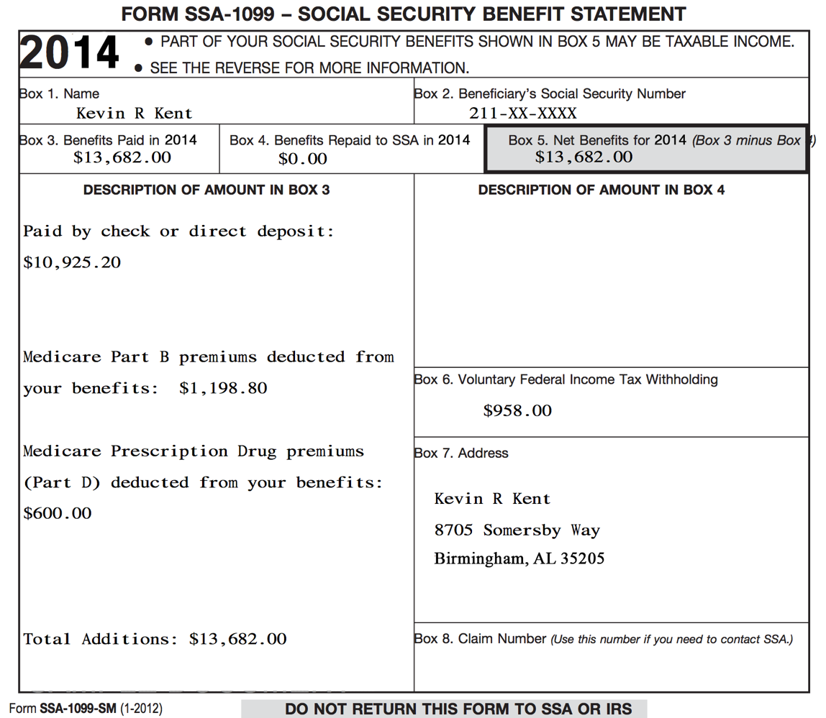

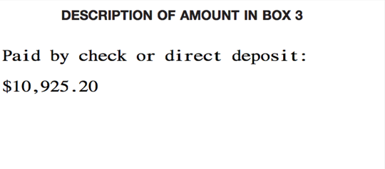
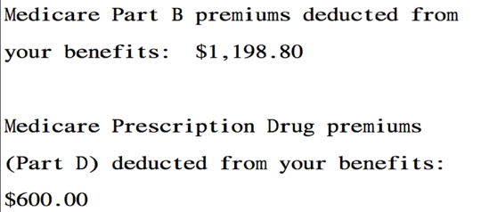

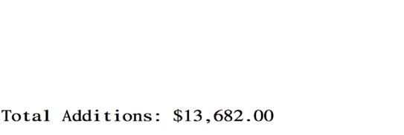
Form SSA-1099:
Social Security Benefit Statement
Notes:
Social security benefits are reported on a SSA-1099. This is what a SSA-1099 looks like.
Box 5 Reports total benefits – this is the important number to use when reporting SS benefits on the income tax return
The top of box 3 shows the amount of cash paid to the taxpayer throughout the course of the tax year
Box 3 also records the amount of Medicare premiums that were deducted from social security benefits.
Box 3 can also report lump-sum benefit payments, which are payments made to a taxpayer for a prior year.
Box 6 notes any federal taxes already withhold.
Social security benefits are reported on line 20a by linking to a 1040 Worksheet 1.

Slide 142
Form SSA-1099: Social Security Benefits
Net benefits reported in box 5
Social Security benefits include monthly retirement, survivor, and disability benefits
They do NOT include Supplemental Security Income (SSI): aimed at helping low-income elderly, blind, and disabled individuals pay for basic needs
Classified as unearned income

Slide 143
Form SSA-1099: Social Security Benefits
Some portion of the Social Security benefits may be taxable.
  Generally, if Social Security benefits are the only source of income, then they are not taxable.
  Dependent upon filing status and other reportable income
Notes:
Part of social security benefits may be taxable. The first thing you need to look at is what type of benefit it is.
Supplemental Security Income (SSI) it is not taxable. This benefit is for low-income elderly, disabled, or blind individuals.

Slide 144
Form SSA-1099: Medicare Premiums
Reported in box 3
Many taxpayers will have Medicare insurance premiums (part B) and/or Medicare prescription drug premiums (part D) deducted from benefits

Slide 145
Form SSA-1099: Voluntary Federal Income Tax Withholding
Reported in box 5
Taxpayers can choose to have federal income tax withheld from benefits (if taxpayers know their benefits may be partially taxable)
Notes:
Most taxpayers will have no federal income tax withheld from SS benefits because it won’t be taxable. However, make sure you are looking to make sure, because this number can be easy to miss if you aren’t looking for it!

Slide 146
Form SSA-1099: Lump Sum Benefit Payments
Reported in box 3
Some taxpayers may have received a lump-sum benefit payment (for current tax year and prior tax years)
See your site coordinator if a taxpayer received lump-sum benefits
Notes:
Very rarely, a taxpayer’s SS benefit statement may report that the taxpayer was paid a lump-sum amount for the current tax year as well as a prior tax year or years.

Slide 147
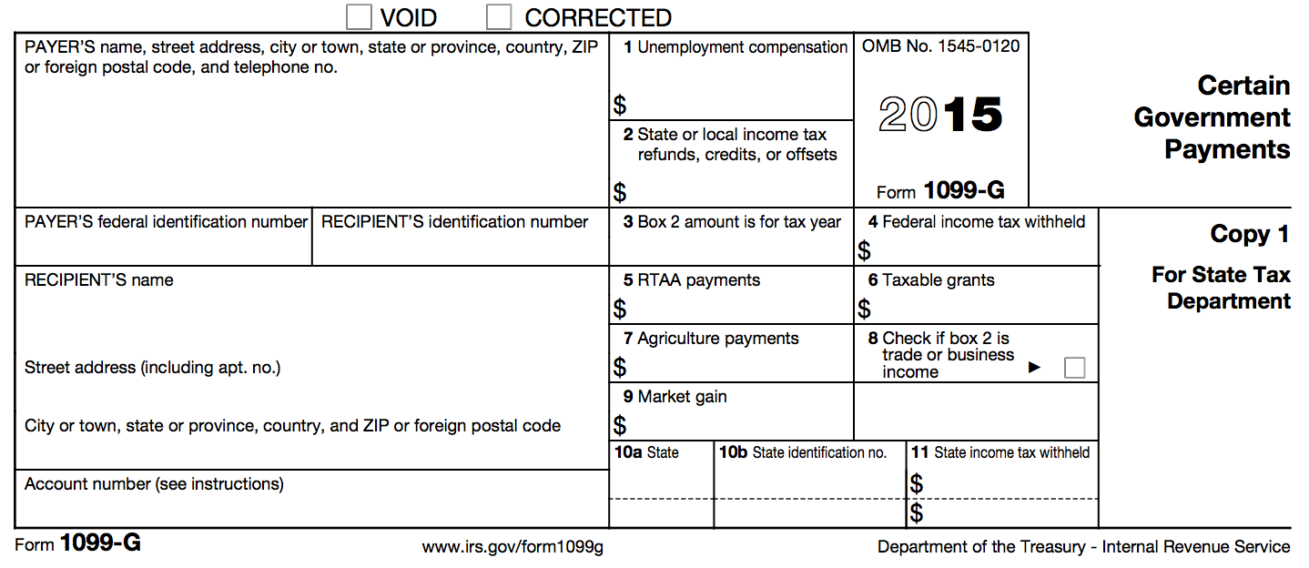
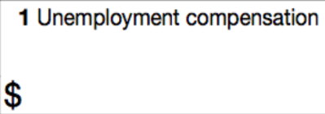
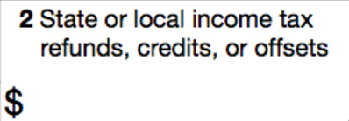

Form 1099-G: Certain Government Payments
Notes:
All unemployment compensation is considered taxable income on the federal level and must be reported.
Unemployment Compensation is reported on a 1099-G. Unemployment compensation is not taxable in many states, including Alabama.
How to look up the 1099-G online:
A taxpayer might report she has unemployment compensation but does have a copy of her 1099-G. You can pull up the 1099-G online.
http://dir.alabama.gov/uc/
File UC Claim
View 1099-G Tax Document Information
Enter DOB, SS #, and Zip

Slide 148
Form 1099-G: Unemployment Compensation
Reported in box 1
Shows the total amount of unemployment compensation for the tax year
Unemployment compensation is fully taxable income
Classified as unearned income

Slide 149
Form 1099-G: Federal Income Tax Withheld
Reported in box 4
Taxpayers can choose to have federal income tax withheld on unemployment compensation

Slide 150
Prior Year State Tax Refund
The 2015 State Tax Refund may be taxable and need to be reported
In order for the refund to be taxable, the taxpayer must have:
  Itemized on Federal Return
  Deducted State Income Tax(5a), NOT sales tax(5b) on Sch A(Federal return)
Notes:
The 2012 State Tax Refund may be taxable and need to be reported as income.
All you need to do is ask the taxpayer the question in the box under line 9: Did you itemize deductions last year and receive state or local tax refunds, credits or offsets? Answer no if you deducted state sales tax instead of state income tax.
If the answer is NO, simply check NO.
If the answer is YES or the taxpayer is unsure, see your supervisor.

Slide 151
Household Employee Income
If a household employee earns less than $2,000 a year, the employer is not required to issue a Form W-2
However, this income must still be reported on the taxpayer’s income tax return
Classified as earned income
Notes:
If a household employee earns less than a certain amount each year, the employer is not required to issue a W2.
For 2015, this amount was $1,900, however, this amount is subject to change from year to year. Publication 926 will offer the most up-to-date number for the current tax year)
Federal income tax and FICA taxes aren’t required to be withheld on this income, however, household employee income must still be reported on the taxpayer’s income tax return.
This will be classified as earned income

Slide 152
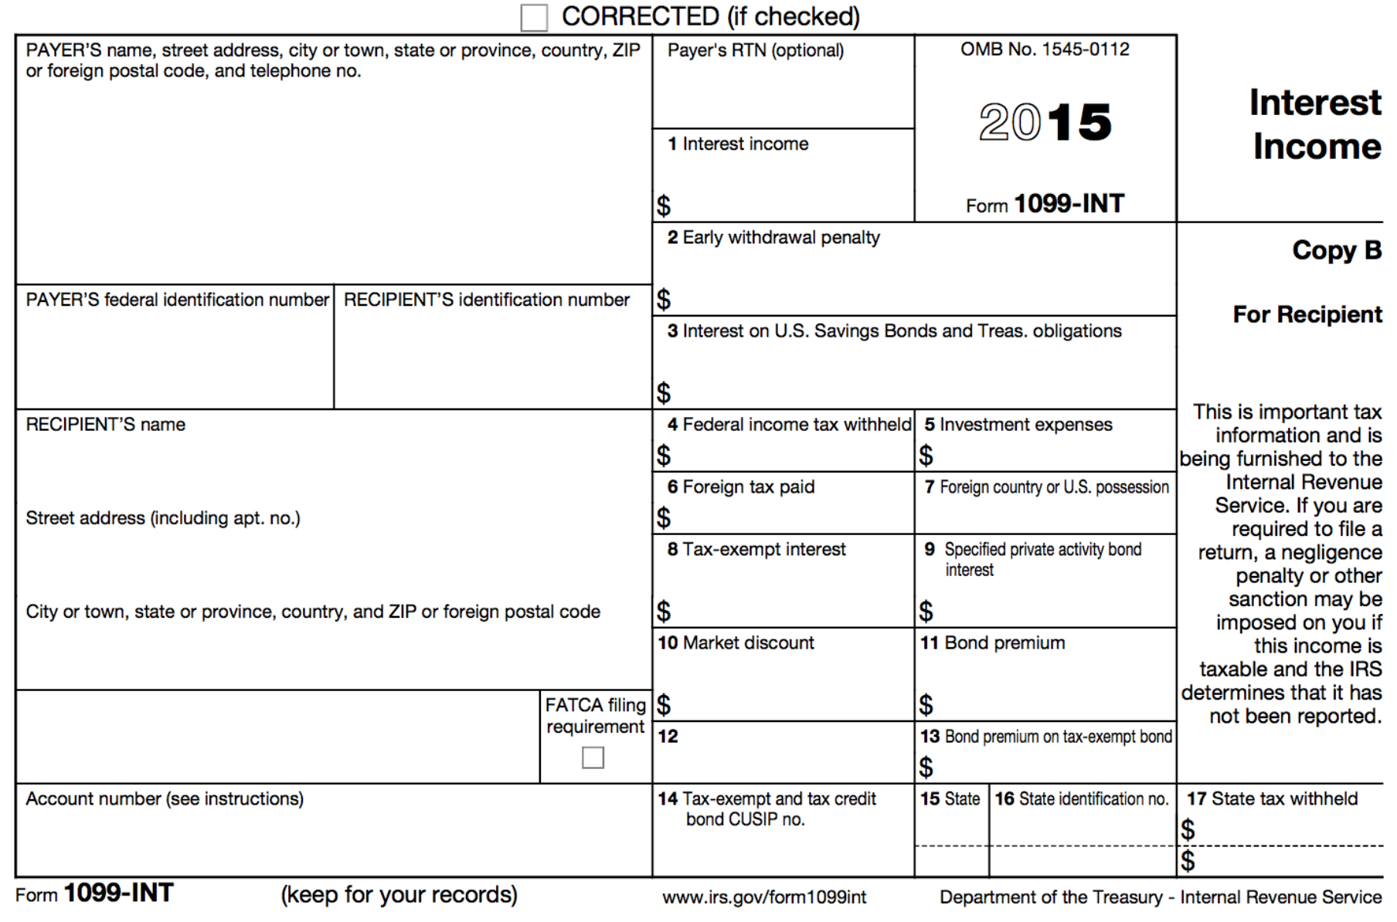


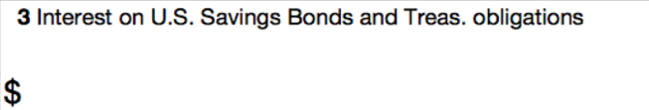

Form 1099-INT: Interest Income
Notes:
Interest income will most often be reported to a taxpayer on a Form 1099-INT. Let’s briefly take a look at each of the boxes we will take a look at on this form
Box 1 – Reports taxable interest paid to the taxpayer during the tax year
Box 2 – this amount reports the interest or principal forfeited as a result of an early withdrawal
Box 3 – Shows interest on U.S. Savings Bonds, Treasury Bills, bonds, and notes
Box 4 – Shows any federal income tax withheld on taxable interest

Slide 153
Form 1099-INT: Interest & Interest on U.S. Savings Bonds & Treas. Obligations
Reported in boxes 1 and 3
Money earns interest when it is:
  Deposited into bank accounts (e.g., savings account)
  Used to buy certificates of deposit (CDs) or bonds
Interest is taxed in the year and is credited to a taxpayer’s account
Classified as unearned income
Notes:
Money earns interest when it is deposited into accounts or used to buy CDs (certificates of deposit) or bonds.
Interest is earned in the year and is credited to a taxpayer’s account.
Interest income is classified as unearned income.

Slide 154
Form 1099-INT: Early Withdrawal Penalty
Reported in box 2
Shows interest/principal forfeited because of early withdrawal of time savings (e.g., from a CD that has a time limit before withdrawal is allowed)
Notes:
If an early withdrawal penalty is incurred, this will be indicated on the taxpayer’s tax statement.

Slide 155
Form 1099-INT: Federal Income Tax Withheld
Reported in box 4
Taxpayer may have had federal income tax withheld in some circumstances
Notes:
Taxpayer’s may have had federal income tax withheld on their taxable interest in some circumstances, which will need to be included when reporting this income on the federal income tax return.

Slide 156
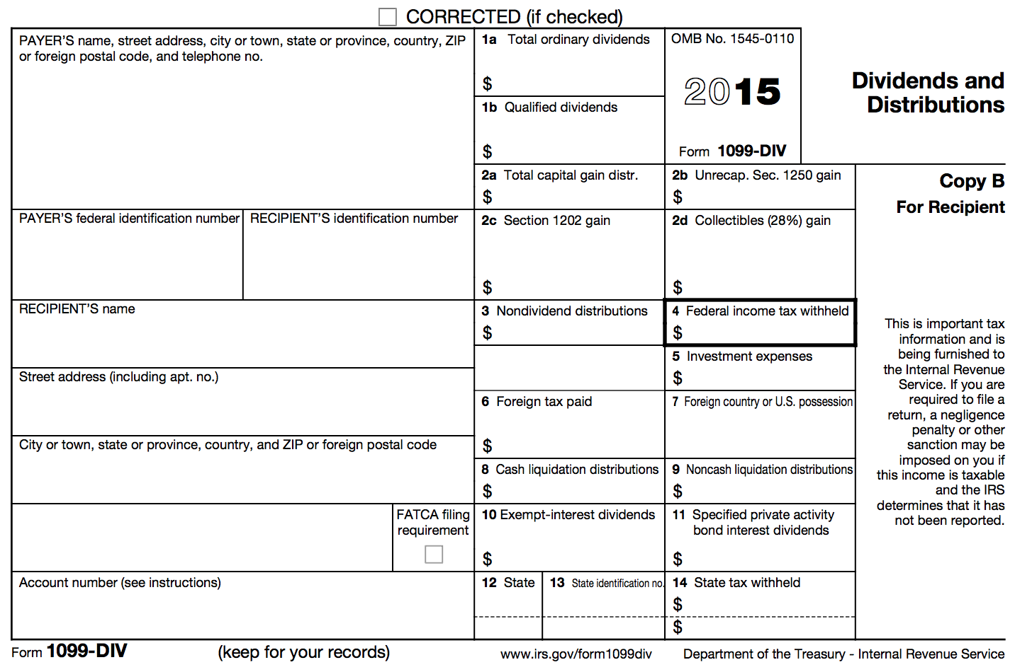
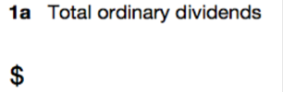
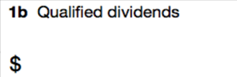


Form 1099-DIV: Dividends and Distributions
Notes:
Dividend income will most often be reported to a taxpayer on a Form 1099-INT. Let’s briefly take a look at each of the boxes we will take a look at on this form
Box 1a & 1b – Reports taxable dividends paid to the taxpayer during the tax year
Box 2a – Reports taxable capital gains distributions the taxpayer received
Box 4 – Shows any federal income tax withheld on taxable interest
Box 6 – Reports any foreign tax that was paid

Slide 157
Form 1099-DIV: Ordinary and Qualified Dividends
Reported in boxes 1a and 1b
A dividend is a distributions of a portion of a company’s earnings to shareholders
E.g., if a taxpayer has investments in a stock, then dividends paid by the corporation are taxable
Classified as unearned income
Notes:
They are payments made by corporations to shareholders. For example, if a taxpayer has investments in a stock, then the dividends paid by the corporation are taxable. They are reported to the federal government annually.
Dividends are also unearned income.

Slide 158
Form 1099-DIV: Capital Gains Distributions
Reported in box 2a
Capital gains distributions occur when a taxpayer sells stocks and securities in a mutual fund
Capital gains are taxable!
Notes:
Capital gains distributions are the income a taxpayer receives when selling stocks and securities in a mutual fund.
These amounts are taxable, but we will discuss stock, securities, and capital gains in a later training!

Slide 159
Form 1099-DIV: Federal Income Tax Withheld
Reported in box 4
Taxpayer may have had federal income tax withheld in some circumstances
Notes:
Taxpayer’s may have had federal income tax withheld on their taxable interest in some circumstances, which will need to be included when reporting this income on the federal income tax return.

Slide 160
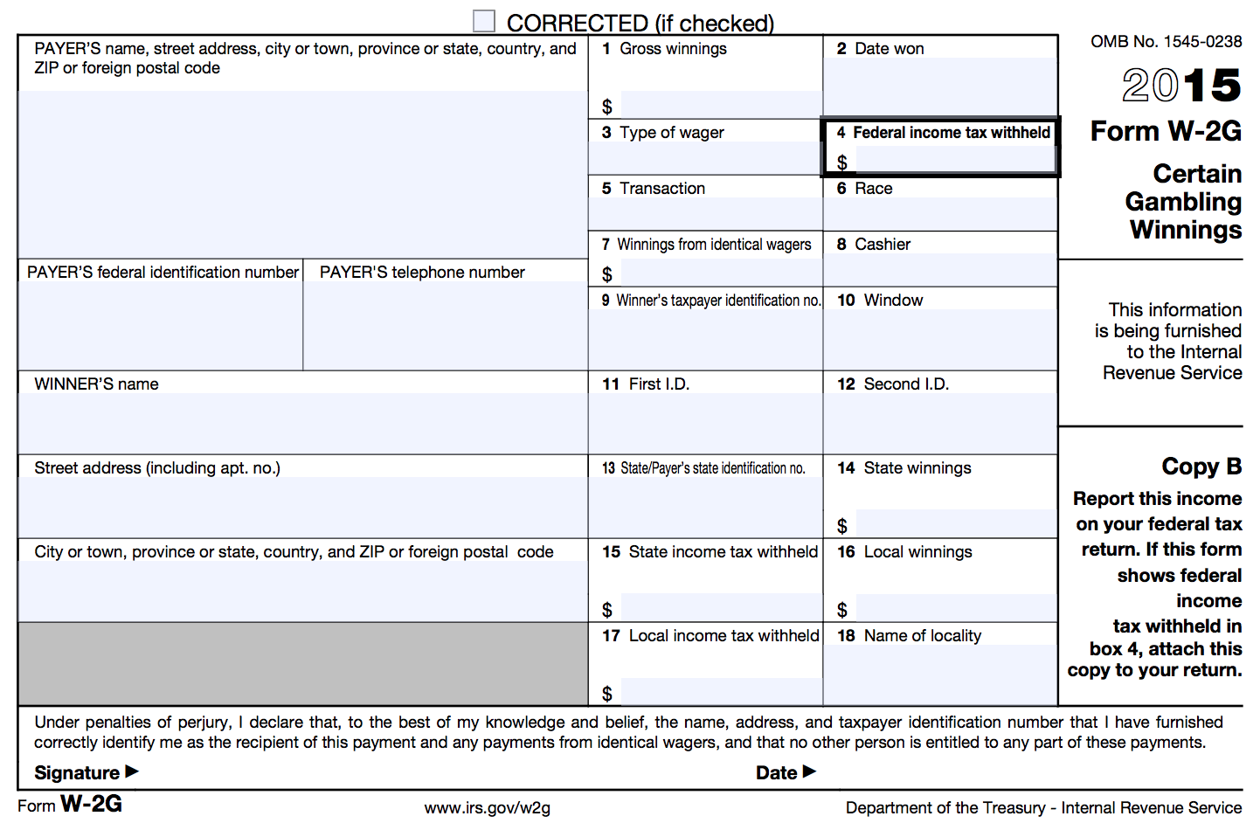
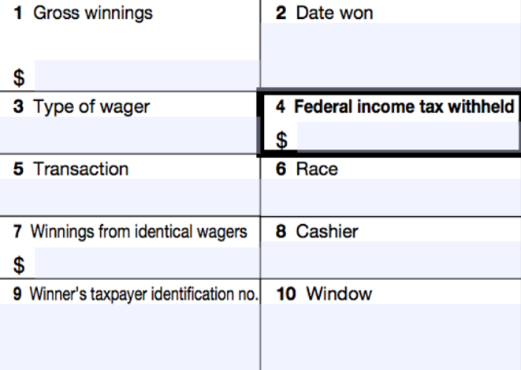
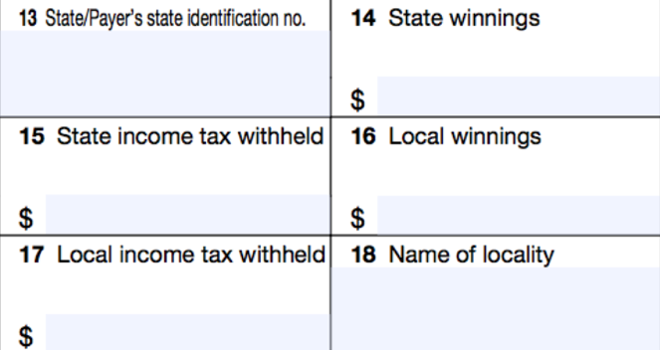
Form W2-G: Certain Gambling Winnings
Notes:
Gambling winnings are taxable and are typically reported on a W-2G.

Slide 161
Form W2-G: Certain Gambling Winnings
A taxpayer may receive one or more Form W2-Gs reporting gambling winnings
Classified as unearned income
Note: If a taxpayer has gambling winnings not reported on a Form W2-G, they must still be reported as income on the tax return

Slide 162
Jury Duty Pay
Jury duty pay must be reported as taxable income
Classified as unearned income

Slide 163
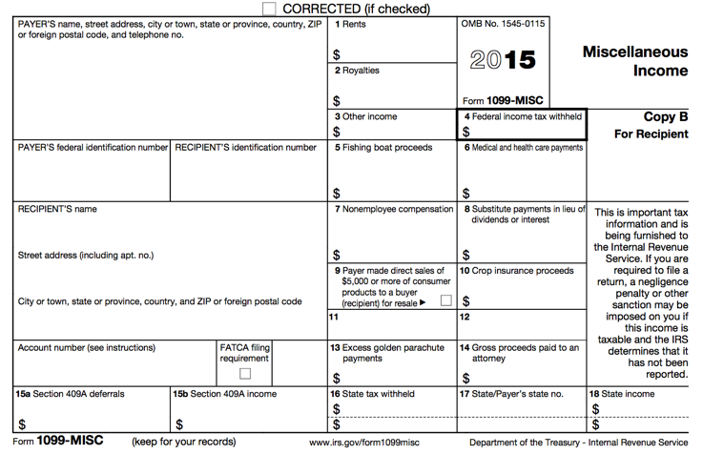

Form 1099-MISC: Miscellaneous Income
Notes:
This form has a lot of miscellaneous information that can be reported on it, and is often incorrectly reported on a taxpayer’s income tax return
For our purposes, we will only focus on three boxes:
Box 3: Other income – various types of income can be reported in this box, and often it is unclear how this information should be reported on the tax return
Box 4: Federal income tax withheld – this box will most likely be empty, but it is possible you may see an amount listed here
Box 7: Nonemployee compensation – this is money paid to an nonemployee independent contractor of a company

Slide 164
Form 1099-MISC: Other Income
Reported in box 3
Other income reported in this box is generally:
  Prizes
  Awards
  Taxable damages (from a lawsuit settlement)
  Other taxable income
Other income in box 3 is classified as unearned income
Notes:
The amounts reported in box 3 are called “other income”
These can include……prizes, awards, taxable damages (from a lawsuit settlement), as well as other taxable income
The majority of the time, the income listed in this box is classified as unearned income

Slide 165
Form 1099-MISC: Federal Income Tax Withheld
Reported in box 4
Taxpayers can choose to have federal income tax withheld on other income in box 3
Notes:
Taxpayers may choose to have federal income tax withheld on other income in box 3, however, most of the time this box will be blank. However, you should always double-check.

Slide 166
Form 1099-MISC: Nonemployee Compensation
Reported in box 7
This is business/self-employment income
Out of scope for basic volunteers
See your site coordinator or a more advanced volunteer if you see a Form 1099-MISC with an amount in Box 7
Notes:
Taxpayers may choose to have federal income tax withheld on other income in box 3, however, most of the time this box will be blank. However, you should always double-check.

Slide 167
Out of Scope for Basic Volunteers
Self-Employment/Business Income (including income reported in box 7 of Form 1099-MISC)
Sale of Stock (Form 1099-B)
IRA/Pension Income (Form 1099-R)
Any form of income we did not just cover
Impact America staff or Advanced trained volunteers must prepare these for taxpayers at sites

Slide 168
TaxSlayer – Beth Branch
Login to TaxSlayer
  Vita.taxslayerpro.com/irstraining
  Password: TRAINPROWEB
  Username: NELSONSTRAIN (last name, first initial, TRAIN)
  Password: SAVEFIRST
Enter all income (wages, social security, unemployment, interest, dividends, gambling winnings, household employee, jury duty, other income)

Slide 169
Standard Deduction

Slide 170
Standard Deduction Objectives
After completing this section, the volunteer will be able to:
  Explain how the standard deduction is determined for each taxpayer
  Distinguish when a taxpayer should itemize deductions and when a taxpayer should take the standard deduction

Slide 171
Standard Deduction
Reduces amount of income that is taxed
Amount of deduction based on
  Filing Status
  Age
  Whether taxpayer/spouse is blind
  Whether taxpayer is a dependent
Calculated automatically in TaxSlayer
Notes:
As we discussed when we reviewed the terminology, the standard deduction reduces the amount of income that is taxed.
The amount of the standard deductions depends on filing status, whether the taxpayer or spouse is 65 or older and/or blind, whether the taxpayer can be claimed as a dependent on someone else’s return.
TaxSlayer will automatically calculate the standard deduction based on the information that you have given during the interview.

Slide 172
Standard Deduction for Most Filers
Open the Publication 4012 to the Deductions Tab to Exhibit1: Standard Deduction for Most People
This table provides the standard deduction amounts for the current tax year
Notes:
If you will open up your Publication 4012 to ____________, this page will provide the most up-to-date standard deduction amounts for the current tax year.
These amounts vary from year to year, but as you can see, Single and MFS have the lowest standard deduction, HoH has a standard deduction around $2,500 or so higher, and MFJ and QW have the highest standard deduction, usually double of the S/MFS amount
These amounts will be what the majority of taxpayers will receive when filing their tax return

Slide 173
Itemized Deductions
Instead of taking the standard deduction, a taxpayer can choose to itemize, which is to list certain deductible expenses separately, in order to receive a greater deduction
Notes:
Every taxpayer can take a "standard deduction" to reduce his taxable income.
However, there are certain designated expenses that a taxpayer can choose to list out separately, and if they total more than the standard deduction, the taxpayer will “itemize” his deductions, which reduces his taxable income by a greater amount.

Slide 174
Itemized Deductions
Itemized deductions include (but are not limited to):
  Un-reimbursed medical expenses
  Charitable contributions
  Home mortgage payments
Out of Scope for Basic Volunteers
Impact America staff or Advanced trained volunteers must complete itemization at tax sites
Notes:
Itemized deductions include (but are not limited to): (a) un-reimbursed medical expenses; (b) charitable contributions; (c) home mortgage payments.
We will discuss this very thoroughly in Unit II, but just be aware that many taxpayers will have these expenses and will want to try and itemize their deductions.
It’s rare that a taxpayer will have enough itemized deductions to be greater than the standard deduction on the federal income tax return, however, many will have enough to make a difference on their state tax returns (because often state tax returns have much lower standard deductions than the federal level)
Again, we will discuss itemized deductions more thoroughly later on.

Slide 175
Nonrefundable Credits

Slide 176
Nonrefundable Credits Objectives
After completing this section, the volunteer will be able to:
  Assess a taxpayer’s eligibility for the Child & Dependent Care Expenses Credit
  Explain how a taxpayer qualifies for the Child Tax Credit
  Assess a taxpayer’s eligibility for the Retirement Savings Contribution Credit

Slide 177
Nonrefundable Tax Credit
Reduces the tax liability – only to zero.
  Child and Dependent Care Expenses
  Child Tax Credit
  Retirement Savings Contribution Credit
Notes:
Nonrefundable tax credit: A nonrefundable tax credit allows the taxpayer to reduce his tax liability to zero, but not to receive any refund if there is any credit left over. So, if you have $1500 of tax liability and $2000 in nonrefundable credits, you can take $1500 of nonrefundable credits. That’s it.

Slide 178
Determining Nonrefundable Credits
Open the Publication 4012 to the Nonrefundable Credits tab
Use this tab to help determine if a taxpayer qualifies for any nonrefundable credits

Slide 179
Child & Dependent Care Expenses Credit
Nonrefundable credit
Applied to offset expenses paid so taxpayer can work or look for work
  Dependent child under 13
  Spouse who is incapable of self-care
  Dependent who is incapable of self-care
Notes:
The child and dependent care credit is a nonrefundable credit that is applied to offset expenses paid so the taxpayer can work or look for work.
The child must be under 13 and claimed as a dependent, but care can also be for a person (including a spouse) who cannot take care of him/herself.

Slide 180
Child & Dependent Care Expenses Credit: Eligibility
Care had to be for qualifying persons
Taxpayer (and spouse) had to have earned income
  A spouse is treated as having earned income for any month the spouse is physically/mentally incapable of care, or is a full-time student.
Notes:
The care had to be for qualifying persons.
The taxpayer had to have earned income (since the credit is for taxpayers who paid for child or dependent care while they were working).

Slide 181
Child & Dependent Care Expenses Credit: Eligibility
Expenses must have been for work or to look for work
Payments can’t have been made to taxpayer’s spouse, dependent child or child under 19
Must have care provider’s name, address, and SSN/EIN (due diligence)
Notes:
The expenses must have been for during a time when the taxpayer worked or was looking for work.
The payments can’t have been made to the taxpayer’s spouse, dependent or child under 19
The taxpayer must have the care provider’s name, address and SSN or EIN (employee identification number).

Slide 182
Child & Dependent Care Expenses Credit: Qualified Work-Related Expenses
Expenses must be paid for the care of the qualifying person to allow the taxpayer (and spouse) to work or look for work
Care includes the costs of services for the qualifying person’s well-being and protection
Notes:
Expenses must be paid for the care of the qualifying person to allow the taxpayer (and spouse) to work or look for work
Care includes the costs of services for the qualifying person’s well-being and protection

Slide 183
Child & Dependent Care Expenses Credit: Qualified Work-Related Expenses
Expenses to attend Kindergarten or a higher grade: NOT AN EXPENSE
Expenses for summer day-camp qualify, but those for over-night camp are not!
$3,000 limit for one qualifying person or $6,000 for two or more qualifying persons.
Notes:
Expenses to attend Kindergarten or a higher grade: NOT A QUALIFYING EXPENSE
Expenses for summer day-camp do qualify, but those for over-night camp do not!
$3,000 limit for one qualifying person or $6,000 for two or more qualifying persons.

Slide 184
Child & Dependent Care Expenses Credit:
Notes
If you had expenses that met the requirements for the previous tax year, except that you did not pay them until the current tax year, you may be able to claim them on your tax return.
Taxpayer’s who cannot provide all of the provider’s information or who have incorrect information may still be able to take the credit if they can show they used due diligence in trying to obtain the info.
Notes:
A couple of things you should note. If you had expenses that met the requirements for 2014, except that you did not pay them until 2015, you may be able to claim them in 2015. Talk to your supervisor if this comes up.
Taxpayer’s who cannot provide all of the provider’s information or who have incorrect information may still be able to take the credit if they can show they used due diligence in trying to obtain the info. However, you should always talk to your supervisor if you cannot get the needed information.
Taxpayers will not usually have a document for this credit – all they need is the name, address and EIN or SSN of the childcare provider. The taxpayer will need to call their provider or come back with this information if they do not have it.

Slide 185
Child & Dependent Care Expenses Credit: Employer Provided Benefits
If a taxpayer had employer-provided benefits, they will appear in box 10 of the Form W-2

Slide 186
Child & Dependent Care Expenses Credit:
Employer Provided Benefits
Reported on Form W-2, box 10
These are dependent care benefits the employer paid either directly to the employee or on the employee’s behalf for dependent care expenses (i.e., to daycare)
Amounts paid on behalf of the taxpayer by the employer will reduce the dollar amount of the credit
Notes:
Sometimes, and employer provides dependent care benefits paid directly to the employee or on the employee’s behalf for dependent care expenses—usually to a daycare.
If there is ever an amount listed in box, an additional form must be completed—Form 2441. This form is for the Child and Dependent Care Expenses Tax Credit
Jus know that an amount in this box will require additional action outside of the W-2.

Slide 187
Child & Dependent Care Expenses Credit: Divorced/Separated Parents
Custodial parent can claim the Child & Dependent Care Expenses Credit, even if he/she did not claim the dependency exemption
This situation is complicated to determine. SEE YOUR SITE COORDINATOR
Notes:
The Child and Dependent Care Expenses Credit is another benefit that always belongs to the custodial parent, even if he/she did not claim the dependency exemption.
Reminder: This occurs with the Division of Benefits when a taxpayer signs a Form 8332.

Slide 188
Example
Julie spent the following amounts on child care for her 10-year-old daughter Melissa. Are any of these eligible costs for the Child & Dependent Care Expenses Credit?
$300 for overnight camp
$1000 to her ex-husband for after school-care
$1500 to her mother for after-school care
$500 to her 15-year-old son for babysitting

Slide 189
Example – Answer
Julie spent the following amounts on child care for her 10-year-old daughter Melissa. Are any of these eligible costs for the Child & Dependent Care Expenses Credit?
$300 for overnight camp – NO
$1000 to her ex-husband for after school care
$1500 to her mother for after-school care
$500 to her 15-year-old son for babysitting

Slide 190
Example – Answer
Julie spent the following amounts on child care for her 10-year-old daughter Melissa. Are any of these eligible costs for the Child & Dependent Care Expenses Credit?
$300 for overnight camp – NO
$1000 to her ex-husband for after school care – NO
$1500 to her mother for after-school care
$500 to her 15-year-old son for babysitting

Slide 191
Example – Answer
Julie spent the following amounts on child care for her 10-year-old daughter Melissa. Are any of these eligible costs for the Child & Dependent Care Expenses Credit?
$300 for overnight camp – NO
$1000 to her ex-husband for after school care – NO
$1500 to her mother for after-school care – YES
$500 to her 15-year-old son for babysitting

Slide 192
Example – Answer
Julie spent the following amounts on child care for her 10-year-old daughter Melissa. Are any of these eligible costs for the Child & Dependent Care Expenses Credit?
$300 for overnight camp – NO
$1000 to her ex-husband for after school care – NO
$1500 to her mother for after-school care – YES
$500 to her 15-year-old son for babysitting – NO

Slide 193
Child Tax Credit
One credit for each qualifying child under 17 years of age
A taxpayer can claim a Child Tax Credit for a child only if they CAN AND DO claim a dependency exemption for the child
Nonrefundable credit with a maximum of $1,000 per child.
  Amount actually claimed depends on taxpayer’s tax liability, MAGI and filing status
  MAGI: typically same as AGI
Notes:
Taxpayers can claim the Child Tax Credit when they have kids under age 17.
The Child Tax Credit is nonrefundable, with a maximum of $1,000 per child.

Slide 194
Child Tax Credit
This is a credit intended to reduce the tax liability owed by the taxpayer, therefore, this part of the credit is nonrefundable
However, the taxpayers may be able to take the Additional Child Tax Credit, which is refundable

Slide 195
Retirement Savings Contributions Credit: General Eligibility Requirements
A contribution to an IRA or other qualified plan for the tax year
AGI limitations (vary based on filing status)
Age 18 or older
Not claimed as a dependent on someone else’s tax return
Not a full-time student during the tax year
Notes:
Taxpayers who meet certain eligibility requirements may be able to claim the Retirement Savings Contributions Credit.
Taxpayers must have contributed to a retirement or IRA plan, meet certain AGI and age limitations, cannot be claimed as dependents and are not full-time students.

Slide 196
Retirement Savings Contribution Credit: Form W-2

Slide 197
Retirement Savings Contribution Credit: Contributions Record
How do I know if the taxpayer has made a qualifying contribution?
  Form W-2, Box 12 and one of the codes: D, E, F, G, H, S, AA or BB
  Form W-2, Box 14 and codes for military personnel: Q or E
CAUTION: Entries in box 14 that are treated a employer contributions are NOT eligible for the credit
Notes:
Indicators to look for to see if a taxpayer made a qualifying retirement contribution can be found on:
Form W-2, Box 12 and one of the codes: D, E, F, G, H, S, AA or BB
Form W-2, Box 14 and codes for military personnel: Q or E

Slide 198
Retirement Savings Contributions Credit: Eligible Contributions
Some retirement distributions reduce the eligible contributions for the credit
In addition to retirement distributions made during the current tax year, the taxpayer must also reduce eligible contributions for distributions taken during the previous two tax years
Notes:
Since this credit is meant to encourage retirement saving, the credit must be reduced by any amount that the taxpayer withdrew during the tax year and the two preceding years.

Slide 199
Example
Bob, age 48, contributed $600 to an IRA during the tax year. During the year, he worked full-time and had an AGI of $24,000. He is not a student. Is Bob eligible to claim the Retirement Savings Contribution Credit?

Slide 200
Example – Answer
Yes: Bob contributed to an IRA, meets the age and AGI limits, is not a dependent and is not a full-time student.

Slide 201
TaxSlayer – Beth Branch
Login to TaxSlayer
  Vita.taxslayerpro.com/irstraining
  Password: TRAINPROWEB
  Username: NELSONSTRAIN (last name, first initial, TRAIN)
  Password: SAVEFIRST
Enter Child & Dependent Care Expenses Credit, Retirement Savings Contribution Credit

Slide 202
Reminders
Don’t forget to complete paperwork on your volunteer profile
Please bring your training materials back to the B session.
Notes:
All materials can be downloaded on our website at www.impactamerica.com/taxprep

Slide 203
Sign Up For a Testing Session
Remember to register for a testing session where an Impact staff member will be available to answer your questions while taking the test!
Upcoming sessions:
  Trainer – insert sessions in your city here

Slide 204
Volunteer Basic Tax Training
B Session

Slide 205
Training Outline: B Session
1) Refundable Credits
  Additional Child Tax Credit
  Earned Income Credit
2) Refund & Amount of Tax Owed
3) Affordable Care Act
4) Alabama Return

Slide 206
Training Outline: B Session
5) Tax Preparation Process
  Preparing the Return in TaxSlayer
  Quality Review
  Finishing the Return
  Filing the Return

Slide 207
Training Outline: B Session
6) Out of Scope Topics
  Additional Affordable Care Act Tax Provisions
  Retirement Income: IRAs and Pensions
  Itemized Deductions
  Education Credits & Student Loan Interest
7) Intake/Interview & Quality Review Process
8) Volunteer Standards of Conduct

Slide 208
Refundable Credits
Notes:
Welcome back to Unit I Training.
In this lesson, we will discuss Exemptions.

Slide 209
Refundable Credits Objectives
After completing this section, the volunteer will be able to:
  Explain how a taxpayer qualifies for the Additional Child Tax Credit
  Assess a taxpayer’s eligibility for the Earned Income Tax Credit

Slide 210
Refundable Tax Credit
Reduces tax liability to zero
Taxpayer will receive the remainder of the credit value as a refund.
  Additional Child Tax Credit
  Earned Income Tax Credit
Notes:
Refundable tax credit: A refundable tax credit allows the taxpayer to reduce his tax liability to zero and then get a refund for the remainder of the credit value. . So, if you have $1500 of tax liability and $2000 in nonrefundable credits, you can take $1500 of credits to reduce your tax liability to $0 and then take the last $500 as a refund.

Slide 211
Additional Child Tax Credit
The Child Tax Credit is intended to reduce the tax liability owed by the taxpayer, therefore, this part of the credit is nonrefundable
However, the taxpayers may be able to take the Additional Child Tax Credit, which is refundable

Slide 212
Additional Child Tax Credit
Refundable credit with a maximum of $1000 per child
Amount claimed depends upon meeting general eligibility requirements as well as how much of the nonrefundable Child Tax Credit is claimed
  Cannot claim more than $1000 of CTC and additional CTC combined for one child
Notes:
If a taxpayer has too little liability to claim the full nonrefundable Child Tax Credit, he can claim the remaining amount as an Additional Child Tax Credit.

Slide 213
Additional Child Tax Credit:
General Eligibility
Meet all the requirement of the Child Tax Credit
  Under 17, U.S. citizen, dependent of taxpayer, qualifying relationship, child did not provide over ½ of own support, lived with taxpayer for more than ½ of year
Must have $3,000 of taxable earned income
  Exception: Taxpayers with three or more children may be eligible regardless of their income
Notes:
To receive this credit, the child in question must meet all of the same requirements for the Child Tax Credit
The taxpayer must have to have at least $3000 of earned income.
There is an exception to this rule—taxpayers will three or more children may be eligible regardless of their income
You may have taxpayers who don’t understand why they aren’t receiving $1000 for their child even though they are under 17—this would be the reason why. If they don’t have $3,000 worth of earned income, they don’t qualify for the refundable portion.

Slide 214
Earned Income Credit
Refundable tax credit for low-to-moderate income workers to encourage work, offset payroll and income taxes, and help meet basic need
The EIC is the largest federal anti-poverty program and has been one of the most successful programs to lift families, especially families with children, out of poverty
Notes:
The Earned Income Tax Credit is a refundable tax credit that applies to individuals who work but make very low incomes. “Refundable” means that even if the taxpayer does not owe any taxes, he can get the full credit back as a refund.
The Earned Income Tax Credit is really the reason that we are here. The EITC is the largest federal anti-poverty program and has been one of the most successful programs to lift individuals and children out of poverty. But, every year in Alabama, about 75% of EITC recipients pay an average of $200 each to commercial tax preparers, eroding the benefit of the EITC.

Slide 215
Earned Income Credit
An estimated 26 million households received more than $65.6 billion in reduced taxes and refunds in the tax year 2015*
*Source: Calendar Year Report, June 2016
Notes:
After the Supplemental Nutritional Assistance Program (SNAP), the EITC is the largest cash or near cash assistance program targeted at low-income families.
Tax Policy Center, a joint project of the Urban Institute and Brookings Institutution more than 26 million households will receive a total of $60 billion in reduced taxes and refunds in the tax year 2015.

Slide 216
Earned Income Credit
In the tax year 2015, the EIC lifted an estimated “6.5 million people out of poverty, including about 3.3 million children”
The EIC has been especially successful in providing an incentive for single mothers with children to find work
*Source: The Center for Budget and Policy Priorities
Notes:
The Center for Budget and Policy Priorities, using Census Bureau data estimated that in 2012, "the credit lifted 6.5 million people out of poverty, including over 3 million children.”
The IRS reports that more than three-fourths of eligible families claimed the Earned Income Tax Credit in 2005, a much higher take-up rate than that for Temporary Assistance to Needy Families (32 percent in 2009) or for SNAP (72 percent in 2009).
The EIC has been especially successful in providing an incentive for single mothers with children to find work .:

Slide 217
Encouraging Work and Reducing Poverty
Research has also found that children in families who get an income boost from the EIC and CTC quickly show improvements in health and school performance relative to other low-income children who did not receive this extra help
In addition, children whose families receive that boost have higher school test scores, on average, and are more likely to go to college and to work and earn more as adults
*Source: The Center for Budget and Policy Priorities

Slide 218
EIC and Alabama Families
498,000 Alabama households received EIC in 2016 for tax year 2015
153,000 Alabamians were lifted out of poverty by the EIC and CTC combined, including 80,000 children, each year, on average, during 2011 to 2013
The EIC put about $1.4 billion into Alabama’s economy in 2012
*Source: The Center for Budget and Policy Priorities

Slide 219
Earned Income Credit
Critics of the EIC have complained that it is too complex, forcing recipients to seek help in filing their return
Two-thirds get such assistance, most from paid tax preparers
It is our job to provide high-quality tax preparation to ensure these families receive the full amount of the EIC they are eligible for!
Notes:
Critics complain that the EITC is too complex, forcing potential recipients to seek help filing their federal tax return: two-thirds of low-income parents get such assistance, typically from paid tax preparers.

Slide 220
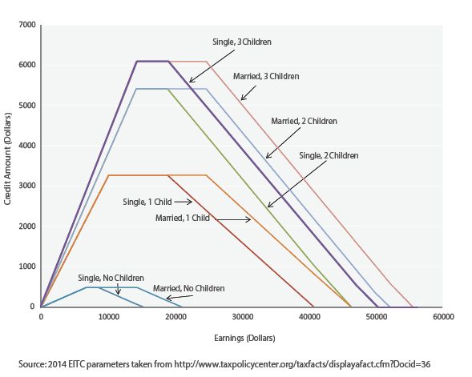
Earned Income Credit: Maximum Credit Amounts
Notes:
This chart shows the amount of the credit based on amount of income and number of children. As earned income increases, the amount of the credit increases up to a point, and then, as earned income further increases, the amount of the credit decreases to a phase out point.
The credit begins to phase out for married taxpayers filing a joint return with children in the $20-25k range. For married taxpayers filing a joint return with no children, the credit begins to phase out and completely phases out at $18,470.
Picture thanks to
Tax Policy Center, a joint project of the Urban Institute and Brookings Institution, posted February 12, 2014; accessed July 20, 2015; web; http://www.taxpolicycenter.org/briefing-book/key-elements/family/eitc.cfm

Slide 221
Determining the Earned Income Credit
Open the Publication 4012 to the Earned Income Credit Tab
Use this tab to help determine if a taxpayer qualifies the Earned Income Credit

Slide 222
Earned Income Credit: Eligibility Requirements
Rules for everyone:
  Must have earned income (and AGI has limits)
  Valid SSNs and U.S. citizens/resident aliens
  Not Married Filing Separately
  No foreign earned income
  Investment income less than $3,400
  Taxpayer cannot be qualifying child of another person

Slide 223
Earned Income Credit: Eligibility Requirements
Rules if taxpayer does NOT have a qualifying child:
  Cannot be claimed as a dependent by another person
  Must be at least 25 but under 65 on December 31st of the tax year
  Must have lived in the United States (and spouse, if MFJ) for more than ½ of the year

Slide 224
Earned Income Credit: Eligibility Requirements
Rules if taxpayer has a qualifying child:
  Qualifying child must have a valid SSN that allows him/her to work
  [Relationship Test] Child must be the taxpayer’s:
    son, daughter, stepchild, eligible foster child
    brother, sister, half brother, half sister, stepbrother, stepsister, or descendent of any of them

Slide 225
Earned Income Credit: Eligibility Requirements
Rules if taxpayer has a qualifying child:
  [Age Test] Child must be
    Under age 19 at the end of the tax year, OR
    Under age 24 and a full-time student at the end of the tax year, OR
    Any age and permanently and totally disabled

Slide 226
Earned Income Credit: Eligibility Requirements
Rules if taxpayer has a qualifying child:
  [Joint Return Test] Qualifying child must not have filed a joint return for the tax year
    Unless the child only filed a joint return with spouse to claim a refund
  [Residency Test] Must have lived with the taxpayer for more than ½ the year
  Must not be the qualifying child of another person

Slide 227
Earned Income Credit: Eligibility Requirements
Note: Just because a person qualifies as the dependent of the taxpayer does not mean they automatically make the taxpayer eligible for the EIC
Child in question must meet the age, relationship, residency, and joint return tests to qualify (therefore, Qualifying Children always meet requirements, HOWEVER, Qualifying Relatives DO NOT)

Slide 228
Earned Income Credit: Qualifying Child of More than One Person
Sometimes, a child meets all of the tests to be claimed by more than one taxpayer
A child cannot be used by more than one person to claim the EIC
The rules for determining who claims the child for EIC are the same as those for determining who claims the the child as a dependent
If this situation arises, please see your Site Coordinator
Notes:
As we saw when we discussed the dependency exemption, sometimes an individual is a qualifying child for more than one person.
When this is the case, the IRS implements a set of “tie-breaker” rules.

Slide 229
Earned Income Credit: Disallowance
EIC can be disallowed for
  Reckless or intentional disregard of the rules: 2 years
  Fraudulent Claim: 10 Years
To claim EIC again, a taxpayer must
  Wait full period of disallowance
  Submit a Form 8862 with the tax return
If this situation arises, please see your Site Coordinator
Notes:
If the EIC has been disallowed for any reason (except for a mathematical error) in any year after 1996, the taxpayer cannot claim the EIC again without submitting Form 8862.
EIC disallowed for:
If credit was disallowed due to reckless or intentional disregard, the taxpayer is ineligible to claim the credit for the next two years.
If credit is claimed fraudulently, taxpayer is ineligible for 10 years. The IRS determines the difference between the two types of disallowance For the most part, an Individual who”fudges,” i.e claims a boyfriend's child, etc will suffer a two- year punishment, whereas someone who steals/creates as SSN, changes income, etc will suffer a 10-year disallowance.
Exception: If the credit was disallowed solely b/c the child listed on the return was determined not to be a qualifying child, and the taxpayer is claiming the credit this year without claiming a qualifying child.
To claim EIC again, a taxpayer must:
In order to claim EIC again, the taxpayer must wait the entire period of disallowance and submit a Form 8862.
IMPORTANT NOTE: Mathematical and clerical errors are NOT bases for disallowance.

Slide 230
Example
Sharon, who has an earned income and AGI of $15,525, takes care of her sister’s son, Eric. If Eric is 12 years old and began living with Sharon in August, can Sharon claim the EIC?

Slide 231
Example – Answer
No
Sharon’s AGI is too high to claim the EIC alone, and since Eric lived with her for less than half a year, he is not her qualifying child
Notes:
Eric is not her qualifying child for EIC because he did not live with her for over half the year. She cannot claim the EIC without a qualifying child because her income is too great.

Slide 232
Example
Doug and Donna are married and live together with their 4-year-old son Sam. Their combined earned income is $25,000, but they file separately. Doug reports an AGI of $11,000 on his return, and Donna reports AGI of $14,000.
Can Doug and/or Donna claim the EIC?

Slide 233
Example – Answer
No
Neither can claim the EIC because both have a filing status of Married Filing Separately

Slide 234
Example
Doug and Donna are still married and still live together with Sam, but now they decide to file a joint return. Their combined earned income and AGI are $25,000. Can they claim the EIC on this return?

Slide 235
Example – Answer
Yes
Their joint income is low enough to claim the EIC with one qualifying child (Sam)

Slide 236
Example
Tom is 64 years old, retired and collected $10,000 of social security during the tax year. He does not have any qualifying children.
Can he claim the EIC on his return?

Slide 237
Example – Answer
No
Tom does not have any earned income

Slide 238
TaxSlayer – Beth Branch
Login to TaxSlayer Vita.taxslayerpro.com/IRSTRAINING
  Password: TRAINPROWEB
  Username: NELSONSTRAIN (last name, first initial,TRAIN)
  Password: SAVEFIRST
Enter Earned Income Credit

Slide 239
Refund & Amount of Tax Owed

Slide 240
Refund & Amount of Tax Owed Objectives
After completing this section, the volunteer will be able to:
  Explain the taxpayer’s options when receiving a tax refund
  Explain the options available to a taxpayer that has tax due
Notes:
This sections contains a lot of information – it’s one of the more difficult concepts to grasp, and also one of the most important.
Make sure you follow along closely, and if there’s something you don’t understand—pause the video, rewind, and watch it again!

Slide 241
Refunds
Taxpayers can choose to receive their refund either by check or direct deposit
Checks take 6-8 weeks to be mailed
Electronic deposits will be made in 1-2 weeks
Taxpayers can also choose to allocate part of their refund to order savings bonds
Notes:
241
Talk to the taxpayer about their refund or payment.
The taxpayer can choose to have all or part of her refund contributed to the next year’s tax return. Most of our clients will want the refund.
If taxpayers want a paper check mailed to them, it will take 6-8 weeks.
A refund that is directly deposited will be credited to the account within 1-2 weeks.

Slide 242
Refunds: Direct Deposit
Encourage taxpayers to use direct deposit
  But, refunds will be delayed 4-6 weeks if the routing and account numbers are not valid
Refunds may only be deposited into their own accounts
Refunds can be deposited in up to three accounts
Notes:
We want to encourage taxpayers to use direct deposit because refunds will be received much faster
Make sure verify the routing and account number be valid or else refunds will be delayed 4-6 weeks
Refunds may only be deposited into their own accounts, but refunds can be deposited in up to three accounts

Slide 243
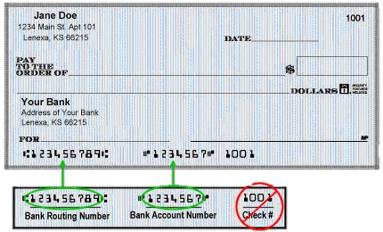
Refunds: Direct Deposit
Routing number (9 digits): can look up online
Account number: do not include check number!
Do NOT include spaces or hyphens!
Notes:
Routing numbers are 9 digits long. If a taxpayer does not know their routing number, we can look this up online
We also need to input an account number for a direct deposit
This slides gives an example of a check where you can locate the routing and account numbers

Slide 244
Refunds: Electronic Deposit
If a mistake is made that increases the amount of the refund, the IRS will send a letter explaining the changes in the adjustment
If a taxpayer owes debts (child support or student loans), the IRS will decrease the refund after you E-file it
  Encourage taxpayers to still E-file
  We do not have access to any of this information!
Notes:
244
Taxpayers can have their refunds deposited into up to three accounts (e.g., if they want to put a portion in a checking account and a portion in a savings account).
Use Form 8888. If you use Form 8888, enter bank account information here – not on Form 1040!

Slide 245
Refunds: Savings Bonds
Our Role
  Explain opportunity - describe savings bonds & chance to order at tax site
  Seek decision – ask client to decide if, how much & for whom to order bonds
  Process order – complete IRS Form 8888
The Government will mail a physical bond to the taxpayer at the address listed on the return.

Slide 246
Refunds: Savings Bonds
All taxpayers can buy bonds for
  Themselves
  And/or 2 other people (kids, grandkids, spouses, nieces/nephews, godchildren, etc.)
How it works
  Taxpayer needs only name of gift recipient
  Client & gift recipient will be listed on bond as co-owners
  Either party may redeem bond
Notes:
Taxpayers can buy bonds for themselves and/or 2 other people. The taxpayer needs only the name of the gift recipient. You don’t even have to have their SSN.
Client and gift recipient will be listed on bond as co-owners. Either of them may redeem the bond.

Slide 247
Refunds: Rate of Return Comparison
 | Savings Account* | 1 Year CD* | Series I U.S. Savings Bond
Rate of Return | .17% | .73% | 2.20%
Annual Fees | $0 | $0 | $0
Minimum to Open | $100 | $1,000 | $50
Rate Fixed | No | Yes | Adjusts bi-annually
Minimum Holding Period | None | 1 year | 1 year
Early Redemption Penalty / Forfeiture | None | All interest earned to withdrawal date | 3 months interest (redemptions within 5 years of purchase)
ChexSystems (Application) | Yes | Yes | No
May Buy as a Gift | No | No | Yes
Notes:
This shows a comparison between Series 1 Savings Bonds and other common avenues to save.
You can clearly see the benefits of this. Better rate of return. No fees. Very low minimum to open.
They don’t have to go through ChexSystems Review. This is huge. If a taxpayer is on this list for having mishandled bank accounts, they don’t have access to a lot of traditional banking options. So, this is perfect. And this is the perfect opportunity to let taxpayers know about the opportunity to save with Savings Bonds because they may not know that they have this option to save even if they don’t have a bank account.
They can buy savings bonds as a gift. Again, a big selling point, especially for parents and grandparents.

Slide 248
Refunds: Locating a Savings Bond
To check the status of a bond purchase for this year: go to Where’s My Refund on IRS.gov or call 1-800-829-1954. If the taxpayer needs information about a savings bond purchase from a previous tax year: contact the Treasury Retail Securities Site at 1-800-245-2804.
Notes:
For information in locating a savings bond, taxpayers can visit the IRS website or call this 1-800 number.

Slide 249
Tax Due
Taxpayers do not have to pay if balance due is less than $1
Payment in full is due by the April filing due date, to avoid interest and penalties
Taxpayer should file his/her return by the April filing date to avoid a failure-to-file penalty
There are separate penalties for filing late and paying late – the late filing penalty is higher
Notes:
To avoid a penalty, taxpayers with an amount owed must file their return by the due date even if they cannot pay the full amount with the return!

Slide 250
Tax Due
Advise taxpayers to file the return on time, even if they cannot pay the full amount owed
They should pay as much as possible by the due date to reduce penalties and interest
Once taxpayers receive a notice, they can pay the remaining amount in full or choose another payment option if needed
Notes:
Advise taxpayers to pay as much as possible by the due date.
Once taxpayers receive a notice, they can pay the remaining amount in full or choose another payment option if needed

Slide 251
Tax Due
Payment options:
  Pay by check or money order with Form 1040-V (Payment Voucher)
  Pay by direct debit from their checking/savings account on a date that they choose (up to the due date)
Notes:
251
The most common is to pay by check or money order.
The most convenient for the taxpayer is to input bank account information on the return for a direct debit.

Slide 252
Tax Due
Payment options:
  Pay with a credit or debit card (convenience fee)
  Electronic Federal Tax Payment System (EFTPS)
    Taxpayers can use EFTPS to file taxes, but they must enroll first (www.irs.gov/e-pay)
  IRS Direct Pay
    Free, one-time payment system offered through IRS.gov
Notes:
252
It can also be paid with a credit or debit card.
Taxpayer can go online to www.irs.gov/e-pay to use the Electronic Federal Tax Payment System, provided by the United States Treasury to make tax payments to the IRS.
Taxpayers can also use a free, one-time payment system offered through IRS.gov called IRS Direct Pay

Slide 253
Tax Due: What if the Taxpayer Cannot Pay?
Pay in full within 120 days
  If taxpayer can pay in full within 120 days, can avoid paying a fee to set up an installment agreement
Apply online for a payment agreement
  Taxpayer can apply online for a payment agreement by going to IRS.gov and searching for “Online Payment Agreement” or “OPA”
Notes:
They can also request an extension to pay in full within 60 to 120 days of deadline.
Taxpayers can also file an Online Payment Agreement. This allows an authorized representative or Power of Attorney to apply for an installment agreement if taxes cannot be paid in full.

Slide 254
Tax Due: Undue Hardship
Taxpayers who can show they will have a substantial financial difficultly if they pay their tax on the due date are considered to have undue hardship.
Can request an extension by filing Form 1127 (out of scope) by the due date
  Advise them to visit or call the local IRS office
Undue hardship is MORE than inconvenience!
Notes:
Taxpayers who can show they will have a substantial financial difficultly if they pay their tax on the due date are considered to have unique hardship.
Can request an extension by filing Form 1127 by the due date
Advise them to visit or call the local IRS office
Undue hardship is MORE than inconvenience!

Slide 255
Tax Due: Estimated Tax Penalty
Out of Scope for VITA!
Calculated on Form 2210 and reported in the Amount You Owe section on Form 1040
Taxpayers must make estimated tax payments if they expect to owe at least $1,000 and their withholding and credits will be less than the smaller of:
  90% of the tax shown on the current return
  100% of the tax shown on the prior year return

Slide 256
Tax Due
To avoid having tax due next year:
  Adjust withholding on Form W-4 (from employer)
    Taxpayers should submit a revised form when there is a change in life events (marriage, child, etc.)
  Make quarterly estimated tax payments
    Out of Scope for VITA!
Notes:
256
If a taxpayer wants to know how they can avoid having a tax due next year, tell them to fill out another W-4 with their employer or submit a form 1040-ES to make quarterly payments.

Slide 257
TaxSlayer – Beth Branch
Login to TaxSlayer
  Vita.taxslayerpro.com/IRSTRAINING
  Password: TRAINPROWEB
  Username: NELSONSTRAIN (last name, first initial)
  Password: SAVEFIRST
Add Form 8888 (and enter bank account information)

Slide 258
Affordable Care Act

Slide 259
What is the Affordable Care Act (ACA)?
The federal government, state governments, insurers, employers, and individuals share responsibility for improving the quality and availability of health insurance coverage in the United States
The ACA reforms the existing health insurance market by prohibiting insurers from denying coverage or charging higher premiums because of an individuals pre-existing conditions.
The ACA also created the Health Insurance Marketplace (also known as www.healthcare.gov)
Notes:
The federal government, state governments, insurers, employers, and individuals share responsibility for improving the quality and availability of health insurance coverage in the United States
The ACA reforms the existing health insurance market by prohibiting insurers from denying coverage or charging higher premiums because of an individuals pre-existing conditions.
The ACA also created the Health Insurance Marketplace (also known as www.healthcare.gov)

Slide 260
Shared Responsibility Provision
The Affordable Care Act requires individuals to:
  Have qualifying health coverage, called minimum essential coverage, for each month of the year
  Qualify for a coverage exemption, OR
  Make a shared responsibility payment when filing their federal income tax returns
    This is essentially a tax penalty for not having coverage

Slide 261
What is Minimum Essential Coverage?
Minimum essential coverage (MEC) is health coverage that satisfies the individual shared responsibility requirement
Most health insurance is MEC
No proof of coverage is needed. Oral statement from the taxpayer is acceptable, unless normal due diligence leads you to believe the taxpayer’s statement is incorrect
Notes:
Minimum essential coverage (MEC) is health coverage that satisfies the individual shared responsibility requirement
Most health insurance is considered MEC – we will discuss specific types in a moment
No proof of coverage is needed. Oral statement from the taxpayer is acceptable, unless normal due diligence leads you to believe the taxpayer’s statement is incorrect

Slide 262
How Many Months Do Taxpayers Need to Have MEC?
Everyone needs MEC for every month
  A person is considered covered for the whole month if they had coverage for at least one day
  A person who was born or died during the year is required to have coverage for every full month alive
Notes:
Everyone needs MEC for every month
A person is considered covered for the whole month if they had coverage for at least one day
A person who was born or died during the year is required to have coverage for every full month alive

Slide 263
What Qualifies as Minimum Essential Coverage?
Employer sponsored health insurance
Individual health insurance
  Purchased from a health insurance company, or through the Health Insurance Marketplace (www.healthcare.gov)
Government-sponsored health insurance
  Medicare
  Most Medicaid
  ALL Kids (healthcare for kids)
Notes:
There are several types of health insurance plans that qualify as minimum essential coverage.
Most employer sponsored health insurance will qualify
Individual health insurance purchased from a health insurance company, as well as insurance purchased through the newly created Affordable Care Act Marketplace will qualify
Most Government sponsored health insurance plans, including Medicare, most Medicaid, and ALL Kids (which is Alabama’s low-cost children’s healthcare program) will also qualify

Slide 264
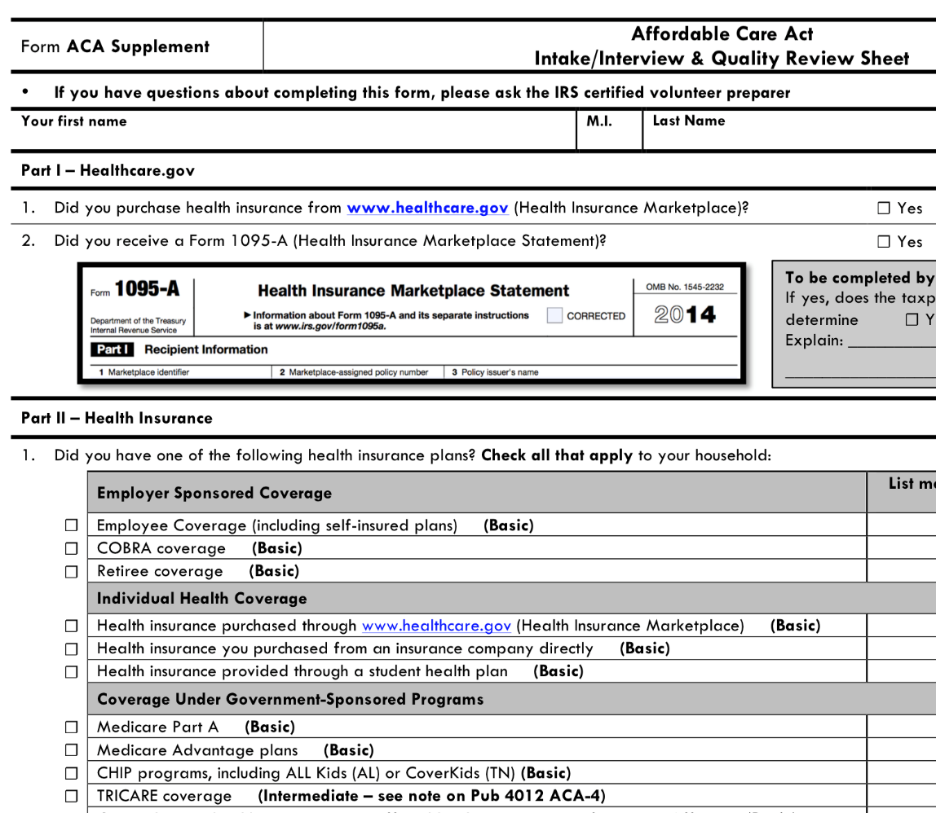
What Qualifies as Minimum Essential Coverage?
There will be a checklist listing different qualifying health plans taxpayers will complete indicating if they have minimum essential coverage—if they do not check one of these plans, a more advanced volunteer will have to complete the next steps
Each taxpayer must complete this checklist to file with the Intake/Interview Form
Notes:
At our tax sites this year, we will be providing taxpayers with a Affordable Care Act minimum essential coverage checklist, which they will complete indicating what type of health insurance plan they had (if they had one).
If they did not have one of the plans indicated on this checklist, or did not have coverage at all, a more advanced volunteer will have to complete the next steps.

Slide 265
Premium Tax Credit
Note that some taxpayers may be eligible for a refundable tax credit to help pay for health insurance premiums called the Premium Tax Credit
A more advanced volunteer must complete this part

Slide 266
TaxSlayer – Beth Branch
Login to TaxSlayer
Vita.taxslayerpro.com/IRSTRAINING
  Password: TRAINPROWEB
  Username: NELSONSTRAIN (last name, first initial)
  Password: SAVEFIRST
Complete the Health Insurance Section

Slide 267
Alabama Return

Slide 268
Alabama Return Objectives
After completing this section, the volunteer will be able to:
  Determine if a taxpayer is eligible to claim a personal exemption on the Alabama tax return
  Assess whether a person qualifies as a dependent on the Alabama tax return

Slide 269
Alabama Return Objectives
After completing this section, the volunteer will be able to:
  Choose the most advantageous (and allowable) filing status for a taxpayer on the Alabama tax return
  Differentiate and explain key differences between the taxability of various income types on the federal tax return and Alabama tax return

Slide 270
Who Must File
FULL/PART YEAR RESIDENTS | Single | Married Filing Separately | Head of Family | Married Filing Jointly
Gross Income (while an AL resident) | $4,000 | $5,250 | $7,700 | $10,500

Slide 271
Personal Exemptions
Amount based on filing status
  Single & Married Filing Separately: $1,500
  Head of Family & Married Filing Jointly: $3,000
Dependents:
  Taxpayer receive a personal exemption in Alabama even if they CAN be claimed as a dependent by someone else

Slide 272
Dependency Exemption
Alabama law defines a dependent as:
  an individual other than the taxpayer and his/her spouse WHO
  received over 50% of his/her support from the taxpayer during the year AND
  is related to the taxpayer in a certain way

Slide 273
Dependency Exemption:
The Relationship Test, Pt. 1
Step 1 | Was the person your son, daughter, legally adopted child, stepson, stepdaughter, or grandchild?* OR Was the person your brother, sister, stepbrother, or stepsister? OR Was the person your mother, father, grandmother, grandfather, stepmother, or stepfather? OR Was the person your mother-in-law, father-in-law, brother-in-law, sister-in-law, son-in-law, or daughter-in-law? | If YES: go to Step 4 If NO: go to Step 2

Slide 274
Dependency Exemption:
The Relationship Test, Pt. 2
Step 2 | Was the person your uncle, aunt, nephew, or niece? | If YES: go to Step 3 If NO: not a dependent

Slide 275
Dependency Exemption:
The Relationship Test, Pt. 3
Step 3 | Was the person in Step 2 related to you by blood? | If YES: go to Step 4 If NO: not a dependent

Slide 276
Dependency Exemption:
The Support Test
Step 4 | Did you provide more than 50% of the person’s total support for the year? | If YES: You can claim this person as your dependent If NO: not a dependent

Slide 277
Dependency Exemption: Notes
Most federal dependents also qualify as Alabama dependents
The following DO NOT qualify as Alabama dependents:
  Foster children
  Friends
  Cousins

Slide 278
Filing Status
Single
Married Filing Jointly
Married Filing Separately
Head of Family

Slide 279
Filing Status: Differences from Federal Tax Return
Single, Married Filing Separately, and Married Filing Jointly all correspond with their counterparts on the federal tax return
Qualifying Widow(er) with Dependent Child does not exist on the Alabama tax return
  Taxpayers will instead be classified as Head of Family
Head of Family is similar to Head of Household, but with a couple of key differences

Slide 280
Filing Status: Head of Family
To qualify for Head of Family, ALL of the following must apply:
  Taxpayer is unmarried or legally separated as of December 31st of the tax year
  Taxpayer paid more than ½ the costs of keeping up the home for the year
  A “qualifying person*” lived with the taxpayer in his/her home for more than ½ the year

Slide 281
Filing Status: Head of Family Qualifying Person
Similar to Head of Household qualifying persons
  Qualifying dependent who is taxpayer’s Mother / Father
    A qualifying person whether or not they live in the taxpayer’s home
    A qualifying person whether or not the taxpayer claims them as dependents

Slide 282
Filing Status: Head of Family Qualifying Person
Similar to Head of Household qualifying persons
  Qualifying dependent who is taxpayer’s child / grandchild / great-grandchild / adopted child / stepchild
    A qualifying person whether or not the taxpayer claims them as dependents (single)
    A qualifying person if a taxpayer claims them as a dependent (married)

Slide 283
Filing Status: Head of Family Qualifying Person
Similar to Head of Household qualifying persons
  Other qualifying dependent (brother / sister / aunt / niece / etc.)
    A qualifying person whether or not the taxpayer claims them as dependents

Slide 284
Taxable Income
All income is subject to Alabama income tax unless specifically exempted by state law

Slide 285
Nontaxable Income
Specific types of income that are nontaxable in Alabama include:
  Unemployment Compensation
  Social Security Benefits

Slide 286
Standard Deduction
Filing Status | Deduction Range
Single | $2000-$2500
Head of Family | $2000-$4700
Married Filing Jointly | $4000-$7500
Married Filing Separately | $2000-$3750

Slide 287
Itemized Deductions
The standard deduction is much lower on the Alabama tax return than on the federal tax return
As a result, many taxpayers will itemize deductions on their Alabama tax returns even though they won’t have enough to itemize on their federal tax returns
  Remember, itemizing is out of scope for Basic Volunteers

Slide 288
Finishing the Alabama Return
You will need to answer the following three questions to finish the Alabama return:
  Did the taxpayer file an Alabama return during the previous tax year?
  Who is the taxpayer’s current employer?
  Does the taxpayer have any income on their federal return that is not on their state return?

Slide 289
Finishing the Alabama Return
Did the taxpayer file an Alabama return for the previous tax year?
  Answer YES or NO
If NO, provide an explanation:
  Taxable income too low
  Lived in a different state
  Neglected to file

Slide 290
Finishing the Alabama Return
Who is the taxpayer’s current employer?
  The Alabama return will ask for the employer’s information to be listed on the return
  If multiple, select the W-2 with the higher amount of wages

Slide 291
Finishing the Alabama Return
Does the taxpayer have any income on their federal return that is not on their state return?
  Unemployment Compensation
  Social Security Benefits
  Defined Benefits (advanced volunteers only)
  Railroad Retirement (advanced volunteers only)

Slide 292
Paying a Balance/Receiving a Refund
Much like the federal return, taxpayers can have their refunds directly deposited or they can receive a check
Taxpayers can also have their liabilities directly debited or they can send a check

Slide 293
TaxSlayer – Beth Branch
Login to TaxSlayer (via Google Chrome)
  Vita.taxslayerpro.com/IRSTRAINING
  Password: TRAINPROWEB
  Username: NELSONSTRAIN (last name, first initial,TRAIN)
  Password: SAVEFIRST
Complete Alabama Return

Slide 294
Tax Preparation Process

Slide 295
Tax Preparation Process
Part 1: Preliminary Interview
Part 2: Preparing the Return in TaxSlayer
Part 3: Quality Review
Part 4: Finishing the Return
Part 5: Filing the Return

Slide 296
Part 2: Preparing the Return in TaxSlayer
Complete the Filing Status, Personal Information, and Dependents.
Click “Enter Myself” on the Income page

Slide 297
Part 2: Preparing the Return in TaxSlayer
Complete the income section, deductions section, the health insurance section, the State section.
Complete the forms: Gen Use, Gen Disclosure and Prep Use
Review the entire return and take care of any diagnostic errors

Slide 298
Part 2: Preparing the Return in TaxSlayer – Taxpayer and Spouse PIN
In the PIN section, have each taxpayer enter a 5-number pin.
This authorizes us to e-file for the taxpayer!

Slide 299
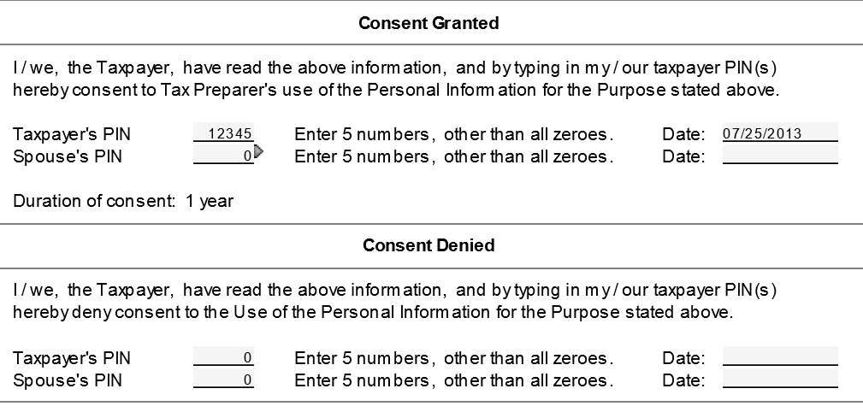
Part 2: Preparing the Return in TaxSlayer – General Use Form

Slide 300
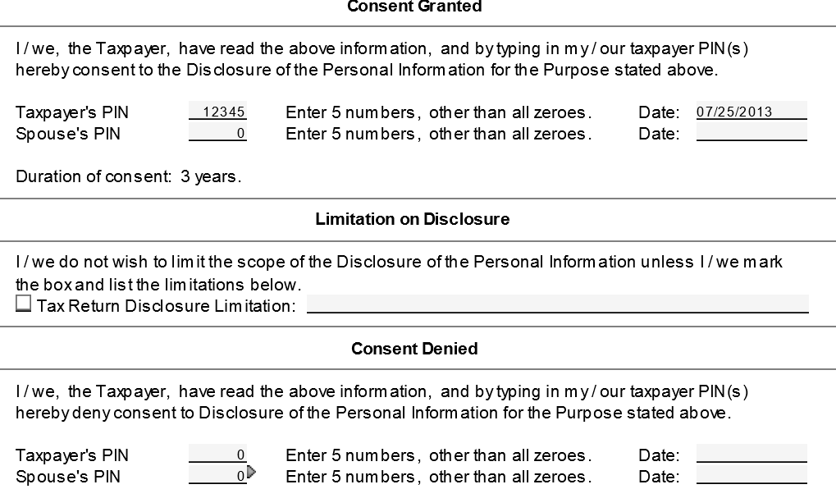
Part 2: Preparing the Return in TaxSlayer – General Disclosure Form

Slide 301
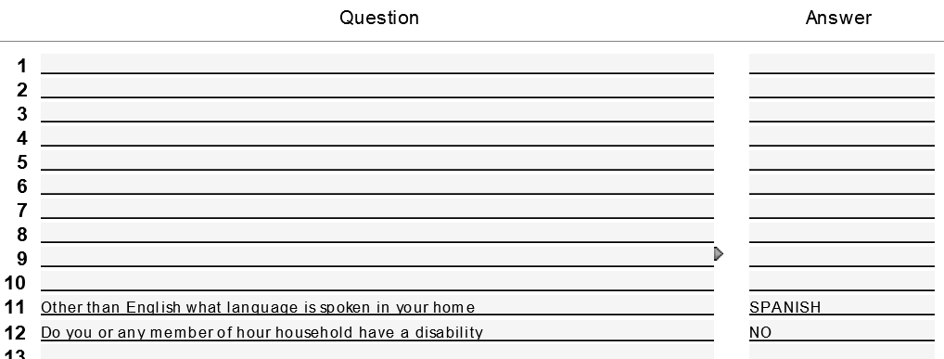
Part 2: Preparing the Return in TaxSlayer – Prep Use Form

Slide 302
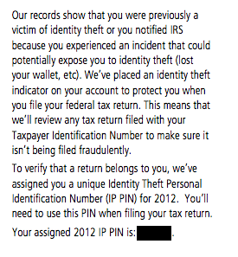
Part 2: Preparing the Return in TaxSlayer – Identity Protection Pin
You’ll enter this on the taxpayer’s return by going to the Federal Section→ Miscellaneous Forms→
Identity Protection Pin
Notes:
If a taxpayer is a victim of identity theft, they can receive an identity protection pin.
This pin number given by the IRS will protect the return from being duplicated.
You will enter this protection pin on the bottom of the main information sheet on the taxpayer’s return.

Slide 303
Tax Preparation Process
Part 1: Preliminary Interview
Part 2: Preparing the Return in TaxSlayer
Part 3: Quality Review
Part 4: Finishing the Return
Part 5: Filing the Return

Slide 304
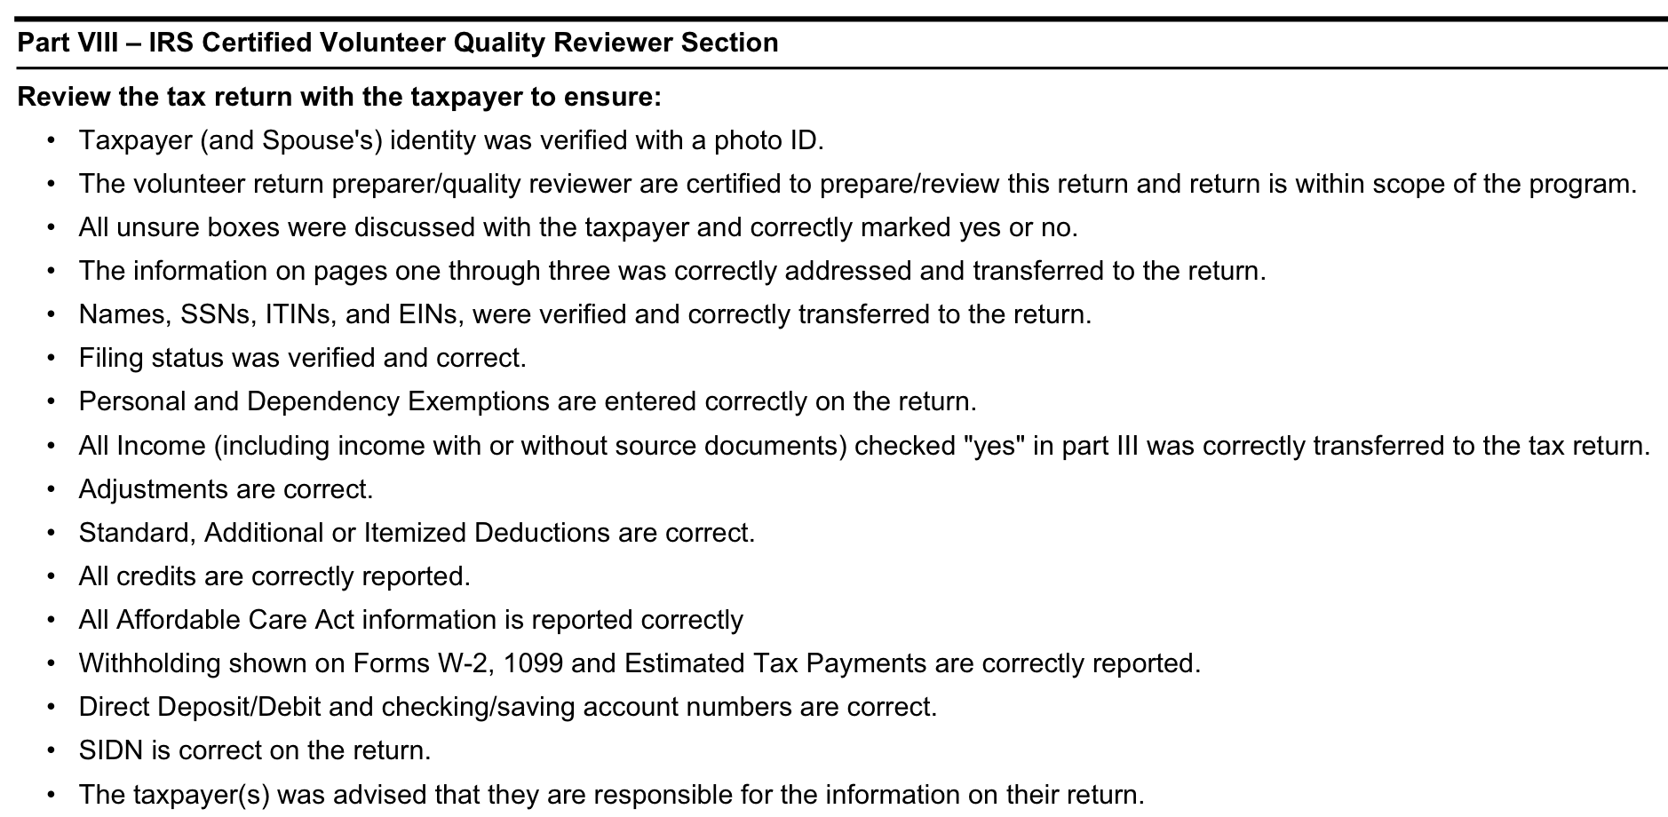
Part 3: Quality Review
Notes:
304
The third part of the tax preparation process is a quality review
Each return will need to be reviewed by a supervisor before it is printed and given to the taxpayer to sign

Slide 305
Tax Preparation Process
Part 1: Preliminary Interview
Part 2: Preparing the Return in TaxSlayer
Part 3: Quality Review
Part 4: Finishing the Return
Part 5: Filing the Return

Slide 306
Part 4: Finishing the Return
Write your name on the Intake/Interview Form
Assist quality reviewer with printing and taxpayer signatures
  Taxpayer and spouse must sign and date federal and state returns and keep for their records
File Intake/Interview Form in filing box
  Do NOT keep any personal documents!

Slide 307
Tax Preparation Process
Part 1: Preliminary Interview
Part 2: Preparing the Return in TaxSlayer
Part 3: Quality Review
Part 4: Finishing the Return
Part 5: Filing the Return

Slide 308
Out of Scope Topics

Slide 309
Additional Topics – Out of Scope at Tax Site
IRS changed VITA certification levels
There are more advanced topics on your 2016 IRS Basic Certification test, but you will not prepare these at the tax sites
We will briefly review now…
Notes:
The IRS has changed the certification levels for the coming tax season and has included new topics on the basic certification exam. We will briefly discuss those topics now. However, these topics will remain out of scope for SaveFirst basic volunteers. Given our time limits with just these two short training sessions, we do not have enough time to thoroughly cover these topics to prepare you to handle them at the tax sites. These topics are not particularly common and will not apply to most taxpayers you serve at the site.
We absolutely welcome you to return as a volunteer next year and certify at a higher level if you are interested in attending additional training to prepare these topics for taxpayers at the sites.

Slide 310
Additional Topics for 2016 VITA Basic Exam –
Out of Scope at Tax Site
1) Additional Affordable Care Act Tax Provisions
2) Retirement Income: IRAs and Pensions
3) Itemized Deductions
4) Education Credits & Student Loan Interest
  Use Handout: “Helpful Tips for Out of Scope Topics
  on 2016 IRS Basic Certification Exam”
  *********
Notes:
These out of scope topics include:
IRAs/Pensions
Higher Education Expenses
Itemized Deductions

Slide 311
Additional Topics – Out of Scope at Tax Site
Additional ACA Tax Provisions
Health Coverage Exemptions
  A reason for not having health insurance that avoids the individual responsibility payment (tax penalty)
  Short Coverage Gap (less than three months)
    Any person that did not have coverage for 2 months or less can claim a short-term coverage gap health exemption on Form 8965

Slide 312
Additional Topics – Out of Scope at Tax Site
Additional ACA Tax Provisions
Health Coverage Exemptions
  Certain noncitizens and U.S. citizens living abroad
    Individuals who are not lawfully present in the United States can claim a health coverage exemption on Form 8965

Slide 313
Additional Topics – Out of Scope at Tax Site
Additional ACA Tax Provisions
Shared Responsibility Payment
  A SRP must be made for ANY month for ANY person listed on the return for which a person does not have:
    minimum essential coverage, OR
    a health coverage exemption
  Note that if a taxpayer has minimum essential coverage for one day of the month, they are considered to have had it the entire month

Slide 314
Additional Topics – Out of Scope at Tax Site
Additional ACA Tax Provisions
Practice Exercise #1: Peter & Nance Armison
Review practice exercise #1 in the Helpful Tips… handout and answer the following question
Peter & Nance qualify for a health coverage exemption
  True
  False

Slide 315
Additional Topics – Out of Scope at Tax Site
Additional ACA Tax Provisions
Practice Exercise #2: Francis & Claire Underwood
Review practice exercise #2 in the Helpful Tips…
Enter filing status, personal information, and dependents, and the W-2
Click Health Insurance Section
  Follow along with trainer in TaxSlayer
Answer questions on following slide
Notes:
IRAs/Pensions
Retirement income from an Individual Retirement Account (IRA) or Pension reported on 1099-R
From Form 1040, link from Line 16 Pension to a Form 1099-R
Gross Distribution
Taxable Amount
Boxes in line 2b
Taxable Amount Not Determined
Total Distribution
Federal Income Tax Withheld
Distribution Code(s)
Total Employee Contributions

Slide 316
Additional Topics – Out of Scope at Tax Site
Additional ACA Tax Provisions
Practice Exercise #2: Francis & Claire Underwood
The Underwoods are not required to make a shared responsibility payment on Form 1040, page 2.
  True
  False

Slide 317
Additional Topics – Out of Scope at Tax Site
Additional ACA Tax Provisions
Practice Exercise #2: Francis & Claire Underwood
Francis did not have Minimum Essential Coverage (MEC) for two months of the tax year. How does this affect their return?
  He must make an Individual Responsibility Payment for himself
  He must complete the Form 8965 to claim the short coverage gap
  It does not affect his return
  None of the above

Slide 318
Additional Topics for 2016 VITA Basic Exam –
Out of Scope at Tax Site
1) Additional Affordable Care Act Tax Provisions
2) Retirement Income: IRAs and Pensions
3) Itemized Deductions
4) Education Credits & Student Loan Interest
  Use Handout: “Helpful Tips for Out of Scope Topics
  on 2016 IRS Basic Certification Exam”
  *********

Slide 319
Additional Topics – Out of Scope at Tax Site
Retirement Income: IRAs and PENSIONS
Taxpayers who received income during the tax year from a retirement account (IRA, pension, etc.) will receive a Form 1099-R to report on their tax return
Most taxpayers receive this after they retire, but some taxpayers may have made an early withdrawal from a retirement account
Notes:
IRAs/Pensions
Retirement income from an Individual Retirement Account (IRA) or Pension reported on 1099-R
From Form 1040, link from Line 16 Pension to a Form 1099-R
Gross Distribution
Taxable Amount
Boxes in line 2b
Taxable Amount Not Determined
Total Distribution
Federal Income Tax Withheld
Distribution Code(s)
Total Employee Contributions

Slide 320
Additional Topics – Out of Scope at Tax Site
Retirement Income: IRAs and PENSIONS
Enter on Form 1099-R in TaxSlayer
  Gross Distribution
  Taxable Amount
  Boxes in line 2b
    Taxable Amount Not Determined
    Total Distribution
  Federal Income Tax Withheld
  Distribution Code(s)
  Total Employee Contributions
Notes:
IRAs/Pensions
Retirement income from an Individual Retirement Account (IRA) or Pension reported on 1099-R
From Form 1040, link from Line 16 Pension to a Form 1099-R
Gross Distribution
Taxable Amount
Boxes in line 2b
Taxable Amount Not Determined
Total Distribution
Federal Income Tax Withheld
Distribution Code(s)
Total Employee Contributions

Slide 321
Additional Topics – Out of Scope at Tax Site
Retirement Income: IRAs and PENSIONS
Check Line 16 on 1040 Page 1 to verify amount pulls through
Find Additional Tax on IRAs, Other Qualified Retirement Plans, etc.
  Form 1040 Pg 2 → Other Taxes section → Line 59
Form W4-P: Withholding Certificate for Pension or Annuity Payments
Notes:
Instruct volunteers to create a new return in TaxSlayer. They do not need to complete the interview section of the return. They should just go directly to the tax forms. This exercise is merely to practice entering the 1099-R retirement income form.
On your screen, enter the 1099-R for Sarah Brown from the “Helpful Tips…” document. Have volunteers look at the 1099-R and enter the information in their own return as you go.
Show your volunteers where the retirement income you just entered pulls through on Line 15/16 on the 1040 page 1.
Show your volunteers where the additional tax on IRAs, Other Qualified Retirement Plans, etc. on the 1040 page 2 Other Taxes section on line 58.
If a taxpayer asks about having more taxes withheld from their retirement payments each month, they can file a Form W4-P on their own to adjust their withholding.

Slide 322
Additional Topics – Out of Scope at Tax Site
Retirement Income: IRAs and PENSIONS
Practice Exercise #3: Sarah Brown
Review practice exercise #3 in the Helpful Tips… handout and answer the following question
Enter basic information and create Form 1099-R in TaxSlayer
  Follow along with trainer
Answer questions on following slides
Notes:
IRAs/Pensions
Retirement income from an Individual Retirement Account (IRA) or Pension reported on 1099-R
From Form 1040, link from Line 16 Pension to a Form 1099-R
Gross Distribution
Taxable Amount
Boxes in line 2b
Taxable Amount Not Determined
Total Distribution
Federal Income Tax Withheld
Distribution Code(s)
Total Employee Contributions

Slide 323
Additional Topics – Out of Scope at Tax Site
Retirement Income: IRAs and PENSIONS
Practice Exercise #3: Sarah Brown
What is the amount that appears on Form 1040, line 16b, Taxable Amount ? _____________
$1,500
What is the amount of Total Earned Income on Form 1040, page 1? _____________
$0
What is the amount of Total Income on Form 1040, line 22? _____________
$1,500
Notes:
IRAs/Pensions
Retirement income from an Individual Retirement Account (IRA) or Pension reported on 1099-R
From Form 1040, link from Line 16 Pension to a Form 1099-R
Gross Distribution
Taxable Amount
Boxes in line 2b
Taxable Amount Not Determined
Total Distribution
Federal Income Tax Withheld
Distribution Code(s)
Total Employee Contributions

Slide 324
Additional Topics – Out of Scope at Tax Site
Retirement Income: IRAs and PENSIONS
Practice Exercise #3: Sarah Brown
What is the amount of additional tax on IRAS, other qualified retirement plans, etc. on Form 1040, line 59? ___________
$150
What is the amount of Federal income tax withheld on Form 1040, line 64? _____________
$300
Sarah must pay a 10% additional tax on the distribution from her 401(k) because she is under 59 ½ years old and does not qualify for an exception: True or False
Notes:
IRAs/Pensions
Retirement income from an Individual Retirement Account (IRA) or Pension reported on 1099-R
From Form 1040, link from Line 16 Pension to a Form 1099-R
Gross Distribution
Taxable Amount
Boxes in line 2b
Taxable Amount Not Determined
Total Distribution
Federal Income Tax Withheld
Distribution Code(s)
Total Employee Contributions

Slide 325
Additional Topics – Out of Scope at Tax Site
Retirement Income: IRAs and PENSIONS
Additional Practice for Form 1099-R Review
Sarah’s sister, Kerry, receives an annual distribution from her retirement account but does not have any tax withheld so she always has a balance due every year. Kerry can submit a Form W4-P to have tax withheld on her pension: True or False
Notes:
IRAs/Pensions
Retirement income from an Individual Retirement Account (IRA) or Pension reported on 1099-R
From Form 1040, link from Line 16 Pension to a Form 1099-R
Gross Distribution
Taxable Amount
Boxes in line 2b
Taxable Amount Not Determined
Total Distribution
Federal Income Tax Withheld
Distribution Code(s)
Total Employee Contributions

Slide 326
Additional Topics for 2016 VITA Basic Exam –
Out of Scope at Tax Site
1) Additional Affordable Care Act Tax Provisions
2) Retirement Income: IRAs and Pensions
3) Itemized Deductions
4) Education Credits & Student Loan Interest
  Use Handout: “Helpful Tips for Out of Scope Topics
  on 2016 IRS Basic Certification Exam”
  *********
Notes:
These out of scope topics include:
IRAs/Pensions
Higher Education Expenses
Itemized Deductions

Slide 327
Additional Topics – Out of Scope at Tax Site
Itemized Deductions
The following items ARE ELIGIBLE to be included as an itemized deduction
  Unreimbursed doctor bills for taxpayer, spouse, and dependents
  Unreimbursed prescription drugs for taxpayer, spouse, and dependents
  Donations to church

Slide 328
Additional Topics – Out of Scope at Tax Site
Itemized Deductions
The following items ARE ELIGIBLE to be included as an itemized deduction
  The fair market value (FMV) of non-cash goods donated to charity
  Home mortgage interest from Form 1098, line 1
  Real estate taxes from Form 1098, line 4

Slide 329
Additional Topics – Out of Scope at Tax Site
Itemized Deductions
The following items ARE NOT ELIGIBLE to be included as an itemized deduction
  Nonprescription drugs (including vitamins)
  Donations (for personal, medical, or any other type of expense) given to an individual
  Homeowner’s insurance

Slide 330
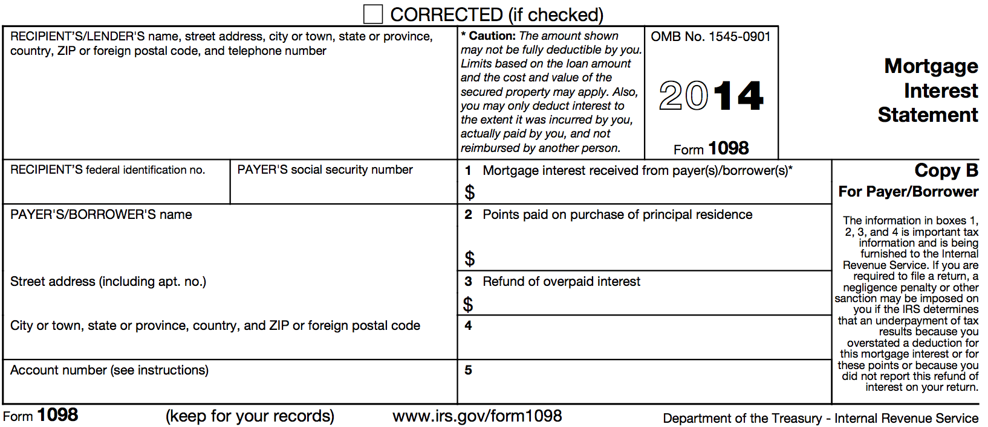


Additional Topics – Out of Scope at Tax Site
Itemized Deductions
Form 1098: Mortgage Interest Statement

Slide 331
Additional Topics for 2016 VITA Basic Exam –
Out of Scope at Tax Site
1) Additional Affordable Care Act Tax Provisions
2) Retirement Income: IRAs and Pensions
3) Itemized Deductions
4) Education Credits & Student Loan Interest
  Use Handout: “Helpful Tips for Out of Scope Topics
  on 2016 IRS Basic Certification Exam”
  *********
Notes:
These out of scope topics include:
IRAs/Pensions
Higher Education Expenses
Itemized Deductions

Slide 332
Additional Topics – Out of Scope at Tax Site
Education Credits & Student Loan Interest
American Opportunity Credit | Lifetime Learning Credit
Up to $2,500 per eligible student ($1,000 is refundable) | Up to $2,000 credit per return
Available for the 1st 4 years of college | Available for all years
Student must be pursuing a degree or recognized education credential | Student does not need to be pursuing a degree or credential
Student must be enrolled at least half time | Available for one or more courses
No felony drug conviction on student’s record | Felony drug conviction does not apply
Expenses include tuition, fees, and course materials | Expenses include only tuition and fees
Cannot claim if MFS
Notes:
You will use this chart, which appears in your “Helpful Tips” packet on page 4.
Quickly review the information in the Tuition and Fees Deduction column, the American Opportunity Credit column, and the Lifetime Learning Credit column

Slide 333
Additional Topics – Out of Scope at Tax Site
Education Credits & Student Loan Interest
Only out-of-pocket tuition expenses can be claimed as eligible expenses
  Amounts paid with scholarships and grants are NOT eligible
For Lifetime Learning Credit, books cannot be included unless purchasing it was a condition of enrollment
If not required for course enrollment, a parking permit is NOT an eligible expense for either credit
Room and board is also NEVER an eligible expense for either credit

Slide 334
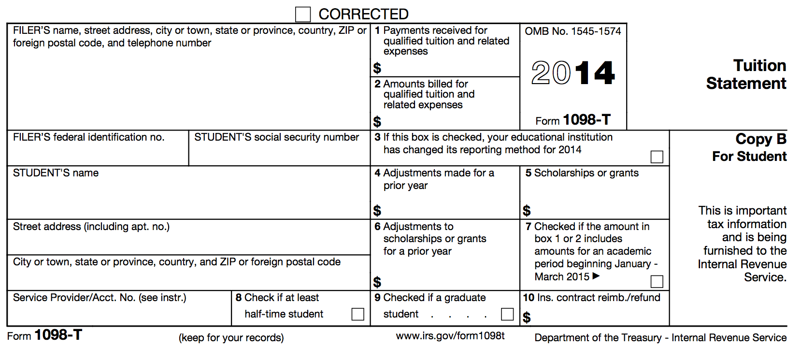


Additional Topics – Out of Scope at Tax Site
Education Credits & Student Loan Interest Form 1098-T: Tuition Statement
Notes:
Often, a taxpayer will have tuition amounts reported on a Form 1098-T.
You may see amounts in box 1, 2, or 5, and box 7 or 8 may be checked

Slide 335
Additional Topics – Out of Scope at Tax Site
Education Credits & Student Loan Interest
Taxpayers can deduct up to $2,500 of student loan interest paid during the year on a loan for qualified higher education expenses at an eligible institution – reported in box 1 of Form 1098-E

Slide 336
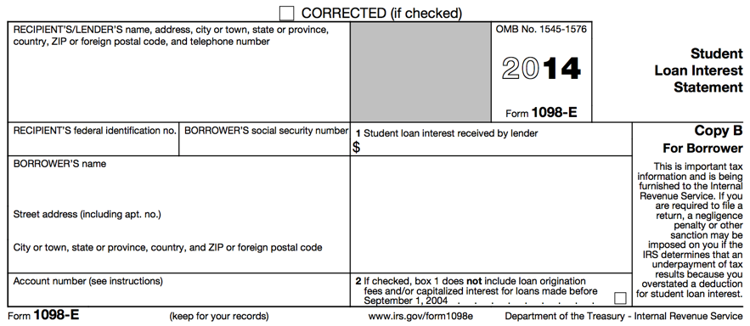

Additional Topics – Out of Scope at Tax Site
Education Credits & Student Loan Interest Form 1098-E: Student Loan Interest Statement

Slide 337
Additional Topics – Out of Scope at Tax Site
Education Credits & Student Loan Interest
Practice Exercise #4: Leslie Knope
Review practice exercise #4 in the Helpful Tips… handout and answer the following questions
Which education credit is Leslie eligible to take?
  American opportunity credit
  Lifetime learning credit
  Both American opportunity and lifetime learning credit
  She does not qualify for any education credit
Notes:
IRAs/Pensions
Retirement income from an Individual Retirement Account (IRA) or Pension reported on 1099-R
From Form 1040, link from Line 16 Pension to a Form 1099-R
Gross Distribution
Taxable Amount
Boxes in line 2b
Taxable Amount Not Determined
Total Distribution
Federal Income Tax Withheld
Distribution Code(s)
Total Employee Contributions

Slide 338
Additional Topics – Out of Scope at Tax Site
Education Credits & Student Loan Interest
Practice Exercise #4: Leslie Knope
Is Leslie’s course book a qualified education expense for the lifetime learning credit
  None, because the book costs too much
  No, because it is not required as a condition of enrollment and paid to the institution
  Yes, because it will improve her job skills
  Yes, because qualified education expenses are the same for all eduation credits
Notes:
IRAs/Pensions
Retirement income from an Individual Retirement Account (IRA) or Pension reported on 1099-R
From Form 1040, link from Line 16 Pension to a Form 1099-R
Gross Distribution
Taxable Amount
Boxes in line 2b
Taxable Amount Not Determined
Total Distribution
Federal Income Tax Withheld
Distribution Code(s)
Total Employee Contributions

Slide 339
Additional Topics – Out of Scope at Tax Site
Itemized Deductions, Education Credits & Student Loan Interest
Practice Exercise #5: Ewan McGregor
Review practice exercise #5 in the Helpful Tips… handout
On your own, in TaxSlayer:
  Enter the filing status, personal information, and dependents.
  Enter the W-2
  Fill out Form 8880 (for Retirement Savings Contribution Credit)

Slide 340
Additional Topics – Out of Scope at Tax Site
Itemized Deductions, Education Credits & Student Loan Interest
Practice Exercise #5: Ewan McGregor
Carl’s higher education expenses:
  Carl is Ewan’s qualifying child
  Can Ewan claim Carl’s education expenses at Brown College?
YES

Slide 341
Additional Topics – Out of Scope at Tax Site
Itemized Deductions, Education Credits & Student Loan Interest
Practice Exercise #5: Ewan McGregor
What credit does Carl qualify for?
  Attended an eligible institution
  Enrolled at least half-time
  Attending 1st year of college
  Pursuing a degree
  Does not have a felony drug conviction
American Opportunity Credit

Slide 342
Additional Topics – Out of Scope at Tax Site
Itemized Deductions, Education Credits & Student Loan Interest
Practice Exercise #5: Ewan McGregor
Qualifying Expenses for American Opportunity Credit
  Course-related books: $1,500
  Room and board: $9,000
  Tuition and fees from Form 1098-T: $6,000
    Remember, only out-of-pocket expenses count
    $6,000 (payments received) – $5,000 (scholarships) = $1,000
  Total qualified expenses:
$2,500

Slide 343
Additional Topics – Out of Scope at Tax Site
Itemized Deductions, Education Credits & Student Loan Interest
Practice Exercise #5: Ewan McGregor
Follow along with your trainer and enter the following into TaxSlayer:
  American Opportunity Credit (to Form 8863)
  Student Loan Interest
Note: the “Helpful Tips...” packet has step-by-step instructions and TaxSlayer screenshots for your reference

Slide 344
Additional Topics – Out of Scope at Tax Site
Itemized Deductions, Education Credits & Student Loan Interest
Practice Exercise #5: Ewan McGregor
Which of the following can Ewan itemize?
  Unreimbursed doctor bills for Ewan: $600
  Unreimbursed prescription drugs: $1,100
  Over the counter vitamins: $200
  Church contributions: $1,450

Slide 345
Additional Topics – Out of Scope at Tax Site
Itemized Deductions, Education Credits & Student Loan Interest
Practice Exercise #5: Ewan McGregor
Which of the following can Ewan itemize?
  FMV of furniture donated to Goodwill: $270
  Medical bills for friend’s daughter: $150
  Homeowner’s insurance: $1,400
  Mortgage interest from Form 1098: $6,552
  Real estate taxes from Form 1098: $1,954

Slide 346
Additional Topics – Out of Scope at Tax Site
Itemized Deductions, Education Credits & Student Loan Interest
Practice Exercise #5: Ewan McGregor
Follow along with your trainer and enter the following into TaxSlayer:
  Itemized Deductions (to Sch A and A Detail)
Answer questions on the following slides once complete
Note: the “Helpful Tips...” packet has step-by-step instructions and TaxSlayer screenshots for your reference

Slide 347
Additional Topics – Out of Scope at Tax Site
Itemized Deductions, Education Credits & Student Loan Interest
Practice Exercise #5: Ewan McGregor
What is Ewan’s total itemized deduction on Schedule A, line 29? _____________
$11,826

Slide 348
Additional Topics – Out of Scope at Tax Site
Itemized Deductions, Education Credits & Student Loan Interest
Practice Exercise #5: Ewan McGregor
To compute the American opportunity credit, which of Carl’s following expenses qualify?
  Tuition and fees paid by the scholarship
  Room and board
  Course-related books
  All of the above

Slide 349
Additional Topics – Out of Scope at Tax Site
Itemized Deductions, Education Credits & Student Loan Interest
Practice Exercise #5: Ewan McGregor
What is the amount of Ewan’s student loan interest deduction from Form 1040, page 1? _____________
$800

Slide 350
Intake/Interview & Quality Review Process

Slide 351
Intake/Interview & Quality Review Sheet
Form 13614-C (October 2016)
All VITA programs are required to use this sheet for every tax return filed at the tax site.
Notes:
By now you’re familiar with this form from your practice exercise. However, we want to spend some time just going through this form and taking the time to really look more closely at every part of it.

Slide 352
Assuring a Quality Service and Accurate Return
Taxpayers using services offered through the Volunteer Tax Assistance (VITA) and Tax Counseling for the Elderly (TCE) Programs should be confident they receive quality service. This includes having an accurate tax return prepared.
A basic component of preparing an accurate return begins with listening to the taxpayer and asking the right questions.
Form 13614-C, Intake/Interview & Quality Review Sheet, is a tool designed to help the volunteer ask the right questions. When used properly, this form effectively contributes to accurate tax return preparation.
Notes:
Taxpayers using services offered through the Volunteer Tax Assistance (VITA) and Tax Counseling for the Elderly (TCE) Programs should be confident they receive quality service. This includes having an accurate tax return prepared.
A basic component of preparing an accurate return begins with listening to the taxpayer and asking the right questions.
Form 13614-C, Intake/Interview & Quality Review Sheet, is a tool designed to help the volunteer ask the right questions. When used properly, this form effectively contributes to accurate tax return preparation.

Slide 353
Using this Form Completely and Appropriately
The IRS conducts oversight to ensure that EVERY part of the form is being used appropriately and completely during the interview with the taxpayer and while preparing their return.
The IRS requires compliance with use of this form to ensure high quality tax returns for our VITA program.
Notes:
The IRS conducts oversight to ensure that EVERY part of the form is being used appropriately and completely during the interview with the taxpayer and while preparing their return.
The IRS requires compliance with use of this form to ensure high quality tax returns for our VITA program.

Slide 354
Required for Use by IRS VITA Sites
An important tool for accuracy and due diligence!
Must be completed by (or with) the taxpayer.
Will be used to conduct the Quality Review process.
Must be kept at tax site for site records (do not let the taxpayer take the form with them)
No records brought to the site should be kept on file
For privacy and identity protection purposes, SSNs should NOT be printed on the I/I form
Notes:
An important tool for accuracy and due diligence!
The form must be completed by (or with) the taxpayer.
The form will be used by your Site Coordinator or a more advanced trained volunteer to conduct the Quality Review process, which further ensures the accuracy of the returns filed for families at our sites.
Must be kept at tax site for site records. If the taxpayer has finished their return and the return is ready to be filed, do not let the taxpayer take the form with them. You will be instructed by your Site Coordinator where to file this form at the tax site.
Note that NO records that the taxpayer brings in to the site should be kept on file at the tax site.
For privacy and identity protection purposes SSNs should not be printed on the Intake/Interview form.

Slide 355
Intake/Interview Form is a Huge Asset to You
Provides an extra record for you to double-check information on the tax return in TaxSlayer and note things the taxpayer forgets to mention when speaking with you
Notes:
The form provides an extra record for you to double-check information on the tax return in TaxSlayer and note things the taxpayer forgets to mention when speaking with you. Since the taxpayer typically fills this out on their own, it’s like an extra set of ears listening to the taxpayer about information they may need to include on the return.

Slide 356
The Intake Process: Completing Form 13614-C
In most cases, the taxpayer completes pages 1, 2, and 3 of the Intake Interview Form (Form 13614-C) and the Affordable Care Act Supplement Form in the waiting room before sitting down with you, the tax preparer.
Provide assistance as needed (be sensitive and perceptive to the needs of the taxpayers)
Notes:
When the taxpayer arrives at the site, he or she will sign in and pick up a clipboard, pen, and Intake/Interview form to complete while they wait for their name to be called to be waited on.
Some taxpayers may need assistance with completing the form due to disability or blindness. It’s important to be sensitive and perceptive to the needs of the taxpayers at your tax site. It is also important to encourage your volunteers to be sensitive and perceptive to the taxpayers’ needs as well.
Always offer assistance to taxpayers completing their Intake/Interview Forms in the waiting room if you are not busy with another taxpayer.
If a taxpayer has not completed the Intake/Interview form before their name is called, they can go with you to the tax preparation station and finish completing the intake/interview form with you at the station.

Slide 357
Complete an Intake/Interview Form for EVERY Return
We MUST have an intake/interview form and Affordable Care Act Supplement Form on file for EVERY return filed at our tax sites.
Notes:
We MUST have an intake/interview form on file for EVERY return filed at our tax sites.

Slide 358
The Intake Process: Tax Return and Volunteer Certification Levels
It is a violation of our VITA Grant and IRS Compliance and your Volunteer Standards of Conduct Agreement to file a tax return that is out of scope of the VITA tax site
At SaveFirst sites, to ensure all returns are in-scope for VITA:
  Consult the SaveFirst Scope of Service Chart – at every tax station and in the Site Coordinator Handbook/Campus Fellow Handbook
  If a topic seems complicated or unfamiliar to you, double-check the SaveFirst Scope of Service Chart to be sure it is listed in scope
  Sometimes this determination may be unclear. If you are unsure, talk to your Site Coordinator
Notes:
It is a violation of our VITA Grant and IRS Compliance and your Volunteer Standards of Conduct Agreement to file a tax return that is out of scope of the VITA tax site.
At SaveFirst sites, to ensure all returns are in-scope for VITA:
Consult the Scope of Service Chart – at every tax station, in the Pub 4012 Volunteer Resource Guide, and in your Site Coordinator Handbook
If a topic seems complicated or unfamiliar to you, double-check the Scope of Service Chart to be sure it is listed in scope.
Sometimes this determination may be unclear. If you are unsure, talk to your Site Coordinator.

Slide 359
The Intake Process: Tax Return and Volunteer Certification Levels
SaveFirst Basic Volunteer Preparers
  Review the 2016 – 2017 SaveFirst Volunteer Scope of Service Chart for SaveFirst Basic Volunteers
Notes:
Instruct your volunteers to pull out their SaveFirst Volunteer Scope of Service Chart in their training materials. Remind them to consult this if they are ever unsure of which topics are in scope for them to prepare at the tax site, or to consult their Site Coordinator if they have questions.
If something is not listed on this chart, it is likely out of scope. Always talk to your Site Coordinator if you have questions!

Slide 360
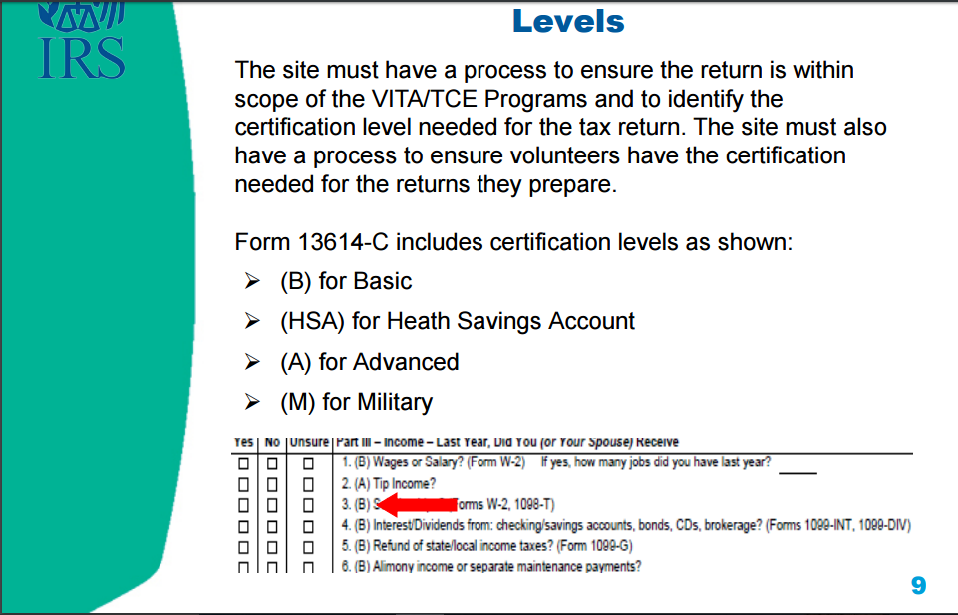

Slide 361
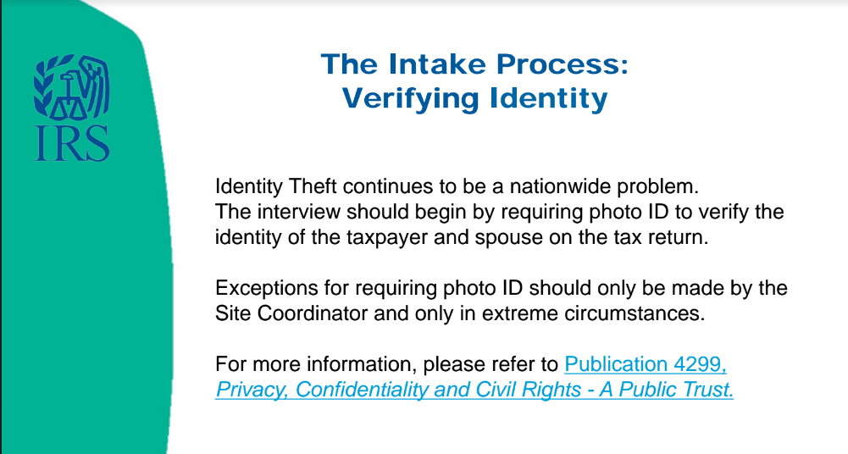

Slide 362
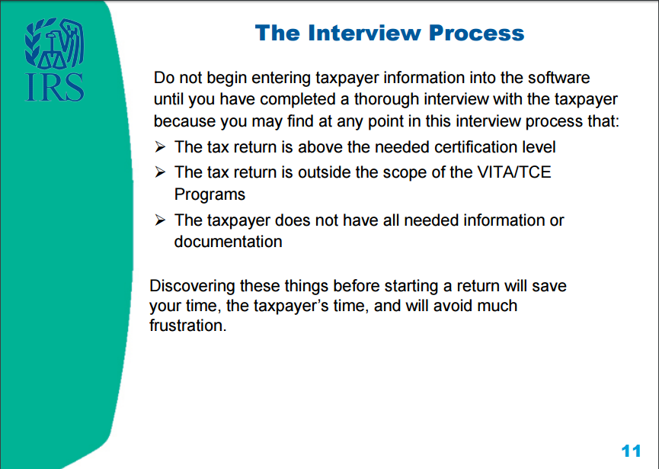

Slide 363
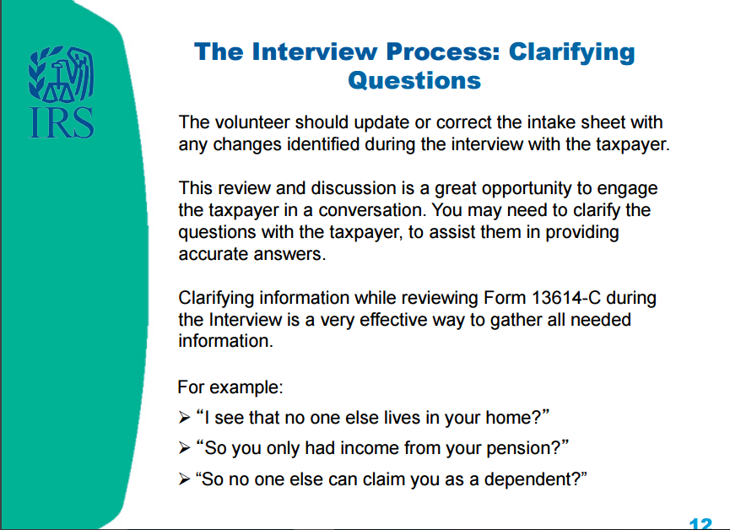

Slide 364
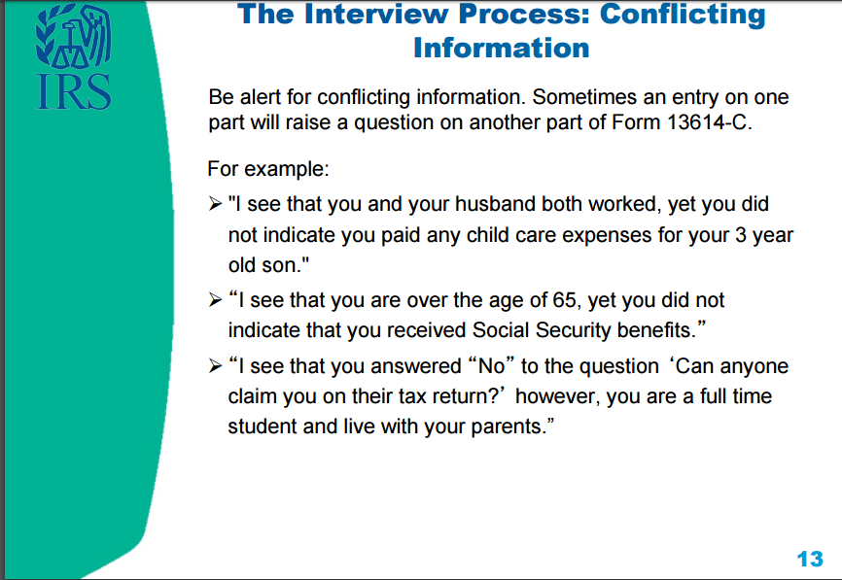

Slide 365
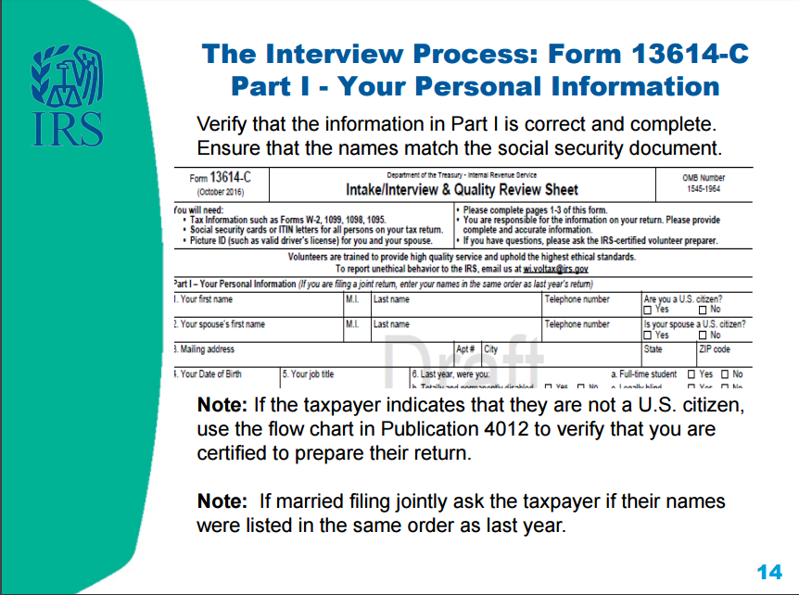

Slide 366
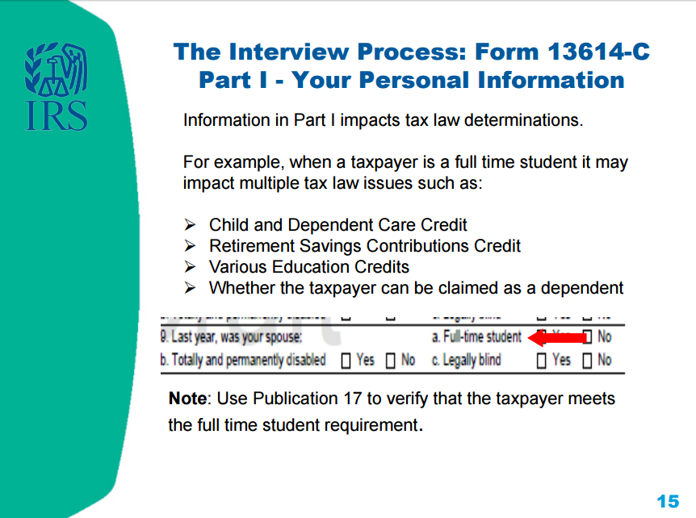

Slide 367
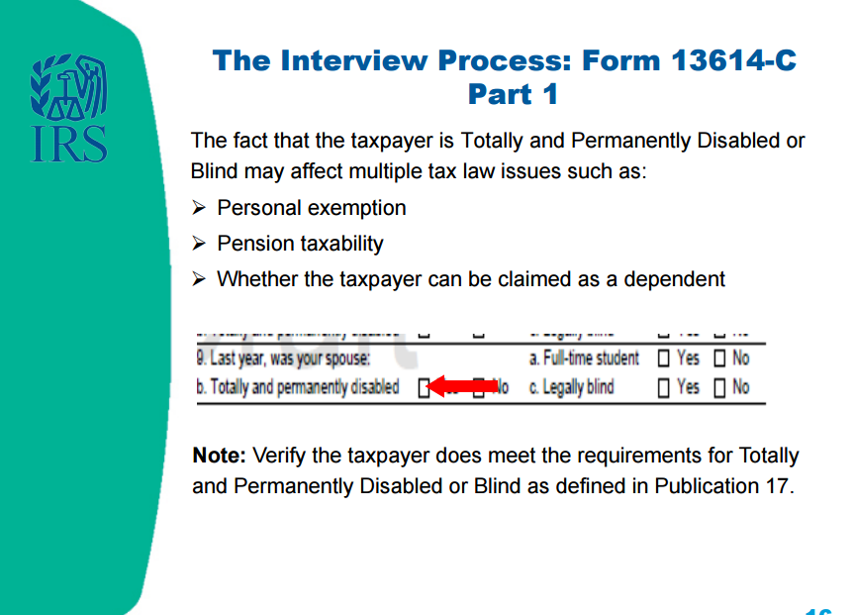

Slide 368
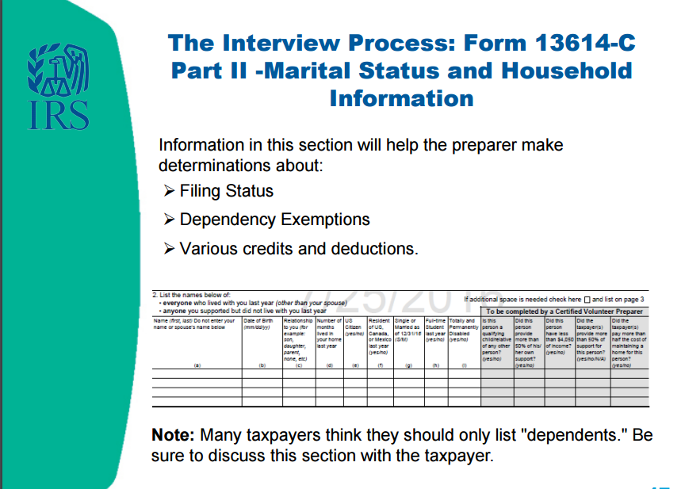

Slide 369
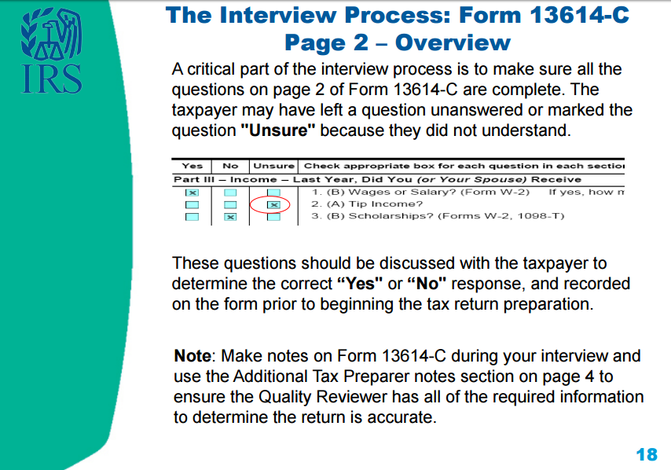

Slide 370
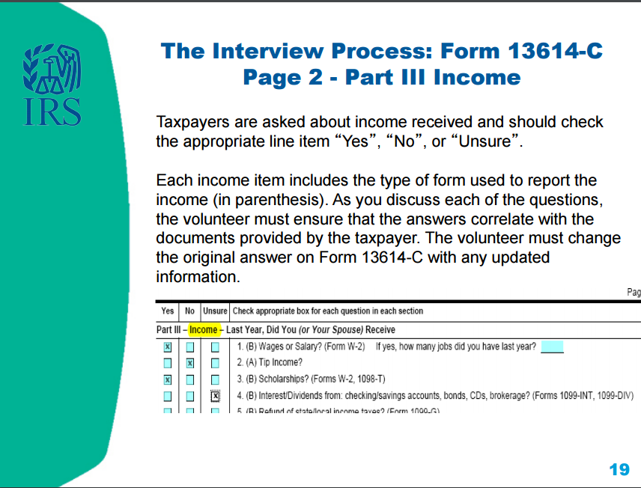

Slide 371
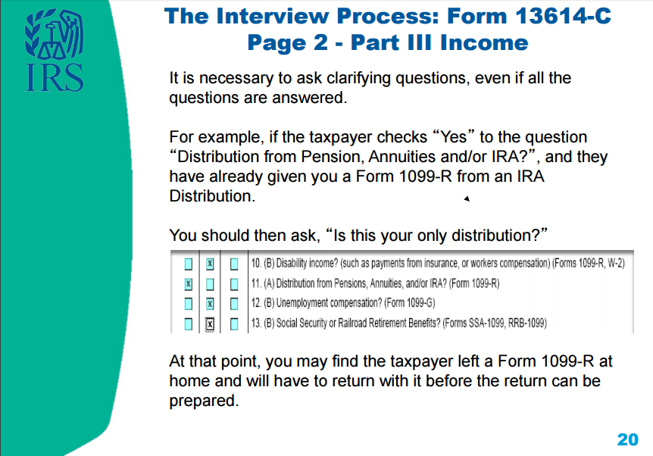

Slide 372
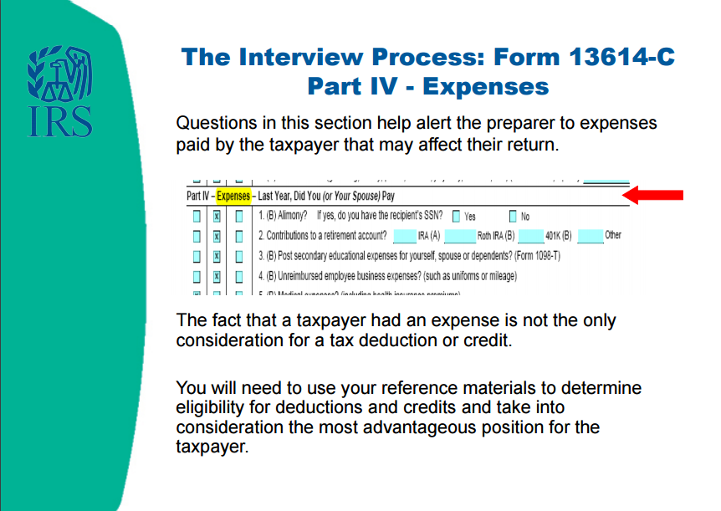

Slide 373
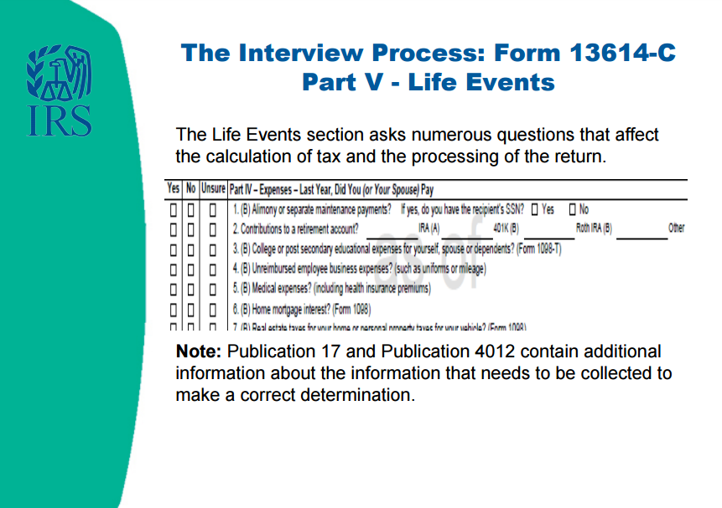

Slide 374
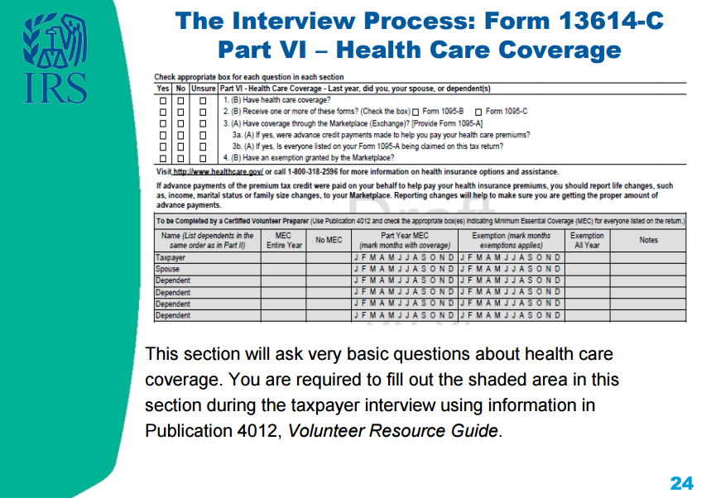

Slide 375
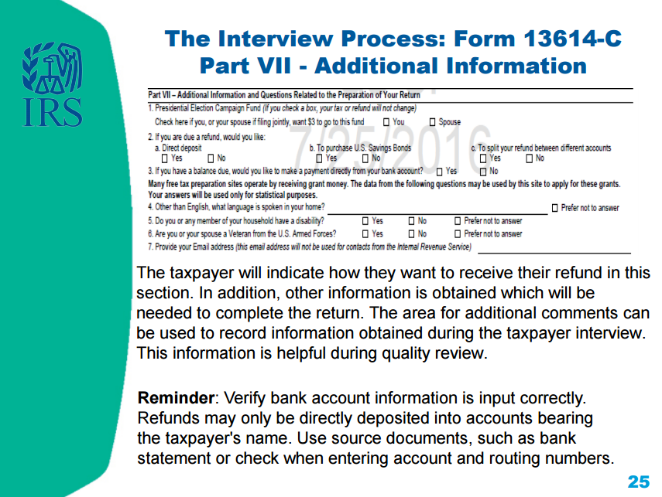

Slide 376
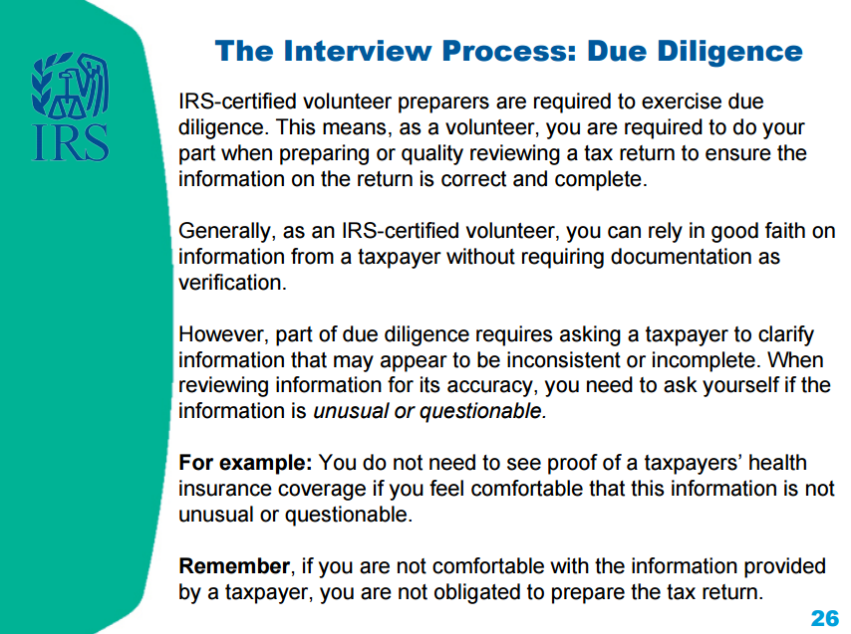

Slide 377
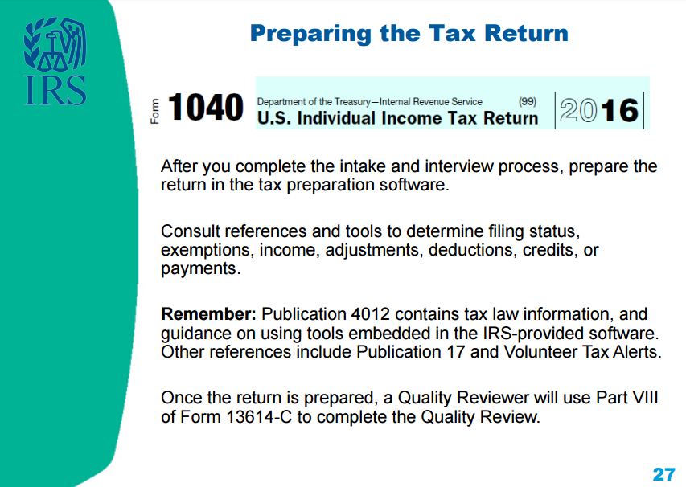

Slide 378

Notes:
The Quality Reviewer will be one of our most experienced SaveFirst volunteers. Most reviews will be conducted by Site Coordinators, and some will also be conducted by Campus Fellows, who are returning SaveFirst volunteers who have attended additional training and acquired a higher level of IRS certification.
Keep in mind that you could apply to be a returning volunteer Campus Fellow next year!

Slide 379


Slide 380
Concepts of the Quality Review
After the quality review is completed, the taxpayer will be advised by the quality reviewer that they are responsible for the accuracy of the information given on the tax return
The last step, after being advised, will be for the taxpayer to sign a paper copy of the return (which they will keep for their records)

Slide 381
Volunteer Standards of Conduct

Slide 382
Volunteer Standards of Conduct
Follow the Quality Site Requirements
Do not accept payment, solicit donations, or accept refund payments for federal or state returns
Do not solicit business or use personal information from taxpayers
Do not knowingly prepare a false return
Do not engage in criminal, infamous, dishonest, notoriously disgraceful conduct
Treat all taxpayers in a professional, courteous manner

Slide 383
Quality Site Requirements
Do only what you are trained to do
Use the intake/interview form for every taxpayer
Ensure a quality review is conducted for every return
Use your reference materials to help prepare the return
Undergo training and pass test to adhere to volunteer standards of conduct

Slide 384
Do Not Accept Payment
Do not accept cash for services
We cannot solicit donations, or have a donation/tip jar in the entry, waiting, or tax preparation areas of the tax site
Refunds CANNOT be deposited into a volunteer’s bank account on behalf of taxpayer’s who don’t have bank accounts

Slide 385
Do Not Solicit Business or Use Personal Knowledge Gained About a Taxpayer
As a volunteer, you must keep taxpayer’s personal information confidential
This means you cannot use your knowledge about a taxpayer to engage in financial transactions
This also means you cannot ask a taxpayer on a date if you notice they are single

Slide 386
Do Not Knowingly Prepare False Return
An ethical violation is a knowing breach of any of the volunteer standards of conduct
Correctly apply tax law to the taxpayer’s situation—trust in the VITA program is broken when ethical standards aren’t followed
NOTE: If you make an accidental mistake, you are protected as a volunteer by the VITA program—and ultimately, taxpayers are responsible for the information entered on their return

Slide 387
Do Not Engage in Negative Conduct
Volunteers performing egregious activities may be barred from the VITA program
Consequences may also include:
  Criminal investigation
  Discontinuing IRS support for tax site
  Revoking sponsoring organization’s grant funds
  Deactivating IRS EFIN (site identification number)

Slide 388
Treat All Taxpayers With Courtesy
All volunteers are expected to conduct themselves professionally in a courteous, businesslike, and diplomatic manner
Taxpayers are often under a lot of stress and may wait extended periods for assistance, and volunteers may also experience stress due to the volume of taxpayers needing service
This situation can make patience run short—It is important to remain calm and create a peaceful and friendly atmosphere!

Slide 389
Taxpayer Civil Rights
Discrimination against taxpayers on the basis of race, color, national origin, disability, sex, age, or sexual orientation is strictly prohibited

Slide 390
Reporting Questionable Activity
Violations that raise substantial questions about another volunteer’s honesty, trustworthiness, or fitness as a tax preparer should be reported
Taxpayers and tax preparers who violate tax law are subject to civil and criminal penalties
You can report a violation by speaking to your site coordinator or emailing WI.Voltax@irs.gov directly

Slide 391
Intake/Interview & Quality Review Test & Volunteer Standards of Conduct Test
ALL volunteers must complete and pass the 2016 Intake/Interview & Quality Review Test & the 2016 Volunteer Standards of Conduct Test with a score of 80% on each
Please login to your account on volunteers.generationforchange.org and follow the links in your profile to take these two tests
You may use all your training materials to complete the short tests!

Slide 392
Your First Day at the Tax Site

Slide 393
Your First Day at the Tax Site
Your First Day - A SaveFirst Training Video
The Process - A SaveFirst Training Video

Slide 394
Congratulations!
This completes your SaveFirst Basic Tax Training
Next steps:
  Complete IRS Basic Certification Exam (with score of 80% or higher)
  Serve families at tax sites!
  Reminder: You MUST bring your photo ID and show it to your site coordinator when you arrive at a tax site

Slide 395
IRS Basic Certification
You must complete the IRS Basic Certification exam with a score of 80% or higher to complete your certification
Take the exam by logging in to your account on volunteers.generationforchange.org and following the link in your profile
Complete:
  On your own
  At a testing session hosted by Impact staff member

Slide 396
Testing Session
If you attend a testing session, please bring a printout of the 2016 IRS Basic Certification Exam
Upcoming testing sessions:
  Trainer – insert upcoming sessions here

Slide 397
Extra Practice
Complete the Charlie Center TaxSlayer Exercise on your own for additional practice
Answer key and video walkthrough will be posted at www.impactamerica.com/taxprep

Slide 398
Volunteer Basic Tax Training

