Slide 1

Volunteer Basic Tax Training
A Session

Slide 2
SaveFirst Basic Volunteer Overview
Basic Tax Training (A & B Sessions)
IRS Basic Certification
  Intake/Interview & Quality Review Exam (B Session)
  Volunteer Standards of Conduct Exam (B Session)
  IRS Basic Certification Exam (attend testing session or on your own)
    Passing Score: 80% or better
    Must pass before serving at a tax site

Slide 3
SaveFirst Basic Volunteer Overview
Please sign-in
Follow your trainer’s instructions on how to complete paperwork on your volunteer profile
There are a number of training materials provided for you to use throughout training. Please bring these materials back to the B session.

Slide 4
The Impact SaveFirst Volunteers will have this Season
Serve a record 11,000 families this year
Save families over $4.2 million in commercial fees
Provide a quality reliable service and an alternative to a costly, predatory industry for hard-working families
SaveFirst: An Initiative of Impact America

Slide 5
Resources
SaveFirst Basic Volunteer Training Agenda
SaveFirst Basic Volunteer Training Notes
SaveFirst Basic Training Summary Chart
SaveFirst Basic Training TaxSlayer Exercises
Helpful Tips for Out of Scope Topics on the 20XX IRS Basic Certification Exam (use on the test)
Selection from IRS Publication 4012 Volunteer Resource Guide
SaveFirst Volunteer FAQs and Volunteer Etiquette
Impact America Staff

Slide 6

Please “Like” our Facebook Page
Please take some time to “like” our Facebook page: Impact America
We will provide important tax season updates on this page

Slide 7
Training Outline: A Session
1) Tax Terminology & Form 1040 Overview
2) Tax Preparation Process
  Preliminary Interview
3) Exemptions
4) Filing Status
5) Filing Basics

Slide 8
Training Outline: A Session
6) Income
7) Standard Deduction
8)Income & Deductions Scope of Service Questions
9) Nonrefundable Credits
  Child & Dependent Care Credit
  Child Tax Credit
  Retirement Savings Contribution Credit
10)Nonrefundable Credits Scope of Service Questions

Slide 9
Tax Terminology
Form 1040 Overview

Slide 10
Tax Terminology Objectives
After completing this section, the volunteer will be able to:
  Define important tax terminology
  Describe the relationship between total income, tax credits, and amount owed or refunded

Slide 11
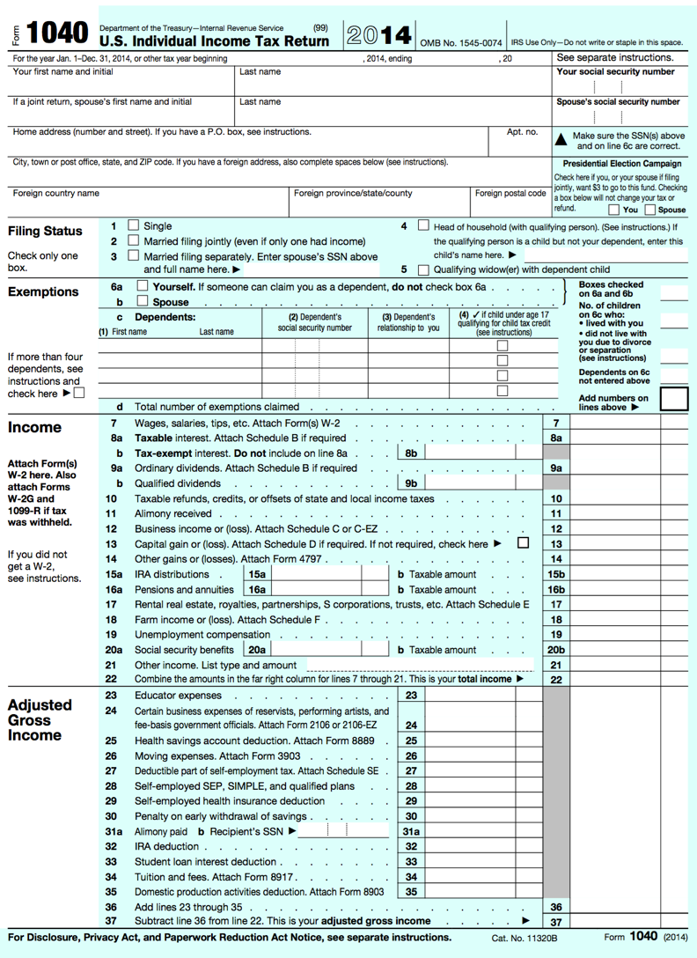
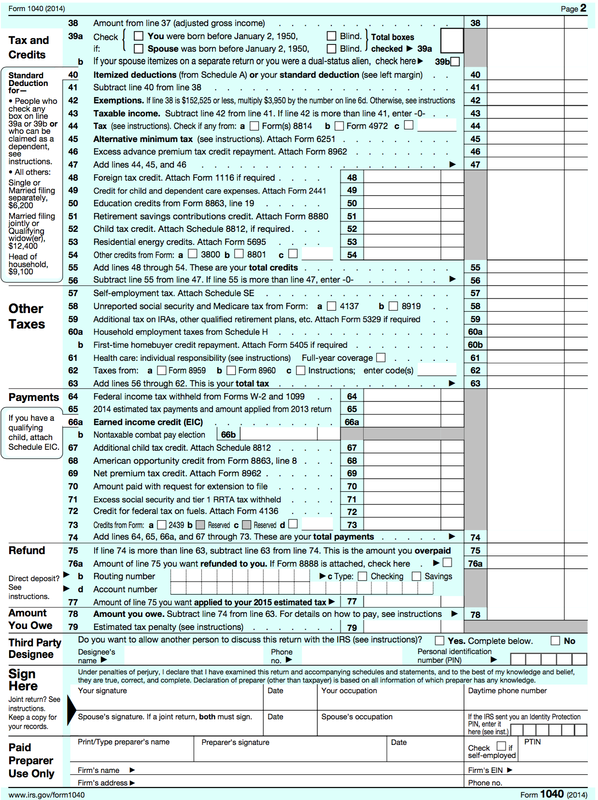

Slide 12
Filing Status
Based on marital status and family situation
  Single
  Married Filing Jointly
  Married Filing Separately
  Head of Household
  Qualifying Widow(er) with Dependent Child
  Choose correct Filing Status on Lines 1-5

Slide 13

Filing Status
Let’s look at the I/I form
  During the interview process, you will refer to this part of the I/I form and clarify with the taxpayer to ensure they answered the question correctly.

Slide 14
Exemption
Amount the taxpayer can claim for himself, his spouse, and his dependents that decreases taxable income.
Total # of Exemptions found on line 6d

Slide 15
Exemption
A taxpayer may claim 2 types of exemptions:
  Personal exemption (lines 6a/6b)
    Taxpayer can claim herself (and spouse)
  Dependency exemption (line 6c)
    Taxpayer can claim qualifying dependents

Slide 16
Dependent
An individual whom the taxpayer supports or lives with the taxpayer
  Qualifying child
  Qualifying relative

Slide 17
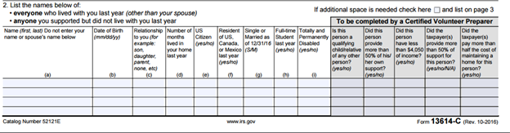
Exemptions
Let’s look at the I/I form:
  During the interview process, you will refer to this part of the I/I form and clarify with the taxpayer to ensure they answered the question correctly.

Slide 18
Earned vs. Unearned Income
Earned: income received through work
  Wages, salary, tips, etc.
Unearned: income other than pay from work
  Interest, social security, retirement, etc.
Income is entered on Lines 7-21
Total income is found on Line 22

Slide 19
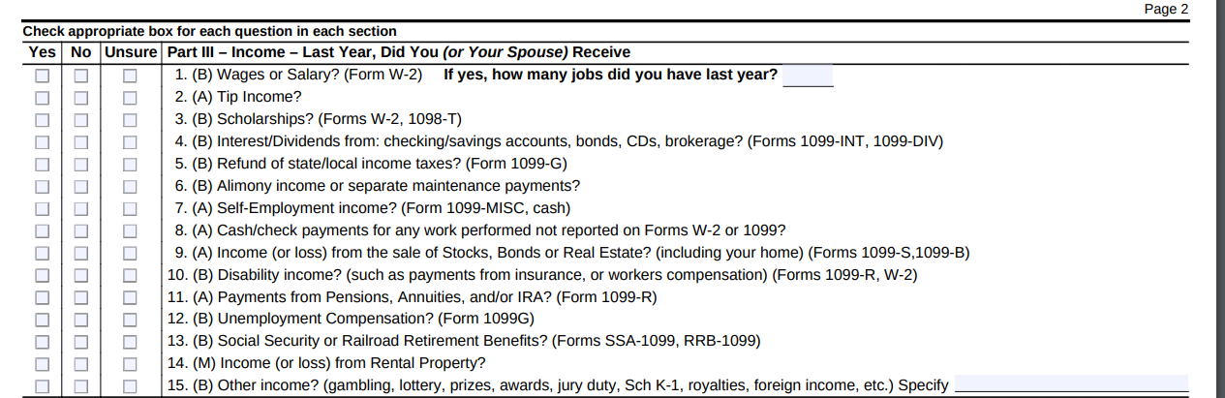
Earned vs. Unearned Income
Let’s look at the I/I form:
  During the interview process, you will refer to this part of the I/I form and clarify with the taxpayer to ensure they answered the question correctly. Ask clarifying questions: If they only marked having one type of income, you should ask “Did you have any other types of income? Interest or self-employment? What about Social Security or retirement?”

Slide 20
Earned vs. Unearned Income
  All of these boxes must be checked yes or no. Otherwise, the document is incorrectly filled out. If the taxpayer marked unsure, clarify with them what the question is asking and change the checkbox to “Yes” or “No” accordingly.

Slide 21
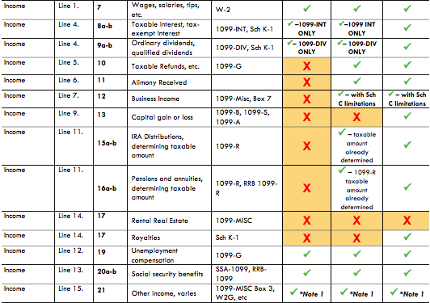
Earned vs. Unearned Income
Let’s look at the scope of service chart!
If a form is out of scope for you, just set it aside for your advanced volunteer and make a note on the back of the I/I form.

Slide 22
Adjustment
Decreases the amount of income on which the taxpayer will be taxed
Adjustments are entered on Lines 23-35
Total adjustments are found on Line 36

Slide 23
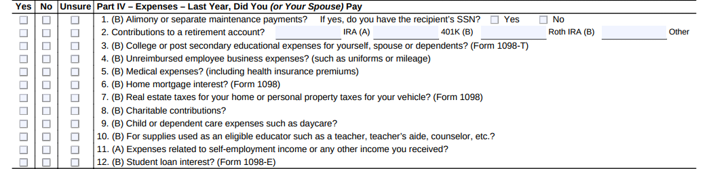
Adjustment
Let’s look at the I/I form: Some of these are adjustments, some are itemized deductions, and some are credits.
  During the interview process, you will refer to this part of the I/I form and clarify with the taxpayer to ensure they answered the question correctly. Ask clarifying questions.

Slide 24
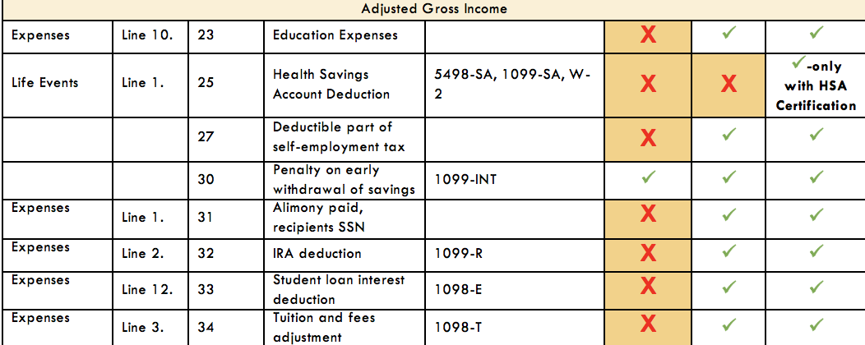
Adjustment
Let’s look at the scope of service chart.
If an adjustment is out of scope for you, just set it aside for your advanced volunteer and make a note on the back of the I/I form.

Slide 25
Adjusted Gross Income (AGI)
Amount of taxable income after adjustments are made
AGI is found on Lines 37/38

Slide 26
Deduction
Amount subtracted from the AGI to further decrease taxable income
  Standard deduction: based on filing status
  Itemized deductions: taxpayer can choose to enter expenses if larger than standard deduction amount
  Standard/Itemized Deduction(s)
  found on Line 40

Slide 27
Deduction
If a taxpayer has expenses they wish to itemize, an advanced volunteer will have to enter the information.
Based on the filing status and age you input in the software, the standard deduction will automatically calculate and no extra steps need to be taken

Slide 28
Taxable Income
Any income that is subject to federal income tax
Can include both earned and unearned income
Taxable Income found on Line 43

Slide 29
Tax Liability
Amount of tax that must be paid based on the taxable income
Tax Liability (before credits
are subtracted) found on Line 47

Slide 30
Tax Credit
Direct reduction of the taxpayer’s liability
Two Types of tax credits:
  Nonrefundable credits
  Refundable credits

Slide 31
Nonrefundable Tax Credit
Reduces the tax liability – only to zero.
  Child and Dependent Care Expenses
  Retirement Savings Contribution Credit
  Child Tax Credit
Nonrefundable Credits entered on Lines 48-54
Total Nonrefundable Credits found on Line 55

Slide 32
Nonrefundable Tax Credit
Let’s look at the I/I form:
We’ll talk about these credits a little bit later, but if the taxpayer has expenses related to childcare or contributions to a retirement account, it should be marked correctly on the I/I form.

Slide 33
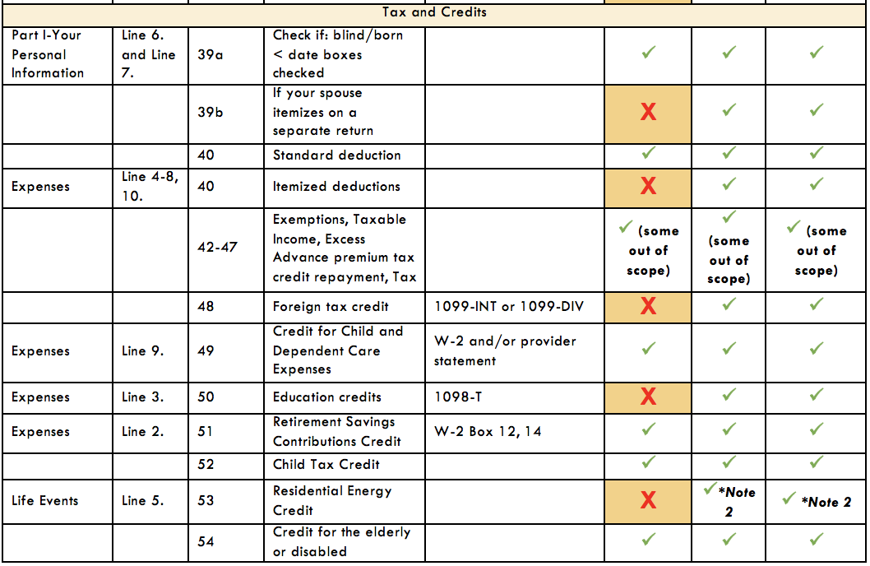
Nonrefundable Tax Credit
Let’s look at the scope of service chart!
If a credit is out of scope for you, just set it aside for your advanced volunteer and make a note on the back of the I/I form.

Slide 34
Refundable Tax Credit
Reduces tax liability to zero
Taxpayer will receive the remainder of the credit value as a refund.
  Earned Income Tax Credit
  Additional Child Tax Credit
  American Opportunity Education Credit
Refundable Tax Credits entered on Lines 66-69

Slide 35
Refundable Tax Credit
Let’s look at the I/I form:
We’ll talk more about these credits later, but if the taxpayer has education expenses, it should be marked correctly on the I/I form. The Additional Child Tax Credit and Earned Income Credit are calculated automatically in the software.

Slide 36
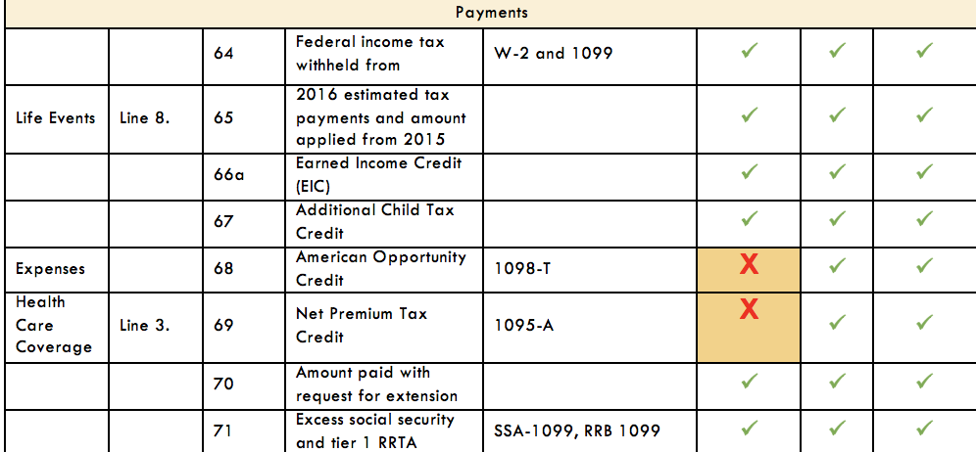
Refundable Tax Credit
Let’s look at the scope of service chart!
If a credit is out of scope for you, just set it aside for your advanced volunteer and make a note on the back of the I/I form.

Slide 37
Withholding
Amount of money that can be taken from each form of income and received by the government each pay period
Total Withholding found on Line 64

Slide 38
Federal Income Tax Process Overview

Slide 39

TOTAL INCOME
Earned Income

Slide 40

TOTAL INCOME
Unearned Income
Earned Income

Slide 41
TOTAL INCOME
TAXABLE INCOME
after adjustments, deductions, and exemptions
Unearned Income
Earned Income

Slide 42
TOTAL INCOME
TAXABLE INCOME
after adjustments, deductions, and exemptions
TAX LIABILITY
Unearned Income
Earned Income

Slide 43
TOTAL INCOME
TAXABLE INCOME
after adjustments, deductions, and exemptions
TAX LIABILITY
Unearned Income
TAX CREDITS
Earned Income
AMOUNT OWED OR REFUNDED

Slide 44
Tax Preparation Process

Slide 45
Tax Preparation Process
Part 1: Preliminary Interview
Part 2: Preparing the Return in TaxSlayer
Part 3: Quality Review
Part 4: Finishing the Return
Part 5: Filing the Return

Slide 46
Part 1: Preliminary Interview
Taxpayer completes pages 1, 2, and 3 of Intake/Interview Form.
Go through the entire I/I form with them, asking clarifying questions and determining what is in scope for you.
Verify photo ID(s) & Social Security card(s)
Ensure taxpayer cannot be a dependent of anyone else (Pub 4012: C-1, C-5 to C-6)
Determine dependents (Pub 4012: C-3 to C-8)

Slide 47
Part 1: Preliminary Interview
Complete part of Section II “To be completed by a Certified Volunteer Preparer”
Determine filing status (Pub 4012: B-1 to B-3)
REVIEW pages 1-3 of I/I Form and ask clarifying questions:
  I see you marked that you are unmarried and have no one else living in your home?
  Collect necessary forms
  “Yes” or “No” answer for all questions on page 2
Write your full name at the bottom of page 4

Slide 48
Part 1: Preliminary Interview
Always consult the Scope of Service Chart to see if the income or expense is in scope for your level of certification.
If something is out of scope for you, put the form to the side and make a note on the back page of the I/I form for the advanced volunteer.

Slide 49
Part 1: Preliminary Interview – Identification
Photo IDs
  Verify photo IDs for taxpayer (and spouse)
Social Security cards
  Obtain and verify a SS card (original or copy)
    Verify SS numbers for taxpayer (and spouse)
    Verify SS numbers for dependent(s)
  Enter name EXACTLY as it appears on SS card!

Slide 50
Part 1: Preliminary Interview – Acceptable Documents other than SS Card
Form SSA-1099 statement
Medicare Card (with an “A” after the SSN)
ITIN card
  Issued for nonresidents who need to file tax returns but cannot receive SS cards
  9XX-XX-XXXX (enter just like SS number)
ATIN for dependent
  Issued for child while adoption is pending
  9XX-XX-XXXX (enter just like SS number)

Slide 51
Part 1: Preliminary Interview – Why conduct an interview?
You get to know the taxpayer and build a relationship
You might miss credits and deductions that could increase the taxpayer’s refund
You might miss important income documents that must be recorded
You may find that the return is out of scope
Required by the IRS for due diligence

Slide 52
Part 1: Preliminary Interview – Why conduct an interview?
You find out if any income documents or expenses need to be entered by a more advanced volunteer.
A diligent and thorough interview saves a huge amount of time in the long run!

Slide 53
Tax Preparation Process
Part 1: Preliminary Interview
Part 2: Preparing the Return in TaxSlayer
Part 3: Quality Review
Part 4: Finishing the Return
Part 5: Filing the Return

Slide 54
Exemptions

Slide 55
Exemptions Objectives
After completing this section, the volunteer will be able to:
  Determine a taxpayer’s eligibility for a personal exemption
  Assess whether a person qualifies as a dependent of a taxpayer

Slide 56
Personal Exemptions
Each personal exemption decreases the taxable income by $4,050
Taxpayers can claim exemptions for:
  Taxpayer UNLESS the taxpayer can be claimed as a dependent by someone else.
  Spouse UNLESS the spouse can be claimed as a dependent by someone else.

Slide 57
Personal Exemptions
Remember:
It’s not whether the taxpayer IS claimed as a dependent, but whether the taxpayer CAN BE claimed as a dependent that determines whether the taxpayer can claim an exemption.

Slide 58
Personal Exemptions
Let’s look at the I/I form

Slide 59
Dependency Exemptions
Each dependency exemption decreases taxable income by $4,050
A taxpayer can claim exemptions for:
  qualifying children
  qualifying relatives
These qualifying individuals usually live in the taxpayer’s home and generally receive significant support from the taxpayer

Slide 60
Determining Dependency Exemptions
Open the Publication 4012 to the Exemptions Tab to Table 1: Dependency Exemption
ALWAYS BEGIN WITH THIS CHART TO DETERMINE IF A PERSON QUALIFIES AS A DEPENDENT

Slide 61
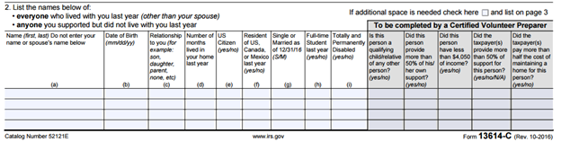
Dependency Exemptions
Let’s look at the I/I form:
As you go through the Pub 4012 and ask questions to determine exemptions, answer “Yes/No” in the shaded area.

Slide 62
Qualifying Child or Qualifying Relative?
If no one else can claim the taxpayer or spouse as a dependent, you need to determine if the other people living in the house can be Qualifying Children, and if not see if they can be Qualifying Relatives
Remember: Each dependent decreases the taxable income by $4,050!

Slide 63
Determining Dependency Exemptions
Always begin with Table 1: Dependency Exemption to determine if a person can be claimed as a dependent:
  If answer is NO in Step 9, then the person is a Qualifying Child
  If answer is YES in Step 9, use Qualifying Child of More Than One Person Table
  If answer is YES in Step 7 AND parents live apart, use Qualifying Child of More Than One Person Table AND Table 3: Children of Divorced or Separated Parents or Parents Who Live Apart
  If answer is NO in Steps 5-7, then use Table 2: Dependency Exemption for Qualifying Relative to see if person is a Qualifying Relative

Slide 64
Qualifying Child:
The Taxpayer Eligibility Test
Step 1 | Can you or your spouse (if filing jointly) be claimed as a dependent on someone else’s tax return this year? | If YES: Stop If NO: Go to Step 2

Slide 65
Qualifying Child:
The Marital Status Test
Step 2 | Was the person married as of December 31st? | If YES: Go to Step 3 If NO: Go to Step 4

Slide 66
Qualifying Child:
The Joint Return Test
Step 3 | Is the person filing a joint return for this tax year? (Answer “NO” if the person is filing a joint return only to claim a refund of income tax withheld or estimated tax paid) | If YES: Stop If NO: Go to Step 4

Slide 67
Qualifying Child:
The Citizenship Test
Step 4 | Was the person a U.S. citizen, U.S. resident alien, U.S. national, or a resident of Canada, or Mexico? | If YES: go to Step 5 If NO: Stop

Slide 68
Note: Taxpayers with ITIN Cards
Remember: Taxpayers receive ITIN numbers if they are nonresidents but need to file a tax return and cannot obtain a SSN
If a taxpayer lived in the United States all year and has an ITIN card, they will be considered a resident alien for tax purposes
A “child” passes the citizenship test in this situation

Slide 69
Qualifying Child:
The Relationship Test
Step 5 | Was the person your son, daughter, stepchild, eligible foster child, brother, sister, half brother, half sister, stepbrother, stepsister, or a descendant of any of them (i.e. your grandchild, niece, or nephew)? | If YES: go to Step 6 If No: Go to Table 2

Slide 70
Qualifying Child:
The Age Test
Step 6 | Was the person: under age 19 at the end of the year and younger than you (or spouse if filing jointly)? OR a full-time student, under age 24 at the end of the year and younger than you (or spouse, if filing jointly)? OR permanently and totally disabled* at any time during the year? | If YES: Go to Step 7 If NO: go to Table 2

Slide 71
“Permanently and Totally Disabled”
A person is considered permanently and totally disabled if he or she cannot engage in any substantial gainful activity because of a physical or mental condition, AND
A doctor determines the condition has lasted or can be expected to last continuously for at least a year or can lead to death

Slide 72
Qualifying Child:
The Residency Test
Step 7 | Did the person live with you as a member of your household, except for temporary absences,* for more than half the year? (Answer “YES” if the child was born or died during the year.) | If YES: Go to Step 8 (Use Table 3 if parents live apart) If NO: go to Table 2

Slide 73
“Temporary Absences”
A child is considered to have lived with you during periods of time when one of you, or both are temporarily absent due to illness, education, business, vacation, military service, or detention in a juvenile facility

Slide 74
Qualifying Child:
The Support Test
Step 8 | Did the person provide more than half of his or her own support* for the year? | If YES: Stop If NO: go to Step 9

Slide 75
Qualifying Child:
The Other Adults Test
Step 9 | Is the person a qualifying child of any other person? | If YES: Go to the chart: QC of More Than One Person If NO: You can claim this child as a dependent.

Slide 76
Dependency Exemptions
When you have asked all of the Pub 4012 questions, the entire section should now be filled out correctly. Don’t forget to change any part the taxpayer may have originally entered incorrectly.

Slide 77
Exercise
TRUE or FALSE:
Every taxpayer can claim a personal exemption for himself.

Slide 78
Exercise – Answer
FALSE
A taxpayer who can be claimed as a dependent by someone else CANNOT claim an exemption for him/herself.

Slide 79
Exercise
Rebecca is unmarried with one child, Colin. Colin is 8 years old and lives full time with his mother, who provides all of his support. He is a U.S. citizen, and no other adults live in their household. Can Rebecca claim Colin as a dependent?
Use the Publication 4012

Slide 80
Exercise – Answer
YES
Colin meets all the requirements to be claimed as a qualifying child.

Slide 81
Exercise
Paul is a U.S. citizen who is 26 years old, permanently disabled, unmarried, did not pay for more than half of his support and lived with his parents for the entire year.
Can Paul be claimed as a dependent by his parents?
Notes:
‹#›

Slide 82
Exercise – Answer
YES.
Paul meets all the requirements to be claimed as a qualifying child.

Slide 83
Determining Dependency Exemptions
Always begin with Table 1: Dependency Exemption to determine if a person can be claimed as a dependent:
  If answer is NO in Step 9, then the person is a Qualifying Child
  If answer is YES in Step 9, use Qualifying Child of More Than One Person Table
  If answer is YES in Step 7 AND parents live apart, use Qualifying Child of More Than One Person Table AND Table 3: Children of Divorced or Separated Parents or Parents Who Live Apart
  If answer is NO in Steps 5-7, then use Table 2: Dependency Exemption for Qualifying Relative to see if person is a Qualifying Relative

Slide 84
Qualifying Child of More Than One Person
Did any other adult live in your home?
What was that other adult’s relationship to the child?
Could the other adult be
claimed as a dependent
by someone else?
Write these questions under STEP 9 in the Pub 4012!

Slide 85
Qualifying Child of More Than One Person
Sometimes, a child meets all of the tests to be claimed by more than one taxpayer.
  Example: a mother and a grandmother
Parenthood and AGI are taken into consideration in determining who is eligible to claim the child.
This situation is complicated to determine. SEE YOUR SITE COORDINATOR if you believe a child meets all the tests to be claimed by more than one taxpayer

Slide 86
Determining Dependency Exemptions
Always begin with Table 1: Dependency Exemption to determine if a person can be claimed as a dependent:
  If answer is NO in Step 9, then the person is a Qualifying Child
  If answer is YES in Step 9, use Qualifying Child of More Than One Person Table
  If answer is YES in Step 7 AND parents live apart, use Qualifying Child of More Than One Person Table AND Table 3: Children of Divorced or Separated Parents or Parents Who Live Apart
  If answer is NO in Steps 5-7, then use Table 2: Dependency Exemption for Qualifying Relative to see if person is a Qualifying Relative

Slide 87
What if the parents live apart?
The custodial parent generally claims the dependency exemption for his/her child
The noncustodial parent can claim the exemption if the parents have signed an agreement
  Form 8332 (REQUIRED for post-2008 divorce)
This situation is complicated to determine. SEE YOUR SITE COORDINATOR

Slide 88
Determining Dependency Exemptions
Always begin with Table 1: Dependency Exemption to determine if a person can be claimed as a dependent:
  If answer is NO in Step 9, then the person is a Qualifying Child
  If answer is YES in Step 9, use Qualifying Child of More Than One Person Table
  If answer is YES in Step 7 AND parents live apart, use Qualifying Child of More Than One Person Table AND Table 3: Children of Divorced or Separated Parents or Parents Who Live Apart
  If answer is NO in Steps 5-7, then use Table 2: Dependency Exemption for Qualifying Relative to see if person is a Qualifying Relative

Slide 89
Qualifying Relative:
The Qualifying Child Test
Step 1 | Is the person your qualifying child or the qualifying child of anyone else? | If YES: Not a qualifying relative If NO: Go to Step 2

Slide 90
Qualifying Relative:
The Relationship Test
Step 2 | Was the person your son, daughter, stepchild, foster child, or a descendant of any of them? OR Was the person your brother, sister, or a son or daughter of either of them? OR Was the person your father, mother, or an ancestor or sibling of either of them? OR Was the person your half brother, half sister, stepbrother, stepsister, stepfather, stepmother, son-in-law, daughter-in-law, father-in-law, mother-in-law, brother-in-law, or sister-in-law?* | If NO, go to Step 3. If YES, go to Step 4

Slide 91
Relationship Test Notes
The relatives in the Step 2 are considered “relatives who do not have to live with you”
Any of the relationships that were established by marriage are not ended by death or divorce

Slide 92
Qualifying Relative:
The Residency Test
Step 3 | Was the person any other person (other than your spouse) who lived with you ALL YEAR as a member of your household? | If NO: You can’t claim this person. If YES: Go to Step 4

Slide 93
Residency Test Notes
Note that any person who is not one of the relationships in Step 2 MUST live with the taxpayer for all 12 months of year, except for the exceptions below
There are exceptions for:
  kidnapped children
  a child who was born or died during the year
  certain temporary absences – school, vacation, medical care, etc.

Slide 94
Qualifying Relative:
The Gross Income Test
Step 4 | Did the person have a gross taxable income of less than the $4,050? | If NO: You cannot claim this person. If YES: Go to Step 5

Slide 95
Qualifying Relative:
The Support Test
Step 5 | Did YOU provide more than half of the person’s total support for the year? | If YES: You can claim this person as your dependent If NO: Go to Step 6

Slide 96
Qualifying Relative:
Multiple Support Tests
Step 6 | Did another person provide more than half of the person’s total support? | If NO: Go to Step 7
Step 7 | Did two or more people together provide more than half the person’s total support? | If YES: Go to Step 8
Step 8 | Did you provide more than 10% of the person’s total support for the year? | If YES: Go to Step 9
Step 9 | Did the other person(s) providing more than 10% of the person’s total support for the year provide you with a signed statement (Form 2120) agreeing not to claim the exemption? | If YES: You can claim an exemption for this person
This situation is complicated to determine. SEE YOUR SITE COORDINATOR

Slide 97
Exercise
Roderick, age 29, lives with his uncle. Last year, he worked part-time and earned $2,100. His uncle provided for the rest of his support, including rent and household costs.
Can his uncle claim Roderick as a dependent? Can Roderick claim a personal exemption?

Slide 98
Exercise – Answer
YES.
His uncle can claim Roderick as a qualifying relative.
NO.
Roderick cannot claim a personal exemption because he can be claimed as a dependent.

Slide 99
Exercise
Gina Brown provides all support for her uncle. Uncle Jim is unmarried, 72 years old, and lives in another city. He has no gross income for the calendar year. Can Gina claim Uncle Jim as a dependent?

Slide 100
Exercise - Answer
YES.
Jim meets all of the requirements to be
a qualifying relative of Gina.

Slide 101
Filing Status

Slide 102
Filing Status Objectives
After completing this section, the volunteer will be able to:
  Choose the most advantageous (and allowable) filing status for a taxpayer

Slide 103
Five Filing Statuses
Single
Married Filing Jointly
Married Filing Separately
Head of Household
Qualifying Widow(er) with Dependent Child

Slide 104
Determining Filing Status
Open the Publication 4012 to the Filing Status Tab to Chart: Determination of Filing Status – Decision Tree, Chart: Filing Status, and Chart: Who is a Qualifying Person Qualifying You To File as Head of Household
ALWAYS USE THESE CHARTS TO DETERMINE A TAXPAYER’S FILING STATUS

Slide 105
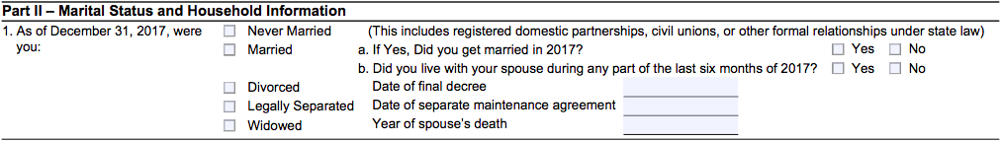
Determining Filing Status
Let’s look at the I/I form
  You will refer to this part of the I/I form while asking questions from the Pub 4012. Correct any mistakes the taxpayer made when filling it out.

Slide 106
Single
If on the last day of the tax year (Dec. 31st), the taxpayer was
  Not married OR
  Legally separated/divorced OR
  Widowed
IMPORTANT:
Some taxpayers considered single can also file under a more advantageous status (HoH or QW).
Be sure to check all options!

Slide 107
Married Filing Jointly
If on the last day of the tax year,
  They lived together as a married couple OR
  They lived apart but were not legally separated/divorced OR
  One spouse died during the year, and the taxpayer did not remarry.

Slide 108
Married Filing Separately
Married taxpayers can also file separately; HOWEVER,
  If one spouse itemizes, the other spouse must itemize.
  Taxpayers filing with this status are not eligible to claim several tax credits.
Be careful!
This status generally results in a HIGHER overall TAX.

Slide 109
Why Do Some Choose MFS?
Sometimes MFS is chosen when one spouse does not want to be responsible for the other spouse’s tax obligations or filing separately may result in a lower total tax (this is rare)
Sometimes to avoid an offset of their refund against their spouse’s outstanding debts (child support, student loans, etc.)
Note: Even in these circumstances, there may be other options that allow them to file jointly and not be responsible for these debts (Injured Spouse Form)

Slide 110
Why Do Some Choose MFS?
Note: sometimes taxpayers must file separately because they are separated and not in communication with their spouse and don’t have the option of filing jointly

Slide 111
Note
If a spouse died during the tax year, and the taxpayer did not remarry, they are considered married for the entire year.
The surviving spouse is eligible to file as MFJ or MFS.
Surviving spouses that remarry must file with the new spouse, as MFJ or MFS.
  The deceased spouse’s filing status becomes MFS.

Slide 112
Head of Household
This is the most complicated filing status to determine, yet it is one of the most common at SaveFirst tax sites
There are two scenarios when a taxpayers can file Head of Household:

Slide 113
Head of Household
Scenario #1: Married Taxpayers
  Must be “considered unmarried”*
  File a separate return from spouse
  Maintain more than half the costs of keeping up a home
  The home is the main home for a dependent child, stepchild, or foster child for more than ½ the year
    Note: A grandchild does NOT meet this test
  The taxpayer claims an exemption for the child

Slide 114
“Considered Unmarried”
    A legally married taxpayer can be considered unmarried if s/he has not lived with the spouse at any time during the last six months of the tax year.

Slide 115
Head of Household
Scenario #2: Single Taxpayers
  Maintain more than half the costs of keeping up a home
  A “qualifying person” lived with the taxpayer for more than ½ the year

Slide 116
Head of Household: Qualifying Person
See
Who Is a Qualifying Person Qualifying You To File as Head of Household
in the
Filing Status Tab of the Pub 4012
for a list of qualifying persons

Slide 117
Head of Household: Qualifying Person
In general, a qualifying child is a qualifying person
  Whether or not the taxpayer claims the exemption
In general, a qualifying relative is a qualifying person if:
  The taxpayer can claim the exemption for the person
  The person meets one of the relationships listed
  The person lives with the taxpayer for more than ½ the year
    Exception: a mother/father who is a qualifying relative does not have to live in the home with the taxpayer

Slide 118
Head of Household: Separated Parents
Even if the custodial parent has given up his/her right to claim the dependency exemption for a child (Form 8332), s/he can file Head of Household using that child as her/his qualifying person
Noncustodial parent can never claim Head of Household
This situation is complicated to determine. SEE YOUR SITE COORDINATOR

Slide 119
Qualifying Widow(er) with Dependent Child
A taxpayer files QW if his/her
  Spouse died recently, AND
  The taxpayer did not remarry, AND
  The taxpayer has a dependent child (son, daughter, stepson, stepdaughter), AND
  The taxpayer provides over half the costs to maintain the main home for himself and the child.

Slide 120
Unmarried, Widowed Taxpayer?
If the spouse died during the current tax year: Married Filing Jointly
If the spouse died during one of the two preceding tax years and taxpayer has a qualifying child: Qualifying Widow(er)
If the spouse died three or more years before the current year: Single or Head of Household

Slide 121
From Lowest to Highest Tax Burden
Married Filing Jointly & Qualifying Widow(er)
Head of Household
Single
Married Filing Separately

Slide 122
Exercise
Lily left her husband in August of the tax year, but they did not get divorced. She took her children with her, supported them during all of the tax year, and will claim them as dependents. Lily refuses to file a joint return with her husband.
Which filing status should she use?

Slide 123
Exercise – Answer
Married Filing Separately.
Because Lily lived with her husband for some part of the last six months of the year, she cannot file as Head of Household.

Slide 124
Exercise
Em left her husband in February of the tax year, but they did not get divorced. She took her children with her, supported them all year, and will claim them as dependents. Em refuses to file a joint return with her husband.
Which filing status should she use?

Slide 125
Exercise – Answer
Head of Household.
A legally married taxpayer can be considered unmarried and file as HoH if he/she has not lived with the spouse at any time during the last six months of the tax year.

Slide 126
Exercise
Lane, a single woman, lives alone. She provides full support for her mother, Theresa, who lives in a nearby town. Since Theresa had no income for the year, Lane paid all costs to maintain her home and will claim her as a dependent.
What is Lane’s filing status?

Slide 127
Exercise – Answer
Head of Household.
A taxpayer can file as Head of Household on the basis of a dependent parent who does not live with him/her only if the taxpayer pays ½ of the costs of keeping up the parent’s home.

Slide 128
Exercise
Brian and Ashley were happily married since 1965. They had no children, but Brian’s brother, who they claim an exemption for, lived with them for the last 10 years. Ashley passed away two years ago. Even after her death, Brian continued to maintain the entire cost for the home and his brother still lived there.
What is Brian’s filing status?

Slide 129
Exercise – Answer
Head of Household.
Brian cannot file as Qualifying Widow(er) with dependent child, because his brother is NOT his dependent child. Even though he is his dependent, he is not Brian’s child.

Slide 130
Filing Basics

Slide 131
Filing Basics Objectives
After completing this section, the volunteer will be able to:
  Verify that a taxpayer is required to file a tax return
  Recommend when a taxpayer should file a tax return, even if not required to

Slide 132
Who Must File?
To decide whether someone must file a tax return, you need to know the individual’s:
  Age
  Gross income (approximate)
    All the income received during the year in the form of money, goods, property and services not exempt from tax (earned and unearned)
    Do not include Social Security unless
      MFS and lived with spouse at any time during year OR
      ½ of Social Security + other gross income and any tax-exempt interest is more than $25,000 ($32,000 if MFJ)
  Filing status

Slide 133
Who is Legally Required to File a Return?
Use Who Must File Tab in the Pub 4012
  Chart A – For Most People Who Must File
  Chart B – For Children and Other Dependents
  Chart C – Other Situations When You Must File
  Chart D – Who Should File

Slide 134
Children & Other Dependents
Refer to Chart B under Who Must File Tab
If a parent can claim a child as a dependent, the dependent may still need to file a return
The filing threshold for dependents is much lower than that of non-dependents

Slide 135
Other Situations When You Must File
Taxpayer owes special taxes
Taxpayer received Health Savings Account distributions
Taxpayer has net self-employment earnings of at least $400
Taxpayer received an advanced premium tax credit to pay for health insurance
Taxpayer owes an individual shared responsibility payment for failing to maintain minimum essential health coverage all year

Slide 136
Who Should File
Had income tax withheld from pay
Made estimated tax payments
Qualify for the Earned Income Credit
Qualify for Additional Child Tax Credit
Qualify for American Opportunity Credit

Slide 137
TaxSlayer – Beth Branch
Review Intake/Interview Form & Notes
Determine personal & dependency exemptions & filing status
vita.taxslayerpro.com/IRSTRAINING
  Password: TRAINPROWEB
Create TaxSlayer account
  Use most regularly checked email address
  Username: SMITHJTRAIN (last name, first initial, the word “train”)
  Password: SavefirstAL123!
  Do not enter a Site ID Number
Walkthrough Interview, Filing Status, Personal Info, and Dependents Info

Slide 138
Break
We will now take a 10 minute break!

Slide 139
Income

Slide 140
Income Objectives
After completing this section, the volunteer will be able to:
  Recognize various types of income documents
  Summarize the taxability of each type of income to the taxpayer

Slide 141
Taxable Income
Wages
Unemployment Compensation
Some Social Security Benefits
Self-Employment Income
Nonemployee Compensation
Dividends
Interest
Gambling Winnings
Awards
Prizes
Punitive Damages (from a Lawsuit Settlement)
Refund of State Taxes
Jury Duty Fees
Tips
Retirement Annuities
Retirement Pensions
Retirement IRA Distributions

Slide 142
Nontaxable Income
Child Support
Gifts
Life Insurance Proceeds
Other Insurance Payments
Sickness/Injury Payments (Third Party Sick Pay)
Public Assistance Payments
Worker’s Compensation
Veterans’ Benefits
Supplemental Security Income (SSI)
Inheritances
Federal Income Tax Refunds

Slide 143
Taxable & Nontaxable Income
Open the Publication 4012 to the Income Tab to
Income Quick References Guide
for a more complete listing of
taxable and nontaxable income

Slide 144
Earned vs. Unearned Income
Earned: income received through work
  Wages, salaries, tips, self-employment
  “Income you have to work for”
Unearned: income other than pay for work
  Produced by investments (such as interest on savings, dividends on stocks), social security benefits, retirement savings
  “Income that works for you”

Slide 145
Income
Let’s look at the I/I form
Remember, in the interview with the taxpayer, you are making sure these questions are answered correctly.

Slide 146
Income
Let’s look at the scope of service chart!
Only certain types of income will be in scope for you, always check the chart!

Slide 147
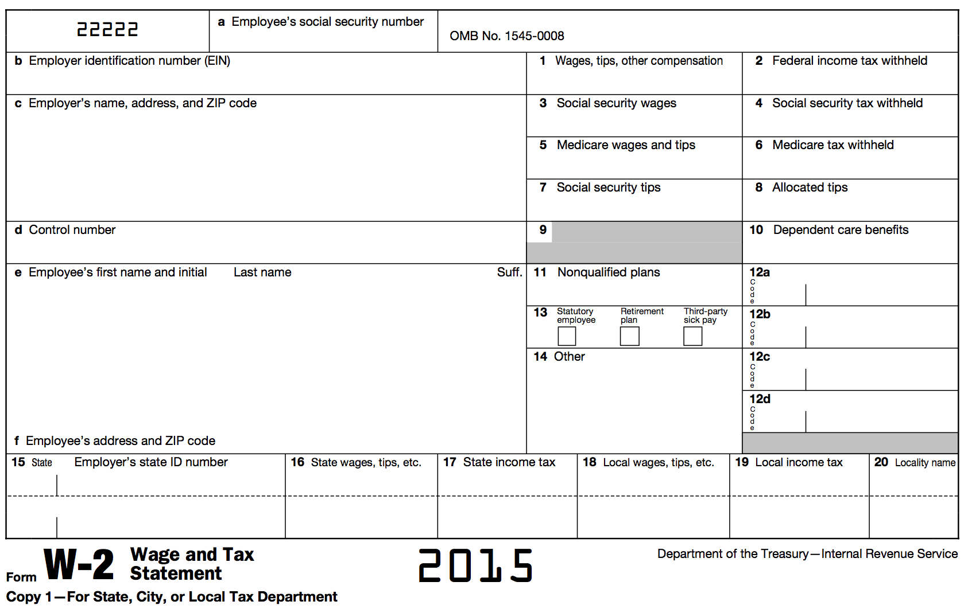


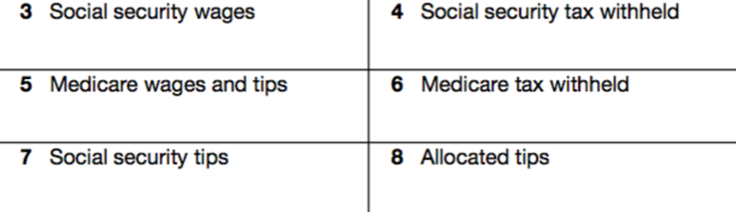






Form W-2: Wage and Tax Statement

Slide 148
Form W-2: Wages, Tips, Other Compensation
Reported in box 1
The total amount of wages, tips, salaries, bonuses, commissions, etc. paid to the employee for the entire tax year
Classified as earned income

Slide 149
Form W-2: Federal Income Tax Withheld
Reported in box 2
The federal tax system is a “pay as you go” system, meaning that tax is paid as income is earned during the year
The tax paid is referred to as withholding
The amount reported in box 2 is the total amount of tax withheld for the entire year

Slide 150
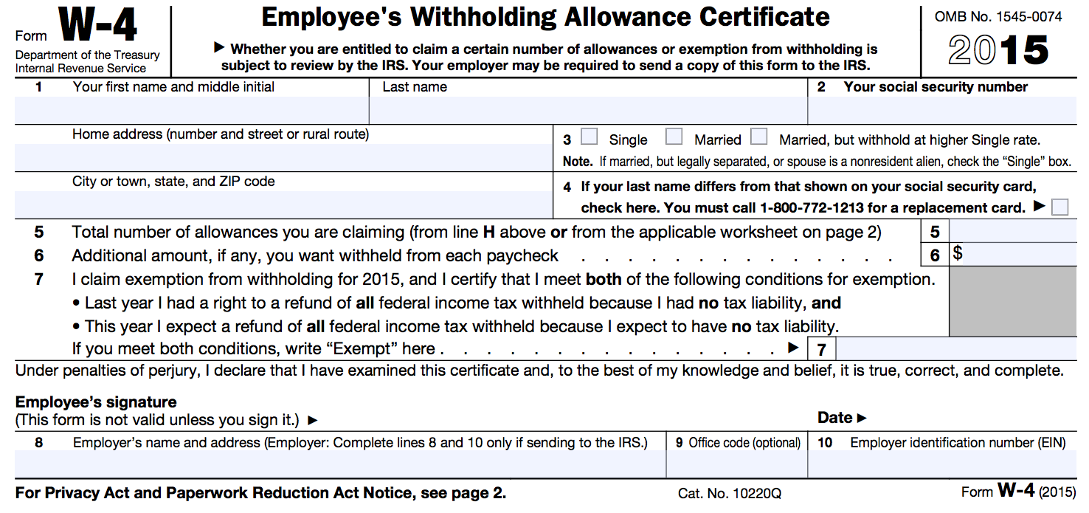
Form W-2: Federal Income Tax Withheld
This amount is determined prior to starting a job by filling out a Form W-4
Personal Allowances
  Single/Married
  Dependents
  Spouse information
  Childcare Expenses
The number of personal allowances listed determines how much federal income tax is withheld from pay

Slide 151
Form W-2: FICA Taxes
Reported in boxes 3, 4, 5, 6, and 7
Federal Insurance Contributions Act
  Employment tax imposed on employees AND employers specifically to fund Social Security and Medicare programs
  FICA is the part of the Internal Revenue Code that gives the federal government the authority to collect these taxes

Slide 152
Form W-2: FICA Taxes
Reported in boxes 3, 4, 5, 6, and 7
Federal Insurance Contributions Act
  Employee pays ½ and employer pays ½
  Boxes 3, 5, and 7 show how much of the employee’s wages are subject to FICA taxes
  Boxes 4 and 6 are the actual FICA taxes withheld from pay and are separate from federal income tax withheld in Box 2

Slide 153
Form W-2: Allocated Tips
Reported in box 8
The difference between the tips the employee reports to the employer and what the employer designated the employee’s tips should be
These amounts not included in box 1
FICA taxes not withheld from allocated tips
  Paid by using Form 4137 when filing tax return

Slide 154
Form W-2: Dependent Care Benefits
Reported in box 10
These are dependent care benefits the employer paid either directly to the employee or on the employee’s behalf for dependent care expenses (i.e., to daycare)

Slide 155
Form W-2: Box 12 Codes
Box 12 reports a variety of amounts with corresponding codes
This information MAY be needed to complete the tax return
Reports information such as:
  401(k) retirement contributions (D)
  Cost of employer-sponsored health coverage (DD)

Slide 156
Form W-2: Box 13
“Retirement Plan” is checked if the taxpayer makes contributions to a retirement plan through the employer
“Third Party Sick Pay” is checked if the amount in box 1 reflects the amount of sick pay paid during the year

Slide 157
Form W-2: Other
Other information is reported in box 14
The information listed is not always clear—even to the taxpayer
There is no standard list of codes, and employers can list any description they choose

Slide 158
Form W-2: Other
Employer may report information such as:
  Union dues
  Health insurance premiums deducted
  Nontaxable income
  Educational assistance payments
  Various types of retirement plan contributions

Slide 159
Form W-2: State and Local Wages, Tax
Reported in boxes 16, 17, 18, and 19
Most states also has an individual income tax, which we will discuss in the B Session
This information will be transferred to complete the state return

Slide 160
Form W-2: State and Local Wages, Tax
State wages are reported in box 16 and state income tax withheld is reported in box 17
Some localities also impose income tax
Local wages are reported in box 17 and local tax is reported in box 18
State wage and tax information will be used to file the appropriate state income tax return (covered in B Session if applicable to your state)

Slide 161
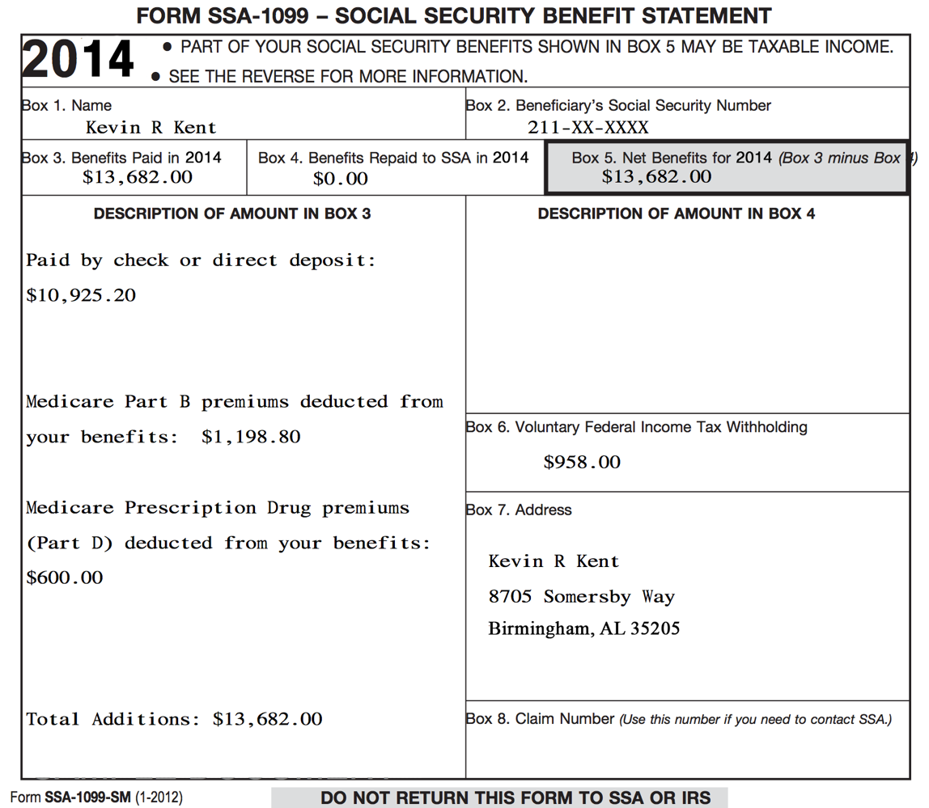

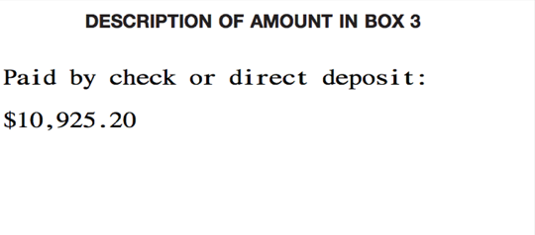
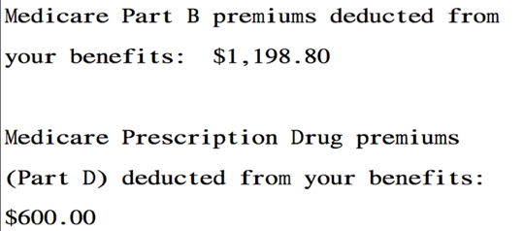

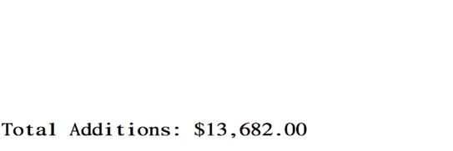
Form SSA-1099:
Social Security Benefit Statement

Slide 162
Form SSA-1099: Social Security Benefits
Net benefits reported in box 5
Social Security benefits include monthly retirement, survivor, and disability benefits
They do NOT include Supplemental Security Income (SSI): aimed at helping low-income elderly, blind, and disabled individuals pay for basic needs
Classified as unearned income

Slide 163
Form SSA-1099: Social Security Benefits
Some portion of the Social Security benefits may be taxable.
  Generally, if Social Security benefits are the only source of income, then they are not taxable.
  Dependent upon filing status and other reportable income

Slide 164
Form SSA-1099: Medicare Premiums
Reported in box 3
Many taxpayers will have Medicare insurance premiums (part B) and/or Medicare prescription drug premiums (part D) deducted from benefits

Slide 165
Form SSA-1099: Voluntary Federal Income Tax Withholding
Reported in box 5
Taxpayers can choose to have federal income tax withheld from benefits (if taxpayers know their benefits may be partially taxable)

Slide 166
Form SSA-1099: Lump Sum Benefit Payments
Reported in box 3
Some taxpayers may have received a lump-sum benefit payment (for current tax year and prior tax years)
See your site coordinator if a taxpayer received lump-sum benefits

Slide 167
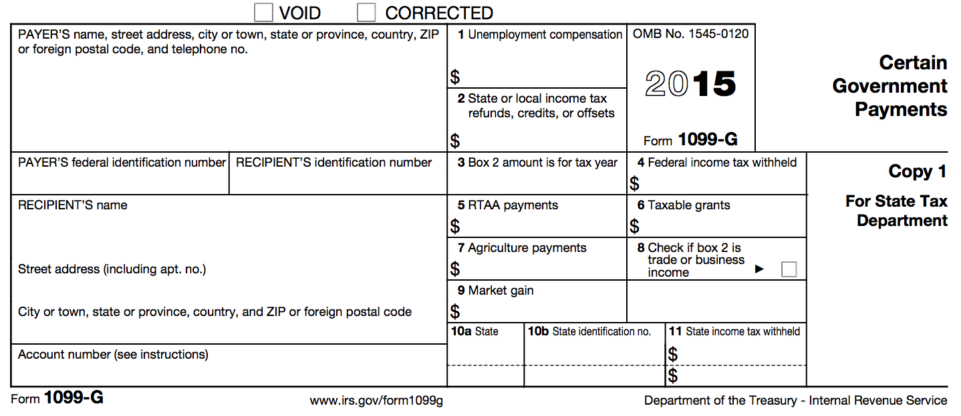
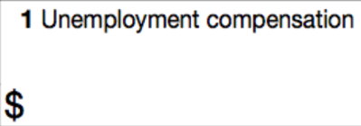
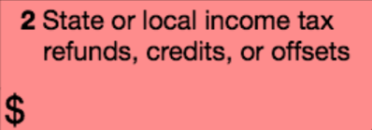

Form 1099-G: Certain Government Payments

Slide 168
Form 1099-G: Unemployment Compensation
Reported in box 1
Shows the total amount of unemployment compensation for the tax year
Unemployment compensation is fully taxable income
Classified as unearned income

Slide 169
Form 1099-G: Federal Income Tax Withheld
Reported in box 4
Taxpayers can choose to have federal income tax withheld on unemployment compensation

Slide 170
Prior Year State Tax Refund
The Prior Year State Tax Refund may be taxable and need to be reported
In order for the refund to be taxable, the taxpayer must have:
  Itemized on Federal Return
  Deducted State Income Tax(5a), NOT sales tax(5b) on Sch A(Federal return)

Slide 171
Household Employee Income
If a household employee earns less than $2,000 a year, the employer is not required to issue a Form W-2
However, this income must still be reported on the taxpayer’s income tax return
Classified as earned income

Slide 172
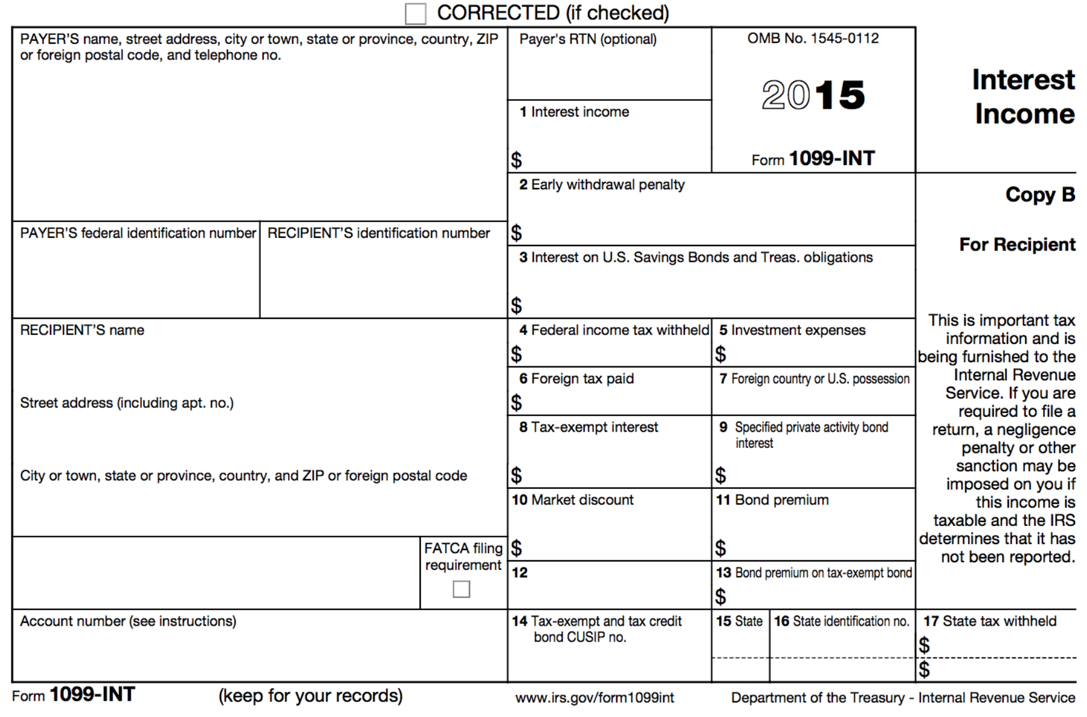
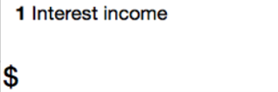
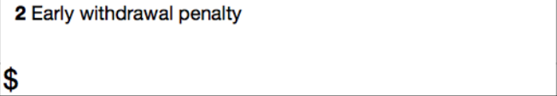
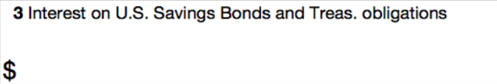

Form 1099-INT: Interest Income

Slide 173
Form 1099-INT: Interest & Interest on U.S. Savings Bonds & Treas. Obligations
Reported in boxes 1 and 3
Money earns interest when it is:
  Deposited into bank accounts (e.g., savings account)
  Used to buy certificates of deposit (CDs) or bonds
Interest is taxed in the year and is credited to a taxpayer’s account
Classified as unearned income

Slide 174
Form 1099-INT: Early Withdrawal Penalty
Reported in box 2
Shows interest/principal forfeited because of early withdrawal of time savings (e.g., from a CD that has a time limit before withdrawal is allowed)

Slide 175
Form 1099-INT: Federal Income Tax Withheld
Reported in box 4
Taxpayer may have had federal income tax withheld in some circumstances

Slide 176
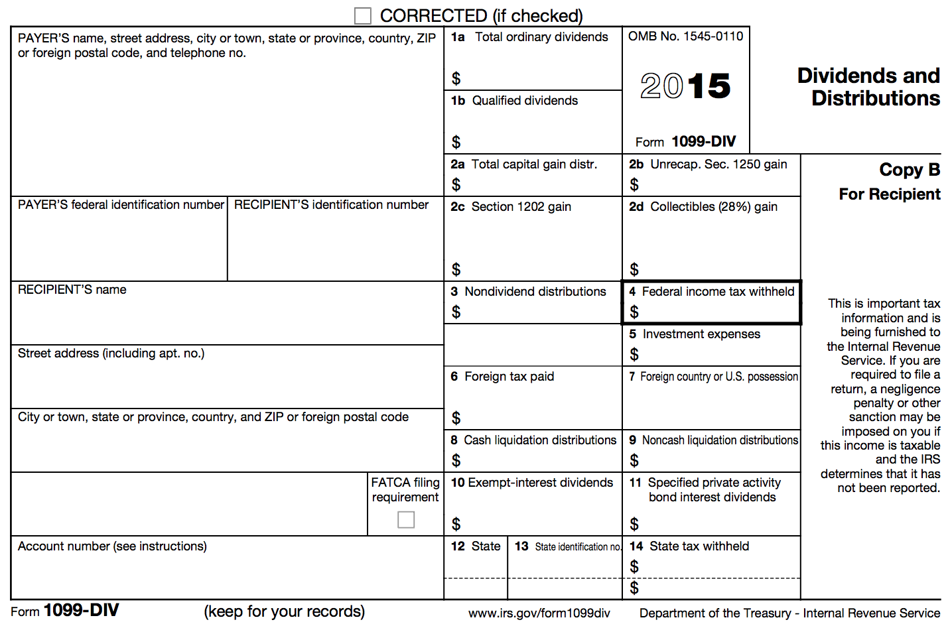
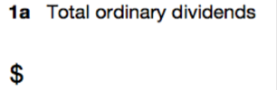
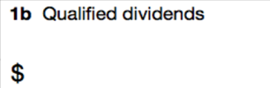


Form 1099-DIV: Dividends and Distributions

Slide 177
Form 1099-DIV: Ordinary and Qualified Dividends
Reported in boxes 1a and 1b
A dividend is a distributions of a portion of a company’s earnings to shareholders
E.g., if a taxpayer has investments in a stock, then dividends paid by the corporation are taxable
Classified as unearned income

Slide 178
Form 1099-DIV: Capital Gains Distributions
Reported in box 2a
Capital gains distributions occur when a taxpayer sells stocks and securities in a mutual fund
Capital gains are taxable!

Slide 179
Form 1099-DIV: Federal Income Tax Withheld
Reported in box 4
Taxpayer may have had federal income tax withheld in some circumstances

Slide 180
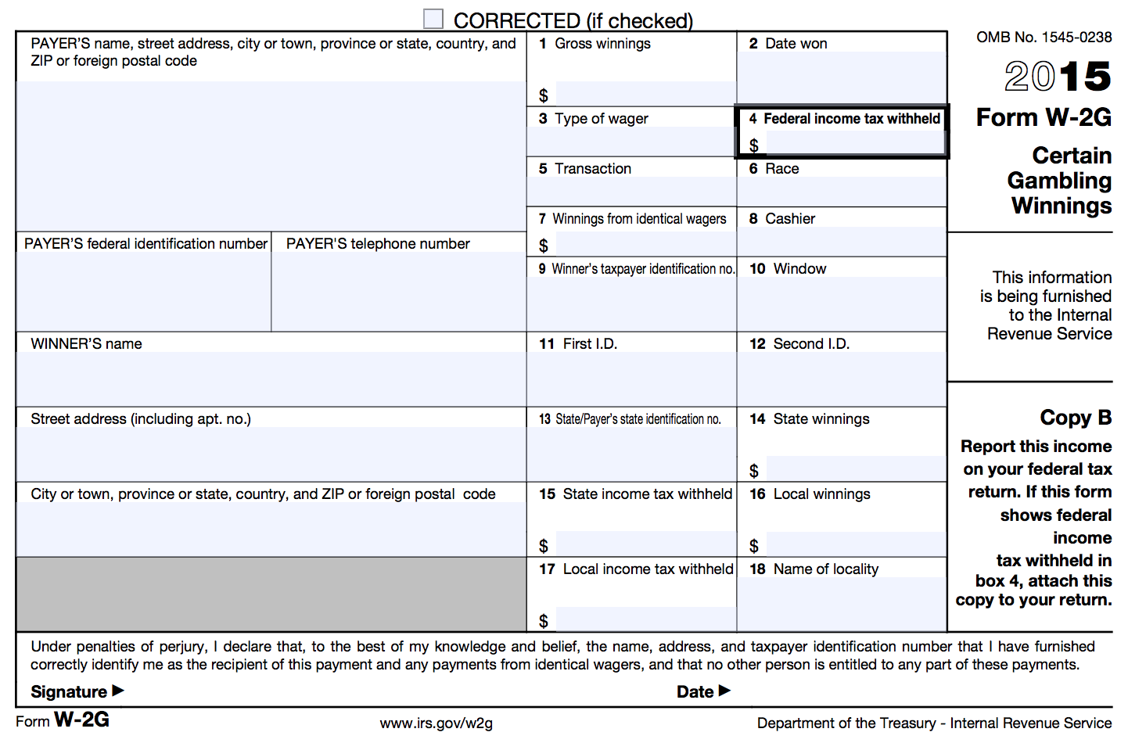
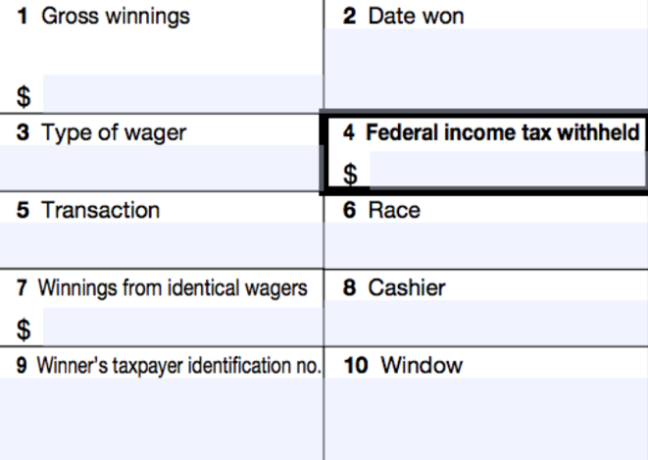
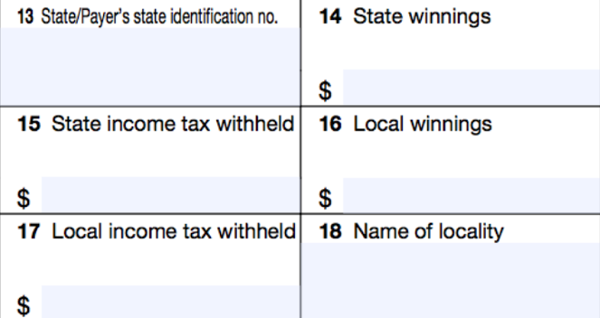
Form W2-G: Certain Gambling Winnings

Slide 181
Form W2-G: Certain Gambling Winnings
A taxpayer may receive one or more Form W2-Gs reporting gambling winnings
Classified as unearned income
Note: If a taxpayer has gambling winnings not reported on a Form W2-G, they must still be reported as income on the tax return

Slide 182
Jury Duty Pay
Jury duty pay must be reported as taxable income
Classified as unearned income

Slide 183
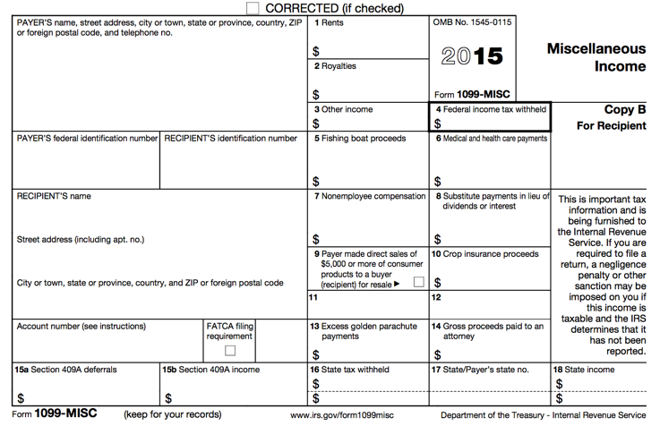


Form 1099-MISC: Miscellaneous Income

Slide 184
Form 1099-MISC: Other Income
Reported in box 3
Other income reported in this box is generally:
  Prizes
  Awards
  Taxable damages (from a lawsuit settlement)
  Other taxable income
Other income in box 3 is classified as unearned income

Slide 185
Form 1099-MISC: Federal Income Tax Withheld
Reported in box 4
Taxpayers can choose to have federal income tax withheld on other income in box 3

Slide 186
Form 1099-MISC: Nonemployee Compensation
Reported in box 7
This is business/self-employment income
Out of scope for basic volunteers
A more advanced volunteer will need to enter the Form 1099-MISC with an amount in Box 7.

Slide 187
Out of Scope for Basic Volunteers
Self-Employment/Business Income (including income reported in box 7 of Form 1099-MISC)
Sale of Stock (Form 1099-B)
IRA/Pension Income (Form 1099-R)
Any form of income we did not just cover
Impact America staff or Advanced trained volunteers must prepare these for taxpayers at our sites

Slide 188
TaxSlayer – Beth Branch
Login to TaxSlayer
  Vita.taxslayerpro.com/irstraining
  Password: TRAINPROWEB
  Username: SMITHJTRAIN (last name, first initial, TRAIN)
  Password: SavefirstAL123!
Enter all income (wages, social security, unemployment, interest, dividends, gambling winnings, household employee, jury duty, other income)

Slide 189
Standard Deduction

Slide 190
Standard Deduction Objectives
After completing this section, the volunteer will be able to:
  Explain how the standard deduction is determined for each taxpayer
  Distinguish when a taxpayer should itemize deductions and when a taxpayer should take the standard deduction

Slide 191
Standard Deduction
Reduces amount of income that is taxed
Amount of deduction based on
  Filing Status
  Age
  Whether taxpayer/spouse is blind
  Whether taxpayer is a dependent
Calculated automatically in TaxSlayer

Slide 192
Standard Deduction for Most Filers
Open the Publication 4012 to the Deductions Tab to Exhibit1: Standard Deduction for Most People
This table provides the standard deduction amounts for the current tax year

Slide 193
Itemized Deductions
Instead of taking the standard deduction, a taxpayer can choose to itemize, which is to list certain deductible expenses separately, in order to receive a greater deduction

Slide 194
Itemized Deductions
Itemized deductions include (but are not limited to):
  Un-reimbursed medical expenses
  Charitable contributions
  Home mortgage payments

Slide 195
Itemized Deductions
Let’s look at the I/I form
If the taxpayer has medical expenses, charitable contributions, home mortgage interest, or other itemizable expenses, the itemized deduction might be better than the standard.

Slide 196
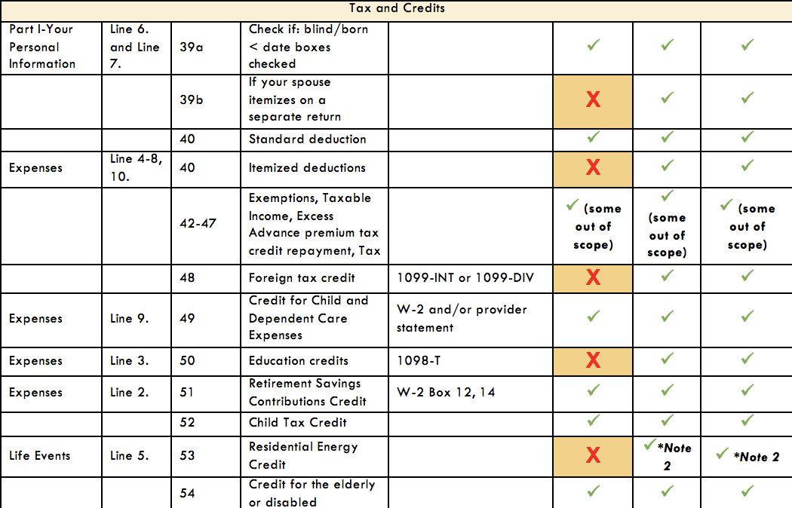
Itemized Deductions
Let’s look at the scope of service chart.
Out of Scope for Basic Volunteers
Impact America staff or Advanced trained volunteers must complete itemization at tax sites

Slide 197
Scope of Service Questions

Slide 198
Exercise
Margaret has filled out her I/I form and after the interview you conduct, you conclude she has the following types of income:
Use your scope of service chart!
Wages(W-2)
Interest(1099-INT)
Alimony Income
Retirement (Form 1099-R)
Social Security Benefits(SSA-1099)

Slide 199
Exercise – Answer
Wages(W-2)-
Interest(1099-INT)
Alimony Income
Retirement (Form 1099-R)
Social Security Benefits(SSA-1099)

Slide 200
Exercise
Margaret has filled out her I/I form and after the interview you conduct, you conclude she has the following types of expenses:
Use your scope of service chart!
Supplies for Classroom(She’s a teacher)
Student Loan Interest
Charitable Donations
Prescription Drugs
Penalty on early withdrawal from her savings account(1099-INT)

Slide 201
Exercise – Answer
Supplies for Classroom(She’s a teacher)
Student Loan Interest
Charitable Donations
Prescription Drugs
Penalty on early withdrawal from her savings account(1099-INT)

Slide 202
Nonrefundable Credits

Slide 203
Nonrefundable Credits Objectives
After completing this section, the volunteer will be able to:
  Assess a taxpayer’s eligibility for the Child & Dependent Care Expenses Credit
  Explain how a taxpayer qualifies for the Child Tax Credit
  Assess a taxpayer’s eligibility for the Retirement Savings Contribution Credit

Slide 204
Nonrefundable Tax Credit
Reduces the tax liability – only to zero.
  Child and Dependent Care Expenses
  Child Tax Credit
  Retirement Savings Contribution Credit

Slide 205
Determining Nonrefundable Credits
Open the Publication 4012 to the Nonrefundable Credits tab
Use this tab to help determine if a taxpayer qualifies for any nonrefundable credits

Slide 206
Nonrefundable Tax Credit
Let’s look at the I/I form
If the taxpayer has childcare expenses or they contributed to a retirement account, they should indicate as such on the “Expenses” section of the I/I form.

Slide 207
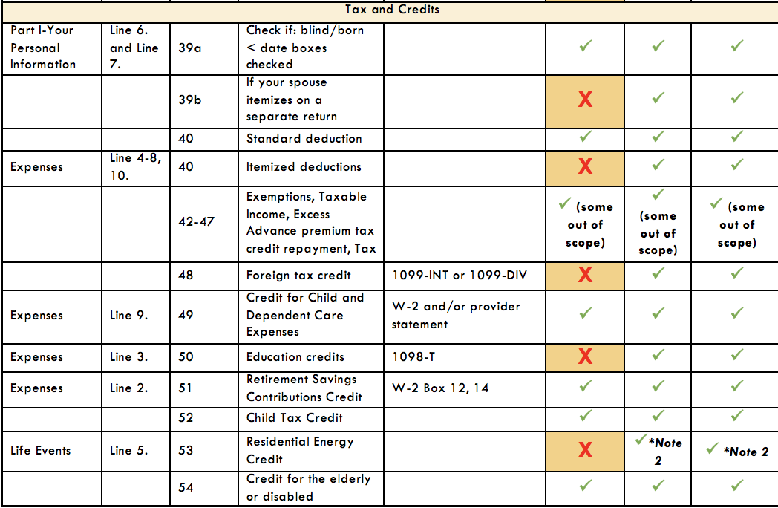
Nonrefundable Tax Credit
Let’s look at the scope of service chart
If a credit is out of scope for you, just set it aside for your advanced volunteer and make a note on the back of the I/I form.

Slide 208
Child & Dependent Care Expenses Credit
Nonrefundable credit
Applied to offset expenses paid so taxpayer can work or look for work
  Dependent child under 13
  Spouse who is incapable of self-care
  Dependent who is incapable of self-care

Slide 209
Child & Dependent Care Expenses Credit: Eligibility
Care had to be for qualifying persons
Taxpayer (and spouse) had to have earned income
  A spouse is treated as having earned income for any month the spouse is physically/mentally incapable of care, or is a full-time student.

Slide 210
Child & Dependent Care Expenses Credit: Eligibility
Expenses must have been for work or to look for work
Payments can’t have been made to taxpayer’s spouse, dependent child or child under 19
Must have care provider’s name, address, and SSN/EIN (due diligence)

Slide 211
Child & Dependent Care Expenses Credit: Qualified Work-Related Expenses
Expenses must be paid for the care of the qualifying person to allow the taxpayer (and spouse) to work or look for work
Care includes the costs of services for the qualifying person’s well-being and protection

Slide 212
Child & Dependent Care Expenses Credit: Qualified Work-Related Expenses
Expenses to attend Kindergarten or a higher grade: NOT AN EXPENSE
Expenses for summer day-camp qualify, but those for over-night camp are not!
$3,000 limit for one qualifying person or $6,000 for two or more qualifying persons.

Slide 213
Child & Dependent Care Expenses Credit:
Notes
If you had expenses that met the requirements for the previous tax year, except that you did not pay them until the current tax year, you may be able to claim them on your tax return.
Taxpayers who cannot provide all of the provider’s information or who have incorrect information may still be able to take the credit if they can show they used due diligence in trying to obtain the info.

Slide 214
Child & Dependent Care Expenses Credit: Employer Provided Benefits
If a taxpayer had employer-provided benefits, they will appear in box 10 of the Form W-2

Slide 215
Child & Dependent Care Expenses Credit:
Employer Provided Benefits
Reported on Form W-2, box 10
These are dependent care benefits the employer paid either directly to the employee or on the employee’s behalf for dependent care expenses (i.e., to daycare)
Amounts paid on behalf of the taxpayer by the employer will reduce the dollar amount of the credit

Slide 216
Child & Dependent Care Expenses Credit: Divorced/Separated Parents
Custodial parent can claim the Child & Dependent Care Expenses Credit, even if he/she did not claim the dependency exemption
This situation is complicated to determine. SEE YOUR SITE COORDINATOR

Slide 217
Exercise
Julie spent the following amounts on child care for her 10-year-old daughter Melissa. Are any of these eligible costs for the Child & Dependent Care Expenses Credit?
$300 for overnight camp
$1000 to her ex-husband for after school-care
$1500 to her mother for after-school care
$500 to her 15-year-old son for babysitting

Slide 218
Exercise – Answer
Julie spent the following amounts on child care for her 10-year-old daughter Melissa. Are any of these eligible costs for the Child & Dependent Care Expenses Credit?
$300 for overnight camp – NO
$1000 to her ex-husband for after school care
$1500 to her mother for after-school care
$500 to her 15-year-old son for babysitting

Slide 219
Exercise– Answer
Julie spent the following amounts on child care for her 10-year-old daughter Melissa. Are any of these eligible costs for the Child & Dependent Care Expenses Credit?
$300 for overnight camp – NO
$1000 to her ex-husband for after school care – NO
$1500 to her mother for after-school care
$500 to her 15-year-old son for babysitting

Slide 220
Exercise – Answer
Julie spent the following amounts on child care for her 10-year-old daughter Melissa. Are any of these eligible costs for the Child & Dependent Care Expenses Credit?
$300 for overnight camp – NO
$1000 to her ex-husband for after school care – NO
$1500 to her mother for after-school care – YES
$500 to her 15-year-old son for babysitting

Slide 221
Exercise– Answer
Julie spent the following amounts on child care for her 10-year-old daughter Melissa. Are any of these eligible costs for the Child & Dependent Care Expenses Credit?
$300 for overnight camp – NO
$1000 to her ex-husband for after school care – NO
$1500 to her mother for after-school care – YES
$500 to her 15-year-old son for babysitting – NO

Slide 222
Child Tax Credit
One credit for each qualifying child under 17 years of age
A taxpayer can claim a Child Tax Credit for a child only if they CAN AND DO claim a dependency exemption for the child
Nonrefundable credit with a maximum of $1,000 per child.
  Amount actually claimed depends on taxpayer’s tax liability, MAGI and filing status
  MAGI: typically same as AGI

Slide 223
Child Tax Credit
This is a credit intended to reduce the tax liability owed by the taxpayer, therefore, this part of the credit is nonrefundable
However, the taxpayers may be able to take the Additional Child Tax Credit, which is refundable
The tax software automatically calculates this, but you should be familiar with the rules in case the taxpayer has questions!

Slide 224
Retirement Savings Contributions Credit: General Eligibility Requirements
A contribution to an IRA or other qualified plan for the tax year
AGI limitations (vary based on filing status)
Age 18 or older
Not claimed as a dependent on someone else’s tax return
Not a full-time student during the tax year

Slide 225
Retirement Savings Contribution Credit: Form W-2

Slide 226
Retirement Savings Contribution Credit: Contributions Record
How do I know if the taxpayer has made a qualifying contribution?
  Form W-2, Box 12 and one of the codes: D, E, F, G, H, S, AA or BB
  Form W-2, Box 14 and codes for military personnel: Q or E
CAUTION: Entries in box 14 that are treated a employer contributions are NOT eligible for the credit

Slide 227
Retirement Savings Contributions Credit: Eligible Contributions
Some retirement distributions reduce the eligible contributions for the credit
In addition to retirement distributions made during the current tax year, the taxpayer must also reduce eligible contributions for distributions taken during the previous two tax years

Slide 228
Exercise
Bob, age 48, contributed $600 to an IRA during the tax year. During the year, he worked full-time and had an AGI of $24,000. He is not a student. Is Bob eligible to claim the Retirement Savings Contribution Credit?

Slide 229
Exercise – Answer
Yes: Bob contributed to an IRA, meets the age and AGI limits, is not a dependent and is not a full-time student.

Slide 230
Scope of Service Questions

Slide 231
Exercise
Use your scope of service chart!
Anna has filled out her I/I form and after the interview you conduct, you conclude she has the following types of expenses:
Daycare expenses for son
Education Expenses for her daughter(1098-T)
Contributed to a retirement account through her job(indicated in Box 12 and 13 of W-2)

Slide 232
Exercise – Answer
Daycare expenses for son
Education Expenses for her daughter(1098-T)
Contributed to a retirement account through her job(indicated in Box 12 and 13 of W-2)

Slide 233
TaxSlayer – Beth Branch
Login to TaxSlayer
  Vita.taxslayerpro.com/irstraining
  Password: TRAINPROWEB
  Username: SMITHJTRAIN (last name, first initial, TRAIN)
  Password: SavefirstAL123!
Enter Child & Dependent Care Expenses Credit, Retirement Savings Contribution Credit

Slide 234
Reminders
Don’t forget to complete paperwork on your volunteer profile
Please bring your training materials back to the B session.

Slide 235
Sign Up For a Testing Session
Please remember to sign up for a Testing Session! These are optional but can be very helpful if you have questions while taking the test.
To see Testing Sessions available to you:
  Log in to your account at volunteers.generationforchange.org
  Select “Register for a Testing Session (Recommended)”
  Select “Register” for the training session you would like to attend

Slide 236
Volunteer Basic Tax Training
B Session

Slide 237
Training Outline: B Session
1) Refundable Credits
  Additional Child Tax Credit
  Earned Income Credit
2) Affordable Care Act
3) State Return
4)Refund/Amount Owed

Slide 238
Training Outline: B Session
5) Tax Preparation Process
  Preparing the Return in TaxSlayer
  Quality Review
  Finishing the Return
  Filing the Return

Slide 239
Training Outline: B Session
6) Out of Scope Topics
  Additional Affordable Care Act Tax Provisions
  Retirement Income: IRAs and Pensions
  Itemized Deductions
  Education Credits & Student Loan Interest
7) Intake/Interview & Quality Review Process
8) Volunteer Standards of Conduct

Slide 240
Refundable Credits

Slide 241
Refundable Credits Objectives
After completing this section, the volunteer will be able to:
  Explain how a taxpayer qualifies for the Additional Child Tax Credit
  Assess a taxpayer’s eligibility for the Earned Income Tax Credit

Slide 242
Refundable Tax Credit
Reduces tax liability to zero
Taxpayer will receive the remainder of the credit value as a refund.
  Additional Child Tax Credit
  Earned Income Tax Credit

Slide 243
Additional Child Tax Credit
The Child Tax Credit is intended to reduce the tax liability owed by the taxpayer, therefore, this part of the credit is nonrefundable
However, the taxpayers may be able to take the Additional Child Tax Credit, which is refundable

Slide 244
Additional Child Tax Credit
Refundable credit with a maximum of $1000 per child
Amount claimed depends upon meeting general eligibility requirements as well as how much of the nonrefundable Child Tax Credit is claimed
  Cannot claim more than $1000 of CTC and additional CTC combined for one child

Slide 245
Additional Child Tax Credit:
General Eligibility
Meet all the requirement of the Child Tax Credit
  Under 17, U.S. citizen, dependent of taxpayer, qualifying relationship, child did not provide over ½ of own support, lived with taxpayer for more than ½ of year
Must have $3,000 of taxable earned income
  Exception: Taxpayers with three or more children may be eligible regardless of their income

Slide 246
Earned Income Credit
Refundable tax credit for low-to-moderate income workers to encourage work, offset payroll and income taxes, and help meet basic need
The EIC is the largest federal anti-poverty program and has been one of the most successful programs to lift families, especially families with children, out of poverty

Slide 247
Earned Income Credit
An estimated 26 million households received more than $65.6 billion in reduced taxes and refunds in the tax year 2015*
*Source: Calendar Year Report, June 2016

Slide 248
Earned Income Credit
In the tax year 2015, the EIC lifted an estimated “6.5 million people out of poverty, including about 3.3 million children”
The EIC has been especially successful in providing an incentive for single mothers with children to find work
*Source: The Center for Budget and Policy Priorities

Slide 249
Encouraging Work and Reducing Poverty
Research has also found that children in families who get an income boost from the EIC and CTC quickly show improvements in health and school performance relative to other low-income children who did not receive this extra help
In addition, children whose families receive that boost have higher school test scores, on average, and are more likely to go to college and to work and earn more as adults
*Source: The Center for Budget and Policy Priorities

Slide 250
EIC and Alabama Families
498,000 Alabama households received EIC in 2016 for tax year 2015
153,000 Alabamians were lifted out of poverty by the EIC and CTC combined, including 80,000 children, each year, on average, during 2011 to 2013
The EIC put about $1.4 billion into Alabama’s economy in 2012
*Source: The Center for Budget and Policy Priorities

Slide 251
Earned Income Credit
Critics of the EIC have complained that it is too complex, forcing recipients to seek help in filing their return
Two-thirds get such assistance, most from paid tax preparers
It is our job to provide high-quality tax preparation to ensure these families receive the full amount of the EIC they are eligible for!

Slide 252
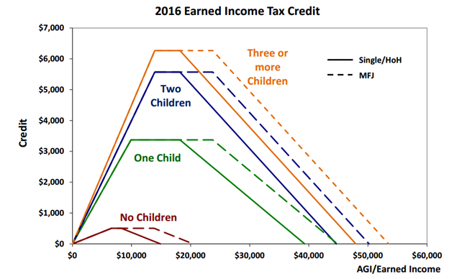
Earned Income Credit: Maximum Credit Amounts
Notes:
Picture thanks to
Tax Policy Center, a joint project of the Urban Institute and Brookings Institution, posted February 12, 2014; accessed July 20, 2015; web; http://www.taxpolicycenter.org/briefing-book/key-elements/family/eitc.cfm

Slide 253
Determining the Earned Income Credit
Open the Publication 4012 to the Earned Income Credit Tab
Use this tab to help determine if a taxpayer qualifies the Earned Income Credit

Slide 254
Earned Income Credit: Eligibility Requirements
Rules for everyone:
  Must have earned income (and AGI has limits)
  Valid SSNs and U.S. citizens/resident aliens
  Not Married Filing Separately
  No foreign earned income
  Limit on investment income
  Taxpayer cannot be qualifying child of another person

Slide 255
Earned Income Credit: Eligibility Requirements
Rules if taxpayer does NOT have a qualifying child:
  Cannot be claimed as a dependent by another person
  Must be at least 25 but under 65 on December 31st of the tax year
  Must have lived in the United States (and spouse, if MFJ) for more than ½ of the year

Slide 256
Earned Income Credit: Eligibility Requirements
Rules if taxpayer has a qualifying child:
  Qualifying child must have a valid SSN that allows him/her to work
  [Relationship Test] Child must be the taxpayer’s:
    son, daughter, stepchild, eligible foster child
    brother, sister, half brother, half sister, stepbrother, stepsister, or descendent of any of them

Slide 257
Earned Income Credit: Eligibility Requirements
Rules if taxpayer has a qualifying child:
  [Age Test] Child must be
    Under age 19 at the end of the tax year, OR
    Under age 24 and a full-time student at the end of the tax year, OR
    Any age and permanently and totally disabled

Slide 258
Earned Income Credit: Eligibility Requirements
Rules if taxpayer has a qualifying child:
  [Joint Return Test] Qualifying child must not have filed a joint return for the tax year
    Unless the child only filed a joint return with spouse to claim a refund
  [Residency Test] Must have lived with the taxpayer for more than ½ the year
  Must not be the qualifying child of another person

Slide 259
Earned Income Credit: Eligibility Requirements
Note: Just because a person qualifies as the dependent of the taxpayer does not mean they automatically make the taxpayer eligible for the EIC
Child in question must meet the age, relationship, residency, and joint return tests to qualify (therefore, Qualifying Children always meet requirements, HOWEVER, Qualifying Relatives DO NOT)

Slide 260
Earned Income Credit: Qualifying Child of More than One Person
Sometimes, a child meets all of the tests to be claimed by more than one taxpayer
A child cannot be used by more than one person to claim the EIC
The rules for determining who claims the child for EIC are the same as those for determining who claims the the child as a dependent
If this situation arises, please see your Site Coordinator

Slide 261
Earned Income Credit: Disallowance
EIC can be disallowed for
  Reckless or intentional disregard of the rules: 2 years
  Fraudulent Claim: 10 Years
To claim EIC again, a taxpayer must
  Wait full period of disallowance
  Submit a Form 8862 with the tax return
If this situation arises, please see your Site Coordinator

Slide 262
Exercise
Sharon, who has an earned income and AGI of $15,525, takes care of her sister’s son, Eric. If Eric is 12 years old and began living with Sharon in August, can Sharon claim the EIC?

Slide 263
Exercise – Answer
No
Sharon’s AGI is too high to claim the EIC alone, and since Eric lived with her for less than half a year, he is not her qualifying child

Slide 264
Exercise
Doug and Donna are married and live together with their 4-year-old son Sam. Their combined earned income is $25,000, but they file separately. Doug reports an AGI of $11,000 on his return, and Donna reports AGI of $14,000.
Can Doug and/or Donna claim the EIC?

Slide 265
Exercise – Answer
No
Neither can claim the EIC because both have a filing status of Married Filing Separately

Slide 266
Example
Doug and Donna are still married and still live together with Sam, but now they decide to file a joint return. Their combined earned income and AGI are $25,000. Can they claim the EIC on this return?

Slide 267
Example – Answer
Yes
Their joint income is low enough to claim the EIC with one qualifying child (Sam)

Slide 268
Example
Tom is 64 years old, retired and collected $10,000 of social security during the tax year. He does not have any qualifying children.
Can he claim the EIC on his return?

Slide 269
Example – Answer
No
Tom does not have any earned income

Slide 270
Earned Income Credit
The software automatically calculates the amount of this credit. You will answer due diligence questions that determine a taxpayer’s eligibility for the credit.
You just need to be familiar with the rules if the taxpayer has questions!

Slide 271
TaxSlayer – Beth Branch
Login to TaxSlayer Vita.taxslayerpro.com/IRSTRAINING
  Password: TRAINPROWEB
  Username: SMITHJTRAIN (last name, first initial,TRAIN)
  Password: SavefirstAL0217!
Enter Earned Income Credit (EIC due diligence)

Slide 272
Refund & Amount of Tax Owed

Slide 273
Refund & Amount of Tax Owed Objectives
After completing this section, the volunteer will be able to:
  Explain the taxpayer’s options when receiving a tax refund
  Explain the options available to a taxpayer that has tax due

Slide 274
Refunds
Taxpayers can choose to receive their refund either by check or direct deposit
Checks take 6-8 weeks to be mailed
Electronic deposits will be made in 1-2 weeks
Taxpayers can also choose to allocate part of their refund to order savings bonds
Notes:
‹#›

Slide 275
Refunds: Direct Deposit
Encourage taxpayers to use direct deposit
  But, refunds will be delayed 4-6 weeks if the routing and account numbers are not valid
Refunds may only be deposited into their own accounts
Refunds can be deposited in up to three accounts

Slide 276
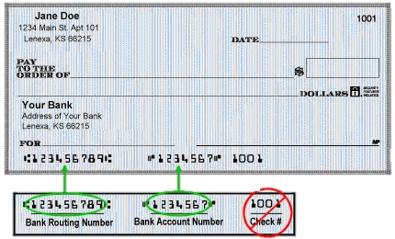
Refunds: Direct Deposit
Routing number (9 digits): can look up online
Account number: do not include check number!
Do NOT include spaces or hyphens!

Slide 277
Refunds: Electronic Deposit
If a mistake is made that increases the amount of the refund, the IRS will send a letter explaining the changes in the adjustment
If a taxpayer owes debts (child support or student loans), the IRS will decrease the refund after you E-file it
  Encourage taxpayers to still E-file
  We do not have access to any of this information!
Notes:
‹#›

Slide 278
Refunds: Savings Bonds
Our Role
  Explain opportunity - describe savings bonds & chance to order at tax site
  Seek decision – ask client to decide if, how much & for whom to order bonds
  Process order – complete IRS Form 8888
The Government will mail a physical bond to the taxpayer at the address listed on the return.

Slide 279
Refunds: Savings Bonds
All taxpayers can buy bonds for
  Themselves
  And/or 2 other people (kids, grandkids, spouses, nieces/nephews, godchildren, etc.)
How it works
  Taxpayer needs only name of gift recipient
  Client & gift recipient will be listed on bond as co-owners
  Either party may redeem bond

Slide 280
Refunds: Rate of Return Comparison
 | Savings Account* | 1 Year CD* | Series I U.S. Savings Bond
Rate of Return | .17% | .73% | 2.20%
Annual Fees | $0 | $0 | $0
Minimum to Open | $100 | $1,000 | $50
Rate Fixed | No | Yes | Adjusts bi-annually
Minimum Holding Period | None | 1 year | 1 year
Early Redemption Penalty / Forfeiture | None | All interest earned to withdrawal date | 3 months interest (redemptions within 5 years of purchase)
ChexSystems (Application) | Yes | Yes | No
May Buy as a Gift | No | No | Yes

Slide 281
Tax Due
Taxpayers do not have to pay if balance due is less than $1
Payment in full is due by the April filing due date, to avoid interest and penalties
Taxpayer should file his/her return by the April filing date to avoid a failure-to-file penalty
There are separate penalties for filing late and paying late – the late filing penalty is higher

Slide 282
Tax Due
Advise taxpayers to file the return on time, even if they cannot pay the full amount owed
They should pay as much as possible by the due date to reduce penalties and interest
Once taxpayers receive a notice, they can pay the remaining amount in full or choose another payment option if needed

Slide 283
Tax Due
Payment options:
  Pay by check or money order with Form 1040-V (Payment Voucher)
  Pay by direct debit from their checking/savings account on a date that they choose (up to the due date)
Notes:
‹#›

Slide 284
Tax Due
Payment options:
  Pay with a credit or debit card (convenience fee)
  Electronic Federal Tax Payment System (EFTPS)
    Taxpayers can use EFTPS to file taxes, but they must enroll first (www.irs.gov/e-pay)
  IRS Direct Pay
    Free, one-time payment system offered through IRS.gov
Notes:
‹#›

Slide 285
Tax Due: What if the Taxpayer Cannot Pay?
Pay in full within 120 days
  If taxpayer can pay in full within 120 days, can avoid paying a fee to set up an installment agreement
Apply online for a payment agreement
  Taxpayer can apply online for a payment agreement by going to IRS.gov and searching for “Online Payment Agreement” or “OPA”

Slide 286
Tax Due: Undue Hardship
Taxpayers who can show they will have a substantial financial difficulty if they pay their tax on the due date are considered to have undue hardship.
Can request an extension by filing Form 1127 (out of scope) by the due date
  Advise them to visit or call the local IRS office
Undue hardship is MORE than inconvenience!

Slide 287
Tax Due: Estimated Tax Penalty
Out of Scope for VITA!
Calculated on Form 2210 and reported in the Amount You Owe section on Form 1040
Taxpayers must make estimated tax payments if they expect to owe at least $1,000 and their withholding and credits will be less than the smaller of:
  90% of the tax shown on the current return
  100% of the tax shown on the prior year return

Slide 288
Tax Due
To avoid having tax due next year:
  Adjust withholding on Form W-4 (from employer)
    Taxpayers should submit a revised form when there is a change in life events (marriage, child, etc.)
  Make quarterly estimated tax payments
    Out of Scope for VITA!
Notes:
‹#›

Slide 289
Affordable Care Act

Slide 290
What is the Affordable Care Act (ACA)?
The federal government, state governments, insurers, employers, and individuals share responsibility for improving the quality and availability of health insurance coverage in the United States
The ACA reforms the existing health insurance market by prohibiting insurers from denying coverage or charging higher premiums because of an individual's pre-existing conditions.
The ACA also created the Health Insurance Marketplace (also known as www.healthcare.gov)

Slide 291
Shared Responsibility Provision
The Affordable Care Act requires individuals to:
  Have qualifying health coverage, called minimum essential coverage, for each month of the year
  Qualify for a coverage exemption, OR
  Make a shared responsibility payment when filing their federal income tax returns
    This is essentially a tax penalty for not having coverage

Slide 292
What is Minimum Essential Coverage?
Minimum essential coverage (MEC) is health coverage that satisfies the individual shared responsibility requirement
Most health insurance is MEC
No proof of coverage is needed. Oral statement from the taxpayer is acceptable, unless normal due diligence leads you to believe the taxpayer’s statement is incorrect

Slide 293
How Many Months Do Taxpayers Need to Have MEC?
Everyone needs MEC for every month
  A person is considered covered for the whole month if they had coverage for at least one day
  A person who was born or died during the year is required to have coverage for every full month alive

Slide 294
What Qualifies as Minimum Essential Coverage?
Employer sponsored health insurance
Individual health insurance
  Purchased directly from a health insurance company OR
  Through the Health Insurance Marketplace (www.healthcare.gov)

Slide 295
What Qualifies as Minimum Essential Coverage?
Government-sponsored health insurance
  Medicare
  Most Medicaid
  ALL Kids (healthcare for kids in AL)
  Healthy Connections Kids(healthcare for kids in SC)
  Florida KidCare
  CoverKids(healthcare for kids in TN)

Slide 296
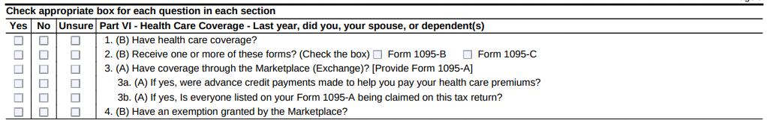
What Qualifies as Minimum Essential Coverage?
As a basic volunteer, you are only allowed to complete the health insurance section in TaxSlayer if the taxpayer had full year coverage all year NOT from the marketplace.

Slide 297
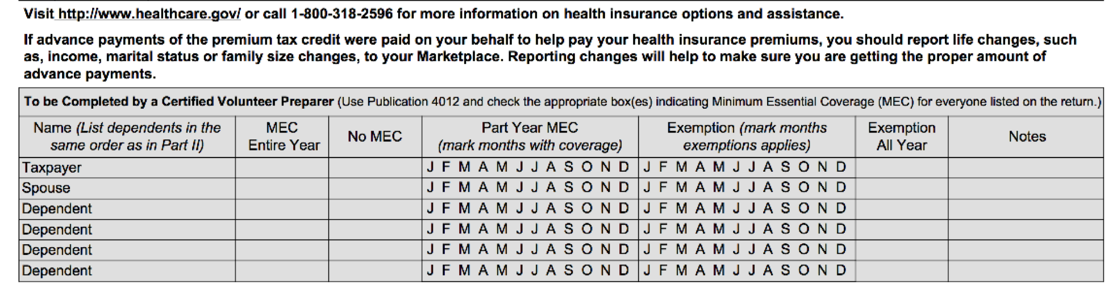
What Qualifies as Minimum Essential Coverage?
In the interview process, you should determine if the taxpayer/spouse/dependents has
MEC for any months of the tax year and mark which months they have coverage.

Slide 298
Premium Tax Credit
Note that some taxpayers may be eligible for a refundable tax credit to help pay for health insurance premiums called the Premium Tax Credit
Any time a taxpayer purchases insurance through the marketplace, they get a 1095-A. A more advanced volunteer must complete the health insurance section.

Slide 299
What if a taxpayer doesn’t have insurance?
A lot of taxpayers will qualify for an exemption and won’t have to pay the penalty.
Any time a taxpayer doesn’t have insurance for any month of the tax year, a more advanced volunteer will need to fill out the Health Insurance Section.

Slide 300
TaxSlayer – Beth Branch
Login to TaxSlayer
Vita.taxslayerpro.com/IRSTRAINING
  Password: TRAINPROWEB
  Username: SMITHJTRAIN (last name, first initial)
  Password: SavefirstAL123!
Complete the Health Insurance Section

Slide 301
Alabama Return

Slide 302
Alabama Return Objectives
After completing this section, the volunteer will be able to:
  Determine if a taxpayer is eligible to claim a personal exemption on the Alabama tax return
  Assess whether a person qualifies as a dependent on the Alabama tax return

Slide 303
Alabama Return Objectives
After completing this section, the volunteer will be able to:
  Choose the most advantageous (and allowable) filing status for a taxpayer on the Alabama tax return
  Differentiate and explain key differences between the taxability of various income types on the federal tax return and Alabama tax return

Slide 304
Who Must File
FULL/PART YEAR RESIDENTS | Single | Married Filing Separately | Head of Family | Married Filing Jointly
Gross Income (while an AL resident) | $4,000 | $5,250 | $7,700 | $10,500

Slide 305
Personal Exemptions
Amount based on filing status
  Single & Married Filing Separately: $1,500
  Head of Family & Married Filing Jointly: $3,000
Dependents:
  Taxpayer receive a personal exemption in Alabama even if they CAN be claimed as a dependent by someone else

Slide 306
Dependency Exemption
Alabama law defines a dependent as:
  an individual other than the taxpayer and his/her spouse WHO
  received over 50% of his/her support from the taxpayer during the year AND
  is related to the taxpayer in a certain way

Slide 307
Dependency Exemption:
The Relationship Test, Pt. 1
Step 1 | Was the person your son, daughter, legally adopted child, stepson, stepdaughter, or grandchild?* OR Was the person your brother, sister, stepbrother, or stepsister? OR Was the person your mother, father, grandmother, grandfather, stepmother, or stepfather? OR Was the person your mother-in-law, father-in-law, brother-in-law, sister-in-law, son-in-law, or daughter-in-law? | If YES: go to Step 4 If NO: go to Step 2

Slide 308
Dependency Exemption:
The Relationship Test, Pt. 2
Step 2 | Was the person your uncle, aunt, nephew, or niece? | If YES: go to Step 3 If NO: not a dependent

Slide 309
Dependency Exemption:
The Relationship Test, Pt. 3
Step 3 | Was the person in Step 2 related to you by blood? | If YES: go to Step 4 If NO: not a dependent

Slide 310
Dependency Exemption:
The Support Test
Step 4 | Did you provide more than 50% of the person’s total support for the year? | If YES: You can claim this person as your dependent If NO: not a dependent

Slide 311
Dependency Exemption: Notes
Most federal dependents also qualify as Alabama dependents
The following DO NOT qualify as Alabama dependents:
  Foster children
  Friends
  Cousins

Slide 312
Filing Status
Single
Married Filing Jointly
Married Filing Separately
Head of Family

Slide 313
Filing Status: Differences from Federal Tax Return
Single, Married Filing Separately, and Married Filing Jointly all correspond with their counterparts on the federal tax return
Qualifying Widow(er) with Dependent Child does not exist on the Alabama tax return
  Taxpayers will instead be classified as Head of Family
Head of Family is similar to Head of Household, but with a couple of key differences

Slide 314
Filing Status: Head of Family
To qualify for Head of Family, ALL of the following must apply:
  Taxpayer is unmarried or legally separated as of December 31st of the tax year
  Taxpayer paid more than ½ the costs of keeping up the home for the year
  A “qualifying person*” lived with the taxpayer in his/her home for more than ½ the year

Slide 315
Filing Status: Head of Family Qualifying Person
Similar to Head of Household qualifying persons
  Qualifying dependent who is taxpayer’s Mother / Father
    A qualifying person whether or not they live in the taxpayer’s home
    A qualifying person whether or not the taxpayer claims them as dependents

Slide 316
Filing Status: Head of Family Qualifying Person
Similar to Head of Household qualifying persons
  Qualifying dependent who is taxpayer’s child / grandchild / great-grandchild / adopted child / stepchild
    A qualifying person whether or not the taxpayer claims them as dependents (single)
    A qualifying person if a taxpayer claims them as a dependent (married)

Slide 317
Filing Status: Head of Family Qualifying Person
Similar to Head of Household qualifying persons
  Other qualifying dependent (brother / sister / aunt / niece / etc.)
    A qualifying person whether or not the taxpayer claims them as dependents

Slide 318
Taxable Income
All income is subject to Alabama income tax unless specifically exempted by state law

Slide 319
Nontaxable Income
Specific types of income that are nontaxable in Alabama include:
  Unemployment Compensation
  Social Security Benefits

Slide 320
Standard Deduction
Filing Status | Deduction Range
Single | $2000-$2500
Head of Family | $2000-$4700
Married Filing Jointly | $4000-$7500
Married Filing Separately | $2000-$3750

Slide 321
Itemized Deductions
The standard deduction is much lower on the Alabama tax return than on the federal tax return
As a result, many taxpayers will itemize deductions on their Alabama tax returns even though they won’t have enough to itemize on their federal tax returns
  Remember, itemizing is out of scope for Basic Volunteers

Slide 322
Finishing the Alabama Return
You will need to answer the following three questions to finish the Alabama return:
  Did the taxpayer file an Alabama return during the previous tax year?
  Who is the taxpayer’s current employer?
  Does the taxpayer have any income on their federal return that is not on their state return?

Slide 323
Finishing the Alabama Return
Did the taxpayer file an Alabama return for the previous tax year?
  Answer YES or NO
If NO, provide an explanation:
  Taxable income too low
  Lived in a different state
  Neglected to file

Slide 324
Finishing the Alabama Return
Who is the taxpayer’s current employer?
  The Alabama return will ask for the employer’s information to be listed on the return
  If multiple, select the W-2 with the higher amount of wages

Slide 325
Finishing the Alabama Return
Does the taxpayer have any income on their federal return that is not on their state return?
  Unemployment Compensation
  Social Security Benefits
  Defined Benefits (advanced volunteers only)
  Railroad Retirement (advanced volunteers only)

Slide 326
Paying a Balance/Receiving a Refund
Much like the federal return, taxpayers can have their refunds directly deposited or they can receive a check
Taxpayers can also have their liabilities directly debited or they can send a check

Slide 327
TaxSlayer – Beth Branch
Login to TaxSlayer (via Google Chrome)
  Vita.taxslayerpro.com/IRSTRAINING
  Password: TRAINPROWEB
  Username: SMITHJTRAIN (last name, first initial,TRAIN)
  Password: SavefirstAL123!
Complete Alabama Return using AL Pub 4012 as a guide!

Slide 328
Tax Preparation Process

Slide 329
Tax Preparation Process
Part 1: Preliminary Interview
Part 2: Preparing the Return in TaxSlayer
Part 3: Quality Review
Part 4: Finishing the Return
Part 5: Filing the Return

Slide 330
Part 2: Preparing the Return in TaxSlayer
Complete the Filing Status, Personal Information, and Dependents.
Click “Enter Myself” on the Income page

Slide 331
Part 2: Preparing the Return in TaxSlayer
Complete the income section, deductions section, the health insurance section, the State section.
Complete the forms: Gen Use, Gen Disclosure and Prep Use
Select the type of return and enter the bank account information.
Review the entire return and take care of any diagnostic errors

Slide 332
Part 2: Preparing the Return in TaxSlayer – Taxpayer and Spouse PIN
In the PIN section, have each taxpayer enter a 5-number pin.
This authorizes us to e-file for the taxpayer!

Slide 333
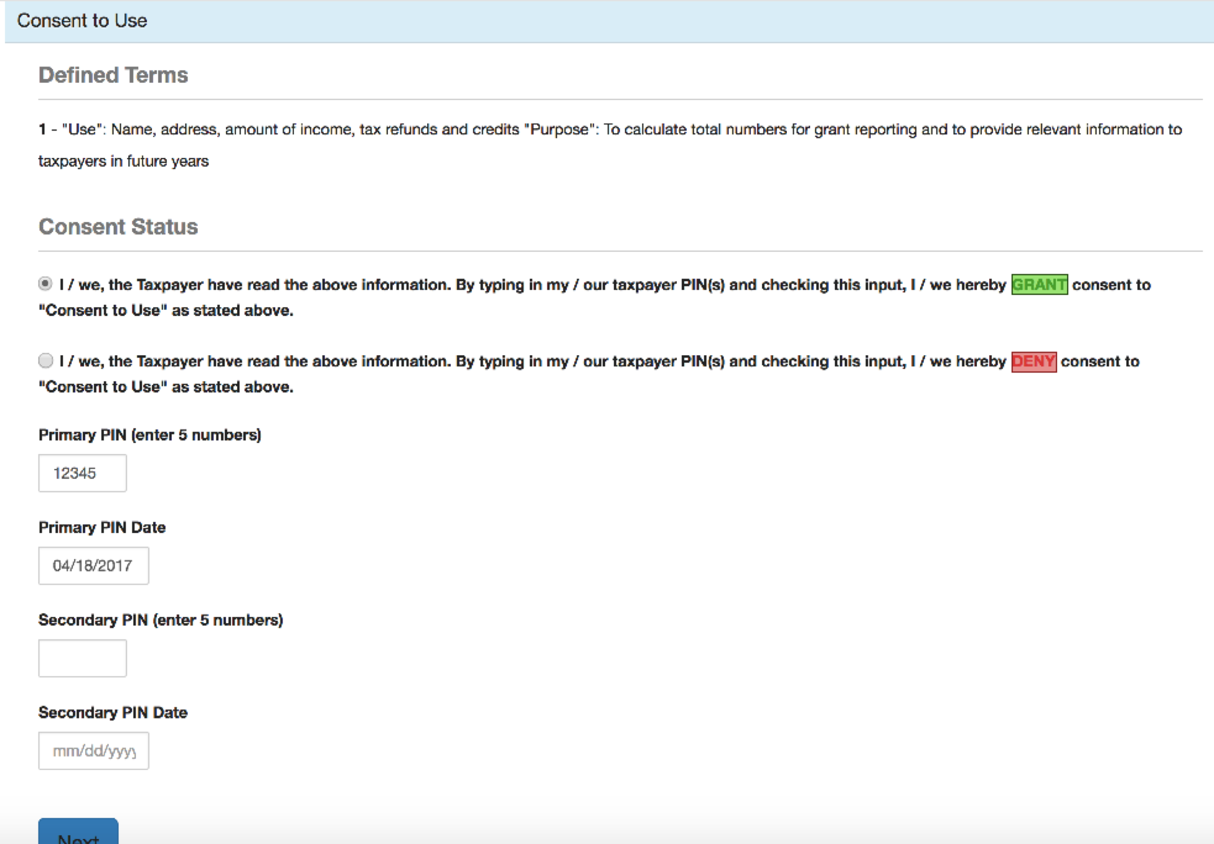
Part 2: Preparing the Return in TaxSlayer – General Use Form

Slide 334
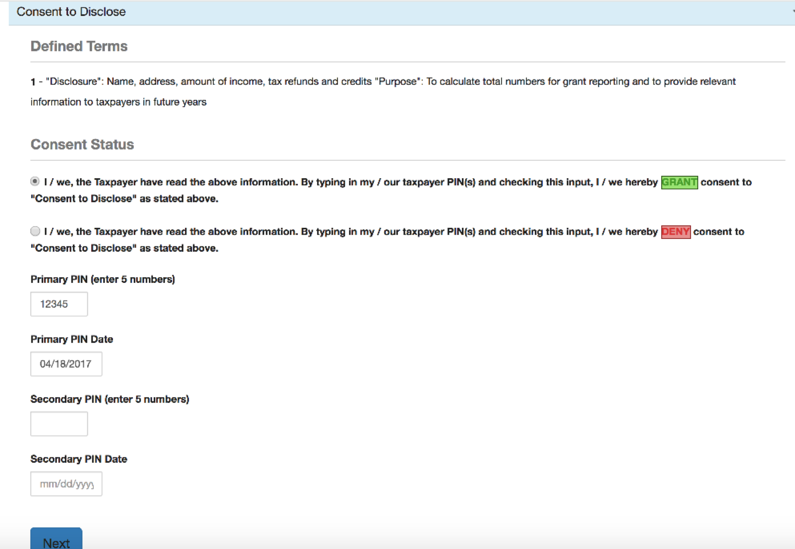
Part 2: Preparing the Return in TaxSlayer – General Disclosure Form

Slide 335
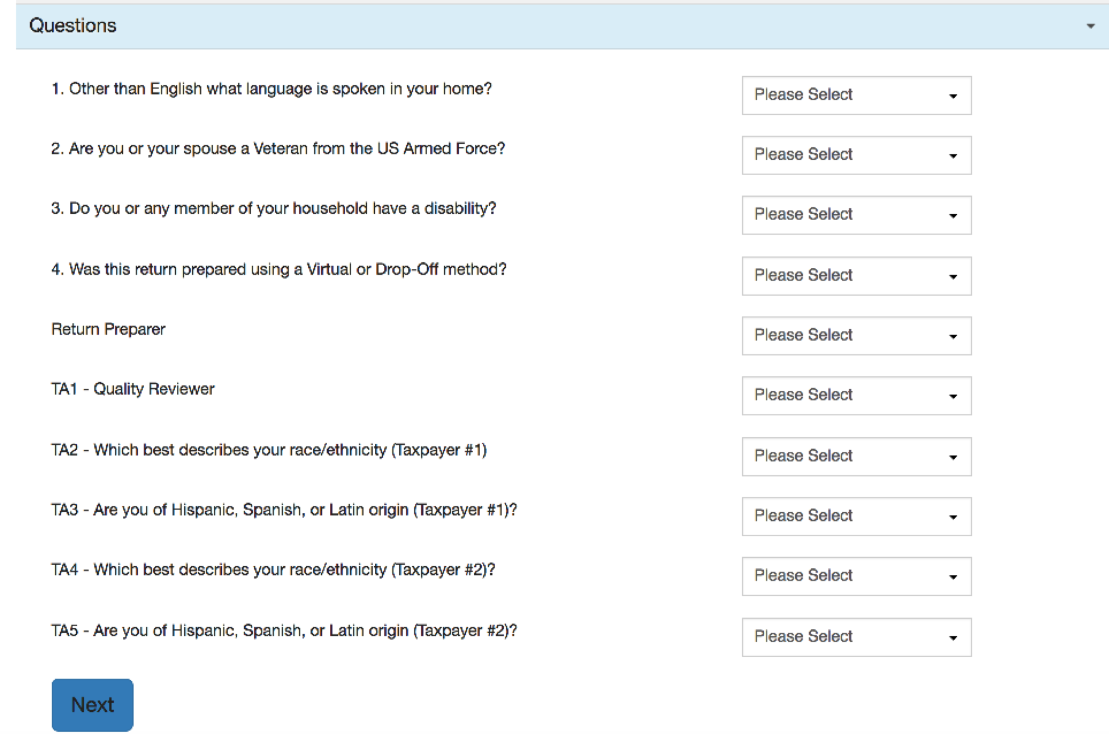
Part 2: Preparing the Return in TaxSlayer – Prep Use Form

Slide 336
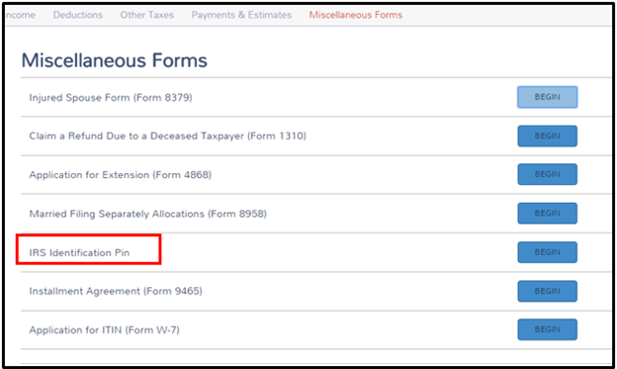
Part 2: Preparing the Return in TaxSlayer – Identity Protection Pin
You’ll enter this on the taxpayer’s return in the “Miscellaneous Forms” section. This won’t affect the taxpayer’s return in any way, but it must be entered or the return will be rejected when it is submitted. This pin ensures that no one fraudulently files their return this year.

Slide 337
Tax Preparation Process
Part 1: Preliminary Interview
Part 2: Preparing the Return in TaxSlayer
Part 3: Quality Review
Part 4: Finishing the Return
Part 5: Filing the Return

Slide 338
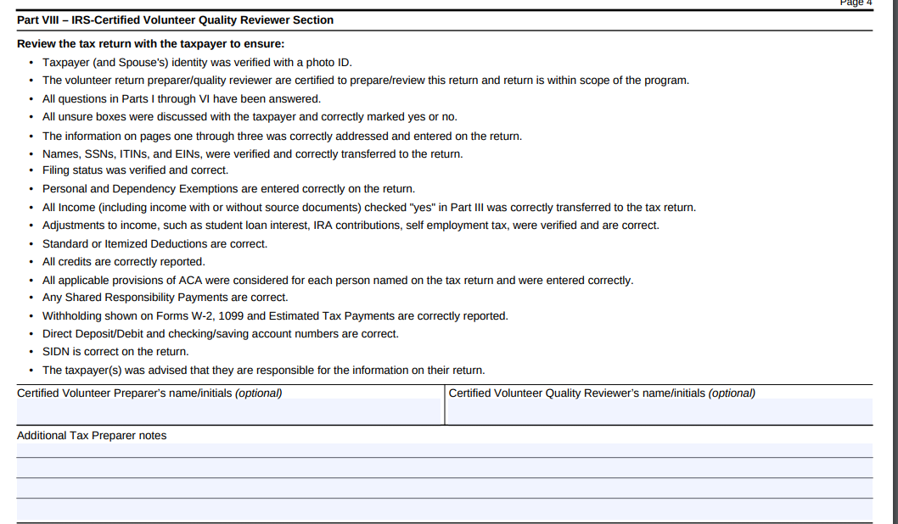
Part 3: Quality Review
Notes:
‹#›

Slide 339
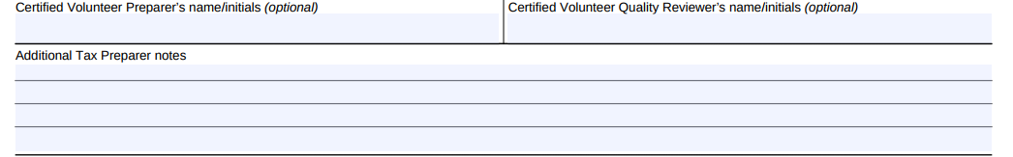
Part 3: Quality Review
Before handing the return off to a quality reviewer, make sure to initial at the bottom of the last page! This is an IRS requirement that we have initials for every preparer and quality reviewer!
Notes:
‹#›

Slide 340
Tax Preparation Process
Part 1: Preliminary Interview
Part 2: Preparing the Return in TaxSlayer
Part 3: Quality Review
Part 4: Finishing the Return
Part 5: Filing the Return

Slide 341
Part 4: Finishing the Return
Write your name on the Intake/Interview Form
Assist quality reviewer with printing and taxpayer signatures
  Taxpayer and spouse must sign and date federal and state returns and keep for their records
File Intake/Interview Form in filing box
  Do NOT keep any personal documents!

Slide 342
Tax Preparation Process
Part 1: Preliminary Interview
Part 2: Preparing the Return in TaxSlayer
Part 3: Quality Review
Part 4: Finishing the Return
Part 5: Filing the Return

Slide 343
Out of Scope Topics

Slide 344
Additional Topics – Out of Scope at Tax Site
IRS changed VITA certification levels
There are more advanced topics on your 2017 IRS Basic Certification test, but you will not prepare these at the tax sites
Let’s look at your Out of Scope Topics Handout!

Slide 345
Additional Topics – Out of Scope at Tax Site
We aren’t going to practice these topics since you won’t be actually doing them at the tax site.
This document will tell you EXACTLY how to complete the topics to get the right answer on the test.

Slide 346
Review: Scope of Service Questions

Slide 347
Scope of Service Questions
Luther Lockett has filled out his I/I form and after the interview you conduct, you conclude he has the following types of income:
1099-INT
W-2
1099-R
SSA-1099
1099-MISC box 7

Slide 348
Scope of Service Questions
Luther Lockett has filled out their I/I form and after the interview you conduct, you conclude they have the following types of income:
1099-INT
W-2
1099-R
SSA-1099
1099-MISC box 7

Slide 349
Scope of Service Questions
Luther Lockett has filled out his I/I form and after the interview you conduct, you conclude he has the following types of expenses:
Prescription drugs
Doctor co-pays
After-school expenses for 7 year old daughter while at work
1098-T education expenses for son who is a freshman at University of Alabama

Slide 350
Scope of Service Questions
Luther Lockett has filled out their I/I form and after the interview you conduct, you conclude they have the following types of expenses:
Prescription drugs
Doctor co-pays
After-school expenses for 7 year old daughter while at work
1098-T education expenses for son who is a freshman at University of Alabama

Slide 351
Scope of Service Questions
Luther Lockett has filled out his I/I form and after the interview you conduct, you conclude the following about his health care coverage for the year:
They received a 1095-A in the mail from the marketplace for months July-December and did not have coverage in January-June
Can you complete the health insurance section?

Slide 352
Scope of Service Questions
Luther Lockett has filled out their I/I form and after the interview you conduct, you conclude the following about his health care coverage for the year:
No, a more advanced volunteer will need to enter the 1095-A and screen them for exemptions for the months January-June

Slide 353
Scope of Service Questions
Lester Loving has filled out his I/I form and after the interview you conduct, you conclude the following about his health care coverage for the year:
They had health insurance through their employer all year.
Their daughter (a dependent) had health insurance through Medicaid all year.
Can you fill out the health insurance section?

Slide 354
Scope of Service Questions
Lester Loving has filled out their I/I form and after the interview you conduct, you conclude the following about their health care coverage for the year:
YES! Since they did not purchase health insurance through the marketplace and had MEC all year, you can fill out the health insurance section.

Slide 355
Mock Tax Site

Slide 356
Mock Tax Site
Partner up and take turns being taxpayer/volunteer!
Use your tax prep process handout!
There are two examples in your packet so:
  Round 1→ Student 1 is taxpayer KK, student 2 is volunteer
  Round 2→ Student 1 is now volunteer and student 2 is taxpayer MM
  Use return you don’t prepare as practice at home! Student 1 can do KK at home, Student 2 can do MM at home. Answer key will be posted online.

Slide 357
Mock Tax Site
Login to TaxSlayer (via Google Chrome)
  Vita.taxslayerpro.com/IRSTRAINING
  Password: TRAINPROWEB
  Username: SMITHJTRAIN (last name, first initial,TRAIN)
  Password: SavefirstAL123!

Slide 358
Intake/Interview & Quality Review Process

Slide 359
Intake/Interview & Quality Review Sheet
Form 13614-C (official IRS version)
All VITA programs are required to use this sheet for every tax return filed at the tax site.

Slide 360
Assuring a Quality Service and Accurate Return
Taxpayers using services offered through the Volunteer Tax Assistance (VITA) and Tax Counseling for the Elderly (TCE) Programs should be confident they receive quality service. This includes having an accurate tax return prepared.
A basic component of preparing an accurate return begins with listening to the taxpayer and asking the right questions.
Form 13614-C, Intake/Interview & Quality Review Sheet, is a tool designed to help the volunteer ask the right questions. When used properly, this form effectively contributes to accurate tax return preparation.

Slide 361
Using this Form Completely and Appropriately
The IRS conducts oversight to ensure that EVERY part of the form is being used appropriately and completely during the interview with the taxpayer and while preparing their return.
The IRS requires compliance with use of this form to ensure high quality tax returns for our VITA program.

Slide 362
Required for Use by IRS VITA Sites
An important tool for accuracy and due diligence!
Must be completed by (or with) the taxpayer.
Will be used to conduct the Quality Review process.
Must be kept at tax site for site records (do not let the taxpayer take the form with them)
No records brought to the site should be kept on file
For privacy and identity protection purposes, SSNs should NOT be printed on the I/I form

Slide 363
Intake/Interview Form is a Huge Asset to You
Provides an extra record for you to double-check information on the tax return in TaxSlayer and note things the taxpayer forgets to mention when speaking with you

Slide 364
The Intake Process: Completing Form 13614-C
In most cases, the taxpayer completes pages 1, 2, and 3 of the Intake Interview Form (Form 13614-C) in the waiting room before sitting down with you, the tax preparer.
Provide assistance as needed (be sensitive and perceptive to the needs of the taxpayers)

Slide 365
Complete an Intake/Interview Form for EVERY Return
We MUST have an intake/interview form on file for EVERY return filed at our tax sites.

Slide 366
The Intake Process: Tax Return and Volunteer Certification Levels
It is a violation of our VITA Grant and IRS Compliance and your Volunteer Standards of Conduct Agreement to file a tax return that is out of scope of the VITA tax site
At SaveFirst sites, to ensure all returns are in-scope for VITA:
  Consult the SaveFirst Scope of Service Chart – at every tax station and in the Site Coordinator Handbook/Campus Fellow Handbook
  If a topic seems complicated or unfamiliar to you, double-check the SaveFirst Scope of Service Chart to be sure it is listed in scope
  Sometimes this determination may be unclear. If you are unsure, talk to your Site Coordinator

Slide 367
The Intake Process: Tax Return and Volunteer Certification Levels
SaveFirst Basic Volunteer Preparers
  Review the 2017 – 2018 SaveFirst Volunteer Scope of Service Chart for SaveFirst Basic Volunteers

Slide 368
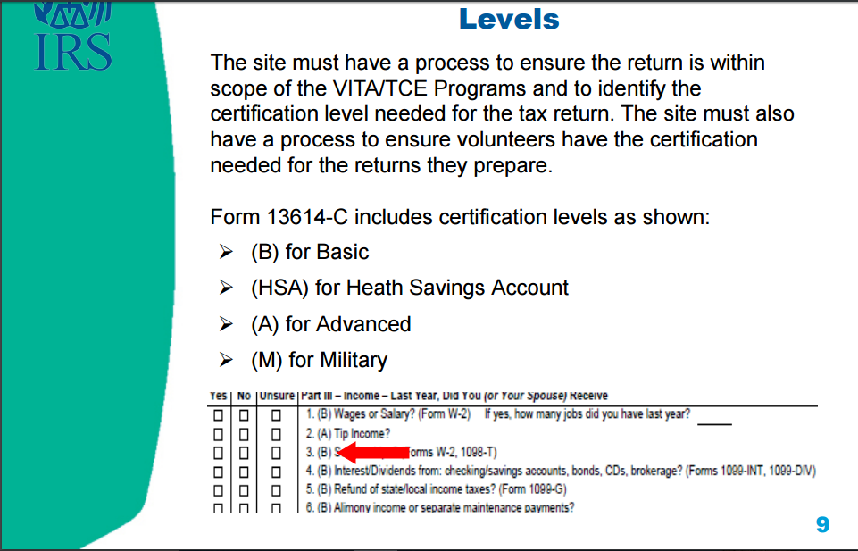

Slide 369
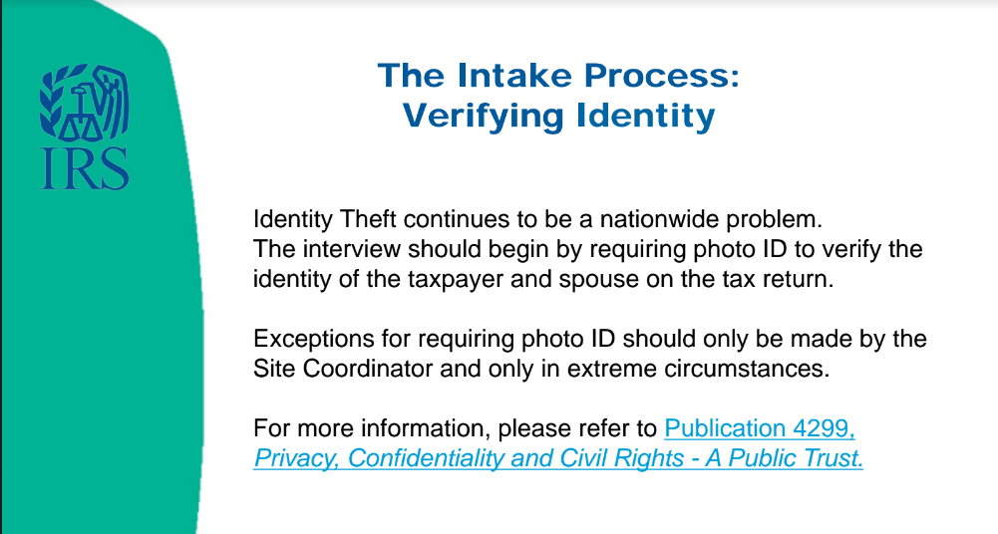

Slide 370
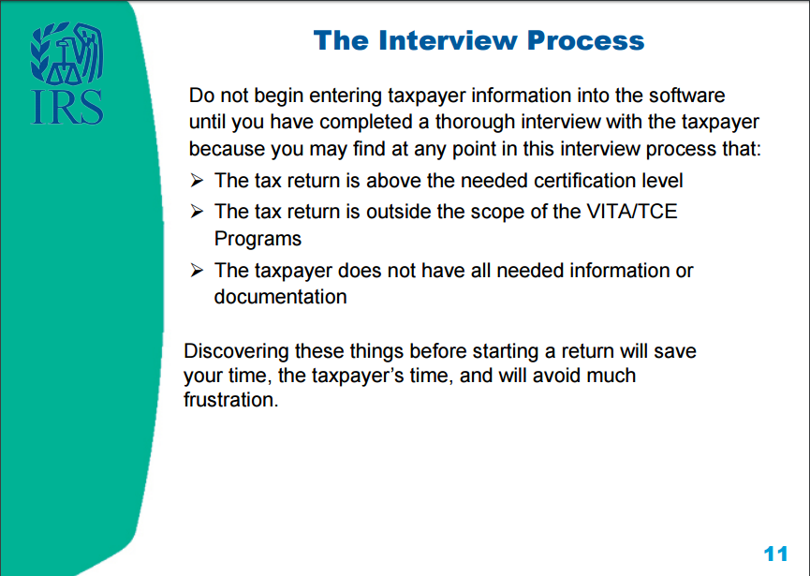

Slide 371
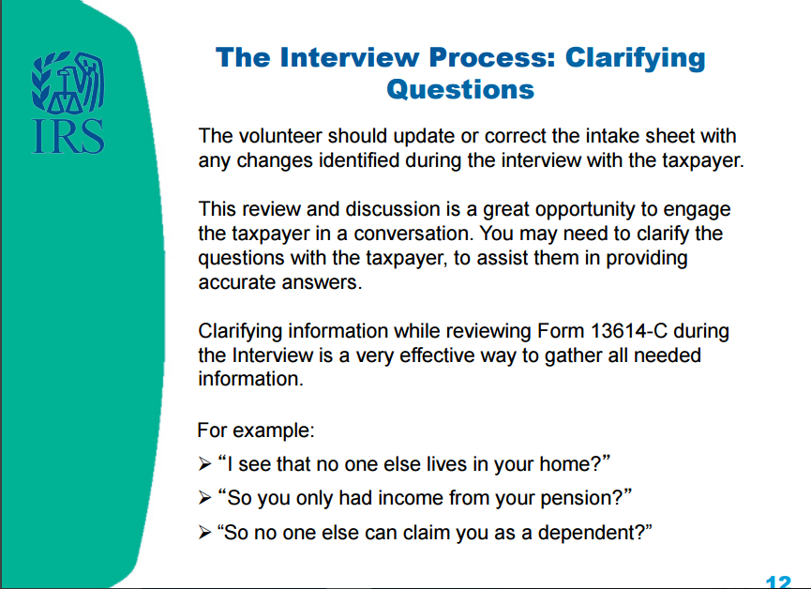

Slide 372

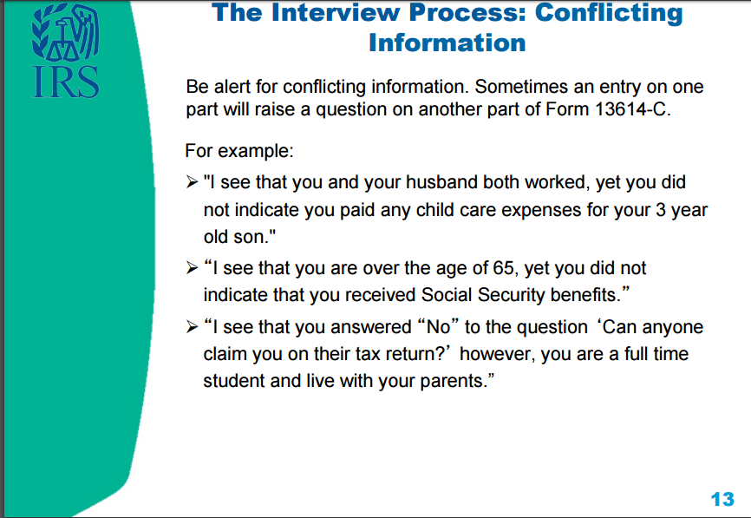

Slide 373
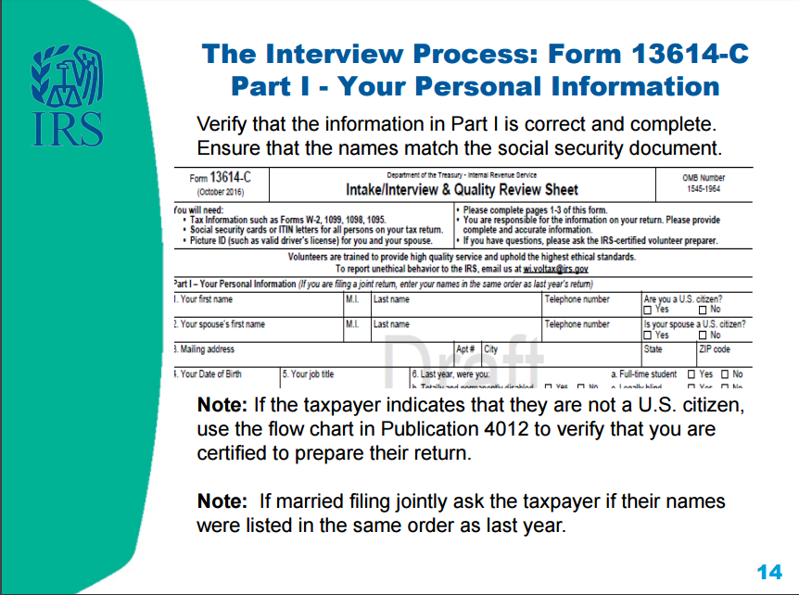

Slide 374


Slide 375


Slide 376


Slide 377


Slide 378


Slide 379


Slide 380


Slide 381


Slide 382


Slide 383


Slide 384


Slide 385


Slide 386


Slide 387


Slide 388
Concepts of the Quality Review
After the quality review is completed, the taxpayer will be advised by the quality reviewer that they are responsible for the accuracy of the information given on the tax return
The last step, after being advised, will be for the taxpayer to sign a paper copy of the return (which they will keep for their records)

Slide 389
Volunteer Standards of Conduct

Slide 390
Volunteer Standards of Conduct
Follow the Quality Site Requirements
Do not accept payment, solicit donations, or accept refund payments for federal or state returns
Do not solicit business or use personal information from taxpayers
Do not knowingly prepare a false return
Do not engage in criminal, infamous, dishonest, notoriously disgraceful conduct
Treat all taxpayers in a professional, courteous manner

Slide 391
Quality Site Requirements
Do only what you are trained to do
Use the intake/interview form for every taxpayer
Ensure a quality review is conducted for every return
Use your reference materials to help prepare the return
Undergo training and pass test to adhere to volunteer standards of conduct

Slide 392
Do Not Accept Payment
Do not accept cash for services
We cannot solicit donations, or have a donation/tip jar in the entry, waiting, or tax preparation areas of the tax site
Refunds CANNOT be deposited into a volunteer’s bank account on behalf of taxpayers who don’t have bank accounts

Slide 393
Do Not Solicit Business or Use Personal Knowledge Gained About a Taxpayer
As a volunteer, you must keep taxpayer’s personal information confidential
This means you cannot use your knowledge about a taxpayer to engage in financial transactions
This also means you cannot ask a taxpayer on a date if you notice they are single

Slide 394
Do Not Knowingly Prepare False Return
An ethical violation is a knowing breach of any of the volunteer standards of conduct
Correctly apply tax law to the taxpayer’s situation—trust in the VITA program is broken when ethical standards aren’t followed
NOTE: If you make an accidental mistake, you are protected as a volunteer by the VITA program—and ultimately, taxpayers are responsible for the information entered on their return

Slide 395
Do Not Engage in Negative Conduct
Volunteers performing egregious activities may be barred from the VITA program
Consequences may also include:
  Criminal investigation
  Discontinuing IRS support for tax site
  Revoking sponsoring organization’s grant funds
  Deactivating IRS EFIN (site identification number)

Slide 396
Treat All Taxpayers With Courtesy
All volunteers are expected to conduct themselves professionally in a courteous, businesslike, and diplomatic manner
Taxpayers are often under a lot of stress and may wait extended periods for assistance, and volunteers may also experience stress due to the volume of taxpayers needing service
This situation can make patience run short—It is important to remain calm and create a peaceful and friendly atmosphere!

Slide 397
Taxpayer Civil Rights
Discrimination against taxpayers on the basis of race, color, national origin, disability, sex, age, or sexual orientation is strictly prohibited

Slide 398
Reporting Questionable Activity
Violations that raise substantial questions about another volunteer’s honesty, trustworthiness, or fitness as a tax preparer should be reported
Taxpayers and tax preparers who violate tax law are subject to civil and criminal penalties
You can report a violation by speaking to your site coordinator or emailing WI.Voltax@irs.gov directly

Slide 399
Intake/Interview & Quality Review Test & Volunteer Standards of Conduct Test
ALL volunteers must complete and pass the 2017 Intake/Interview & Quality Review Test & the 2017 Volunteer Standards of Conduct Test with a score of 80% on each
Please login to your account on volunteers.generationforchange.org and follow the links in your profile to take these two tests
You may use all your training materials to complete the short tests!

Slide 400
Your First Day at the Tax Site

Slide 401
Your First Day at the Tax Site
Your First Day - A SaveFirst Training Video
The Process - A SaveFirst Training Video

Slide 402
Congratulations!
This completes your SaveFirst Basic Tax Training
Next steps:
  Complete IRS Basic Certification Exam (with score of 80% or higher)
  Serve families at tax sites!
  Reminder: You MUST bring your photo ID and show it to your site coordinator when you arrive at a tax site

Slide 403
IRS Basic Certification
You must complete the IRS Basic Certification exam with a score of 80% or higher to complete your certification
Take the exam by logging in to your account on volunteers.generationforchange.org and following the link in your profile
Complete:
  On your own
  At a testing session hosted by Impact staff member

Slide 404
Testing Session
Please remember to sign up for a Testing Session! These are optional but can be very helpful if you have questions while taking the test.
To see Testing Sessions available to you:
  Log in to your account at volunteers.generationforchange.org
  Select “Register for a Testing Session (Recommended)”
  Select “Register” for the training session you would like to attend

Slide 405
Extra Practice
Complete the Charlie Center TaxSlayer Exercise on your own for additional practice
Answer key and video walkthrough will be posted at www.impactamerica.com/taxprep

Slide 406
Volunteer Basic Tax Training

