Slide 1

Campus Fellow Training
Fall Refresher

Slide 2
Welcome!
Please sign-in
  Use the same email used for your volunteer profile
Please collect one copy of each training document
  Summary Chart
  Beth Branch exercise
  Selection of the Pub 4012
All available on www.impactamerica.com/taxprep

Slide 3
Training Agenda
Complete Volunteer Forms
Basic Training Refresher
Complete a return in TaxSlayer!

Slide 4
Volunteer Paperwork
Complete Volunteer Paperwork by logging into your account on volunteers.generationforchange.org. It’s very important you complete this BEFORE you leave today.
  Complete Acknowledgment of Risk and Release From Liability Form
  Complete Media and Publicity Release Form
  Complete Confidentiality Form

Slide 5
The impact SaveFirst Volunteers
will have this season
Serve more than 9,200 families this year
Save families over $4.2 million in commercial fees
Provide a quality, reliable service and an alternative to a costly, predatory industry for hard-working families
SaveFirst: An Initiative of Impact America

Slide 6
Resources
SaveFirst Training Summary Chart
SaveFirst Training TaxSlayer Exercise
Selection from IRS Publication 4012 Volunteer Guide
Impact America Staff
www.impactamerica.com/taxprep

Slide 7
Basic Training Refresher Outline
Tax Terminology/Form 1040 Overview
Exemptions
Filing Status
Filing Basics
Income
Standard Deduction

Slide 8
Basic Training Refresher Outline
Nonrefundable Credits
Refundable Credits
Refund & Amount of Tax Owed
Affordable Care Act
Tax Preparation Process

Slide 9
Tax Terminology
Form 1040 Overview

Slide 10
Tax Terminology Objectives
After completing this section, the volunteer will be able to:
  Define important tax terminology
  Describe the relationship between total income, tax credits, and amount owed or refunded

Slide 11
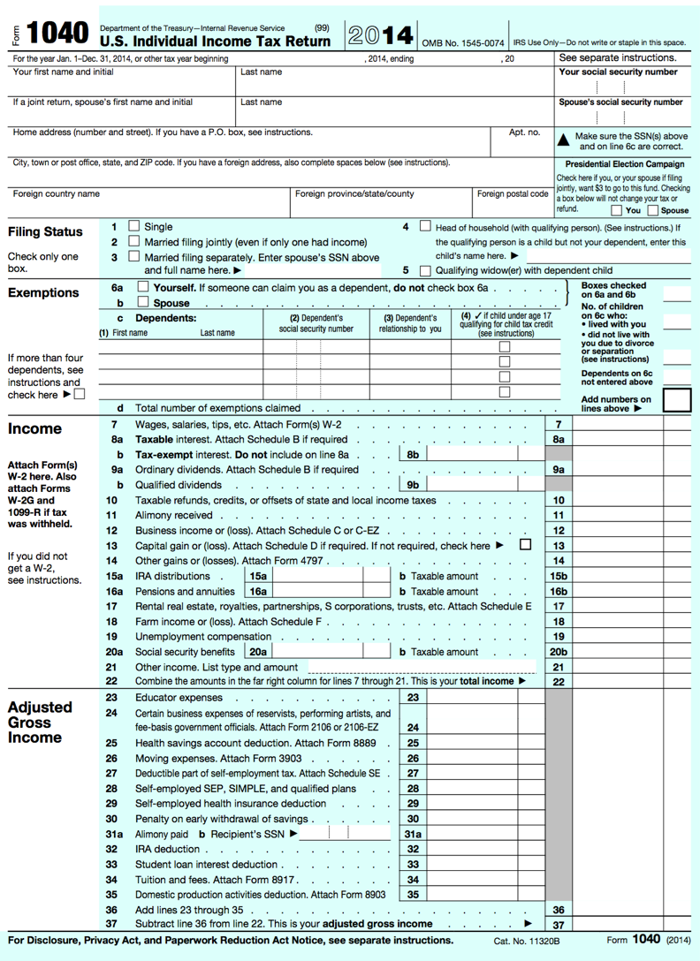
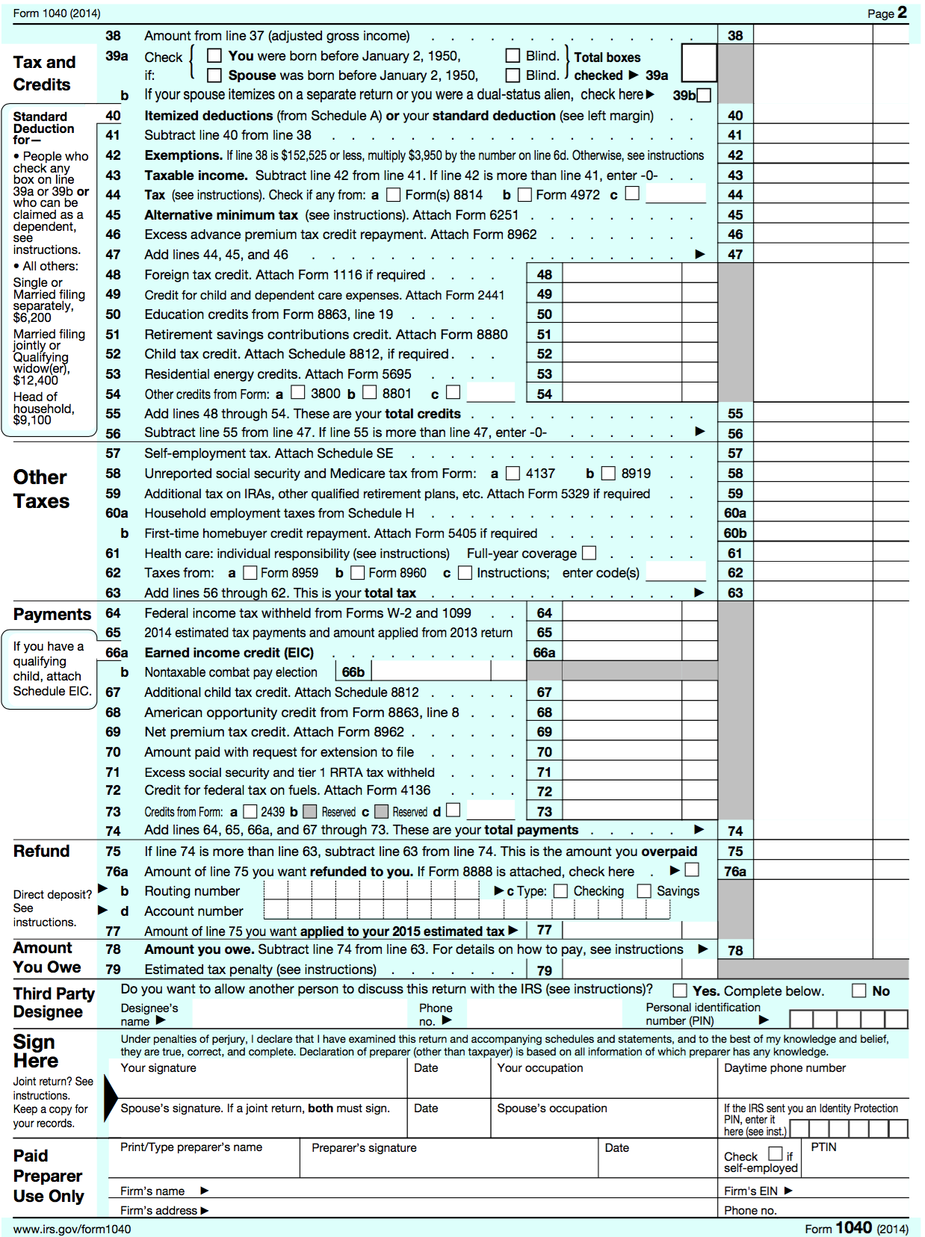

Slide 12
Filing Status
Based on marital status and family situation
  Single
  Married Filing Jointly
  Married Filing Separately
  Head of Household
  Qualifying Widow(er) with Dependent Child
  Choose correct Filing Status on Lines 1-5

Slide 13
Exemption
Amount the taxpayer can claim for himself, his spouse, and his dependents that decreases taxable income.
Total # of Exemptions found on line 6d

Slide 14
Exemption
A taxpayer may claim 2 types of exemptions:
  Personal exemption (lines 6a/6b)
    Taxpayer can claim herself (and spouse)
  Dependency exemption (line 6c)
    Taxpayer can claim qualifying dependents

Slide 15
Dependent
An individual whom the taxpayer supports or lives with the taxpayer
  Qualifying child
  Qualifying relative
Remember, you can’t claim a personal exemption if you CAN be claimed as a dependent on another tax return.

Slide 16
Earned vs. Unearned Income
Earned: income received through work
  Wages, salary, tips, etc.
Unearned: income other than pay from work
  Interest, social security, retirement, etc.
Income is entered on Lines 7-21
Total income is found on Line 22

Slide 17
Adjustment
Decreases the amount of income on which the taxpayer will be taxed
Adjustments are entered on Lines 23-36
Total adjustments are found on Line 37

Slide 18
Adjusted Gross Income (AGI)
Amount of taxable income after adjustments are made
AGI is found on Lines 37/38

Slide 19
Deduction
Amount subtracted from the AGI to further decrease taxable income
  Standard deduction: based on filing status, etc.
  Itemized deductions: taxpayer can choose to enter expenses if larger than standard deduction amount
  Standard/Itemized Deduction(s)
  found on Line 40

Slide 20
Taxable Income
Any income that is subject to federal income tax
Can include both earned and unearned income
Taxable Income found on Line 43

Slide 21
Tax Liability
Amount of tax that must be paid based on the taxable income
Tax Liability (before credits
are subtracted) found on Line 47

Slide 22
Tax Credit
Direct reduction of the taxpayer’s liability
Two Types of tax credits:
  Nonrefundable credits
  Refundable credits

Slide 23
Nonrefundable Tax Credit
Reduces the tax liability – only to zero.
  Child and Dependent Care Expenses
  Retirement Savings Contribution Credit
  Child Tax Credit
Nonrefundable Credits entered on Lines 48-54
Total Nonrefundable Credits found on Line 55

Slide 24
Refundable Tax Credit
Reduces tax liability to zero
Taxpayer will receive the remainder of the credit value as a refund.
  Earned Income Tax Credit
  Additional Child Tax Credit
  American Opportunity Education Credit
Refundable Tax Credits entered on Lines 66-69

Slide 25
Withholding
Amount of money that can be taken from each form of income and received by the government each pay period
Total Withholding found on Line 64

Slide 26
Federal Income Tax Process:
Form 1040 Flow Overview

Slide 27

TOTAL INCOME
Earned Income

Slide 28

TOTAL INCOME
Unearned Income
Earned Income

Slide 29
TOTAL INCOME
TAXABLE INCOME
after adjustments, deductions, and exemptions
Unearned Income
Earned Income

Slide 30
TOTAL INCOME
TAXABLE INCOME
after adjustments, deductions, and exemptions
TAX LIABILITY
Unearned Income
Earned Income

Slide 31
TOTAL INCOME
TAXABLE INCOME
after adjustments, deductions, and exemptions
TAX LIABILITY
Unearned Income
TAX CREDITS
Earned Income
AMOUNT OWED OR REFUNDED

Slide 32
Exemptions

Slide 33
Exemptions Objectives
After completing this section, the volunteer will be able to:
  Determine a taxpayer’s eligibility for a personal exemption
  Assess whether a person qualifies as a dependent of a taxpayer

Slide 34
Personal Exemptions
Each personal exemption decreases the taxable income by $4,050
Taxpayers can claim exemptions for:
  Taxpayer UNLESS the taxpayer can be claimed as a dependent by someone else.
  Spouse UNLESS the spouse can be claimed as a dependent by someone else.

Slide 35
Determining Dependency Exemptions
Open the Publication 4012 to the Exemptions Tab to Table 1: Dependency Exemption
ALWAYS BEGIN WITH THIS CHART TO DETERMINE IF A PERSON QUALIFIES AS A DEPENDENT

Slide 36
Qualifying Child or Qualifying Relative?
If no one else can claim the taxpayer or spouse as a dependent, you need to determine if the other people living in the house can be Qualifying Children, and if not see if they can be Qualifying Relatives
Remember: Each dependent decreases the taxable income by $4,050!

Slide 37
Note: Taxpayers with ITIN Cards
Remember: Taxpayers receive ITIN numbers if they are nonresidents but need to file a tax return and cannot obtain a SSN
If a taxpayer lived in the United States all year and has an ITIN card, they will be considered a resident alien for tax purposes
A “child” passes the citizenship test in this situation

Slide 38
“Permanently and Totally Disabled”
A person is considered permanently and totally disabled if he or she cannot engage in any substantial gainful activity because of a physical or mental condition, AND
A doctor determines the condition has lasted or can be expected to last continuously for at least a year or can lead to death

Slide 39
“Temporary Absences”
A child is considered to have lived with you during periods of time when one of you, or both are temporarily absent due to illness, education, business, vacation, military service, or detention in a juvenile facility

Slide 40
Exercise
TRUE or FALSE:
Every taxpayer can claim a personal exemption for himself.

Slide 41
Exercise – Answer
FALSE
A taxpayer who can be claimed as a dependent by someone else CANNOT claim an exemption for him/herself.

Slide 42
Exercise
Rebecca is unmarried with one child, Colin. Colin is 8 years old and lives full time with his mother, who provides all of his support. He is a U.S. citizen, and no other adults live in their household. Can Rebecca claim Colin as a dependent?
Use the Publication 4012

Slide 43
Exercise – Answer
YES
Colin meets all the requirements to be claimed as a qualifying child.

Slide 44
Exercise
Paul is a U.S. citizen who is 26 years old, permanently disabled, unmarried, did not pay for more than half of his support and lived with his parents for the entire year.
Can Paul be claimed as a dependent by his parents?
Notes:
‹#›

Slide 45
Exercise – Answer
YES.
Paul meets all the requirements to be claimed as a qualifying child.

Slide 46
What if the parents live apart?
The custodial parent generally claims the dependency exemption for his/her child
The noncustodial parent can claim the exemption if the parents have signed an agreement
  Form 8332 (REQUIRED for post-2008 divorce)
This situation is complicated to determine.
SEE YOUR SITE COORDINATOR

Slide 47
Exercise
Roderick, age 29, lives with his uncle. Last year, he worked part-time and earned $2,100. His uncle provided for the rest of his support, including rent and household costs.
Can his uncle claim Roderick as a dependent? Can Roderick claim a personal exemption?

Slide 48
Exercise – Answer
YES.
His uncle can claim Roderick as a qualifying relative.
NO.
Roderick cannot claim a personal exemption because he can be claimed as a dependent.

Slide 49
Exercise
Gina Brown provides all support for her uncle. Uncle Jim is unmarried, 72 years old, and lives in another city. He has no gross income for the calendar year. Can Gina claim Uncle Jim as a dependent?

Slide 50
Exercise - Answer
YES.
Jim meets all of the requirements to be
a qualifying relative of Gina.

Slide 51
Filing Status

Slide 52
Filing Status Objectives
After completing this section, the volunteer will be able to:
  Choose the most advantageous (and allowable) filing status for a taxpayer

Slide 53
Five Filing Statuses
Single
Married Filing Jointly
Married Filing Separately
Head of Household
Qualifying Widow(er) with Dependent Child

Slide 54
Determining Filing Status
Open the Publication 4012 to the Filing Status Tab to Chart: Determination of Filing Status – Decision Tree, Chart: Filing Status, and Chart: Who is a Qualifying Person Qualifying You To File as Head of Household
ALWAYS USE THESE CHARTS TO DETERMINE A TAXPAYER’S FILING STATUS

Slide 55
Single
If on the last day of the tax year (Dec. 31st), the taxpayer was
  Not married OR
  Legally separated/divorced OR
  Widowed
IMPORTANT:
Some taxpayers considered single can also file under a more advantageous status (HoH or QW).
Be sure to check all options!

Slide 56
Married Filing Jointly
If on the last day of the tax year,
  They lived together as a married couple OR
  They lived apart but were not legally separated/divorced OR
  One spouse died during the year, and the taxpayer did not remarry.

Slide 57
Married Filing Separately
Married taxpayers can also file separately; HOWEVER,
  If one spouse itemizes, the other spouse must itemize.
  Ineligible to claim several tax credits.
Be careful!
This status generally results in a HIGHER overall TAX.

Slide 58
Why Do Some Choose MFS?
Sometimes MFS is chosen when one spouse does not want to be responsible for the other spouse’s tax obligations or filing separately may result in a lower total tax (this is rare)
Sometimes to avoid an offset of their refund against their spouse’s debts (child support, student loans, etc.)
Note: there may be other options that allow them to file jointly and not be responsible for these debts (Injured Spouse Form)

Slide 59
Why Do Some Choose MFS?
Sometimes taxpayers must file separately because they are separated and not in communication with their spouse and don’t have the option of filing jointly

Slide 60
Note
If a spouse died during the tax year, and the taxpayer did not remarry, they are considered married for the entire year.
The surviving spouse is eligible to file as MFJ or MFS.
Surviving spouses who remarry must file with the new spouse, as MFJ or MFS.
  The deceased spouse’s filing status becomes MFS.

Slide 61
Head of Household
This is the most complicated filing status to determine, yet it is one of the most common at SaveFirst tax sites
There are two scenarios when a taxpayers can file Head of Household:

Slide 62
Head of Household
Scenario #1: Married Taxpayers
  Must be “considered unmarried”*
  File a separate return from spouse
  Maintain more than half the costs of keeping up a home
  The home is the main home for a dependent child, stepchild, or foster child for more than ½ the year
    Note: A grandchild does NOT meet this test
  The taxpayer claims an exemption for the child

Slide 63
“Considered Unmarried”
    A legally married taxpayer can be considered unmarried if s/he has not lived with the spouse at any time during the last six months of the tax year.

Slide 64
Head of Household
Scenario #2: Single Taxpayers
  Maintain more than half the costs of keeping up a home
  A “qualifying person” lived with the taxpayer for more than ½ the year

Slide 65
Head of Household: Qualifying Person
See
Who Is a Qualifying Person Qualifying You To File as Head of Household
in the
Filing Status Tab of the Pub 4012
for a list of qualifying persons

Slide 66
Head of Household: Qualifying Person
In general, a qualifying child is a qualifying person
  Whether or not the taxpayer claims the exemption
In general, a qualifying relative is a qualifying person if:
  The taxpayer can claim the exemption for the person
  The person meets one of the relationships listed
  The person lives with the taxpayer for more than ½ the year
    Exception: a mother/father who is a qualifying relative does not have to live in the home with the taxpayer

Slide 67
Head of Household: Separated Parents
Even if the custodial parent has given up his/her right to claim the dependency exemption for a child (Form 8332), s/he can file Head of Household using that child as her/his qualifying person
Noncustodial parent can never claim Head of Household
This situation is complicated to determine.
SEE YOUR SITE COORDINATOR

Slide 68
Qualifying Widow(er) with Dependent Child
A taxpayer files QW if his/her
  Spouse died recently, AND
  The taxpayer did not remarry, AND
  The taxpayer has a dependent child (son, daughter, stepson, stepdaughter), AND
  The taxpayer provides over half the costs to maintain the main home for taxpayer and child.

Slide 69
Unmarried, Widowed Taxpayer?
If the spouse died during the current tax year: Married Filing Jointly
If the spouse died during one of the two preceding tax years and taxpayer has a qualifying child: Qualifying Widow(er)
If the spouse died three or more years before the current year: Single or Head of Household

Slide 70
From Lowest to Highest Tax Burden
Married Filing Jointly & Qualifying Widow(er)
Head of Household
Single
Married Filing Separately

Slide 71
Exercise
Lily left her husband in August of the tax year, but they did not get divorced. She took her children with her, supported them during all of the tax year, and will claim them as dependents. Lily refuses to file a joint return with her husband.
Which filing status should she use?

Slide 72
Exercise – Answer
Married Filing Separately.
Because Lily lived with her husband for some part of the last six months of the year, she cannot file as Head of Household.

Slide 73
Exercise
Em left her husband in February of the tax year, but they did not get divorced. She took her children with her, supported them all year, and will claim them as dependents. Em refuses to file a joint return with her husband.
Which filing status should she use?

Slide 74
Exercise – Answer
Head of Household.
A legally married taxpayer can be considered unmarried and file as HoH if he/she has not lived with the spouse at any time during the last six months of the tax year.

Slide 75
Exercise
Lane, a single woman, lives alone. She provides full support for her mother, Theresa, who lives in a nearby town. Since Theresa had no income for the year, Lane paid all costs to maintain her home and will claim her as a dependent.
What is Lane’s filing status?

Slide 76
Exercise – Answer
Head of Household.
A taxpayer can file as Head of Household on the basis of a dependent parent who does not live with him/her only if the taxpayer pays more than ½ of the costs of keeping up the parent’s home.

Slide 77
Exercise
Brian and Ashley were happily married since 1965. They had no children, but Brian’s brother, who they claim an exemption for, lived with them for the last 10 years. Ashley passed away two years ago. Even after her death, Brian continued to maintain the entire cost for the home and his brother still lived there.
What is Brian’s filing status?

Slide 78
Exercise – Answer
Head of Household.
Brian cannot file as Qualifying Widow(er) with dependent child, because his brother is NOT his dependent child. Even though he is his dependent, he is not Brian’s child.

Slide 79
Filing Basics

Slide 80
Filing Basics Objectives
After completing this section, the volunteer will be able to:
  Verify that a taxpayer is required to file a tax return
  Recommend when a taxpayer should file a tax return, even if not required to

Slide 81
Who Must File?
To decide whether someone must file a tax return, you need to know the individual’s:
  Age
  Gross income (approximate)
    All the income received during the year in the form of money, goods, property and services not exempt from tax (earned and unearned)
    Do not include Social Security (unless two conditions on Pub 4012 A-1 are met)
  Filing status

Slide 82
Who is Legally Required to File a Return?
Use Who Must File Tab in the Pub 4012
  Chart A – For Most People Who Must File
  Chart B – For Children and Other Dependents
  Chart C – Other Situations When You Must File
  Chart D – Who Should File

Slide 83
Children & Other Dependents
Refer to Chart B under Who Must File Tab
If a parent can claim a child as a dependent, the dependent may still need to file a return
A dependent needs to file a return if earned income is greater than $6,300

Slide 84
Other Situations When You Must File
Taxpayer owes special taxes
Taxpayer received Health Savings Account distributions
Taxpayer has net self-employment earnings of $400+
Taxpayer received an advanced premium tax credit
Taxpayer owes an individual shared responsibility payment

Slide 85
Who Should File
Had income tax withheld from pay
Made estimated tax payments
Qualify for the refundable credits

Slide 86
TaxSlayer
Login to TaxSlayer:
  vita.taxslayerpro.com/IRSTraining/
  Password: TRAINPROWEB
Create Account
  Use most regularly checked email address
  Username: Last Name, First initial, TRAIN (e.g., SMITHJTRAIN)
  Password: SavefirstAL123!
Select "VITA" as Program Type
Leave SIDN blank

Slide 87
Break
We will now take a 10 minute break!

Slide 88
Income

Slide 89
Income Objectives
After completing this section, the volunteer will be able to:
  Recognize various types of income documents
  Summarize the taxability of each type of income to the taxpayer

Slide 90
Taxable Income
Wages
Unemployment Compensation
Some Social Security Benefits
Self-Employment Income
Nonemployee Compensation
Dividends
Interest
Gambling Winnings
Awards
Prizes
Punitive Damages (from a Lawsuit Settlement)
Refund of State Taxes
Jury Duty Fees
Tips
Retirement Annuities
Retirement Pensions
Retirement IRA Distributions

Slide 91
Nontaxable Income
Child Support
Gifts
Life Insurance Proceeds
Other Insurance Payments
Sickness/Injury Payments (Third Party Sick Pay)
Public Assistance Payments
Worker’s Compensation
Veterans’ Benefits
Supplemental Security Income (SSI)
Inheritances
Federal Income Tax Refunds

Slide 92
Taxable & Nontaxable Income
Open the Publication 4012 to the Income Tab to
Income Quick References Guide
for a more complete listing of
taxable and nontaxable income

Slide 93
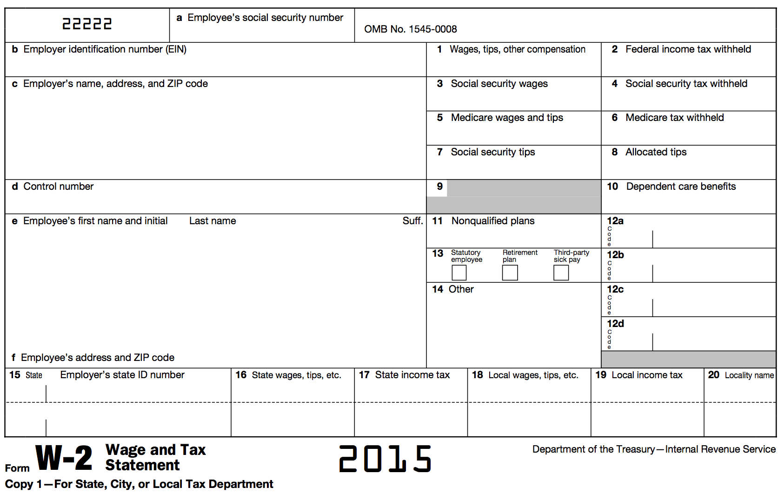


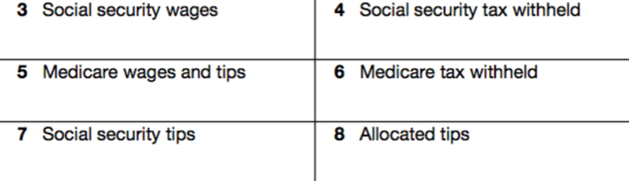






Form W-2: Wage and Tax Statement

Slide 94
Form W-2
Classified as earned income
W-2 includes
  box 1: wages, tips, other compensation
  box 2: total federal withholding (pay as you go)
  boxes 3-7: FICA
      Employment tax imposed on employees AND employers specifically to fund Social Security and Medicare programs
  boxes 12-14: miscellaneous info (health insurance, retirement, etc)
  boxes 15-20: state/local wages & withholding

Slide 95
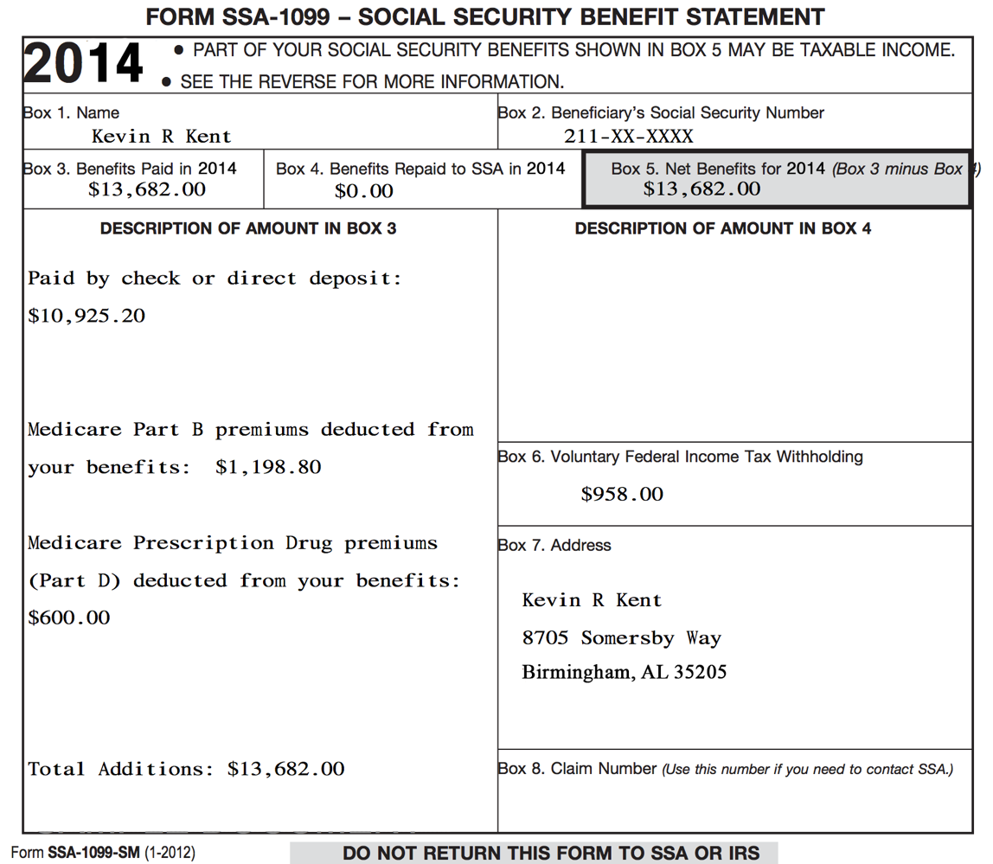

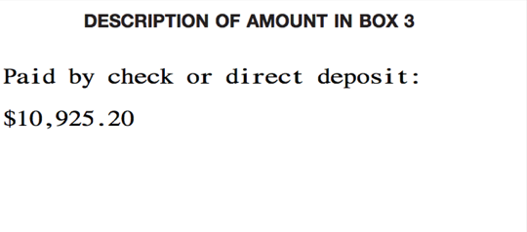
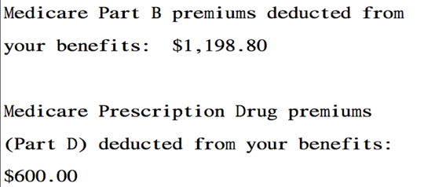

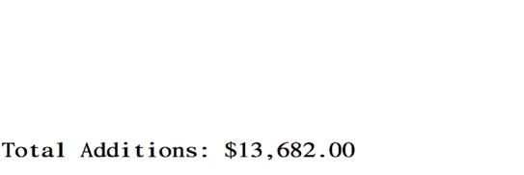
Form SSA-1099:
Social Security Benefit Statement

Slide 96
Form SSA-1099: Social Security Benefits
Net benefits reported in box 5
Social Security benefits include monthly retirement, survivor, and disability benefits
They do NOT include Supplemental Security Income (SSI): aimed at helping low-income elderly, blind, and disabled individuals pay for basic needs
Classified as unearned income

Slide 97
Form SSA-1099: Social Security Benefits
Some portion of the Social Security benefits may be taxable.
  Generally, if Social Security benefits are the only source of income, then they are not taxable.
  Dependent upon filing status and other reportable income

Slide 98
Form SSA-1099: Box 3
Many taxpayers will have Medicare insurance premiums (part B) and/or Medicare prescription drug premiums (part D) deducted from benefits
Some taxpayers may have received a lump-sum benefit payment (for current tax year and prior tax years)
See your site coordinator if a taxpayer received lump-sum benefits

Slide 99
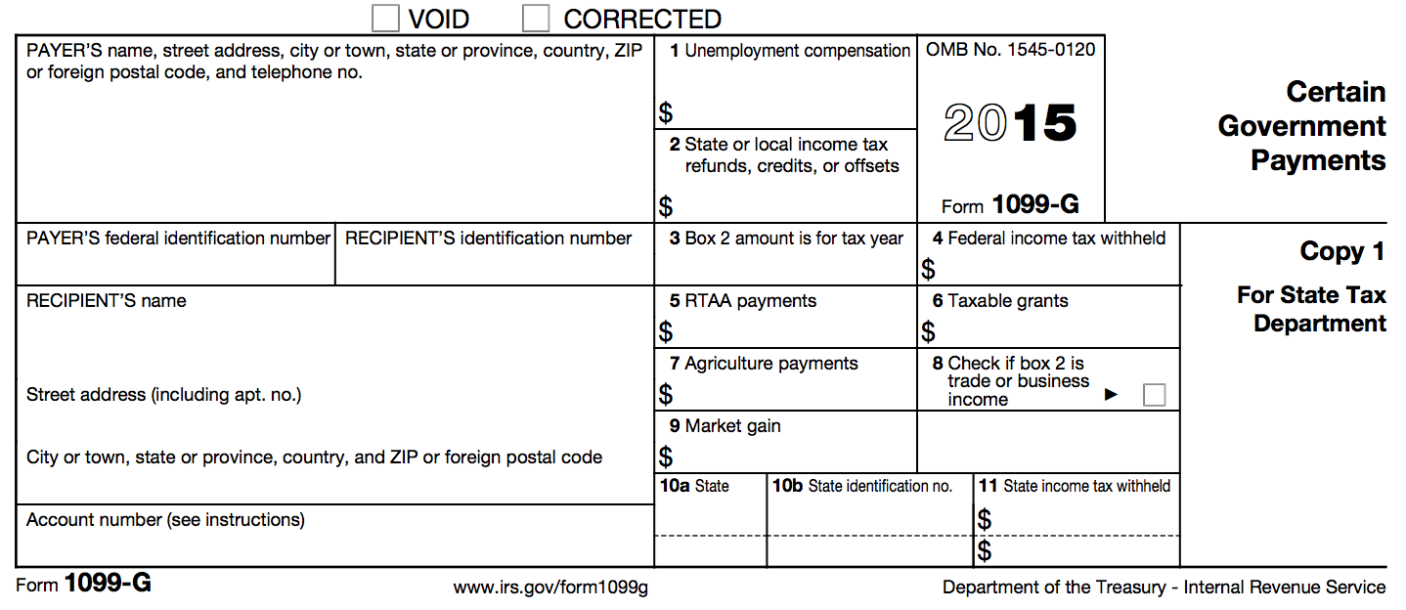
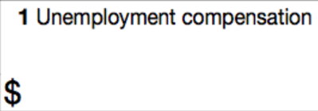
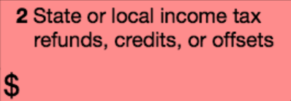

Form 1099-G: Certain Government Payments

Slide 100
Form 1099-G: Unemployment Compensation
Reported in box 1
Shows the total amount of unemployment compensation for the tax year
Unemployment compensation is fully taxable income
Classified as unearned income

Slide 101
Form 1099-G:
Prior Year State Tax Refund
The Prior Year’s State Tax Refund may be taxable and need to be reported
Three conditions must be met:
  Received a state refund in prior year
  Itemized deductions on federal in prior year
  Deducted state income tax NOT sales tax when itemized on federal in prior year (Sch A line 5a/5b)

Slide 102
Household Employee Income
If a household employee earns less than $2,000 a year, the employer is not required to issue a Form W-2
However, this income must still be reported on the taxpayer’s income tax return
Classified as earned income
Has its own entry point in TaxSlayer*

Slide 103
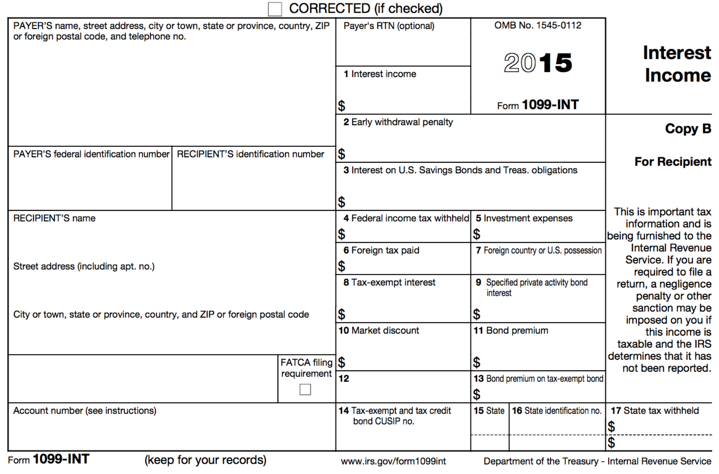


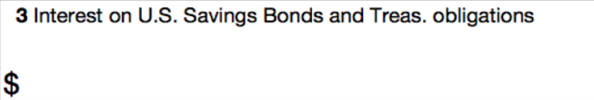

Form 1099-INT: Interest Income

Slide 104
Form 1099-INT: Interest Income
Money earns interest when it is:
  Deposited into bank accounts (e.g., savings account)
  Used to buy certificates of deposit (CDs) or bonds
Box 1: Interest
Box 2: Early withdrawal penalty (for CD w/ time limit)
Box 3: Interest on U.S. Savings Bonds & Treas. Obligations
Classified as unearned income

Slide 105
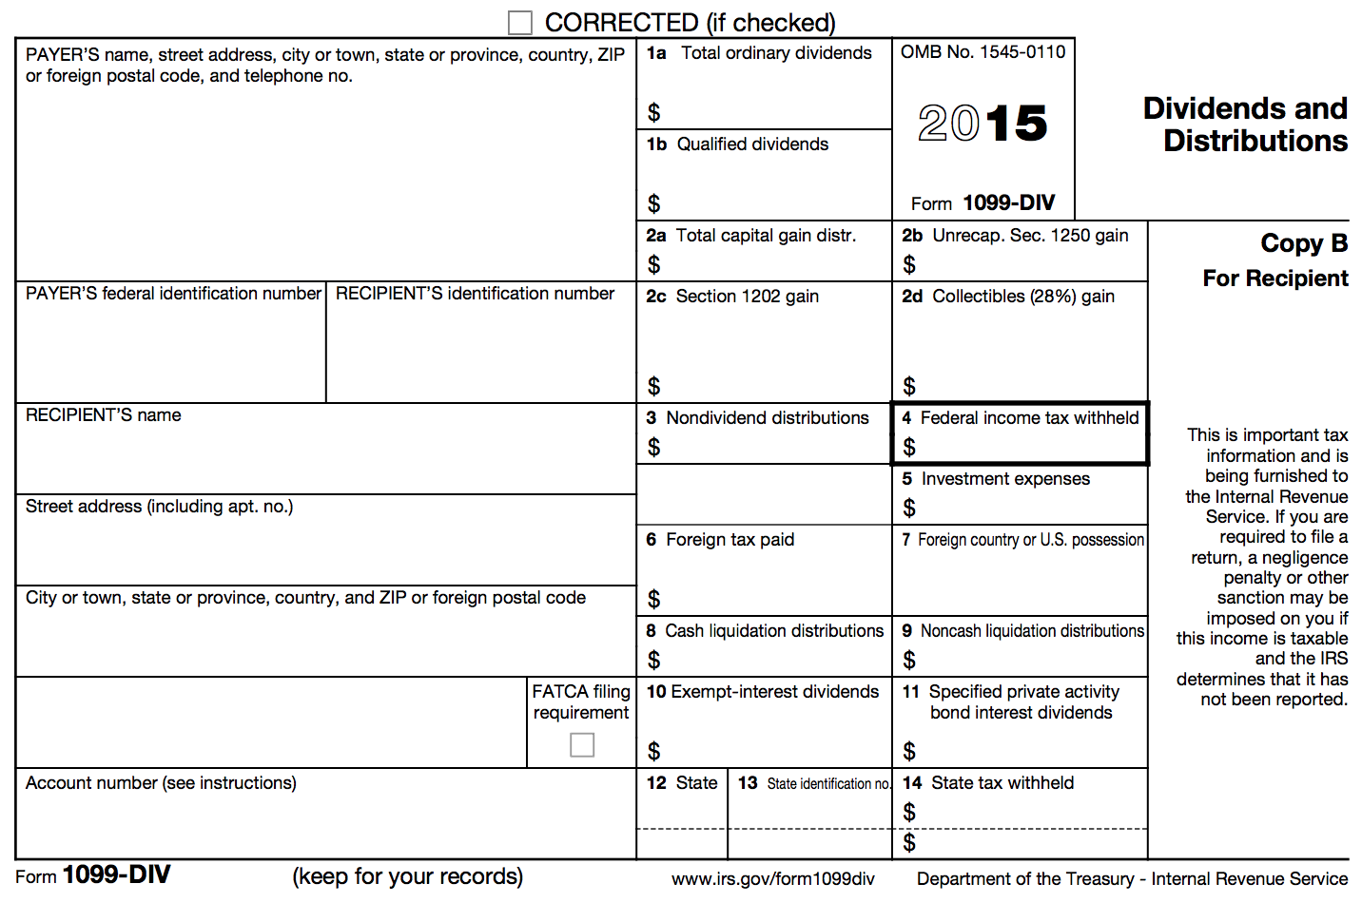
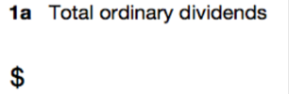



Form 1099-DIV: Dividends and Distributions

Slide 106
Form 1099-DIV: Ordinary and Qualified Dividends
Reported in boxes 1a and 1b
A dividend is a distributions of a portion of a company’s earnings to shareholders
E.g., if a taxpayer has investments in a stock, then dividends paid by the corporation are taxable
Classified as unearned income

Slide 107
Form 1099-DIV: Capital Gains Distributions
Reported in box 2a
Capital gains distributions occur when a taxpayer sells stocks and securities in a mutual fund
Capital gains are taxable!

Slide 108
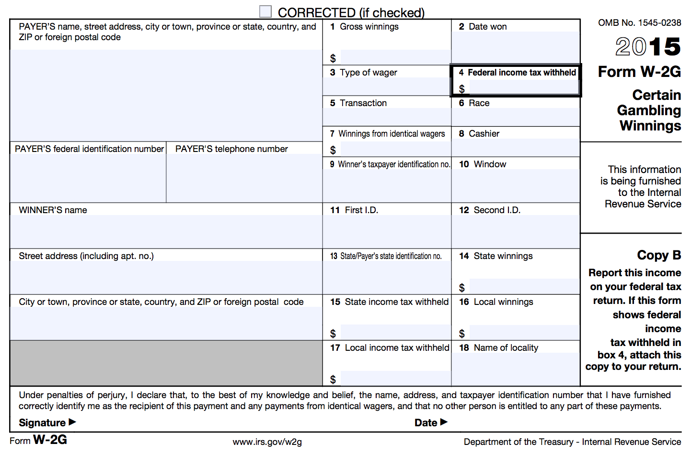
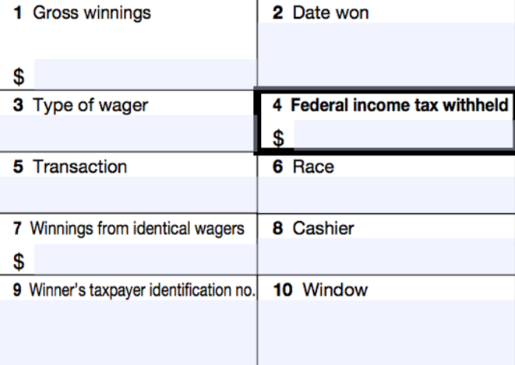
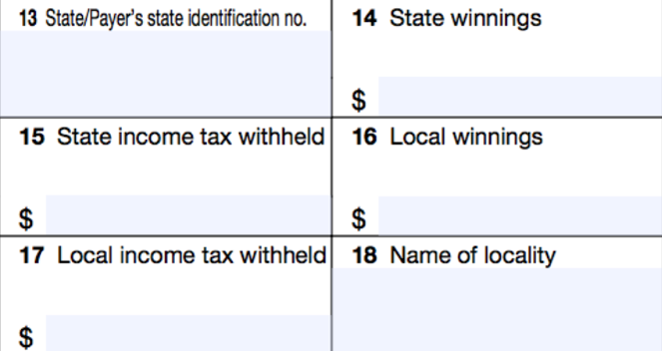
Form W2-G: Certain Gambling Winnings

Slide 109
Form W2-G: Certain Gambling Winnings
A taxpayer may receive one or more Form W2-Gs reporting gambling winnings
Classified as unearned income
Note: If a taxpayer has gambling winnings not reported on a Form W2-G, they must still be reported as income on the tax return

Slide 110
Jury Duty Pay
Jury duty pay must be reported as taxable income
Classified as unearned income

Slide 111
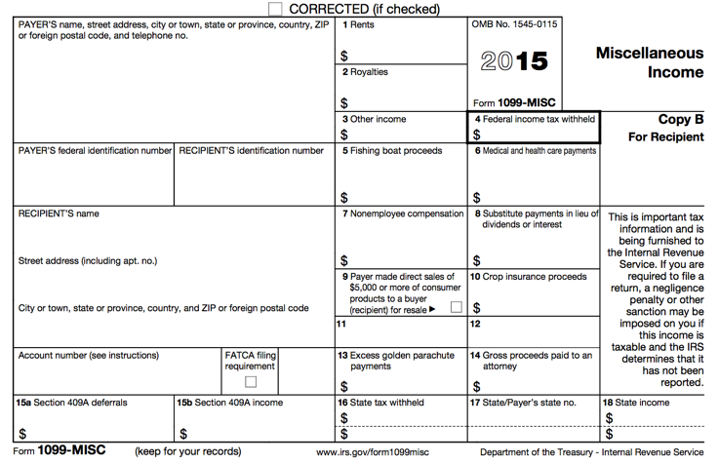

Form 1099-MISC: Miscellaneous Income

Slide 112
Form 1099-MISC: Other Income
Reported in box 3
Other income reported in this box is generally:
  Prizes
  Awards
  Taxable damages (from a lawsuit settlement)
  Other taxable income
Other income in box 3 is classified as unearned income

Slide 113
Form 1099-MISC: Nonemployee Compensation
Reported in box 7
This is business/self-employment income
Y’all will learn how to do Business Income in January!

Slide 114
Withholding
On most forms of income, taxpayers have the option to withhold. Be sure to enter any withholding you see on tax documents into TaxSlayer

Slide 115
Standard Deduction

Slide 116
Standard Deduction Objectives
After completing this section, the volunteer will be able to:
  Explain how the standard deduction is determined for each taxpayer
  Distinguish when a taxpayer should itemize deductions and when a taxpayer should take the standard deduction

Slide 117
Standard Deduction
Reduces amount of income that is taxed
Amount of deduction based on
  Filing Status
  Age
  Whether taxpayer/spouse is blind
  Whether taxpayer is a dependent
Calculated automatically in TaxSlayer

Slide 118
Standard Deduction for Most Filers
Open the Publication 4012 to the Deductions Tab to Exhibit 1: Standard Deduction for Most People
This table provides the standard deduction amounts for the current tax year

Slide 119
Itemized Deductions
Instead of taking the standard deduction, a taxpayer can choose to itemize, which is to list certain deductible expenses separately, in order to receive a greater deduction

Slide 120
Itemized Deductions
Itemized deductions include (but are not limited to):
  Un-reimbursed medical expenses
  Charitable contributions
  Home mortgage payments
Y’all will learn how to Itemize Deductions in January!

Slide 121
Nonrefundable Credits

Slide 122
Nonrefundable Credits Objectives
After completing this section, the volunteer will be able to:
  Assess a taxpayer’s eligibility for the Child & Dependent Care Expenses Credit
  Explain how a taxpayer qualifies for the Child Tax Credit
  Assess a taxpayer’s eligibility for the Retirement Savings Contribution Credit

Slide 123
Nonrefundable Tax Credit
Reduces the tax liability – only to zero.
  Child and Dependent Care Expenses
  Child Tax Credit
  Retirement Savings Contribution Credit

Slide 124
Child & Dependent Care Expenses Credit
Nonrefundable credit
Applied to offset expenses paid so taxpayer can work or look for work
  Dependent child under 13
  Spouse who is incapable of self-care
  Dependent who is incapable of self-care

Slide 125
Child & Dependent Care Expenses Credit: Eligibility
Care had to be for qualifying persons
Taxpayer (and spouse) had to have earned income
  A spouse is treated as having earned income for any month the spouse is physically/mentally incapable of care, or is a full-time student.

Slide 126
Child & Dependent Care Expenses Credit: Eligibility
Expenses must have been for work or to look for work
Payments can’t have been made to taxpayer’s spouse (or other parent of the child), dependent child, or child under 19
Must have care provider’s name, address, and SSN/EIN (due diligence)

Slide 127
Child & Dependent Care Expenses Credit: Qualified Work-Related Expenses
Expenses to attend Kindergarten or a higher grade: NOT AN EXPENSE
Expenses for summer day-camp qualify, but those for overnight camp do not!
$3,000 expense limit for 1 qualifying person or $6,000 expense limit for 2+ qualifying persons.

Slide 128
Child & Dependent Care Expenses Credit: Notes
If you had expenses that met the requirements for the previous tax year, except that you did not pay them until the current tax year, you may be able to claim them on your tax return.
Obtaining care provider’s information: due diligence

Slide 129
Child & Dependent Care Expenses Credit: Employer Provided Benefits
If a taxpayer had employer-provided benefits, they will appear in box 10 of the Form W-2 (reduces the credit)

Slide 130
Example
Julie spent the following amounts on child care for her 10-year-old daughter Melissa. Are any of these eligible costs for the Child & Dependent Care Expenses Credit?
$300 for overnight camp
$1000 to her ex-husband for after school-care
$1500 to her mother for after-school care
$500 to her 15-year-old son for babysitting

Slide 131
Example – Answer
Julie spent the following amounts on child care for her 10-year-old daughter Melissa. Are any of these eligible costs for the Child & Dependent Care Expenses Credit?
$300 for overnight camp – NO
$1000 to her ex-husband for after school care
$1500 to her mother for after-school care
$500 to her 15-year-old son for babysitting

Slide 132
Example – Answer
Julie spent the following amounts on child care for her 10-year-old daughter Melissa. Are any of these eligible costs for the Child & Dependent Care Expenses Credit?
$300 for overnight camp – NO
$1000 to her ex-husband for after school care– NO
$1500 to her mother for after-school care
$500 to her 15-year-old son for babysitting

Slide 133
Example – Answer
Julie spent the following amounts on child care for her 10-year-old daughter Melissa. Are any of these eligible costs for the Child & Dependent Care Expenses Credit?
$300 for overnight camp – NO
$1000 to her ex-husband for after school care– NO
$1500 to her mother for after-school care–YES
$500 to her 15-year-old son for babysitting

Slide 134
Example – Answer
Julie spent the following amounts on child care for her 10-year-old daughter Melissa. Are any of these eligible costs for the Child & Dependent Care Expenses Credit?
$300 for overnight camp – NO
$1000 to her ex-husband for after school care– NO
$1500 to her mother for after-school care– YES
$500 to her 15-year-old son for babysitting – NO

Slide 135
Child Tax Credit
One credit for each qualifying child under 17 years old
A taxpayer can claim a Child Tax Credit for a child only if they CAN AND DO claim a dependency exemption for the child
Nonrefundable credit with a maximum of $1,000 per child.
  Amount actually claimed depends on taxpayer’s tax liability, MAGI, and filing status
  MAGI: typically same as AGI

Slide 136
Child Tax Credit
This is a credit intended to reduce the tax liability owed by the taxpayer, therefore, this part of the credit is nonrefundable
However, the taxpayers may be able to take the Additional Child Tax Credit, which is refundable

Slide 137
Retirement Savings Contributions Credit: General Eligibility Requirements
A contribution to an IRA or other qualified plan
AGI limitations (vary based on filing status)
Age 18 or older
Not claimed as a dependent
Not a full-time student during the tax year

Slide 138
Retirement Savings Contribution Credit: Form W-2

Slide 139
Retirement Savings Contribution Credit: Contributions Record
How do I know if the taxpayer has made a qualifying contribution?
  Form W-2, Box 12 and one of the codes: D, E, F, G, H, S, AA or BB
  Form W-2, Box 14 and codes for military personnel: Q or E
CAUTION: Entries in box 14 that are treated a employer contributions are NOT eligible for the credit

Slide 140
Retirement Savings Contributions Credit: Eligible Contributions
Some retirement distributions reduce the eligible contributions for the credit
In addition to retirement distributions made during the current tax year, the taxpayer must also reduce eligible contributions for distributions taken during the previous two tax years

Slide 141
Example
Bob, age 48, contributed $600 to an IRA during the tax year. During the year, he worked full-time and had an AGI of $24,000. He is not a student. Is Bob eligible to claim the Retirement Savings Contribution Credit?

Slide 142
Example – Answer
Yes: Bob contributed to an IRA, meets the age and AGI limits, is not a dependent and is not a full-time student.

Slide 143
Retirement Savings Contribution Credit
TaxSlayer calculates this for you, but if the taxpayer made any distributions from their retirement account, they need include those on the form 8880.
  Current Year distributions: 1099-R
  Prior Year distributions: ask TP

Slide 144
Refundable Credits

Slide 145
Refundable Credits Objectives
After completing this section, the volunteer will be able to:
  Explain how a taxpayer qualifies for the Additional Child Tax Credit
  Assess a taxpayer’s eligibility for the Earned Income Tax Credit

Slide 146
Refundable Tax Credit
Reduces tax liability to zero
Taxpayer will receive the remainder of the credit value as a refund.
  Additional Child Tax Credit
  Earned Income Tax Credit

Slide 147
Additional Child Tax Credit
The Child Tax Credit is intended to reduce the tax liability owed by the taxpayer, therefore, this part of the credit is nonrefundable
However, the taxpayers may be able to take the Additional Child Tax Credit, which is refundable

Slide 148
Additional Child Tax Credit
Refundable credit with a maximum of $1000 per child
Amount claimed depends upon meeting general eligibility requirements as well as how much of the nonrefundable Child Tax Credit is claimed
  Cannot claim more than $1000 of CTC and additional CTC combined for one child

Slide 149
Additional Child Tax Credit:
General Eligibility
Meet all the requirement of the Child Tax Credit
  Under 17, U.S. citizen, dependent of taxpayer, qualifying relationship, child did not provide over ½ of own support, lived with taxpayer for more than ½ of year
Must have $3,000 of taxable earned income
  Exception: Taxpayers with three or more children may be eligible regardless of their income

Slide 150
Earned Income Credit
Refundable tax credit for low-to-moderate income workers to encourage work, offset payroll and income taxes, and help meet basic need
The EIC is the largest federal anti-poverty program and has been one of the most successful programs to lift families, especially families with children, out of poverty

Slide 151
Earned Income Credit
In the tax year 2015, the EIC lifted an estimated “6.2 million people out of poverty, including over 3.2 million children”
The EIC has been especially successful in providing an incentive for single mothers with children to find work
*Source: The Center for Budget and Policy Priorities

Slide 152
Encouraging Work and Reducing Poverty
Research has also found that children in families who get an income boost from the EIC and CTC quickly show improvements in health and school performance relative to other low-income children who did not receive this extra help
In addition, children whose families receive that boost have higher school test scores, on average, and are more likely to go to college and to work and earn more as adults
*Source: The Center for Budget and Policy Priorities

Slide 153
Earned Income Credit
Critics of the EIC have complained that it is too complex, forcing recipients to seek help in filing their return
Two-thirds get such assistance, most from paid tax preparers
It is our job to provide high-quality tax preparation to ensure these families receive the full amount of the EIC they are eligible for!

Slide 154
EIC and Alabama Families
537,000 Alabama households received EIC in 2012
153,000 Alabamians were lifted out of poverty by the EIC and CTC combined, including 80,000 children, each year, on average, during 2011 to 2013
The EIC put about $1.4 billion into Alabama’s economy in 2012
*Source: The Center for Budget and Policy Priorities

Slide 155
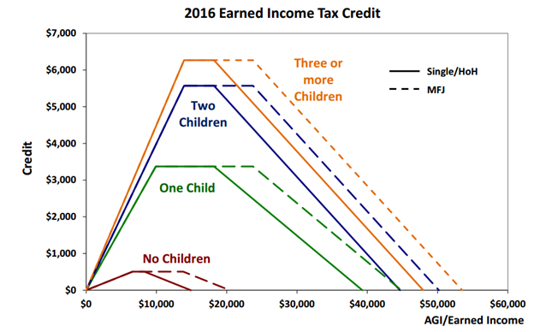
Earned Income Credit: Maximum Credit Amounts
Notes:
Picture thanks to
Tax Policy Center, a joint project of the Urban Institute and Brookings Institution, posted February 12, 2014; accessed July 20, 2015; web; http://www.taxpolicycenter.org/briefing-book/key-elements/family/eitc.cfm

Slide 156
Determining the Earned Income Credit
Open the Publication 4012 to the Earned Income Credit Tab
Use this tab to help determine if a taxpayer qualifies the Earned Income Credit

Slide 157
Earned Income Credit: Eligibility Requirements
Rules for everyone:
  Must have earned income (and AGI has limits)
  Valid SSNs and U.S. citizens/resident aliens
  Not Married Filing Separately
  No foreign earned income
  Investment income less than $3,400
  Taxpayer cannot be qualifying child of another person

Slide 158
Earned Income Credit: Eligibility Requirements
Rules if taxpayer does NOT have a qualifying child:
  Cannot be claimed as a dependent by another person
  Must be at least 25 but under 65 on December 31st of the tax year
  Must have lived in the United States (and spouse, if MFJ) for more than ½ of the year

Slide 159
Earned Income Credit: Eligibility Requirements
Rules if taxpayer has a qualifying child:
  Qualifying child must have a valid SSN that allows him/her to work
  [Relationship Test] Child must be the taxpayer’s:
    son, daughter, stepchild, eligible foster child
    brother, sister, half brother, half sister, stepbrother, stepsister, or descendent of any of them

Slide 160
Earned Income Credit: Eligibility Requirements
Rules if taxpayer has a qualifying child:
  [Age Test] Child must be
    Under age 19 at the end of the tax year, OR
    Under age 24 and a full-time student at the end of the tax year, OR
    Any age and permanently and totally disabled

Slide 161
Earned Income Credit: Eligibility Requirements
Rules if taxpayer has a qualifying child:
  [Joint Return Test] Qualifying child must not have filed a joint return for the tax year
    Unless the child only filed a joint return with spouse to claim a refund
  [Residency Test] Must have lived with the taxpayer for more than ½ the year
  Must not be the qualifying child of another person

Slide 162
Earned Income Credit: Eligibility Requirements
Note: Just because a person qualifies as the dependent of the taxpayer does not mean they automatically make the taxpayer eligible for the EIC
Child in question must meet the age, relationship, residency, and joint return tests to qualify (therefore, Qualifying Children always meet requirements, HOWEVER, Qualifying Relatives DO NOT)

Slide 163
Earned Income Credit: Qualifying Child of More than One Person
A child cannot be used by more than one person to claim the EIC
The rules for determining who claims the child for EIC are the same as those for determining who claims the the child as a dependent
If this situation arises, please see your Site Coordinator

Slide 164
Earned Income Credit: Disallowance
EIC can be disallowed for
  Reckless or intentional disregard of the rules: 2 years
  Fraudulent Claim: 10 Years
To claim EIC again, a taxpayer must
  Wait full period of disallowance
  Submit a Form 8862 with the tax return
If this situation arises, please see your Site Coordinator

Slide 165
Example
Sharon, who has an earned income and AGI of $15,525, takes care of her sister’s son, Eric. If Eric is 12 years old and began living with Sharon in August, can Sharon claim the EIC?

Slide 166
Example – Answer
No
Sharon’s AGI is too high to claim the EIC alone, and since Eric lived with her for less than half a year, he is not her qualifying child

Slide 167
Example
Doug and Donna are married and live together with their 4-year-old son Sam. Their combined earned income is $25,000, but they file separately. Doug reports an AGI of $11,000 on his return, and Donna reports AGI of $14,000.
Can Doug and/or Donna claim the EIC?

Slide 168
Example – Answer
No
Neither can claim the EIC because both have a filing status of Married Filing Separately

Slide 169
Example
Doug and Donna are still married and still live together with Sam, but now they decide to file a joint return. Their combined earned income and AGI are $25,000. Can they claim the EIC on this return?

Slide 170
Example – Answer
Yes
Their joint income is low enough to claim the EIC with one qualifying child (Sam)

Slide 171
Example
Tom is 64 years old, retired and collected $10,000 of social security during the tax year. He does not have any qualifying children.
Can he claim the EIC on his return?

Slide 172
Example – Answer
No
Tom does not have any earned income

Slide 173
Refund & Amount of Tax Owed

Slide 174
Refund & Amount of Tax Owed Objectives
After completing this section, the volunteer will be able to:
  Explain the taxpayer’s options when receiving a tax refund
  Explain the options available to a taxpayer that has tax due

Slide 175
Refunds
Taxpayers can choose to receive their refund either by check or direct deposit
Checks take 6-8 weeks to be mailed
Electronic deposits will be made in 1-2 weeks
Taxpayers can also choose to allocate part of their refund to order savings bonds
Notes:
‹#›

Slide 176
Refunds: Direct Deposit
Encourage taxpayers to use direct deposit
  But, refunds will be delayed 4-6 weeks if the routing and account numbers are not valid
Refunds may only be deposited into their own accounts
Refunds can be deposited in up to three accounts

Slide 177
Tax Due
Taxpayers do not have to pay if balance due is less than $1
Payment in full is due by the April filing due date, to avoid interest and penalties
Taxpayer should file his/her return by the April filing date to avoid a failure-to-file penalty
There are separate penalties for filing late and paying late – the late filing penalty is higher

Slide 178
Tax Due
Advise taxpayers to file the return on time, even if they cannot pay the full amount owed
Pay as much as possible by the due date to reduce penalties and interest
Once taxpayers receive a notice, they can pay the remaining amount in full or choose another payment option if needed

Slide 179
Tax Due Payment Options
Most common:
  Pay by check or money order with Form 1040-V (Payment Voucher)
  Pay by direct debit from their checking/savings account on a date that they choose (up to the due date)
Least common:
  Pay with a credit or debit card (convenience fee)
  Electronic Federal Tax Payment System (EFTPS)
    www.irs.gov/e-pay
  IRS Direct Pay
    Free, one-time payment system offered through IRS.gov
Notes:
‹#›

Slide 180
Tax Due: What if the Taxpayer Cannot Pay?
Pay in full within 120 days
  If taxpayer can pay in full within 120 days, can avoid paying a fee to set up an installment agreement
Apply online for a payment agreement
  Taxpayer can apply online for a payment agreement on IRS.gov (search “Online Payment Agreement” or “OPA”)

Slide 181
Tax Due: Undue Hardship
Taxpayers who can show they will have a substantial financial difficulty if they pay their tax on the due date are considered to have undue hardship.
Can request an extension by filing Form 1127 (out of scope) by the due date
  Advise them to visit or call the local IRS office
Undue hardship is MORE than inconvenience!

Slide 182
Tax Due: Estimated Tax Penalty
Out of Scope for VITA!
Calculated on Form 2210 and reported in the Amount You Owe section on Form 1040
Taxpayers must make estimated tax payments if they expect to owe at least $1,000 and their withholding and credits will be less than the smaller of:
  90% of the tax shown on the current return
  100% of the tax shown on the prior year return

Slide 183
Tax Due
To avoid having tax due next year:
  Adjust withholding on Form W-4 (from employer)
    Taxpayers should submit a revised form when there is a change in life events (marriage, child, etc.)
  Make quarterly estimated tax payments
    Out of Scope for VITA!
Notes:
‹#›

Slide 184
Affordable Care Act

Slide 185
What is the Affordable Care Act (ACA)?
The federal government, state governments, insurers, employers, and individuals share responsibility for improving the quality and availability of health insurance coverage in the United States
The ACA reforms the existing health insurance market by prohibiting insurers from denying coverage or charging higher premiums because of an individual's pre-existing conditions.
The ACA also created the Health Insurance Marketplace (also known as www.healthcare.gov)

Slide 186
Shared Responsibility Provision
The Affordable Care Act requires individuals to:
  Have qualifying health coverage, called minimum essential coverage, for each month of the year
  Qualify for a coverage exemption, OR
  Make a shared responsibility payment when filing their federal income tax returns
    This is essentially a tax penalty for not having coverage

Slide 187
What is Minimum Essential Coverage?
Minimum essential coverage (MEC) is health coverage that satisfies the individual shared responsibility requirement
Most health insurance is MEC
No proof of coverage is needed. Oral statement from the taxpayer is acceptable, unless normal due diligence leads you to believe the taxpayer’s statement is incorrect

Slide 188
How Many Months Do Taxpayers Need to Have MEC?
Everyone needs MEC for every month
  A person is considered covered for the whole month if they had coverage for at least one day
  A person who was born or died during the year is required to have coverage for every full month alive

Slide 189
What Qualifies as Minimum Essential Coverage?
Employer sponsored health insurance
Individual health insurance
  Purchased from a health insurance company, or through the Health Insurance Marketplace (www.healthcare.gov)
Government-sponsored health insurance
  Medicare
  Most Medicaid
  ALL Kids (healthcare for kids)

Slide 190
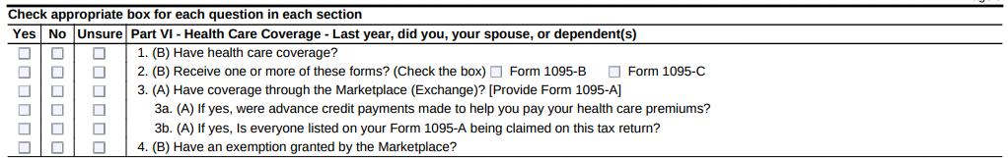
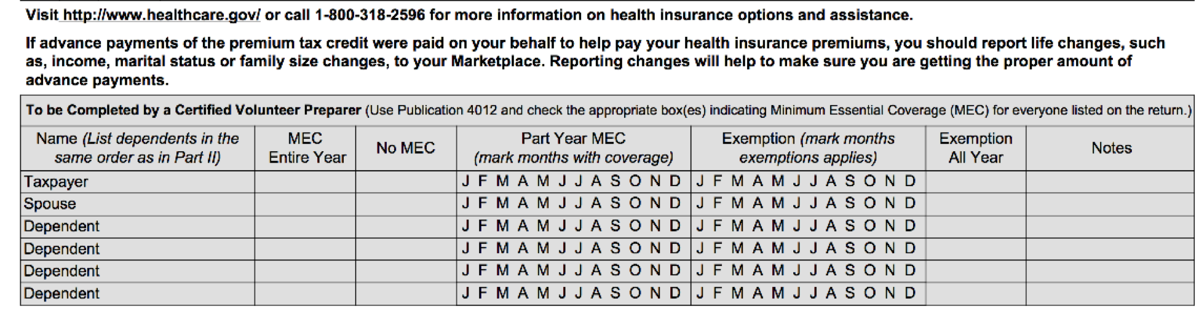
What Qualifies as Minimum Essential Coverage?
On the I/I form, mark whether the Taxpayer had health insurance, the type of form they received, whether it was purchased through the marketplace, and whether the taxpayer had an exemption granted by the Marketplace.
****It is your responsibility to make sure the grayed-out section is complete and filled out!!!!****
Notes:
Needs to be edited on script

Slide 191
Premium Tax Credit
Note that some taxpayers may be eligible for a refundable tax credit to help pay for health insurance premiums called the Premium Tax Credit
Basic volunteers cannot complete this part

Slide 192
Tax Preparation Process

Slide 193
Tax Preparation Process
Part 1: Preliminary Interview
Part 2: Preparing the Return in TaxSlayer
Part 3: Quality Review
Part 4: Finishing the Return
Part 5: Filing the Return

Slide 194
Part 1: Preliminary Interview
Acceptable Documents other than SS Card
Form SSA-1099 statement
Medicare Card (with an “A” after the SSN)
ITIN card
  Issued for nonresidents who need to file tax returns but cannot receive SS cards
  9XX-XX-XXXX (enter just like SS number)
ATIN for dependent
  Issued for child while adoption is pending
  9XX-XX-XXXX (enter just like SS number)

Slide 195
Tax Preparation Process
Part 1: Preliminary Interview
Part 2: Preparing the Return in TaxSlayer
Part 3: Quality Review
Part 4: Finishing the Return
Part 5: Filing the Return

Slide 196
Part 2: Preparing the Return in TaxSlayer
Complete the Federal Section according to TaxSlayer Categories:
  Income: Wages, Interest, Dividends, SS benefits, Retirement, Gambling income, Business income, Other income
  Deductions: Adjustments, Itemized deductions, Credits
  Other Taxes

Slide 197
Part 2: Preparing the Return in TaxSlayer
Complete the Federal Section according to TaxSlayer Categories Continued:
  Payments and Estimates
  Miscellaneous Forms
  Health Insurance Section
  State Section: where you will add the AL return!

Slide 198
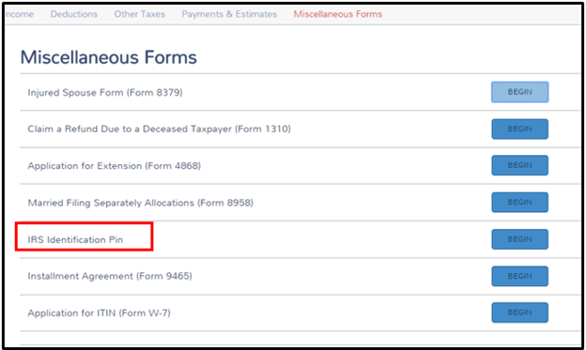
Part 2: Preparing the Return in TaxSlayer – Identity Protection Pin
You’ll enter this on the taxpayer’s return in the “Miscellaneous Forms” section. This won’t affect the taxpayer’s return in any way, but it must be entered or the return will be rejected when it is submitted. This pin ensures that no one fraudulently files their return this year.

Slide 199
Tax Preparation Process
Part 1: Preliminary Interview
Part 2: Preparing the Return in TaxSlayer
Part 3: Quality Review
Part 4: Finishing the Return
Part 5: Filing the Return

Slide 200
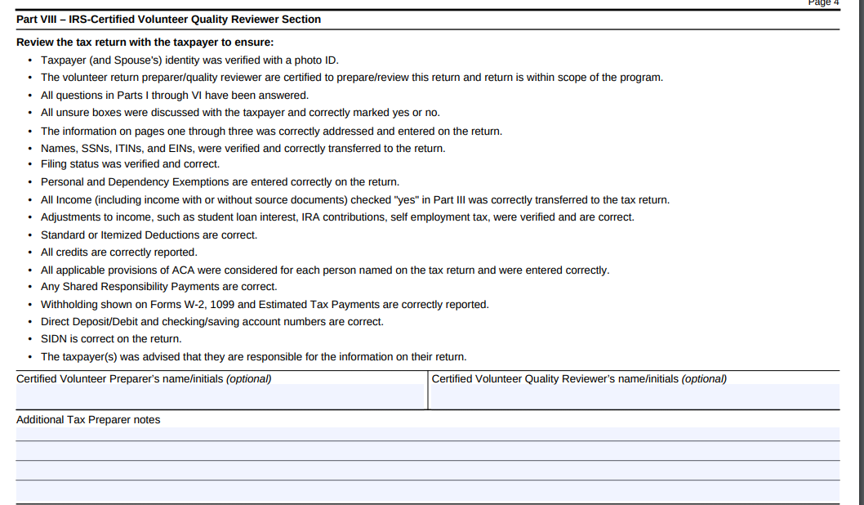
Part 3: Quality Review
Notes:
‹#›

Slide 201
Tax Preparation Process
Part 1: Preliminary Interview
Part 2: Preparing the Return in TaxSlayer
Part 3: Quality Review
Part 4: Finishing the Return
Part 5: Filing the Return

Slide 202
Part 4: Finishing the Return
Write your name on the Intake/Interview Form
Assist with printing and taxpayer signatures
  Taxpayer and spouse must sign and date federal and state returns and keep for their records
File Intake/Interview Form in filing box
  Do NOT keep any personal documents!

Slide 203
Tax Preparation Process
Part 1: Preliminary Interview
Part 2: Preparing the Return in TaxSlayer
Part 3: Quality Review
Part 4: Finishing the Return
Part 5: Filing the Return
Notes:
CF don’t e-file so they don’t have to worry about this!

Slide 204
Sign Up For a January A and B Session
Expect to receive an email from Maggie to register for an A session and B session
Mark your calendars!

Slide 205
W-9
Please fill out a W-9 and:
  Be sure to sign and date
  Return to your trainers

Slide 206

Please “Like” our Facebook Page
Please take some time to “like” our Facebook page: Impact America
We will provide important tax season updates on this page

Slide 207
Campus Fellow Training
Fall Refresher

