Slide 1

Advanced Training
Fall Refresher

Slide 2
Volunteer paperwork
Please log in to volunteers.generationforchange.org and fill out any necessary volunteer paperwork
forms

Slide 3
The impact SaveFirst Volunteers
will have this season
Serve more than 13,000 families this year
Save families over $5 million in commercial fees
Provide a quality, reliable service and an alternative to a costly, predatory industry for hard-working families
SaveFirst: An Initiative of Impact America

Slide 4
Resources
SaveFirst Training Summary Chart
SaveFirst Training Scope of Service Chart
SaveFirst Training TaxSlayer Exercise
Pub 4012 Selections
impactamerica.com/taxprep
Impact America Staff

Slide 5
Basic Training Refresher Outline
Conducting a Thorough Interview
Exemptions(Part II of I/I form)
Filing Status(Part II of I/I form)
Filing Basics
Income(Part III of I/I form)
Expenses(Part IV of I/I form)

Slide 6
Basic Training Refresher Outline
Refund and Amount of Tax Owed
Health Care Coverage(Part VI of I/I form)
Tax Preparation Process

Slide 7
Conducting a Thorough Interview

Slide 8
Interview Objectives
After completing this section, the volunteer will be able to:
  Conduct a thorough interview with taxpayer to ensure accurate return preparation
  Navigate use of I/I form, Scope of Service Chart, and Summary Chart to complete return preparation

Slide 9
Conducting a Thorough Interview
Taxpayer completes pages 1, 2, and 3 of Intake/Interview Form.
Verify photo ID(s) & Social Security card(s)
Go through the entire I/I form with them, asking clarifying questions and determining what is in scope for you.
Ensure taxpayer cannot be a dependent of anyone else (Pub 4012: C-2, C-5 to C-6)
Determine dependents (Pub 4012: C-3 to C-8)
Determine filing status (Pub 4012: B-8 to B-10)

Slide 10
Conducting a Thorough Interview
The first thing you ask from the taxpayer is for photo ID and Social Security Card
If a taxpayer is filing jointly with a spouse, the spouse needs to be present with their photo ID and Social Security Card as well.

Slide 11
Conducting a Thorough Interview
Photo IDs
  Verify photo IDs for taxpayer (and spouse)
Social Security cards
  Verify photo IDs for taxpayer (and spouse)
AND dependents
  Enter name EXACTLY as it appears on SS card!

Slide 12
Conducting a Thorough Interview: Acceptable forms of social security identification
Form SSA-1099 statement
Medicare Card (with an “A” after the SSN)
ITIN card
  Issued for nonresidents who need to file tax returns but cannot receive SS cards
  9XX-XX-XXXX (enter just like SS number)
ATIN for dependent
  Issued for child while adoption is pending
  9XX-XX-XXXX (enter just like SS number)

Slide 13
Conducting a Thorough Interview
What if a taxpayer doesn’t have their social security card for themselves/dependents?
  they lost it
  they don’t have one
  they left it at home
We have to see the card(or acceptable replacement) in order to submit the return!
They can start the return with us, but in order to e-file, they will need to return with the social security card(or acceptable replacement).

Slide 14
Conducting a Thorough Interview
What about…..
  They did their return here at the site last year
  the SSN is on their prior year tax return they brought in
  the SSN is on the taxpayer’s W-2
None of these are acceptable forms of verification because they were not documents issued by the social security administration!

Slide 15
Conducting a Thorough Interview
Once you’ve verified the photo ID and Social Security Card, you need to go through the entire I/I form with the taxpayer, asking clarifying questions and making sure it is filled out completely.

Slide 16
Conducting a Thorough Interview
You may find out that the taxpayer has a form that is out of scope for us!
  We don’t want to waste a taxpayer’s time
  We have a “Scope of Service Chart” that you’ll use to determine if something is out of scope
Better to catch this at the beginning of the process than at the end!

Slide 17
Conducting a Thorough Interview
REVIEW pages 1-3 of I/I Form and ask clarifying questions:
  I see you marked that you are unmarried and have no one else living in your home?
  Collect necessary forms
  “Yes” or “No” answer for all questions on page 2

Slide 18
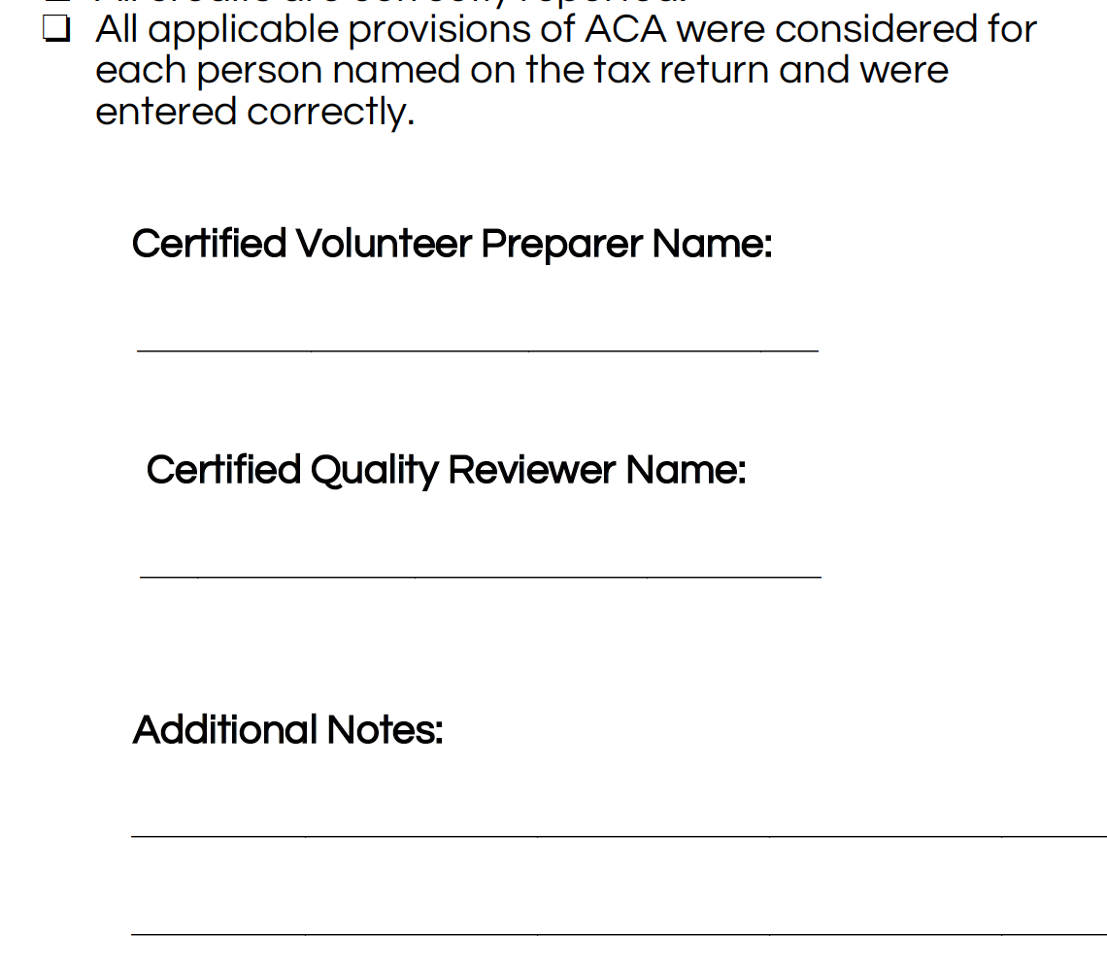
Conducting a Thorough Interview
Write full name on the Intake/Interview Supplement form!

Slide 19
Conducting a Thorough Interview
You need to go through the entire I/I form and ask clarifying questions and make sure everything has been filled out.
If the taxpayer left a question blank, you need to ask and clarify, then fill out the answer on the I/I form.
Before you start the return in TaxSlayer, the entire I/I form needs to be completely filled out!

Slide 20
Conducting a Thorough Interview
Always consult the Scope of Service Chart to see if the income/expense/life event is in scope for your level of certification.
If something is out of scope for you, put the form to the side and make a note on the I/I supplement form for the advanced volunteer.

Slide 21
Conducting a Thorough Interview
Taxpayer has a form and you can’t find it on the scope of service chart or summary chart?
  call over a Site Coordinator to determine if the form is in scope
We want to determine if something is out of scope as early in the process as possible!

Slide 22
Conducting a Thorough Interview
Once you have gone through the I/I form, you need to use the Pub 4012 to determine dependency exemptions and filing status

Slide 23
Conducting a Thorough Interview
Complete part of Section II “To be completed by a Certified Volunteer Preparer”
Determine dependency exemptions(Pub 4012: C-5 to C-7)
Determine filing status (Pub 4012: B-8 to B-10)
We will discuss dependency exemptions and filing status in depth shortly

Slide 24
Conducting a Thorough Interview
You get to know the taxpayer and build a relationship
You might miss credits and deductions that could increase the taxpayer’s refund
You might miss important income documents that must be recorded
You may find that the return is out of scope
Required by the IRS for due diligence

Slide 25
Conducting a Thorough Interview – Why conduct an interview?
You find out if any income documents or expenses need to be entered by a more advanced volunteer.
A diligent and thorough interview saves a huge amount of time in the long run!

Slide 26
Exemptions (Part II of I/I form)

Slide 27
Exemptions Objectives
After completing this section, the volunteer will be able to:
  Determine a taxpayer’s eligibility for a personal exemption
  Assess whether a person qualifies as a dependent of a taxpayer

Slide 28
Exemption
A taxpayer may claim 2 types of exemptions:
  Personal exemption
    Taxpayer can claim themself (and spouse)
  Dependency exemption
    Taxpayer can claim qualifying dependents

Slide 29
Dependent
An individual whom the taxpayer supports or lives with the taxpayer
  Qualifying child
  Qualifying relative

Slide 30
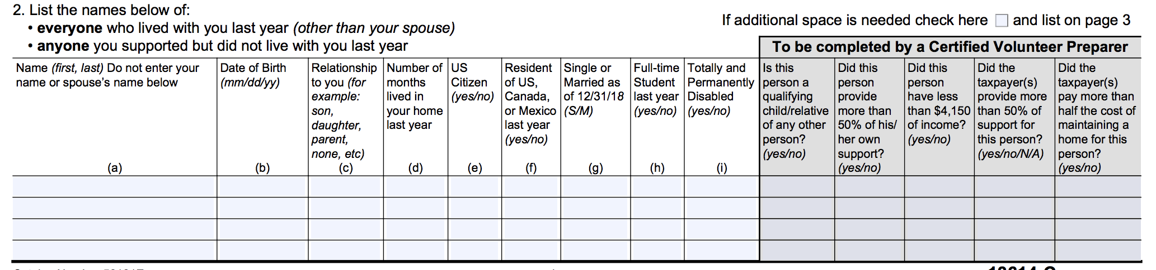
Exemptions
Let’s look at the I/I form:
  During the interview process, you will refer to this part of the I/I form and clarify with the taxpayer to ensure they answered the question correctly.

Slide 31
Personal Exemptions
Taxpayers can claim exemptions for:
  Taxpayer UNLESS the taxpayer can be claimed as a dependent by someone else.
  Spouse UNLESS the spouse can be claimed as a dependent by someone else.

Slide 32
Personal Exemptions
Remember:
It’s not whether the taxpayer IS claimed as a dependent, but whether the taxpayer CAN BE claimed as a dependent that determines whether the taxpayer can claim an exemption.

Slide 33
Personal Exemptions
Let’s look at the I/I form

Slide 34
Dependency Exemptions
Prior to new tax law, each exemption would decrease taxpayer’s taxable income by a certain amount (4,050 in TY 2017)
A taxpayer can claim exemptions for:
  qualifying children
  qualifying relatives
These qualifying individuals usually live in the taxpayer’s home and generally receive significant support from the taxpayer

Slide 35
Dependency Exemptions
Even though taxpayers will not get a certain amount for their dependents, you still need to determine the dependents for other tax benefits (Filing Status, Credits, etc.)

Slide 36
Determining Dependency Exemptions
Open the Publication 4012 to the Exemptions Tab to Table 1: Dependency Exemption
ALWAYS BEGIN WITH THIS CHART TO DETERMINE IF A PERSON QUALIFIES AS A DEPENDENT

Slide 37
Dependency Exemptions
Let’s look at the I/I form:
As you go through the Pub 4012 and ask questions to determine exemptions, answer “Yes/No” in the shaded area.

Slide 38
Qualifying Child or Qualifying Relative?
If no one else can claim the taxpayer or spouse as a dependent, you need to determine if the other people living in the house can be Qualifying Children, and if not see if they can be Qualifying Relatives
Remember: Each exemption will result in possible tax benefits(Nonrefundable and Refundable Credits)

Slide 39
Note: Taxpayers with ITIN Cards
Remember: Taxpayers receive ITIN numbers if they are nonresidents but need to file a tax return and cannot obtain a SSN
If a taxpayer lived in the United States all year and has an ITIN card, they will be considered a resident alien for tax purposes
A “child” passes the citizenship test in this situation

Slide 40
“Permanently and Totally Disabled”
A person is considered permanently and totally disabled if he or she cannot engage in any substantial gainful activity because of a physical or mental condition, AND
A doctor determines the condition has lasted or can be expected to last continuously for at least a year or can lead to death

Slide 41
“Temporary Absences”
A child is considered to have lived with you during periods of time when one of you, or both are temporarily absent due to illness, education, business, vacation, military service, or detention in a juvenile facility

Slide 42
Dependency Exemptions
When you have asked all of the Pub 4012 questions, the entire section should now be filled out correctly. Don’t forget to change any part the taxpayer may have originally entered incorrectly.
no
Tommy Taxpayer
05/05/2010
son
12
yes
yes
single
yes
no
no
no
yes
yes
yes

Slide 43
Exercise
TRUE or FALSE:
Every taxpayer can claim a personal exemption for themself.

Slide 44
Exercise – Answer
FALSE
A taxpayer who can be claimed as a dependent by someone else CANNOT claim an exemption for themself.

Slide 45
Exercise
Rebecca is unmarried with one child, Colin. Colin is 8 years old and lives full time with his mother, who provides all of his support. He is a U.S. citizen, and no other adults live in their household. Can Rebecca claim Colin as a dependent?
Use the Publication 4012

Slide 46
Exercise – Answer
YES
Colin meets all the requirements to be claimed as a qualifying child.

Slide 47
Exercise
Paul is a U.S. citizen who is 26 years old, permanently disabled, unmarried, did not pay for more than half of his support and lived with his parents for the entire year.
Can Paul be claimed as a dependent by his parents?
Notes:
‹#›

Slide 48
Exercise – Answer
YES.
Paul meets all the requirements to be claimed as a qualifying child.

Slide 49
What if the parents live apart?
The custodial parent generally claims the dependency exemption for his/her child
The noncustodial parent can claim the exemption if the parents have signed an agreement
  Form 8332 (REQUIRED for post-2008 divorce)
This situation is complicated to determine. SEE YOUR SITE COORDINATOR

Slide 50
Exercise
Roderick, age 29, lives with his uncle. Last year, he worked part-time and earned $2,100. His uncle provided for the rest of his support, including rent and household costs.
Can his uncle claim Roderick as a dependent? Can Roderick claim a personal exemption?

Slide 51
Exercise – Answer
YES.
His uncle can claim Roderick as a qualifying relative.
NO.
Roderick cannot claim a personal exemption because he can be claimed as a dependent.

Slide 52
Exercise
Gina Brown provides all support for her uncle. Uncle Jim is unmarried, 72 years old, and lives in another city. He has no gross income for the calendar year. Can Gina claim Uncle Jim as a dependent?

Slide 53
Exercise - Answer
YES.
Jim meets all of the requirements to be
a qualifying relative of Gina.

Slide 54
Filing Status (Part II of I/I form)

Slide 55
Filing Status Objectives
After completing this section, the volunteer will be able to:
  Choose the most advantageous (and allowable) filing status for a taxpayer

Slide 56
Filing Status
Based on marital status and family situation
  Single
  Married Filing Jointly
  Married Filing Separately
  Head of Household
  Qualifying Widow(er) with Dependent Child

Slide 57
Determining Filing Status
Open the Publication 4012 to the Filing Status Tab to Chart: Determination of Filing Status – Decision Tree, Chart: Filing Status, and Chart: Who is a Qualifying Person Qualifying You To File as Head of Household
ALWAYS USE THESE CHARTS TO DETERMINE A TAXPAYER’S FILING STATUS
Notes:
It is very important to always use the chart in the Pub 4012 to determine the number of qualifying persons. The IRS requires that we use these charts to determine filing. A taxpayer may think they already know what filing status they should use, but these questions will help you accurately determine the most advantageous allowable filing status for the taxpayer.

Slide 58
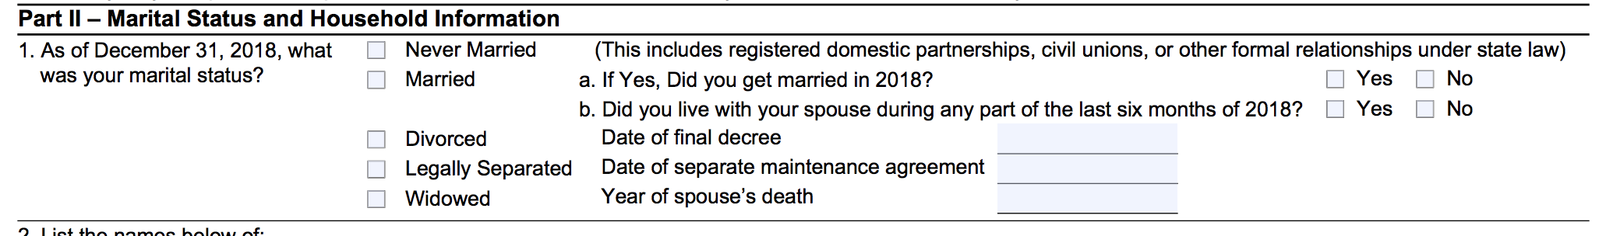
Determining Filing Status
Let’s look at the I/I form
  During the interview process, you will refer to this part of the I/I form and clarify with the taxpayer to ensure they answered the question correctly.

Slide 59
Single
If on the last day of the tax year (Dec. 31st), the taxpayer was
  Not married OR
  Legally separated/divorced OR
  Widowed
IMPORTANT:
Some taxpayers considered single can also file under a more advantageous status (HoH or QW).
Be sure to check all options!

Slide 60
Married Filing Jointly
If on the last day of the tax year,
  They lived together as a married couple OR
  They lived apart but were not legally separated/divorced OR
  One spouse died during the year, and the taxpayer did not remarry.

Slide 61
Married Filing Separately
Married taxpayers can also file separately; HOWEVER,
  If one spouse itemizes, the other spouse must itemize.
  Taxpayers filing with this status are not eligible to claim several tax credits.
Be careful!
This status generally results in a HIGHER overall TAX.

Slide 62
Why Do Some Choose MFS?
Sometimes MFS is chosen when one spouse does not want to be responsible for the other spouse’s tax obligations or filing separately may result in a lower total tax (this is rare)
Sometimes to avoid an offset of their refund against their spouse’s outstanding debts (child support, student loans, etc.)
Note: Even in these circumstances, there may be other options that allow them to file jointly and not be responsible for these debts (Injured Spouse Form)

Slide 63
Why Do Some Choose MFS?
Note: Sometimes taxpayers must file separately because they are separated and not in communication with their spouse and don’t have the option of filing jointly
Notes:
Sometimes MFS is chosen when one spouse does not want to be responsible for the other spouse’s tax obligations or filing separately may result in a lower total tax. But this rarely happens!
Sometimes to avoid an offset of their refund against their spouse’s outstanding debts (child support, student loans…)
There may be a more advantageous way for the taxpayer to file (with the Injured Spouse Form), which can be filed with a joint return but relieve the “injured spouse” of the debts from other spouse, allowing them to keep their portion of the refund

Slide 64
Note
If a spouse died during the tax year, and the taxpayer did not remarry, they are considered married for the entire year.
The surviving spouse is eligible to file as MFJ or MFS.
Surviving spouses that remarry must file with the new spouse, as MFJ or MFS.
  The deceased spouse’s filing status becomes MFS.
Notes:
If a spouse died during the tax year, and the taxpayer did not remarry, they are considered married for the entire year.
The surviving spouse is eligible to file as MFJ or MFS.
Surviving spouses that remarry must file with the new spouse, as MFJ or MFS. The deceased spouse’s filing status becomes MFS.

Slide 65
Head of Household
This is the most complicated filing status to determine, yet it is one of the most common at SaveFirst tax sites
There are two scenarios when a taxpayers can file Head of Household:
Notes:
This is the most complicated filing status to determine, and will require you to use multiple charts in the Publication 4012 to help you determine, yet it is one of the most common at SaveFirst tax sites
There are two scenarios in which a taxpayer can file of Head of Household:

Slide 66
Head of Household
Scenario #1: Married Taxpayers
  Must be “considered unmarried”*
  File a separate return from spouse
  Maintain more than half the costs of keeping up a home
  The home is the main home for a dependent child, stepchild, or foster child for more than ½ the year
    Note: A grandchild does NOT meet this test
  The taxpayer claims an exemption for the child
Notes:
The first scenario concerns a married taxpayer who is separated from his or her spouse
The taxpayer must be “considered unmarried” – we will discuss what this means in a moment
The taxpayer must file a separate return from their spouse
The taxpayer must maintain more than half the costs of keeping up a home
The home must be the main home for a dependent (the key word here is dependent) child, stepchild, or foster child for more than ½ the year
Note that a grandchild does NOT meet this test!
So even though a grandchild can be a qualifying child for the dependency exemption, they are not a qualifying person in this scenario for HoH
Finally, the taxpayer must claim the exemption for the dependent child—no one else can claim the dependent child

Slide 67
“Considered Unmarried”
    A legally married taxpayer can be considered unmarried if s/he has not lived with the spouse at any time during the last six months of the tax year.
Notes:
For a married taxpayer to be “consider unmarried” for the purposes of Head of Household, he or she must not have lived with the spouse AT ANY TIME during the last six months of the tax year
This means that if a taxpayer moved out from their spouse on August 1st of the tax year, they cannot be considered unmarried for the purposes of HoH

Slide 68
Head of Household
Scenario #2: Single Taxpayers
  Maintain more than half the costs of keeping up a home
  A “qualifying person” lived with the taxpayer for more than ½ the year
Notes:
The second scenario concerns a single taxpayer with a qualifying person for Head of Household
In this scenario, the taxpayer must maintain more than half the costs of keep up a home
And a qualifying person must live with the taxpayer for more than ½ the year
There is a unique situation in which the qualifying person does NOT have to live in the home, but we will discuss that in a moment

Slide 69
Head of Household: Qualifying Person
See
Who Is a Qualifying Person Qualifying You To File as Head of Household
in the
Filing Status Tab of the Pub 4012
for a list of qualifying persons
Notes:
Turn in the Filing Status Tab to the Chart: Who is a Qualifying Person Qualifying You To File as Head of Household
You will always need to consult this page when determining if a single taxpayer has a qualifying person for HoH

Slide 70
Head of Household: Qualifying Person
In general, a qualifying child is a qualifying person
  Whether or not the taxpayer claims the exemption
In general, a qualifying relative is a qualifying person if:
  The taxpayer can claim the exemption for the person
  The person meets one of the relationships listed
  The person lives with the taxpayer for more than ½ the year
    Exception: a mother/father who is a qualifying relative does not have to live in the home with the taxpayer
Notes:
Let’s talk about who is a qualifying person. In general, a qualifying child (as determined in the Exemptions chart) is a qualifying person for HoH
Whether or not the taxpayer claims the exemption or not
If you will remember from the Exemptions lesson, sometime parents will sign a Division of Benefits form which allows the custodial parent to file as HoH without claiming the exemption for the child
In general, a qualifying relative (as determined in the Exemptions chart) is a qualifying person if:
The taxpayer can claim the exemption for the person
The person meets one of the relationships listed:
These are the same relationships as defined in the Relationship Test in Qualifying Relatives Exemptions chart
The person lives with the taxpayer for more than ½ the year
There is one exception to this rule—a mother/father who is a qualifying relative does not have to live in the home with the taxpayer to be considered a qualifying person, but the taxpayer does have to pay ½ the cost of keeping up the parent’s home
Determining if a taxpayer can qualifying for HoH can get complicated, which is why it is extremely important to use the charts in the Publication 4012. If you aren’t quite sure that you understand how to determine HoH—rewind the video and watch it again! This will be one of the most important pieces of tax knowledge for you to know this year.

Slide 71
Head of Household: Separated Parents
Even if the custodial parent has given up his/her right to claim the dependency exemption for a child (Form 8332), s/he can file Head of Household using that child as her/his qualifying person
Noncustodial parent can never claim Head of Household
This situation is complicated to determine.
SEE YOUR SITE COORDINATOR
Notes:
If the custodial parent has given up her right to claim the dependency exemption for a child (Form 8332), that child is still her qualifying person for HoH.
The noncustodial parent can NEVER claim HoH (unless he has some other qualifying person living in his household).

Slide 72
Qualifying Widow(er) with Dependent Child
A taxpayer files QW if his/her
  Spouse died recently, AND
  The taxpayer did not remarry, AND
  The taxpayer has a dependent child (son, daughter, stepson, stepdaughter), AND
  The taxpayer provides over half the costs to maintain the main home for taxpayer and child.
Notes:
Qualifying Widow with dependent child is perhaps the most exclusive filing status.
Only taxpayers whose spouses died recently, who remain single, and who are able to claim a dependency exemption for a son, daughter, stepson, or stepdaughter can use this status.

Slide 73
Unmarried, Widowed Taxpayer?
If the spouse died during the current tax year: Married Filing Jointly
If the spouse died during one of the two preceding tax years and taxpayer has a qualifying child: Qualifying Widow(er)
If the spouse died three or more years before the current year: Single or Head of Household
Notes:
If the spouse died in the tax year, the taxpayer will file MFJ.
If the spouse died in one of the two preceding years, the taxpayer can file QW if he/she meets all of the qualifications:
(a) taxpayer has not remarried;
(b) taxpayer has a son, daughter, stepson, stepdaughter for whom he/she can claim an exemption;
(c) taxpayer pays over half the costs of keeping up a main home for him/herself and child(ren).
If the spouse died in three or more years before the current tax year, the taxpayer cam file as single or HoH.

Slide 74
From Lowest to Highest Tax Burden
Married Filing Jointly & Qualifying Widow(er)
Head of Household
Single
Married Filing Separately
Notes:
This slide shows the filing statuses from lowest to highest tax burden (i.e., from lowest taxes owed to highest taxes owed).
You’ll want to give the taxpayer the best status that he/she qualifies for.
Remember that we want to strongly discourage taxpayers from filing separately. Discuss the taxpayer’s concerns and present any possible alternatives.

Slide 75
Exercise
Lily left her husband in August of the tax year, but they did not get divorced. She took her children with her, supported them during all of the tax year, and will claim them as dependents. Lily refuses to file a joint return with her husband.
Which filing status should she use?
Notes:
Have a volunteer read the scenario, then walk through the charts together in Tab B.

Slide 76
Exercise – Answer
Married Filing Separately.
Because Lily lived with her husband for some part of the last six months of the year, she cannot file as Head of Household.
Notes:
Answer: MARRIED FILING SEPARATELY

Slide 77
Exercise
Em left her husband in February of the tax year, but they did not get divorced. She took her children with her, supported them all year, and will claim them as dependents. Em refuses to file a joint return with her husband.
Which filing status should she use?
Notes:
Have a volunteer read the scenario, then walk through the charts together in Tab B.

Slide 78
Exercise – Answer
Head of Household.
A legally married taxpayer can be considered unmarried and file as HoH if he/she has not lived with the spouse at any time during the last six months of the tax year.
Notes:
Answer: Head of Household

Slide 79
Exercise
Lane, a single woman, lives alone. She provides full support for her mother, Theresa, who lives in a nearby town. Since Theresa had no income for the year, Lane paid all costs to maintain her home and will claim her as a dependent.
What is Lane’s filing status?
Notes:
Have a volunteer read the scenario, then walk through the charts together in Tab B.

Slide 80
Exercise – Answer
Head of Household.
A taxpayer can file as Head of Household on the basis of a dependent parent who does not live with them only if the taxpayer pays more than ½ of the costs of keeping up the parent’s home.
Notes:
Because Ginger’s mother does not live with her, Ginger must provide over half the costs of keeping up her mother’s home in order to claim HoH. A taxpayer can file HoH for a parent (only a parent, not grandparent or any other relative) who does not live in the taxpayer's home, provided that the taxpayer provides over half the costs of keeping up the parent's home

Slide 81
Exercise
Brian and Ashley were happily married since 1965. They had no children, but Brian’s brother, who they claim an exemption for, lived with them for the last 10 years. Ashley passed away two years ago. Even after her death, Brian continued to maintain the entire cost for the home and his brother still lived there.
What is Brian’s filing status?
Notes:
Have a volunteer read the scenario, then walk through the charts together in Tab B.

Slide 82
Exercise – Answer
Head of Household.
Brian cannot file as Qualifying Widow(er) with dependent child, because his brother is NOT his dependent child. Even though he is his dependent, he is not Brian’s child.
Notes:
HoH: Brian cannot file as QW because his brother is NOT his dependent child.

Slide 83
Filing Basics

Slide 84
Filing Basics Objectives
After completing this section, the volunteer will be able to:
  Verify that a taxpayer is required to file a tax return
  Recommend when a taxpayer should file a tax return, even if not required to

Slide 85
Who Must File?
To decide whether someone must file a tax return, you need to know the individual’s:
  Age
  Gross income (approximate)
    All the income received during the year in the form of money, goods, property and services not exempt from tax (earned and unearned)
    Do not include Social Security unless
      MFS and lived with spouse at any time during year OR
      ½ of Social Security + other gross income and any tax-exempt interest is more than $25,000 ($32,000 if MFJ)
  Filing status

Slide 86
Who is Legally Required to File a Return?
Use Who Must File Tab in the Pub 4012
  Chart A – For Most People Who Must File
  Chart B – For Children and Other Dependents
  Chart C – Other Situations When You Must File
  Chart D – Who Should File

Slide 87
Children & Other Dependents
Refer to Chart B under Who Must File Tab
If a parent can claim a child as a dependent, the dependent may still need to file a return
A dependent needs to file a return if earned income is greater than $6,300

Slide 88
Other Situations When You Must File
Taxpayer owes special taxes
Taxpayer received Health Savings Account distributions
Taxpayer has net self-employment earnings of at least $400
Taxpayer received an advanced premium tax credit to pay for health insurance

Slide 89
Who Should File
Had income tax withheld from pay
Made estimated tax payments
Qualify for the Earned Income Credit
Qualify for Additional Child Tax Credit
Qualify for American Opportunity Credit

Slide 90
TaxSlayer
Login to TaxSlayer:
  vita.taxslayerpro.com/IRSTraining/
  Password: TRAINPROWEB
Create Account(or log in to existing account)
  Use most regularly checked email address
  Username: Last Name, First initial, TRAIN (e.g., SMITHJTRAIN)
  Password: SaveFirstTaxes2019!
Select "VITA" as Program Type
Leave SIDN blank
Enter BB Basic Information(filing status, dependents, personal info)
Notes:
At this point, CFs are only creating their accounts (not starting a return)

Slide 91
Income (Part III of I/I form)

Slide 92
Income Objectives
After completing this section, the volunteer will be able to:
  Recognize various types of income documents
  Summarize the taxability of each type of income to the taxpayer
  Use I/I form, Scope of Service, Summary Chart to ensure accurate return preparation

Slide 93
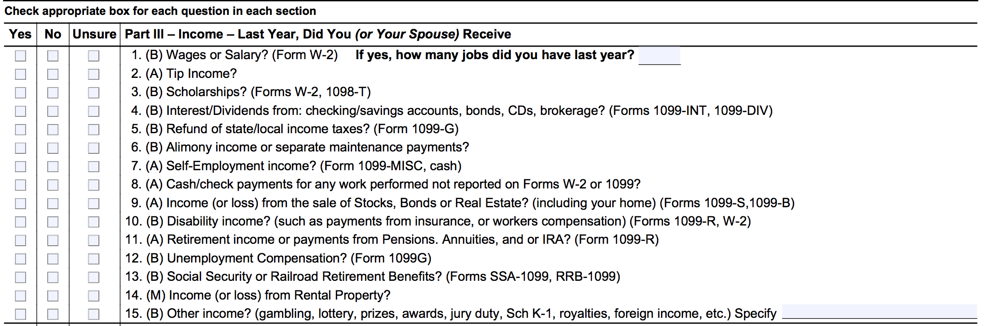
Income
Let’s look at the I/I form:
  During the interview process, you will refer to this part of the I/I form and clarify with the taxpayer to ensure they answered the question correctly. Ask clarifying questions: If they only marked having one type of income, you should ask “Did you have any other types of income? Interest or self-employment? What about Social Security or retirement?”

Slide 94
Income
  All of these boxes must be checked yes or no. Otherwise, the document is incorrectly filled out. If the taxpayer marked unsure, clarify with them what the question is asking and change the checkbox to “Yes” or “No” accordingly.

Slide 95
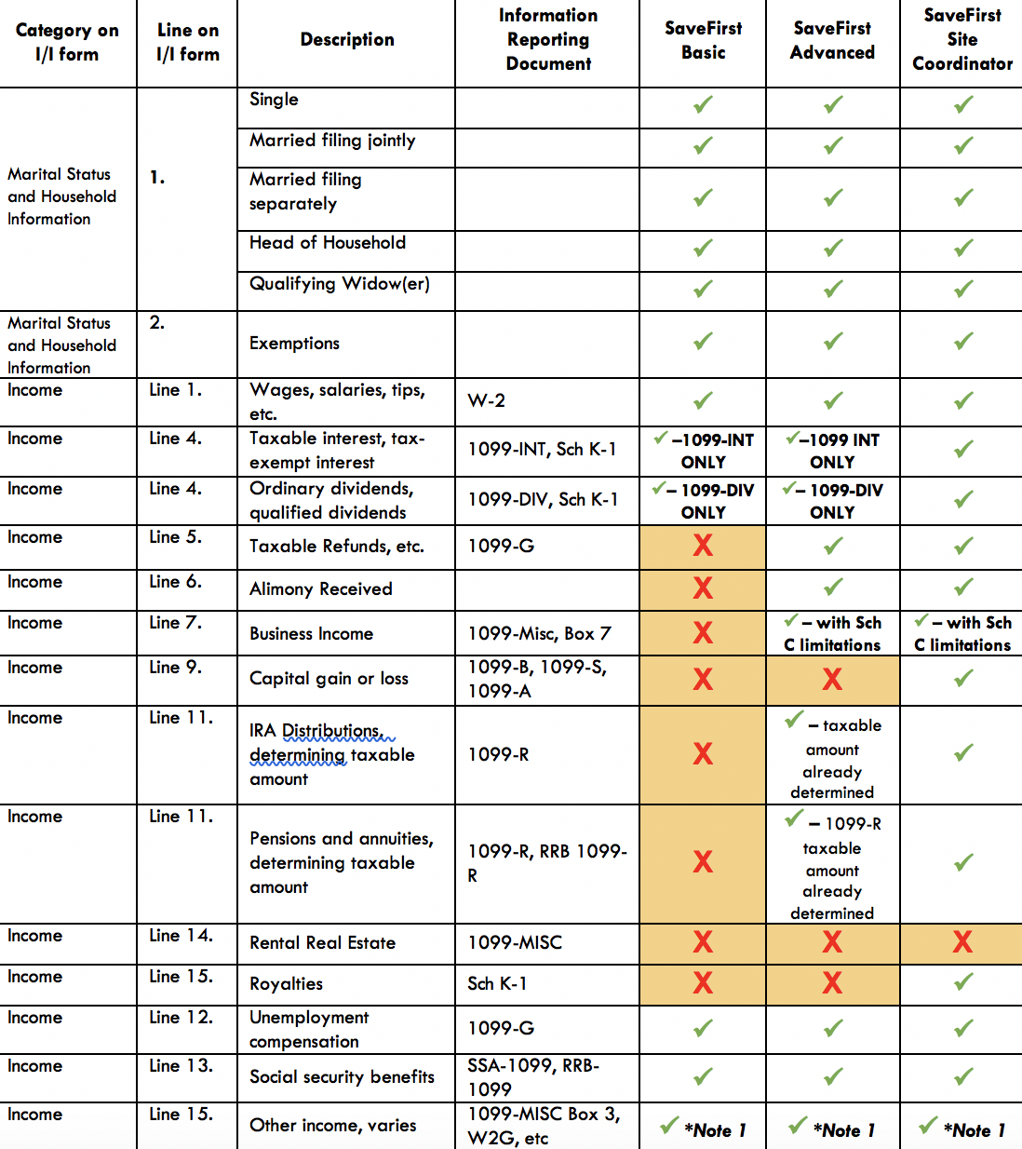
Income
Let’s look at the scope of service chart!
If a form is out of scope for you, just set it aside for your advanced volunteer and make a note on the I/I supplement form.

Slide 96
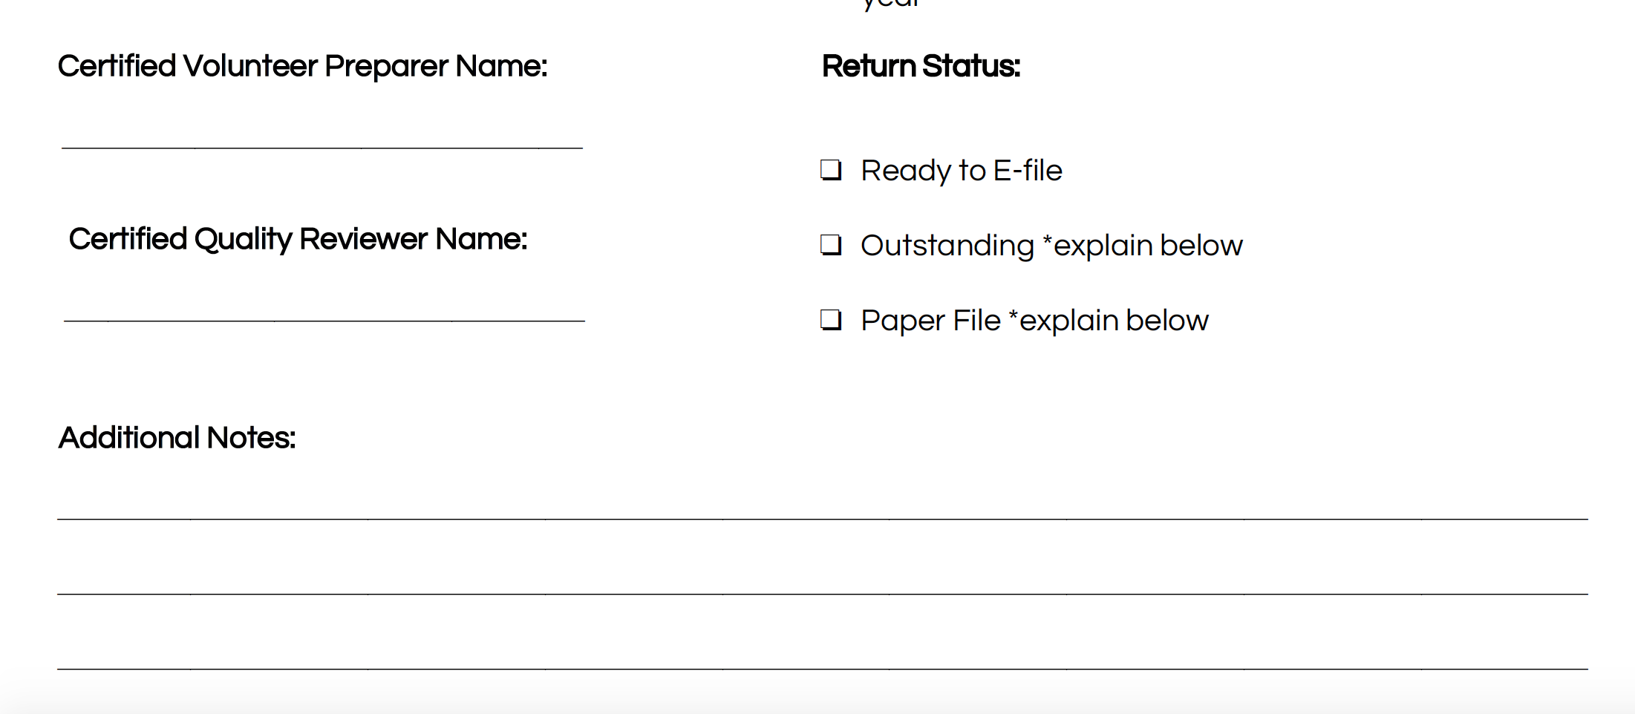
Income
Making notes on the I/I supplement form is crucial!
It lets the Site Coordinator know what needs to be entered in addition to the Quality Review
Need to enter: Capital gains 1099-B

Slide 97
Taxable Income
Wages
Unemployment Compensation
Some Social Security Benefits
Self-Employment Income
Nonemployee Compensation
Dividends
Interest
Gambling Winnings
Awards
Prizes
Punitive Damages (from a Lawsuit Settlement)
Refund of State Taxes
Jury Duty Fees
Tips
Retirement Annuities
Retirement Pensions
Retirement IRA Distributions

Slide 98
Nontaxable Income
Child Support
Gifts
Life Insurance Proceeds
Other Insurance Payments
Sickness/Injury Payments (Third Party Sick Pay)
Public Assistance Payments
Worker’s Compensation
Veterans’ Benefits
Supplemental Security Income (SSI)
Inheritances
Federal Income Tax Refunds

Slide 99
Taxable & Nontaxable Income
Open the Publication 4012 to the Income Tab to
Income Quick References Guide
for a more complete listing of
taxable and nontaxable income

Slide 100
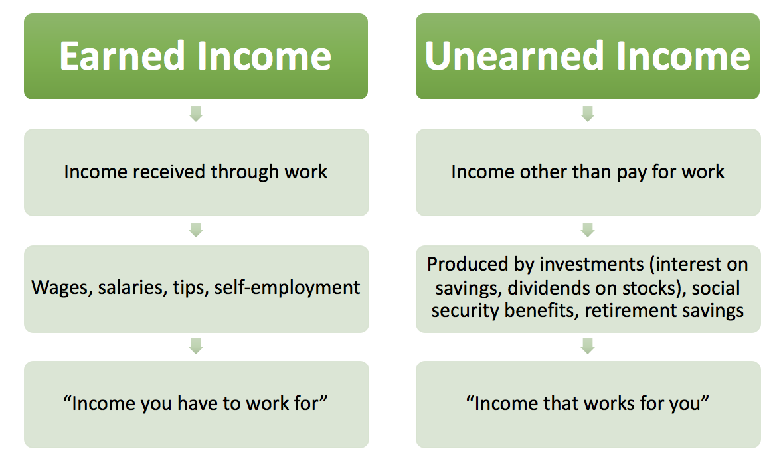
Earned vs. Unearned Income

Slide 101
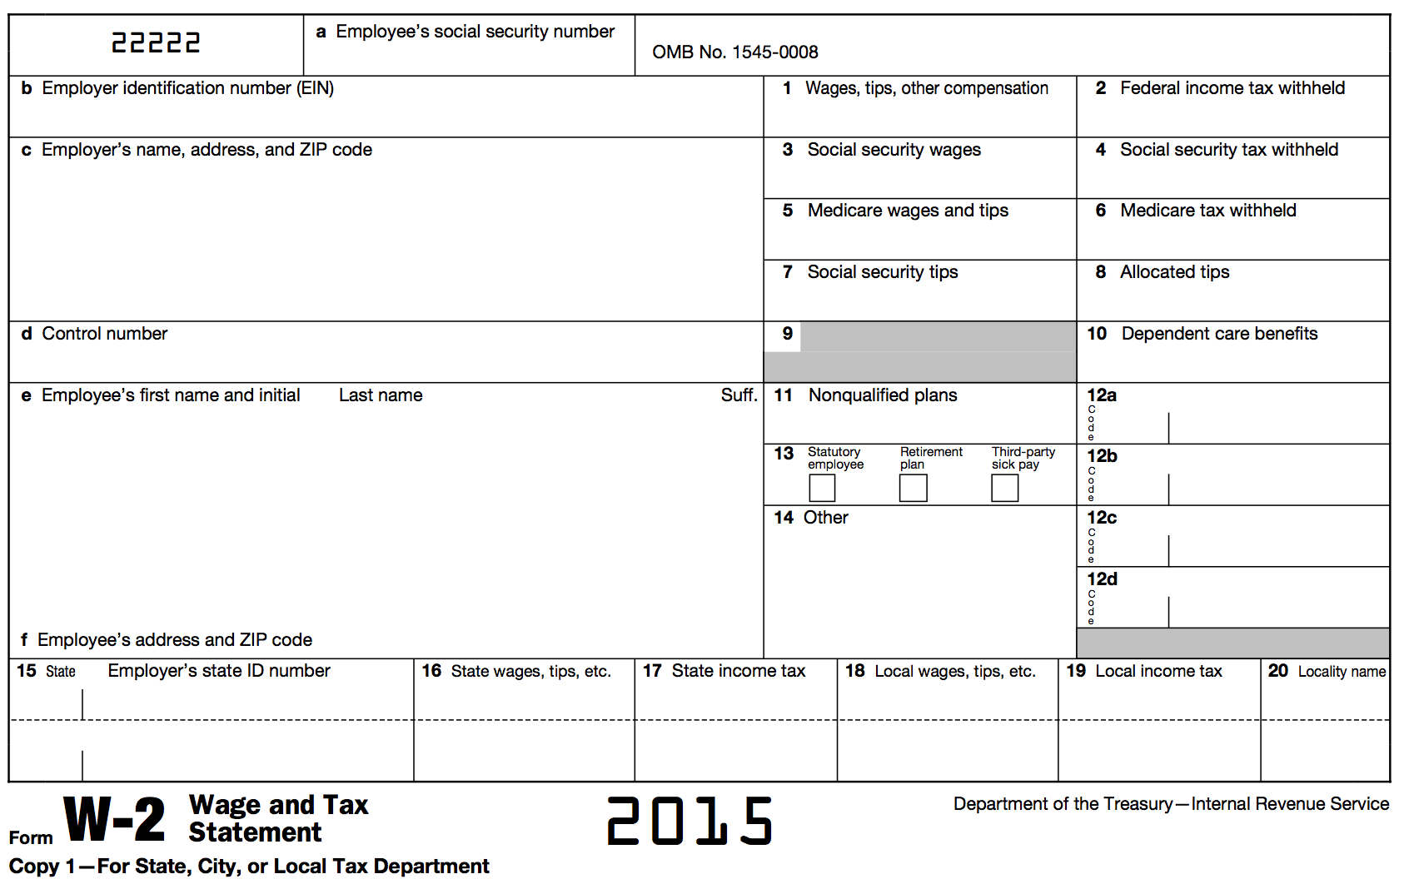
Form W-2: Wage and Tax Statement

Slide 102
Form W-2: Wages, Tips, Other Compensation
Classified as earned income
The federal tax system is a “pay as you go” system, meaning that tax is paid as income is earned during the year
The tax paid is referred to as withholding

Slide 103
TaxSlayer
vita.taxslayerpro.com/IRSTRAINING
Password: TRAINPROWEB
Username: DOEJTRAIN
Password: SaveFirstTaxes2019!
Enter Beth Branch’s W-2s
Notes:
At this point, CFs are only creating their accounts (not starting a return)

Slide 104
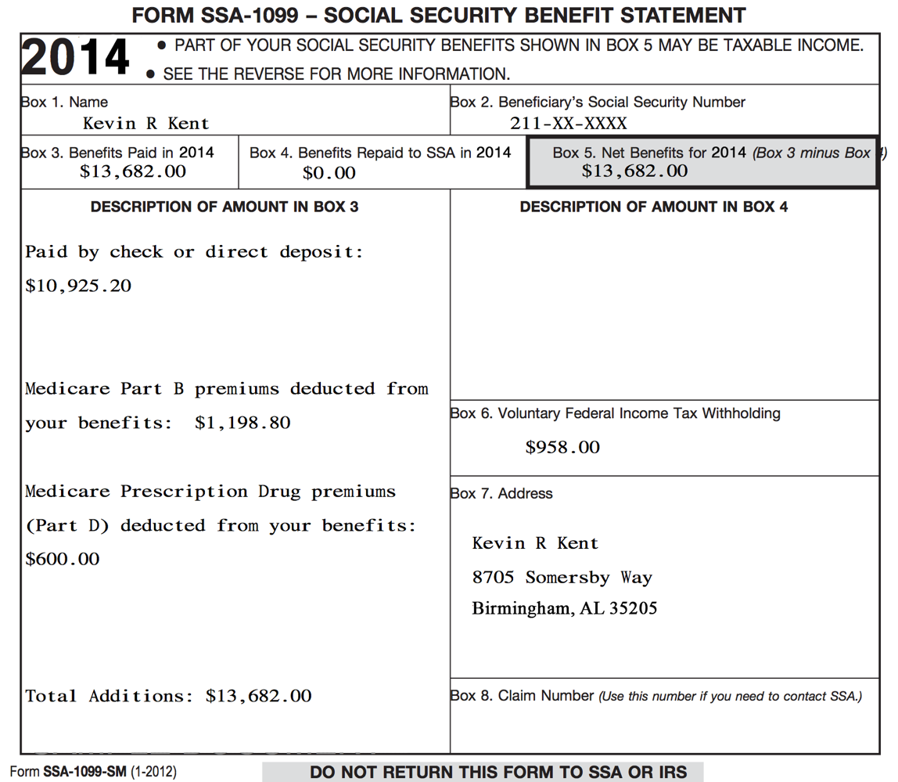
Form SSA-1099:
Social Security Benefit Statement

Slide 105
Form SSA-1099: Social Security Benefits
Social Security benefits include monthly retirement, survivor, and disability benefits
They do NOT include Supplemental Security Income (SSI): aimed at helping low-income elderly, blind, and disabled individuals pay for basic needs
Classified as unearned income

Slide 106
Form SSA-1099: Social Security Benefits
Some portion of the Social Security benefits may be taxable.
  Generally, if Social Security benefits are the only source of income, then they are not taxable.
  Dependent upon filing status and other reportable income
  As the preparer, simply input the SSA-1099 and the software calculates the taxable portion!

Slide 107
Form SSA-1099: Box 3
Many taxpayers will have Medicare insurance premiums (part B) and/or Medicare prescription drug premiums (part D) deducted from benefits
Some taxpayers may have received a lump-sum benefit payment (for current tax year and prior tax years)
See your site coordinator if a taxpayer received lump-sum benefits
Notes:
Very rarely, a taxpayer’s SS benefit statement may report that the taxpayer was paid a lump-sum amount for the current tax year as well as a prior tax year or years.

Slide 108
TaxSlayer
vita.taxslayerpro.com/IRSTRAINING
Password: TRAINPROWEB
Username: DOEJTRAIN
Password: SaveFirstTaxes2019!
Enter Beth Branch’s SSA-1099
Notes:
At this point, CFs are only creating their accounts (not starting a return)

Slide 109
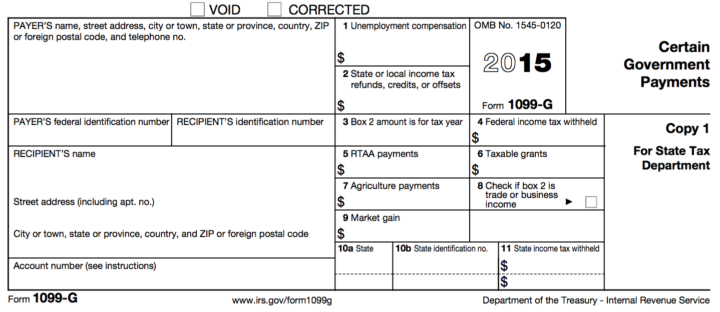
Form 1099-G: Certain Government Payments

Slide 110
Form 1099-G: Unemployment Compensation
Unemployment compensation is fully taxable income
Classified as unearned income
Taxpayers can choose to have federal income tax withheld on unemployment compensation

Slide 111
Form 1099-G:
20XX State Tax Refund
The Prior Year’s State Tax Refund may be taxable and need to be reported
Three conditions must be met:
  Received a state refund in prior year
  Itemized deductions on federal in prior year
  Deducted state income tax NOT sales tax when itemized on federal in prior year (Sch A line 5a/5b)
Notes:
The 2012 State Tax Refund may be taxable and need to be reported as income.
All you need to do is ask the taxpayer the question in the box under line 9: Did you itemize deductions last year and receive state or local tax refunds, credits or offsets? Answer no if you deducted state sales tax instead of state income tax.
If the answer is NO, simply check NO.
If the answer is YES or the taxpayer is unsure, see your supervisor.

Slide 112
Household Employee Income
If a household employee earns less than $2,000 a year, the employer is not required to issue a Form W-2
However, this income must still be reported on the taxpayer’s income tax return
Classified as earned income

Slide 113
TaxSlayer
vita.taxslayerpro.com/IRSTRAINING
Password: TRAINPROWEB
Username: DOEJTRAIN
Password: SaveFirstTaxes2019!
Enter Beth Branch’s 1099-G
Notes:
At this point, CFs are only creating their accounts (not starting a return)

Slide 114
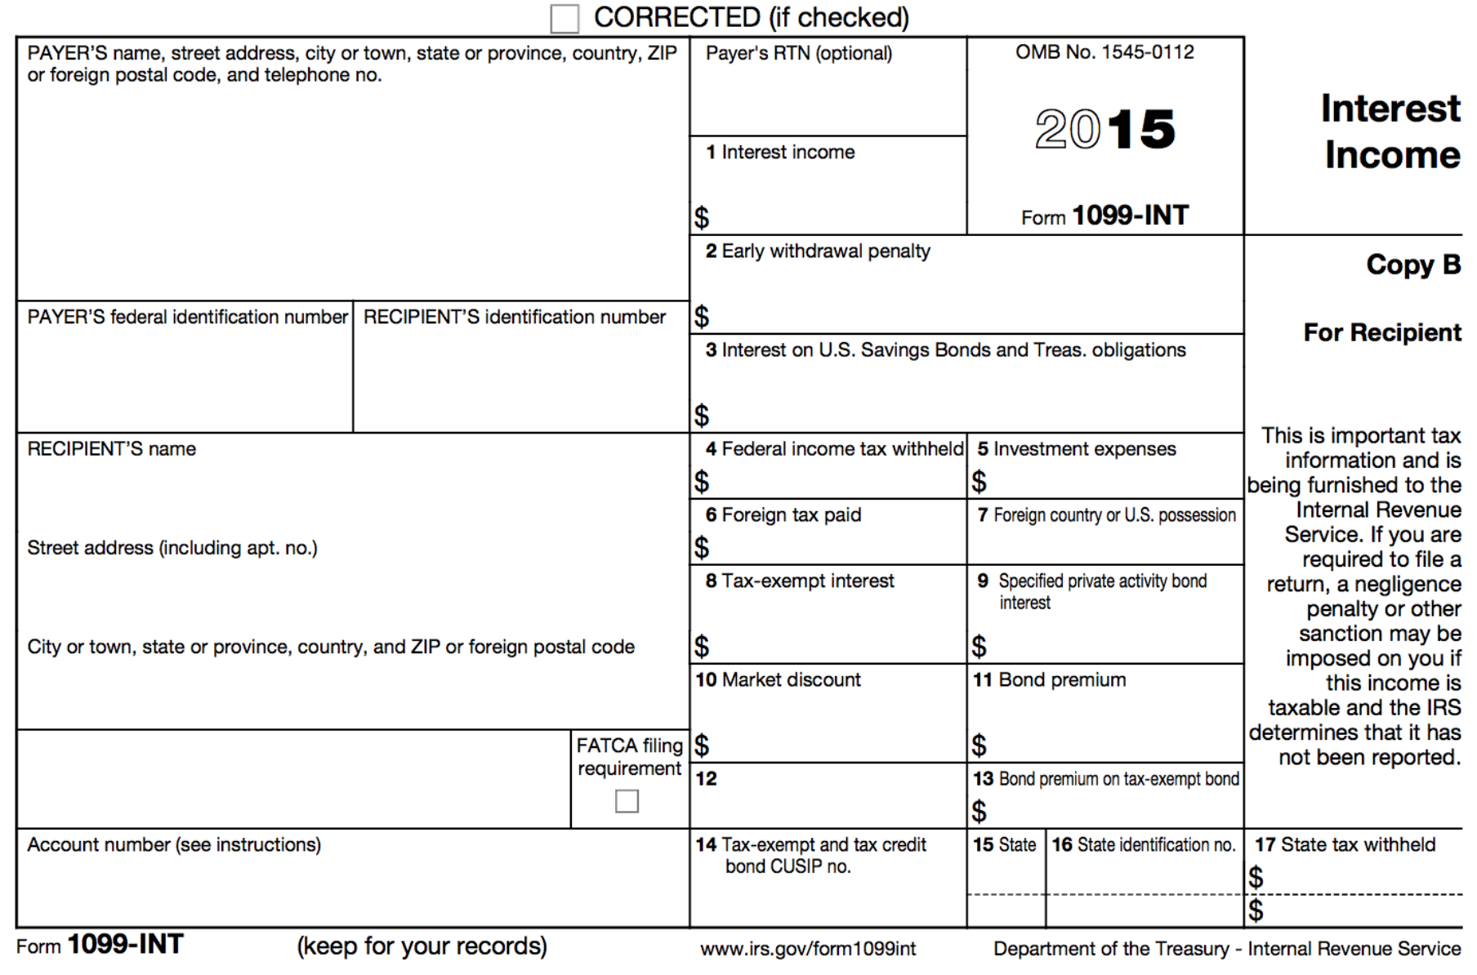
Form 1099-INT: Interest Income

Slide 115
Form 1099-INT: Interest & Interest on U.S. Savings Bonds & Treas. Obligations
Money earns interest when it is:
  Deposited into bank accounts (e.g., savings account)
  Used to buy certificates of deposit (CDs) or bonds
Classified as unearned income
Taxpayer may have had federal income tax withheld in some circumstances

Slide 116
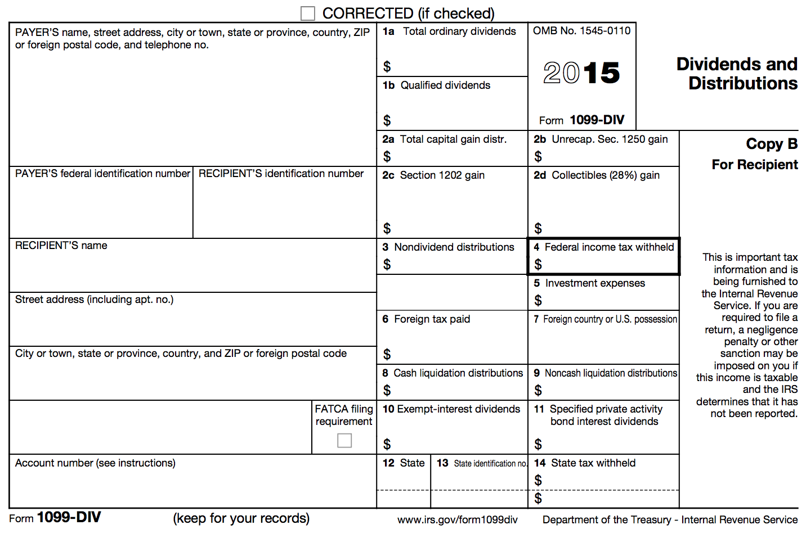
Form 1099-DIV: Dividends and Distributions

Slide 117
Form 1099-DIV: Ordinary and Qualified Dividends
A dividend is a distributions of a portion of a company’s earnings to shareholders
E.g., if a taxpayer has investments in a stock, then dividends paid by the corporation are taxable
Classified as unearned income
Taxpayer may have had federal income tax withheld in some circumstances

Slide 118
Form 1099-DIV: Capital Gains Distributions
Capital gains distributions occur when a taxpayer sells stocks and securities in a mutual fund
Capital gains are taxable!

Slide 119
TaxSlayer
vita.taxslayerpro.com/IRSTRAINING
Password: TRAINPROWEB
Username: DOEJTRAIN
Password: SaveFirstTaxes2018!
Enter Beth Branch’s 1099-INT and 1099-DIV
Notes:
At this point, CFs are only creating their accounts (not starting a return)

Slide 120
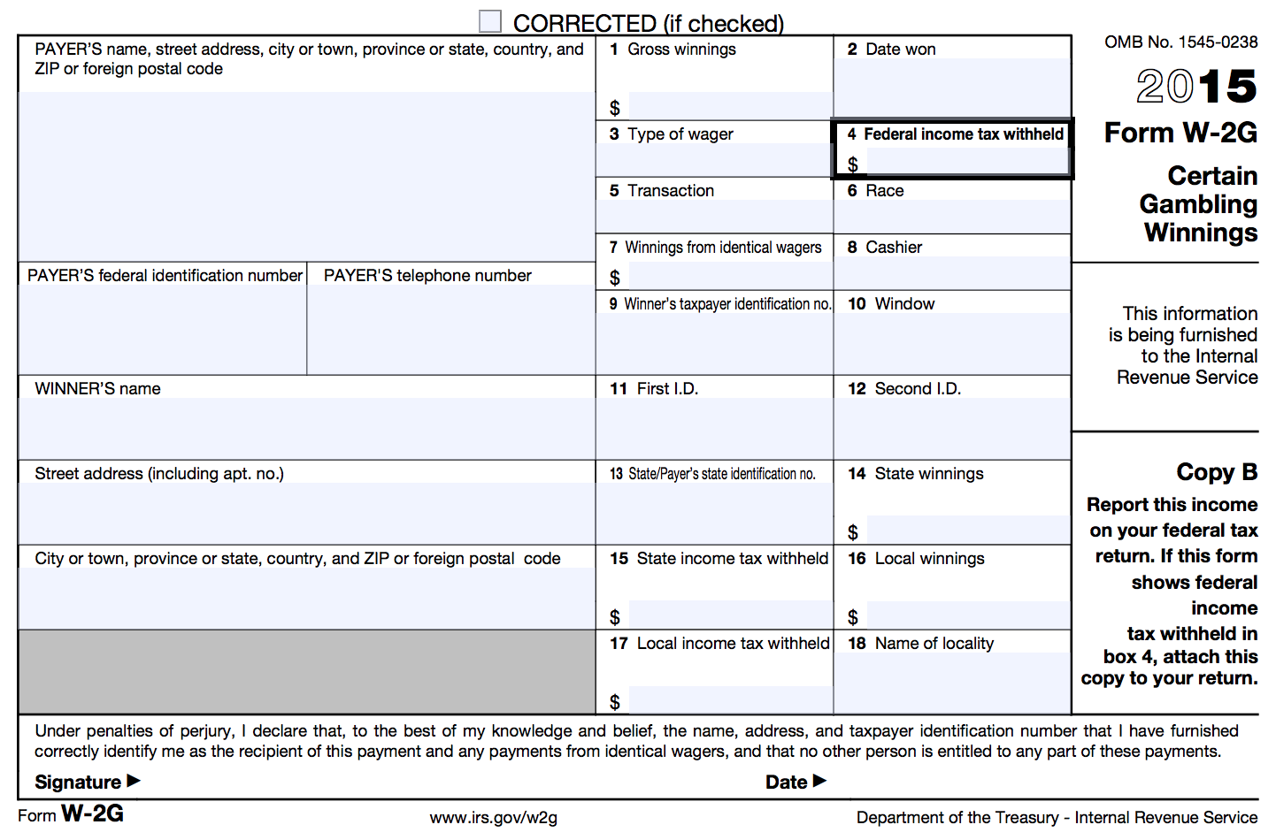
Form W2-G: Certain Gambling Winnings

Slide 121
Form W2-G: Certain Gambling Winnings
A taxpayer may receive one or more Form W2-Gs reporting gambling winnings
Classified as unearned income
Note: If a taxpayer has gambling winnings not reported on a Form W2-G, they must still be reported as income on the tax return

Slide 122
TaxSlayer
vita.taxslayerpro.com/IRSTRAINING
Password: TRAINPROWEB
Username: DOEJTRAIN
Password: SaveFirstTaxes2018!
Enter Beth Branch’s W-2G
Notes:
At this point, CFs are only creating their accounts (not starting a return)

Slide 123
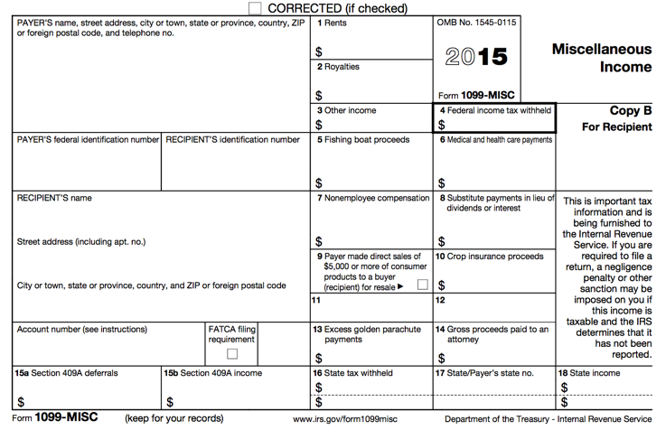

Form 1099-MISC: Miscellaneous Income

Slide 124
Form 1099-MISC: Other Income
Reported in box 3
Other income reported in this box is generally:
  Prizes
  Awards
  Taxable damages (from a lawsuit settlement)
  Other taxable income
Other income in box 3 is classified as unearned income
Taxpayers can choose to have federal income tax withheld on other income in box 3

Slide 125
Form 1099-MISC: Nonemployee Compensation
Reported in box 7
This is business/self-employment income
Y’all will learn how to do Business Income in January!
Notes:
Taxpayers may choose to have federal income tax withheld on other income in box 3, however, most of the time this box will be blank. However, you should always double-check.

Slide 126
Expenses (Part IV of I/I form)

Slide 127
Expenses Objectives
After completing this section, the volunteer will be able to:
  Interpret taxpayer expenses
  Use I/I form, Scope of Service, Summary Chart to ensure accurate return preparation

Slide 128
Expenses
Most things in the “Expenses” category result in tax benefits that can be divided up into the following categories
  Adjustments
  Credits
  Itemized deductions

Slide 129
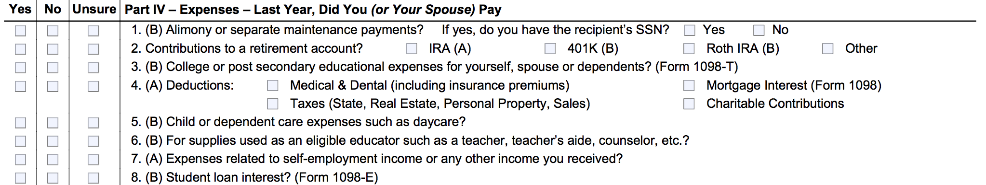
Adjustment
Let’s look at the I/I form: Some of these are adjustments, some are itemized deductions, and some are credits.
  During the interview process, you will refer to this part of the I/I form and clarify with the taxpayer to ensure they answered the question correctly. Ask clarifying questions.

Slide 130
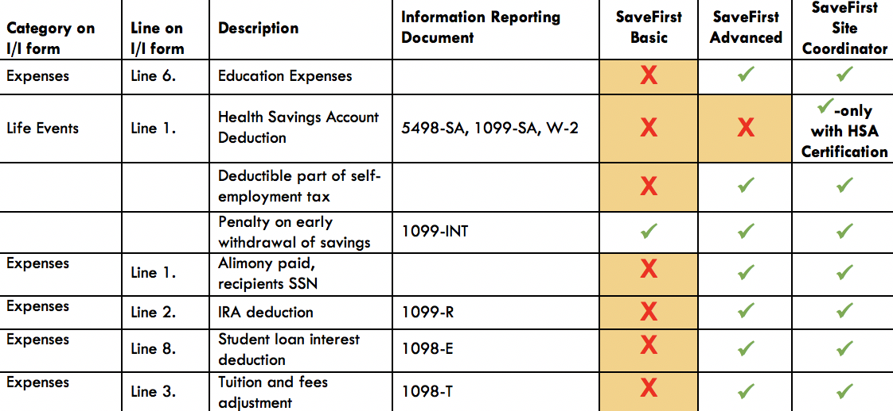
Adjustment
Let’s look at the scope of service chart.
If an adjustment is out of scope for you, just set it aside for your site coordinator and make a note on the the I/I supplement form.

Slide 131
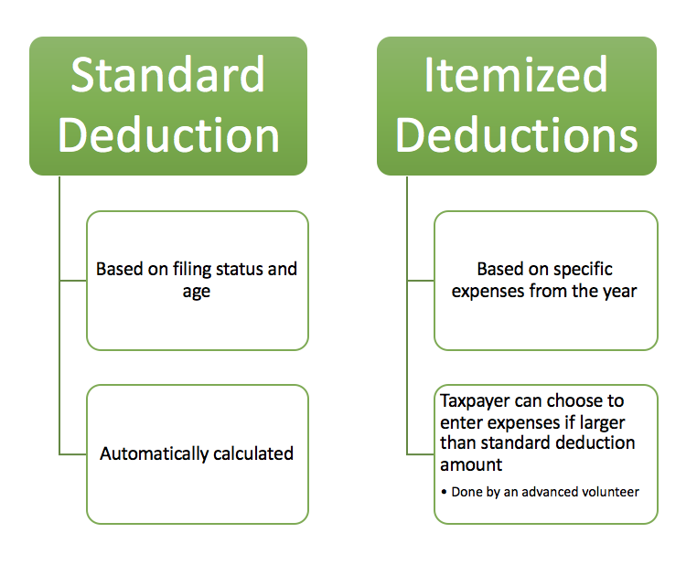
Deduction

Slide 132
Deduction
If a taxpayer has expenses they wish to itemize, an advanced volunteer will have to enter the information.
Based on the filing status and age you input in the software, the standard deduction will automatically calculate and no extra steps need to be taken

Slide 133
Standard Deduction
Reduces amount of income that is taxed
Amount of deduction based on
  Filing Status
  Age
  Whether taxpayer/spouse is blind
  Whether taxpayer is a dependent
Calculated automatically in TaxSlayer

Slide 134
Standard Deduction for Most Filers
Open the Publication 4012 to the Deductions Tab to Exhibit 1: Standard Deduction for Most People
This table provides the standard deduction amounts for the current tax year

Slide 135
Itemized Deductions
Instead of taking the standard deduction, a taxpayer can choose to itemize, which is to list certain deductible expenses separately, in order to receive a greater deduction
The new tax law increased the standard deduction by doubling it, so many taxpayers will not itemize on the federal return

Slide 136
Itemized Deductions
Itemized deductions include (but are not limited to):
  Unreimbursed medical expenses
  Charitable contributions
  Home mortgage payments

Slide 137
Itemized Deductions
Let’s look at the I/I form
If the taxpayer has medical expenses, charitable contributions, home mortgage interest, or other itemizable expenses, the itemized deduction might be better than the standard.

Slide 138
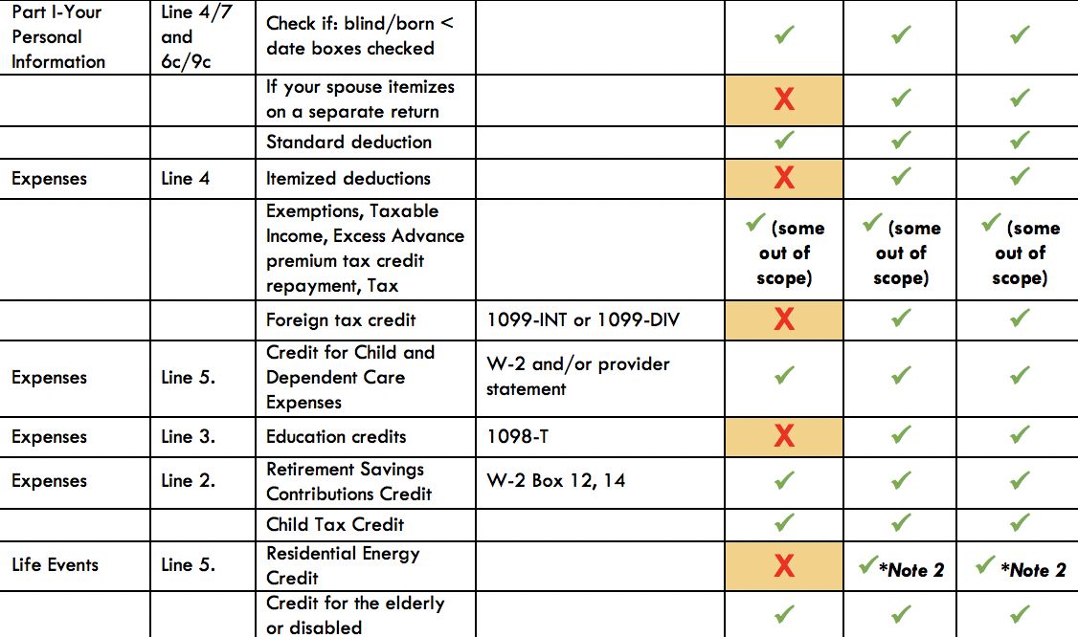
Itemized Deductions
Let’s look at the scope of service chart.
Out of Scope for Basic Volunteers
Impact America staff or Advanced trained volunteers must complete itemized deductions
**You will learn how to itemize in the January sessions!

Slide 139
Tax Credit
Direct reduction of the taxpayer’s liability
Two Types of tax credits:
  Nonrefundable credits
  Refundable credits

Slide 140
Nonrefundable Tax Credit
Reduces the tax liability – only to zero.
  Child and Dependent Care Expenses
  Retirement Savings Contribution Credit
  Child Tax Credit

Slide 141
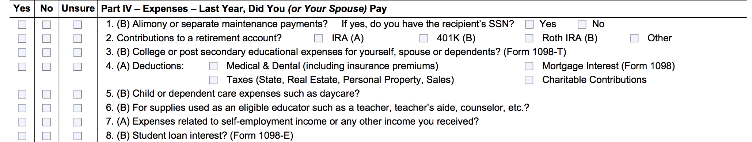
Nonrefundable Tax Credit
Let’s look at the I/I form:
We’ll talk about these credits a little bit later, but if the taxpayer has expenses related to childcare or contributions to a retirement account, it should be marked correctly on the I/I form.

Slide 142
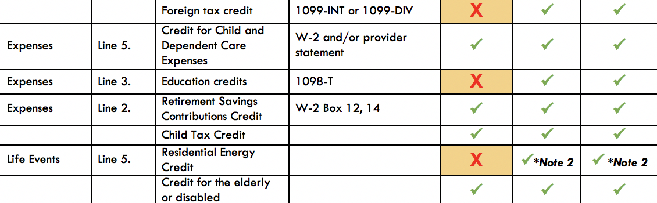
Nonrefundable Tax Credit
Let’s look at the scope of service chart!
If a credit is out of scope for you, just set it aside for your site coordinator and make a note on the I/I supplement form.

Slide 143
Child & Dependent Care Expenses Credit
Nonrefundable credit
Applied to offset expenses paid so taxpayer can work or look for work
  Dependent child under 13
  Spouse who is incapable of self-care
  Dependent who is incapable of self-care

Slide 144
Child & Dependent Care Expenses Credit: Eligibility
Care had to be for qualifying persons
Taxpayer (and spouse) had to have earned income
  A spouse is treated as having earned income for any month the spouse is physically/mentally incapable of care, or is a full-time student.

Slide 145
Child & Dependent Care Expenses Credit: Eligibility
Expenses must have been for work or to look for work
Payments can’t have been made to taxpayer’s spouse, dependent child or child under 19
Must have care provider’s name, address, and SSN/EIN (due diligence)

Slide 146
Child & Dependent Care Expenses Credit: Qualified Work-Related Expenses
Expenses must be paid for the care of the qualifying person to allow the taxpayer (and spouse) to work or look for work
Care includes the costs of services for the qualifying person’s well-being and protection

Slide 147
Child & Dependent Care Expenses Credit: Qualified Work-Related Expenses
Expenses to attend Kindergarten or a higher grade: NOT AN EXPENSE
Expenses for summer day-camp qualify, but those for over-night camp are not!
$3,000 limit for one qualifying person or $6,000 for two or more qualifying persons.

Slide 148
Child & Dependent Care Expenses Credit:
Notes
If you had expenses that met the requirements for the previous tax year, except that you did not pay them until the current tax year, you may be able to claim them on your tax return.
Taxpayer’s who cannot provide all of the provider’s information or who have incorrect information may still be able to take the credit if they can show they used due diligence in trying to obtain the info.

Slide 149
Child & Dependent Care Expenses Credit: Divorced/Separated Parents
Custodial parent can claim the Child & Dependent Care Expenses Credit, even if they did not claim the dependency exemption
This situation is complicated to determine. SEE YOUR SITE COORDINATOR

Slide 150
Exercise
Julie spent the following amounts on child care for her 10-year-old daughter Melissa. Are any of these eligible costs for the Child & Dependent Care Expenses Credit?
$300 for overnight camp
$1000 to her ex-husband for after school-care
$1500 to her mother for after-school care
$500 to her 15-year-old son for babysitting

Slide 151
Exercise – Answer
Julie spent the following amounts on child care for her 10-year-old daughter Melissa. Are any of these eligible costs for the Child & Dependent Care Expenses Credit?
$300 for overnight camp – NO
$1000 to her ex-husband for after school care
$1500 to her mother for after-school care
$500 to her 15-year-old son for babysitting

Slide 152
Exercise– Answer
Julie spent the following amounts on child care for her 10-year-old daughter Melissa. Are any of these eligible costs for the Child & Dependent Care Expenses Credit?
$300 for overnight camp – NO
$1000 to her ex-husband for after school care – NO
$1500 to her mother for after-school care
$500 to her 15-year-old son for babysitting

Slide 153
Exercise – Answer
Julie spent the following amounts on child care for her 10-year-old daughter Melissa. Are any of these eligible costs for the Child & Dependent Care Expenses Credit?
$300 for overnight camp – NO
$1000 to her ex-husband for after school care – NO
$1500 to her mother for after-school care – YES
$500 to her 15-year-old son for babysitting

Slide 154
Exercise– Answer
Julie spent the following amounts on child care for her 10-year-old daughter Melissa. Are any of these eligible costs for the Child & Dependent Care Expenses Credit?
$300 for overnight camp – NO
$1000 to her ex-husband for after school care – NO
$1500 to her mother for after-school care – YES
$500 to her 15-year-old son for babysitting – NO

Slide 155
TaxSlayer
vita.taxslayerpro.com/IRSTRAINING
Password: TRAINPROWEB
Username: DOEJTRAIN
Password: SaveFirstTaxes2019!
Enter Beth Branch’s expenses for child and dependent care expenses
Notes:
At this point, CFs are only creating their accounts (not starting a return)

Slide 156
Child Tax Credit
One credit for each qualifying child under 17 years of age(500 nonrefundable “credit for other dependents”)
A taxpayer can claim a Child Tax Credit for a child only if they CAN AND DO claim a dependency exemption for the child
Nonrefundable credit with a maximum of $2,000 per child(refundable portion limited to $1,400)
  Amount actually claimed depends on taxpayer’s tax liability, MAGI and filing status
  MAGI: typically same as AGI

Slide 157
Child Tax Credit
This is a credit intended to reduce the tax liability owed by the taxpayer, therefore, this part of the credit is nonrefundable
However, the taxpayers may be able to take the Additional Child Tax Credit, which is refundable
The tax software automatically calculates this, but you should be familiar with the rules in case the taxpayer has questions!

Slide 158
Retirement Savings Contributions Credit: General Eligibility Requirements
A contribution to an IRA or other qualified plan for the tax year
AGI limitations (vary based on filing status)
Age 18 or older
Not claimed as a dependent on someone else’s tax return
Not a full-time student during the tax year

Slide 159



Retirement Savings Contribution Credit: Form W-2

Slide 160
Retirement Savings Contribution Credit: Contributions Record
How do I know if the taxpayer has made a qualifying contribution?
  Form W-2, Box 12 and one of the codes: D, E, F, G, H, S, AA or BB
  Form W-2, Box 14 and codes for military personnel: Q or E
CAUTION: Entries in box 14 that are treated a employer contributions are NOT eligible for the credit

Slide 161
Retirement Savings Contributions Credit: Eligible Contributions
Some retirement distributions reduce the eligible contributions for the credit
In addition to retirement distributions made during the current tax year, the taxpayer must also reduce eligible contributions for distributions taken during the previous two tax years

Slide 162
Exercise
Bob, age 48, contributed $600 to an IRA during the tax year. During the year, he worked full-time and had an AGI of $24,000. He is not a student. Is Bob eligible to claim the Retirement Savings Contribution Credit?

Slide 163
Exercise – Answer
Yes: Bob contributed to an IRA, meets the age and AGI limits, is not a dependent and is not a full-time student.

Slide 164
Refundable Tax Credit
Reduces tax liability to zero
Taxpayer will receive the remainder of the credit value as a refund.
  Earned Income Tax Credit
  Additional Child Tax Credit
  American Opportunity Education Credit

Slide 165
Refundable Tax Credit
Let’s look at the I/I form:
We’ll talk more about these credits later, but if the taxpayer has education expenses, it should be marked correctly on the I/I form. The Additional Child Tax Credit and Earned Income Credit are calculated automatically in the software.

Slide 166
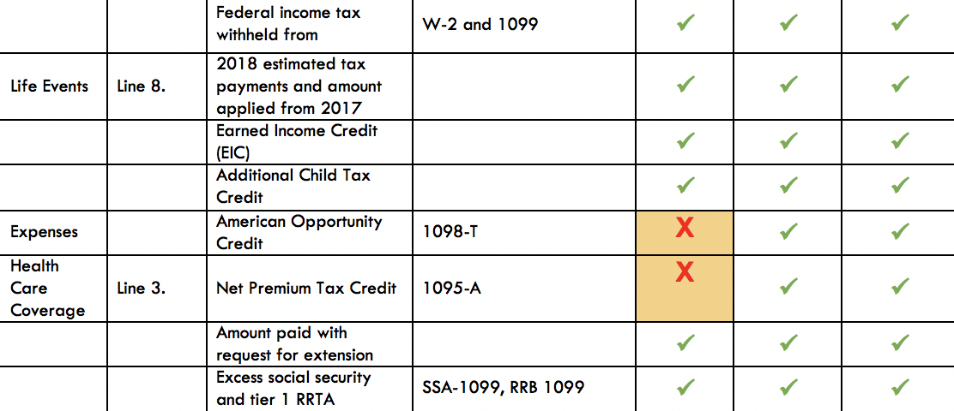
Refundable Tax Credit
Let’s look at the scope of service chart!
If a credit is out of scope for you, just set it aside for your site coordinator and make a note on the I/I supplement form.

Slide 167
Additional Child Tax Credit
The Child Tax Credit is intended to reduce the tax liability owed by the taxpayer, therefore, this part of the credit is nonrefundable
However, the taxpayers may be able to take the Additional Child Tax Credit, which is refundable
TaxSlayer automatically applies this credit to the tax return based on income and dependents

Slide 168
Additional Child Tax Credit
Refundable credit with a maximum of $1400 per child
Amount claimed depends upon meeting general eligibility requirements as well as how much of the nonrefundable Child Tax Credit is claimed
  Cannot claim more than $2000 of CTC and additional CTC combined for one child

Slide 169
Additional Child Tax Credit:
General Eligibility
Meet all the requirement of the Child Tax Credit
  Under 17, U.S. citizen, dependent of taxpayer, qualifying relationship, child did not provide over ½ of own support, lived with taxpayer for more than ½ of year
Must have $2,500 of taxable earned income
  Exception: Taxpayers with three or more children may be eligible regardless of their income

Slide 170
Earned Income Credit
Refundable tax credit for low-to-moderate income workers to encourage work, offset payroll and income taxes, and help meet basic need
TaxSlayer automatically applies this credit to the tax return based on income and dependents

Slide 171
Earned Income Credit
The rules for everyone are as follows:
  Must have earned income (and AGI has limits)
  Valid SSNs and U.S. citizens/resident aliens
  Not MFS
  No foreign earned income
  Investment income less than $3,400
  Taxpayer cannot be qualifying child of another person

Slide 172
Earned Income Credit: Eligibility Requirements
Rules if taxpayer does NOT have a qualifying child:
  Cannot be claimed as a dependent by another person
  Must be at least 25 but under 65 on December 31st of the tax year
  Must have lived in the United States (and spouse, if MFJ) for more than ½ of the year
  cannot be MFS

Slide 173
Earned Income Credit: Eligibility Requirements
Rules if taxpayer has a qualifying child:
  [Age Test] Child must be
    Under age 19 at the end of the tax year, OR
    Under age 24 and a full-time student at the end of the tax year, OR
    Any age and permanently and totally disabled
Still cannot be MFS

Slide 174
Earned Income Credit: Eligibility Requirements
Rules if taxpayer has a qualifying child:
  [Joint Return Test] Qualifying child must not have filed a joint return for the tax year
    Unless the child only filed a joint return with spouse to claim a refund
  [Residency Test] Must have lived with the taxpayer for more than ½ the year
  Must not be the qualifying child of another person

Slide 175
Earned Income Credit: Eligibility Requirements
Note: Just because a person qualifies as the dependent of the taxpayer does not mean they automatically make the taxpayer eligible for the EIC
Child in question must meet the age, relationship, residency, and joint return tests to qualify (therefore, Qualifying Children always meet requirements, HOWEVER, Qualifying Relatives DO NOT)

Slide 176
Earned Income Credit: Qualifying Child of More than One Person
Sometimes, a child meets all of the tests to be claimed by more than one taxpayer
A child cannot be used by more than one person to claim the EIC
The rules for determining who claims the child for EIC are the same as those for determining who claims the the child as a dependent
If this situation arises, please see your Site Coordinator

Slide 177
Earned Income Credit: Disallowance
EIC can be disallowed for
  Reckless or intentional disregard of the rules: 2 years
  Fraudulent Claim: 10 Years
To claim EIC again, a taxpayer must
  Wait full period of disallowance
  Submit a Form 8862 with the tax return
If this situation arises, please see your Site Coordinator

Slide 178
Exercise
Sharon, who has an earned income and AGI of $15,525, takes care of her sister’s son, Eric. If Eric is 12 years old and began living with Sharon in August, can Sharon claim the EIC?

Slide 179
Exercise – Answer
No
Sharon’s AGI is too high to claim the EIC alone, and since Eric lived with her for less than half a year, he is not her qualifying child

Slide 180
Exercise
Doug and Donna are married and live together with their 4-year-old son Sam. Their combined earned income is $25,000, but they file separately. Doug reports an AGI of $11,000 on his return, and Donna reports AGI of $14,000.
Can Doug and/or Donna claim the EIC?

Slide 181
Exercise – Answer
No
Neither can claim the EIC because both have a filing status of Married Filing Separately

Slide 182
Example
Doug and Donna are still married and still live together with Sam, but now they decide to file a joint return. Their combined earned income and AGI are $25,000. Can they claim the EIC on this return?

Slide 183
Example – Answer
Yes
Their joint income is low enough to claim the EIC with one qualifying child (Sam)

Slide 184
Example
Tom is 64 years old, retired and collected $10,000 of social security during the tax year. He does not have any qualifying children.
Can he claim the EIC on his return?

Slide 185
Example – Answer
No
Tom does not have any earned income

Slide 186
TaxSlayer
vita.taxslayerpro.com/IRSTRAINING
Password: TRAINPROWEB
Username: DOEJTRAIN
Password: SaveFirstTaxes2019!
EIC pulls through automatically to 66a on the 1040(2017)
Notes:
At this point, CFs are only creating their accounts (not starting a return)

Slide 187
Refund & Amount of Tax Owed

Slide 188
Refund & Amount of Tax Owed Objectives
After completing this section, the volunteer will be able to:
  Explain the taxpayer’s options when receiving a tax refund
  Explain the options available to a taxpayer that has tax due

Slide 189
Refunds
Taxpayers can choose to receive their refund either by check or direct deposit
Checks take 6-8 weeks to be mailed
Electronic deposits will be made in 1-2 weeks
Taxpayers can also choose to allocate part of their refund to order savings bonds
Notes:
‹#›

Slide 190
Refunds: Direct Deposit
Encourage taxpayers to use direct deposit
  But, refunds will be delayed 4-6 weeks if the routing and account numbers are not valid
Refunds may only be deposited into their own accounts
Refunds can be deposited in up to three accounts

Slide 191
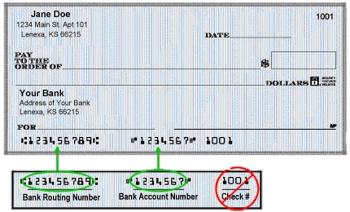
Refunds: Direct Deposit
Routing number (9 digits): can look up online
Account number: do not include check number!
Do NOT include spaces or hyphens!

Slide 192
Refunds: Savings Bonds
Our Role
  Explain opportunity - describe savings bonds & chance to order at tax site
  Seek decision – ask client to decide if, how much & for whom to order bonds
  Process order – complete IRS Form 8888
The Government will mail a physical bond to the taxpayer at the address listed on the return.

Slide 193
Refunds: Savings Bonds
All taxpayers can buy bonds for
  Themselves
  And/or 2 other people (kids, grandkids, spouses, nieces/nephews, godchildren, etc.)
How it works
  Taxpayer needs only name of gift recipient
  Client & gift recipient will be listed on bond as co-owners
  Either party may redeem bond

Slide 194
Tax Due
Payment in full is due by the April filing due date, to avoid interest and penalties
Taxpayer should file his/her return by the April filing date to avoid a failure-to-file penalty
There are separate penalties for filing late and paying late – the late filing penalty is higher

Slide 195
Tax Due
Payment options available at SaveFirst site:
  Pay by check or money order with Form 1040-V (Payment Voucher)
  Pay by direct debit from their checking/savings account on a date that they choose (up to the due date)
Notes:
‹#›

Slide 196
Tax Due
Payment options(on their own):
  Pay with a credit or debit card (convenience fee)
  Electronic Federal Tax Payment System (EFTPS)
    Taxpayers can use EFTPS to file taxes, but they must enroll first (www.irs.gov/e-pay)
  IRS Direct Pay
    Free, one-time payment system offered through IRS.gov
Notes:
‹#›

Slide 197
Tax Due: What if the Taxpayer Cannot Pay?
Apply online for a payment agreement(on their own)
  Taxpayer can apply online for a payment agreement by going to IRS.gov and searching for “Online Payment Agreement” or “OPA”

Slide 198
Tax Due: Undue Hardship
Taxpayers who can show they will have a substantial financial difficulty if they pay their tax on the due date are considered to have undue hardship.
Can request an extension by filing Form 1127 (out of scope) by the due date
  Advise them to visit or call the local IRS office
Undue hardship is MORE than inconvenience!

Slide 199
Tax Due
To avoid having tax due next year:
  Adjust withholding on Form W-4 (from employer)
    Taxpayers should submit a revised form when there is a change in life events (marriage, child, etc.)
  Make quarterly estimated tax payments
Notes:
‹#›

Slide 200
Health Care Coverage
(Part VI of I/I form)

Slide 201
What is the Affordable Care Act (ACA)?
The federal government, state governments, insurers, employers, and individuals share responsibility for improving the quality and availability of health insurance coverage in the United States
The ACA reforms the existing health insurance market by prohibiting insurers from denying coverage or charging higher premiums because of an individual’s pre-existing conditions.
The ACA also created the Health Insurance Marketplace (also known as www.healthcare.gov)

Slide 202
Shared Responsibility Provision
The Affordable Care Act requires individuals to:
  Have qualifying health coverage, called minimum essential coverage, for each month of the year
  Qualify for a coverage exemption, OR
  Make a shared responsibility payment when filing their federal income tax returns
    This is essentially a tax penalty for not having coverage
    Shared responsibility payment expires NEXT year. For Tax Year 2018, taxpayers still owe the penalty

Slide 203
What is Minimum Essential Coverage?
Minimum essential coverage (MEC) is health coverage that satisfies the individual shared responsibility requirement
Most health insurance is MEC
No proof of coverage is needed. Oral statement from the taxpayer is acceptable, unless normal due diligence leads you to believe the taxpayer’s statement is incorrect

Slide 204
How Many Months Do Taxpayers Need to Have MEC?
Everyone needs MEC for every month
  A person is considered covered for the whole month if they had coverage for at least one day
  A person who was born or died during the year is required to have coverage for every full month alive

Slide 205
What Qualifies as Minimum Essential Coverage?
Employer sponsored health insurance
Individual health insurance
  Purchased directly from a health insurance company OR
  Through the Health Insurance Marketplace (www.healthcare.gov)

Slide 206
What Qualifies as Minimum Essential Coverage?
Government-sponsored health insurance
  Medicare
  Most Medicaid
  ALL Kids (healthcare for kids in AL)
  Healthy Connections Kids(healthcare for kids in SC)
  Florida KidCare
  CoverKids(healthcare for kids in TN)

Slide 207
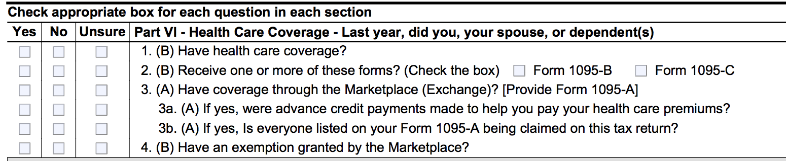
Health Care Coverage on I/I form
Basic Volunteers- only allowed to complete the health insurance section in TaxSlayer if the taxpayer had full year coverage all year NOT from the marketplace.
Advanced Volunteers-able to enter marketplace insurance(1095-A) and coverage exemptions for any months the taxpayer did not have health insurance!

Slide 208
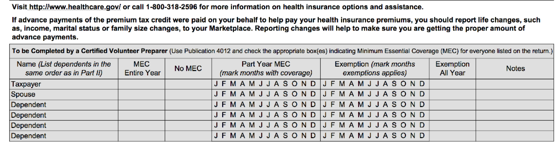
Health Care Coverage on I/I form
In the interview process, you should determine if the taxpayer/spouse/dependents has
MEC for any months of the tax year and mark which months they have coverage.

Slide 209
Premium Tax Credit
Note that some taxpayers may be eligible for a refundable tax credit to help pay for health insurance premiums called the Premium Tax Credit
Any time a taxpayer purchases insurance through the marketplace, they get a 1095-A. An advanced volunteer/Site Coordinator will need to complete the health insurance section.

Slide 210
What if a taxpayer doesn’t have insurance?
Many of our taxpayers will qualify for an exemption and won’t have to pay the penalty.
Any time a taxpayer doesn’t have insurance for any month of the tax year, an advanced volunteer or site coordinator will need to fill out the Health Insurance Section.

Slide 211
TaxSlayer – Beth Branch
Login to TaxSlayer
Vita.taxslayerpro.com/IRSTRAINING
  Password: TRAINPROWEB
  Username: DOEJTRAIN (last name, first initial)
  Password: SaveFirstTaxes2019!
Enter Beth Branch’s health insurance information

Slide 212
Federal Income Tax Process Overview

Slide 213
Federal Income Tax Process Overview

Slide 214

TOTAL INCOME
Earned Income

Slide 215

TOTAL INCOME
Unearned Income
Earned Income

Slide 216
TOTAL INCOME
TAXABLE INCOME
after adjustments, and deductions
Unearned Income
Earned Income

Slide 217
TOTAL INCOME
TAXABLE INCOME
after adjustments, and deductions
TAX LIABILITY
Unearned Income
Earned Income

Slide 218
TOTAL INCOME
TAXABLE INCOME
after adjustments, deductions, and exemptions
TAX LIABILITY
Unearned Income
TAX CREDITS(based on exemptions and eligibility)
Earned Income
AMOUNT OWED OR REFUNDED

Slide 219
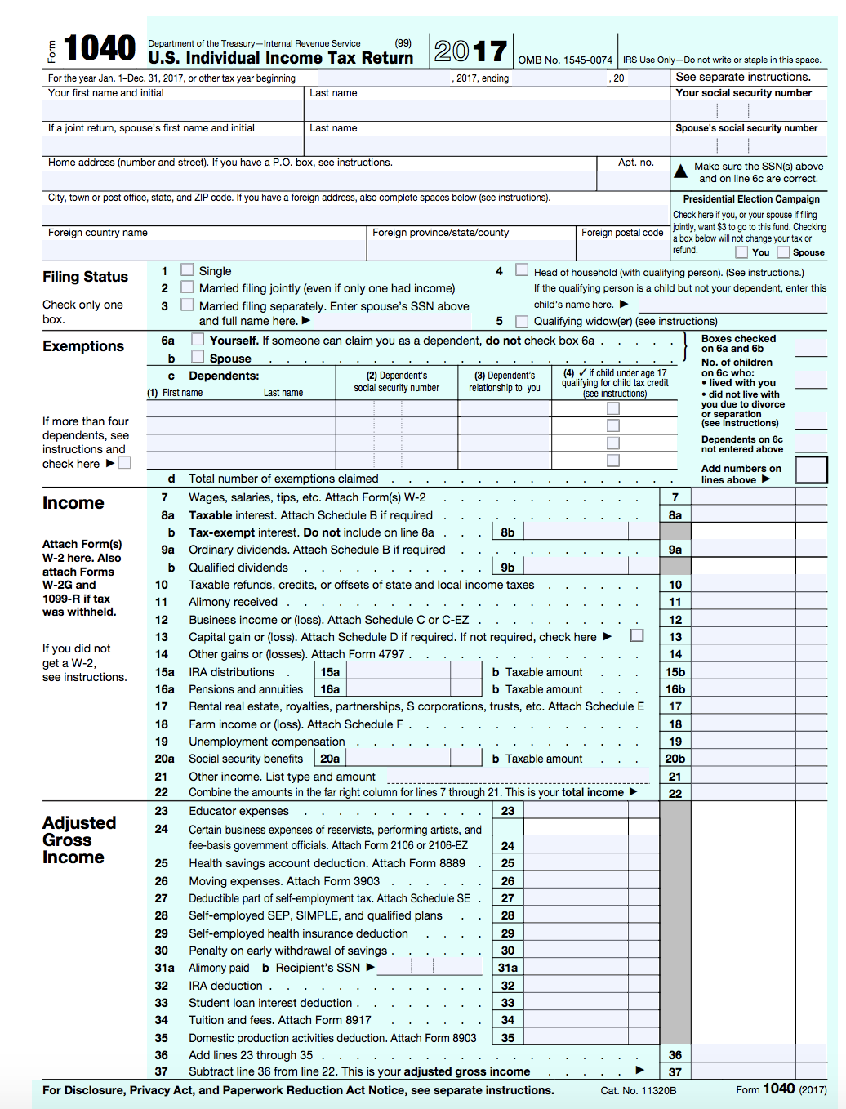
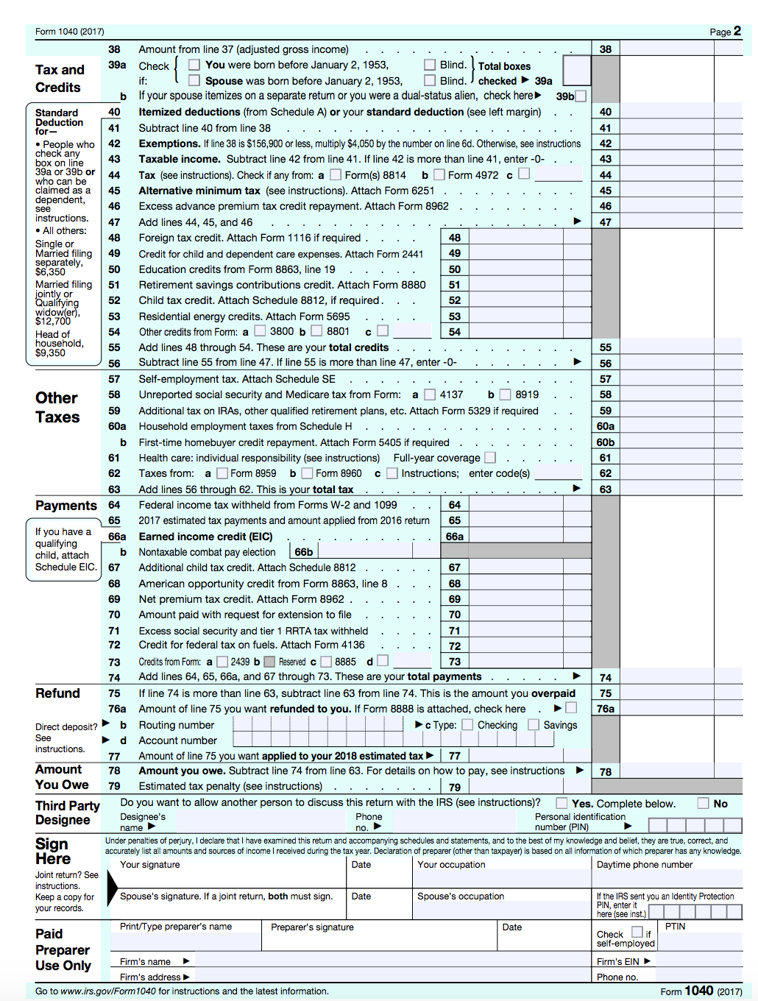

Slide 220
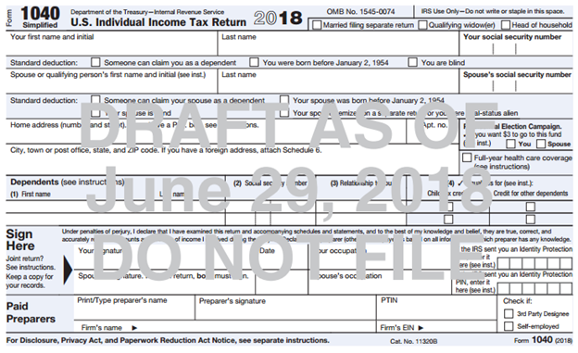
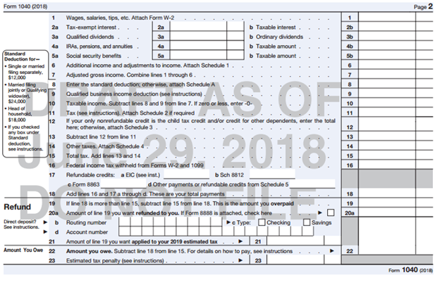
Form 1040-Draft for 2018

Slide 221
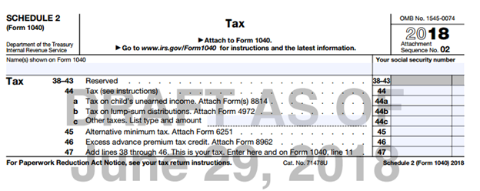
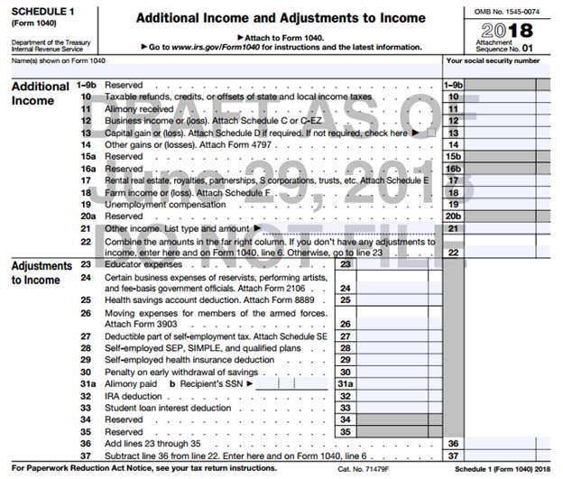
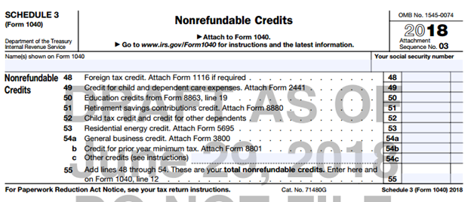
Form 1040-Schedules
Draft for 2018

Slide 222
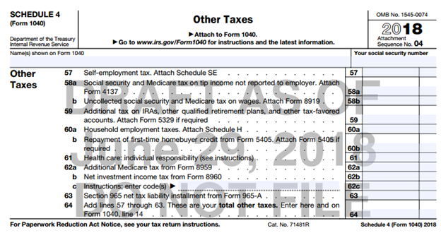
Form 1040-Schedules
Draft for 2018

Slide 223
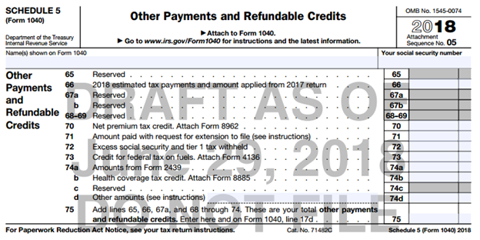
Form 1040-Schedules
Draft for 2018

Slide 224
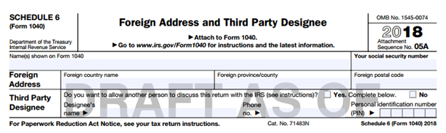
Form 1040-Schedules
Draft for 2018

Slide 225
TaxSlayer – Beth Branch
Login to TaxSlayer
  Vita.taxslayerpro.com/irstraining
  Password: TRAINPROWEB
  Username: DOEJTRAIN (last name, first initial, TRAIN)
  Password: SaveFirstTaxes2019!
Let’s look at the 1040

Slide 226
Tax Preparation Process

Slide 227
Tax Preparation Process
Part 1: Preliminary Interview
Part 2: Preparing the Return in TaxSlayer
Part 3: Quality Review
Part 4: Finishing the Return
Part 5: Filing the Return

Slide 228
Tax Preparation Process
When you arrive at the site on your first day, you’ll need to show your photo ID to the Site Coordinator
They will then check your volunteer certification in the VMS system to make sure you’ve completed all the steps
You will get a nametag specific to your certification level
  Basic Volunteers-Green Badge
  Advanced Volunteers-Blue Badge

Slide 229
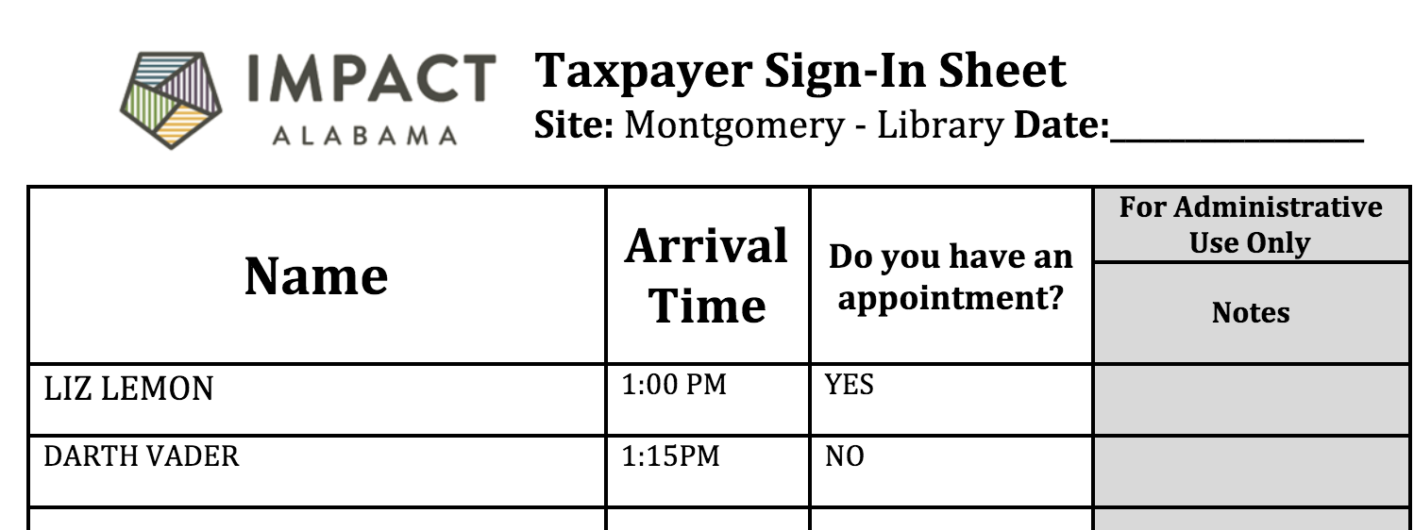
Tax Preparation Process
Taxpayer Sign-In Sheet
  We prioritize appointments over walk-ins!
  Your site coordinator will have the schedule printed next to the sign-in sheet
  When you start a return with a taxpayer, make sure to highlight them off the sign-in sheet AND the appointment schedule!

Slide 230
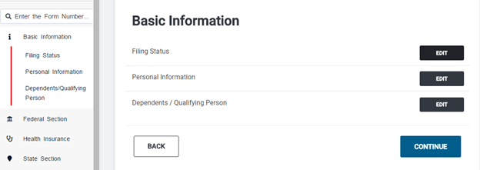
Part 2: Preparing the Return in TaxSlayer
Complete the Filing Status, Personal Information, and Dependents.
**Reminder: Always type in ALL CAPS**

Slide 231
Part 2: Preparing the Return in TaxSlayer-TaxSlayer Logins
You will have a different username for every site location
  DOEJSMITHFIELD
  DOEJWESTEND
  DOEJPENSACOLA
It is very important you use the correct username for the site you are preparing returns!
If you are logged in to the wrong software, the return could get lost!

Slide 232
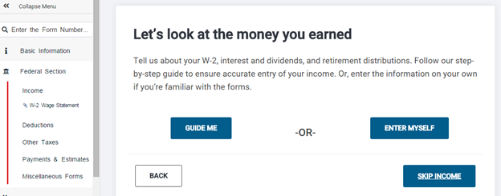
Part 2: Preparing the Return in TaxSlayer
Click “Enter Myself” on the Income page

Slide 233
Part 2: Preparing the Return in TaxSlayer
Complete the income section, deductions section, the health insurance section, the State section(if applicable).
Complete the forms: Gen Use, Gen Disclosure and Prep Use
Select the type of return and enter the bank account information.
Review the entire return and take care of any diagnostic errors

Slide 234
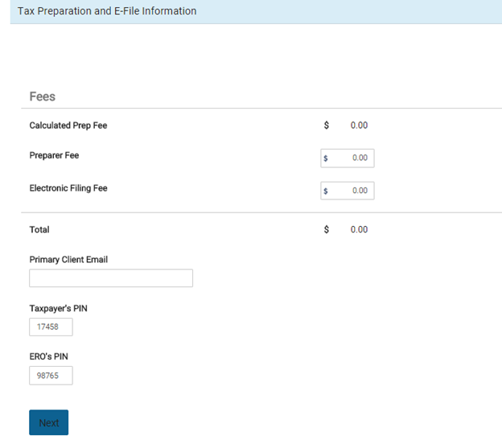
Part 2: Preparing the Return in TaxSlayer – Taxpayer and Spouse PIN
Ask the taxpayer if they are willing to give us their email so we can send them a reminder next year!
In the PIN section, have each taxpayer enter a 5-number pin.
This authorizes us to e-file for the taxpayer!

Slide 235
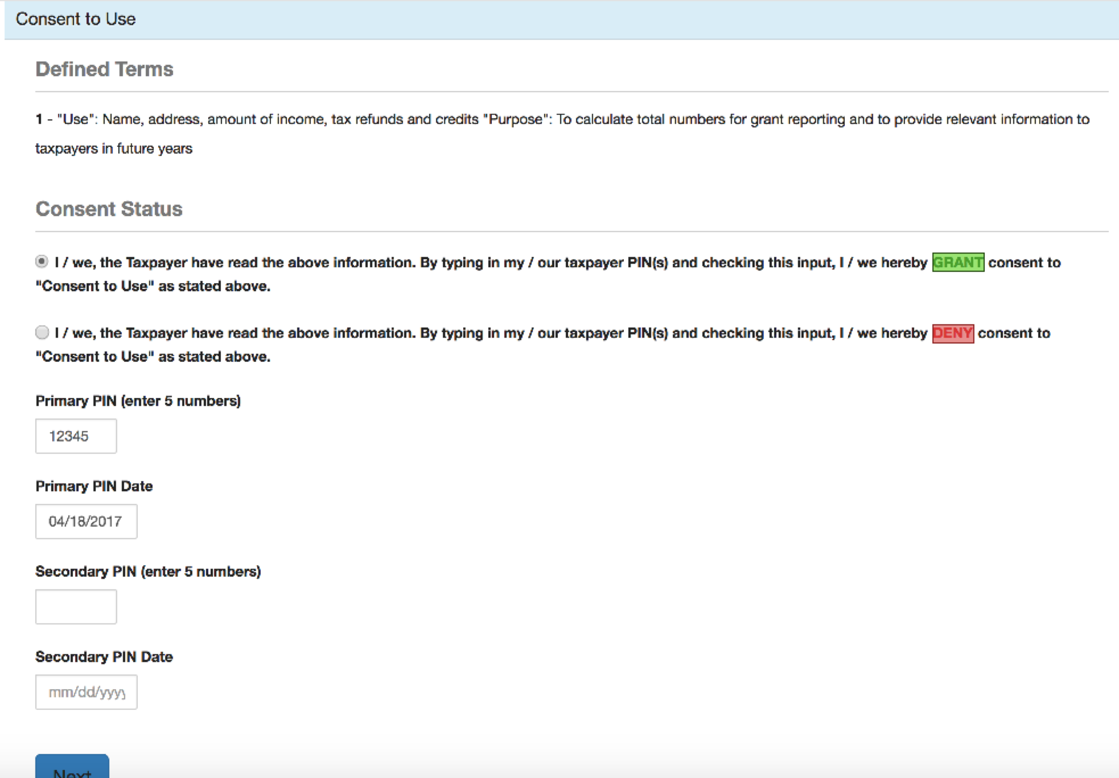
Part 2: Preparing the Return in TaxSlayer – General Use Form

Slide 236
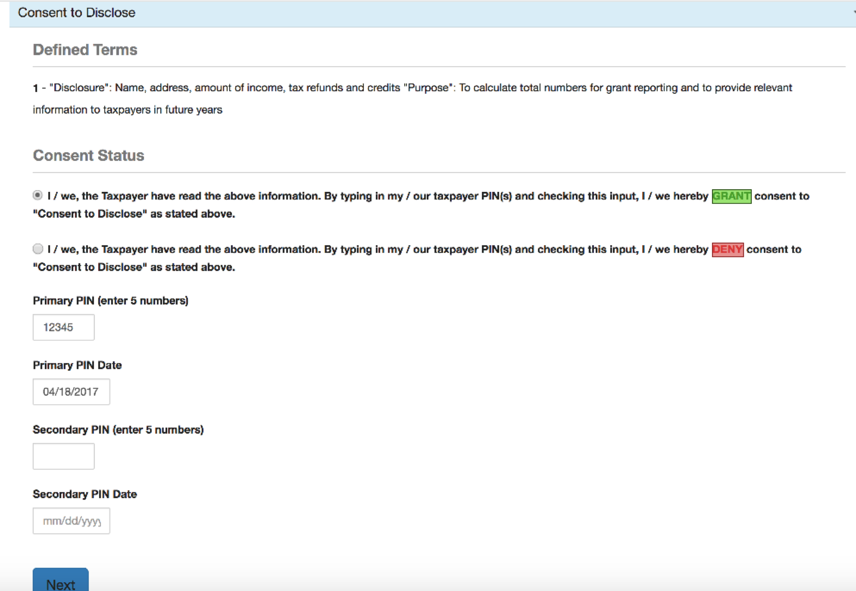
Part 2: Preparing the Return in TaxSlayer – General Disclosure Form

Slide 237
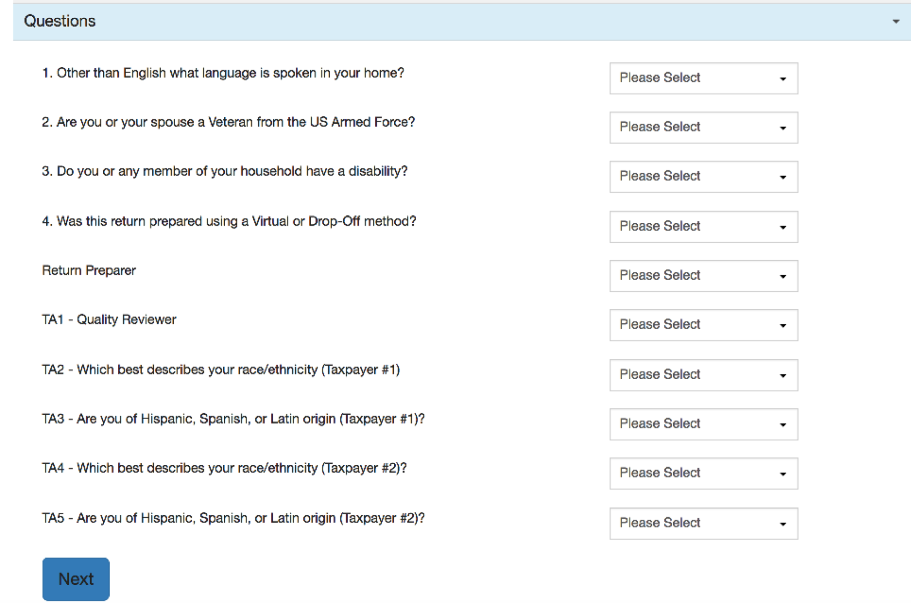
Part 2: Preparing the Return in TaxSlayer – Prep Use Form

Slide 238
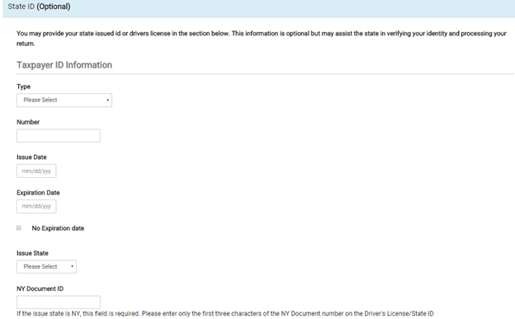
Part 2: Preparing the Return in TaxSlayer – State ID(NOT Optional)

Slide 239
Part 2: Preparing the Return in TaxSlayer – State ID(NOT Optional in some states)
Providing the state ID/driver’s license in the e-file section is NOT optional for certain state returns
In AL, it is required for e-file submission of state return
In SC, it is not required for e-file submission of state return, BUT if the taxpayer has a state ID, the information should be entered

Slide 240
Part 2: Preparing the Return in TaxSlayer – State ID(NOT Optional in some states)
If taxpayer has driver’s license and TaxSlayer requests the info in the e-file section, you should enter the information.
If the taxpayer does not have a driver’s license and TaxSlayer requests the info, you should see your Site Coordinator.

Slide 241
Tax Preparation Process
Part 1: Preliminary Interview
Part 2: Preparing the Return in TaxSlayer
Part 3: Quality Review
Part 4: Finishing the Return
Part 5: Filing the Return

Slide 242
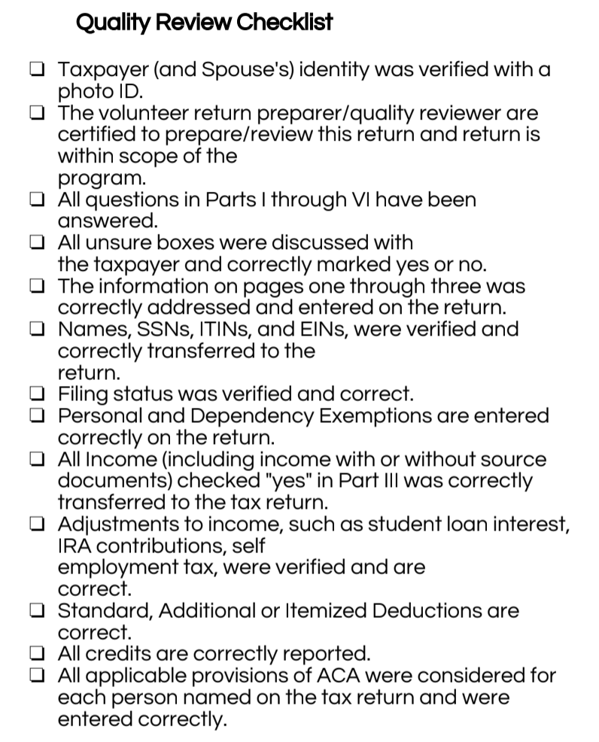
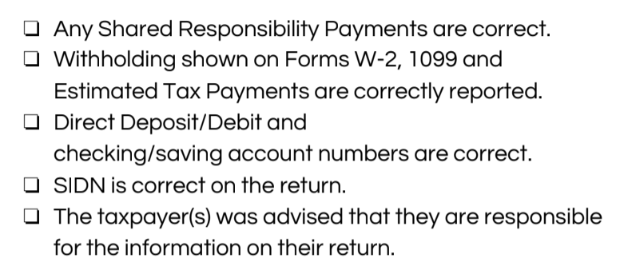
Part 3: Quality Review
Notes:
‹#›

Slide 243
Part 3: Quality Review
Before handing the return off to a quality reviewer, make sure to write your name at the bottom of the last page! This is will help us if we have any questions about the return during the Quality Review!
Jane Volunteer
Notes:
‹#›

Slide 244
Part 3: Quality Review
Remember: If at any point in the return you come across something out of scope for you, but in scope for a more advanced volunteer, you should write a note at the bottom of the I/I supplement form!
Jane Volunteer
Need to enter: Capital Gains 1099-B
Notes:
‹#›

Slide 245
Part 3: Quality Review
Once the return has been quality reviewed and is ready to e-file, the quality reviewer will check the box “Ready to E-file”
If the return is outstanding, there needs to be an explanation
If the return needs to be paper filed for some reason there needs to be an explanation
Jane Volunteer
Jenn Volunteer
Need to enter: Capital Gains 1099-B
Notes:
‹#›

Slide 246
Tax Preparation Process
Part 1: Preliminary Interview
Part 2: Preparing the Return in TaxSlayer
Part 3: Quality Review
Part 4: Finishing the Return
Part 5: Filing the Return

Slide 247
Part 4: Finishing the Return
Write your name on the Intake/Interview Supplement Form
Assist quality reviewer with printing and taxpayer signatures
  Taxpayer and spouse must sign and date federal and state returns and keep for their records
File Intake/Interview Form in filing box
  Do NOT keep any personal documents!

Slide 248
Tax Preparation Process
Part 1: Preliminary Interview
Part 2: Preparing the Return in TaxSlayer
Part 3: Quality Review
Part 4: Finishing the Return
Part 5: Filing the Return

Slide 249
Advanced Training
Fall Refresher

