Slide 1

Advanced Training
A Session

Slide 2
Welcome!
Please sign-in
Follow your trainer’s instructions on how to complete paperwork on your volunteer profile
There are a number of training materials provided for you to use throughout training. Please bring these materials back to the B session.

Slide 3
Training Agenda: A Session
Basic Training Refresher
Part III(Part III of I/I form)
  Alimony Income
  State Tax Refund
  Business Income
  Retirement Income (with taxable amount)
Adjustments to Income(Part IV of I/I form)
Miscellaneous Nonrefundable Credits(Part IV of I/I form)
Volunteer Paperwork

Slide 4
Basic Training Refresher

Slide 5
Basic Training Refresher
Kyle Kent Exercise
  Wages
  Interest
  Unemployment
  Social Security
  Other income
    1099-MISC with Box 3
    Lottery winnings
  Child & Dependent Care Credit
  Earned Income Credit
  State Return (if applicable)
Login to TaxSlayer
  Vita.taxslayerpro.com/IRSTRAINING
  Password:TRAINPROWEB
    Username: Last Name, First initial, “TRAIN” (e.g., DOEJTRAIN)
    Password: SaveFirstTaxes2019!

Slide 6
Income(Part III of I/I form)

Slide 7
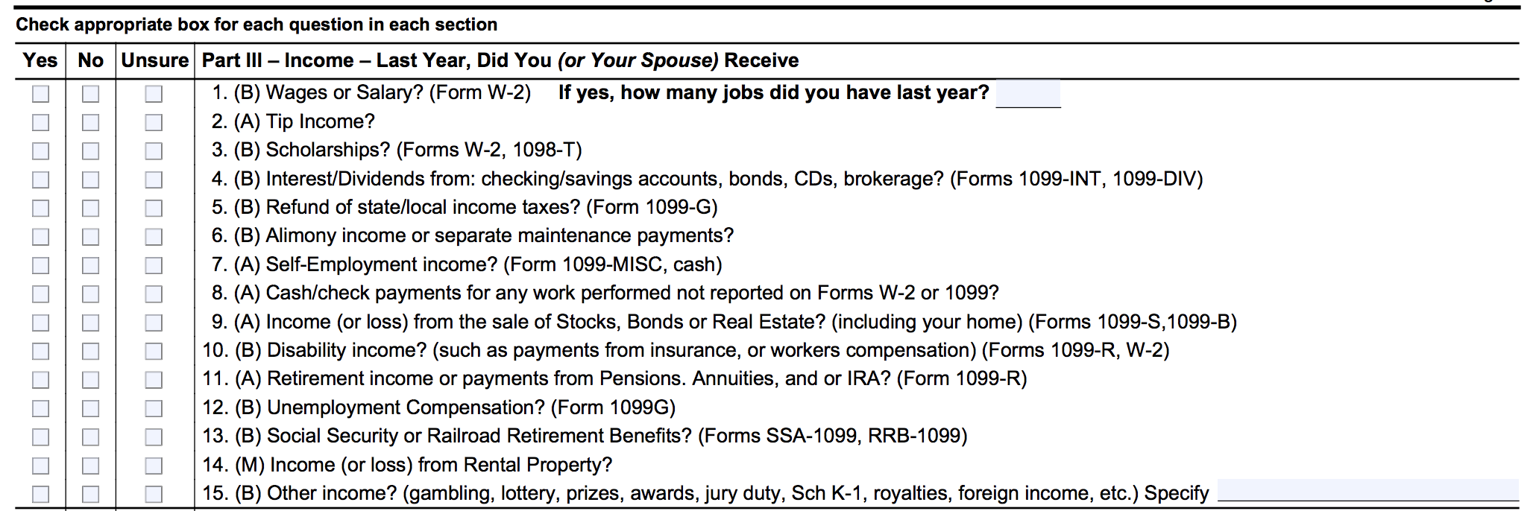
Income(Part III of I/I form)
Let’s look at the I/I form!

Slide 8
State Tax Refund

Slide 9
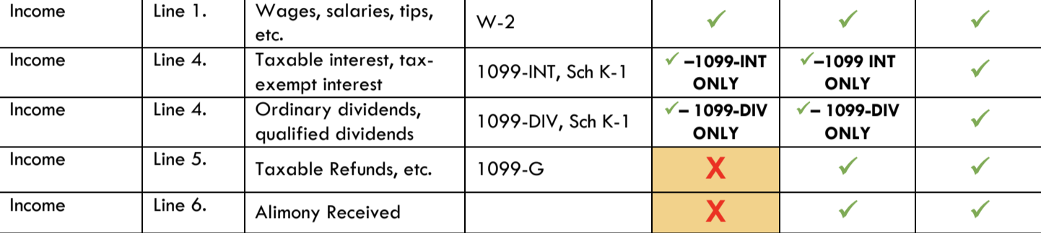
State Tax Refund
Let’s look at the scope of service chart!

Slide 10
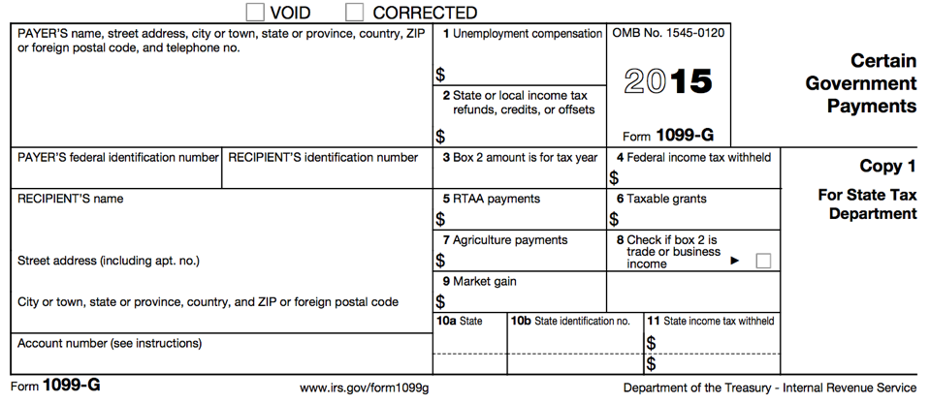

Form 1099-G: Certain Government Payments
Just because a taxpayer receives a 1099-G with an amount in box 2, does not mean they have to report it as taxable! All three tests must be met

Slide 11
State Tax Refund
Conditions in which PTY state tax refund is taxable:
  Received a refund on a state return
  Itemized Deductions in PTY (Federal) AND
  Deducted state income tax instead of state sales tax when itemizing deductions (Federal)

Slide 12
State Tax Refund
What if taxpayer doesn’t know if they itemized deductions last year?
  Ask: “Did you have any mortgage interest, medical expenses, charitable contributions, etc., that you listed on your return last year?”
  A taxpayer may not be sure if they did, but often they are very confident that they did not have any of these deductions listed last year

Slide 13
State Tax Refund
Note: Many taxpayers may have itemized deductions on their state tax returns but NOT their federal tax returns
In this case, the previous tax year state tax refund will NOT be taxable on the federal tax return
Just because a taxpayer receives a 1099-G with an amount in box 2, does not mean they have to report it as taxable! all three tests must be met

Slide 14
PTY State Tax Refund
If the taxpayer needs to report the state tax refund, go to:
  Federal Section →Income → State and local refunds
  Enter in the necessary information

Slide 15
Info Needed from PTY Return
To correctly report a state tax refund amount, the following info from the PTY return is needed:
  State tax refund amount
  Sch A, line 5a, state income taxes (TBD)
  Total itemized deductions amount
  Filing status

Slide 16
State Tax Refund
Open up Kyle Kent in TaxSlayer
  Enter State Tax Refund on Line 10
  Federal Section → Income → State and Local Refund

Slide 17
Alimony Income

Slide 18
Alimony Income
Let’s look at the scope of service chart!

Slide 19
Alimony Income
A payment to or for a spouse or former spouse under a separation or divorce instrument
Person RECEIVING the alimony must report it as income if agreement was before Dec 31, 2018
  Note: person PAYING the alimony can take amount as an adjustment – we will cover later on in this training

Slide 20
Alimony Income
Does NOT include:
  Child support -stops once child turns 18
  voluntary payments-giving ex-spouse certain amount of money OUTSIDE the terms of the alimony agreement

Slide 21
Alimony Information
You need the EXACT amount
Amount of alimony reported on one tax return as income must match the alimony adjustment amount on the spouse’s tax return

Slide 22
Alimony Income
Open up Kyle Kent in TaxSlayer
  Enter Alimony on line 11
  Federal Section → Adjustments → “Alimony Received”

Slide 23
Income: Other Income, Business/Self-Employment

Slide 24
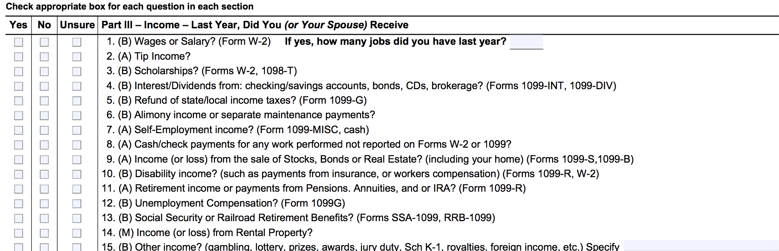
Business/Self-Employment Income
Let’s look at the I/I form!

Slide 25
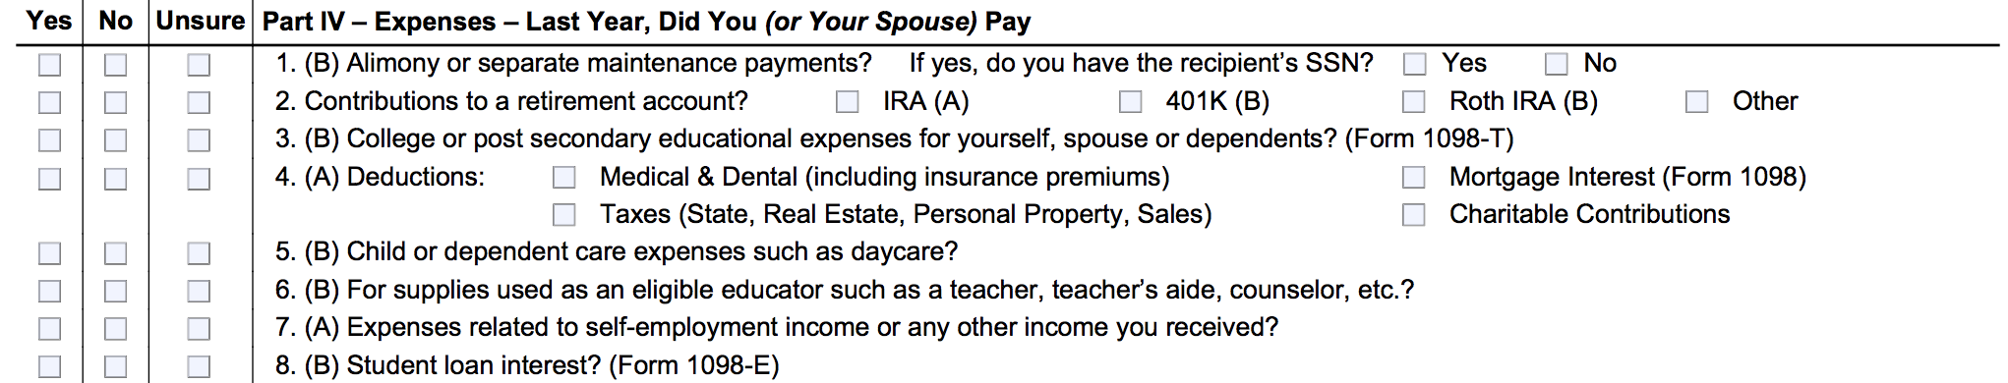
Business/Self-Employment Income
Let’s look at the I/I form!

Slide 26
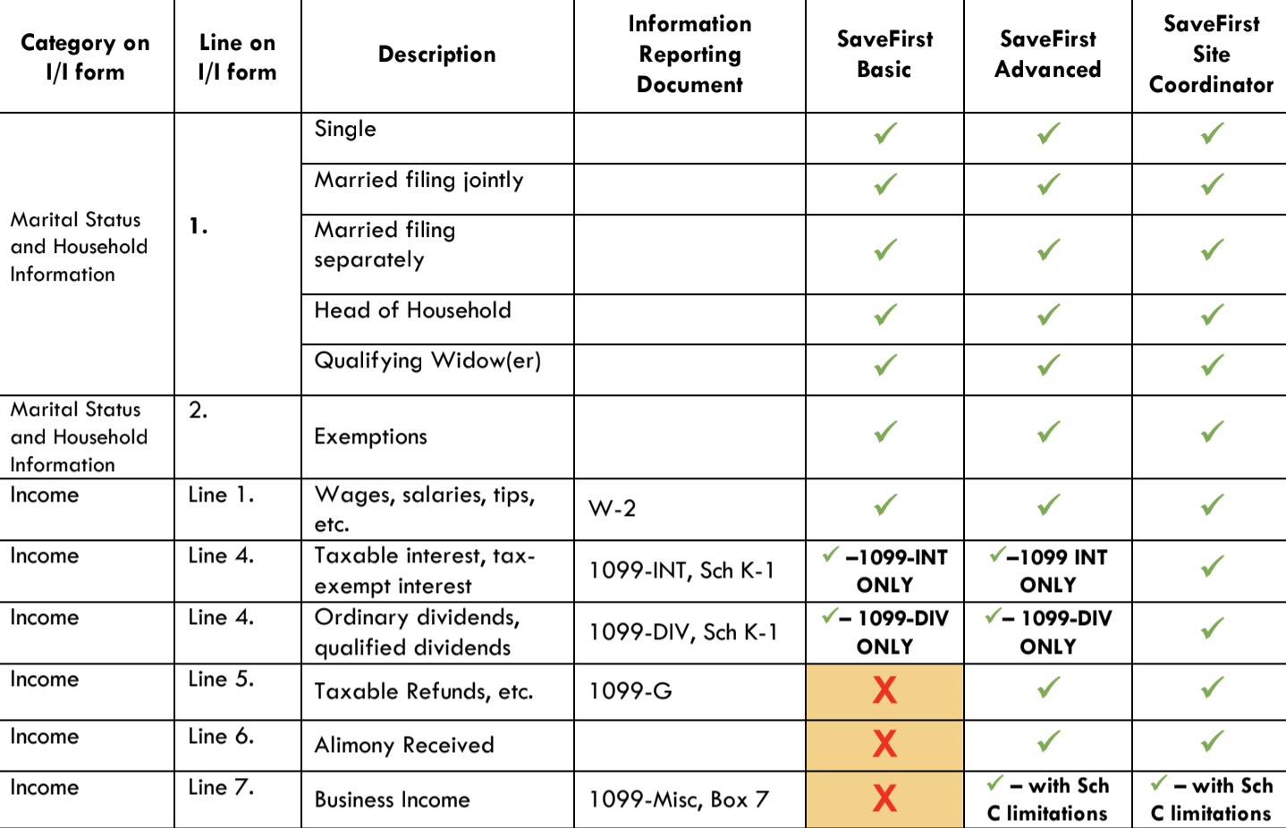
Business/Self-Employment Income
Let’s look at the scope of service chart!

Slide 27
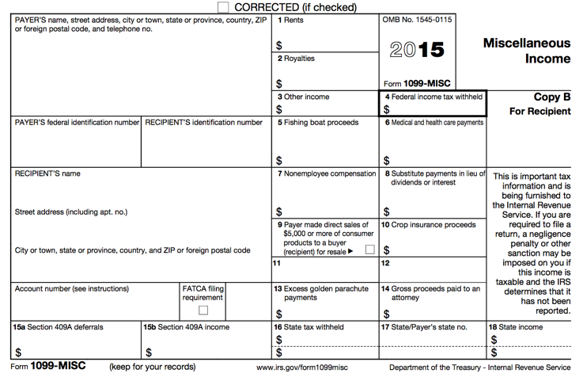

Form 1099-MISC

Slide 28
Form 1099-MISC: Other Income
Reported in box 3
Other income reported in this box is generally:
  Prizes
  Awards
  Taxable damages (from a lawsuit settlement)
  Other taxable income
Other income in box 3 is classified as unearned income
Taxpayers can choose to have federal income tax withheld on other income in box 3

Slide 29
Form 1099-MISC:
Nonemployee Compensation
Reported in box 7
Nonemployee compensation is paid to an independent contractor
Independent contractors work for a company or organization without being considered an “employee”
  Freelancers, part-time workers, contractors, interns

Slide 30
Form 1099-MISC:
Nonemployee Compensation
If payment for services from a company or organization is reported in box 7, the taxpayer is being treated as a self-employed worker
Self-employment income, also known as business income, is taxed differently than wages/salary

Slide 31
Business/Self-Employment Income
Income from a personal business (sole proprietor) or independent contractor (nonemployee compensation)

Slide 32
Business/Self-Employment Income
Why is it important to designate between wages and business/self-employment income?
  Federal income taxes are not withheld from business income
  FICA taxes are not withheld from business income
  However, the taxpayer must still pay federal income taxes and FICA taxes on business income!

Slide 33
Business/Self-Employment Income
Business/self-employment income can be reported to taxpayers in a variety of ways

Slide 34
Form 1099-MISC

Slide 35
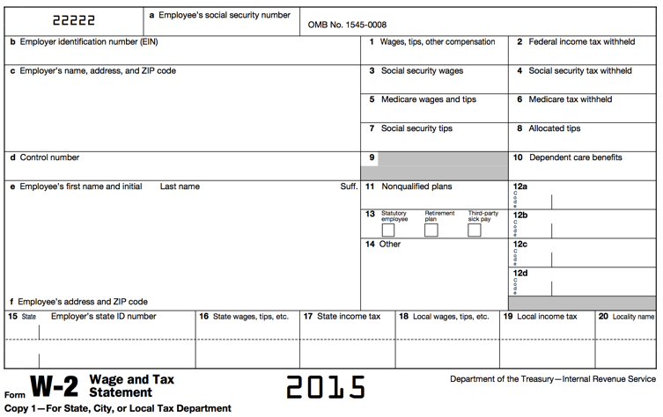
Form W-2: Wage and Tax Statement
See Your
Site Coordinator Coordinator

Slide 36
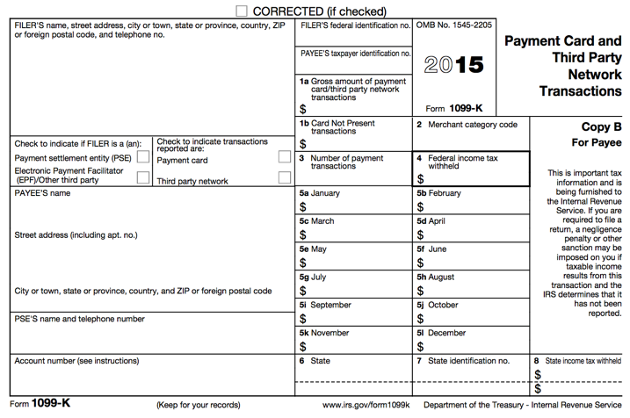
Form 1099-K
See Your
Site Coordinator Coordinator

Slide 37

Cash Payments

Slide 38
Business/Self-Employment Income
Having a part-time business (even in addition to another job) may still be self-employment income and need to be reported
Remember: Income that was not reported on Form W-2, 1099-MISC or 1099-K still needs to be reported as cash payments.

Slide 39
Example
Andy works as an independent contractor for a painting company. He received a 1099-MISC from the company that shows he made $10,000. He also received $2,000 in cash payments from a few different people for the work he completed, but he did not receive a 1099-MISC for the $2,000.
What is Andy’s total business/self-employment income that needs to be reported?

Slide 40
Example – Answer
Andy must include the amounts from both the 1099-MISC and cash payments. His total business income that must be reported is $12,000.

Slide 41
Business/Self-Employment Income vs. Other Income
Business Income
  An activity qualifies as a business if:
    The primary purpose for engaging in the activity is for income or profit
    The taxpayer is involved in the activity with continuity and regularity
Other Income
  A sporadic activity or a hobby does not qualify as a business
  Hobby: undertaken for pleasure during leisure time (not for profit)

Slide 42
Business/Self-Employment Income Terms
Business expenses: amounts that are ordinary and necessary to carry on the business
  Business expenses are subtracted from gross receipts to obtain the net profit/loss
  Net profit/Loss = Gross Receipts – Expenses
Cash method of accounting: Reports all income when received and deducts all expenses when paid

Slide 43
Business/Self-Employment Income Terms
Inventory: the items the taxpayer buys or makes for resale for others
Depreciation: the cost of items that are expected to last more than a year should be spread over a period of years, rather than deducted in the year of purchase

Slide 44
Business/Self-Employment Income
VITA Filing Conditions
Less than $25,000 of business expenses
Cash method of accounting
No inventory
Does not want to depreciate assets
Must report a profit— no net loss!
No employees
No business use of home
Notes:
There are a number of conditions that must be met for us to file a tax return with business income:
The taxpayer must have less than $25,000 of business expenses
The taxpayer must use the cash method of accounting
The taxpayer cannot have inventory for sale
The taxpayer must not want to depreciate any assets
The taxpayer must report a profit—NO NET LOSS!
Cannot have any employees
No business use of home

Slide 45
Scope Conditions Continued
What is Inventory?
  Inventory is a quantity of goods or materials that is on hand and held for sale.
  For example, if a taxpayer takes specific orders from customers, buys the product and then sells it to that customer; that's not an inventory. However, if the taxpayer buys in bulk and then sells some items and holds others until next year, that probably is inventory and, therefore, out of scope.

Slide 46
Scope Conditions Continued
What is considered business use of home?
  Most taxpayers who think they can deduct business use of home actually can’t (very strict rules)
  Must be a room/space completely devoted to business. If you have a desk in your living room, NOT business use of home.
  If you have a garage apartment that you use 100% of the time for your self-employment, then that is qualified business use of home.

Slide 47
Scope Conditions Continued
If a taxpayer has a part of their home dedicated 100% to their self-employment, the return is out of scope, because that is qualified business use of home, and you are required to report all qualified expenses.

Slide 48
Scope Conditions Continued
Individuals that operate daycare in their homes have a different, less strict, definition of business use of home. They don’t need a part of their home dedicated 100% to their self-employment. They are the exception to this rule. They typically all qualify to claim household expenses as business use of home on Sch C, so they are out of scope.

Slide 49
Deductible Business Expenses
Anytime a taxpayer has a 1099-MISC Box 7 or any other self-employment income, you are REQUIRED to ask if they have any expenses related to their business.
Taxpayers are required to report all allowable expenses, they can not simply choose to not report them.

Slide 50
Deductible Business Expenses:
Advertising
Costs associated with promoting the business through various means:
  Yellow pages
  Newspapers
  Magazines
  Billboards
  Racing sponsors
  Television spots

Slide 51
Deductible Business Expenses:
Car & Truck Expenses
Taxpayers that use their vehicle for their business may either take the standard mileage rate or deduct actual expenses(gas, oil changes, tires, depreciation).
At VITA sites, we can only do the standard mileage rate

Slide 52
Deductible Business Expenses:
Commissions and Fees
Commissions paid to both individuals and businesses
Any kind of fee necessary to operate the business

Slide 53
Deductible Business Expenses:
Insurance
Insurance policies and coverage are deductible for the business operation
  Property
  Automobile (business vehicles only)
  Malpractice
If the standard mileage rate is used, no deduction is allowed for automobile insurance premiums
Health insurance is NOT deductible

Slide 54
Deductible Business Expenses:
Interest
Interest paid on operating loans
NOT mortgage interest

Slide 55
Deductible Business Expenses:
Legal and Professional Services
Fees paid to professionals:
  Attorneys
  Accountants
  Appraisers
  Engineers

Slide 56
Deductible Business Expenses:
Office Expense
Supplies:
  Pens
  Paper
  Postage
  Other necessarily office supplies

Slide 57
Deductible Business Expenses:
Rent or Lease
Rental fees for:
  Cars
  Trucks
  Vans
  Machinery, equipment and other personal property
Leases of more than 30 days are out of scope

Slide 58
Deductible Business Expenses:
Repairs and Maintenance
Repairs on:
  Equipment
  Automobiles
  Office space
  Buildings
  Etc.

Slide 59
Deductible Business Expenses:
Supplies
Costs for general operating supplies not associated with the cost of goods sold
Remember: business/self-employment income involving inventory is out of scope

Slide 60
Deductible Business Expenses:
Taxes and Licenses
Taxes and license fees paid in the operation of the business:
  State and local sales taxes imposed on the taxpayer as the seller of services
  Real estate and personal property taxes
  Certain licenses and regulatory fees

Slide 61
Deductible Business Expenses: Travel/Meals and Entertainment
Ordinary and necessary expenses of traveling away from home for business

Slide 62
Deductible Business Expenses:
Utilities
Normal electric, gas, water and telephone
No deduction for personal expenses

Slide 63
Business/Self-Employment Income
Open up Kyle Kent in TaxSlayer
  Enter Business/Self-Employment on Line 12
  Federal Section→Income→1099-MISC→ADD TO SCH C

Slide 64
Retirement Income

Slide 65
Retirement Income
Let’s look at the I/I form!

Slide 66
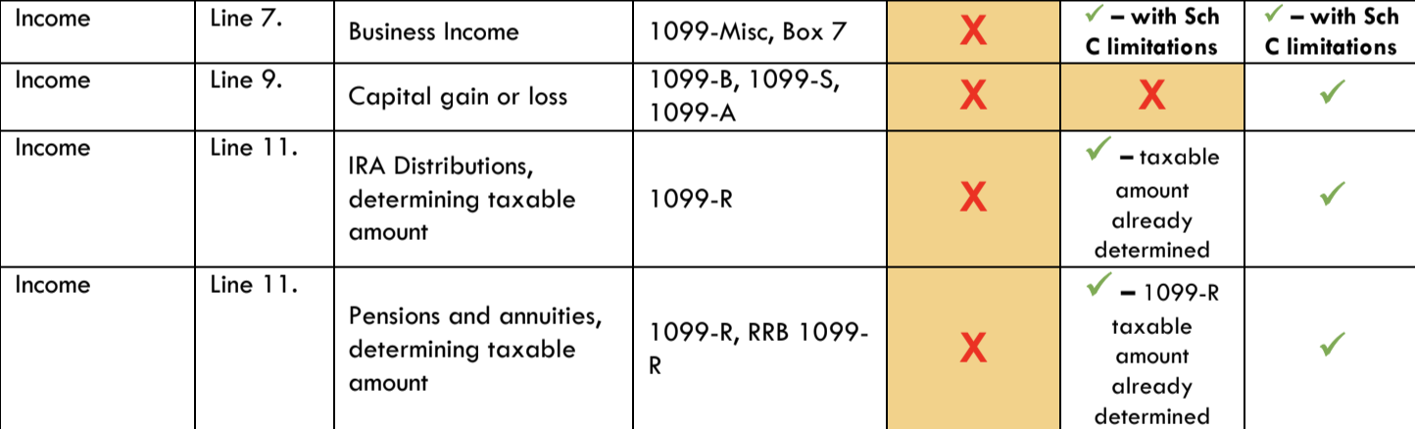
Retirement Income
Let’s look at the scope of service chart!

Slide 67
Employer Controlled
Employer Sponsored
Defined Contribution Retirement Plans
Defined Benefit Retirement Plans
Pensions
Civil Service
Annuities
401(k)
Retirement Income
403(b)
Annuities
Taxpayer Funded
IRA
Individual Retirement Plans
Roth IRA

Slide 68


Defined Benefit Plans
An older, traditional type of pension plan
Workers’ retirement benefits are calculated (and thus “defined”) by a formula that takes into account
  YEARS OF SERVICE
  SALARY HISTORY

Slide 69
Defined Benefit Plans
Employer controls the plan and guarantees that the employee will receive a certain amount of retirement compensation
Most employees under a DB plan do not have to contribute any portion of their salary to the plan
Funded mostly by the employer
Can be referred to as a pension plan

Slide 70
Defined Benefit Plans
Numerous rules governing when retirees can start drawing their pension benefits
DB plans not very “portable”
Who has a Defined Benefit plan?
  Civil Servants (teachers, city employees, federal workers, soldiers, etc.)
  Some older, mature corporations with stable workforces

Slide 71
Defined Contribution Plans
More modern type of employer plan
Employee controls amount contributed to the plan as well as how the funds are invested
Retirement benefits depend on how the fund assets perform and grow
Funded primarily by the employee, with the employer often matching contributions to a certain amount

Slide 72
Defined Contribution Plans
Most common type of DC plan is a 401(k)
Participants may elect to defer a portion of his/her gross salary via a pretax payroll deduction to the plan
Contributions can be invested, at the employee’s direction, in select mutual funds, money market funds, annuities, or stock offered by the plan

Slide 73
Defined Contribution Plans
The employee must direct contributions and investments to grow the assets adequate for retirement
Examples:
  401(k)
  403(b)
  Some Annuity Contracts

Slide 74
Individual Retirement Plans
Investing tool used by individual taxpayers to earmark funds for retirement savings
Traditional IRA (in scope) and Roth IRA (out of scope for Advanced Volunteers)
Established by individual taxpayers, who are allowed to contribute 100% of compensation (or self-employment income) up to a certain dollar amount each year

Slide 75
Individual Retirement Plans
Offers numerous tax benefits
  Contributions to Traditional IRA can be taken as an adjustment to income (dependent on certain conditions)
  In general, eventual withdrawal from an IRA is taxed as income; including capital gains on the investment
  Because income is likely to be lower after retirement, the tax rate may be lower

Slide 76
Individual Retirement Plans
Combined with potential tax savings at the time of contributions, IRAs can be a very valuable tax management tool for individuals
Also, depending on income, an individual may be able to fit into a lower tax bracket during his/her working years because of the adjustment to income from contributions

Slide 77
Defined Benefit Retirement Plans
Funded by the employer
Monthly set amount based on salary history, years of service
Employee pays taxes on payments received
Defined Contribution Retirement Plans
Employer-sponsored, employee contributes portion of gross salary pre-tax
Offers benefits by allowing employee to defer taxes
Individual Retirement Plans
Funded by individual taxpayers
Like DC plans, offers benefits by allowing employee to defer taxes

Slide 78
Common Types of Retirement Plans
Pension: series of payments for past work (based on salary history and years of service)
  Defined Benefit Plan
401(k) Plan: part of employee’s gross salary is placed in a retirement plan on a pre-tax basis (not subject to income tax until employee receives it as a distribution from retirement account)
  Defined Contribution Plan

Slide 79
Common Types of Retirement Plans
Individual Retirement Arrangements: A personal savings plan that offers tax advantages to set aside money for retirement
  Earnings generally accumulate tax free until withdrawn
  Types:
    Traditional
    Roth: Usually Out of Scope (in scope under certain conditions)
    SIMPLE: Out of Scope!
    SEP: Out of Scope!

Slide 80
Retirement Forms
Retirement income can be reported on:
  Form 1099-R → Distributions From Pensions, Annuities, Retirement or Profit-Sharing Plans, IRAs, Insurance Contracts, etc.
  Form CSA 1099-R → Statement of Annuity Paid (civil service retirement payments)
  Form CSF 1099-R → Statement of Survivor Annuity Paid
  Form RRB1099R → Annuities or Pensions by the Retirement Railroad Board (out of scope for Advanced Volunteers-see Site Coordinator)

Slide 81
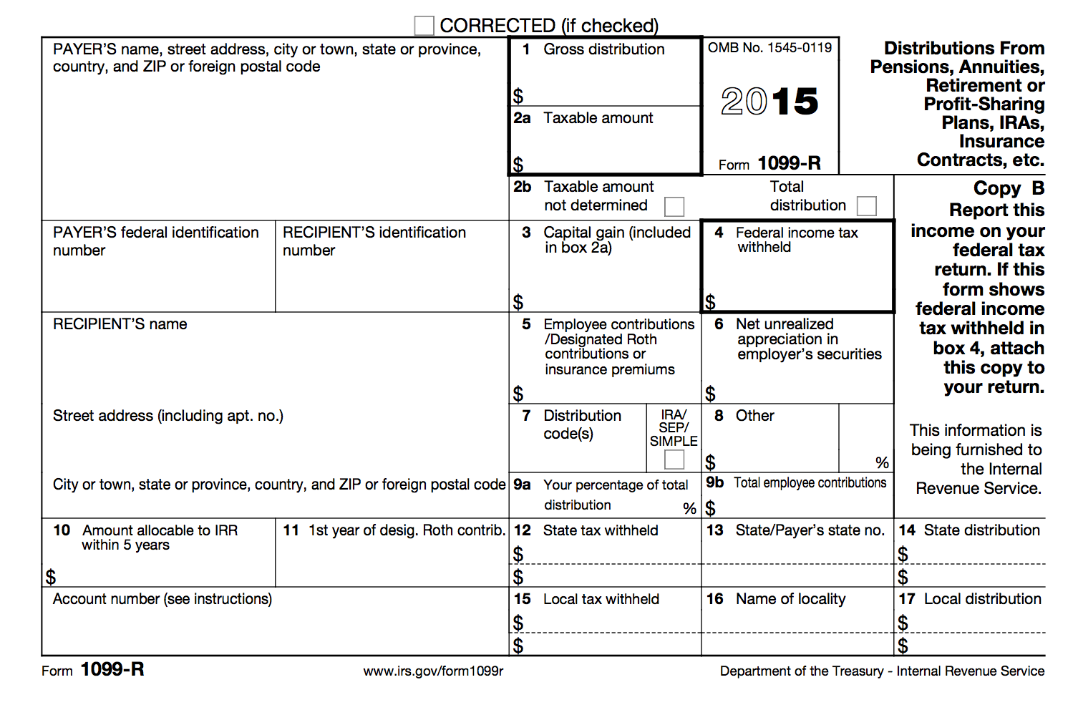
Form 1099-R: Distributions From Pensions, Annuities, Retirement…

Slide 82
Form 1099-R: Gross Distribution
Reported in box 1
Shows the total amount received during the tax year
Amount could be a rollover, or taxpayer may have received it as periodic payments, as non-periodic payments, or as a total distribution

Slide 83

Form 1099-R: Taxable Amount
Reported in box 2a
Shows the total amount that is subject to federal income tax
The box MAY be blank and require additional computation to determine taxable amount
  This out of scope for Advanced Volunteers-see your Site Coordinator!

Slide 84

Form 1099-R: Taxable Amount Not Determined & Total Distribution
Reported in box 2b
❒Taxable Amount Not Determined indicates that the payer was unable to determine the taxable amount—box 2a should also be blank
❒Total Distribution indicates that the distribution was a total distribution that closed out the account

Slide 85

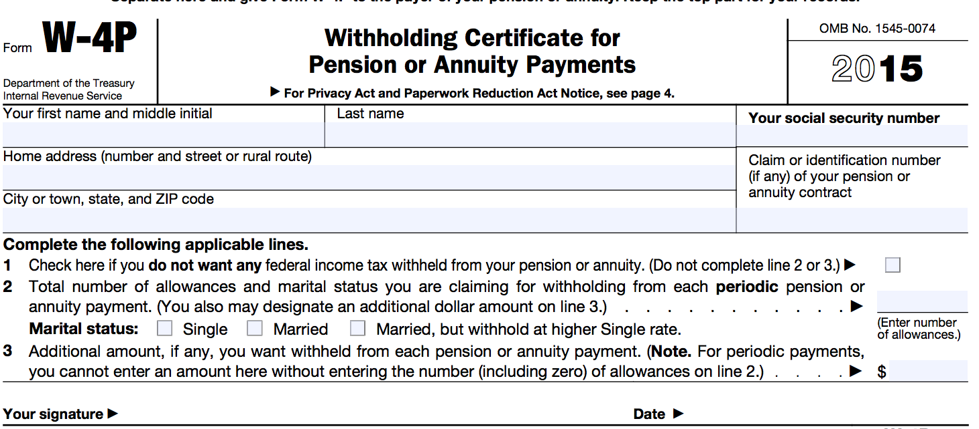
Form 1099-R: Federal Income Tax Withheld
Reported in box 4
Reports the amount of federal income tax withheld on the gross distribution
Similar to the Form W-2, this amount is determined by filling out a Form W-4P

Slide 86

Form 1099-R: Distribution Code(s) & IRA/SEP/SIMPLE
Reported in box 7
Distribution Code(s) identify the type of distribution received
Only certain distribution types are in scope for VITA

Slide 87
Form 1099-R: Distribution Code(s) & IRA/SEP/SIMPLE
1: Early distribution, no known exception (in most cases, under age 59 ½)
2: Early distribution, exception applies (under age 59 ½)
3: Disability
4: Death
7: Normal distribution
B: Designated Roth account distribution
G: Direct rollover and rollover distribution
See the Publication 4012, Income Tab for a full list of box 7 distribution codes (and which are in scope)

Slide 88
Form 1099-R: Distribution Code(s) & IRA/SEP/SIMPLE
❒IRA/SEP/SIMPLE indicates that the distribution was from a traditional IRA, SEP, or SIMPLE retirement account
ONLY traditional IRAs are in scope for Advanced Volunteers!
Verify with the taxpayer that the amount distributed was from a traditional IRA

Slide 89

Form 1099-R: Total Employee Contributions
Reported in box 9b
For certain plans, an amount may be listed here showing the taxpayer’s contributions to the plan
This amount is used to help determine the taxable amount if box 2a is blank.
  This out of scope for Advanced Volunteers-see your Site Coordinator!

Slide 90
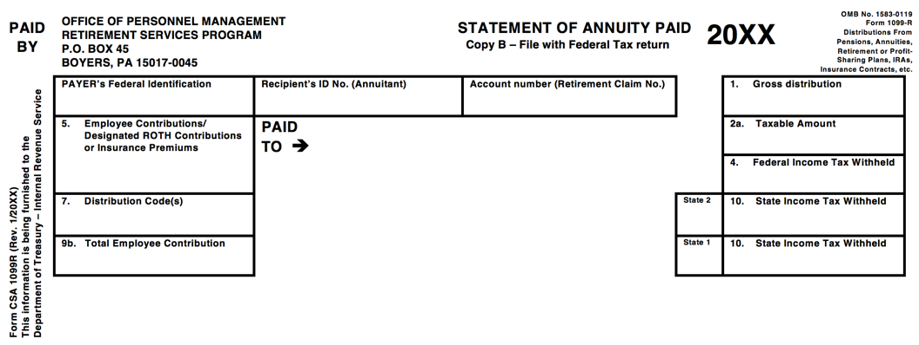
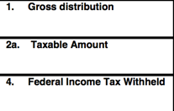
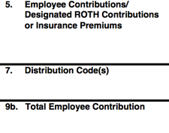
Form CSA 1099-R: Statement of Annuity Paid

Slide 91
Form CSA 1099-R: Statement of Annuity Paid
Provides the same information as the Form 1099-R
Issued to civil service employees
Remember, civil service employees have Defined Benefit retirement plans

Slide 92
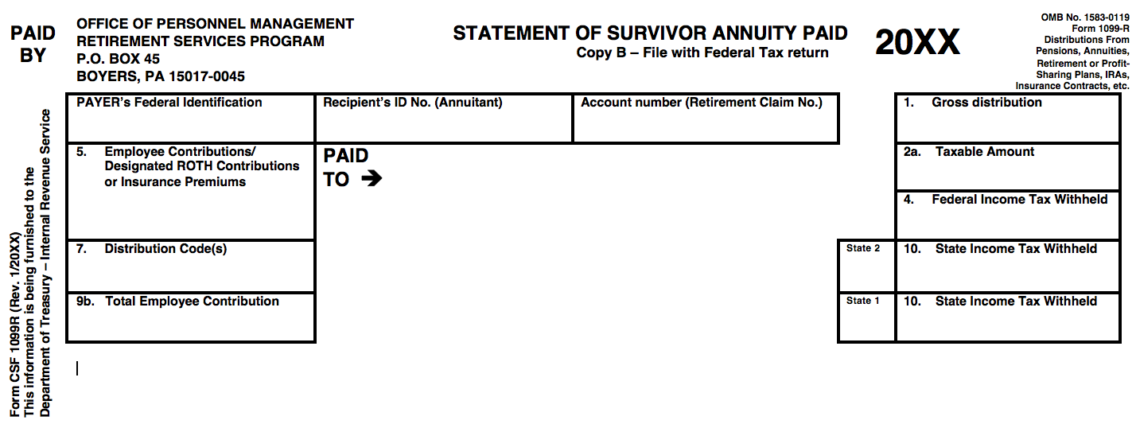
Form CSF 1099-R: Statement of Survivor Annuity Paid

Slide 93
Form CSF 1099-R: Statement of Survivor Annuity Paid
Provides the same information as the Form 1099-R
Issued to survivors of civil service employees (if the employee elected to have a survivor annuity for spouse and/or children)
Remember, civil service employees have Defined Benefit retirement plans

Slide 94
Rollover
Refers to transferring the holdings in one retirement account to another
Specifically, the retirement account is emptied and distributed to the owner, who then deposits them into a new account for reinvestment
This is a TAX-FREE DISTRIBUTION
  But still must be reported on the federal tax return
  Code G will be in Box 7 of the 1099-R

Slide 95
Rollover
Why do taxpayers do this?
  The money is really not going to be used, it is still be saved for retirement—it’s simply being rolled over into a new qualified retirement savings plan or back into the same retirement account
Example:
  Julia left her job at Dog Food Company, but wanted to take her 401(k)—Julie is going to take a full tax-free distribution of her account and roll it over to a new qualified retirement savings plan

Slide 96
Disability Pension Income
Why would a taxpayer have disability pension income?
  Perhaps they had an accident that rendered them totally and permanently disabled
Disability payments may be coming from a qualified retirement pension plan

Slide 97
Disability Pension Income
Why is it important to determine if a taxpayer’s 1099-R is for disability pension payments?
…because until a taxpayer reaches the retirement age FOR THAT SPECIFIC PLAN, the income will be treated like wages, which might make the taxpayer eligible for the...
EARNED INCOME TAX CREDIT

Slide 98
Disability Pension Income
Code 3 will be in box 7 on a 1099-R, HOWEVER, you must…
  Check to see if taxpayer has reached retirement age for that specific plan
    If taxpayer isn’t sure, may need to consult retirement paperwork or contact plan manager
    Don’t just rely on a previous year return—previous tax preparer might not have entered in correctly

Slide 99
Disability Pension Income
If taxpayer has not reached retirement age, check the box that says “Check here to report on Form 1040, Line 7 (Distribution code must be a "3")”and verify that amount appears on the Form 1040 as wages
If taxpayer has reached retirement age, do NOT check that box and verify that the amount appears on the Form 1040 as retirement income

Slide 100
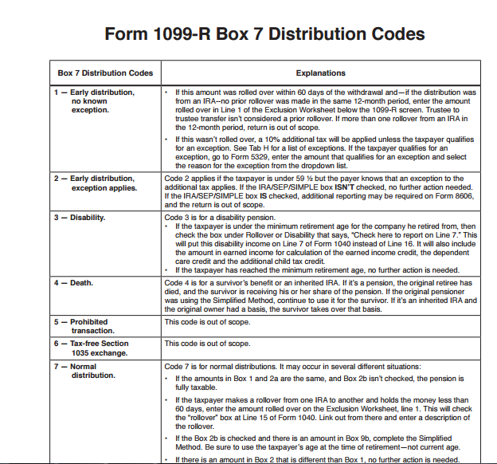
Retirement Income
On page D-37, you will find the distribution codes.
You don’t need to memorize what everything means!
Use your resources!

Slide 101
Retirement Income
Open up Kyle Kent in TaxSlayer
  Enter Retirement income
  Federal Section → Income→ IRA/Pension Distribution → Add or Edit a 1099-R

Slide 102
Adjustments to Income

Slide 103
Adjustments to Income
Let’s look at the I/I form!
Reminder: You don’t need to remember which expenses are adjustments, itemized deductions, or credits. You just need to use your resources!

Slide 104
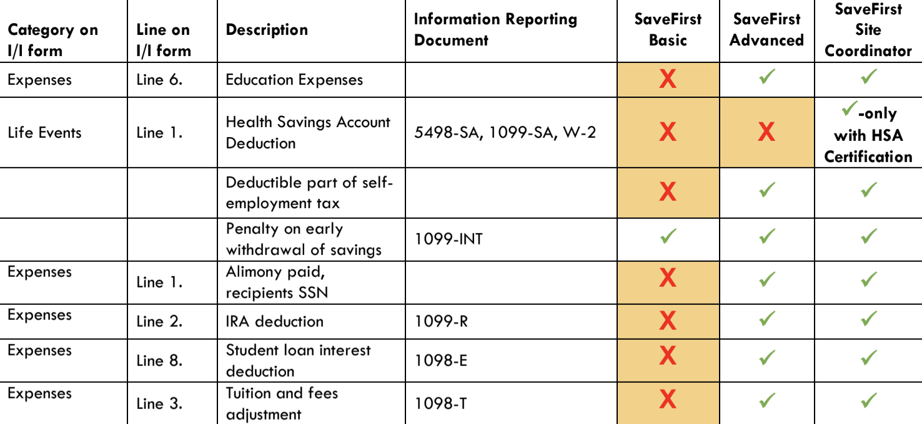
Adjustments to Income
Let’s look at the scope of service chart!

Slide 105
Total Income
(Earned + Unearned)
Adjusted Gross Income
Adjustments

Slide 106
Adjustments to Income
Adjustments are basic life expenses that help decrease the amount of taxable income:
  Educator expenses
  Half of self-employment tax
  Early withdrawal penalty
  Alimony paid
  IRA contributions (traditional)
  Student loan interest
  College tuition payments
  Jury duty pay turned over to employer

Slide 107
Educator Expenses
Eligible Educators
  K-12 teachers, instructors, counselors, principals, or aides
  Worked at least 900 hours (part-time)
  Ordinary and necessary amounts of:
    Books
    Supplies
    Equipment

Slide 108
Educator Expenses
Qualified expenses up to $250 are eligible
If taxpayer and spouse are both eligible educators, up to $500 are eligible
Note: More than $250 (or $500 total for taxpayer/spouse) can be taken as an itemized deduction

Slide 109
Half of Self-Employment Tax
Self-Employment Taxes
  Nonemployees & self-employed must pay an additional tax that covers FICA taxes that weren’t withheld during the year
  Note that nonemployees & self-employed workers don’t have an employer to pay ½ of these FICA taxes, so they end up paying the full share

Slide 110
Half of Self-Employment Tax
Offsets the tax burden placed on individuals who do not have employers to pay half of their taxes
Available to all self-employed workers who were required to pay the self-employment tax
This is calculated automatically in TaxSlayer!

Slide 111
Penalty on Early Withdrawal of Savings
When a taxpayer withdraws savings before maturity, a penalty is incurred
  Box 3: Form 1099-INT or Form 1099-OID
Taxpayer can deduct these penalties from income
This will calculate automatically in TaxSlayer when you enter the 1099-INT!

Slide 112
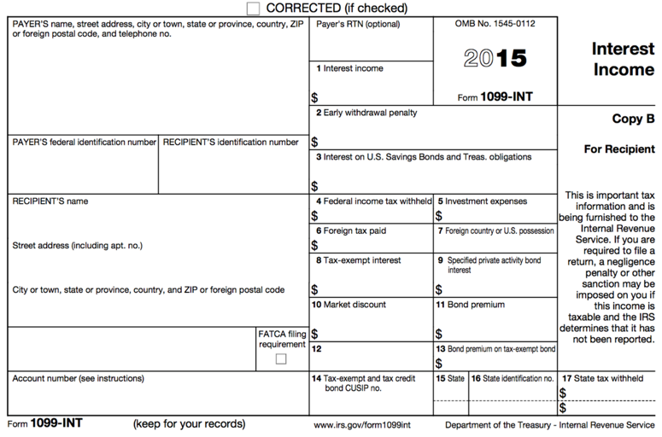

Form 1099-INT: Interest Income

Slide 113
Alimony Paid
A payment to or for a spouse or former spouse under a separation or divorce instrument entered into before December 31, 2018
  Child support and voluntary payments NOT considered alimony
Deduct total alimony paid for the entire year, not just one month

Slide 114
IRA Contributions Deduction
Eligibility Requirements
  Only contributions to a Traditional IRA are deductible
  Must be under the age of 70 ½ at the end of the tax year
  Must have taxable compensation
  Contributions must be made by the filing date of the return

Slide 115
IRA Contributions Deduction
Contribution limit is the lesser of:
  Total amount of earned income(combined if MFJ), or
  $5,500 per spouse ($6,500 if over the age of 50)
    Note: these amounts are subject to change

Slide 116
Student Loan Interest
Up to $2,500 of interest paid during the year on a loan for qualified higher education expenses in the name of a:
  Taxpayer
  Spouse
  Dependent (or a dependent at the time the loan was obtained)
Note: Student must have been enrolled at least half-time in a program leading to a degree, certificate, or other credential.

Slide 117
Student Loan Interest
Eligibility Requirements
  Loan was obtained for an eligible student and was paid within a reasonable period of time before/after obtaining the loan
  School is:
    Accredited
    Qualified to participate in a student aid program or conduct internship/residency programs leading to a degree or certificate

Slide 118
Student Loan Interest
Eligibility Requirements
  Taxpayer is NOT:
    Married Filing Separately
    Able to be claimed as a dependent
Note: If the taxpayer cannot be claimed as a dependent but his/her parents paid the student loan interest and the student is legally liable for the loan, the student should claim the deduction.

Slide 119
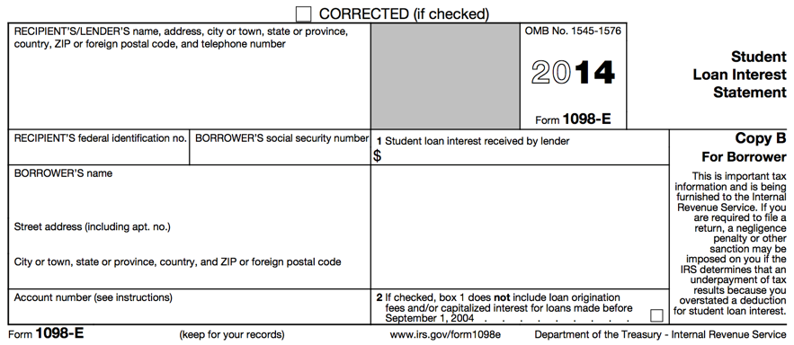

Form 1098-E: Student Loan Interest Statement

Slide 120
Tuition and Fees Deduction
Tuition amounts paid by the taxpayer can be taken as an adjustment to income OR used to claim an education credit (if taxpayer qualifies)
The tuition and fees deduction can be claimed for the taxpayer, spouse, and/or any qualified dependents

Slide 121
Tuition and Fees Deduction
Tuition and fees deduction CANNOT be claimed if the taxpayer is:
  Married Filing Separately
  Able to be claimed as a dependent
Note: Only OUT-OF-POCKET expenses can be claimed; you must subtract amounts paid with scholarships and grants

Slide 122
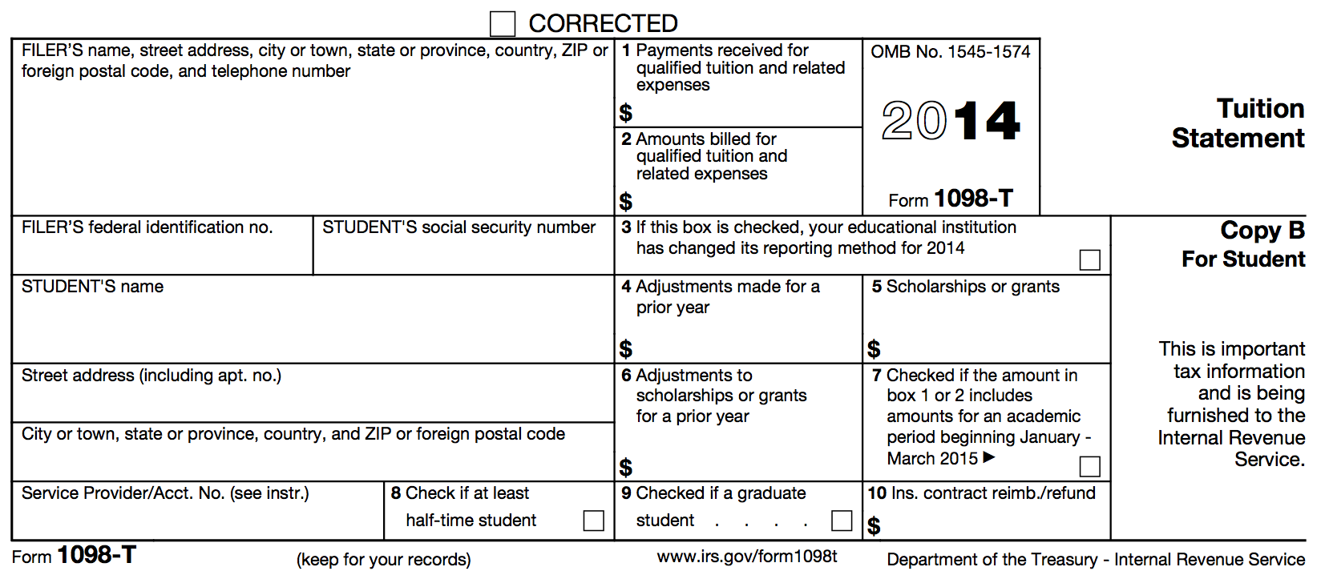


Form 1098-T: Tuition Statement

Slide 123
Tuition and Fees Deduction
Qualified Expenses:
  Up to $4,000 in qualified tuition and related expenses;
  NOT BOOKS unless a condition of enrollment/attendance

Slide 124
Jury Duty Pay Given to Employer
Jury duty pay is taxable income
BUT: if that pay is given to the employer, it can be deducted as an adjustment

Slide 125
Adjustments to Income
TaxSlayer Walkthrough
Open up Kyle Kent in TaxSlayer
  Enter Adjustments to Income

Slide 126
Miscellaneous Nonrefundable Credits

Slide 127
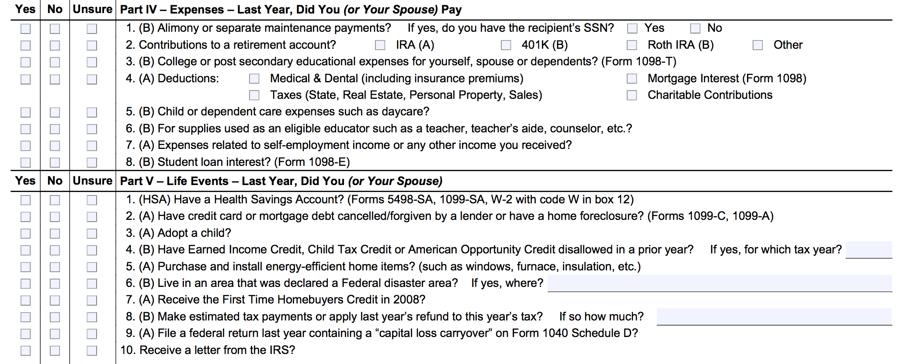
Miscellaneous Nonrefundable Credits
Let’s look at the I/I form!

Slide 128
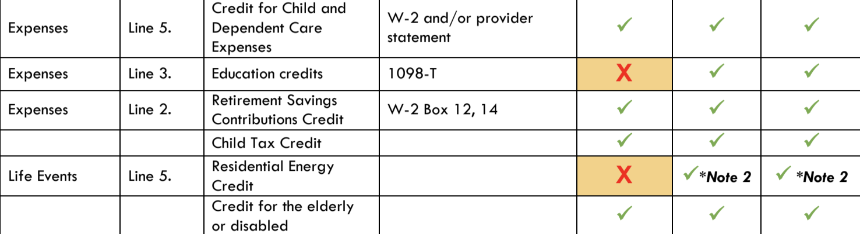
Miscellaneous Nonrefundable Credits
Let’s look at the scope of service chart!

Slide 129
Nonrefundable Credits
Remember: Nonrefundable credits directly reduce the tax liability, but only to zero (no refund of additional credit is available)
Foreign tax credit
Residential energy credit

Slide 130
Foreign Tax Credit
Taken if a taxpayer paid income tax to a foreign country; U.S. possession; or political subdivision, agency, or instrumentality of a foreign country
Foreign tax paid > $300 ($600 if MFJ) is out of our scope!
We may see some foreign tax reported on a 1099-DIV or 1099-INT in Box 6

Slide 131
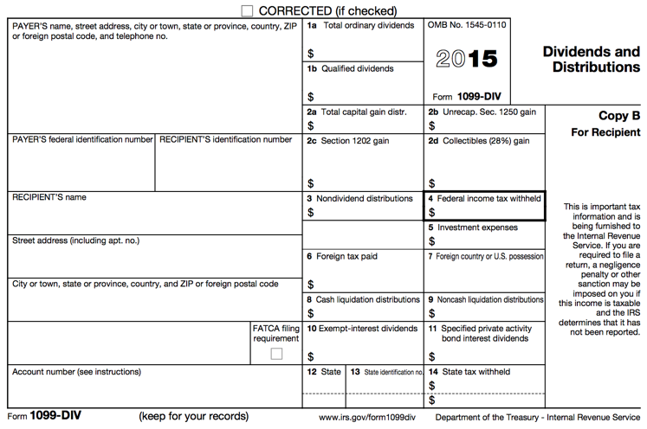

Form 1099-DIV: Dividends and Distributions
When you enter the 1099-DIV or 1099-INT in TaxSlayer, the credit will calculate automatically!

Slide 132
Residential Energy Credit
Two Types of Residential Energy Credits
  Residential energy-efficient property credit – OUT OF SCOPE!
  Nonbusiness energy property credit
Available to a taxpayer:
  Who made purchases for qualified energy efficient improvements for his/her main home
  Who owns his/her home

Slide 133
Nonbusiness Energy Property Credit
Nonbusiness energy property (for home improvement):
  Heating
  Ventilating
  Air-conditioning
  Insulation
  Roofs
  Water heaters (non-solar)
  Windows
  Doors

Slide 134
Eligibility Requirements
Improvements must be for taxpayer’s main home
  The home where the taxpayer lives most of the time
  Temporary absences do not change main home
Credit is only available for improvements made to existing homes
  Cannot claim based on expenses paid during the construction of a home

Slide 135
Eligible Expenses
Any insulation material or system that is specifically and primarily designed to reduce heat loss or gain of a home when installed in or on such a home
Exterior windows and skylights
Exterior doors
Any metal roof with appropriate pigmented coatings or asphalt roof with appropriate cooling granules that are specifically and primarily designed to reduce the heat gain of your home

Slide 136
Eligible Expenses
Certain electric heat pump water heaters
Electric heat pumps
Central air conditioners
Natural gas, propane, or oil water heaters
Stoves that use biomass fuel

Slide 137
Eligible Expenses
Qualified natural gas, propane, or oil furnaces
Qualified natural gas, propane, or oil hot water boilers
Certain advanced main air circulating fans used in natural gas, propane, or oil furnaces

Slide 138
Credit Dollar Limits
Total combined credit – $500
  For all tax years after 2005
Windows credit limit – $200
  For all tax years after 2005
Air circulating fan – $50
Natural gas, propane, oil furnace or hot water boiler - $150
Energy-efficient building property – $300

Slide 139
Miscellaneous Nonrefundable Credits
TaxSlayer Walkthrough
Open up Kyle Kent in TaxSlayer
  Enter Foreign Tax Credit & Residential Energy Credits

Slide 140
End of A Session
Please complete Volunteer Paperwork online
This must be complete before you leave the A session today!

Slide 141
Advanced Training
B Session

Slide 142
Training Agenda: B Session
Itemized Deductions(Part IV of I/I form)
Education Credits(Part IV of I/I form)
Health Care Coverage(Part VI of I/I form)
State Return(if applicable)
Form 1040 Overview
Out of Scope Topics
Quality Review Process(Part VIII of I/I form)

Slide 143
Itemized Deductions (Part IV of I/I form)

Slide 144
Itemized Deductions
Let’s look at the I/I form!
Reminder: You don’t need to remember which expenses are adjustments, itemized deductions, or credits. You just need to use your resources!

Slide 145
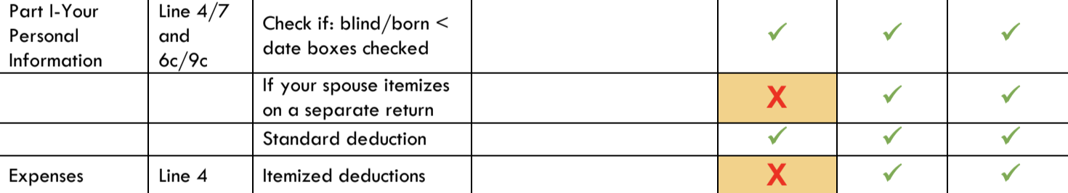
Itemized Deductions
Let’s look at the scope of service chart!

Slide 146
Itemized Deductions
Every taxpayer can take a specific amount for a “standard” deduction
  Reduces taxable income
There are certain designated expenses that a taxpayer can choose to list out separately, and, if they total more than the standard deduction, the taxpayer will “itemize” deductions
  Reduces taxable income by a greater amount

Slide 147
When to Itemize Deductions
A taxpayer can receive a larger deduction by itemizing if he/she has:
  At the Federal Level (higher standard deduction):
    Home mortgage payment
    Large number of medical bills
  At the State Level (lower standard deduction):
    Expenses that may/may not have been sufficient to justify itemization on the federal level
Note: If a taxpayer is MFS and his/her spouse itemizes, the taxpayer must also itemize, regardless of whether the Standard Deduction would be higher

Slide 148
Qualifying Expenses
Unreimbursed Medical Expenses
Charitable Contributions
Taxes
Home Mortgage Interest
Miscellaneous Deductions

Slide 149
Unreimbursed Medical Expenses
A taxpayer can claim expenses for
  Themself
  Spouse
  Dependents

Slide 150
Unreimbursed Medical Expenses
Covered Medical Expenses
  Unreimbursed medical and dental expenses
  Eligible long-term care premiums
Be sure the expenses were not paid with pretax dollars or reimbursed by an insurance company.

Slide 151
Unreimbursed Medical Expenses
Why can a taxpayer not itemize expenses paid with pretax dollars?
  NO DOUBLE BENEFITS!
  Expenses that were deducted pretax from pay have already given the taxpayer the benefit of a lower taxable income
  Cannot use these expenses a second time to lower taxable income again

Slide 152
Unreimbursed Medical Expenses
Deductible Medical Expenses
  Co-pays to doctor, dentist, eye doctor
  Prescription drugs
  Cost of glasses or hearing aids
  Cost of medical equipment

Slide 153
Unreimbursed Medical Expenses
Deductible Medical Expenses
  Health insurance premiums
  Long-term care insurance premiums
  Cost of surgery, operations
  Miles to and from doctor
NOTE: For a complete listing of deductible and nondeductible expenses
see Advanced Volunteer Handbook and Schedule A instructions

Slide 154
Unreimbursed Medical Expenses
Nondeductible Medical Expenses
  Life insurance policy premiums
  Funeral, burial, cremation costs
  Unnecessary cosmetic surgery
  Nonprescription drugs
NOTE: For a complete listing of deductible and nondeductible expenses
see Advanced Volunteer Handbook and Schedule A instructions

Slide 155
Charitable Contributions
Non-qualifying Organizations:
  Business
  Civic/Political
  Social
  Foreign
  Homeowners’ Associations
Qualifying Organizations:
  Religious
  Charitable
  Educational
  Scientific
  Literary

Slide 156
Charitable Contributions
Deductible Expenses:
  Monetary donations
  Dues, fees, and assessments
  Fair market value (FMV) of clothing, furniture
  Uniforms required to be worn during service
  Unreimbursed transportation expenses
    Tolls, bus fare, parking fees, charitable miles
IMPORTANT: The taxpayer must keep receipts!

Slide 157
Charitable Contributions
FMV of Donated Goods
  If a taxpayer has made non-cash contributions to charity and does not have receipts, use the following resources to determine the FMV of donated items:
  Salvation Army Valuation Guide

Slide 158
Charitable Contributions
Nondeductible Expenses:
  Raffle, bingo, lottery tickets
  Tuition
  Value of time of service
  Blood
  Contributions to individuals
  The FMV of any good received in exchange for a donation (i.e. t-shirts, cds, tote bags, etc.)

Slide 159
Charitable Contributions
Limits to Charitable Contributions
  Contributions that total more than 20% of their AGI may be able to deduct only a percentage of their contributions, and must carry over the remainder to a later tax year
  If taxpayers have >$500 of noncash contributions, they need to be referred to a professional preparer if they want to deduct the full amount.
    Form 8283 (OUT OF SCOPE)

Slide 160
Charitable Contributions
Recordkeeping – cash contributions
  Canceled check or bank statement
  Written communication from the charity
    Name of charity, date and amount

Slide 161
Charitable Contributions
Recordkeeping – noncash contribution
  For each contribution < $250
    Written communication, description, FMV
  For each contribution between $250 and $500
    Written communication, description, FMV and acknowledgement of any goods received in return
  For each contribution > $500
    Refer to professional preparer if taxpayer wants to take full amount

Slide 162
Taxes
Deductible
  Taxes imposed on and paid by the taxpayer in the tax year
Nondeductible
  Taxes the taxpayer pays for someone else
  Taxes not paid during the tax year

Slide 163
Taxes
Deductible
  State and local taxes
  Real estate taxes
  Personal property taxes
  State and local taxes on a new car purchase
  Ad valorem tax on car tags
Nondeductible
  Federal taxes
  Hunting licenses
  Water/sewer
  Taxes on alcohol, tobacco, or gas
  Utilities

Slide 164
State and Local Taxes
Taxpayers can choose one of the following, but not both:
  Income taxes
  Sales taxes
    County sales tax amounts differ
    AL state sales tax is 4%
    TaxSlayer will make an estimate of sales tax paid based on income

Slide 165
Home Mortgage Interest
Any interest paid on a loan secured by the taxpayer’s home, line of credit, or a home equity loan.
Generally reported on Form 1098

Slide 166
Home Mortgage Interest
Only taxpayers who are legally liable for the debt can deduct the interest
Taxpayers may have more than one mortgage or may have refinanced and have multiple statements
Points: only points paid as a form of interest (for the use of money) can be deducted

Slide 167
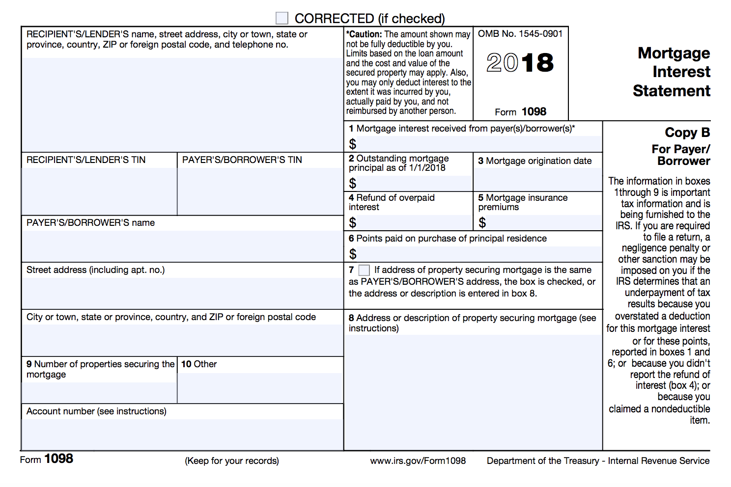

Form 1098: Mortgage Interest Statement
Make sure you pay attention to box descriptions!
Do not mistake the mortgage principal(how much of the loan they have left to pay) for mortgage interest!

Slide 168
Form 1098: Mortgage Interest Statement
Boxes 10 may also report real estate taxes
These amounts can be included as an itemized deduction

Slide 169
Nondeductible Interest
Personal interest
  personal loans
  car loans
  credit cards
  etc.

Slide 170
Casualty and Theft Losses
Out of Scope!

Slide 171
Miscellaneous Deductions
Union dues
Uniforms (that cannot be worn in any other circumstance)
Professional books, journals
Small tools and supplies, used for business

Slide 172
Miscellaneous Deductions
Employment-related educational expenses
  Includes educator expenses > $250 (after the adjustment)
Expenses for looking for a new job
Tax preparation fee from last year
Safe deposit box
Gambling losses up to amount of winnings

Slide 173
Nondeductible Expenses
Burial or funeral expenses
Wedding expenses
Fees and licenses
Fines, penalties, traffic tickets
Home repairs and insurance
Rent
Insurance premiums (except health and mortgage)
Losses from sale of home

Slide 174
Example
Are the following expenses deductible?
Medical insurance premiums
Vitamins
Federal income tax
Interest on car loan
Church contribution
Tax preparation fee from last year

Slide 175
Example – Answer
Are the following expenses deductible?
Medical insurance premiums - YES
Vitamins
Federal income tax
Interest on car loan
Church contribution
Tax preparation fee from last year

Slide 176
Example – Answer
Are the following expenses deductible?
Medical insurance premiums - YES
Vitamins - NO
Federal income tax
Interest on car loan
Church contribution
Tax preparation fee from last year

Slide 177
Example – Answer
Are the following expenses deductible?
Medical insurance premiums - YES
Vitamins - NO
Federal income tax - NO
Interest on car loan
Church contribution
Tax preparation fee from last year

Slide 178
Example – Answer
Are the following expenses deductible?
Medical insurance premiums - YES
Vitamins - NO
Federal income tax - NO
Interest on car loan - NO
Church contribution
Tax preparation fee from last year

Slide 179
Example – Answer
Are the following expenses deductible?
Medical insurance premiums - YES
Vitamins - NO
Federal income tax - NO
Interest on car loan - NO
Church contribution - YES
Tax preparation fee from last year

Slide 180
Example – Answer
Are the following expenses deductible?
Medical insurance premiums - YES
Vitamins - NO
Federal income tax - NO
Interest on car loan - NO
Church contribution - YES
Tax preparation fee from last year - YES

Slide 181
Itemized Deductions (State Return)
If the taxpayer is itemizing deductions on the Federal and State returns or if the taxpayer is just itemizing on the State return, you always enter the itemized deductions on Sch A on the Federal return.
  Never start to itemize on the state return.
  It is okay to leave the deductions on the Federal return even if the taxpayer does not have enough to itemize, because there is a good chance he/she can itemize on the State return.
All of the information from the Sch A carries over to the form for the state return.

Slide 182
Itemized Deductions
TaxSlayer Walkthrough
Open up Kyle Kent in TaxSlayer
  Enter Itemized Deductions

Slide 183
Education Credits (Part VI of I/I form)

Slide 184
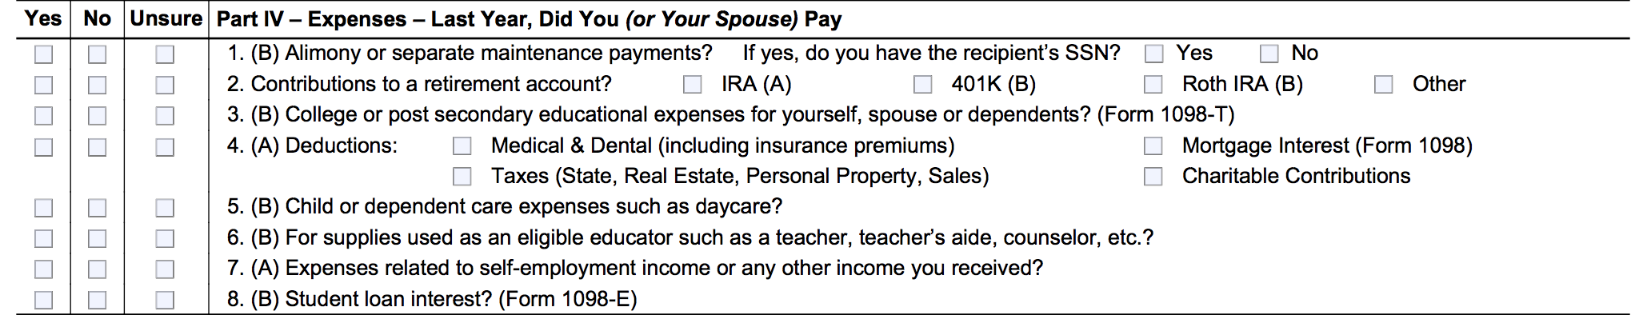
Education Credits
Let’s look at the I/I form!

Slide 185


Education Credits
Let’s look at the scope of service chart!

Slide 186
Education Credits
Education credits help to offset the cost of higher education expenses paid during the year
Two education credits available
  Nonrefundable: Lifetime learning credit
  Partially Refundable: American opportunity credit

Slide 187
General Eligibility
Filing status cannot be Married Filing Separately
Cannot be claimed as a dependent on someone else’s return
Accredited institution
CAN claim on the basis of expenses paid with student loans

Slide 188
Dependents
When the student can be claimed as a dependent:
  Taxpayer must claim credit if taxpayer claims the exemption
  Student must claim credit if taxpayer does not claim exemption
If the taxpayer claims the dependency exemption, any amount paid by the student is considered to have been paid by the taxpayer

Slide 189
American Opportunity (Hope) Credit | Lifetime Learning Credit
Up to $2,500 per eligible student ($1,000 is refundable) | Up to $2,000 credit per return
Available for the 1st 4 years of college | Available for all years
Student must be pursuing a degree or recognized education credential | Student does not need to be pursuing a degree or credential
Student must be enrolled at least half time | Available for one or more courses
No felony drug conviction on student’s record | Felony drug conviction does not apply
Expenses include tuition, fees, and course materials | Expenses include only tuition and fees
Cannot claim if MFS

Slide 190



Form 1098-T: Tuition Statement

Slide 191
Form 1098-T: Payments Received For Qualified Tuition and Related Expenses
Reported in box 1
Shows the total payments RECEIVED by the institution in the tax year from any source for qualified tuition and related expenses

Slide 192
Form 1098-T: Amounts Billed for Qualified Tuition and Related Expenses
Reported in box 2
Shows the total payments BILLED in the tax year for qualified tuition and related expenses
Some institutions will only list an amount in box 2 (and will not list the amount RECEIVED in box 1)
If there is ONLY an amount listed in box 2, you must ask the taxpayer how much they actually paid during the tax year before using the amount for the credit (or adjustment)

Slide 193
Form 1098-T: Scholarships or Grants
Reported in box 5
Shows the total of all scholarships or grants administered and processed by the institution
The amount of scholarships or grants must be subtracted from the total amount of expenses paid when figuring the credit (or adjustment)

Slide 194
Form 1098-T: Amounts for an Academic Period Beginning Jan – March 20XX
Reported in box 7
This box will be checked if the amount in box 1 or 2 (amounts RECEIVED and BILLED by the institution) includes amounts paid for an academic period beginning in January AFTER the tax year

Slide 195
Form 1098-T: Amounts for an Academic Period Beginning Jan – March 20XX
Example:
  A taxpayer is filing a 2018 tax return
  Box 7 is checked
  Box 1 or 2 amounts thus include amounts that were received or billed by the institution for the spring academic period beginning in January – March of 2019

Slide 196
Form 1098-T: Check if At Least Half-time Student
Reported in box 8
Shows whether the student is considered to be carrying at least one-half the full-time workload for the student’s course of study at the institution
Number of hours considered half-time can vary based on the institution’s policies

Slide 197
Qualified Expenses for Credit
American Opportunity (Hope) Credit
  Qualified tuition and related expenses up to $4,000 per eligible student
  Includes expenses for course materials – books, supplies, and equipment needed for a course of study, whether or not they were purchased from institution

Slide 198
Qualified Expenses for Credit
Lifetime Learning Credit
  Expenses include only tuition and fees
  Course-related books, supplies and fees are included ONLY if they must be paid to the institution as a condition of enrollment

Slide 199
Expenses That Do Not Qualify
Room and board
Insurance
Medical expenses (including student health fees)
Transportation costs
Personal, living or family expenses
Expenses for a course involving sports, games or hobbies, unless it is required for the degree/certificate

Slide 200
No Double Benefits
The taxpayer CANNOT claim:
  Both the American opportunity and lifetime learning credits for the same qualified tuition expenses
  Expenses paid with a tax-free scholarship, grant, or other assistance, including Pell grants (in other words, the taxpayer must subtract these scholarships from the total expenses before claiming either credit)

Slide 201
No Double Benefits
The taxpayer CANNOT claim:
  Both an education credit AND the tuition and fees adjustment for the same qualified tuition expenses
  Most taxpayers benefit more from the credit, but you should try the expenses as both an adjustment AND a credit to determine which benefits the taxpayer more

Slide 202
Qualified Expenses
IMPORTANT!
Verify with the taxpayer that the amount in Box 1 or 2 of Form 1098-T is actually the amount paid in the current tax year for qualified expenses!

Slide 203
Payments for the Next Academic Year
Taxpayers can claim payments paid in the tax year for the academic period that begins in January – March of the next tax year
Remember: Box 7 will be checked on the Form 1098-T indicating that the amount in box 1 or 2 includes amounts paid for the next academic year

Slide 204
Payments for the Next Academic Year
Example:
  Michael pays $1,500 in December 2018 for the winter semester that begins in January 2019
  He can use the $1,500 paid in December 2018 to compute his credit for his 2018 TY tax return
  However, he cannot count the $1,500 again on his 2019 TY tax return

Slide 205
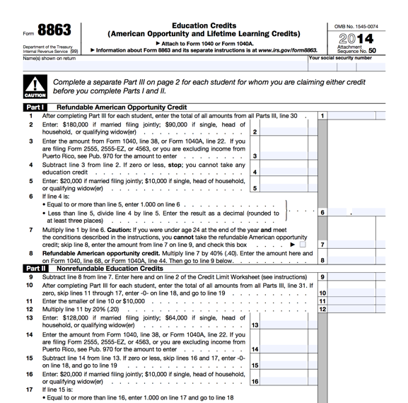
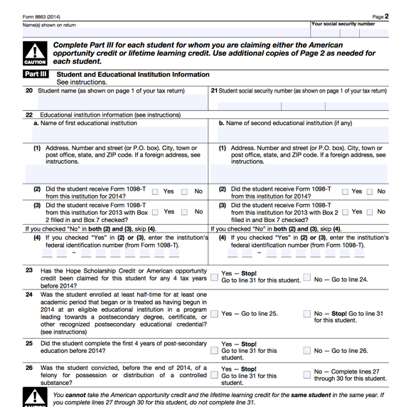
Form 8863: Education Credits

Slide 206
Determining the Amount of the Credit
Review the list of qualifying students and expenses and decide which credit is best.
Enter each qualifying student on Form 8863
Enter the students’ qualifying expenses
  Include only qualified expenses
  Are reduced by untaxed benefits (scholarships, grants, etc.)
  Are reduced by amounts paid in previous years
  Do not exceed the limit for the credit

Slide 207
Nonrefundable vs. Refundable
Lifetime Learning Credit
  Entirely nonrefundable
  Limit to $2,000 PER RETURN (not per eligible student)
American Opportunity Credit
  Partially refundable – up to $1,000 PER STUDENT
  Limit to $2,500 PER STUDENT (not per return)

Slide 208
Refundable American Opportunity Credit for Taxpayers under the age of 24
See Your Site Coordinator if you have a taxpayer under the age of 24 claiming an education credit – the taxpayer may or may not be eligible to take the refundable American Opportunity Credit, but the process for determining eligibility is complicated

Slide 209
Example
James takes one course at a local community college. He received a Form 1098-T showing qualified tuition expenses of $1,000. He lives with his parents, who can claim him as a dependent. Who is entitled to claim the credit? Which credit?

Slide 210
Example – Answer
If James’s parents claim him, they must claim the credit
If James’s parents do not claim him, James must claim the credit
Lifetime Learning Credit

Slide 211
Example
LaQuandra is a sophomore enrolled at UAB full-time. She provides all of her own support. She paid $10,000 in the tax year for tuition and fees for enrollment to UAB. She received a tax-free scholarship worth $4,000, and paid the rest from a student loan in her name. Can LaQuandra claim an education credit? Which one? How much of her expenses are qualified expenses?

Slide 212
Example – Answer
Yes
American Opportunity Credit
Qualified expenses = $6,000 ($4,000)

Slide 213
Education Credits
TaxSlayer Walkthrough
Open up Kyle Kent in TaxSlayer
  Enter Education Credits

Slide 214
Health Care Coverage
(Part VI of I/I form)

Slide 215
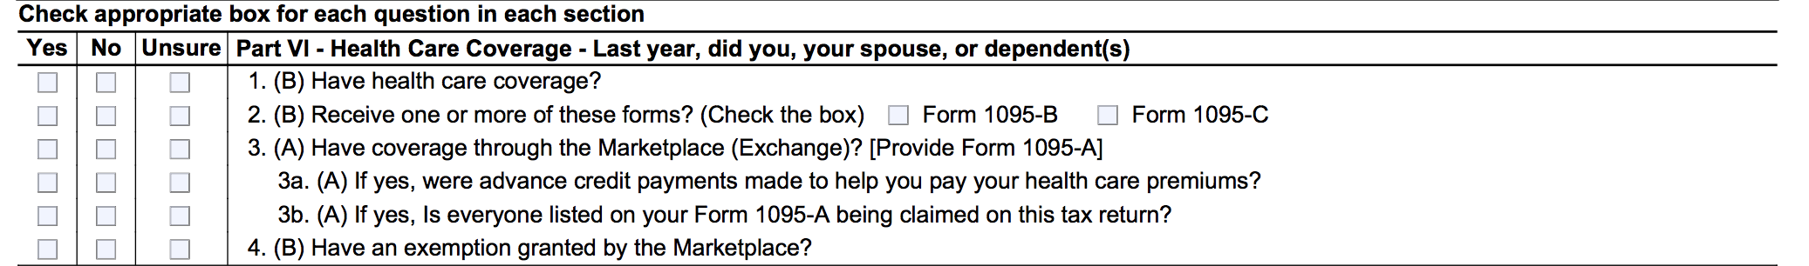
Affordable Care Act
Let’s look at the I/I form!

Slide 216
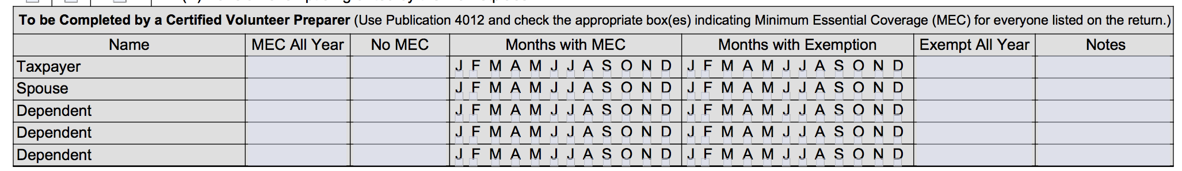
Affordable Care Act
Let’s look at the I/I form!
In the interview process, you should determine if the taxpayer/spouse/dependents has
MEC for any months of the tax year and mark which months they have coverage.

Slide 217
Affordable Care Act
Let’s look at the scope of service chart!

Slide 218
What is the Affordable Care Act (ACA)?
The federal government, state governments, insurers, employers, and individuals share responsibility for improving the quality and availability of health insurance coverage in the United States
The ACA reforms the existing health insurance market by prohibiting insurers from denying coverage or charging higher premiums because of an individuals pre-existing conditions.
The ACA also created the Health Insurance Marketplace (also known as www.healthcare.gov)

Slide 219
Healthcare.gov
Where taxpayers:
  Find information about health insurance options
  Purchase health insurance
  Obtain help paying premiums and out-of-pocket costs (if eligible)
A refundable tax credit, The Premium Tax Credit, is available through the Marketplace and helps eligible taxpayers pay for coverage

Slide 220
Shared Responsibility Provision
The Affordable Care Act requires individuals to:
  Have qualifying health coverage, called minimum essential coverage, for each month of the year
  Qualify for a coverage exemption, OR
  Make a shared responsibility payment when filing their federal income tax returns
    This is essentially a tax penalty for not having coverage

Slide 221
Use Your Resources!
Use the Publication 4012, ACA Tab
to help you complete the ACA provisions on the tax return!

Slide 222
What is Minimum Essential Coverage?
Minimum essential coverage (MEC) is health coverage that satisfies the individual shared responsibility requirement
Most health insurance is MEC
No proof of coverage is needed. Oral statement from the taxpayer is acceptable, unless normal due diligence leads you to believe the taxpayer’s statement is incorrect

Slide 223
Who Needs MEC?
Everyone on the tax return needs MEC or a coverage exemption
The taxpayer is responsible for the insurance, coverage exemption, or individual shared responsibility payment (penalty) of each person on the return

Slide 224
How Many Months Do Taxpayers Need to Have MEC?
Everyone needs MEC for every month
  A person is considered covered for the whole month if they had coverage for at least one day
  A person who was born or died during the year is required to have coverage for every full month alive

Slide 225
Types of Minimum Essential Coverage
Employer-Sponsored Coverage
  Group health insurance coverage for employees under
    A governmental plan (such as the Federal Employees Health Benefit Program)
    A grandfathered health plan
  A self-insured health plan for employees
  COBRA coverage
  Retiree coverage

Slide 226
Types of Minimum Essential Coverage
Individual Health Coverage
  Health insurance purchased directly from an insurance company
  Health insurance purchased through healthcare.gov
  Health insurance through a student health plan

Slide 227
Types of Minimum Essential Coverage
Government-Sponsored Programs:
  Medicare Part A coverage
  Medicare Advantage plans
  Most Medicaid coverage
  Children’s Health Insurance Program (CHIP)
    ALL Kids (Alabama)
    Florida KidCare
    CoverKids(TN)
    Healthy Connections Kids(South Carolina)

Slide 228
Types of Minimum Essential Coverage
Government-Sponsored Programs:
  Most TRICARE coverage
  Veteran Affairs comprehensive health care
  Peace Corps volunteer health coverage
  Department of Defense Nonappropriated Fund Health Benefits Program
  Refugee Medical Assistance

Slide 229
Types of Minimum Essential Coverage
Other Coverage
  Certain foreign coverage
  Certain coverage for business owners

Slide 230
Does NOT Qualify as MEC
There are some health plans that may provide limited benefits but do not qualify as MEC
Includes:
  Coverage consisting solely of excepted benefits such as standalone dental/vision insurance, disability income insurance, workers’ comp insurance
  Medicaid providing only specific medical services (such as family planning, pregnancy-related, etc.)
  AmeriCorps and AfterCorps coverage

Slide 231
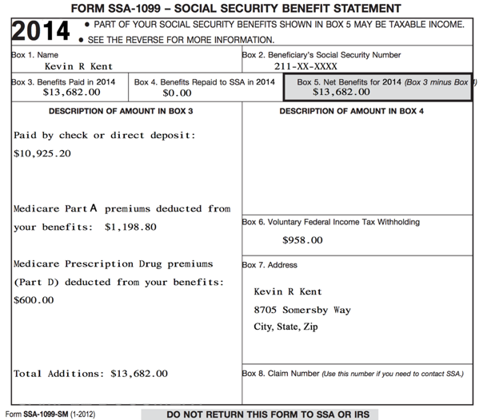
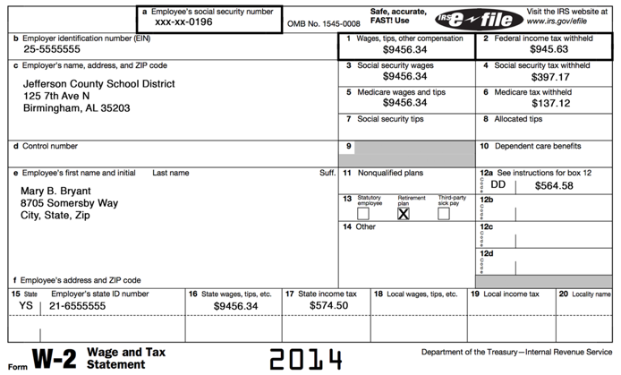

Tax Forms That Show Evidence of Coverage: Form W-2, Form SSA-1099

Slide 232
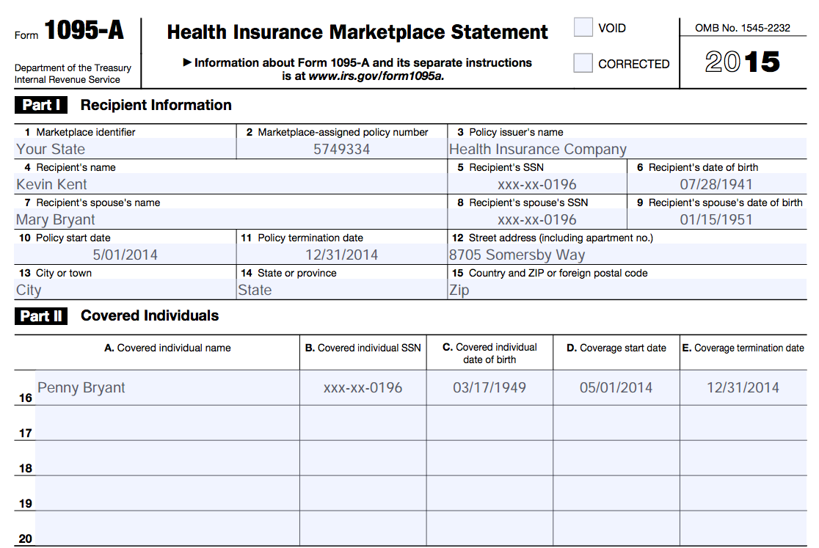
Tax Forms That Show Evidence of Coverage: Form 1095-A

Slide 233
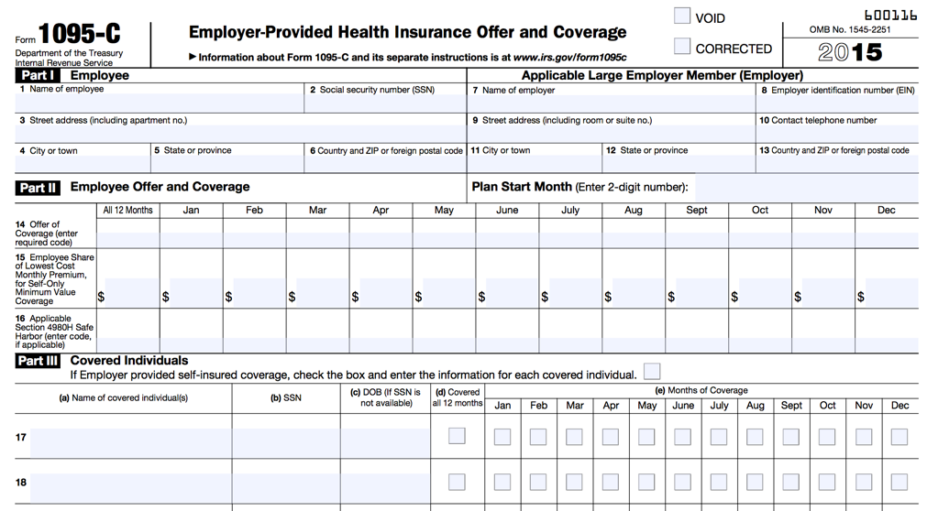
Tax Forms That Show Evidence of Coverage: Form 1095-C

Slide 234
What is a Health Coverage Exemption?
A reason for not having health insurance that avoids payment of the individual shared responsibility payment

Slide 235
Who Needs a Health Coverage Exemption?
Anyone without insurance coverage for any month should be screened for exemption eligibility

Slide 236
Exemptions: Where Do I Start?
Step 1 | Does anyone on the tax return already have an exemption in hand from the Marketplace (healthcare.gov)?
 | Marketplace exemptions require an application. If a person applied for an exemption, they should have received an Exemption Certificate Number (ECN) from healthcare.gov (it is a 6 or 7 alphanumeric code)

Slide 237
Exemptions: Where Do I Start?
Step 2 | Is household or gross income under the filing threshold?
 | If YES, everyone on the tax return is exempt from the coverage requirement, and there is no need to consider additional exemptions

Slide 238
Exemptions: Where Do I Start?
Step 3 | If the family does not qualify for an exemption under Step 2, does any individual qualify for an exemption that can be claimed directly on the return?
 | If YES, enter the exemption code on the tax return

Slide 239
Exemptions: Where Do I Start?
Step 4 | For any uninsured individual that does not qualify under Step 2 or 3, does any individual on the tax return qualify for an exemption from healthcare.gov?
 | If YES, see your Site Coordinator for additional help in applying for the exemption and enter “pending” on the tax return

Slide 240
Exemptions: Granted By Healthcare.gov
Homelessness
Eviction in the last 6 months or facing eviction or foreclosure
Utility shut-off notice
Domestic violence
Recent death of a close family member

Slide 241
Exemptions: Granted By Healthcare.gov
Disaster that resulted in significant property damage
Bankruptcy in the past 6 months
Debt from medical expense in last 24 months
High expense caring for ill, disabled or aging relative

Slide 242
Exemptions: Granted By Healthcare.gov
Determined ineligible for Medicaid because state did not expand coverage**
  Will be common at SaveFirst sites!
Other exemptions
If it seems your taxpayer may qualify for a hardship exemption granted from healthcare.gov, see your Site Coordinator!

Slide 243
Exemptions: Household/Gross Income Below Filing Threshold
Household Income
The Modified Adjusted Gross Income (MAGI) of each individual on the tax return with a filing requirement. Include dependent income ONLY IF the dependent has a filing requirement
Gross Income
All the income received in the form of money, goods, property, and services that is not exempt from tax, including taxable portions of Social Security (do not include dependent income)
TaxSlayer calculates and applies these automatically!

Slide 244
Exemptions: Claimed on the Tax Return
Certain noncitizens and U.S. citizens living abroad
Federally recognized Indian tribe or eligible for services through the Indian Health Service
Member of a health care sharing ministry
Incarceration

Slide 245
Exemptions: Claimed on the Tax Return
Unaffordable Insurance (cost of coverage exceeds 8.XX% of household income)
Aggregate cost of employer insurance in unaffordable
Short coverage gap (less than 3 months)
Full list of exemptions for Individuals claimed on the tax return can be found in Pub 4012, ACA Tab

Slide 246
What is a Premium Tax Credit?
A premium tax credit (PTC) lowers the cost of health insurance coverage purchased from healthcare.gov
PTCs can be either:
Taken in advance (payment forwarded directly to the insurer monthly to reduce premiums), OR
Taken on the tax return (payment is claimed as a lump sum when filing the return)

Slide 247
Premium Tax Credits: Where Do I Start?
If a taxpayer(or one of their dependents) has insurance from the marketplace, you will just enter the 1095-A in TaxSlayer, and the software will calculate if they had too much or too little premium tax credit based on their actual income.

Slide 248
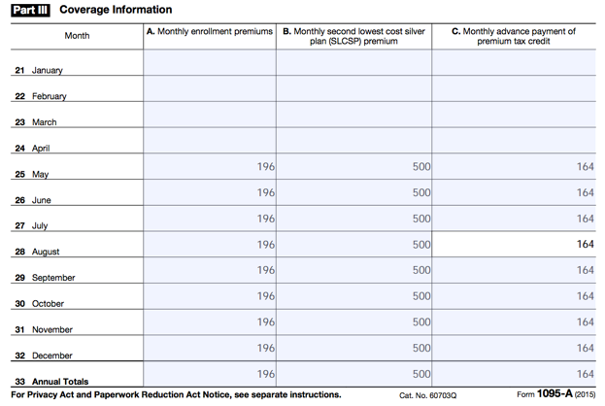
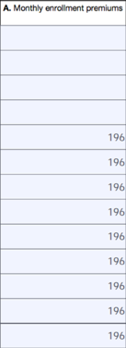
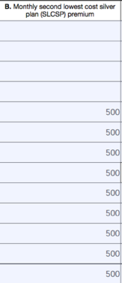
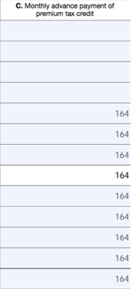
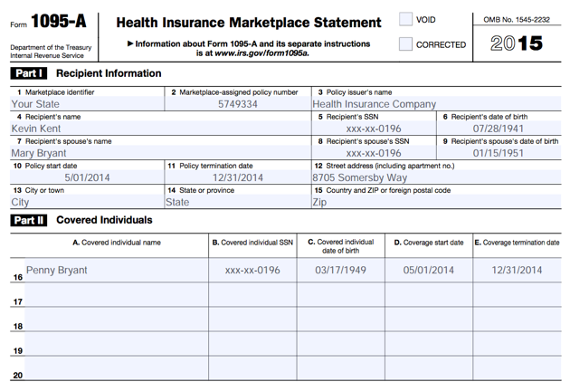
Form 1095-A: Health Insurance Marketplace Statement

Slide 249
Affordable Care Act
TaxSlayer Walkthrough
Open up Kyle Kent in TaxSlayer
  Enter Affordable Care Act related information
  For Alabama volunteers, revisit the state return, noting manual entries

Slide 250
Form 1040 Overview

Slide 251
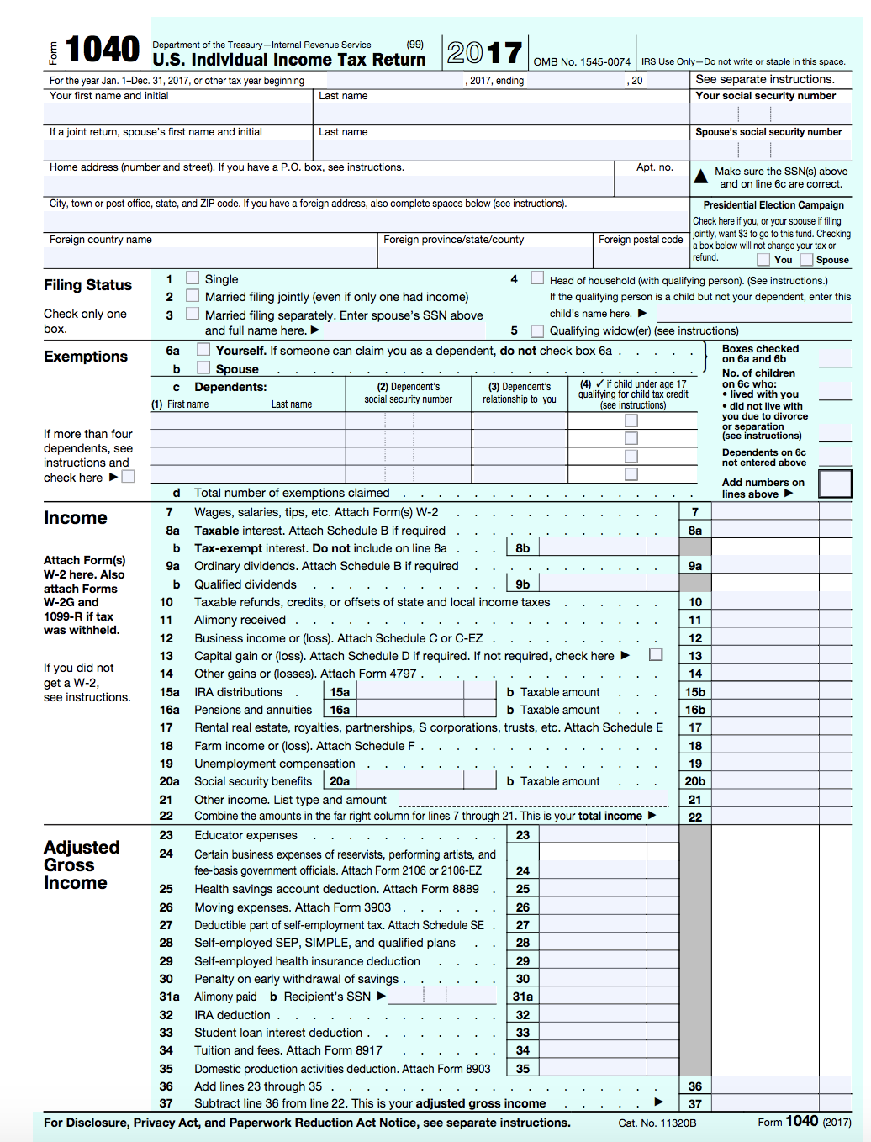
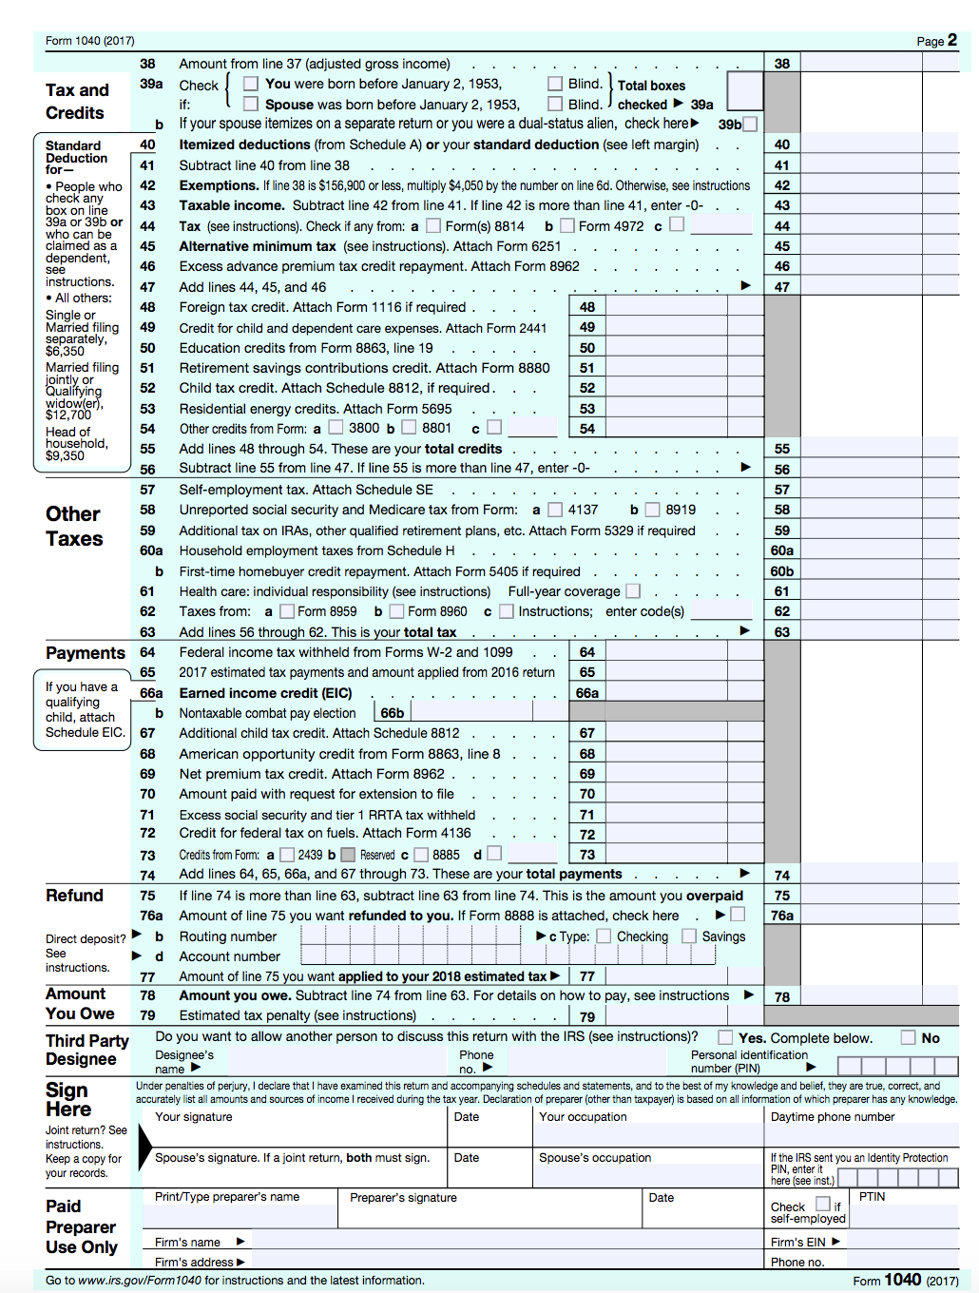

Slide 252
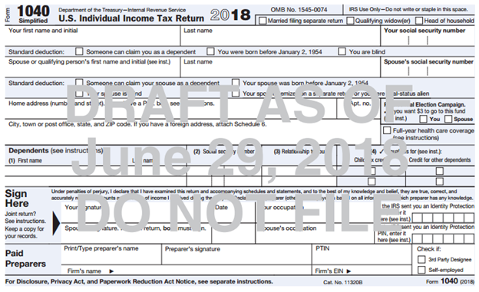
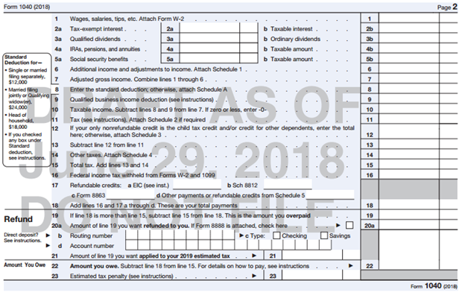
Form 1040-Draft for 2018

Slide 253
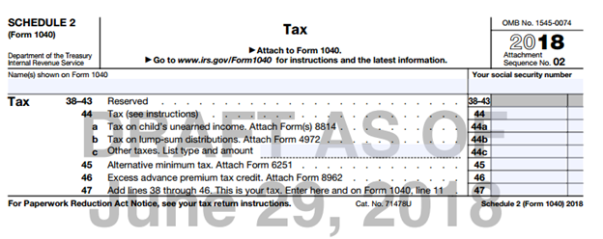
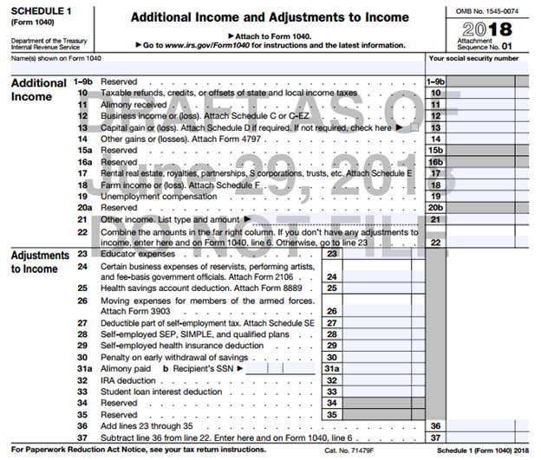
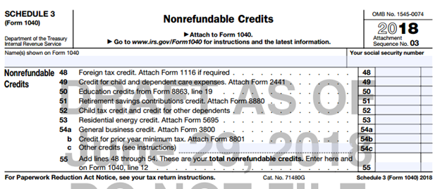
Form 1040-Schedules
Draft for 2018

Slide 254
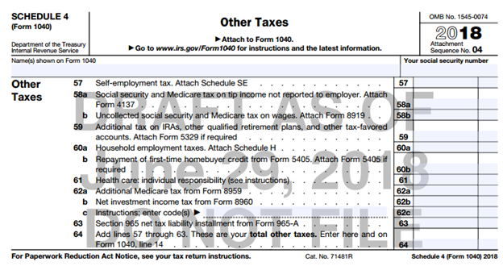
Form 1040-Schedules
Draft for 2018

Slide 255
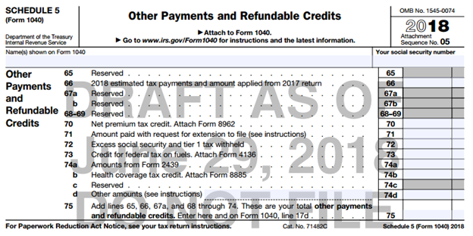
Form 1040-Schedules
Draft for 2018

Slide 256
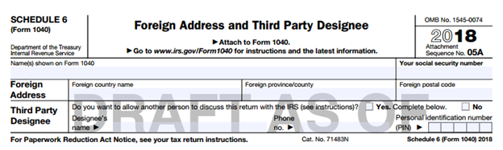
Form 1040-Schedules
Draft for 2018

Slide 257
Out of Scope Topics and Taking the IRS Exam

Slide 258
Additional Topics – Out of Scope at Tax Site
IRS changed VITA certification levels
There are more advanced topics on your 2018 IRS Advanced Certification test, but you will not prepare these at the tax sites
Let’s look at your Out of Scope Topics Handout!

Slide 259
Review: Scope of Service Questions

Slide 260
Scope of Service Questions
Sally Smith has filled out her I/I form and after the interview you conduct, you conclude she has the following types of income:
1099-INT
1099-MISC box 7
RRB-1099
1099-B
1095-A

Slide 261
Scope of Service Questions
Sally Smith has filled out her I/I form and after the interview you conduct, you conclude she has the following types of income:
1099-INT
1099-MISC box 7
RRB-1099
1099-B
1095-A

Slide 262
Scope of Service Questions
Sally Smith has filled out her I/I form and after the interview you conduct, you conclude she has the following types of expenses:
Prescription drugs
Doctor co-pays
After-school expenses for 7 year old daughter while at work
Health Savings Account Contributions
Tuition Expenses for dependent daughter

Slide 263
Scope of Service Questions
Sally Smith has filled out her I/I form and after the interview you conduct, you conclude she has the following types of expenses:
Prescription drugs
Doctor co-pays
After-school expenses for 7 year old daughter while at work
Health Savings Account Contributions
Tuition Expenses for dependent daughter

Slide 264
Intake/Interview & Quality Review Process

Slide 265
Your Role as an Advanced Volunteer
In addition to completing intermediate topics on the tax return, one of your primary roles will be assisting your Site Coordinator with the Quality Review Process
We will now review the Intake/Interview Form and discuss the Quality Review Process in detail

Slide 266
Intake/Interview & Quality Review Sheet
Form 13614-C (October 2018)
All VITA programs are required to use this sheet for every tax return filed at the tax site.

Slide 267
Assuring a Quality Service and Accurate Return
Taxpayers using services offered through the Volunteer Tax Assistance (VITA) and Tax Counseling for the Elderly (TCE) Programs should be confident they receive quality service. This includes having an accurate tax return prepared.
A basic component of preparing an accurate return begins with listening to the taxpayer and asking the right questions.
Form 13614-C, Intake/Interview & Quality Review Sheet, is a tool designed to help the volunteer ask the right questions. When used properly, this form effectively contributes to accurate tax return preparation.

Slide 268
Using this Form Completely and Appropriately
The IRS conducts oversight to ensure that EVERY part of the form is being used appropriately and completely during the interview with the taxpayer and while preparing their return.
The IRS requires compliance with use of this form to ensure high quality tax returns for our VITA program.

Slide 269
Required for Use by IRS VITA Sites
An important tool for accuracy and due diligence!
Must be completed by (or with) the taxpayer.
Will be used to conduct the Quality Review process.
Must be kept at tax site for site records (do not let the taxpayer take the form with them)
No records brought to the site should be kept on file
For privacy and identity protection purposes, SSNs should NOT be printed on the I/I form

Slide 270
Intake/Interview Form is a Huge Asset to You
Provides an extra record for you to double-check information on the tax return in TaxSlayer and note things the taxpayer forgets to mention when speaking with you

Slide 271
The Intake Process: Completing Form 13614-C
In most cases, the taxpayer completes pages 1, 2, and 3 of the Intake Interview Form (Form 13614-C) in the waiting room before sitting down with you, the tax preparer.
Provide assistance as needed (be sensitive and perceptive to the needs of the taxpayers)

Slide 272
Complete an Intake/Interview Form for EVERY Return
We MUST have an intake/interview form on file for EVERY return filed at our tax sites.

Slide 273



Part 3: Quality Review
Notes:
‹#›

Slide 274
Part 3: Quality Review
Before handing the return off to a quality reviewer, make sure to write your name at the bottom of the last page! This is will help us if we have any questions about the return during the Quality Review!
Jane Volunteer
Notes:
‹#›

Slide 275
Part 3: Quality Review
Remember: If at any point in the return you come across something out of scope for you, but in scope for a more advanced volunteer, you should write a note at the bottom of the I/I supplement form!
Jane Volunteer
Need to enter: HSA and capital gains 1099-B
Notes:
‹#›

Slide 276
Part 3: Quality Review
Once the return has been quality reviewed and is ready to e-file, the quality reviewer will check the box “Ready to E-file”
If the return is outstanding, there needs to be an explanation
If the return needs to be paper filed for some reason there needs to be an explanation
Jane Volunteer
Jenn Volunteer
Need to enter: HSA and capital gains 1099-B
Notes:
‹#›

Slide 277
The Intake Process: Tax Return and Volunteer Certification Levels
It is a violation of our VITA Grant and IRS Compliance and your Volunteer Standards of Conduct Agreement to file a tax return that is out of scope of the VITA tax site.
At SaveFirst sites, to ensure all returns are in-scope for VITA:
  Consult the SaveFirst Scope of Service Chart – at every tax station and in the Site Coordinator Handbook/Advanced Volunteer Handbook
  If a topic seems complicated or unfamiliar to you, double-check the SaveFirst Scope of Service Chart to be sure it is listed in scope.
  Sometimes this determination may be unclear. If you are unsure, talk to your Site Coordinator.

Slide 278


Slide 279


Slide 280


Slide 281


Slide 282


Slide 283


Slide 284


Slide 285


Slide 286


Slide 287


Slide 288


Slide 289


Slide 290


Slide 291


Slide 292


Slide 293


Slide 294


Slide 295


Slide 296


Slide 297


Slide 298


Slide 299


Slide 300


Slide 301


Slide 302


Slide 303


Slide 304
Take the Quizzes!
Log in to your VMS account and complete the two quizzes:
  Intake Interview and Quality Review
  Volunteer Standards of Conduct

Slide 305
Congratulations!
This completes the Advanced Volunteer Training
Please complete the Jack White – Advanced Training Exercise for practice on your own
Continue to check impactamerica.com/taxprep – we will update with additional training videos throughout the fall/winter
  Specifically, we will post a walkthrough video of the Kyle Kent exercise for you to watch

Slide 306
Next Steps
Attend Testing Session
  Pass IRS Advanced Certification with score of 80% or higher!
  To see Testing Sessions available to you:
    Log in to your account at volunteers.generationforchange.org
    Select “Register for a Testing Session (Recommended)”
    Select “Register” for the training session you would like to attend
Feel free to contact your trainer with questions

Slide 307
Advanced Training
B Session

