Slide 1

Volunteer Basic Tax Training
A Session

Slide 2
SaveFirst Basic Volunteer Overview
Basic Tax Training (A & B Sessions)
IRS Basic Certification
  Intake/Interview & Quality Review Exam (B Session)
  Volunteer Standards of Conduct Exam (B Session)
  IRS Basic Certification Exam (attend testing session or on your own)
    Passing Score: 80% or better
    Must pass before serving at a tax site

Slide 3
SaveFirst Basic Volunteer Overview
Please sign-in
Follow your trainer’s instructions on how to complete paperwork on your volunteer profile
There are a number of training materials provided for you to use throughout training. Please bring these materials back to the B session.

Slide 4
The Impact SaveFirst Volunteers will have this Season
Serve over 13,000 families this year
Save families over $5 million in commercial fees
Provide a quality reliable service and an alternative to a costly, predatory industry for hard-working families
SaveFirst: An Initiative of Impact America

Slide 5
Resources
SaveFirst Basic Volunteer Training Agenda
SaveFirst Volunteer FAQs and Etiquette
SaveFirst Basic Volunteer Training Notes
SaveFirst Tax Prep Process
SaveFirst Scope of Service Chart
SaveFirst Basic Training Summary Chart
State Resources(if applicable)
Impact America Staff

Slide 6
Resources
Pub 4012 Selections
SaveFirst Basic Training TaxSlayer Exercises
Helpful Tips for 2018 Basic IRS Exam-B Session
All resources can be found at www.impactamerica.com/taxprep

Slide 7
Volunteer Responsibilities: Overview
Prepare returns
Enter taxpayer information into the preparation software (TaxSlayer)
Greet taxpayers
Assist taxpayers in completing the I/I form
Assist in making day-before calls to taxpayers

Slide 8
Training Outline: A Session
Creating a TaxSlayer Account
Conducting a Thorough Interview
Exemptions(Part II of I/I form)

Slide 9
Training Outline: A Session
Filing Status(Part II of I/I form)
Income (Part III of I/I form)
Expenses (Part IV of I/I form)

Slide 10
Creating a TaxSlayer Account

Slide 11
Creating a TaxSlayer Account
Go to vita.taxslayerpro.com/IRSTRAINING
  password:TRAINPROWEB
Username format
  (Last name, First Initial, the word “TRAIN”)
  DOEJTRAIN
Password
  SaveFirstTaxes2020!
Program Type: VITA
SIDN: Leave blank

Slide 12
Conducting a Thorough Interview

Slide 13
Interview Objectives
After completing this section, the volunteer will be able to:
  Conduct a thorough interview with taxpayer to ensure accurate return preparation
  Navigate use of I/I form, Scope of Service Chart, and Summary Chart to complete return preparation

Slide 14
Conducting a Thorough Interview
Taxpayer completes pages 1, 2, and 3 of Intake/Interview Form.
Verify photo ID(s) & Social Security card(s)
Go through the entire I/I form with them, asking clarifying questions and determining what is in scope for you.
Ensure taxpayer cannot be a dependent of anyone else (Pub 4012: Tab C)
Determine dependents (Pub 4012: Tab C)

Slide 15
Conducting a Thorough Interview
The first thing you ask from the taxpayer is for photo ID and Social Security Card
If a taxpayer is filing jointly with a spouse, the spouse needs to be present with their photo ID and Social Security Card as well.

Slide 16
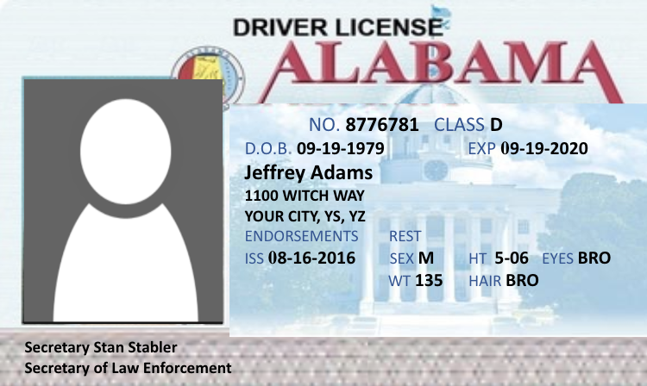

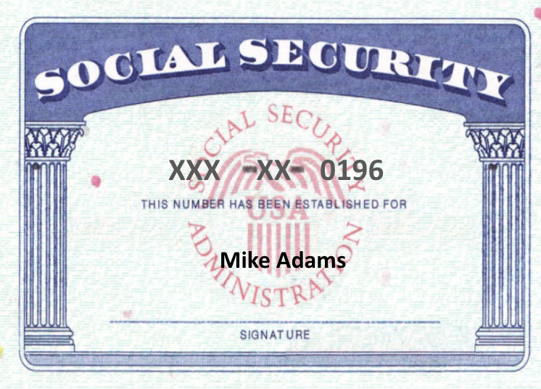
Conducting a Thorough Interview
Photo ID’s
Taxpayer Spouse(if applicable)
Social Security Cards
Taxpayer Spouse(if applicable) Dependents
Taxpayer
Dependent Child

Slide 17
Conducting a Thorough Interview: Acceptable forms of social security identification
Form SSA-1099 statement
Medicare Card (with an “A” after the SSN)
ITIN card
  Issued for nonresidents who need to file tax returns but cannot receive SS cards
  9XX-XX-XXXX (enter just like SS number)
ATIN for dependent
  Issued for child while adoption is pending
  9XX-XX-XXXX (enter just like SS number)

Slide 18
Conducting a Thorough Interview
What if a taxpayer doesn’t have their SSC?
  lost it
  don’t have one
  left it at home
We have to see the card(or acceptable replacement) in order to submit the return!
Required to E-file
follow-up appointment if necessary

Slide 19
Conducting a Thorough Interview
What about…..
  They did their return at our site last year
  the SSN is on their prior year tax return they brought in
  the SSN is on the taxpayer’s W-2
None of these are documents issued by the social security administration!

Slide 20
Conducting a Thorough Interview
Once you’ve verified the photo ID and Social Security Card, you need to go through the entire I/I form with the taxpayer, asking clarifying questions and making sure it is filled out completely.

Slide 21
Conducting a Thorough Interview
You may find out that the taxpayer has a form that is out of scope for us!
  We don’t want to waste a taxpayer’s time
  We have a “Scope of Service Chart” that you’ll use to determine if something is out of scope
Better to catch at the beginning than at the end!

Slide 22
Conducting a Thorough Interview
REVIEW pages 1-3 of I/I Form and ask clarifying questions:
  I see you marked that you are unmarried and have no one else living in your home?
  Collect necessary forms
  “Yes” or “No” answer for all questions on page 2

Slide 23
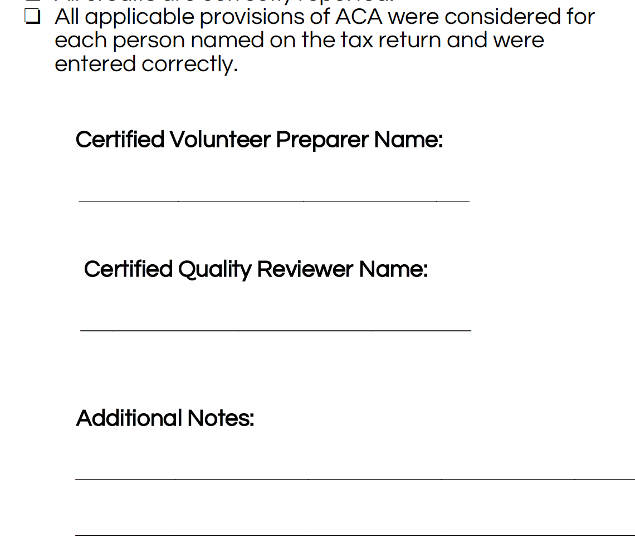
Conducting a Thorough Interview
Write full name on the Intake/Interview Supplement form!

Slide 24
Conducting a Thorough Interview
You need to go through the entire I/I form and ask clarifying questions and make sure everything has been filled out.
If the taxpayer left a question blank, you need to ask and clarify, then fill out the answer on the I/I form.
Before you start the return in TaxSlayer, the entire I/I form needs to be completely filled out!

Slide 25
Conducting a Thorough Interview
Always consult the Scope of Service Chart to see if the income/expense/life event is in scope for your level of certification.
If something is out of scope for you, put the form to the side and make a note on the I/I supplement form for the advanced volunteer.

Slide 26
Conducting a Thorough Interview
Taxpayer has a form and you can’t find it on the scope of service chart or summary chart?
  call over a more advanced volunteer to determine if the form is in scope
We want to determine if something is out of scope as early in the process as possible!

Slide 27
Conducting a Thorough Interview
Once you have gone through the I/I form, you need to use the Pub 4012 to determine dependency exemptions and filing status

Slide 28
Conducting a Thorough Interview
Complete part of Section II “To be completed by a Certified Volunteer Preparer”
Determine dependency exemptions(Pub 4012: Tab C)
Determine filing status (Pub 4012: Tab B)
We will discuss dependency exemptions and filing status in depth shortly

Slide 29
Conducting a Thorough Interview
You get to know the taxpayer and build a relationship
You might miss credits and deductions that could increase the taxpayer’s refund
You might miss important income documents that must be recorded
You may find that the return is out of scope
Required by the IRS for due diligence

Slide 30
Conducting a Thorough Interview – Why conduct an interview?
You find out if any income documents or expenses need to be entered by a more advanced volunteer.
A diligent and thorough interview saves a huge amount of time in the long run!

Slide 31
Exemptions (Part II of I/I form)

Slide 32
Exemptions Objectives
After completing this section, the volunteer will be able to:
  Determine a taxpayer’s eligibility for a personal exemption
  Assess whether a person qualifies as a dependent of a taxpayer

Slide 33
Exemption
A taxpayer may claim 2 types of exemptions:
  Personal exemption
    Taxpayer can claim themself (and spouse)
  Dependency exemption
    Taxpayer can claim qualifying dependents

Slide 34
Dependent
An individual whom the taxpayer supports or lives with the taxpayer
  Qualifying child
  Qualifying relative

Slide 35
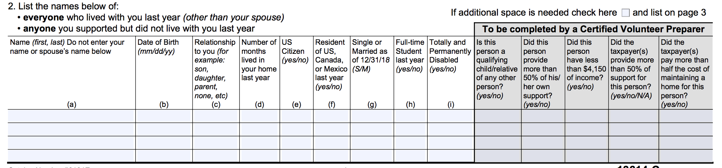
Exemptions
Let’s look at the I/I form:
  During the interview process, you will refer to this part of the I/I form and clarify with the taxpayer to ensure they answered the question correctly.

Slide 36
Personal Exemptions
Taxpayers can claim exemptions for:
  Taxpayer UNLESS the taxpayer can be claimed as a dependent by someone else.
  Spouse UNLESS the spouse can be claimed as a dependent by someone else.

Slide 37
Personal Exemptions
Remember:
It’s not whether the taxpayer IS claimed as a dependent, but whether the taxpayer CAN BE claimed as a dependent that determines whether the taxpayer can claim an exemption.

Slide 38
Personal Exemptions
Let’s look at the I/I form

Slide 39
Dependency Exemptions
Prior to TCJA, each exemption would decrease taxpayer’s taxable income by a certain amount (4,050 in TY 2017)
A taxpayer can claim exemptions for:
  qualifying children
  qualifying relatives
These qualifying individuals usually live in the taxpayer’s home and generally receive significant support from the taxpayer

Slide 40
Dependency Exemptions
Even though taxpayers will not get a certain amount for their dependents, you still need to determine the dependents for other tax benefits (Filing Status, Credits, etc.)

Slide 41
Determining Dependency Exemptions
Open the Publication 4012 to the Exemptions Tab to Table 1: Dependency Exemption
ALWAYS BEGIN WITH THIS CHART TO DETERMINE IF A PERSON QUALIFIES AS A DEPENDENT

Slide 42
Dependency Exemptions
Let’s look at the I/I form:
As you go through the Pub 4012 and ask questions to determine exemptions, answer “Yes/No” in the shaded area.

Slide 43
Qualifying Child or Qualifying Relative?
If no one else can claim the taxpayer or spouse as a dependent, you need to determine if the other people living in the house can be Qualifying Children, and if not see if they can be Qualifying Relatives
Remember: Each exemption will result in possible tax benefits(Nonrefundable and Refundable Credits)

Slide 44
Determining Dependency Exemptions
Always begin with Table 1: Dependency Exemption to determine if a person can be claimed as a dependent:
  If answer is NO in Step 9, then the person is a Qualifying Child
  If answer is YES in Step 9, use Qualifying Child of More Than One Person Table
  If answer is YES in Step 7 AND parents live apart, use Qualifying Child of More Than One Person Table AND Table 3: Children of Divorced or Separated Parents or Parents Who Live Apart
  If answer is NO in Steps 5-7, then use Table 2: Dependency Exemption for Qualifying Relative to see if person is a Qualifying Relative

Slide 45
Qualifying Child:
The Taxpayer Eligibility Test
Step 1 | Can you or your spouse (if filing jointly) be claimed as a dependent on someone else’s tax return this year? | If YES: Stop If NO: Go to Step 2

Slide 46
Qualifying Child:
The Marital Status Test
Step 2 | Was the person married as of December 31st? | If YES: Go to Step 3 If NO: Go to Step 4

Slide 47
Qualifying Child:
The Joint Return Test
Step 3 | Is the person filing a joint return for this tax year? (Answer “NO” if the person is filing a joint return only to claim a refund of income tax withheld or estimated tax paid) | If YES: Stop If NO: Go to Step 4

Slide 48
Qualifying Child:
The Citizenship Test
Step 4 | Was the person a U.S. citizen, U.S. resident alien, U.S. national, or a resident of Canada, or Mexico? | If YES: go to Step 5 If NO: Stop

Slide 49
Note: Taxpayers with ITIN Cards
Remember: Taxpayers receive ITIN numbers if they are nonresidents but need to file a tax return and cannot obtain a SSN
If a taxpayer lived in the United States all year and has an ITIN card, they will be considered a resident alien for tax purposes
A “child” passes the citizenship test in this situation

Slide 50
Qualifying Child:
The Relationship Test
Step 5 | Was the person your son, daughter, stepchild, eligible foster child, brother, sister, half brother, half sister, stepbrother, stepsister, or a descendant of any of them (i.e. your grandchild, niece, or nephew)? | If YES: go to Step 6 If No: Go to Table 2

Slide 51
Qualifying Child:
The Age Test
Step 6 | Was the person: under age 19 at the end of the year and younger than you (or spouse if filing jointly)? OR a full-time student, under age 24 at the end of the year and younger than you (or spouse, if filing jointly)? OR permanently and totally disabled* at any time during the year? | If YES: Go to Step 7 If NO: go to Table 2

Slide 52
“Permanently and Totally Disabled”
A person is considered permanently and totally disabled if he or she cannot engage in any substantial gainful activity because of a physical or mental condition, AND
A doctor determines the condition has lasted or can be expected to last continuously for at least a year or can lead to death

Slide 53
Qualifying Child:
The Residency Test
Step 7 | Did the person live with you as a member of your household, except for temporary absences,* for more than half the year? (Answer “YES” if the child was born or died during the year.) | If YES: Go to Step 8 (Use Table 3 if parents live apart) If NO: go to Table 2

Slide 54
“Temporary Absences”
A child is considered to have lived with you during periods of time when one of you, or both are temporarily absent due to illness, education, business, vacation, military service, or detention in a juvenile facility

Slide 55
Qualifying Child:
The Support Test
Step 8 | Did the person provide more than half of his or her own support* for the year? | If YES: Stop If NO: go to Step 9

Slide 56
Qualifying Child:
The Other Adults Test
Step 9 | Is the person a qualifying child of any other person? | If YES: Go to the chart: QC of More Than One Person If NO: You can claim this child as a dependent.

Slide 57
Dependency Exemptions
When you have asked all of the Pub 4012 questions, the entire section should now be filled out correctly. Don’t forget to change any part the taxpayer may have originally entered incorrectly.

Slide 58
Exercise
TRUE or FALSE:
Every taxpayer can claim a personal exemption for themself.

Slide 59
Exercise – Answer
FALSE
A taxpayer who can be claimed as a dependent by someone else CANNOT claim an exemption for themself.

Slide 60
Exercise
Rebecca is unmarried with one child, Colin. Colin is 8 years old and lives full time with his mother, who provides all of his support. He is a U.S. citizen, and no other adults live in their household. Can Rebecca claim Colin as a dependent?
Use the Publication 4012

Slide 61
Exercise – Answer
YES
Colin meets all the requirements to be claimed as a qualifying child.

Slide 62
Exercise
Paul is a U.S. citizen who is 26 years old, permanently disabled, unmarried, did not pay for more than half of his support and lived with his parents for the entire year.
Can Paul be claimed as a dependent by his parents?
Notes:
‹#›

Slide 63
Exercise – Answer
YES.
Paul meets all the requirements to be claimed as a qualifying child.

Slide 64
Determining Dependency Exemptions
Always begin with Table 1: Dependency Exemption to determine if a person can be claimed as a dependent:
  If answer is NO in Step 9, then the person is a Qualifying Child
  If answer is YES in Step 9, use Qualifying Child of More Than One Person Table
  If answer is YES in Step 7 AND parents live apart, use Qualifying Child of More Than One Person Table AND Table 3: Children of Divorced or Separated Parents or Parents Who Live Apart
  If answer is NO in Steps 5-7, then use Table 2: Dependency Exemption for Qualifying Relative to see if person is a Qualifying Relative

Slide 65
Qualifying Child of More Than One Person
Did any other adult live in your home?
What was that other adult’s relationship to the child?
Could the other adult be
claimed as a dependent
by someone else?
Write these questions under STEP 9 in the Pub 4012!

Slide 66
Qualifying Child of More Than One Person
Sometimes, a child meets all of the tests to be claimed by more than one taxpayer.
  Example: a mother and a grandmother
Parenthood and Adjusted Gross Income(AGI) are taken into consideration in determining who is eligible to claim the child.
This situation is complicated to determine. SEE YOUR SITE COORDINATOR if you believe a child meets all the tests to be claimed by more than one taxpayer

Slide 67
Determining Dependency Exemptions
Always begin with Table 1: Dependency Exemption to determine if a person can be claimed as a dependent:
  If answer is NO in Step 9, then the person is a Qualifying Child
  If answer is YES in Step 9, use Qualifying Child of More Than One Person Table
  If answer is YES in Step 7 AND parents live apart, use Qualifying Child of More Than One Person Table AND Table 3: Children of Divorced or Separated Parents or Parents Who Live Apart
  If answer is NO in Steps 5-7, then use Table 2: Dependency Exemption for Qualifying Relative to see if person is a Qualifying Relative

Slide 68
What if the parents live apart?
The custodial parent generally claims the dependency exemption for his/her child
The noncustodial parent can claim the exemption if the parents have signed an agreement
  Form 8332 (REQUIRED for post-2008 divorce)
This situation is complicated to determine. SEE YOUR SITE COORDINATOR

Slide 69
Determining Dependency Exemptions
Always begin with Table 1: Dependency Exemption to determine if a person can be claimed as a dependent:
  If answer is NO in Step 9, then the person is a Qualifying Child
  If answer is YES in Step 9, use Qualifying Child of More Than One Person Table
  If answer is YES in Step 7 AND parents live apart, use Qualifying Child of More Than One Person Table AND Table 3: Children of Divorced or Separated Parents or Parents Who Live Apart
  If answer is NO in Steps 5-7, then use Table 2: Dependency Exemption for Qualifying Relative to see if person is a Qualifying Relative

Slide 70
Qualifying Relative:
The Qualifying Child Test
Step 1 | Is the person your qualifying child or the qualifying child of anyone else? | If YES: Not a qualifying relative If NO: Go to Step 2

Slide 71
Qualifying Relative:
The Relationship Test
Step 2 | Was the person your son, daughter, stepchild, foster child, or a descendant of any of them? OR Was the person your brother, sister, or a son or daughter of either of them? OR Was the person your father, mother, or an ancestor or sibling of either of them? OR Was the person your half brother, half sister, stepbrother, stepsister, stepfather, stepmother, son-in-law, daughter-in-law, father-in-law, mother-in-law, brother-in-law, or sister-in-law?* | If NO, go to Step 3. If YES, go to Step 4

Slide 72
Relationship Test Notes
The relatives in the Step 2 are considered “relatives who do not have to live with you”
Any of the relationships that were established by marriage are not ended by death or divorce

Slide 73
Qualifying Relative:
The Residency Test
Step 3 | Was the person any other person (other than your spouse) who lived with you ALL YEAR as a member of your household? | If NO: You can’t claim this person. If YES: Go to Step 4

Slide 74
Residency Test Notes
Note that any person who is not one of the relationships in Step 2 MUST live with the taxpayer for all 12 months of year, except for the exceptions below
There are exceptions for:
  kidnapped children
  a child who was born or died during the year
  certain temporary absences – school, vacation, medical care, etc.

Slide 75
Qualifying Relative:
The Gross Income Test
Step 4 | Did the person have a gross taxable income of less than the $4,200? | If NO: You cannot claim this person. If YES: Go to Step 5

Slide 76
Qualifying Relative:
The Support Test
Step 5 | Did YOU provide more than half of the person’s total support for the year? | If YES: You can claim this person as your dependent If NO: Go to Step 6

Slide 77
Qualifying Relative:
Multiple Support Tests
Step 6 | Did another person provide more than half of the person’s total support? | If NO: Go to Step 7
Step 7 | Did two or more people together provide more than half the person’s total support? | If YES: Go to Step 8
Step 8 | Did you provide more than 10% of the person’s total support for the year? | If YES: Go to Step 9
Step 9 | Did the other person(s) providing more than 10% of the person’s total support for the year provide you with a signed statement (Form 2120) agreeing not to claim the exemption? | If YES: You can claim an exemption for this person
This situation is complicated to determine. SEE YOUR SITE COORDINATOR

Slide 78
Exercise
Roderick, age 29, lives with his uncle. Last year, he worked part-time and earned $2,100. His uncle provided for the rest of his support, including rent and household costs.
Can his uncle claim Roderick as a dependent? Can Roderick claim a personal exemption?

Slide 79
Exercise – Answer
YES.
His uncle can claim Roderick as a qualifying relative.
NO.
Roderick cannot claim a personal exemption because he can be claimed as a dependent.

Slide 80
Exercise
Gina Brown provides all support for her uncle. Uncle Jim is unmarried, 72 years old, and lives in another city. He has no gross income for the calendar year. Can Gina claim Uncle Jim as a dependent?

Slide 81
Exercise - Answer
YES.
Jim meets all of the requirements to be
a qualifying relative of Gina.

Slide 82
Filing Status (Part II of I/I form)

Slide 83
Filing Status Objectives
After completing this section, the volunteer will be able to:
  Choose the most advantageous (and allowable) filing status for a taxpayer

Slide 84
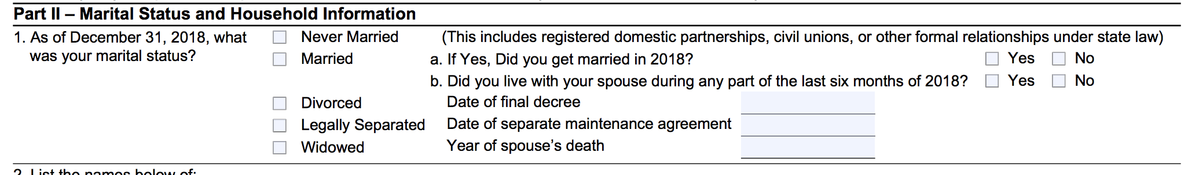
Filing Status
Let’s look at the I/I form
  During the interview process, you will refer to this part of the I/I form and clarify with the taxpayer to ensure they answered the question correctly.

Slide 85
Five Filing Statuses
Single
Married Filing Jointly
Married Filing Separately
Head of Household
Qualifying Widow(er) with Dependent Child

Slide 86
Determining Filing Status
Open the Publication 4012 to the Filing Status Tab to Chart: Determination of Filing Status – Decision Tree, Chart: Filing Status, and Chart: Who is a Qualifying Person Qualifying You To File as Head of Household
ALWAYS USE THESE CHARTS TO DETERMINE A TAXPAYER’S FILING STATUS

Slide 87
Determining Filing Status
Let’s look at the I/I form
  You will refer to this part of the I/I form while asking questions from the Pub 4012. Correct any mistakes the taxpayer made when filling it out.

Slide 88
Single
If on the last day of the tax year (Dec. 31st), the taxpayer was
  Not married OR
  Legally separated/divorced OR
  Widowed
IMPORTANT:
Some taxpayers considered single can also file under a more advantageous status (HoH or QW).
Be sure to check all options!

Slide 89
Married Filing Jointly
If on the last day of the tax year,
  They lived together as a married couple OR
  They lived apart but were not legally separated/divorced OR
  One spouse died during the year, and the taxpayer did not remarry.

Slide 90
Married Filing Separately
Married taxpayers can also file separately; HOWEVER,
  If one spouse itemizes, the other spouse must itemize.
  Taxpayers filing with this status are not eligible to claim several tax credits.
Be careful!
This status generally results in a HIGHER overall TAX.

Slide 91
Why Do Some Choose MFS?
One spouse does not want to be responsible for the other spouse’s tax obligations or filing separately may result in a lower total tax (this is rare)
One spouse wants to avoid an offset of their refund against their spouse’s outstanding debts (child support, student loans, etc.)
Note: Even in these circumstances, there may be other options that allow them to file jointly and not be responsible for these debts (Injured Spouse Form)

Slide 92
Why Do Some Choose MFS?
Note: Sometimes taxpayers must file separately because they are separated and not in communication with their spouse and don’t have the option of filing jointly

Slide 93
Note
If a spouse died during the tax year, and the taxpayer did not remarry, they are considered married for the entire year.
The surviving spouse is eligible to file as MFJ or MFS.
Surviving spouses that remarry must file with the new spouse, as MFJ or MFS.
  The deceased spouse’s filing status becomes MFS.

Slide 94
Head of Household
This is the most complicated filing status to determine, yet it is one of the most common at SaveFirst tax sites
There are two scenarios when a taxpayers can file Head of Household:

Slide 95
Head of Household
Scenario #1: Married Taxpayers
  Must be “considered unmarried”*
  File a separate return from spouse
  Maintain more than half the costs of keeping up a home
  The home is the main home for a dependent child, stepchild, or foster child for more than ½ the year
    Note: A grandchild does NOT meet this test
  The taxpayer claims an exemption for the child

Slide 96
“Considered Unmarried”
    A legally married taxpayer can be considered unmarried if s/he has not lived with the spouse at any time during the last six months of the tax year.

Slide 97
Head of Household
Scenario #2: Single Taxpayers
  Maintain more than half the costs of keeping up a home
  A “qualifying person” lived with the taxpayer for more than ½ the year

Slide 98
Head of Household: Qualifying Person
See
Who Is a Qualifying Person Qualifying You To File as Head of Household
in the
Filing Status Tab of the Pub 4012
for a list of qualifying persons

Slide 99
Head of Household: Qualifying Person
In general, a qualifying child is a qualifying person
  Whether or not the taxpayer claims the exemption
In general, a qualifying relative is a qualifying person if:
  The taxpayer can claim the exemption for the person
  The person meets one of the relationships listed
  The person lives with the taxpayer for more than ½ the year
    Exception: a mother/father who is a qualifying relative does not have to live in the home with the taxpayer

Slide 100
Head of Household: Separated Parents
Even if the custodial parent has given up the right to claim the dependency exemption for a child (Form 8332), they can file Head of Household using that child as their qualifying person
Noncustodial parent can never claim Head of Household
This situation is complicated to determine. SEE YOUR SITE COORDINATOR

Slide 101
Qualifying Widow(er) with Dependent Child
A taxpayer files QW if his/her
  Spouse died recently, AND
  The taxpayer did not remarry, AND
  The taxpayer has a dependent child (son, daughter, stepson, stepdaughter), AND
  The taxpayer provides over half the costs to maintain the main home for taxpayer and the child.

Slide 102
Unmarried, Widowed Taxpayer?
If the spouse died during the current tax year: Married Filing Jointly
If the spouse died during one of the two preceding tax years and taxpayer has a qualifying child: Qualifying Widow(er)
If the spouse died three or more years before the current year: Single or Head of Household

Slide 103
From Lowest to Highest Tax Burden
Married Filing Jointly & Qualifying Widow(er)
Head of Household
Single
Married Filing Separately

Slide 104
Exercise
Lily left her husband in August of the tax year, but they did not get divorced. She took her children with her, supported them during all of the tax year, and will claim them as dependents. Lily refuses to file a joint return with her husband.
Which filing status should she use?

Slide 105
Exercise – Answer
Married Filing Separately.
Because Lily lived with her husband for some part of the last six months of the year, she cannot file as Head of Household.

Slide 106
Exercise
Em left her husband in February of the tax year, but they did not get divorced. She took her children with her, supported them all year, and will claim them as dependents. Em refuses to file a joint return with her husband.
Which filing status should she use?

Slide 107
Exercise – Answer
Head of Household.
A legally married taxpayer can be considered unmarried and file as HoH if he/she has not lived with the spouse at any time during the last six months of the tax year.

Slide 108
Exercise
Lane, a single woman, lives alone. She provides full support for her mother, Theresa, who lives in a nearby town. Since Theresa had no income for the year, Lane paid all costs to maintain her home and will claim her as a dependent.
What is Lane’s filing status?

Slide 109
Exercise – Answer
Head of Household.
A taxpayer can file as Head of Household on the basis of a dependent parent who does not live with him/her only if the taxpayer pays ½ of the costs of keeping up the parent’s home.

Slide 110
Exercise
Brian and Ashley were happily married since 1965. They had no children, but Brian’s brother, who they claim an exemption for, lived with them for the last 10 years. Ashley passed away two years ago. Even after her death, Brian continued to maintain the entire cost for the home and his brother still lived there.
What is Brian’s filing status?

Slide 111
Exercise – Answer
Head of Household.
Brian cannot file as Qualifying Widow(er) with dependent child, because his brother is NOT his dependent child. Even though he is his dependent, he is not Brian’s child.

Slide 112
TaxSlayer – Bella Brown
Login to TaxSlayer
  Vita.taxslayerpro.com/irstraining
  Password: TRAINPROWEB
  Username: DOEJTRAIN (last name, first initial, TRAIN)
  Password: SaveFirstTaxes2019!
Enter filing status, personal information, and dependents

Slide 113
Let’s take a break!

Slide 114
Income (Part III of I/I form)

Slide 115
Income Objectives
After completing this section, the volunteer will be able to:
  Recognize various types of income documents
  Summarize the taxability of each type of income to the taxpayer
  Use I/I form, Scope of Service, Summary Chart to ensure accurate return preparation

Slide 116
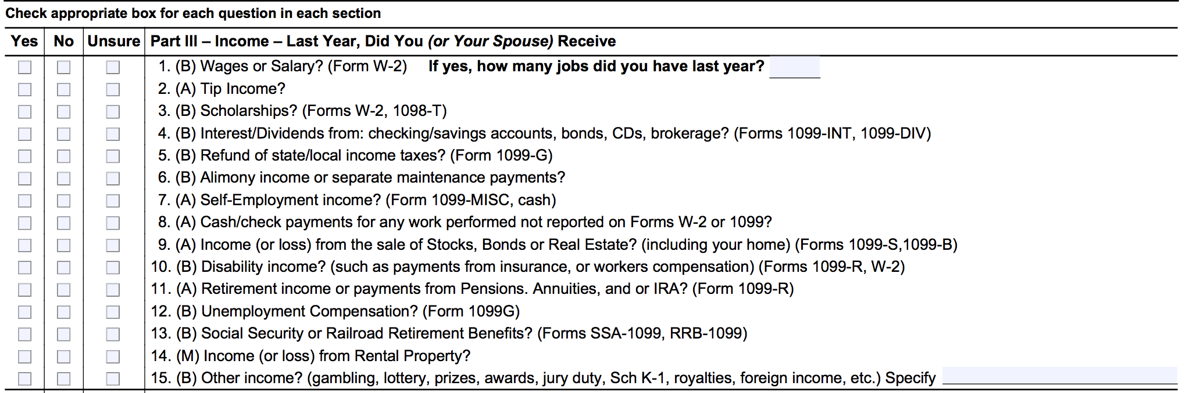
Income
Let’s look at the I/I form:
  During the interview process, you will refer to this part of the I/I form and clarify with the taxpayer to ensure they answered the question correctly. Ask clarifying questions: If they only marked having one type of income, you should ask “Did you have any other types of income? Interest or self-employment? What about Social Security or retirement?”

Slide 117
Income
  All of these boxes must be checked yes or no. Otherwise, the document is incorrectly filled out. If the taxpayer marked unsure, clarify with them what the question is asking and change the checkbox to “Yes” or “No” accordingly.

Slide 118
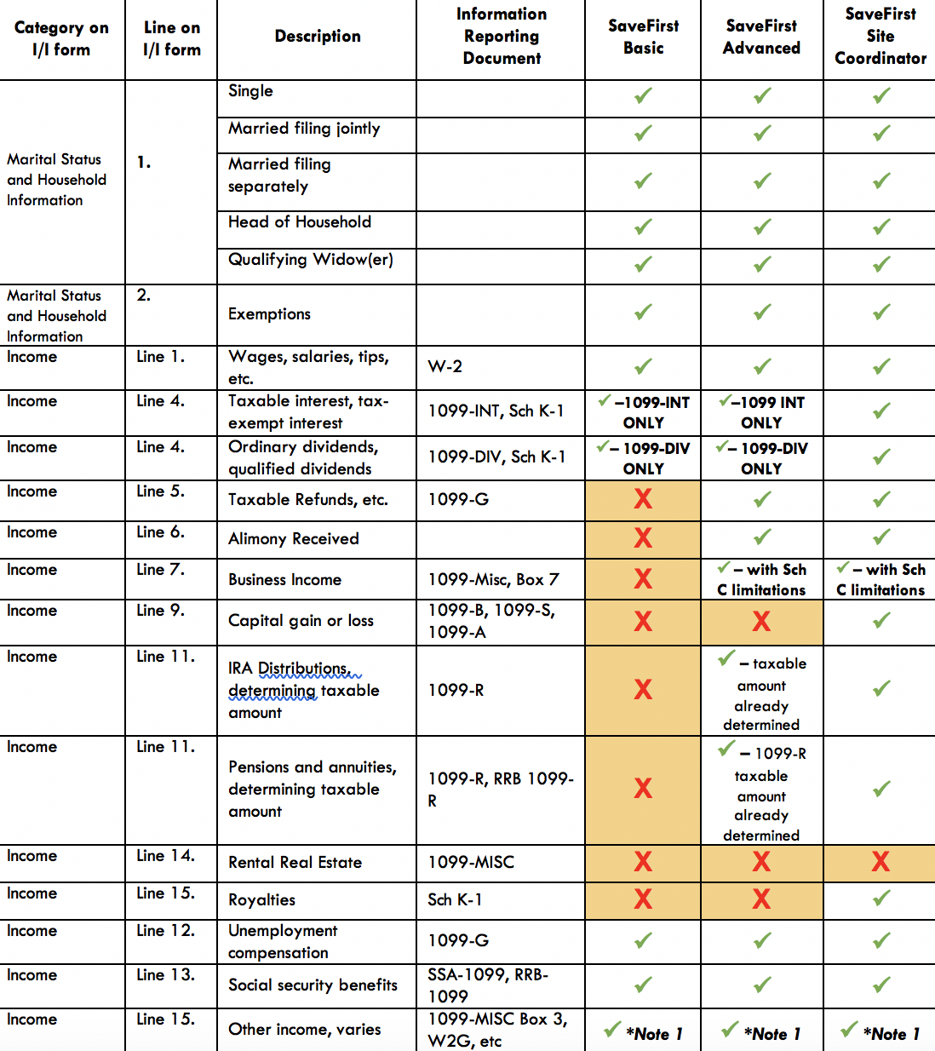
Income
Let’s look at the scope of service chart!
If a form is out of scope for you, just set it aside for your advanced volunteer and make a note on the I/I supplement form.

Slide 119
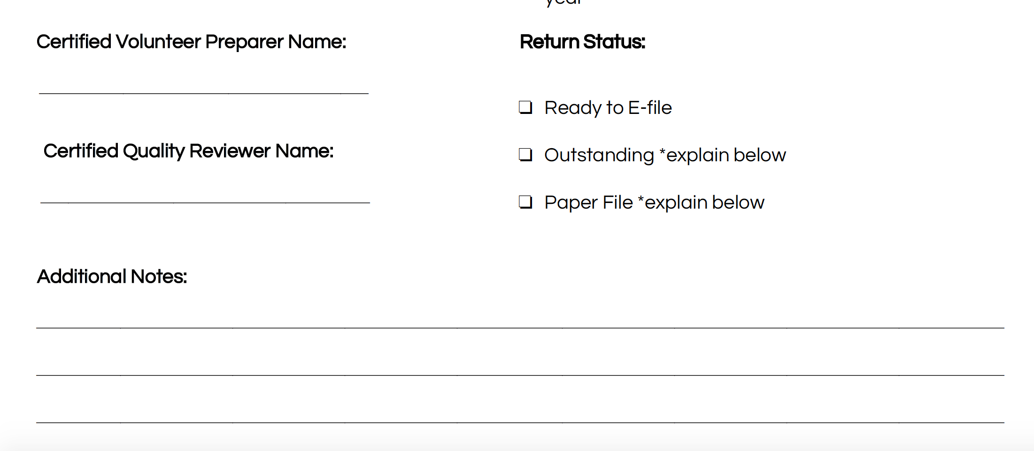
Income
Making notes on the I/I supplement form is crucial!
It lets the quality reviewer know what needs to be entered in addition to the Quality Review
Need to enter: 1099-R and self-employment(1099-MISC box 7)

Slide 120
Taxable Income
Wages
Unemployment Compensation
Some Social Security Benefits
Self-Employment Income
Nonemployee Compensation
Dividends
Interest
Gambling Winnings
Awards
Prizes
Punitive Damages (from a Lawsuit Settlement)
Refund of State Taxes
Jury Duty Fees
Tips
Retirement Annuities
Retirement Pensions
Retirement IRA Distributions

Slide 121
Nontaxable Income
Child Support
Gifts
Life Insurance Proceeds
Other Insurance Payments
Sickness/Injury Payments (Third Party Sick Pay)
Public Assistance Payments
Worker’s Compensation
Veterans’ Benefits
Supplemental Security Income (SSI)
Inheritances
Federal Income Tax Refunds

Slide 122
Taxable & Nontaxable Income
Open the Publication 4012 to the Income Tab to
Income Quick References Guide
for a more complete listing of
taxable and nontaxable income

Slide 123
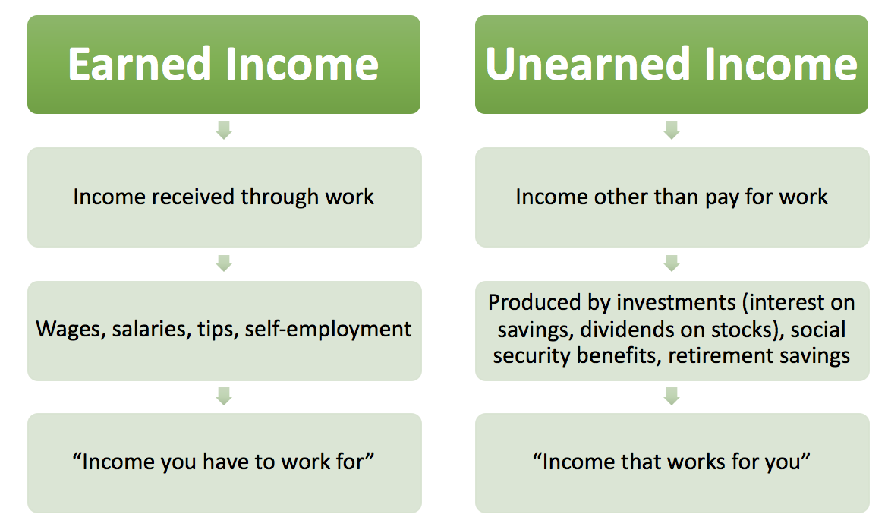
Earned vs. Unearned Income

Slide 124
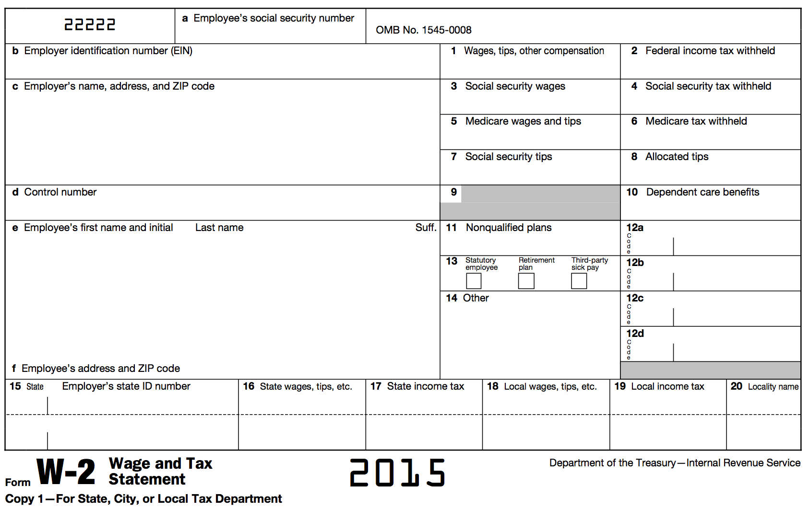
Form W-2: Wage and Tax Statement

Slide 125
Form W-2: Wages, Tips, Other Compensation
Classified as earned income
The federal tax system is a “pay as you go” system, meaning that tax is paid as income is earned during the year
The tax paid is referred to as withholding

Slide 126
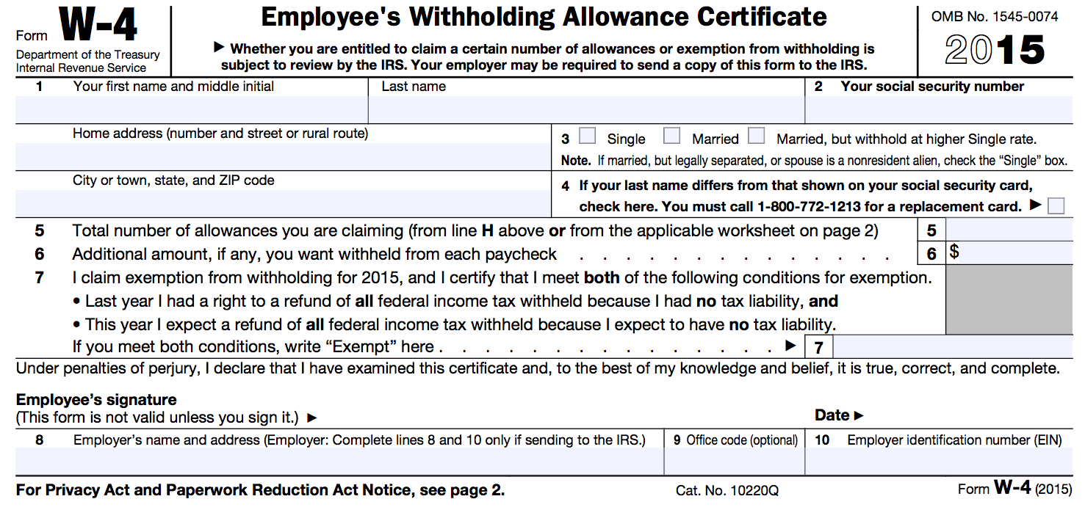
Form W-2: Federal Income Tax Withheld
This amount is determined prior to starting a job by filling out a Form W-4
Personal Allowances
  Single/Married
  Dependents
  Spouse information
  Childcare Expenses
The number of personal allowances listed determines how much federal income tax is withheld from pay

Slide 127
Form W-2: FICA Taxes
Federal Insurance Contributions Act
  Employment tax imposed on employees AND employers specifically to fund Social Security and Medicare programs
  FICA is the part of the Internal Revenue Code that gives the federal government the authority to collect these taxes

Slide 128
Form W-2: Box 12 Codes
In Box 12 reports a variety of amounts with corresponding codes
This information MAY be needed to complete the tax return
Reports information such as:
  401(k) retirement contributions (D)
  Cost of employer-sponsored health coverage (DD)

Slide 129
Form W-2: Box 13
“Retirement Plan” is checked if the taxpayer makes contributions to a retirement plan through the employer
“Third Party Sick Pay” is checked if the amount in box 1 reflects the amount of sick pay paid during the year

Slide 130
Form W-2: Other
Other information is reported in box 14
The information listed is not always clear—even to the taxpayer
There is no standard list of codes, and employers can list any description they choose

Slide 131
Form W-2: Other
Employer may report information such as:
  Union dues
  Health insurance premiums deducted
  Nontaxable income
  Educational assistance payments
  Various types of retirement plan contributions

Slide 132
Form W-2: State and Local Wages, Tax
Reported in boxes 16, 17, 18, and 19
Most states also has an individual income tax, which we will discuss in the B Session
This information will be transferred to complete the state return
Some localities also impose income tax
State wage and tax information will be used to file the appropriate state income tax return (covered in B Session if applicable to your state)

Slide 133
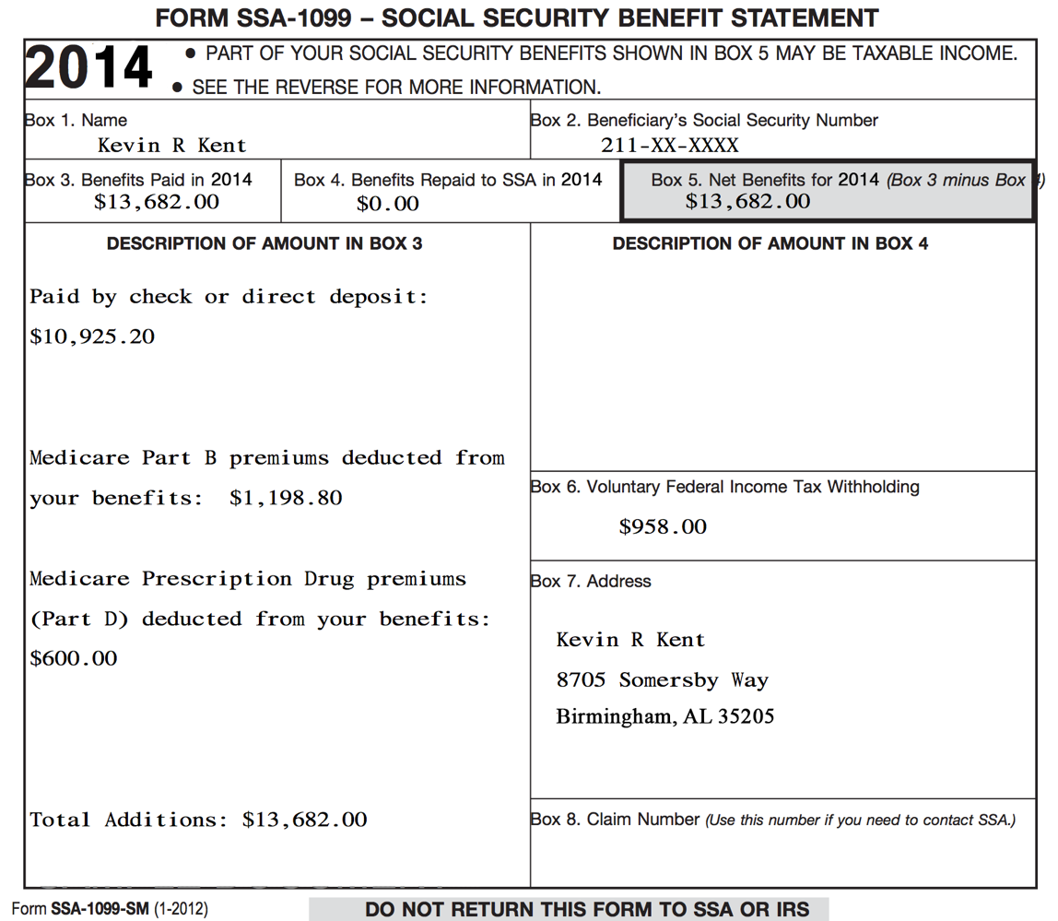
Form SSA-1099:
Social Security Benefit Statement

Slide 134
Form SSA-1099: Social Security Benefits
Social Security benefits include monthly retirement, survivor, and disability benefits
They do NOT include Supplemental Security Income (SSI): aimed at helping low-income elderly, blind, and disabled individuals pay for basic needs
Classified as unearned income

Slide 135
Form SSA-1099: Social Security Benefits
Some portion of the Social Security benefits may be taxable.
  Generally, if Social Security benefits are the only source of income, then they are not taxable.
  Dependent upon filing status and other reportable income
  As the preparer, simply input the SSA-1099 and the software calculates the taxable portion!

Slide 136
Form SSA-1099: Medicare Premiums
Many taxpayers will have Medicare insurance premiums (part B) and/or Medicare prescription drug premiums (part D) deducted from benefits

Slide 137
Form SSA-1099: Voluntary Federal Income Tax Withholding
Taxpayers can choose to have federal income tax withheld from benefits (if taxpayers know their benefits may be partially taxable)

Slide 138
Form SSA-1099: Lump Sum Benefit Payments
Reported in box 3
Some taxpayers may have received a lump-sum benefit payment (for current tax year and prior tax years)
See your site coordinator if a taxpayer received lump-sum benefits

Slide 139
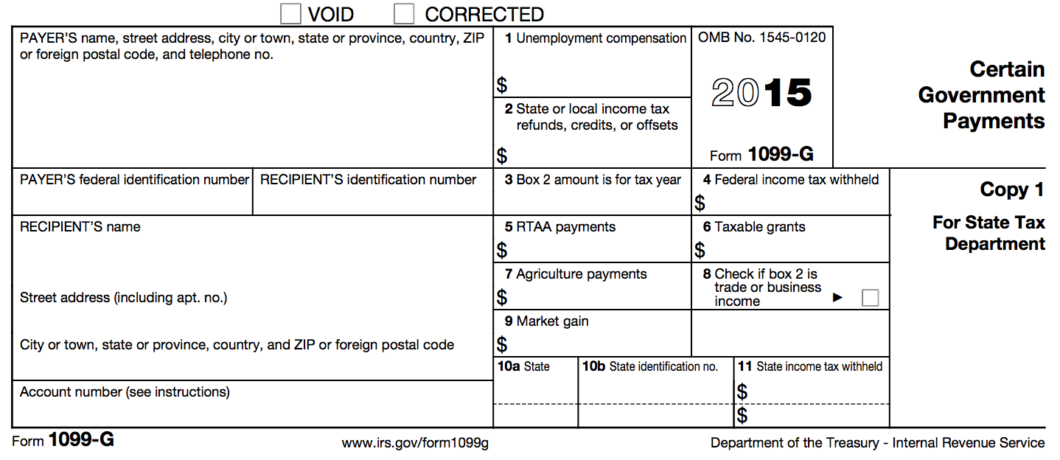
Form 1099-G: Certain Government Payments

Slide 140
Form 1099-G: Unemployment Compensation
Unemployment compensation is fully taxable income
Classified as unearned income
Taxpayers can choose to have federal income tax withheld on unemployment compensation

Slide 141
Prior Year State Tax Refund
If the form has an amount in box 2, the taxpayer may need to report their prior year refund.
Out of Scope for Basic Volunteers
A more advanced volunteer will need to enter the Form 1099-G with an amount in Box 2.

Slide 142
Household Employee Income
If a household employee earns less than $2,000 a year, the employer is not required to issue a Form W-2
However, this income must still be reported on the taxpayer’s income tax return
Classified as earned income

Slide 143
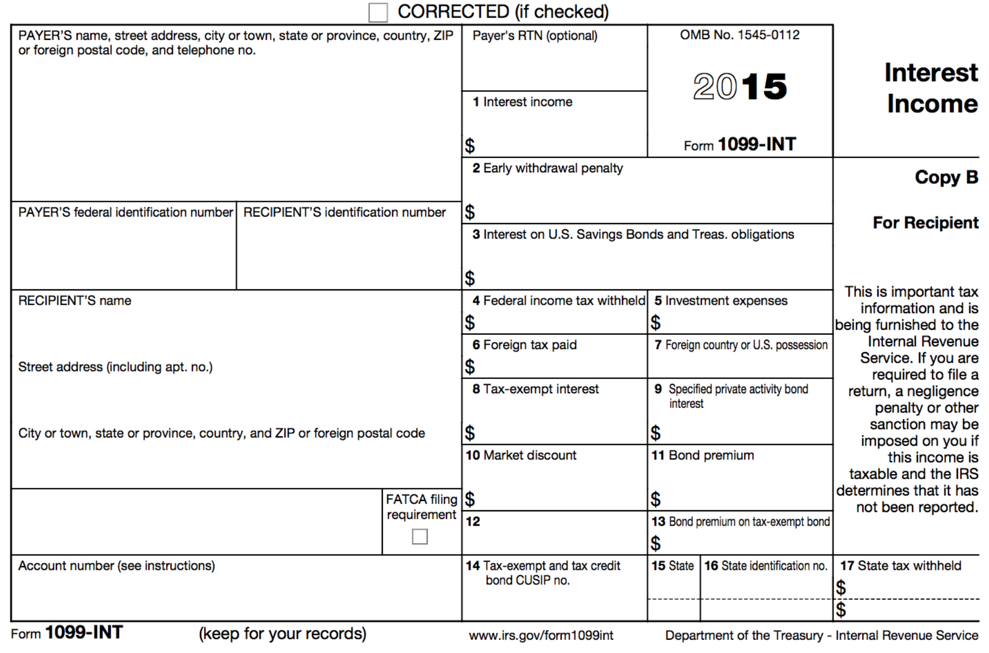
Form 1099-INT: Interest Income

Slide 144
Form 1099-INT: Interest & Interest on U.S. Savings Bonds & Treas. Obligations
Money earns interest when it is:
  Deposited into bank accounts (e.g., savings account)
  Used to buy certificates of deposit (CDs) or bonds
Classified as unearned income
Taxpayer may have had federal income tax withheld in some circumstances

Slide 145
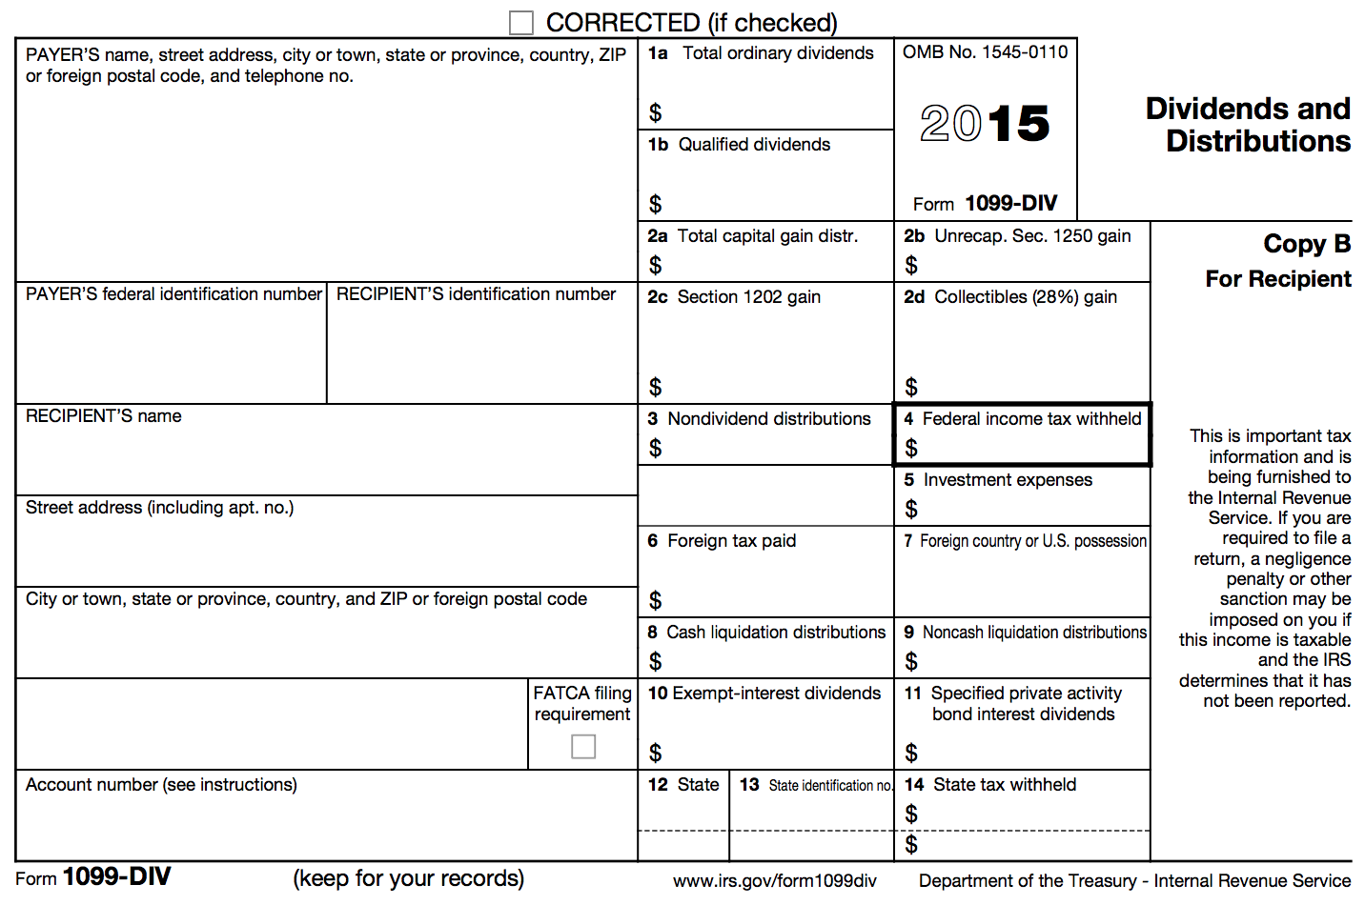
Form 1099-DIV: Dividends and Distributions

Slide 146
Form 1099-DIV: Ordinary and Qualified Dividends
A dividend is a distributions of a portion of a company’s earnings to shareholders
E.g., if a taxpayer has investments in a stock, then dividends paid by the corporation are taxable
Classified as unearned income
Taxpayer may have had federal income tax withheld in some circumstances

Slide 147
Form 1099-DIV: Capital Gains Distributions
Capital gains distributions occur when a taxpayer sells stocks and securities in a mutual fund
Capital gains are taxable!

Slide 148
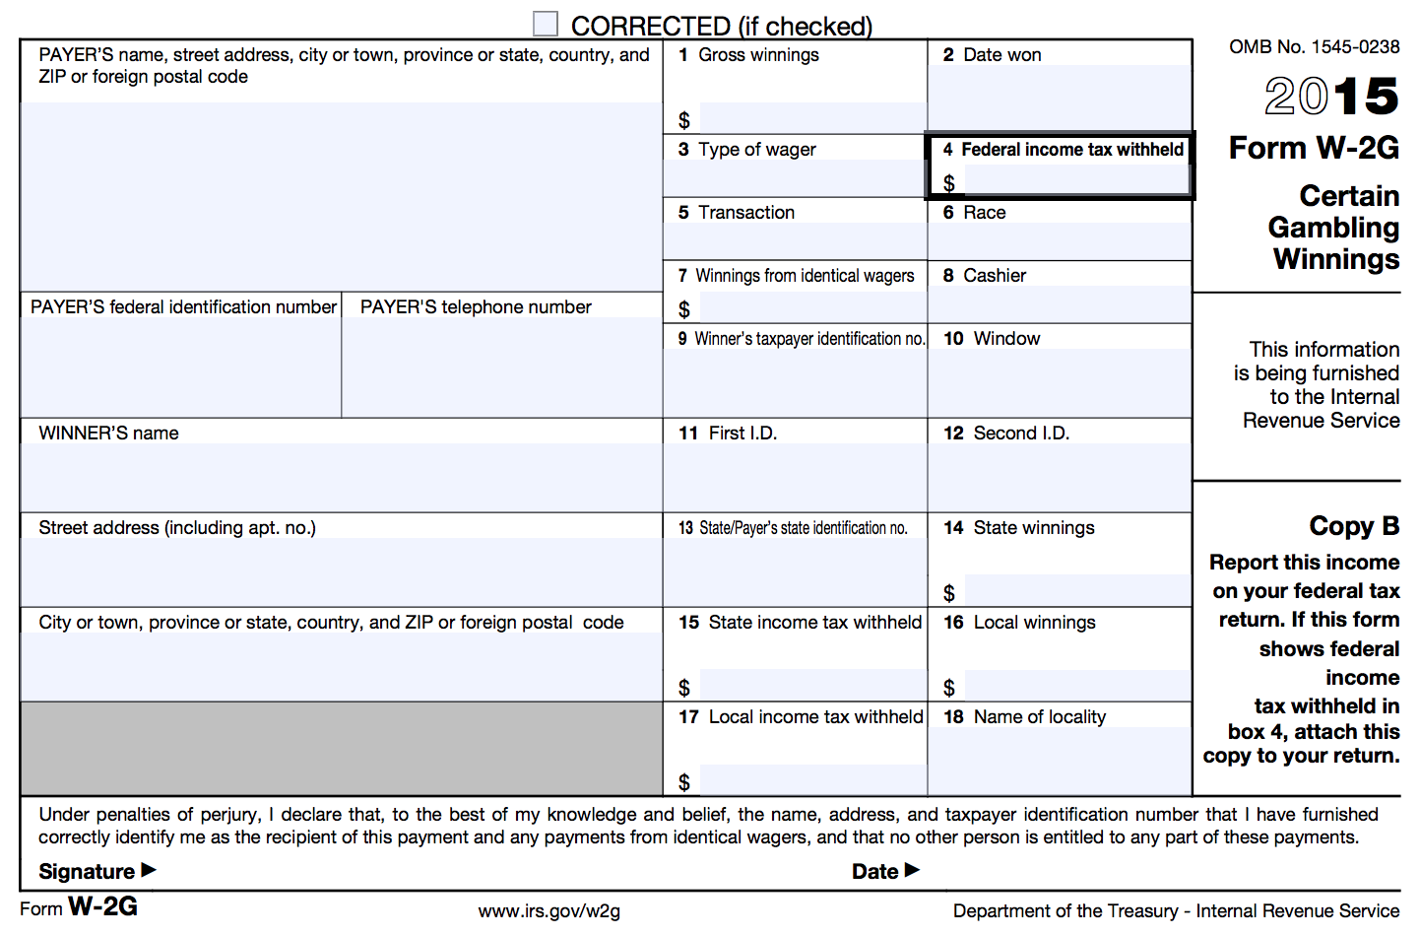
Form W-2G: Certain Gambling Winnings

Slide 149
Form W-2G: Certain Gambling Winnings
A taxpayer may receive one or more Form W2-Gs reporting gambling winnings
Classified as unearned income
Note: If a taxpayer has gambling winnings not reported on a Form W2-G, they must still be reported as income on the tax return

Slide 150
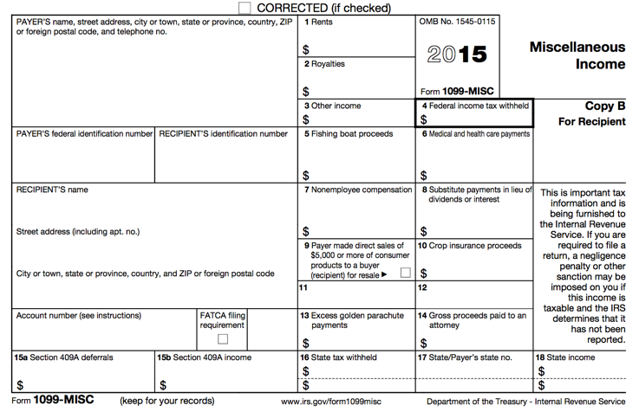

Form 1099-MISC: Miscellaneous Income

Slide 151
Form 1099-MISC: Other Income
Reported in box 3
Other income reported in this box is generally:
  Prizes
  Awards
  Taxable damages (from a lawsuit settlement)
  Other taxable income
Other income in box 3 is classified as unearned income
Taxpayers can choose to have federal income tax withheld on other income in box 3

Slide 152
Form 1099-MISC: Nonemployee Compensation
Reported in box 7
This is business/self-employment income
Out of scope for basic volunteers
A more advanced volunteer will need to enter the Form 1099-MISC with an amount in Box 7.

Slide 153
Out of Scope for Basic Volunteers
Self-Employment/Business Income (including income reported in box 7 of Form 1099-MISC)
Sale of Stock (Form 1099-B)
IRA/Pension Income (Form 1099-R)
Any form of income we did not just cover
Impact America staff or Advanced trained volunteers must prepare these for taxpayers at our sites

Slide 154
TaxSlayer – Bella Brown
Login to TaxSlayer
  Vita.taxslayerpro.com/irstraining
  Password: TRAINPROWEB
  Username: DOEJTRAIN (last name, first initial, TRAIN)
  Password: SaveFirstTaxes2020!
Enter all income (wages, social security, unemployment, interest, dividends, gambling winnings, household employee, jury duty, other income)

Slide 155
Expenses (Part IV of I/I form)

Slide 156
Expenses Objectives
After completing this section, the volunteer will be able to:
  Interpret taxpayer expenses
  Use I/I form, Scope of Service, Summary Chart to ensure accurate return preparation

Slide 157
Expenses
Most things in the “Expenses” category result in tax benefits that can be divided up into the following categories
  Adjustments
  Credits
  Itemized deductions

Slide 158
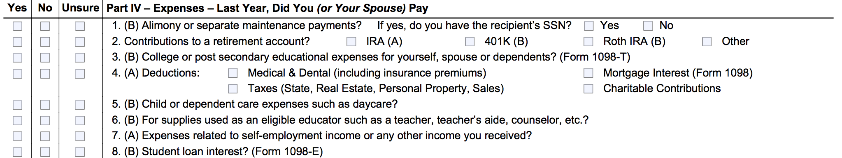
Adjustment
Let’s look at the I/I form: Some of these are adjustments, some are itemized deductions, and some are credits.
  During the interview process, you will refer to this part of the I/I form and clarify with the taxpayer to ensure they answered the question correctly. Ask clarifying questions.

Slide 159
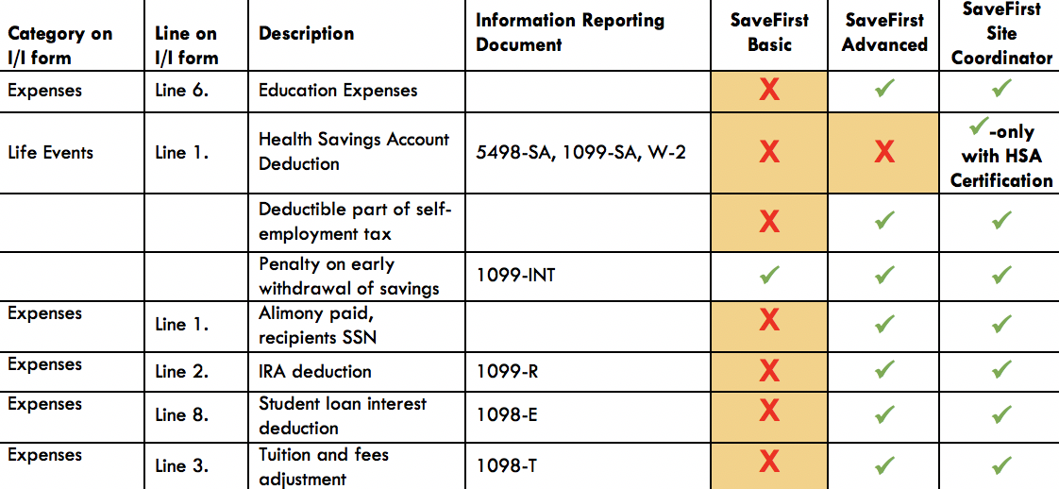
Adjustment
Let’s look at the scope of service chart.
If an adjustment is out of scope for you, just set it aside for your advanced volunteer and make a note on the the I/I supplement form.

Slide 160
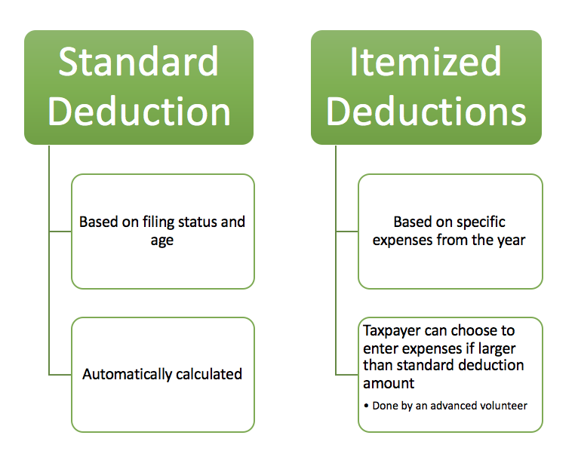
Deduction

Slide 161
Deduction
If a taxpayer has expenses they wish to itemize, an advanced volunteer will have to enter the information.
Based on the filing status and age you input in the software, the standard deduction will automatically calculate and no extra steps need to be taken

Slide 162
Standard Deduction
Reduces amount of income that is taxed
Amount of deduction based on
  Filing Status
  Age
  Whether taxpayer/spouse is blind
  Whether taxpayer is a dependent
Calculated automatically in TaxSlayer

Slide 163
Standard Deduction for Most Filers
Open the Publication 4012 to the Deductions Tab to Exhibit1: Standard Deduction for Most People
This table provides the standard deduction amounts for the current tax year

Slide 164
Itemized Deductions
Instead of taking the standard deduction, a taxpayer can choose to itemize, which is to list certain deductible expenses separately, in order to receive a greater deduction
The new tax law increased the standard deduction by doubling it, so many taxpayers will not itemize on the federal return

Slide 165
Itemized Deductions
Itemized deductions include (but are not limited to):
  Unreimbursed medical expenses
  Charitable contributions
  Home mortgage payments

Slide 166
Itemized Deductions
Let’s look at the I/I form
If the taxpayer has medical expenses, charitable contributions, home mortgage interest, or other itemizable expenses, the itemized deduction might be better than the standard.

Slide 167
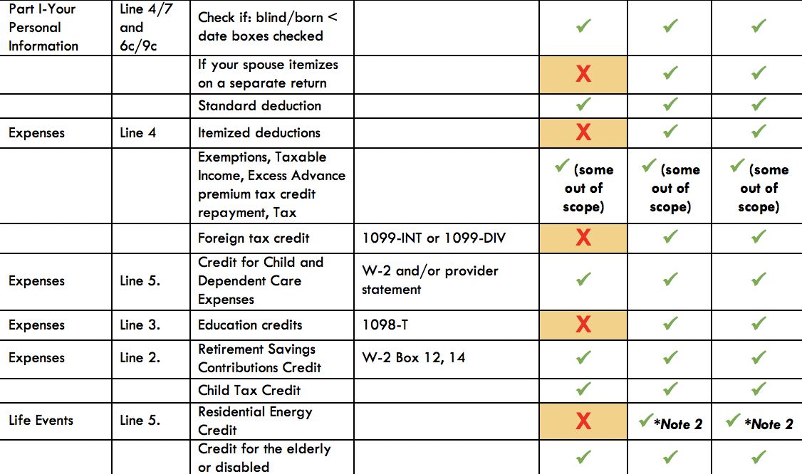
Itemized Deductions
Let’s look at the scope of service chart.
Out of Scope for Basic Volunteers
Impact America staff or Advanced trained volunteers must complete itemization at tax sites

Slide 168
Tax Credit
Direct reduction of the taxpayer’s liability
Two Types of tax credits:
  Nonrefundable credits
  Refundable credits

Slide 169
Nonrefundable Tax Credit
Reduces the tax liability – only to zero.
  Child and Dependent Care Expenses
  Retirement Savings Contribution Credit
  Child Tax Credit and Credit for Other Dependents

Slide 170
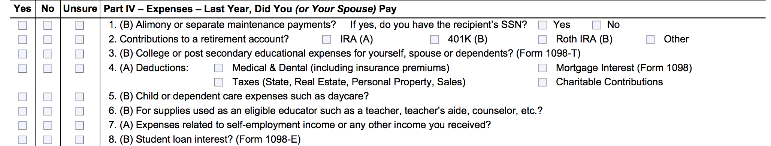
Nonrefundable Tax Credit
Let’s look at the I/I form:
We’ll talk about these credits a little bit later, but if the taxpayer has expenses related to childcare or contributions to a retirement account, it should be marked correctly on the I/I form.

Slide 171
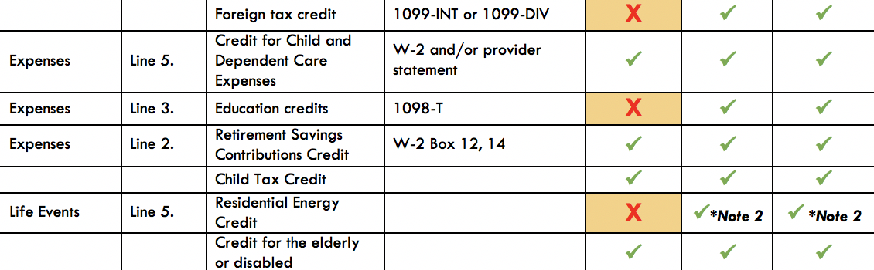
Nonrefundable Tax Credit
Let’s look at the scope of service chart!
If a credit is out of scope for you, just set it aside for your advanced volunteer and make a note on the I/I supplement form.

Slide 172
Child & Dependent Care Expenses Credit
Nonrefundable credit
Applied to offset expenses paid so taxpayer can work or look for work
  Dependent child under 13
  Spouse who is incapable of self-care
  Dependent who is incapable of self-care

Slide 173
Child & Dependent Care Expenses Credit: Eligibility
Care had to be for qualifying persons
Taxpayer (and spouse) must have earned income
  A spouse is treated as having earned income for any month the spouse is physically/mentally incapable of care, or is a full-time student.

Slide 174
Child & Dependent Care Expenses Credit: Eligibility
Expenses must have been for work or to look for work
Payments can’t have been made to taxpayer’s spouse, dependent child or child under 19
Must have care provider’s name, address, and SSN/EIN (due diligence)

Slide 175
Child & Dependent Care Expenses Credit: Qualified Work-Related Expenses
Expenses must be paid for the care of the qualifying person to allow the taxpayer (and spouse) to work or look for work
Care includes the costs of services for the qualifying person’s well-being and protection

Slide 176
Child & Dependent Care Expenses Credit: Qualified Work-Related Expenses
Expenses to attend Kindergarten or a higher grade: NOT AN EXPENSE
Expenses for summer day-camp qualify, but those for over-night camp are not!
$3,000 limit for one qualifying person or $6,000 for two or more qualifying persons.

Slide 177
Child & Dependent Care Expenses Credit:
Notes
If you had expenses that met the requirements for the previous tax year, except that you did not pay them until the current tax year, you may be able to claim them on your tax return.
Taxpayer’s who cannot provide all of the provider’s information or who have incorrect information may still be able to take the credit if they can show they used due diligence in trying to obtain the info.

Slide 178
Child & Dependent Care Expenses Credit: Divorced/Separated Parents
Custodial parent can claim the Child & Dependent Care Expenses Credit, even if he/she did not claim the dependency exemption
This situation is complicated to determine. SEE YOUR SITE COORDINATOR

Slide 179
Exercise
Julie spent the following amounts on child care for her 10-year-old daughter Melissa. Are any of these eligible costs for the Child & Dependent Care Expenses Credit?
$300 for overnight camp
$1000 to her ex-husband for after school-care
$1500 to her mother for after-school care
$500 to her 15-year-old son for babysitting

Slide 180
Exercise – Answer
Julie spent the following amounts on child care for her 10-year-old daughter Melissa. Are any of these eligible costs for the Child & Dependent Care Expenses Credit?
$300 for overnight camp – NO
$1000 to her ex-husband for after school care
$1500 to her mother for after-school care
$500 to her 15-year-old son for babysitting

Slide 181
Exercise– Answer
Julie spent the following amounts on child care for her 10-year-old daughter Melissa. Are any of these eligible costs for the Child & Dependent Care Expenses Credit?
$300 for overnight camp – NO
$1000 to her ex-husband for after school care – NO
$1500 to her mother for after-school care
$500 to her 15-year-old son for babysitting

Slide 182
Exercise – Answer
Julie spent the following amounts on child care for her 10-year-old daughter Melissa. Are any of these eligible costs for the Child & Dependent Care Expenses Credit?
$300 for overnight camp – NO
$1000 to her ex-husband for after school care – NO
$1500 to her mother for after-school care – YES
$500 to her 15-year-old son for babysitting

Slide 183
Exercise– Answer
Julie spent the following amounts on child care for her 10-year-old daughter Melissa. Are any of these eligible costs for the Child & Dependent Care Expenses Credit?
$300 for overnight camp – NO
$1000 to her ex-husband for after school care – NO
$1500 to her mother for after-school care – YES
$500 to her 15-year-old son for babysitting – NO

Slide 184
Child Tax Credit
One credit for each qualifying child under 17 years of age(500 nonrefundable “credit for other dependents”)
A taxpayer can claim a Child Tax Credit for a child only if they CAN AND DO claim a dependency exemption for the child
Nonrefundable credit with a maximum of $2,000 per child(refundable portion limited to $1,400)
  Amount actually claimed depends on taxpayer’s tax liability, MAGI and filing status
  MAGI: typically same as AGI

Slide 185
Child Tax Credit
This is a credit intended to reduce the tax liability owed by the taxpayer, therefore, this part of the credit is nonrefundable
However, the taxpayers may be able to take the Additional Child Tax Credit, which is refundable
The tax software automatically calculates this, but you should be familiar with the rules in case the taxpayer has questions!

Slide 186
Credit for Other Dependents
Credit applies to TY 2018 & subsequent years
There is a $500 credit for all other dependents who do not qualify for the Child Tax Credit.
  QC over 17
  QC with an ITIN
  QR
The dependent in question must:
  Be a U.S. Citizen, U.S. National, or resident of the U.S. AND
  Have a valid identification number (ATIN, ITIN, SSN)
Notes:
The next is the Elderly and Disabled Credit:
The taxpayer must be:
over 65 or
retired on permanent and total disability by the end of the year and did not reach the mandatory retirement age before the year
They should also have received taxable disability income this year
One last thing, the taxpayer needs to keep a physician statement for their records if they claim this credit
Elderly are seldom eligible because of income limits
But Taxwise will automatically calculate the credit on the Schedule R according to what you enter in for social security benefits – so you must link social security benefits from Line 20 (even if you know they are not taxable).

Slide 187
Retirement Savings Contributions Credit: General Eligibility Requirements
A contribution to an IRA or other qualified plan for the tax year
AGI limitations (vary based on filing status)
Age 18 or older
Not claimed as a dependent on someone else’s tax return
Not a full-time student during the tax year

Slide 188



Retirement Savings Contribution Credit: Form W-2

Slide 189
Retirement Savings Contribution Credit: Contributions Record
How do I know if the taxpayer has made a qualifying contribution?
  Form W-2, Box 12 and one of the codes: D, E, F, G, H, S, AA or BB
  Form W-2, Box 14 and codes for military personnel: Q or E
CAUTION: Entries in box 14 that are treated a employer contributions are NOT eligible for the credit

Slide 190
Retirement Savings Contributions Credit: Eligible Contributions
Some retirement distributions reduce the eligible contributions for the credit
In addition to retirement distributions made during the current tax year, the taxpayer must also reduce eligible contributions for distributions taken during the previous two tax years

Slide 191
Exercise
Bob, age 48, contributed $600 to an IRA during the tax year. During the year, he worked full-time and had an AGI of $24,000. He is not a student. Is Bob eligible to claim the Retirement Savings Contribution Credit?

Slide 192
Exercise – Answer
Yes: Bob contributed to an IRA, meets the age and AGI limits, is not a dependent and is not a full-time student.

Slide 193
Refundable Tax Credit
Reduces tax liability to zero
Taxpayer will receive the remainder of the credit value as a refund.
  Earned Income Tax Credit
  Additional Child Tax Credit
  American Opportunity Education Credit

Slide 194
Refundable Tax Credit
Let’s look at the I/I form:
We’ll talk more about these credits later, but if the taxpayer has education expenses, it should be marked correctly on the I/I form. The Additional Child Tax Credit and Earned Income Credit are calculated automatically in the software.

Slide 195
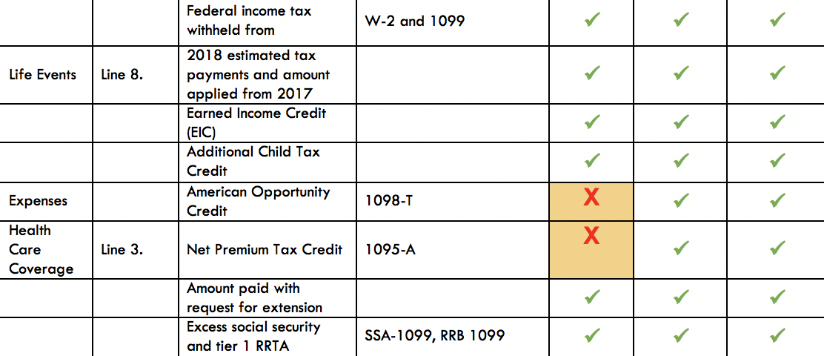
Refundable Tax Credit
Let’s look at the scope of service chart!
If a credit is out of scope for you, just set it aside for your advanced volunteer and make a note on the I/I supplement form.

Slide 196
TaxSlayer – Bella Brown
Login to TaxSlayer
  Vita.taxslayerpro.com/irstraining
  Password: TRAINPROWEB
  Username: DOEJTRAIN (last name, first initial, TRAIN)
  Password: SaveFirstTaxes2020!
Use your summary chart to enter the child and dependent care expenses credit, and check the 1040 for the retirement savings credit.

Slide 197
Reminders
Don’t forget to complete paperwork on your volunteer profile
Please bring your training materials back to the B session.

Slide 198
Sign Up For a Testing Session
Please remember to sign up for a Testing Session! These are optional but can be very helpful if you have questions while taking the test.
To see Testing Sessions available to you:
  Log in to your account at volunteers.generationforchange.org
  Select “Register for a Testing Session (Recommended)”
  Select “Register” for the training session you would like to attend

Slide 199
Volunteer Basic Tax Training
B Session

Slide 200
Training Outline: B Session
Life Events(Part V of I/I form)
Federal Income Tax Process Overview
Filing Basics
Scope of Service Questions
Health Care Coverage(Part VI of I/I form)
State Return(if applicable)
Refundable Credits
  Additional Child Tax Credit
  Earned Income Credit

Slide 201
Training Outline: B Session
Refund/Amount Owed
Tax Preparation Process
  Preparing the Return in TaxSlayer
  Quality Review
  Finishing the Return
  Filing the Return

Slide 202
Training Outline: B Session
Out of Scope Topics
Review: Scope of Service Questions
IRS Exam Practice
Mock Tax Site
Intake/Interview & Quality Review Process
Volunteer Standards of Conduct

Slide 203
Life Events (Part V of I/I form)

Slide 204
Life Events
Most of the events listed will need to be addressed by a more advanced volunteer
Some common ones
  Receive the First Time Homebuyers Credit
  Have Earned Income credit/CTC/Education Credits disallowed in a prior year
  Purchase energy-efficient items

Slide 205
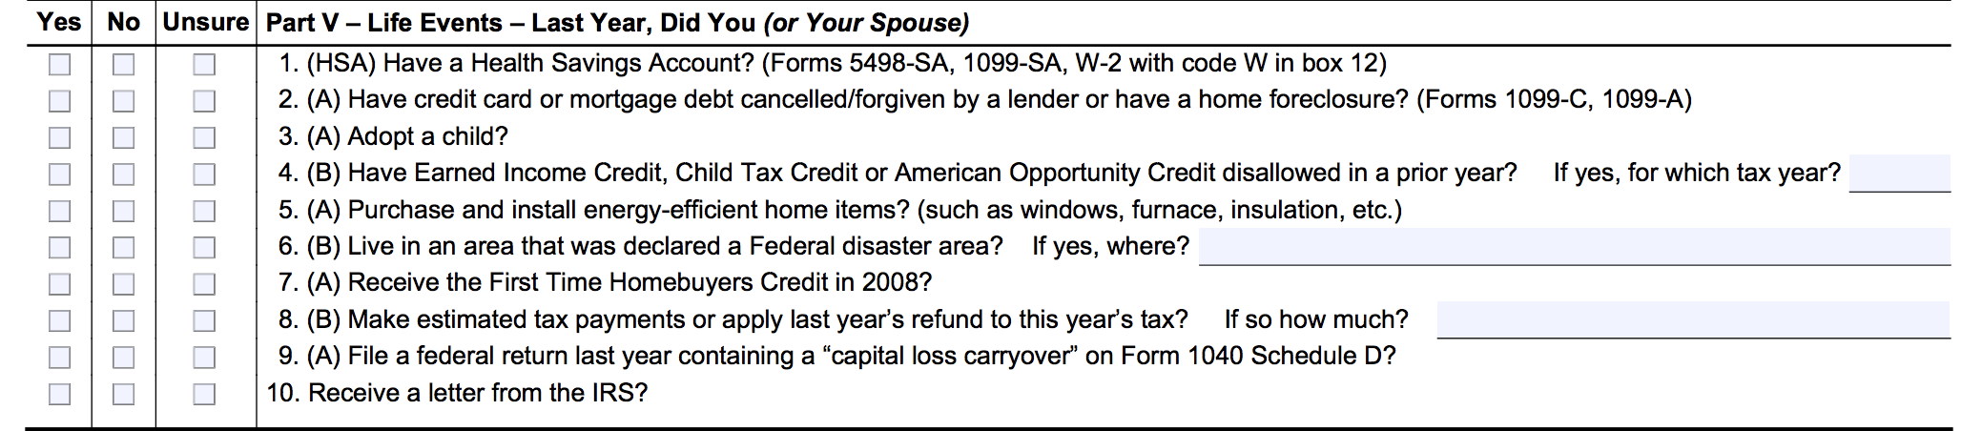
Life Events
Let’s look at the I/I form:

Slide 206
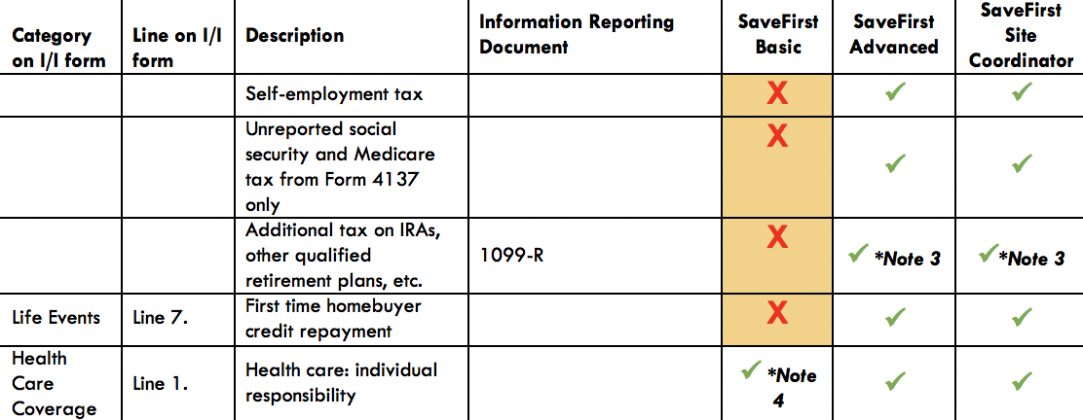
Life Events
Let’s look at the scope of service chart
If something is out of scope for you, just set it aside for your advanced volunteer & make a note on the I/I supplement form.

Slide 207
Federal Income Tax Process Overview

Slide 208
Federal Income Tax Process Overview

Slide 209

TOTAL INCOME
Earned Income

Slide 210

TOTAL INCOME
Unearned Income
Earned Income

Slide 211
TOTAL INCOME
TAXABLE INCOME
after adjustments, and deductions
Unearned Income
Earned Income

Slide 212
TOTAL INCOME
TAXABLE INCOME
after adjustments, and deductions
TAX LIABILITY
Unearned Income
Earned Income

Slide 213
TOTAL INCOME
TAXABLE INCOME
after adjustments, deductions, and exemptions
TAX LIABILITY
Unearned Income
TAX CREDITS(based on exemptions and eligibility)
Earned Income
AMOUNT OWED OR REFUNDED

Slide 214
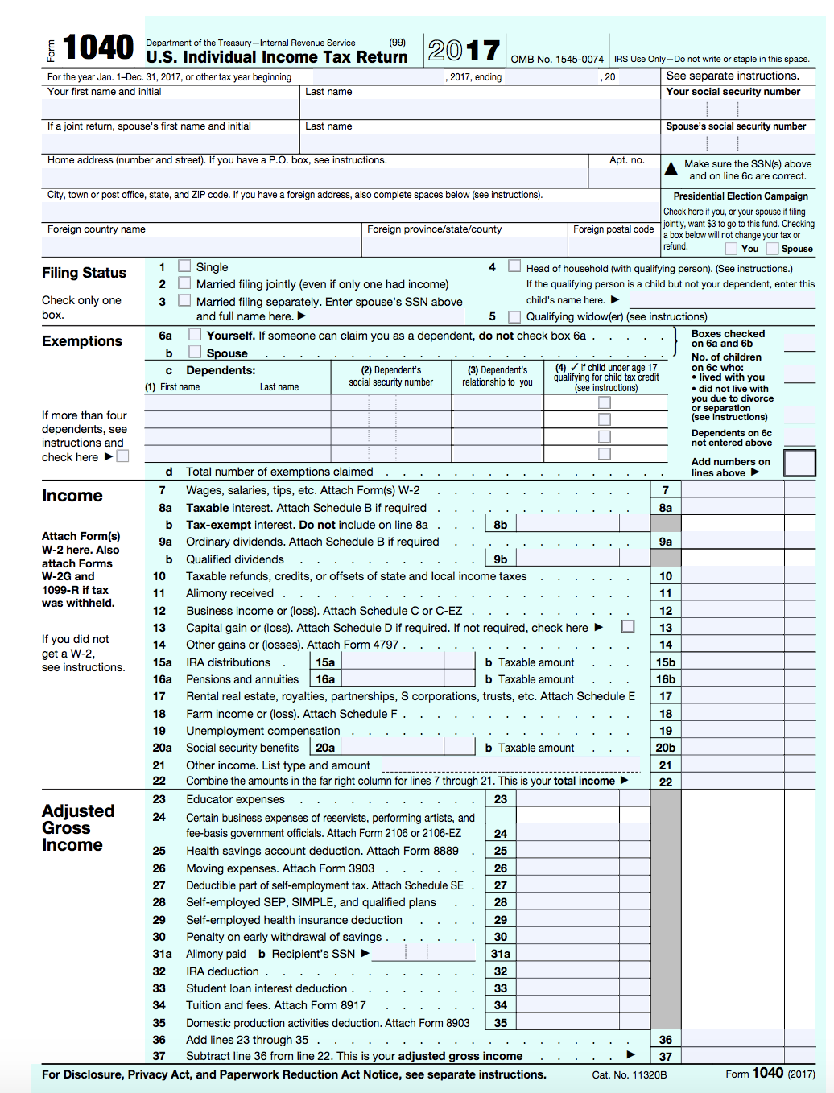
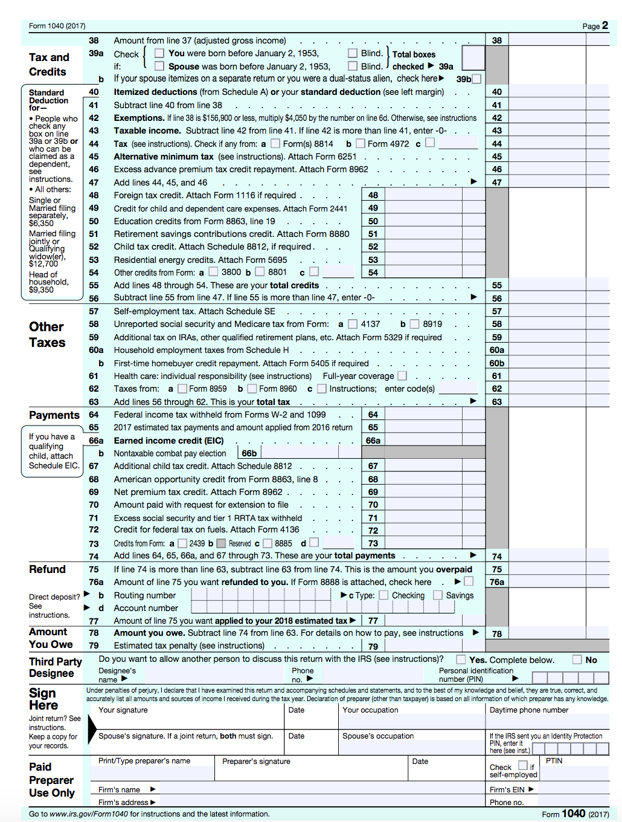

Slide 215
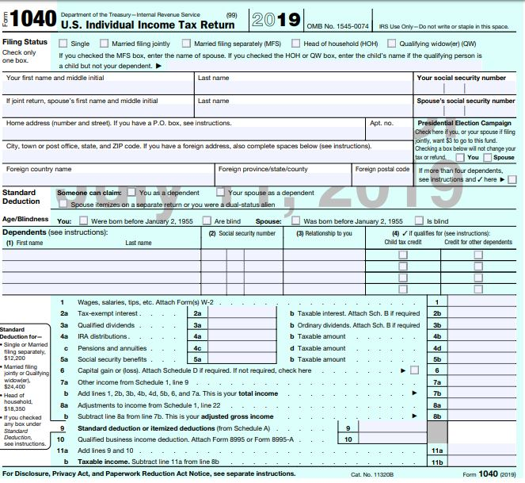
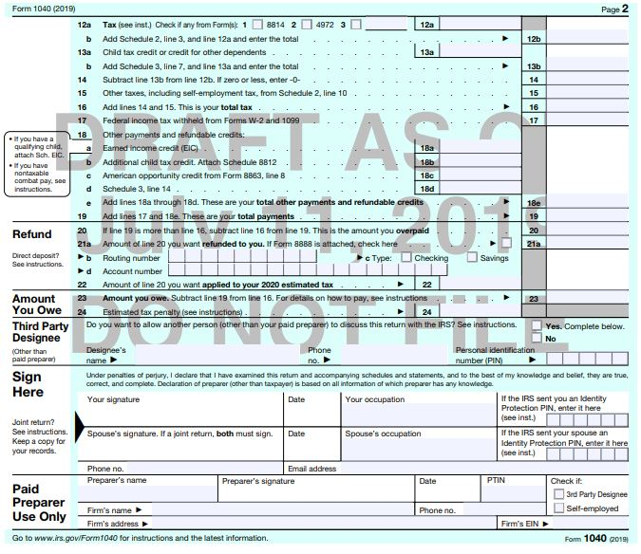
Form 1040-Draft for 2019

Slide 216
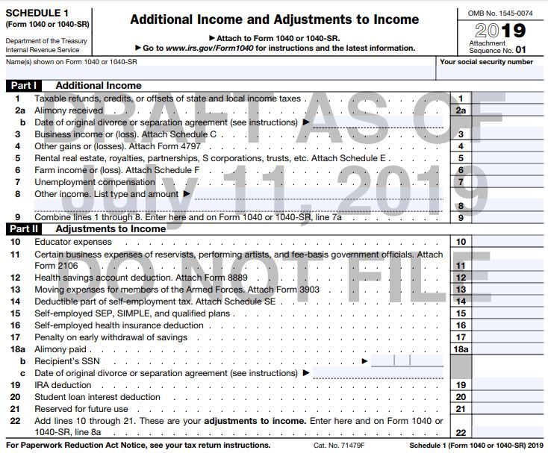
Form 1040-Schedules
Drafts for 2019

Slide 217
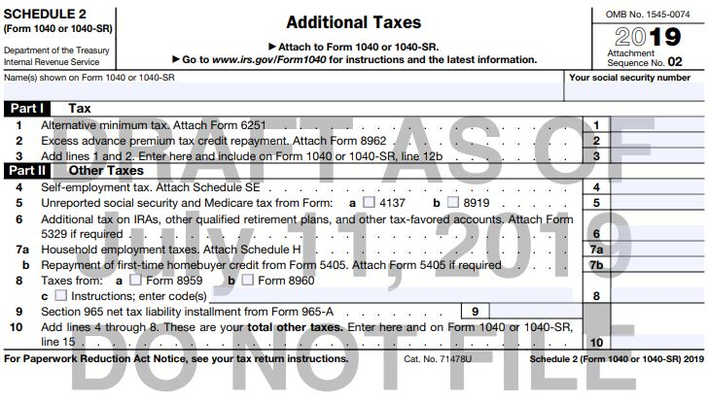
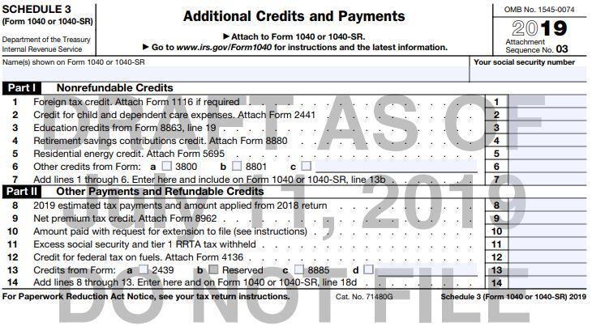
Form 1040-Schedules
Draft for 2019

Slide 218
TaxSlayer – Bella Brown
Login to TaxSlayer
  Vita.taxslayerpro.com/irstraining
  Password: TRAINPROWEB
  Username: DOEJTRAIN (last name, first initial, TRAIN)
  Password: SaveFirstTaxes2020!
Let’s look at the 1040

Slide 219
Filing Basics

Slide 220
Filing Basics Objectives
After completing this section, the volunteer will be able to:
  Verify that a taxpayer is required to file a tax return
  Recommend when a taxpayer should file a tax return, even if not required to

Slide 221
Who Must File?
To decide whether someone must file a tax return, you need to know the individual’s:
  Age
  Gross income (approximate)
    All the income received during the year in the form of money, goods, property and services not exempt from tax (earned and unearned)
    Do not include Social Security unless
      MFS and lived with spouse at any time during year OR
      ½ of Social Security + other gross income and any tax-exempt interest is more than $25,000 ($32,000 if MFJ)
  Filing status

Slide 222
Who is Legally Required to File a Return?
Use Who Must File Tab in the Pub 4012
  Chart A – For Most People Who Must File
  Chart B – For Children and Other Dependents
  Chart C – Other Situations When You Must File
  Chart D – Who Should File

Slide 223
Children & Other Dependents
Refer to Chart B under Who Must File Tab.
If a parent can claim a child as a dependent, the dependent may still need to file a return.
A dependent needs to file a return if earned income is greater than $12,200.

Slide 224
Other Situations When You Must File
Taxpayer owes special taxes
Taxpayer received Health Savings Account distributions
Taxpayer has net self-employment earnings of at least $400
Taxpayer received an advanced premium tax credit to pay for health insurance

Slide 225
Who Should File
Had income tax withheld from pay
Made estimated tax payments
Qualify for the Earned Income Credit
Qualify for Additional Child Tax Credit
Qualify for American Opportunity Credit

Slide 226
Scope of Service Questions

Slide 227
Exercise
Margaret has filled out her I/I form and after the interview you conduct, you conclude she has the following types of income:
Use your scope of service chart!
Wages (W-2)
Interest (1099-INT)
Alimony Income
Retirement (Form 1099-R)
Social Security Benefits (SSA-1099)

Slide 228
Exercise – Answer
Wages (W-2)-
Interest (1099-INT)
Alimony Income
Retirement (Form 1099-R)
Social Security Benefits (SSA-1099)

Slide 229
Exercise
Margaret has filled out her I/I form and after the interview you conduct, you conclude she has the following types of expenses:
Use your scope of service chart!
Supplies for Classroom (She’s a teacher)
Student Loan Interest
Charitable Donations
Prescription Drugs
Penalty on early withdrawal from her savings account(1099-INT)

Slide 230
Exercise – Answer
Supplies for Classroom(She’s a teacher)
Student Loan Interest
Charitable Donations
Prescription Drugs
Penalty on early withdrawal from her savings account(1099-INT)

Slide 231
Health Care Coverage
(Part VI of I/I form)

Slide 232
What is the Affordable Care Act (ACA)?
The federal government, state governments, insurers, employers, and individuals share responsibility for improving the quality and availability of health insurance coverage in the United States
The ACA reforms the existing health insurance market by prohibiting insurers from denying coverage or charging higher premiums because of an individual’s pre-existing conditions.
The ACA also created the Health Insurance Marketplace (also known as www.healthcare.gov)

Slide 233
Shared Responsibility Provision
The Affordable Care Act requires individuals to:
  Have qualifying health coverage, called minimum essential coverage, for each month of the year
  Qualify for a coverage exemption, OR
  Make a shared responsibility payment when filing their federal income tax returns
    This is essentially a tax penalty for not having coverage
    Shared responsibility payment expires starting in TY 2019. Taxpayers will no longer owe a penalty if they don’t have insurance or qualify for an exemption.

Slide 234
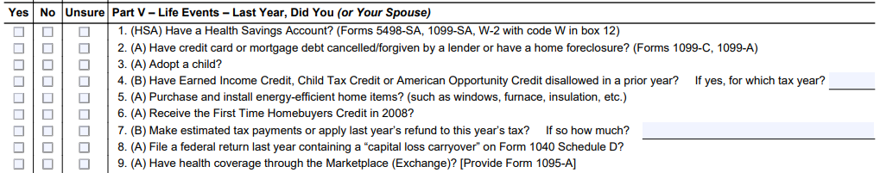
What Qualifies as Minimum Essential Coverage?
As a basic volunteer, you are only allowed to complete the health insurance section in TaxSlayer if the taxpayer had full year coverage all year NOT from the marketplace.

Slide 235
Premium Tax Credit
Note that some taxpayers may be eligible for a refundable tax credit to help pay for health insurance premiums called the Premium Tax Credit.
Any time a taxpayer purchases insurance through the marketplace, they get a 1095-A. A more advanced volunteer must complete the health insurance section.

Slide 236
TaxSlayer – Bella Brown
Login to TaxSlayer
Vita.taxslayerpro.com/IRSTRAINING
  Password: TRAINPROWEB
  Username: DOEJTRAIN (last name, first initial)
  Password: SaveFirstTaxes2020!
Complete the Health Insurance Section

Slide 237
Refundable Credits

Slide 238
Refundable Credits Objectives
After completing this section, the volunteer will be able to:
  Explain how a taxpayer qualifies for the Additional Child Tax Credit
  Assess a taxpayer’s eligibility for the Earned Income Tax Credit

Slide 239
Refundable Tax Credit
Reduces tax liability to zero
Taxpayer will receive the remainder of the credit value as a refund.
  Additional Child Tax Credit
  Earned Income Tax Credit

Slide 240
Additional Child Tax Credit
The Child Tax Credit is intended to reduce the tax liability owed by the taxpayer, therefore, this part of the credit is nonrefundable.
However, the taxpayers may be able to take the Additional Child Tax Credit, which is refundable.

Slide 241
Additional Child Tax Credit
Refundable credit with a maximum of $1400 per child
Amount claimed depends upon meeting general eligibility requirements as well as how much of the nonrefundable Child Tax Credit is claimed
  Cannot claim more than $2000 of CTC and additional CTC combined for one child

Slide 242
Additional Child Tax Credit:
General Eligibility
Meet all the requirement of the Child Tax Credit
  Under 17, U.S. citizen, dependent of taxpayer, qualifying relationship, child did not provide over ½ of own support, lived with taxpayer for more than ½ of year
Must have $2,500 of taxable earned income
  Exception: Taxpayers with three or more children may be eligible regardless of their income

Slide 243
Earned Income Credit
Refundable tax credit for low-to-moderate income workers to encourage work, offset payroll and income taxes, and help meet basic need.
The EIC is the largest federal anti-poverty program and has been one of the most successful programs to lift families, especially families with children, out of poverty.

Slide 244
Earned Income Credit
More than 26 million households received the EIC in Tax Year 2017*
*Source: CBPP, Policy Basics: The Earned Income Tax Credit, 2019

Slide 245
Earned Income Credit
In the tax year 2017, the EIC lifted an estimated “5.7 million people out of poverty, including about 3 million children”
The EIC reduces poverty by supplementing the earnings of low-wage workers and rewarding work.
*Source: The Center for Budget and Policy Priorities

Slide 246
Encouraging Work and Reducing Poverty
Research has also found that children in families who get an income boost from the EIC and CTC quickly show improvements in health and school performance relative to other low-income children who did not receive this extra help
In addition, children whose families receive that boost have higher school test scores, on average, and are more likely to go to college and to work and earn more as adults
*Source: The Center for Budget and Policy Priorities

Slide 247
Earned Income Credit
Critics of the EIC have complained that it is too complex, forcing recipients to seek help in filing their return
Two-thirds get such assistance, most from paid tax preparers
It is our job to provide high-quality tax preparation to ensure these families receive the full amount of the EIC they are eligible for!

Slide 248
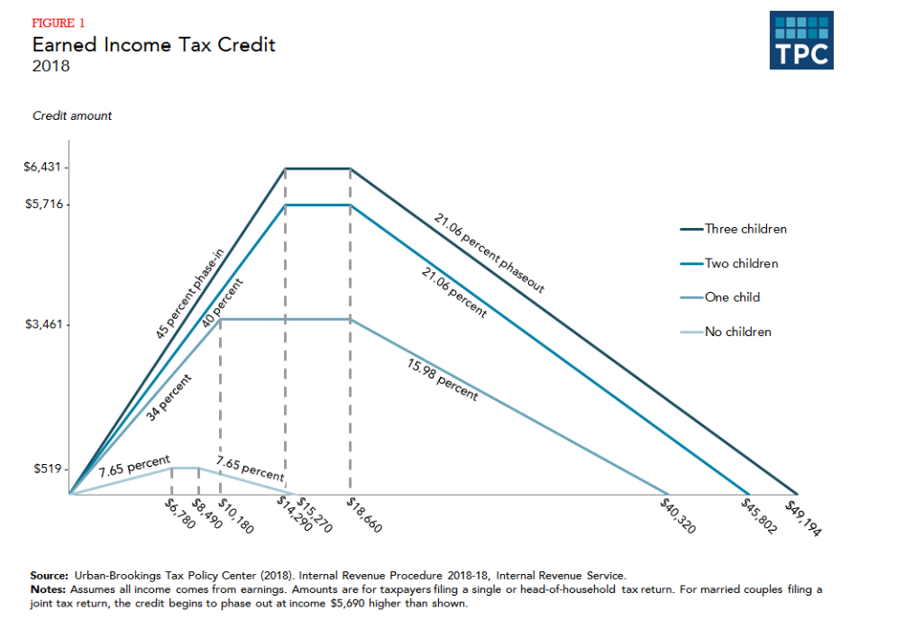
Earned Income Credit: Maximum Credit Amounts
Notes:
Picture thanks to
Tax Policy Center, a joint project of the Urban Institute and Brookings Institution, posted February 12, 2014; accessed July 20, 2015; web; http://www.taxpolicycenter.org/briefing-book/key-elements/family/eitc.cfm

Slide 249
Determining the Earned Income Credit
Open the Publication 4012 to the Earned Income Credit Tab
Use this tab to help determine if a taxpayer qualifies the Earned Income Credit

Slide 250
Earned Income Credit: Eligibility Requirements
Rules for everyone:
  Must have earned income (and AGI has limits)
  Valid SSNs and U.S. citizens/resident aliens
  Not Married Filing Separately
  No foreign earned income
  Investment income less than $3,600
  Taxpayer cannot be qualifying child of another person

Slide 251
Earned Income Credit: Eligibility Requirements
Rules if taxpayer does NOT have a qualifying child:
  Cannot be claimed as a dependent by another person
  Must be at least 25 but under 65 on December 31st of the tax year
  Must have lived in the United States (and spouse, if MFJ) for more than ½ of the year

Slide 252
Earned Income Credit: Eligibility Requirements
Rules if taxpayer has a qualifying child:
  Qualifying child must have a valid SSN that allows him/her to work
  [Relationship Test] Child must be the taxpayer’s:
    son, daughter, stepchild, eligible foster child
    brother, sister, half brother, half sister, stepbrother, stepsister, or descendent of any of them

Slide 253
Earned Income Credit: Eligibility Requirements
Rules if taxpayer has a qualifying child:
  [Age Test] Child must be
    Under age 19 at the end of the tax year, OR
    Under age 24 and a full-time student at the end of the tax year, OR
    Any age and permanently and totally disabled

Slide 254
Earned Income Credit: Eligibility Requirements
Rules if taxpayer has a qualifying child:
  [Joint Return Test] Qualifying child must not have filed a joint return for the tax year
    Unless the child only filed a joint return with spouse to claim a refund
  [Residency Test] Must have lived with the taxpayer for more than ½ the year
  Must not be the qualifying child of another person

Slide 255
Earned Income Credit: Eligibility Requirements
Note: Just because a person qualifies as the dependent of the taxpayer does not mean they automatically make the taxpayer eligible for the EIC
Child in question must meet the age, relationship, residency, and joint return tests to qualify (therefore, Qualifying Children always meet requirements, HOWEVER, Qualifying Relatives DO NOT)

Slide 256
Earned Income Credit: Qualifying Child of More than One Person
Sometimes, a child meets all of the tests to be claimed by more than one taxpayer.
A child cannot be used by more than one person to claim the EIC.
The rules for determining who claims the child for EIC are the same as those for determining who claims the the child as a dependent.
If this situation arises, please see your Site Coordinator

Slide 257
Earned Income Credit: Disallowance
EIC can be disallowed for
  Reckless or intentional disregard of the rules: 2 years
  Fraudulent Claim: 10 Years
To claim EIC again, a taxpayer must
  Wait full period of disallowance
  Submit a Form 8862 with the tax return
If this situation arises, please see your Site Coordinator

Slide 258
Exercise
Sharon, who has an earned income and AGI of $15,625, takes care of her sister’s son, Eric. If Eric is 12 years old and began living with Sharon in August, can Sharon claim the EIC?

Slide 259
Exercise – Answer
No
Sharon’s AGI is too high to claim the EIC alone, and since Eric lived with her for less than half a year, he is not her qualifying child

Slide 260
Exercise
Doug and Donna are married and live together with their 4-year-old son Sam. Their combined earned income is $25,000, but they file separately. Doug reports an AGI of $11,000 on his return, and Donna reports AGI of $14,000.
Can Doug and/or Donna claim the EIC?

Slide 261
Exercise – Answer
No
Neither can claim the EIC because both have a filing status of Married Filing Separately

Slide 262
Example
Doug and Donna are still married and still live together with Sam, but now they decide to file a joint return. Their combined earned income and AGI are $25,000. Can they claim the EIC on this return?

Slide 263
Example – Answer
Yes
Their joint income is low enough to claim the EIC with one qualifying child (Sam)

Slide 264
Example
Tom is 64 years old, retired and collected $10,000 of social security during the tax year. He does not have any qualifying children.
Can he claim the EIC on his return?

Slide 265
Example – Answer
No
Tom does not have any earned income

Slide 266
Earned Income Credit
The software automatically calculates the amount of this credit.
You just need to be familiar with the rules if the taxpayer has questions!

Slide 267
TaxSlayer – Bella Brown
Login to TaxSlayer Vita.taxslayerpro.com/IRSTRAINING
  Password: TRAINPROWEB
  Username: DOEJTRAIN (last name, first initial,TRAIN)
  Password: SaveFirstTaxes2020!
EIC pulls through to 18a on the 1040-2019 draft

Slide 268
Refund & Amount of Tax Owed

Slide 269
Refund & Amount of Tax Owed Objectives
After completing this section, the volunteer will be able to:
  Explain the taxpayer’s options when receiving a tax refund
  Explain the options available to a taxpayer that has tax due

Slide 270
Refunds
Taxpayers can choose to receive their refund either by check or direct deposit.
Checks take 6-8 weeks to be mailed.
Electronic deposits will be made in 1-2 weeks.
Taxpayers can also choose to allocate part of their refund to order savings bonds.
Notes:
‹#›

Slide 271
Refunds: Direct Deposit
Encourage taxpayers to use direct deposit
  But, refunds will be delayed 4-6 weeks if the routing and account numbers are not valid.
Refunds may only be deposited into their own accounts.
Refunds can be deposited in up to three accounts.

Slide 272
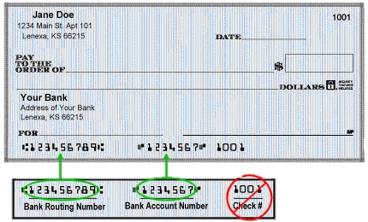
Refunds: Direct Deposit
Routing number (9 digits): can look up online
Account number: do not include check number!
Do NOT include spaces or hyphens!

Slide 273
Refunds: Electronic Deposit
If a mistake is made that increases the amount of the refund, the IRS will send a letter explaining the changes in the adjustment.
If a taxpayer owes debts (child support or student loans), the IRS will decrease the refund after the return is e-filed.
  Encourage taxpayers to still E-file
  We do not have access to any of this information!
Notes:
‹#›

Slide 274
Refunds: Savings Bonds
Our Role
  Explain opportunity - describe savings bonds & chance to order at tax site
  Seek decision – ask client to decide if, how much & for whom to order bonds
  Process order – complete IRS Form 8888
The Government will mail a physical bond to the taxpayer at the address listed on the return.

Slide 275
Refunds: Savings Bonds
All taxpayers can buy bonds for
  Themselves
  And/or 2 other people (kids, grandkids, spouses, nieces/nephews, godchildren, etc.)
How it works
  Taxpayer needs only name of gift recipient
  Client & gift recipient will be listed on bond as co-owners
  Either party may redeem bond

Slide 276
Tax Due
Payment in full is due by the April filing due date, to avoid interest and penalties
Taxpayer should file his/her return by the April filing date to avoid a failure-to-file penalty
There are separate penalties for filing late and paying late – the late filing penalty is higher

Slide 277
Tax Due
Advise taxpayers to file the return on time, even if they cannot pay the full amount owed.
Pay as much as possible by the due date to reduce penalties and interest.
Once taxpayers receive a notice, they can pay the remaining amount in full or choose another payment option.

Slide 278
Tax Due
Payment options available at SaveFirst site:
  Pay by check or money order with Form 1040-V (Payment Voucher)
  Pay by direct debit from their checking/savings account on a date that they choose (up to the due date)
Notes:
‹#›

Slide 279
Tax Due
Payment options (on their own):
  Pay with a credit or debit card (convenience fee)
  Electronic Federal Tax Payment System (EFTPS)
    Taxpayers can use EFTPS to file taxes, but they must enroll first (www.irs.gov/e-pay)
  IRS Direct Pay
    Free, one-time payment system offered through IRS.gov
Notes:
‹#›

Slide 280
Tax Due: What if the Taxpayer Cannot Pay?
Apply online for a payment agreement (on their own)
  Taxpayer can apply online for a payment agreement by going to IRS.gov and searching for “Online Payment Agreement” or “OPA”

Slide 281
Tax Due: Undue Hardship
Taxpayers who can show they will have a substantial financial difficulty if they pay their tax on the due date are considered to have undue hardship.
Can request an extension by filing Form 1127 (out of scope) by the due date
  Advise them to visit or call the local IRS office
Undue hardship is MORE than inconvenience!

Slide 282
Tax Due
To avoid having tax due next year:
  Adjust withholding on Form W-4 (from employer)
    Taxpayers should submit a revised form when there is a change in life events (marriage, child, etc.)
  Make quarterly estimated tax payments
  Use withholding calculator in irs.gov
Notes:
‹#›

Slide 283
Tax Preparation Process

Slide 284
Tax Preparation Process
Part 1: Preliminary Interview
Part 2: Preparing the Return in TaxSlayer
Part 3: Quality Review
Part 4: Finishing the Return
Part 5: Filing the Return

Slide 285
Tax Preparation Process
When you arrive at the site on your first day, you’ll need to show your photo ID to the Site Coordinator
They will then check your volunteer certification in the VMS system to make sure you’ve completed all the steps.
You will get a nametag specific to your certification level.
  Basic Volunteers-Green Badge
  Advanced Volunteers-Blue Badge

Slide 286
Tax Preparation Process
Your first day at the tax site, partner up with another volunteer!
You will feel so much more confident once you get through that first return!
If you have some down time during your first day, ask the Site Coordinator if you can watch a return being completed by another volunteer.

Slide 287
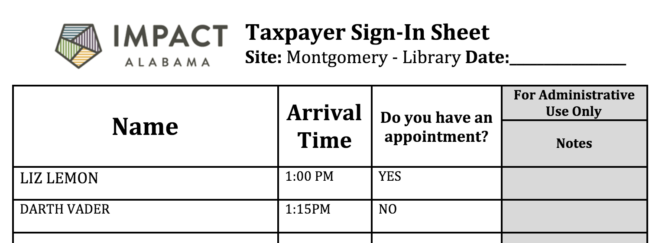
Tax Preparation Process
Taxpayer Sign-In Sheet
  We prioritize appointments over walk-ins!
  Your site coordinator will have the schedule printed next to the sign-in sheet
  When you start a return with a taxpayer, make sure to highlight them off the sign-in sheet AND the appointment schedule!

Slide 288
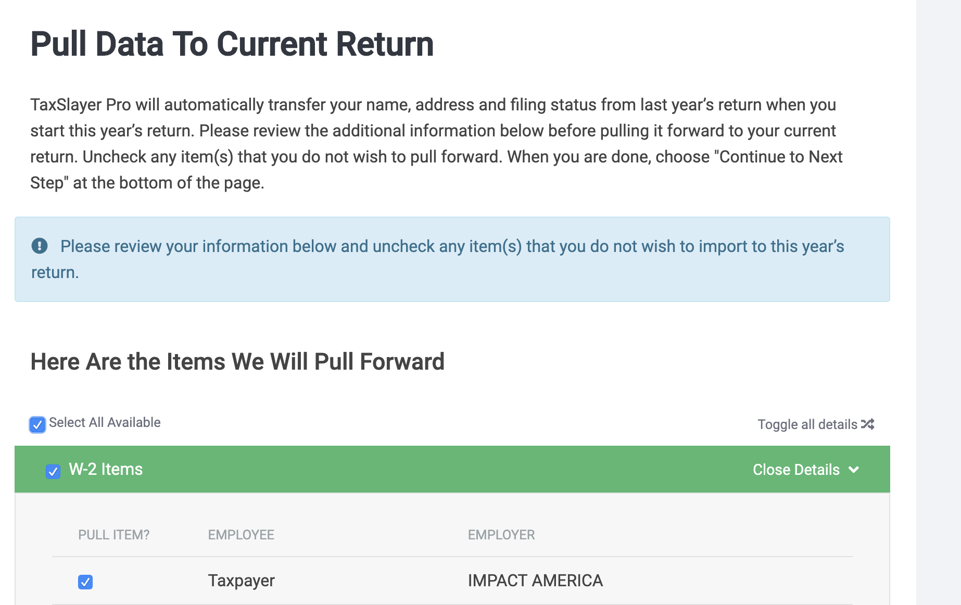
Tax Preparation Process
Helpful tip:
When you enter a returning taxpayer’s SSN, you will see a message asking if you want to pull forward info from a prior year…...

Slide 289
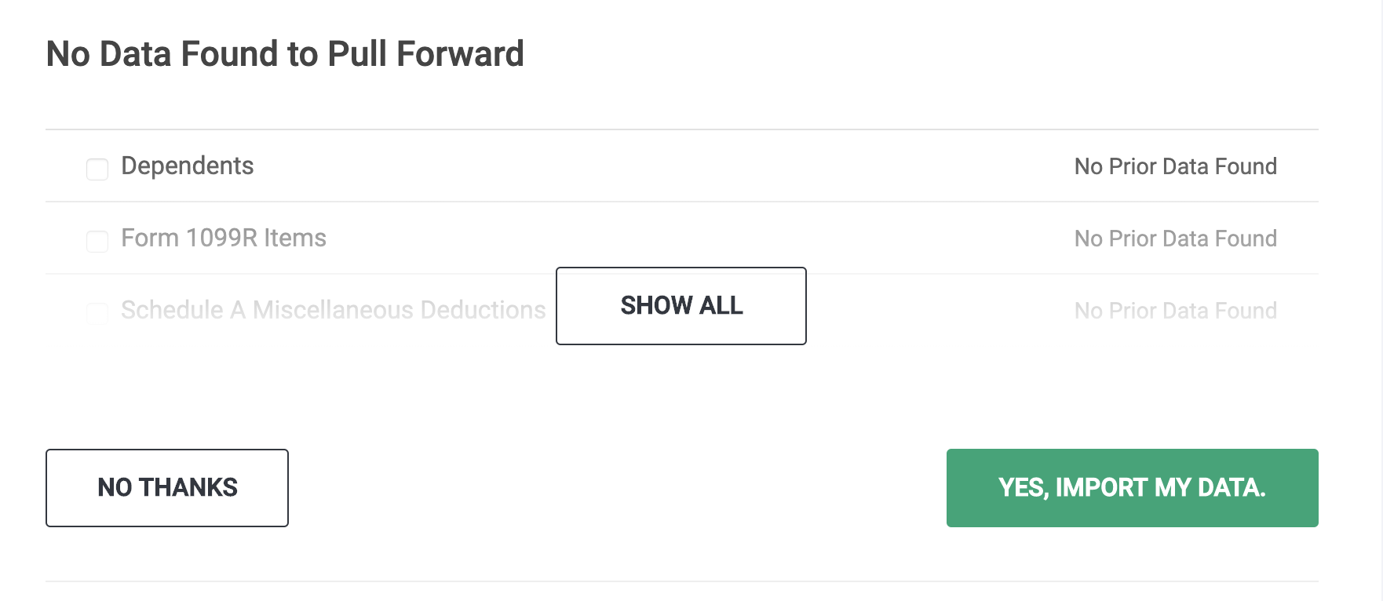
Tax Preparation Process
Helpful tip:
Always select “No Thanks”
We never want to import data from a prior year! It increases likelihood of erroneous entries!

Slide 290
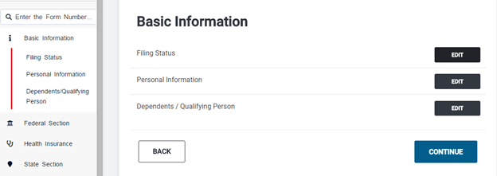
Part 2: Preparing the Return in TaxSlayer
Complete the Filing Status, Personal Information, and Dependents.
**Reminder: Always type in ALL CAPS**

Slide 291
Part 2: Preparing the Return in TaxSlayer-TaxSlayer Logins
You will have a different username for every site location
  DOEJSMITHFIELD
  DOEJWESTEND
  DOEJEDRICE
It is very important you use the correct username for the site you are preparing returns!
If you are logged in to the wrong software, the return could get lost!

Slide 292
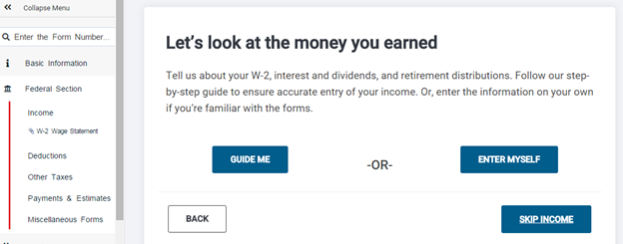
Part 2: Preparing the Return in TaxSlayer
Click “Enter Myself” on the Income page

Slide 293
Part 2: Preparing the Return in TaxSlayer
Complete the income section, deductions section, the health insurance section, the State section (if applicable).
Complete the forms: Gen Use, Gen Disclosure and Prep Use
Select the type of return and enter the bank account information.
Review the entire return and take care of any diagnostic errors.

Slide 294
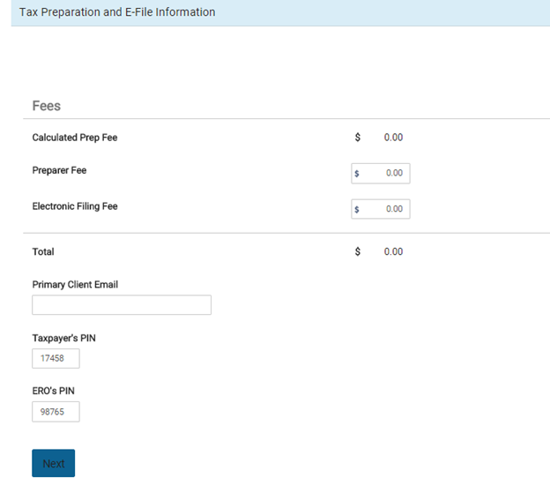
Part 2: Preparing the Return in TaxSlayer – Taxpayer and Spouse PIN
Ask the taxpayer if they are willing to give us their email so we can send them a reminder next year!
In the PIN section, have each taxpayer enter a 5-number pin.
This authorizes us to e-file for the taxpayer!

Slide 295
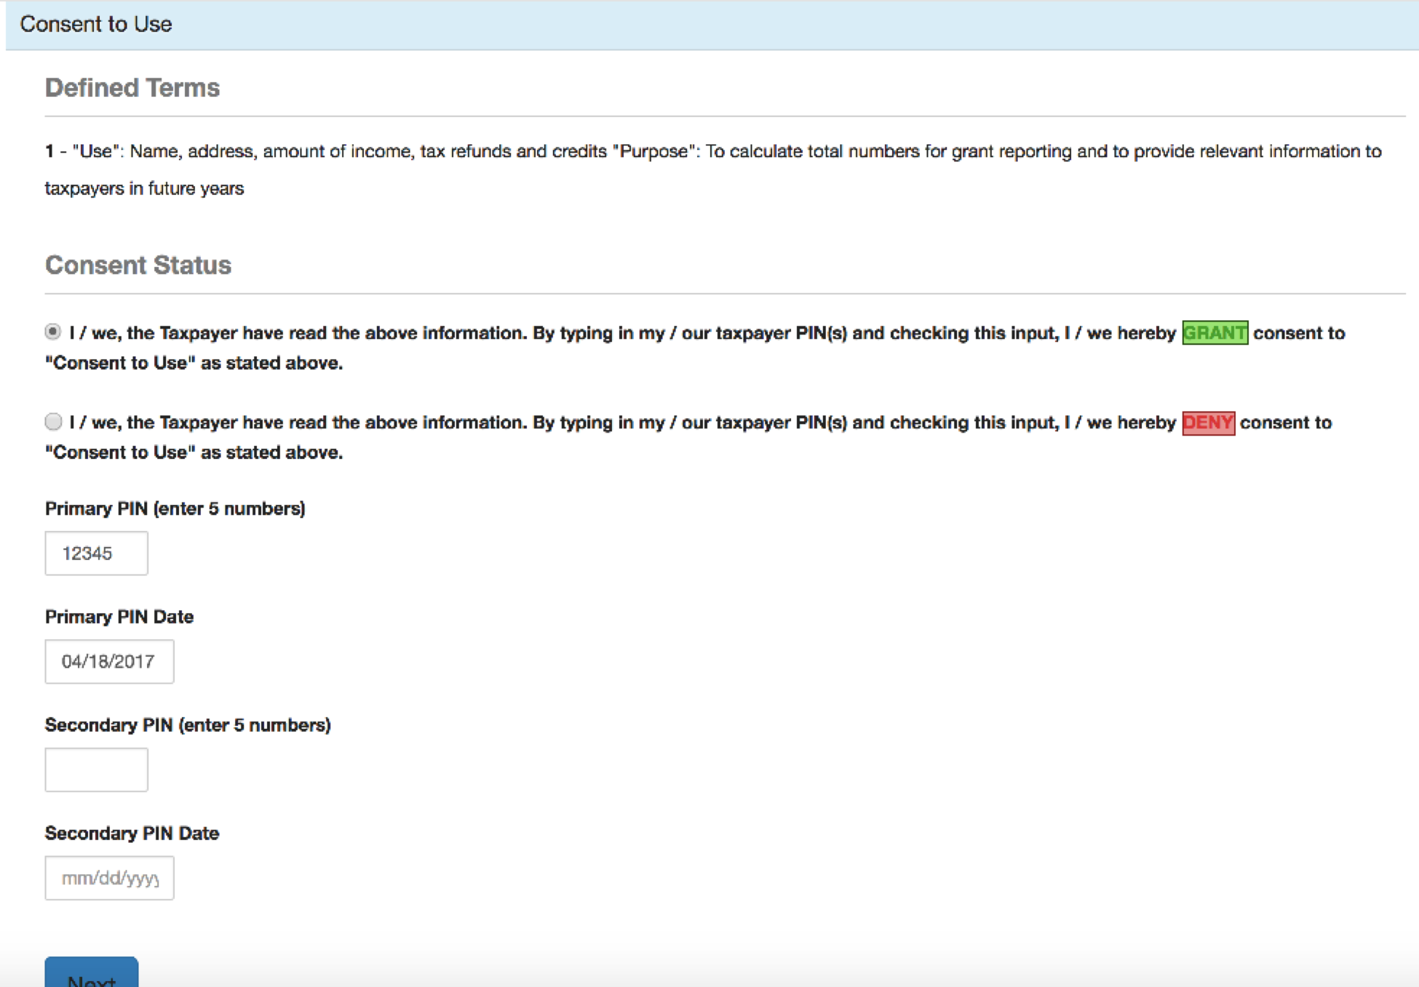
Part 2: Preparing the Return in TaxSlayer – General Use Form

Slide 296
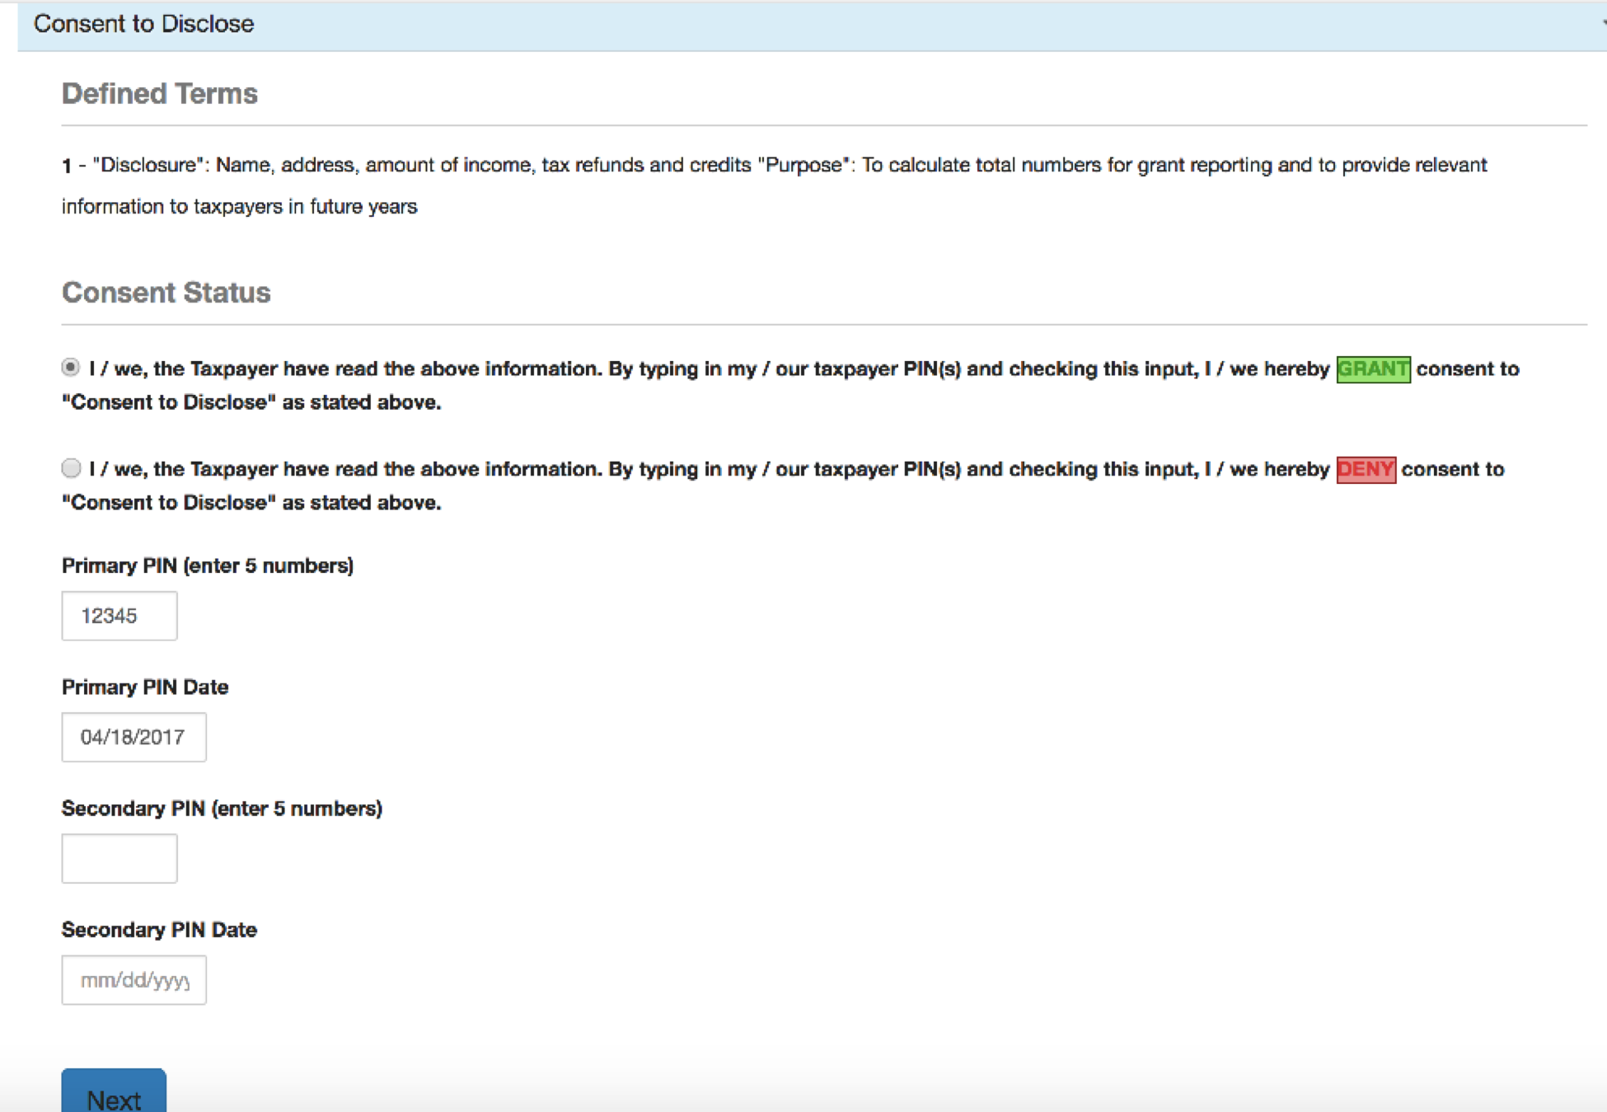
Part 2: Preparing the Return in TaxSlayer – General Disclosure Form

Slide 297
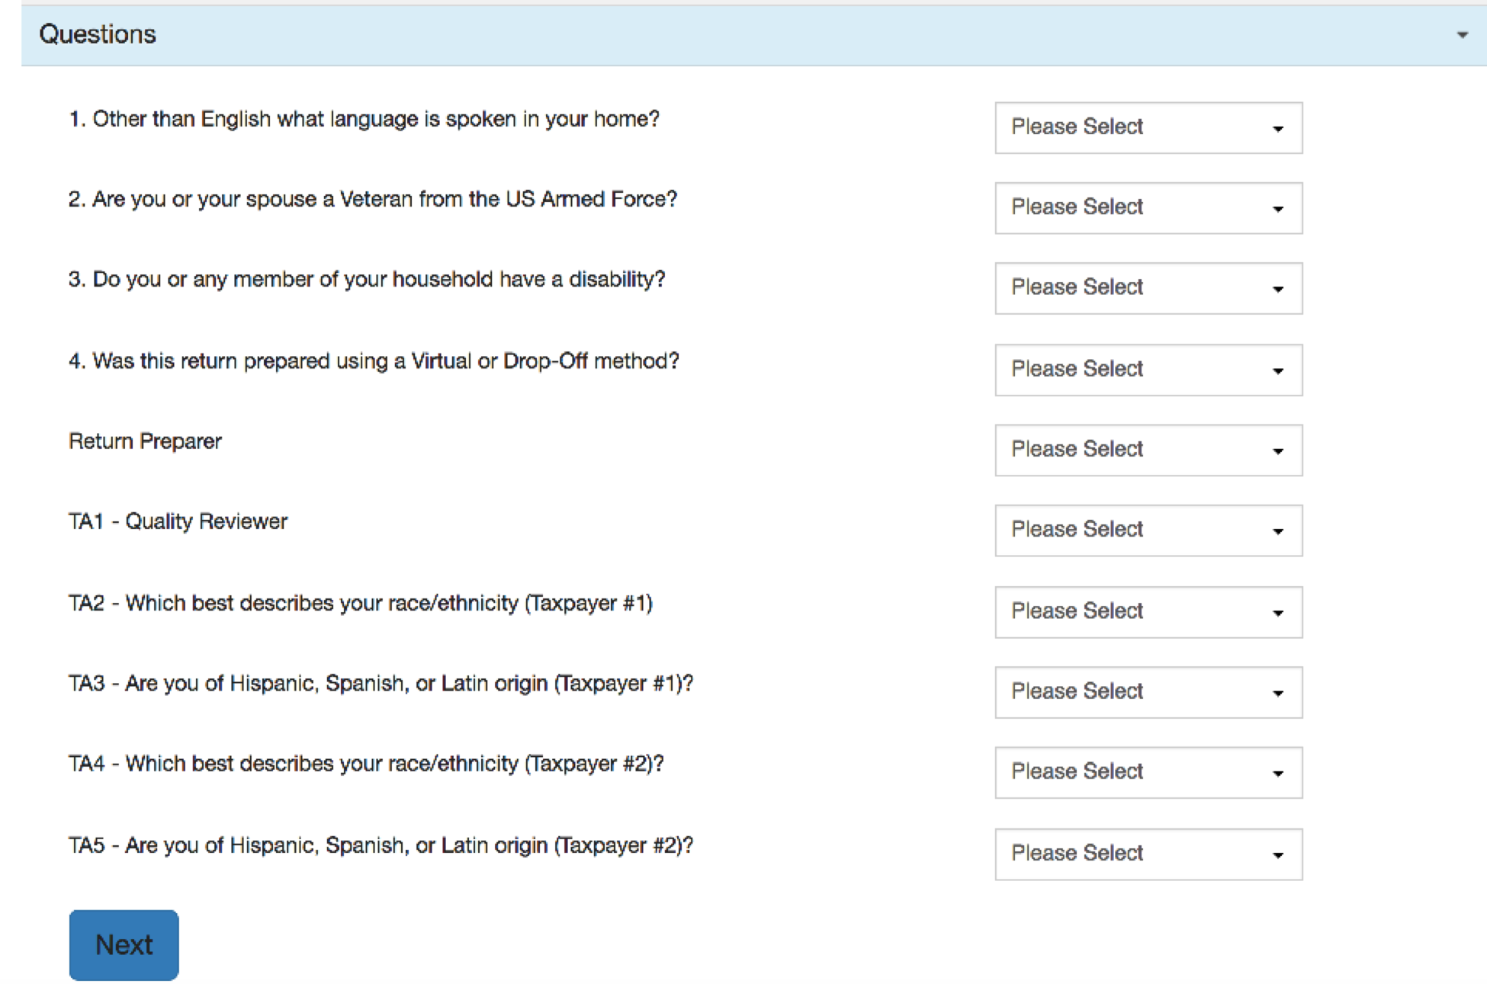
Part 2: Preparing the Return in TaxSlayer – Prep Use Form

Slide 298
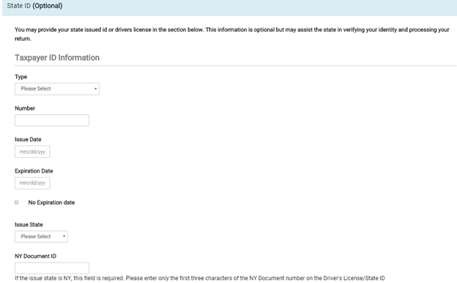
Part 2: Preparing the Return in TaxSlayer – State ID (NOT Optional)

Slide 299
Part 2: Preparing the Return in TaxSlayer – State ID (NOT Optional in some states)
Providing the state ID/driver’s license in the e-file section is NOT optional for certain state returns
In AL, it is required for e-file submission of state return
In SC, it is not required for e-file submission of state return, BUT if the taxpayer has a state ID, the information should be entered

Slide 300
Part 2: Preparing the Return in TaxSlayer – State ID(NOT Optional in some states)
If taxpayer has driver’s license and TaxSlayer requests the info in the e-file section, you should enter the information.
If the taxpayer does not have a driver’s license and TaxSlayer requests the info, you should see your Site Coordinator.

Slide 301
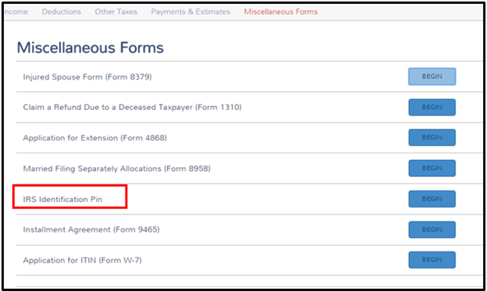
Part 2: Preparing the Return in TaxSlayer – Identity Protection Pin
You’ll enter this on the taxpayer’s return in the “Miscellaneous Forms” section. This won’t affect the taxpayer’s return in any way, but it must be entered or the return will be rejected when it is submitted. This pin ensures that no one fraudulently files their return this year.

Slide 302
Tax Preparation Process
Part 1: Preliminary Interview
Part 2: Preparing the Return in TaxSlayer
Part 3: Quality Review
Part 4: Finishing the Return
Part 5: Filing the Return

Slide 303
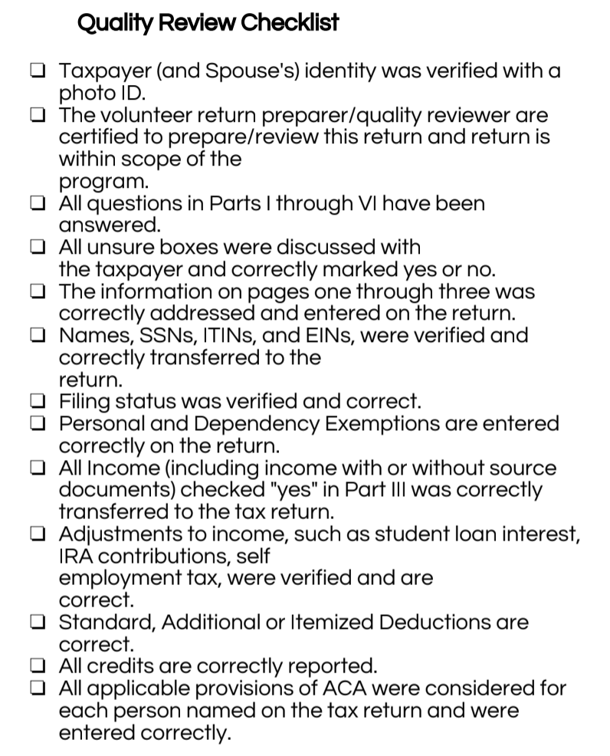
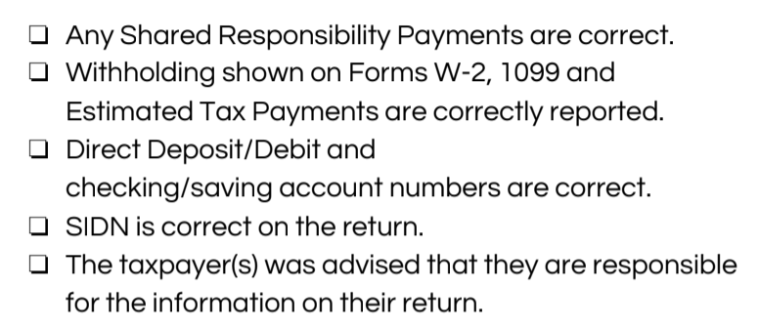
Part 3: Quality Review
Notes:
‹#›

Slide 304
Part 3: Quality Review
Helpful tip:
Keep all the taxpayer‘s documents out for the quality reviewer!
Before handing the return off to a quality reviewer, make sure to write your name at the bottom of the last page! This is will help us if we have any questions about the return during the Quality Review!
Jane Volunteer
Notes:
‹#›

Slide 305
Part 3: Quality Review
Remember: If at any point in the return you come across something out of scope for you, but in scope for a more advanced volunteer, you should write a note at the bottom of the I/I supplement form!
Jane Volunteer
Need to enter: 1099-R
Notes:
‹#›

Slide 306
Part 3: Quality Review
Once the return has been quality reviewed and is ready to e-file, the quality reviewer will check the box “Ready to E-file”
If the return is outstanding, there needs to be an explanation
If the return needs to be paper filed for some reason there needs to be an explanation
Jane Volunteer
Jenn Volunteer
Need to enter: 1099-R
Notes:
‹#›

Slide 307
Tax Preparation Process
Part 1: Preliminary Interview
Part 2: Preparing the Return in TaxSlayer
Part 3: Quality Review
Part 4: Finishing the Return
Part 5: Filing the Return

Slide 308
Part 4: Finishing the Return
Write your name on the Intake/Interview Form
Assist quality reviewer with printing and taxpayer signatures
  Taxpayer and spouse must sign and date federal and state returns and keep for their records
File Intake/Interview Form in filing box
  Do NOT keep any personal documents!

Slide 309
Tax Preparation Process
Part 1: Preliminary Interview
Part 2: Preparing the Return in TaxSlayer
Part 3: Quality Review
Part 4: Finishing the Return
Part 5: Filing the Return

Slide 310
Out of Scope Topics

Slide 311
Additional Topics – Out of Scope at Tax Site
IRS changed VITA certification levels
There are more advanced topics on your 2018 IRS Basic Certification Exam, but you will not prepare these at the tax sites
Let’s look at your Helpful Tips for 2018 IRS Basic Exam!

Slide 312
Additional Topics – Out of Scope at Tax Site
We aren’t going to practice these topics since you won’t be actually doing them at the tax site.
This document will tell you EXACTLY how to complete the topics to get the right answer on the test.

Slide 313
Let’s take a break!

Slide 314
Review: Scope of Service Questions

Slide 315
Scope of Service Questions
Luther Lockett has filled out their I/I form and after the interview you conduct, you conclude they have the following types of income:
1099-INT
W-2
1099-R
SSA-1099
1099-MISC box 7

Slide 316
Scope of Service Questions-Answer
Luther Lockett has filled out their I/I form and after the interview you conduct, you conclude they have the following types of income:
1099-INT
W-2
1099-R
SSA-1099
1099-MISC box 7

Slide 317
Scope of Service Questions
Luther Lockett has filled out his I/I form and after the interview you conduct, you conclude they have the following types of expenses:
Prescription drugs
Doctor co-pays
After-school expenses for 7 year old daughter while at work
1098-T education expenses for son who is a freshman at University of Alabama

Slide 318
Scope of Service Questions-Answer
Luther Lockett has filled out their I/I form and after the interview you conduct, you conclude they have the following types of expenses:
Prescription drugs
Doctor co-pays
After-school expenses for 7 year old daughter while at work
1098-T education expenses for son who is a freshman at University of Alabama

Slide 319
Scope of Service Questions
Luther Lockett has filled out their I/I form and after the interview you conduct, you conclude the following about their health care coverage for the year:
They received a 1095-A in the mail from the marketplace for months July-December.
Can you complete the health insurance section?

Slide 320
Scope of Service Questions-Answer
Luther Lockett has filled out their I/I form and after the interview you conduct, you conclude they have the following types of expenses:
No, a more advanced volunteer will need to enter the 1095-A

Slide 321
Scope of Service Questions
Lester Loving has filled out their I/I form and after the interview you conduct, you conclude the following about their health care coverage for the year:
They had health insurance through their employer all year.
Their daughter (a dependent) had health insurance through Medicaid all year.
Can you fill out the health insurance section?

Slide 322
Scope of Service Questions-Answer
Lester Loving has filled out their I/I form and after the interview you conduct, you conclude the following about their health care coverage for the year:
YES! Since they did not purchase health insurance through the marketplace, you can fill out the health insurance section.

Slide 323
Scope of Service Questions
Use your scope of service chart!
Anna has filled out her I/I form and after the interview you conduct, you conclude she has the following types of expenses:
Daycare expenses for son
Education Expenses for her daughter(1098-T)
Contributed to a retirement account through her job(indicated in Box 12 and 13 of W-2)

Slide 324
Scope of Service Questions-Answer
Daycare expenses for son
Education Expenses for her daughter(1098-T)
Contributed to a retirement account through her job(indicated in Box 12 and 13 of W-2)

Slide 325
IRS Exam Practice

Slide 326
Exercise
• Bob is 46 and made $45,000 in wages in 20XX. He divorced his wife three years ago and has not remarried. He pays all the cost of keeping up his home.
• Bob’s daughter, Joan, lived with him all year.
• Joan is 27, single, and had no income in 20XX She is not disabled.
• Joan’s baby, Sara, was born two years ago. Sara lived in Bob’s home since birth.
• Bob provides more than half of the support for both Joan and Sara.
• Bob, Joan, and Sara are all U.S. citizens with valid Social Security numbers.
Who can Bob claim as a qualifying child(ren) for the earned income credit?
a. Bob has no qualifying children.
b. Bob can claim Joan, but not Sara.
c. Bob can claim Sara, but not Joan.
d. Bob can claim both Joan and Sara.

Slide 327
Exercise
First, determine if Bob can claim Joan→ C-3 through C-4
Then determine if Bob can claim Sara→ C-3 through C-4
Then determine if Bob can claim either for the EIC→ I-3 through I-4
• Bob is 46 and made $45,000 in wages in 20XX. He divorced his wife three years ago and has not remarried. He pays all the cost of keeping up his home.
• Bob’s daughter, Joan, lived with him all year.
• Joan is 27, single, and had no income in 20XX She is not disabled.
• Joan’s baby, Sara, was born two years ago. Sara lived in Bob’s home since birth.
• Bob provides more than half of the support for both Joan and Sara.
• Bob, Joan, and Sara are all U.S. citizens with valid Social Security numbers.

Slide 328
Exercise-Answer
• Bob is 46 and made $45,000 in wages in 20XX. He divorced his wife three years ago and has not remarried. He pays all the cost of keeping up his home.
• Bob’s daughter, Joan, lived with him all year.
• Joan is 27, single, and had no income in 20XX She is not disabled.
• Joan’s baby, Sara, was born two years ago. Sara lived in Bob’s home since birth.
• Bob provides more than half of the support for both Joan and Sara.
• Bob, Joan, and Sara are all U.S. citizens with valid Social Security numbers.
Who can Bob claim as a qualifying child(ren) for the earned income credit?
a. Bob has no qualifying children.
b. Bob can claim Joan, but not Sara.
c. Bob can claim Sara, but not Joan.
d. Bob can claim both Joan and Sara.
Joan doesn’t qualify Bob for the EIC because she fails the Age Test step 3 on I-4.

Slide 329
Exercise
Who can claim Sara as a dependent?
a. Joan can claim Sara because she is Sara’s mother.
b. Bob can claim Sara. Joan cannot claim Sara because Joan is Bob’s dependent.
c. Bob cannot claim Sara because Sara is not Bob’s child.
d. No one can claim Sara.

Slide 330
Exercise – Answer
Who can claim Sara as a dependent?
a. Joan can claim Sara because she is Sara’s mother.
b. Bob can claim Sara. Joan cannot claim Sara because Joan is Bob’s dependent.
c. Bob cannot claim Sara because Sara is not Bob’s child.
d. No one can claim Sara.

Slide 331
Exercise
• Will has lived in the United States since 2000 and has an Individual Taxpayer
Identification Number (ITIN).
• Will is single and 24 years old.
• Will has one child, R.J., who is 3 years old and lived with him all year.
• Will earned $26,700 in wages. He had no other income.
• Will provided all the support for R.J. and all the costs of keeping up their home.
• Will paid for R.J. to attend day care while he worked.
• R.J. has a valid Social Security number and is a U.S. citizen.
Will may claim R.J. as a dependent on his tax return.
a. True
b. False

Slide 332
Exercise
First, determine if Will can claim RJ → C-3
• Will has lived in the United States since 2000 and has an Individual Taxpayer
Identification Number (ITIN).
• Will is single and 24 years old.
• Will has one child, R.J., who is 3 years old and lived with him all year.
• Will earned $26,700 in wages. He had no other income.
• Will provided all the support for R.J. and all the costs of keeping up their home.
• Will paid for R.J. to attend day care while he worked.
• R.J. has a valid Social Security number and is a U.S. citizen.

Slide 333
Exercise-Answer
• Will has lived in the United States since 2000 and has an Individual Taxpayer
Identification Number (ITIN).
• Will is single and 24 years old.
• Will has one child, R.J., who is 3 years old and lived with him all year.
• Will earned $26,700 in wages. He had no other income.
• Will provided all the support for R.J. and all the costs of keeping up their home.
• Will paid for R.J. to attend day care while he worked.
• R.J. has a valid Social Security number and is a U.S. citizen.
Will may claim R.J. as a dependent on his tax return.
a. True
b. False
R.J. meets the tests to be a Qualifying Child of Will

Slide 334
Exercise
• Will has lived in the United States since 2000 and has an Individual Taxpayer
Identification Number (ITIN).
• Will is single and 24 years old.
• Will has one child, R.J., who is 3 years old and lived with him all year.
• Will earned $26,700 in wages. He had no other income.
• Will provided all the support for R.J. and all the costs of keeping up their home.
• Will paid for R.J. to attend day care while he worked.
• R.J. has a valid Social Security number and is a U.S. citizen.
Is Will able to claim R.J. as a qualifying child for the earned income credit (EIC)?
a. Yes, because his income is below the threshold for claiming EIC.
b. Yes, because R.J. has a Social Security number.
c. No, because Will has an ITIN.
d. Both a and b

Slide 335
Exercise
Now, determine if Will can claim RJ for the EIC → I-3 through I-4. Hint: Step 2 on I-3 is VERY important
• Will has lived in the United States since 2000 and has an Individual Taxpayer
Identification Number (ITIN).
• Will is single and 24 years old.
• Will has one child, R.J., who is 3 years old and lived with him all year.
• Will earned $26,700 in wages. He had no other income.
• Will provided all the support for R.J. and all the costs of keeping up their home.
• Will paid for R.J. to attend day care while he worked.
• R.J. has a valid Social Security number and is a U.S. citizen.

Slide 336
Exercise-Answer
• Will has lived in the United States since 2000 and has an Individual Taxpayer
Identification Number (ITIN).
• Will is single and 24 years old.
• Will has one child, R.J., who is 3 years old and lived with him all year.
• Will earned $26,700 in wages. He had no other income.
• Will provided all the support for R.J. and all the costs of keeping up their home.
• Will paid for R.J. to attend day care while he worked.
• R.J. has a valid Social Security number and is a U.S. citizen.
Is Will able to claim R.J. as a qualifying child for the earned income credit (EIC)?
a. Yes, because his income is below the threshold for claiming EIC.
b. Yes, because R.J. has a Social Security number.
c. No, because Will has an ITIN.
d. Both a and b

Slide 337
Exercise
• Will has lived in the United States since 2000 and has an Individual Taxpayer
Identification Number (ITIN).
• Will is single and 24 years old.
• Will has one child, R.J., who is 3 years old and lived with him all year.
• Will earned $26,700 in wages. He had no other income.
• Will provided all the support for R.J. and all the costs of keeping up their home.
• Will paid for R.J. to attend day care while he worked.
• R.J. has a valid Social Security number and is a U.S. citizen.
Which benefit(s) can Will claim on his tax return? (Choose the best answer)
a. Child and dependent care credit
b. Child tax credit
c. Head of Household filing status
d. All of the above

Slide 338
Exercise
Child and Dependent Care Expenses Credit qualifications→ G-5
Child Tax Credit qualifications→ G-12 and G-13
Head of Household qualifications→ B-6, B-7
• Will has lived in the United States since 2000 and has an Individual Taxpayer
Identification Number (ITIN).
• Will is single and 24 years old.
• Will has one child, R.J., who is 3 years old and lived with him all year.
• Will earned $26,700 in wages. He had no other income.
• Will provided all the support for R.J. and all the costs of keeping up their home.
• Will paid for R.J. to attend day care while he worked.
• R.J. has a valid Social Security number and is a U.S. citizen.

Slide 339
Exercise-Answer
• Will has lived in the United States since 2000 and has an Individual Taxpayer
Identification Number (ITIN).
• Will is single and 24 years old.
• Will has one child, R.J., who is 3 years old and lived with him all year.
• Will earned $26,700 in wages. He had no other income.
• Will provided all the support for R.J. and all the costs of keeping up their home.
• Will paid for R.J. to attend day care while he worked.
• R.J. has a valid Social Security number and is a U.S. citizen.
Which benefit(s) can Will claim on his tax return? (Choose the best answer)
a. Child and dependent care credit
b. Child tax credit
c. Head of Household filing status
d. All of the above
The ITIN only makes Will ineligible for the EIC

Slide 340
Exercise
John and Marsha are both 30 years old.
• They are not married and lived together all year.
• Marsha had $35,000 in wages during 20XX. John earned $10,000 in wages.
• John has two children from a previous relationship. Mark is 9 and Kevin is 6 years
old. Mark and Kevin lived with Marsha and John for all of 20XX. Mark and Kevin did
not provide over half of their own support.
• Marsha paid all the rent, utilities, and household expenses. John occasionally paid
for groceries but did not pay any household expenses.
• John, Marsha, Mark, and Kevin are all U.S. citizens with valid Social Security
numbers.
What are the correct filing statuses?
a. Both John and Marsha must file as Single.
b. John and Marsha can choose which one files as Head of Household.
c. Both John and Marsha can file as Head of Household.
d. John can file as Head of Household and Marsha must file as Single.

Slide 341
Exercise
First, determine who can claim Mark and Kevin→ C-3
remember, you are asking the questions from the perspective of John and Marsha individually, not combined
Then determine filing status for John→ B-6
Then determine filing status for Marsha→ B-6
John and Marsha are both 30 years old.
• They are not married and lived together all year.
• Marsha had $35,000 in wages during 20XX. John earned $10,000 in wages.
• John has two children from a previous relationship. Mark is 9 and Kevin is 6 years
old. Mark and Kevin lived with Marsha and John for all of 20XX. Mark and Kevin did
not provide over half of their own support.
• Marsha paid all the rent, utilities, and household expenses. John occasionally paid
for groceries but did not pay any household expenses.
• John, Marsha, Mark, and Kevin are all U.S. citizens with valid Social Security
numbers.

Slide 342
Exercise-Answer
John and Marsha are both 30 years old.
• They are not married and lived together all year.
• Marsha had $35,000 in wages during 20XX. John earned $10,000 in wages.
• John has two children from a previous relationship. Mark is 9 and Kevin is 6 years
old. Mark and Kevin lived with Marsha and John for all of 20XX. Mark and Kevin did
not provide over half of their own support.
• Marsha paid all the rent, utilities, and household expenses. John occasionally paid
for groceries but did not pay any household expenses.
• John, Marsha, Mark, and Kevin are all U.S. citizens with valid Social Security
numbers.
What are the correct filing statuses?
a. Both John and Marsha must file as Single.
b. John and Marsha can choose which one files as Head of Household.
c. Both John and Marsha can file as Head of Household.
d. John can file as Head of Household and Marsha must file as Single.
John can not claim HOH because he did not provide more than ½ the cost of keeping up the home. Marsha can not claim HOH because neither Mark or Kevin qualify to be her dependents.
John can not claim HOH because he did not provide more than ½ the cost of keeping up the home. Marsha can not claim HOH because neither Mark or Kevin qualify to be her dependents.

Slide 343
Exercise
John and Marsha are both 30 years old.
• They are not married and lived together all year.
• Marsha had $35,000 in wages during 20XX. John earned $10,000 in wages.
• John has two children from a previous relationship. Mark is 9 and Kevin is 6 years
old. Mark and Kevin lived with Marsha and John for all of 20XX. Mark and Kevin did
not provide over half of their own support.
• Marsha paid all the rent, utilities, and household expenses. John occasionally paid
for groceries but did not pay any household expenses.
• John, Marsha, Mark, and Kevin are all U.S. citizens with valid Social Security
numbers.
Is it allowable for John and Marsha to each claim one qualifying child for the earned income credit on their individual returns?
a. Yes
b. No

Slide 344
Exercise-Answer
John and Marsha are both 30 years old.
• They are not married and lived together all year.
• Marsha had $35,000 in wages during 20XX. John earned $10,000 in wages.
• John has two children from a previous relationship. Mark is 9 and Kevin is 6 years
old. Mark and Kevin lived with Marsha and John for all of 20XX. Mark and Kevin did
not provide over half of their own support.
• Marsha paid all the rent, utilities, and household expenses. John occasionally paid
for groceries but did not pay any household expenses.
• John, Marsha, Mark, and Kevin are all U.S. citizens with valid Social Security
numbers.
Is it allowable for John and Marsha to each claim one qualifying child for the earned income credit on their individual returns?
a. Yes
b. No
Only John is eligible to claim the children because they meet the relationship test and are his children. They don’t meet the relationship test for Marsha because Marsha and John are not married

Slide 345
Mock Tax Site

Slide 346
Mock Tax Site
Partner up and take turns being taxpayer/volunteer!
Use your tax prep process handout!
There are two examples in your packet so:
  Round 1→ Student 1 is taxpayer KK, student 2 is volunteer
  Round 2→ Student 1 is now volunteer and student 2 is taxpayer MM
  Use return you don’t prepare as practice at home! Student 1 can do KK at home, Student 2 can do MM at home. Answer key will be posted online.

Slide 347
Mock Tax Site
Login to TaxSlayer (via Google Chrome)
  Vita.taxslayerpro.com/IRSTRAINING
  Password: TRAINPROWEB
  Username: DOEJTRAIN (last name, first initial,TRAIN)
  Password: SaveFirstTaxes2020!

Slide 348
Intake/Interview & Quality Review Process

Slide 349
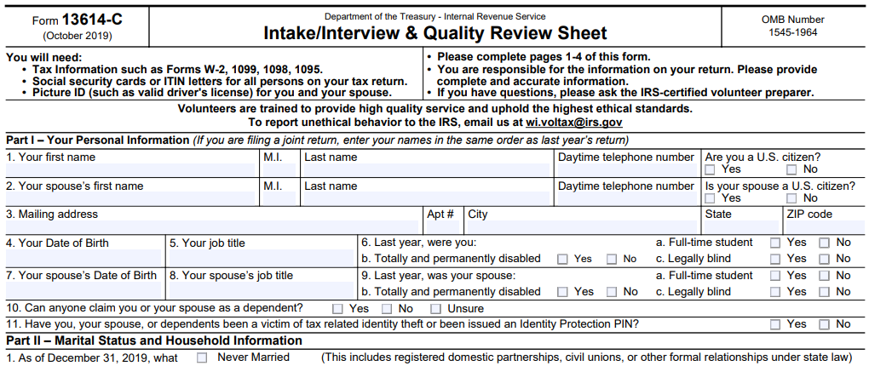
Intake/Interview & Quality Review Sheet
Form 13614-C (official IRS version)
All VITA programs are required to use this sheet for every tax return filed at the tax site.

Slide 350
Assuring a Quality Service and Accurate Return
Taxpayers using services offered through the Volunteer Tax Assistance (VITA) and Tax Counseling for the Elderly (TCE) Programs should be confident they receive quality service. This includes having an accurate tax return prepared.
A basic component of preparing an accurate return begins with listening to the taxpayer and asking the right questions.
Form 13614-C, Intake/Interview & Quality Review Sheet, is a tool designed to help the volunteer ask the right questions. When used properly, this form effectively contributes to accurate tax return preparation.

Slide 351
Using this Form Completely and Appropriately
The IRS conducts oversight to ensure that EVERY part of the form is being used appropriately and completely.
The IRS requires compliance with use of this form to ensure high quality tax returns for our VITA program.

Slide 352
Required for Use by IRS VITA Sites
An important tool for accuracy and due diligence!
Must be completed by (or with) the taxpayer.
Will be used to conduct the Quality Review process.
Must be kept at tax site for site records (do not let the taxpayer take the form with them)
No records brought to the site should be kept on file
For privacy and identity protection purposes, SSNs should NOT be printed on the I/I form

Slide 353
Intake/Interview Form is a Huge Asset to You
Provides an extra record for you to double-check information on the tax return in TaxSlayer and note things the taxpayer forgets to mention when speaking with you

Slide 354
The Intake Process: Completing Form 13614-C
In most cases, the taxpayer completes pages 1, 2, and 3 of the Intake Interview Form (Form 13614-C) in the waiting room before sitting down with you, the tax preparer.
Provide assistance as needed (be sensitive and perceptive to the needs of the taxpayers)

Slide 355
Complete an Intake/Interview Form for EVERY Return
We MUST have an intake/interview form on file for EVERY return filed at our tax sites.

Slide 356
The Intake Process: Tax Return and Volunteer Certification Levels
It is a violation of our VITA Grant and IRS Compliance and your Volunteer Standards of Conduct Agreement to file a tax return that is out of scope of the VITA tax site.
At SaveFirst sites, to ensure all returns are in-scope for VITA:
  Consult the SaveFirst Scope of Service Chart – at every tax station and in the Site Coordinator Handbook/Advanced Volunteer Handbook
  If a topic seems complicated or unfamiliar to you, double-check the SaveFirst Scope of Service Chart to be sure it is listed in scope
  Sometimes this determination may be unclear. If you are unsure, talk to your Site Coordinator

Slide 357
The Intake Process: Tax Return and Volunteer Certification Levels
SaveFirst Basic Volunteer Preparers
  Review the SaveFirst Volunteer Scope of Service Chart for SaveFirst Basic Volunteers

Slide 358


Slide 359


Slide 360


Slide 361


Slide 362



Slide 363


Slide 364


Slide 365


Slide 366


Slide 367


Slide 368


Slide 369


Slide 370


Slide 371


Slide 372


Slide 373


Slide 374


Slide 375


Slide 376



Slide 377


Slide 378
Concepts of the Quality Review
After the quality review is completed, the taxpayer will be advised by the quality reviewer that they are responsible for the accuracy of the information given on the tax return
The last step, after being advised, will be for the taxpayer to sign a paper copy of the return (which they will keep for their records).

Slide 379
Volunteer Standards of Conduct

Slide 380
Volunteer Standards of Conduct
Follow the Quality Site Requirements
Do not accept payment, solicit donations, or accept refund payments for federal or state returns
Do not solicit business or use personal information from taxpayers
Do not knowingly prepare a false return
Do not engage in criminal, infamous, dishonest, notoriously disgraceful conduct
Treat all taxpayers in a professional, courteous manner

Slide 381
Quality Site Requirements
QSR #1-Certification (do only what you’re trained to do)
QSR#2-Intake/Interview and Quality Review Process
QSR #3-Confirming Photo ID and Taxpayer Identification Number (TIN)
QSR#4-Reference Materials
QSR#5-Volunteer Agreement

Slide 382
Quality Site Requirements
QSR #6-Timely Filing
QSR #7-Civil Rights
QSR#8-Site Identification Number
QSR #9-Electronic Filing Identification Number
QSR #10-Security

Slide 383
Do Not Accept Payment
Do not accept cash for services.
We cannot solicit donations, or have a donation/tip jar in the entry, waiting, or tax preparation areas of the tax site.
Refunds CANNOT be deposited into a volunteer’s bank account on behalf of taxpayer’s who don’t have bank accounts.

Slide 384
Do Not Solicit Business or Use Personal Knowledge Gained About a Taxpayer
As a volunteer, you must keep taxpayer’s personal information confidential.
This means you cannot use your knowledge about a taxpayer to engage in financial transactions.
This also means you cannot ask a taxpayer on a date if you notice they are single.

Slide 385
Do Not Solicit Business or Use Personal Knowledge Gained About a Taxpayer
Example: Your primary business includes selling health insurance policies. During the interview, you find out the taxpayer lost access to health insurance in January of the current year. You cannot offer to sell the taxpayer health insurance through your business.

Slide 386
Do Not Knowingly Prepare False Return
An ethical violation is a knowing breach of any of the volunteer standards of conduct.
Correctly apply tax law to the taxpayer’s situation—trust in the VITA program is broken when ethical standards aren’t followed.
NOTE: If you make an accidental mistake, you are protected as a volunteer by the VITA program—and ultimately, taxpayers are responsible for the information entered on their return.

Slide 387
Do Not Knowingly Prepare False Return
Example: A volunteer preparer told the taxpayer that cash income does not need to be reported. The return was completed without the cash income. The quality reviewer simply missed this omission and the return was printed, signed, and e-filed. The volunteer preparer has violated this standard.
However, since the quality reviewer did not knowingly allow this return to be e-filed incorrectly, the quality reviewer did not violate this standard. Remember not to confuse an unethical action with a lack of knowledge or a simple mistake.

Slide 388
Do Not Engage in Negative Conduct
Volunteers performing egregious activities may be barred from the VITA program.
Consequences may also include:
  Criminal investigation
  Discontinuing IRS support for tax site
  Revoking sponsoring organization’s grant funds
  Deactivating IRS EFIN (site identification number)

Slide 389
Treat All Taxpayers With Courtesy
All volunteers are expected to conduct themselves professionally in a courteous, businesslike, and diplomatic manner.
Taxpayers are often under a lot of stress and may wait extended periods for assistance, and volunteers may also experience stress due to the volume of taxpayers needing service.
This situation can make patience run short—It is important to remain calm and create a peaceful and friendly atmosphere!

Slide 390
Checklist-Cultural Awareness
be aware of your own cultural assumptions and how these may affect your understanding and responses
listen with respect and a genuine wish to learn
find out how people see themselves and their culture, what they value, what they see as important
understand that in discussing culture we are discussing possibilities, not certainties – a framework, not a straitjacket

Slide 391
Checklist-Cultural Awareness
be prepared to change your understanding as new information becomes available
understand the importance of factors such as age, generation, life experience, occupation, education and so on
realise that culture is one factor, but not the only factor in anybody’s life. remember that the person you are working with is always the expert on their own life, wishes and needs

Slide 392
Taxpayer Civil Rights
Discrimination against taxpayers on the basis of race, color, national origin, disability, sex, age, or sexual orientation is strictly prohibited.

Slide 393
Reporting Questionable Activity
Violations that raise substantial questions about another volunteer’s honesty, trustworthiness, or fitness as a tax preparer should be reported.
Taxpayers and tax preparers who violate tax law are subject to civil and criminal penalties.
You can report a violation by speaking to your site coordinator or emailing WI.Voltax@irs.gov directly.

Slide 394
Intake/Interview & Quality Review Test & Volunteer Standards of Conduct Test
ALL volunteers must complete and pass the 2017 Intake/Interview & Quality Review Test & the 2017 Volunteer Standards of Conduct Test with a score of 80% on each.
Please login to your account on volunteers.generationforchange.org and follow the links in your profile to take these two tests.
You may use all your training materials to complete the short tests!

Slide 395
Your First Day at the Tax Site

Slide 396
Your First Day at the Tax Site
Your First Day - A SaveFirst Training Video
The Process - A SaveFirst Training Video

Slide 397
Congratulations!
This completes your SaveFirst Basic Tax Training
Next steps:
  Complete IRS Basic Certification Exam (with score of 80% or higher)
  Serve families at tax sites!
  Reminder: You MUST bring your photo ID and show it to your site coordinator when you arrive at a tax site.

Slide 398
IRS Basic Certification
You must complete the IRS Basic Certification exam with a score of 80% or higher to complete your certification
Take the exam by logging in to your account on volunteers.generationforchange.org and following the link in your profile
Complete:
  On your own
  At a testing session hosted by Impact staff member

Slide 399
Testing Session
Please remember to sign up for a Testing Session! These are optional but can be very helpful if you have questions while taking the test.
To see Testing Sessions available to you:
  Log in to your account at volunteers.generationforchange.org
  Select “Register for a Testing Session (Recommended)”
  Select “Register” for the training session you would like to attend

Slide 400
Extra Practice
Complete the Charlie Center TaxSlayer Exercise on your own for additional practice
Answer key and video walkthrough will be posted at www.impactamerica.com/taxprep

Slide 401
Volunteer Basic Tax Training

